Slide 1
Course Introduction
Programs and Programming

Slide 2
Computer Programs
Applications (“apps”)
also “mods”/“expansion packs” and more
Instructions the computer can follow
Written down in special languages
computers do not understand human languages
computers need to be told precisely what to do
LOTS of different languages
lots of different kinds of languages

Slide 3
Programming Languages
Programmers create programs
Programs are instructions to the computer
compare: recipes are instructions to cooks
Generally we write instructions
but computers don’t understand English
or any other natural language
many special languages for programming
programming languages

Slide 4
Example Languages
FORTRAN
LISP
ALGOL
COBOL
SNOBOL
PL/I
BASIC
APL
Pascal
Smalltalk
c
Prolog
Scheme
Modula
SQL
Ada
C++
Prograph
Perl
Python
Java
Javascript
C#
Ruby
and lots, lots more!

Slide 5
5. Rem calculate an average
10. sum = 0
20. count = 0
30. print("Enter a number: ")
40. input(n)
50. if n <= 0 goto 90
60. sum = sum + n
70. count = count + 1
80. goto 30
90. ave = sum/count
100. print("Average = ", ave)
BASIC
an old beginners’ language

Slide 6
Program Average(Input, Output);
var sum, count, n: integer;
begin
sum := 0;
count := 0;
write("Enter a number: ");
read(n);
while n > 0
begin
sum := sum + n;
count := count + 1;
write("Enter a number: ");
read(n);
end;
writeln("Average = ", sum/count)
end.
Pascal
a “structured” language

Slide 7
#include <iostream> using namespace std;
void main() {
int sum = 0;
int count = 0;
int n;
cout << "Enter a number: ";
cin >> n;
while (n > 0) {
sum += n; count++;
cout << "Enter a number: ";
cin >> n;
}
cout << "Average = "
<< (double)sum/(double)count;
}
C++
we used this language in 1226 until a few years ago

Slide 8
#!/usr/bin/ruby
sum = 0
count = 0
puts "Enter a number"
number = gets.to_i
while number > 0 do
sum += number
count += 1
puts "Enter another number or 0 to quit"
number = gets.to_i
end
average = sum / count
puts "The average is #{average}."
Ruby
The language behind “Ruby on Rails” web design tool

Slide 9
import java.util.Scanner;
public class JavaAverage {
public static void main(String[] args) {
Scanner kbd = new Scanner(System.in);
int sum = 0;
int count = 0;
double ave;
System.out.print("Enter a number: ");
num = kbd.nextInt();
while (num > 0) {
sum += number
count += 1
System.out.print("Enter a # or 0 to quit: ");
num = kbd.nextInt();
}
double ave = (double)sum / (double)count;
System.out.println("The average is" + ave);
}
}
Java
The language we’ll be using this year

Slide 10
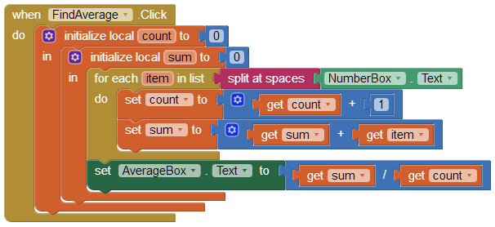
AppInventor
a graphical programming tool

Slide 11
What Do Those Programs Do?
They tell the computer to do things:
to create a variable (to remember a number)
to print out a message
to get a number from the user
to check if a number is positive
to do math (adding / dividing)
to go back to repeat some steps
In order to calculate and show the average of some positive numbers the user enters

Slide 12
Kinds of Languages
Imperative (*)
tell it what to do
Functional
specify processes
Logical
specify meanings
say what you want
Object Oriented (*)
data & process abstraction
Parallel
process control
Graphical
use pictures
some languages look very different from Java
many of the most important are very similar

Slide 13
average(List, Average) :-
sumList(List, Sum),
length(List, Length),
Average is Sum / Length.
sumList([], 0).
sumList([Num | MoreNums], Total) :-
sumList(MoreNums, SubTotal),
Total is Num + SubTotal.
Prolog
a logic-programming language

Slide 14
average
average
^(self
inject: 0
into: [:element :tempsum |
tempsum + element])
/
self size.
Smalltalk
a pure object-oriented language

Slide 15
Java
Java is object-oriented
Source code arranged like objects
Objects know how to do things that need doing
Java is also imperative
Tell computer what to do
Java is ideal for internet applications
Compile once, run anywhere

Slide 16
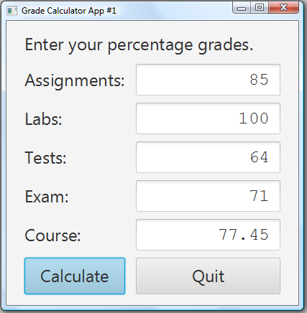
Object Oriented
Objects:
the window
the labels
the fields
the buttons
many more
Each object knows how to show itself and how to do things for itself and others

Slide 17
Imperative
Tell computer to do things
When the “Calculate” button is clicked:
get the numbers from the top four fields
adjust them according to the component weights
add them up
put the result into the bottom field
Uses the objects
get the numbers by asking the fields what’s in them

Slide 18
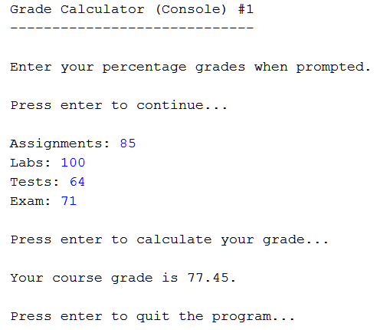
Console Programs
GUI programs usually long and complex
about 200 lines
lots of different objects
We will do console programs at first
about 100 lines
only a few objects

Slide 19
Compare

Slide 20
Differences
Objects involved
text fields and buttons in app
Scanner in console
we will learn more about Scanner objects soon
Interaction
can change numbers and recalculate in app
console only lets you do one calculation
we will learn later how to make console repeat

Slide 21
Similarities
A title
Grade Calculator App/Console
Short instructions
Enter percentage grades
A way for the user to enter data
same numbers
A way for the user to see the results
same result

Slide 22
Similarities
Purpose of program is the same
calculate a final course grade for this course
Input is the same
user provides component grades
assignments, labs, tests, exam
Steps for doing calculation the same
read the numbers
calculate the result
show the result

Slide 23
Pseudocode / Algorithms
Program is instructions for computer
recipe is instructions for cook
Can be in any programming language
recipe can be in English, French, Korean, ...
Generally start in a mixture of English and some generic programming language
called pseudocode (“almost code”)
make an algorithm (steps to solve the problem)

Slide 24
Grade Calculator Pseudo-Code
High-level description
Step 1: Get all the component scores
Step 2: Do the calculation
Step 3: Show the result
Lower-level description
Step 1a: get the assignment grade
Step 1b: get the lab grade
Step 1c: get the test grade
Step 1d: get the exam grade

Slide 25
Grade Calculator Pseudo-Code
Lowest levels may differ
Step 1a: get the assignment grade
Application:
get numeral from assignment text field
translate it into a number
Console:
prompt user for assignment grade
read number from keyboard
clear up input stream
But the purpose is still the same

Slide 26
Programming Programs
We use programs to write programs
need to write the code (can use Notepad)
need to compile (translate) the code (javac)
need to run the code (java)
IDE: Integrated Development Environment
use to write, compile and run
JCreator, NetBeans, Eclipse, ...

Slide 27
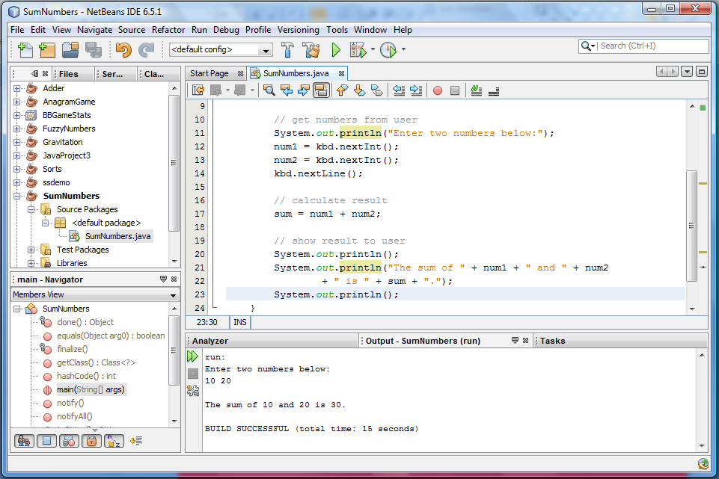
Our IDE (NetBeans)
List
of
projects
Program code
Program
parts
Program output

Slide 28
For This Course
Can use any IDE you like (or none)
Can get NetBeans for your computer
versions for Mac, Windows, Linux
any version since 8.0 will work
slightly different ways of starting programs
links to versions 8.2 and 12.4:
https://www.oracle.com/technetwork/java/javase/downloads/jdk-netbeans-jsp-3413139-esa.html
https://netbeans.apache.org/download/nb124/nb124.html

Slide 29
Questions?

