Slide 1
Basic Programming
The Program Class, the main Method, Variables, Output, and Input

Slide 2
Overview
Making Programs with NetBeans
A Program “class”
A Problem; a Solution: an Algorithm
Variables
Math
Output
Input

Slide 3
Making a Program
We need programs to make programs
we need to write the program
we need an editor
we need to compile the program
we need a compiler
we need to run the program
for Java, we need an emulator
we will probably need to fix mistakes
back to the editor!

Slide 4
The Development Environment
You can use separate programs…
Notepad to edit, javac to compile, java to run
…but nicer to have a do-it-all program
Integrated Development Environment (IDE)
Our IDE will be NetBeans
free download for your personal computer
Windows, Mac OS X, Linux (x86/x64)
any version after 8.2 is fine
make sure it includes the JDK (it usually does)

Slide 5
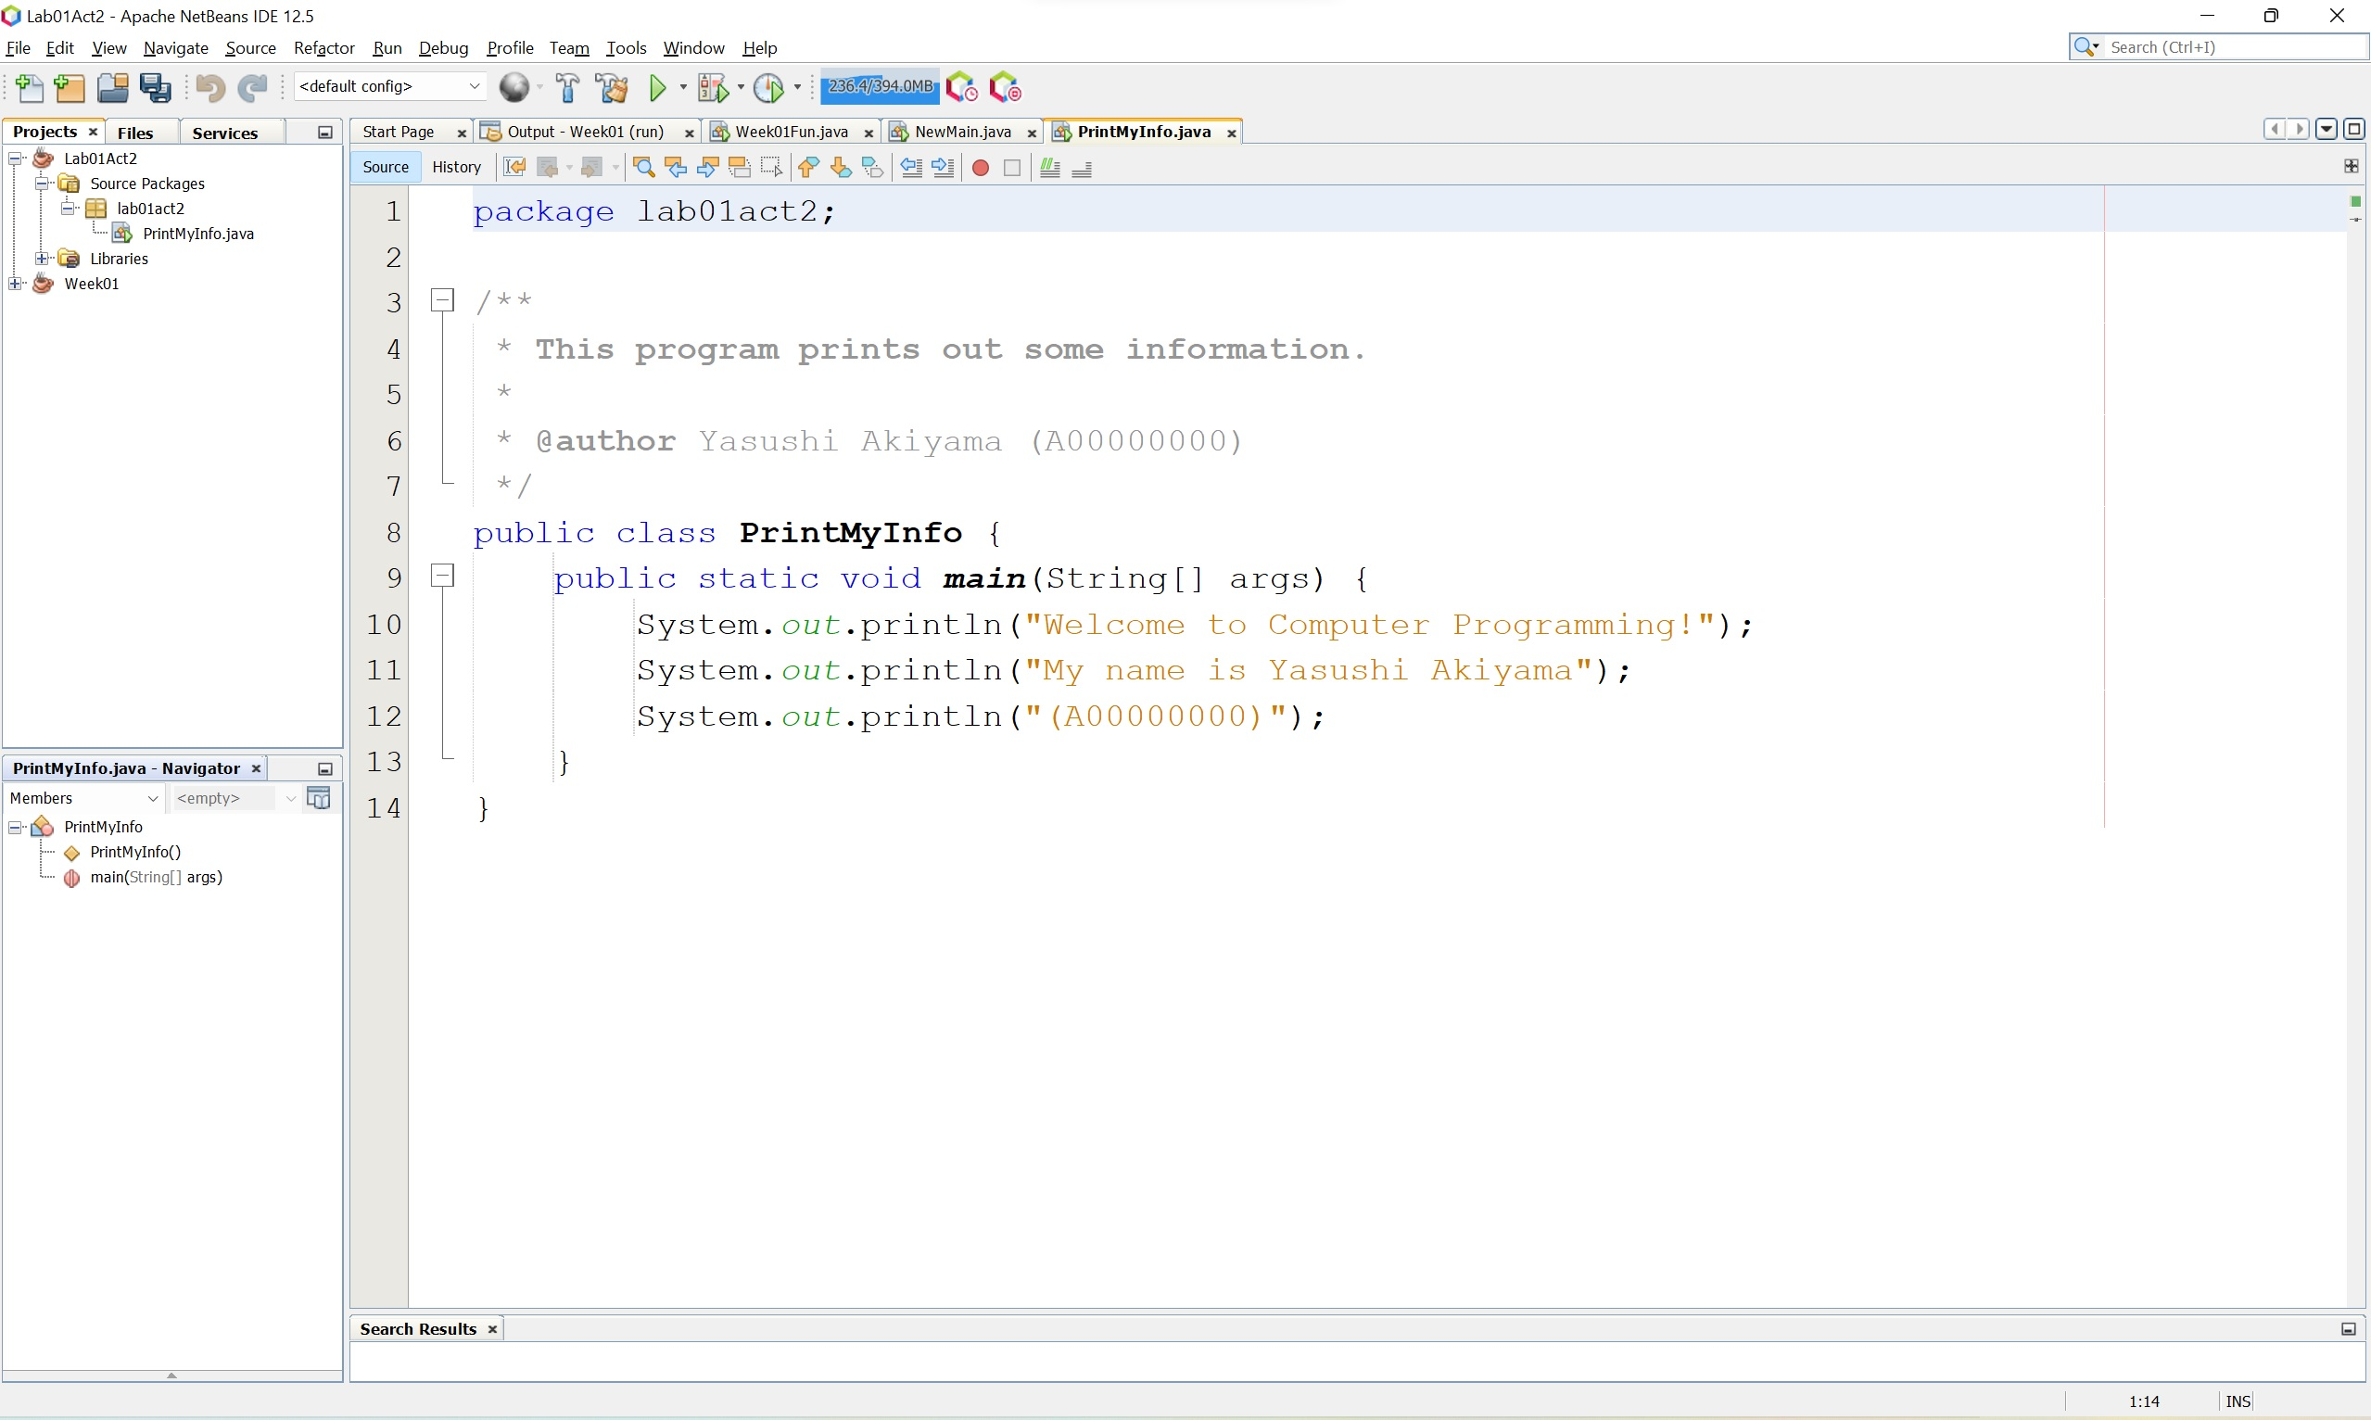
Running NetBeans
List
of
projects
Type program here
Program
parts
Run program here

Slide 6
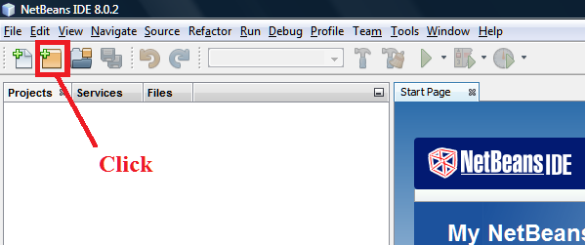
Creating a Program
Click the “New Project…” icon
or File > New Project
or Ctrl-Shift-N on Windows
possibly the same on Linux & Mac

Slide 7
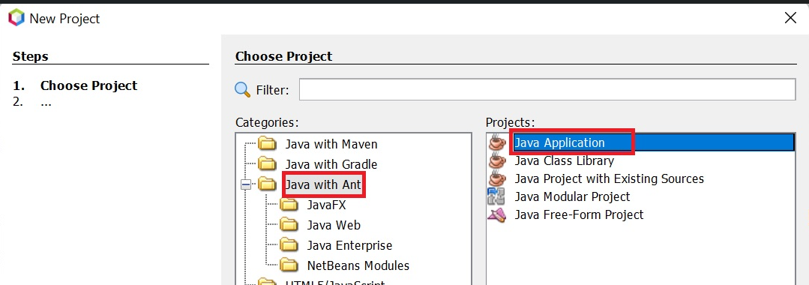
Creating a Program
Select Java with Ant and Java Application
click Next >

Slide 8
Creating a Program
Name your project
Browse to your CSCI1226 folder
Name your program
Click Finish

Slide 9
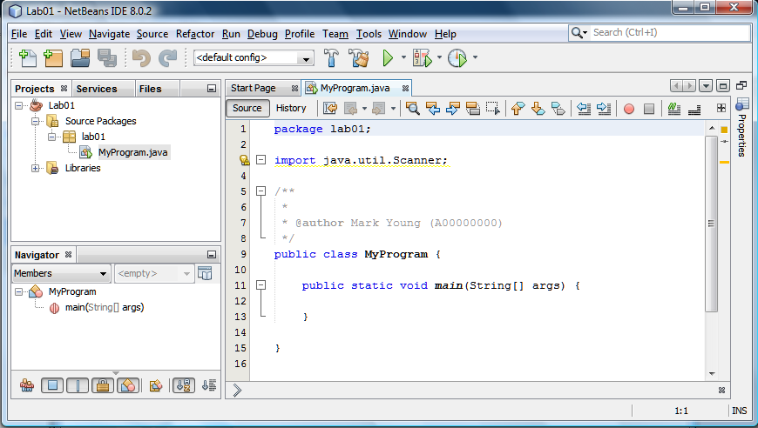
Creating a Program
You have a program!
Of course it doesn’t do anything yet….

Slide 10
The Basic Program Class
Every Java program has this stuff:
public class ProgramClassName {
public static void main(String[] args) {
}
}
the word after class is the name of the program
each program will have its own name
file will have same name, but with .java added
the braces { and } must be there
I’ll explain public static void line later

Slide 11
Where the Code Goes
For now our programs will be very simple
only one file in the project
the one file will have a method named main
almost all our code will go inside the {} of main
ONLY import commands here
public class ProgramClassName {
NOT here
public static void main(String[] args) {
code goes in here!
}
NOT here
}
NOT here

Slide 12
What is Code?
Code is instructions for the computer
written in a computer language
for us, that language will be Java
Code is like a recipe
lists all the steps, in order, to complete the task
But we don’t start with code!
We start with a problem

Slide 13
Problems
We want to do something on the computer
keep track of stats at a basketball game
find the average of a bunch of numbers
find the area of a rectangle
draw a happy face
whatever
Need to understand the problem
need to work out the details

Slide 14
Problem: Draw This Face
How would we do that?
We need a plan
We need an algorithm

Slide 15
Algorithms
A set of step-by-step instructions for solving a problem
start with “high level”
not very detailed
work toward “low level”
lots of details provided
Pseudocode
computer instructions written in a mixture of English (e.g.) and programming commands

Slide 16
to Draw a Happy Face
1. Draw a circle
2. Draw an eye in the upper left quadrant
3. Draw an eye in the upper right quadrant
4. Draw a smile in the lower half
High-level pseudocode

Slide 17
to Draw a Happy Face
1. Draw a circle 200 pixels wide, with its left edge 100 pixels from the left edge of the screen, and its top 50 pixels down from the top of the screen
2. Draw a filled oval 10 pixels wide and 20 tall, with its left edge 155 pixels from the left edge of the screen, and its top 100 pixels down from the top of the screen
3. Draw a filled oval 10 pixels wide and 20 tall, with its left edge 230 pixels from the left edge of the screen, and its top 100 pixels down from the top of the screen
4. Draw the lower half of an oval 100 pixels wide and 50 pixels tall, with its left edge 150 pixels from the left edge of the screen, and its top 160 pixels down from the top of the screen.
Low-level pseudocode

Slide 18
Programming a Computer
Understand the problem
do not skip this step!
Figure out how to solve it
(make high-level pseudocode)
Break solution into smaller/lower steps
keep going until each step is “obvious”
Write it down in computer language
Compile it; test it; fix any mistakes

Slide 19
to Find the Area of a Rectangle
Get the length and width of the rectangle
Multiply them together to get the area
Questions:
get the dimensions from where?
what shall we do with the area once we have it?
Answers:
maybe from the user (input) ← later
maybe tell the user (output)
Later we will write code that doesn’t involve the user.

Slide 20
Working with Numbers
Need the computer to keep track of numbers
the length of the rectangle
the width of the rectangle
the area of the rectangle
Don’t know those numbers yet
user will tell us when the program’s running
but we need to talk about them before that!
to tell computer what to do with them

Slide 21
Variables
Use names instead of numbers
one number will be the length of the rectangle
let’s call it length
one number will be the width of the rectangle
let’s call it width
what shall we call the area of the rectangle?
These names are called variables
they can have any number as a value
we must create variables before using them

Slide 22
to Find the Area of a Rectangle
Create variables for length, width and area
Get length and width of rectangle
Multiply length by width to get area
Report dimensions and area to user
Revised pseudocode

Slide 23
Writing Code
Write steps in your program as comments
comments start with // and go to end of line
public class RectangleArea {
public static void main(String[] args) {
}
}
public class RectangleArea {
public static void main(String[] args) {
// 1. create variables for length, width and area
}
}
public class RectangleArea {
public static void main(String[] args) {
// 1. create variables for length, width and area
// 2. get length and width of rectangle
// 3. multiply length by width to get area
// 4. report dimensions and area to user
}
}

Slide 24
Writing Code
Fill in code below each comment
comment and code each indented same amount
public class RectangleArea {
public static void main(String[] args) {
// 1. create variables for length, width and area
// 2. get length and width of rectangle
// 3. multiply length by width to get area
// 4. report dimensions and area to user
}
}
public class RectangleArea {
public static void main(String[] args) {
// 1. create variables for length, width and area
// 2. get length and width of rectangle
// 3. multiply length by width to get area
// 4. report dimensions and area to user
}
}
public class RectangleArea {
public static void main(String[] args) {
// 1. create variables for length, width and area
int length, width, area;
// 2. get length and width of rectangle
// 3. multiply length by width to get area
// 4. report dimensions and area to user
}
}
public class RectangleArea {
public static void main(String[] args) {
// 1. create variables for length, width and area
int length, width, area;
// 2. get length and width of rectangle
// 3. multiply length by width to get area
// 4. report dimensions and area to user
}
}

Slide 25
Declaring Variables
Say what kind of values the variables have
int: integer values (3, 5, -7)
double: numbers with decimal points (2.4, -1.1)
many, many more kinds of values
This is called the variable’s data type
Say it in front of the variables name(s)
separate names with commas (,)
end line with a semi-colon (;)

Slide 26
Exercise
State name and data type of each variable:
int num;
double height;
int num1, num2;
double priceInDollars;
String myName;
String title, surname;
Scanner kbd;
Thingamajig whatchamacallit, doohickey;
When I ask “What kind of a thing is _____?ˮ I want you to tell me its data type.
Notes:
Name: num – Type: int
Name: height – Type: double
Name: num1 – Type: int
Name: num2 – Type: int
Name: priceInDollars – Type: double
Name: myName – Type: String
Name: title – Type: String
Name: surname – Type: String
Name: Scanner – Type: Scanner
Name: whatchamacallit – Type: Thingamajig
Name: doohickey – Type: Thingamajig

Slide 27
Notes on Names
No spaces or punctuation allowed in names
int bad name, bad-name, bad&name, badPriceIn$;
Names of programs start with Capitals
RectangleArea, DrawFace, FindAverage, ...
Names of variables start with little letters
length, width, area, name
Words after first one start with Capitals
RectangleArea, priceInDollars

Slide 28
Exercise
Is your family name a valid Java identifier?
if so, is it a variable name or a program name?
if not, what’s wrong with it?
if we got rid of those problems, then would it be a variable name or a program name?
Notes:
My family name is Young.
It is a valid variable identifier.
It would be a program name (it starts with a capital letter).
Another family name is van Beethoven.
It is not a valid identifier.
It has a space in it.
If we changed it to vanBeethoven, then it would be a variable name (starts with a little letter).
Another family name is O'Toole.
It is not a valid identifier.
It has an apostrophe in it.
If we changed it to OToole, then it would be a program name (starts with a capital letter).

Slide 29
Giving Variables Values
We will want to read values from user...
...but for now we’ll assign values directly
// 1. create variables for length, width and area
int length, width, area;
// 2. get length and width of rectangle
// 3. multiply length by width to get area
// 4. report dimensions and area to user
}
}
// 1. create variables for length, width and area
int length, width, area;
// 2. get length and width of rectangle
length = 15;
width = 24;
// 3. multiply length by width to get area
// 4. report dimensions and area to user

Slide 30
Giving Variables Values
Area we want to calculate
multiply length by width
// 1. create variables for length, width and area
int length, width, area;
// 2. get length and width of rectangle
length = 15;
width = 24;
// 3. multiply length by width to get area
// 4. report dimensions and area to user
// 1. create variables for length, width and area
int length, width, area;
// 2. get length and width of rectangle
length = 15;
width = 24;
// 3. multiply length by width to get area
area = length * width;

Slide 31
Assignment Statements
Give a value to a variable
length = 15;
width = 24;
area = length * width;
Variable name, equals sign, expression
expression may be simple or complicated
can use numbers and variables in expression
length
length
width
width
area
area
?
15
?
24
?
360

Slide 32
Assignment Statements
You can change the value of a variable
width = 500;
same way as you gave it its value before
But no other variables change
computer doesn’t redo old calculations
if you need the area to change, too, then you need to tell the computer to do the multiplication again!
length
width
width
area
15
24
500
360

Slide 33
Simple Math
Can assign using math expressions
use + for addition
totalTaxes = federalTaxes + provincialTaxes;
use – for subtraction
netIncome = grossIncome – totalTaxes;
use * for multiplication
salesTax = totalSales * 0.15;
use / for division
applesPerPerson = numApples / numPeople;
NOTE: More about math on a later slide.

Slide 34
Reporting Results to the User
Print results on the screen
IDE: in the “run” area at bottom of screen
Need to tell computer to print something
System.out.print( ... );
System.out.println( ... );
Need to say what to print
what to print goes inside the parentheses ()
Don’t worry about what System.out means! I’ll explain later.

Slide 35
println vs. print
println prints and then ends the line
print just prints (line doesn’t end)
System.out.println("Hello!");
System.out.print("Bye");
System.out.print("-");
System.out.print("bye");
System.out.println("!!!");
Hello!
Bye-bye!!!

Slide 36
Output Commands
System.out knows how to print stuff
can print Strings
System.out.println( "This is a String!" );
can print numbers, expressions, and variables
System.out.println( 10 );
System.out.println( 20 + 25 );
System.out.println( area );
This is a String!
10
45
360

Slide 37
Quotes, or No Quotes?
Quotes → print these characters
No quotes → print the value of this
can be variable or math expression
System.out.println( "area" ); // prints four letters
System.out.println( area ) // prints value of variable
System.out.println( 10 + 15 ); // prints expression value
System.out.println( "10 + 15" ); // prints seven “letters”
area
360
25
10 + 15

Slide 38
Printing Spaces
If you want spaces printed, they need to go inside the quotation marks
spaces outside the quotation marks are ignored
System.out.print( "Start1>" );
System.out.println( "<End1" );
System.out.print(" Start2> ");
System.out.println(" <End2 ");
Start1><End1
Start2> <End2

Slide 39
Adding Things to Print
Can add items to print
don’t need a separate command for each item
System.out.println(23 + "skidoo");
note: no space added!
be careful with math – add parentheses
System.out.println("10 + 34 is " + (10 + 34));
note which parts have quotes and which don’t
23skidoo
10 + 34 is 44

Slide 40
Line Breaks in Your Program
Output commands can be VERY long
too long to fit on one line
Break line at + signs
System.out.println("This is OK. " + "And I can add more here. " + "Even a number: " + 42);
do NOT break line between quotation marks
System.out.println("This is not OK!");
NOTE: all printed on one line.
This is OK. And I can add more here. Even a number: 42
But NetBeans is nice; it’ll add the quotes and plus sign for you….

Slide 41
Reporting on the Rectangle
Report length and width as well as area
helps user understand the answer
// 1. create variables for length, width and area
int length, width, area;
// 2. get length and width of rectangle
length = 15;
width = 24;
// 3. multiply length by width to get area
area = length * width;
length = 15;
width = 24;
// 3. multiply length by width to get area
area = length * width;
// 4. report dimensions and area to user
System.out.println("A " + length + " by " + width
+ " rectangle has an area of " + area + ".");

Slide 42
Note on Blank Lines
Blank lines group commands together
create variables
blank line
get values
blank line
calculate result
blank line
output result
Computer doesn’t care – humans do
Four steps
to complete
the program:
an algorithm

Slide 43
Exercise
Write a program fragment to report how much 25 boxes of girl guide cookies would cost, given that each box costs $2.
Use variables
howMany: how many boxes of cookies
pricePer: cost per box
total: total amount owed
Your 25 boxes of cookies cost you $50.
Notes:
total = pricePer * howMany;
System.out.println("Your " + howMany + " boxes of cookies cost you $" + total + ".");

Slide 44
Running Your Program
Click the Run Project button
if there are no mistakes, it runs the program
You WILL make mistakes
I still make mistakes (40 years of experience)
The computer has no compassion

Slide 45
If There are No Mistakes
Output appears in window
usually at the bottom of the NetBeans screen
the bit in black is written by your program
the bits in grey and green (or red) are added by NetBeans

Slide 46
Mistakes in Computer Programs
Two main kinds of mistakes
Syntax errors
what you said doesn’t make sense
“Go the frog and.”
Logic errors
what you said to do is not what it should do
“Subtract the tax from the base price to get the final price.”

Slide 47
Syntax Error: NetBeans
NetBeans notices syntax errors right away
look for red squiggle and in margin
mouse over the to see the explanation

Slide 48
Fixing Syntax Errors
Understand why you got that message!
cannot find symbol
symbol: method say
location: class java.io.PrintStream
did you spell it wrong?
No, that is how you spell “say”
did you forget to declare it?
No, class java.io.PrintStream is not this program
did you use the wrong name?
Yes, the method is called “print”, not “say”
NOTE: spelling matters; and CapiTaliZatiOn matters, too!

Slide 49
Logic Error
Compiler will not notice!
System.out.println("A length by width" + "rectangle has an area of area.");
Program just does the wrong thing
what did it do wrong?
why did it do that?
how can we fix it?
Figure out what, why and how before making any changes to the code!

Slide 50
Exercise
Find the errors:
To find the area of a circle
1. get it’s diameter
2. raduis = diameter / pi
3. area = pi * radius * squared
which ones are syntax errors?
which ones are logic errors?
Notes:
it's → its
(syntax error)
raduis → radius
(syntax error)
diameter / pi → diameter / 2
(logic error)
squared → radius
(syntax error)

Slide 51
Changing the Width & Height
If you run the program again, it’ll give you exactly the same result
Change the numbers to change the result
you need to run it again, of course!
A 15 by 24 rectangle has an area of 360.
length = 18;
width = 104;
A 18 by 104 rectangle has an area of 1872.

Slide 52
Getting Input from the User
Want to ask user for the height and width
want to set length equal to a number that the user types in; and ditto the width
area will still be length times width
Many ways to do input in Java
We will use a Scanner to do it
a Scanner knows how to read numbers (and other things) from the user

Slide 53
Get Input
Scanner kbd = new Scanner(System.in);
length = kbd.nextInt();
width = kbd.nextInt();
kbd is a Scanner object
it’s connected to the keyboard (System.in)
it knows how to get an integer from the user
nextInt is the command to get an int value
assignment operation (=) saves the numbers
first number saved in the variable named length
second number saved in the variable named width
We will learn more about objects and how they work later.

Slide 54
Problem
Java complains:
it knows that Scanner should be a class
but it doesn’t know that class!
Scanner is not “built in” to Java
it’s an “optional extra”
need to tell Java you’re using it
need to import it
need to know where to import it from
cannot find symbol
symbol: class Scanner
location: (my program)
It will say the name of your program as the location.

Slide 55
The import Command
Goes before “public class” line
Scanner is what we want to use
java.util is “where it is” (it’s a package)
Now Java is happy with the program
import java.util.Scanner;
public class RectangleArea {
public static void main(String[] args) {

Slide 56
Another Problem
The program doesn’t seem to do anything!
it just sits there
It’s waiting for you to type a number!
type the number 15 and press the Enter key
type the number 40 and press the Enter key
then the output appears
15
15
40
15
40
A 15 by 40 rectangle has an area of 600.

Slide 57
Prompting for Input
Tell the user you want input!
say what you want
say it just before the kbd.nextInt() line
// 2. get length and width of rectangle
Scanner kbd = new Scanner(System.in);
System.out.print( "Enter the length: ");
length = kbd.nextInt();
System.out.print( "Enter the width: ");
width = kbd.nextInt();
// 3. multiply length by width to get area

Slide 58
Now Program Asks for Input
Now program has conversation with user
program asks user for length, waits for user
user types in length, presses Enter
program asks user for width, waits for user
user types in width, presses Enter
program prints dimensions and area
Enter the length: 20
Enter the width: 14
A 20 by 14 rectangle has an area of 280.
User types 20 and 14 (and Enter after each). They won’t be blue/bold on the computer.

Slide 59
Tidying Up After Yourself
User has to press enter key after the number
program should read the enter key
program works without it, but it’s a good idea!
helps prevent mysterious errors later on
so do it!
System.out.print( "Enter the length: ");
length = kbd.nextInt();
kbd.nextLine();
System.out.print( "Enter the width: ");
width = kbd.nextInt();
kbd.nextLine();

Slide 60
Letting the User Know
It’d be nice for the program to explain to the user what it is going to do
put it between steps 1 and 2 (call it step 1.5)
// tell user what you plan to do
System.out.println("I will tell you the area of a "
+ "rectangle.");
System.out.println("You need to tell me its length "
+ "and width.");
// get length and width of rectangle

Slide 61
Input Methods
The command to read an int is kbd.nextInt()
kbd because our Scanner is named kbd
Scanner kbd = new Scanner(System.in);
nextInt() because we want to get the next int
What’s the command to read a double?
How is it spelled exactly?
What’s the command to read a String?
Wrong! (That’d be too easy!)

Slide 62
More Input Methods
Two methods for reading Strings:
kbd.nextLine() reads a whole line
kbd.next() reads a single “word”
String firstWord, secondWord, restOfLine;
firstWord = kbd.next();
secondWord = kbd.next();
restOfLine= kbd.nextLine();
System.out.println(secondWord+firstWord+restOfLine);
firstWord
“First”
secondWord
“Second”
restOfLine
“ Third Fourth”
First Second Third Fourth
SecondFirst Third Fourth

Slide 63
Reading Spaces
Most of the reading methods skip spaces
skip spaces until a non-space appears
Tabs and Enters are also spaces
next(), nextInt(), nextDouble() all do that
nextLine() does not skip spaces
reads whatever is left on the line
it’s the only reading method that reads spaces

Slide 64
More about Input
If the user types something wrong...
a number with a decimal point or a word
...the Scanner will throw an exception (and crash)
this crash was on line 24 of Rectangle.java
in the method named “main”
Enter the length: 10
Enter the width: 14.4
Exception in thread "main" java.util.InputMismatchException
at java.util.Scanner.throwFor(Scanner.java:840)
at java.util.Scanner.next(Scanner.java:1461)
at java.util.Scanner.nextInt(Scanner.java:2091)
at java.util.Scanner.nextInt(Scanner.java:2050)
at RectangleArea.main(RectangleArea.java:24)

Slide 65
Exercise
Ask the user what year it is and how old they are. Then calculate and print the year they were born. Use variables and suitable output.
do not worry about exceptions!
there is nothing that a CSCI 1226 student can do
we will learn about catching them in CSCI 1228.
Notes:
System.out.print("What year is it? ");
year = kbd.nextInt();
kbd.nextLine();
System.out.print("How old are you? ");
age = kbd.nextInt();
kbd.nextLine();
born = year – age;
System.out.println("You were born (about) " + born + ".");

Slide 66
Math
Math operators different for ints & doubles
Addition: +
7 + 3 → 10 7.0 + 3.0 → 10.0
Subtraction: –
7 – 3 → 4 7.0 – 3.0 → 4.0
Multiplication: *
7 * 3 → 21 7.0 * 3.0 → 21.0

Slide 67
Division Operators
Division: /
8 / 3 → 2 8.0 / 3.0 → 2.6666667
integer division for ints; floating-point division for doubles
(mixed expressions – later)
Modulus (Division Remainder): %
8 % 3 → 1 7.7 % 3.1 → 1.5

Slide 68
Math Expressions
int m; m
int n; ? n
m = 3 + 5; 8 ?
n = 4 * m; 8 32
m = n % 5; 2 32
n = n / 5; 2 6
n = m + 8 / m + 3; 2 __

Slide 69
Order of Operations
Precedence: the order things get done
Left to right except:
Parentheses ( ... ) done before
Multiplying * / % done before
Adding + – done before
PEMDAS / PEDMAS
parentheses, (exponents), mult/div, add/sub
Java doesn’t do exponents

Slide 70
Common Mistake
x + 8 / x + 3, where x = 2
2 + 8 / 2 + 3
2 + 4 + 3
6 + 3 = 9
BUT
(x + 8) / (x + 3)
10 / 5 = 2

Slide 71
Multiple Choice
2 * 2 + 3 * 4 = _____
2 * 5 * 4 = 10 * 4 = 40
4 + 3 * 4 = 4 + 12 = 16
4 + 3 * 4 = 7 * 4 = 28
5 / 3 – 1 = _____
1 – 1 = 0
1.667 – 1 = 0.667
5 / 2 = 2
5 / 2 = 2.5

Slide 72
Mixed Mode Expressions
Expressions with both doubles and ints
3 + 2.5 = ?
Integers are converted to double
3.0 + 2.5 = 5.5
Type Coercion
Just what you’d expect
usually!

Slide 73
When Coercion Happens
Not before needed
int sub-expressions use int math
3.6 + 4 / 2 3.6 + 5 / 2 (3.6 + 5) / 2
3.6 + 2 3.6 + 2 (3.6 + 5.0) / 2
3.6 + 2.0 3.6 + 2.0 8.6 / 2
5.6 5.6 8.6 / 2.0
4.3

Slide 74
Mixed Mode Assignments
Assign an int value to a double variable…
double x;
x = 0;
…it gets automatically changed to double
assignment above is same as
x = 0.0;
Use the second way, anyway!
helps prevent confusion

Slide 75
Mixed Mode Assignments
Assign an double value to an int variable…
int n;
n = 0.0;
Java compiler objects!
can’t assign a double value to an int variable!
even tho’ 0.0 is equal to 0, which is an integer!

Slide 76
Type Casting
You can tell the computer to change a number from one type to another
used especially with variables
int count = 0;
int sum = 0;
…
double average = (double)sum / (double)count;
45 / 4 = 11
45.0 / 4.0 = 11.25
count
average
count
sum
sum
45.0
0
11.25
45
0
4
4.0

Slide 77
Changing Double to Int
When change double to int…
double price;
int intPrice;
price = 19.95; // price in $ and ¢
intPrice = (int)price; // just $
…everything after the decimal point is lost
it is not “rounded off”!
we’ll see how to round off later
price
19.95
intPrice
19

Slide 78
Exercises
Say what value gets assigned
int j;
double f; j f
f = 3; __ __
f = f + 2.6; __ __
j = (int)f; __ __
f = (double)j / 2 + 1.1; __ __
f = (double)(j / 2) + 1.1; __ __
Notes:
j f
f = 3; - 3.0
f = f + 2.6; - 5.6
j = (int) f; 5 5.6
f = (double) j / 2 + 1.1 5 3.6
f = (double) (j / 2) + 1.1 5 3.1

Slide 79
Questions?

