Slide 1
Methods I
Introduction to Methods
Declaring and Calling void Methods
Arguments and Parameters
Javadocs for Methods

Slide 2
Outline
What are methods?
what are they for?
what do they look like?
how do we use them?
Making our own methods (other than main)
void, parameterless methods
void methods with parameters
javadocs

Slide 3
Using Methods
Consider the bolded parts of this program:
Scanner kbd = new Scanner(System.in);
int num, sum;
sum = 0;
System.out.println("Enter positive integers below.");
System.out.println("Enter a negative integer when you're done.");
num = kbd.nextInt();
while (num >= 0) {
sum += num;
num = kbd.nextInt();
}
kbd.nextLine();
System.out.print("The total of those positive integers is ");
System.out.println(sum);

Slide 4
Method Calls
We have been using methods since the start
System.out.println(…)
System.out.print(…)
kbd.nextInt()
kbd.nextDouble()
kbd.next()
kbd.nextLine()
Those are all method calls
they tell the computer to run a method

Slide 5
What are Methods?
Methods are named bits of code
instructions for carrying out some task
main is for doing a whole program
other methods not usually a whole program
also called procedures, subroutines, functions
Method call is command to run that code
System.out.println("Hello?") is command to run println method
kbd.nextInt() is command to run nextInt method

Slide 6
What Are Methods For?
Most methods do one thing
System.out.print prints what you give it
System.out.println prints it and ends the line
kbd.nextInt reads an integer value
Usually something you want to do many times
print lots of things; read lots of numbers
Often just one step of an algorithm
the low-level details of a high-level step
A few other reasons….

Slide 7
Named Instructions
Calling the method makes the computer run those instructions
running a program = calling main
Someone wrote instructions for printing
saved them in a method called print
put that method into System.out
call System.out.print = run those instructions
Someone wrote instructions for reading an int
call kbd.nextInt = run those instructions

Slide 8
How Do Methods Work
Instructions written down in one place . . .
Scanner.java, String.java, Math.java, …
. . . call comes from some other place
MyProg.java, ExamGrades.java, …
Computer remembers where it was . . .
. . . follows instructions for the method . . .
. . . returns to where it left off

Slide 9
Flow of Control
You ask System.out to print “Hello”
computer stops working on your program (for a moment) & takes “Hello” to the print method
the steps of the print method are followed to completion → Hello appears on the screen
your program starts up again, right where it left off

Slide 10
Flow of Control
You ask kbd to get the next int
computer stops working on your program (for a moment) & starts doing the nextInt method
the steps of the nextInt method are followed to completion, getting an int from the user
that int is brought back to your program
your program starts up again, right where it left off, with that int where kbd.nextInt is/was

Slide 11
Calling a Method
Telling the computer to do the instructions
to print this thing or read a number or whatever
Method calls look like this:
target.name(arguments)
target (e.g. System.out or kbd)
sometimes it can be left off entirely
name (e.g. println or nextDouble)
may be zero, one or more arguments
separated by commas
but parentheses are needed, even if no arguments

Slide 12
Exercise
State the target, name, and arguments for each method call:
System.out.println("Hello, World!")
System.out.println(42)
kbd.nextInt()
answer.startsWith("y")
Math.pow(radius, 2)
What about this one?
kbd.next().toLowerCase().startsWith("n")
Notes:
Target: System.out – Name: println – Argument: "Hello, World!"
Target: System.out – Name: println – Argument: 42
Target: kbd – Name: nextInt – Arguments: (none)
Target: answer – Name: startsWith – Argument: "y"
Target: Math – Name: pow – Arguments: radius and 2
There are three (3) method calls in the last command:
Target: kbd – Name: next – Arguments: (none)
Target: kbd.next() – Name: toLowerCase() – Arguments: (none)
Target: kbd.next().toLowerCase() – Name: startsWith – Argument: "n"

Slide 13
Why Do We Make Methods?
Code Re-use
Doing “same” thing in multiple places
we do a lot of printing!
Code Hiding (Encapsulation)
Secret
Implementation independence
Code Abstraction
Top-down design

Slide 14
Adding Methods to a Program
We’ll redo RectangleArea using methods
public class RectangleArea {
public static void main(String[] args) {
// create variables for length, width and area
// print an introduction for the user
// get length and width of rectangle
// calculate the area
// report dimensions and area to user
}
}
find the version with code on-line

Slide 15
Method Purpose
Method has a job to do
get an int from the user
print a string on the screen
translate a temperature in Celsius to Fahrenheit
Method does its job
how it does its job is not the caller’s business (recall: code hiding)
caller should not worry about it (nor have to)
how does printing work, in detail?
you don’t need to know!

Slide 16
Method Design
What is the purpose of this method?
need to know what it’s supposed to do
be very clear on its job
write its job as a comment
// Print the introduction for this program.
write this down before you create the method!
you need to know what it needs to do before you start telling it how to do it!
choose a name that reflects that job
printIntroduction
looks like a command

Slide 17
Replacing Code
Code to print an introduction already in main
public class RectangleArea {
public static void main(String[] args) {
// create variables for length, width and area
// print an introduction for the user
System.out.println("This program calculates "
+ "the area of a rectangle.");
// get length and width of rectangle
// calculate the area
// report dimensions and area to user
}
}

Slide 18
Move Code to Method
Create a new void method to hold that code
public class RectangleArea {
public static void main(String[] args) {
…
}
// Print the introduction of this program
public static void printIntroduction() {
System.out.println("This program calculates "
+ "the area of a rectangle.");
}
}

Slide 19
The Method Definition
Starts with the comment …
… then the method header …
same three words as main (public static void)
I’ll explain those later
name of method (printIntroduction)
empty parentheses
… then the body in {braces}
the same command(s) we had in main

Slide 20
Calling the Method
Replace the println command(s) from main with a call to the new method
include the target, name and () – i.e. no arguments
public static void main(String[] args) {
// create variables for length, width and area
int length, width, area;
// print an introduction for the user
RectangleArea.printIntroduction();
// get length and width of rectangle

Slide 21
Flow of Control
You ask RectangleArea to print an introduction
computer stops working on main (for a moment) & goes to the printIntroduction method in the RectangleArea program
the steps of the printIntroduction method are followed to completion → program introduction appears on the screen
main starts up again, right where it left off

Slide 22
Simplification
You don’t actually need to say RectangleArea
public class RectangleArea {
public static void main(String[] args) {
// create variables for length, width and area
// print an introduction for the user
printIntroduction();
no target → the method is in this class
will find the method if it’s in this class
if it’s not in this class, you get red underlines

Slide 23
Run the Program
Program behaves exactly as it did before
Introduction gets printed because:
main asked printIntroduction to do it (method call)
printIntroduction did it (method definition)
This program calculates the area of a rectangle.
Enter the length of the rectangle: 10
Enter the width of the rectangle: 7
The area of a 10 x 7 rectangle is 70.

Slide 24
Next Method: Pause
Follow same procedure as before
determine its purpose; write comment
prompt user then wait for them to press enter
add pause() to main right after printIntroduction()
you’ll get red squigglies because it’s not defined yet
public class RectangleArea {
public static void main(String[] args) {
// create variables for length, width and area
// print an introduction for the user
printIntroduction();
pause();

Slide 25
Add the Definition
Needs to ask user to press the enter key …
… then read the enter key …
… then print a blank line
// prompt user and wait for them to press enter
public static void pause() {
System.out.print("Press enter…");
kbd.nextLine();
System.out.println();
}
Problem: doesn’t know kbd!

Slide 26
Local Variables
Every method has its own variables
declared at beginning of method
or possibly somewhere later in the method
Each method’s variables are its alone
no other method can use them
kbd belongs to main
pause can’t use it

Slide 27
Local Variables
Declare another kbd in pause method
// prompt user and wait for them to press enter
public static void pause() {
Scanner kbd = new Scanner(System.in);
System.out.print("Press enter…");
kbd.nextLine();
System.out.println();
}
problem solved!
NOTE: it’s a different variable with the same name
that’s OK because it’s in a different method

Slide 28
Run Program Again
Make sure what we just did works
main calls printIntroduction which prints stuff
main then calls pause which prints stuff and waits for the user to press enter
This program calculates the area of a rectangle.
Press enter…
Enter the length of the rectangle: 10
Enter the width of the rectangle: 7

Slide 29
Add Another Pause
Can call pause again after the input and report
can call same method as many times as you want
only need to define it once
public static void main(String[] args) {
pause();
pause();
pause();
}
public static void pause() {
…
}

Slide 30
Next Method: printReport
Purpose is to report findings to user
// Report findings to user. Include length, width and area of
// the rectangle in the report.
needs to print length, width and area
so it needs to be told those values
printReport(length, width, area);
those variables need to be created and given values
in main, because that’s who’s doing the telling!
Recall: the values given to methods are called arguments

Slide 31
Variables in main
Declare the variables and give them values
int length, width, area;
…
length = kbd.nextInt();
width = kbd.nextInt();
…
area = length * width;
Add call to printReport (after all the above)
printReport(length, width, area);

Slide 32
Declaring a Method w. Arguments
Same as before, except need to make variables for the arguments
variables for arguments are called parameters
they are declared inside the parentheses of the method header
public static void printReport(int len, int wid, int area) {
}
NOTE: can use the same names as main uses …
… but don’t need to
and they’re different variables either way

Slide 33
Parameters
Those variables are called parameters
have to be same type as the arguments
are names this method will use for the arguments
same names as in main is fine
but they are different variables
get their values from the arguments
printReport(10, 20, 42);
printReport(int l, int w, int a) → l = 10, w = 20, a = 42
printReport(50, 77, -3);
printReport(int l, int w, int a) → l = 50, w = 77, a = -3

Slide 34
Multiple Parameters
Every parameter needs to be told its data type
public static void printReport(int length, int width, int area)
Not like other variable declarations, where you can just say the data type once
int length, width, area;
Parameters do not need to be initialized
the method call will initialize them
printReport(10, 20, 200);
The area of a 10 x 20 rectangle is 200.

Slide 35
Exercise
Assume the calls below are correct. What argument type(s) does each method take?
Math.getExponent(3400.2)
Math.ulp(2.6)
Math.scalb(4.5, 2)
str.split(":", "one:two:three:four")
str.length()
thingy.doesItDo("2", 2, 2.0, "to", "too", "two")
Utility.readPositiveNumberFrom(kbd)
Notes:
getExponent: double
ulp: double
scalb: double and int
split: String and String
length: (none)
doesItDo: String, int, double, String, String and String
readPositiveNumberFrom: Scanner

Slide 36
Method Body
Have it print out the report
public static void printReport(int length, int width, int area) {
System.out.print("The area of a " + length + "x"
+ width + " rectangle is " + area + ".");
System.out.println();
}
use names of parameters; not of arguments
public static void printReport(int len, int wid, int ar) {
System.out.print("The area of a " + len + "x"
+ wid + " rectangle is " + ar + ".");
System.out.println();
}

Slide 37
Parameter Values
Parameter values come from the caller
main is the only caller our methods have, yet
Do not read a value into a parameter!
the parameter already has a value; don’t change it!
main already asked the user for length and width
main (will have) already calculated the area
if printReport asks user for those values…
…user will be asked twice for length and width
…user will be asked for the area, which is what the user wanted from the program in the first place!

Slide 38
Run the Program
Program works exactly as before
make sure it does
if it doesn’t, you did something wrong
Numbers from main passed to printReport
length and width that user entered, area that main calculated
printReport prints those numbers

Slide 39
Not My Job
printReport does not check whether the numbers you gave it make sense
that is NOT its job
its job is just to print the dang report
checking the numbers is somebody else’s problem
Programming principle: GIGO
garbage in; garbage out
if you give a method/program the wrong information, it will do the wrong thing
it is following its instructions; that is all it can do

Slide 40
Garbage In; Garbage Out
Give the method call the wrong area …
printReport(length, width, -10);
… the wrong area gets printed out!
This program calculates the area of a rectangle.
Enter the length of the rectangle: 10
Enter the width of the rectangle: 7
The length of a 10 x 7 rectangle is -10.

Slide 41
Programming Principle
Don’t give yourself a chance to put garbage in
printReport says it’s printing the area
maybe printReport should calculate the area itself
then it just needs length and width
no way for main to give it the wrong area
printArea(length, width); // revised call in main
…
public static void printArea(int len, int wid) { // revised …
int area; // moved from main
area = len * wid; // moved from main
… // same as before
}

Slide 42
Commenting Methods
Should have description before you write code
know what the method is supposed to do
Should know the arguments/parameters, too
what extra information will it need to do its job
Document this, too
// Report findings to user. Include length, width and area of
// the rectangle in the report.
// Needs to be told length and width of rectangle!

Slide 43
Javadoc Comments
Note that some comments in program start with /** and end with */
those are javadoc comments
they are special
they are used to generate web pages documenting the code you’re writing
see, for example:
https://docs.oracle.com/javase/10/docs/api/java/lang/String.html
https://docs.oracle.com/javase/10/docs/api/java/util/Scanner.html
both generated from javadoc in Java program

Slide 44
Class Javadoc
Javadoc comment for class just before class
/**
* This program calculates and prints the area of a
* rectangle.
*
* @author Mark Young (A00000000)
*/
public class RectangleArea {
…
}
contains description of program
contains an @author tag to identify the author

Slide 45
Method Javadoc
Javadoc comment just before method def ^{n}
/**
* Report findings to user. Include length, width and area of
* the rectangle in the report.
*
* @param len the length of the rectangle
* @param wid the width of the rectangle
*/
public class printReport(int len, int wid) { … }
contains description of method
contains @param tags to identify the parameters

Slide 46
Parameter Tags
Format (all parts required)
@param parameterName more info about this parameter
The name should describe the contents of the parameter …
like all good names
… description gives more details
* @param len the length of the rectangle
* @param wid the width of the rectangle

Slide 47
No Parameter Tags
If the method has no parameters…
such as printIntroduction and pause
… then its javadoc has no @param tags
/**
* Prompt user then wait for them to press the enter key.
*/
public static void pause() {
Scanner kbd = new Scanner(System.in);
System.out.print("…press enter…");
kbd.nextLine();
System.out.println();
}

Slide 48
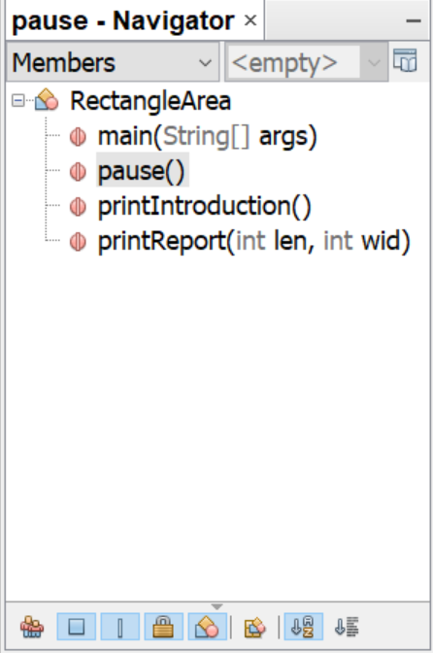
NetBeans Navigation Pane
Methods appear in the navigation pane
bottom-left corner of NetBeans window
Double-click to go directly to method definition

Slide 49
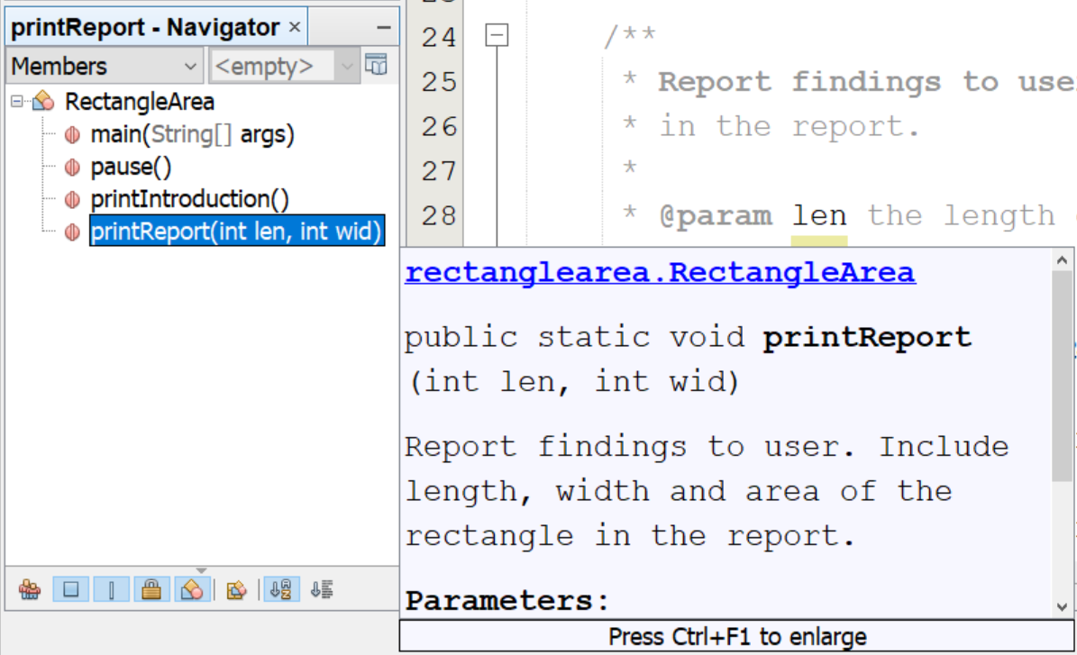
Viewing the Javadoc
Hover over the method name in the nav. pane

Slide 50
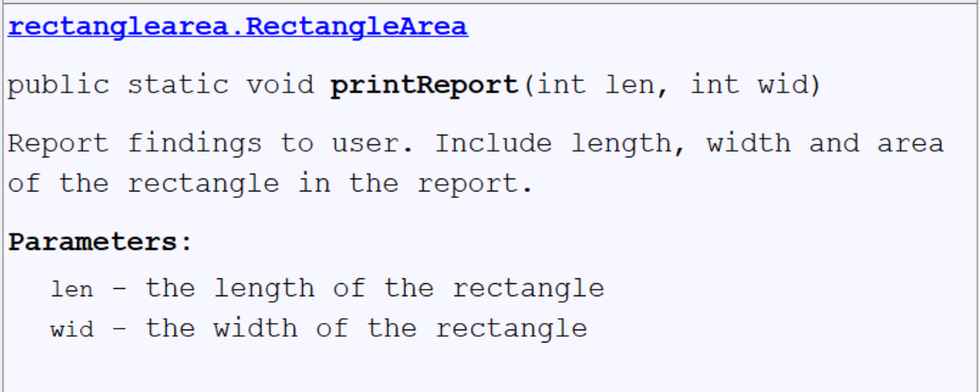
Full Javadoc
Type Ctrl+F1 to see whole Javadoc
includes method header, description, and parameter descriptions

Slide 51
Exercise
Write methods to:
print a given line and a blank line after it.
“givenˮ means given to the method
print the sum of three given numbers.
print the sum of the numbers from 1 to 10.
print the sum of the numbers from 1 to n, where the caller says what n is.
Add javadocs to each method
Notes:
/**
* Print the given line with a blank line after it.
*
* @param line the line to print.
*/
private static void printPlusBlank(String line) {
sopln(line);
sopln();
}
/**
* Print the sum of the given three numbers.
*
* @param num1 the first of the three numbers.
* @param num2 the second of the three numbers.
* @param num3 the third of the three numbers.
*/
private static void printSumOf(int num1, int num2, int num3) {
sopln(num1 + num2 + num3);
}
/**
* Print the sum of the numbers from 1 to 10;
*/
private static void printSumToTen() {
int sum = 0;
for (int n = 1; n <= 10; ++n) {
sum += n;
}
sopln(sum);
}
/**
* Print the sum of the numbers from 1 to num.
*
* @param num the number to sum up to.
*/
private static void printSumToNum(int num) {
int sum = 0;
for (int n = 1; n <= num; ++n) {
sum += n;
}
sopln(sum);
}

Slide 52
A Solution for Last Exercise
The method to sum the numbers from 1 to n
/**
* Print the sum of the numbers from 1 to n.
*
* @param n the number to sum up to
*/
public static void printSumTo(int n) {
int sum = 0;
for (int i = 1; i <= n; ++i) {
sum += i;
}
System.out.println("The sum of the numbers from 1 to " + n + " is "
+ sum + ".");
}

Slide 53
Calling Methods from Methods
It is possible to call one of your own methods from another one of your own methods
call pause from printIntroduction and printReport
public static void printIntroduction() {
System.out.println(“…”);
pause();
}
public static void printReport(int l, int w) {
…
pause();
}

Slide 54
Creating Methods
Have a clear idea of what you want it to do
print a line of n stars (needs to be told n)
Make it do that
public static void printNStarsLine(int n) {
for (int s = 1; s <= n; ++s) {
System.out.print("*");
}
System.out.println();
}

Slide 55
Creating Methods
Have a clear idea of what you want it to do
print a rectangle (needs told #rows and #columns)
Make it do that
OK to use other methods you created
public static void printRectangle(int rows, int cols) {
for (int r = 1; r <= rows; ++r) {
printNStarsLine(cols);
}
}

Slide 56
Exercise
Using the methods from the previous slides, write a method that prints the following:
note: 3 rows of 1 star, 3 rows of 2 stars, 3 rows of 3 stars, 3 rows of 4 stars, and 3 rows of 5 stars
can you do it using only one loop?
*
*
*
**
**
**
***
***
***
****
****
****
*****
*****
*****
Notes:
private static void printFigure() {
for (int n = 1; n <= 5; ++n) {
printRectangle(3, n);
}
}

Slide 57
Methods Summary
Can create our own methods
public static methods
void methods just do something
arguments saved into parameters
use local variables and parameters
don’t change parameter values

Slide 58
Questions

