Slide 1
Methods II

Slide 2
Outline
Value-returning Methods
methods from Scanner and String
methods from Math
Creating our own value-returning methods
return type and the return command

Slide 3
Last Time
void Methods
just do something
print the introduction, print a report, pause, …
method call with arguments
printReport(length, width);
method definition with parameters
public static void printReport(int len, int wid) {
int area = len * wid;
System.out.println("The area of a " + len + "x" + wid
+ " rectangle is " + area + ".");
}
The call tells the computer to do something; the definition says how to do it.

Slide 4
Named Instructions
Calling the method makes the computer run those instructions
running a program = calling main
Someone wrote instructions for printing
saved them in a method called print
put that method into System.out
call System.out.print = run those instructions
Someone wrote instructions for reading an int
call kbd.nextInt = run those instructions

Slide 5
Flow of Control
You ask System.out to print “Hello”
computer stops working on your program (for a moment) & takes “Hello” to the print method
the steps of the print method are followed to completion → Hello appears on the screen
your program starts up again, right where it left off

Slide 6
Flow of Control
You ask kbd to get the next int
computer stops working on your program (for a moment) & starts doing the nextInt method
the steps of the nextInt method are followed to completion, getting an int from the user
that int is brought back to your program
your program starts up again, right where it left off, with that int where kbd.nextInt is/was

Slide 7
Two Kinds of Methods
Methods like print: void methods
System.out.print("Hello, ");
System.out.println("World!");
just do something
Methods like nextInt: value-returning methods
num = kbd.nextInt();
answer = kbd.next();
upperAnswer = answer.toUpperCase();
get or create a value

Slide 8
void Methods
We have only used the print methods
System.out.print("Hello, ")
System.out.println("World!")
Appear as a whole command on their own
not part of an assignment statement
unlike num = kbd.nextInt()
not condition part of an if or while
unlike if (answer.startsWith("yes"))
trying to use them a different way is wrong
get the red squiggly underlines

Slide 9
Value-Returning Methods
Most of the ones we’ve used so far
Used in assignment statement:
num = kbd.nextInt();
answer = kbd.nextLine();
upperAnswer = answer.toUpperCase();
Used as if/while condition:
if (answer.startsWith("yes")) { … }
Can be used as a complete command:
kbd.nextLine(); // don't care what they typed

Slide 10
Exercise
Void or Value-Returning?
win.setVisible(true);
distance = Math.hypot(x1 – x2, y1 – y2);
area = Math.PI * Math.pow(radius, 2);
root.add(okButton, 0, 3, 2, 1);
if (myList.isEmpty()) { … }
myList.add(10);
while (it.hasNext()) { … }
Are you sure about the void ones?
Notes:
void
value-returning
value-returning
void
value-returning
void
value-returning

Slide 11
Things We Can Ask a Scanner
We can ask a Scanner (e.g. kbd):
to get the next int – nextInt()
to get the next double – nextDouble()
to get the next word – next()
to get the next line – nextLine()
to get the next boolean – nextBoolean()
user must type true or false
We will learn more Scanner methods later

Slide 12
Things We Can Ask a String
We can ask a String (e.g. answer):
if it equals another String – equals("yes")
ditto, but ignoring case – equalsIgnoreCase("yes")
if it starts with some String – startsWith("y")
what it would be in all capitals – toUpperCase()
ditto, but small letters – toLowerCase()
how many characters it has – length()
We will learn more String methods later

Slide 13
Return Types
Each method returns one kind of value
kbd.nextInt() returns an int value
kbd.nextDouble() returns a double value
kbd.next() returns a String value
answer.toUpperCase() returns a String value
answer.startsWith("yes") returns a boolean value
Math.sqrt(10) returns a double value
the square root of 10
Math.pow(radius, 2) returns a double value
radius squared (radius²)

Slide 14
Using Return Values
The value returned replaces the method call
you can save the result to a variable:
bestScore = Math.max(testScore, examScore);
Math.max call replaced with maximum of the two given test scores; bestScore is set to that value
you can send the result to another method:
System.out.println(Math.pow(5, 2));
Math.pow(5, 2) replaced with 25.0; it gets printed
you can include it in a larger expression:
root = (-b + Math.sqrt(b*b – 4*a*c)) / (2 * a);

Slide 15
More Math Methods
Lots of useful methods found in Math
Math.pow(x, y) – returns x^{y}
Math.max(a, b) – returns maximum of a and b
Math.min(a, b) – returns minimum of a and b
Math.sqrt(x) – returns square root of x
Math.log(x) – returns natural log of x
Math.log10(x) – returns log₁₀ of x
Math.sin(theta) – returns sin of theta
also cos, tan, asin, acos, atan
theta is in radians (not degrees)

Slide 16
Yet More Math Methods
Rounding off
(int)Math.round(x) – x rounded to nearest int
(int)Math.rint(x) – same(!)
NOTE the (int)
Math.round returns a long value
Math.rint returns a double (!)
Random numbers
Math.random() – returns a random number in [0,1)
might be zero; won’t ever be one
1 + (int)(6 * Math.random()) – returns 1, 2, 3, 4, 5 or 6

Slide 17
Exercise
Assuming the code below is correct, what kind of value does each method return?
double x, y = 3.2;
int n = 42;
String name = "Mark";
boolean good;
name = name.replaceFirst("a", "o");
x = Math.exp(y);
n = Math.getExponent(x);
good = (name.equalsIgnoreCase("mork"));
Notes:
replaceFirst returns a String (saved in String variable name)
exp returns a double (saved in double variable x)
getExponent returns an int (saved in int variable n)
equalsIgnoreCase returns boolean (used as the condition of an if control)

Slide 18
Arguments
“Arguments” are given to the method
we also say that the method takes arguments
Math.sqrt(10) – 10 is the (only) argument
sqrt knows how to find the square root of a number
but need to tell it what number to find the square root of
Math.pow(5, 2) – 5 and 2 are both arguments
pow knows how to raise a number to a power
but need to tell it what number to raise to what power
arguments must be in the right order!
Math.pow(2, 5) is 2⁵, not 5²

Slide 19
Why Arguments?
Methods may need extra information
what should it print?
System.out.println("This!")
what number do you want the square root of?
Math.sqrt(thisNumber)
what power of what number?
Math.pow(thisBase, thatExponent)
what should I check to see if I start with?
answer.startsWith("this")
kbd.nextInt() doesn’t need any extra information

Slide 20
Argument Types
Arguments must be the right type!
Math.pow("fred", true) makes no sense!
the two arguments must be numbers
doubles are OK: Math.pow(3.7, 1.98)
name.startsWith(7) makes no sense!
the argument must be a String: name.startsWith("7")
There must be the right number of them!
Math.pow(5) makes no sense!
Math.pow(1, 2, 3) makes no sense!

Slide 21
Exercise
Assume the calls below are correct. What argument type(s) does each method take?
Math.getExponent(3400.2)
Math.ulp(2.6)
Math.scalb(4.5, 2)
str.split(":", "one:two:three:four")
str.length()
thingy.doesItDo("2", 2, 2.0, "to", "too", "two")
Notes:
getExponent takes a double
ulp takes a double
scalb takes a double and an int
split takes a String and another String
length has no arguments
doesItDo takes a String, an int, a double, and three more Strings
Eith int in the above answers MIGHT be double instead: it's OK to pass an int value into a double parameter. BUT it's NOT OK to pass a double into an int parameter.

Slide 22
Making Methods
So far we’ve only done void methods
all start with public static void
public static void main(String[] args) { …}
private static void printIntroduction() { … }
private static void pause() { … }
private static void drawRectangle(int hgt, int wid) { … }
Value-returning methods replace void with the method’s return type
private static double sqrt(double x) { … }
private static boolean startsWith(String s) { … }

Slide 23
RectangleArea: calculateArea
Purpose of the method is to calculate the area of a rectangle of a given length and width
needs to be given the length and width
needs to return the area
we will save the result in the variable area
recall that in RectangleArea, we use int values
int area;
area = calculateArea(length, width);

Slide 24
Return Types
New method has a return type: int
private static int calculateArea(int length, int width) {
…
}
int replaces the word void
same as data type of area
the variable we saved the result in
says that this method will return an int value
programmer must tell it what value to return

Slide 25
Returning a Value
Area is product of length and width
private static int calculateArea(int length, int width) {
area = length * width;
}
problem: area is not recognized
it belongs to main, not calculateArea
so declare it here…
private static int calculateArea(int length, int width) {
int area;
area = length * width;
}
but there’s still a problem

Slide 26
Returning a Value
Don’t say what to do with the area
private static int calculateArea(int length, int width) {
int area;
area = length * width;
}
need to return the value to main
return command
private static int calculateArea(int length, int width) {
int area;
area = length * width;
return area;
}

Slide 27
RectangleArea: readDimension
Recall our steps for reading length and width
System.out.print("Enter the length of the rectangle: ");
length = kbd.nextInt();
kbd.nextLine();
System.out.print("Enter the width of the rectangle: ");
width = kbd.nextInt();
kbd.nextLine();
Would be nice if we could do this:
length, width = readLengthAndWidth();
not a statement
';' expected
We will learn how to do something like this later, tho’…

Slide 28
One Return Value; No Changesies
Methods can only return ONE value
length and width are two separate values
Can’t change variables in a different method
length = 10;
changeLength(length);
System.out.println("length == " + length);
…
private static void changeLength(int length) {
length = 20;
}
length == 10
Parameter length is not used
This is called “pass-by-value”
Some languages allow “pass-by-reference”

Slide 29
Two Methods?
One for length, another for width?
length = readLength();
width = readWidth();
The readLength method definition:
private static int readLength() {
Scanner kbd = new Scanner(System.in);
int length;
System.out.print("Enter the length of the rectangle: ");
length = kbd.nextInt();
kbd.nextLine();
return length;
}
This works, but readWidth will be almost exactly the same as readLength.

Slide 30
Same and Different
See what’s the same, and what’s different:
prints "Enter the … of the rectangle"
prints length or width where the … is
reads an integer value
Can just tell it which word to print
length = readDimension("length");
width = readDimension("width");
Enter the length of the rectangle: 10
Enter the width of the rectangle: 20

Slide 31
Multiple Calls to a Method
Call once to read length; again to read width
need to tell the method what to prompt for
length = readDimension("length");
width = readDimension("width");
method reads one integer value each time
and returns one value each time
put what it returns into the appropriate variable
prompt for length → save length
prompt for width → save width

Slide 32
readDimension Body
Argument says which dimension to ask for
need our own local variables
private static int readDimension(String dimension) {
Scanner kbd = new Scanner(System.in);
int result;
System.out.print("Enter the " + dimension + " of the rectangle: ");
result = kbd.nextInt();
kbd.nextLine();
return result;
}

Slide 33
Run the Program Again
It works properly!
run:
This program calculates the area of a rectangle.
Press enter…
Enter the length of the rectangle: 10
Enter the width of the rectangle: 20
The area of a 10x20 rectangle is 200.
BUILD SUCCESSFUL …

Slide 34
Variable Names
Note that readDimension returns an int value
it does not decide what to do with that value
main decides what to do with that value
length = readDimension("…") → save in length
width = readDimension("…") → save in width
That number named value in readDimension
but it doesn’t matter to the computer
could call it length, or width, or area, or ludicrous
method will still do the same thing
but it does matter to other programmers

Slide 35
Adding Javadocs with NetBeans
Insert a blank line just above method header
Type /** on that line and press enter
NetBeans fills in a javadoc comment template
private static int readDimension(String dimension) {
Scanner kbd = new Scanner(System.in);
int answer;
System.out.print("Enter the length of the rectangle: ");
answer = kbd.nextInt();
kbd.nextLine();
private static int readDimension(String dimension) {
Scanner kbd = new Scanner(System.in);
int answer;
System.out.print("Enter the length of the rectangle: ");
answer = kbd.nextInt();
/**
private static int readDimension(String dimension) {
Scanner kbd = new Scanner(System.in);
int answer;
System.out.print("Enter the length of the rectangle: ");
answer = kbd.nextInt();
/**
*
* @param dimension
* @return
*/
private static int readDimension(String dimension) {

Slide 36
Filling in the Javadoc Comment
Type the purpose on the second line
add more lines as required; add a blank line after
Describe every parameter (on @param lines)
Describe the return value (on @return lines)
/**
* Read one dimension (length or width) of a rectangle.
*
* @param dimension the name of the dimension to read
* @return the user-given value of that dimension
*/

Slide 37
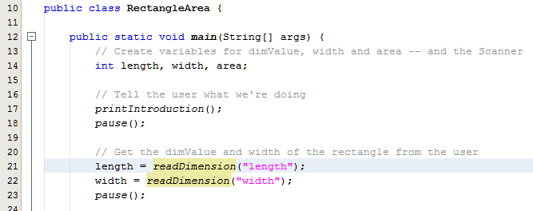
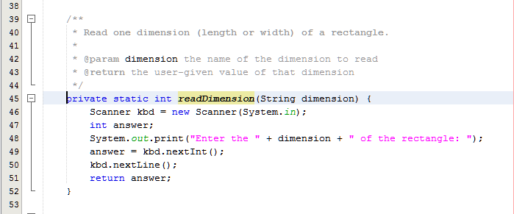
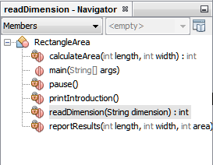
NetBeans’ Navigation Pane
Bottom-left side of IDE window
double-click method to jump to its definition
hover to see its javadoc
remind you in case you forgot what it’s for

Slide 38
Exercise
Write methods to:
print a given line and a blank line after it.
“givenˮ means given to the method
calculate f(x) where f(x) = 2x³ – 3x + 5.
print the sum of three given numbers.
sum three given numbers.
what’s different from the previous question?
Notes:
private static void printPlusBlankLine(String text) {
sout(text);
sout();
}
private static double f(double x) {
return 2 * Math.pow(x, 3) – 3 * x + 5;
}
private static void printSumOf3(int num1, int num2, int num3) {
sout(num1 + num2 + num3);
}
private static int getSumOf3(int num1, int num2, int num3) {
return num1 + num2 + num3;
}
// This method RETURNs the sum instead of PRINTing it.

Slide 39
Back to Greesie Burger
Wanted to check answer to see if yes or no
lots of ways to say yes
several ways to say no
Needed to check for yes twice:
while (!answer means yes and !answer means no)
get another answer
if (answer means yes)
add fries to the order
Methods would be helpful

Slide 40
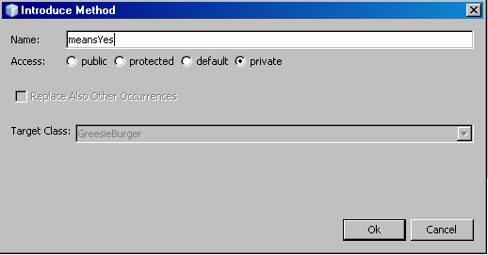
Great Way to Create Method
Available in NetBeans
type the code you want in the place you want it
select the bit you want in your method
select Refactor > Introduce > Method…
fill in method name
click Ok

Slide 41
Boom!
NetBeans makes the changes you need
creates method call
creates required method
you make corresponding change to other code
unless NetBeans does it automatically – which it might
while (!meansYes(answer) && !answer.startsWith("no")) {

Slide 42
Public vs. Private
NetBeans defaults to making methods private
that is OK
private → can only be used inside this class
public → other classes can use this method
Do you want other classes to use this method?
Math, Scanner, and String do want others to use
so they declare methods public
so far, we don’t care!
make it public or leave it private. Whatevs!
Later we will learn when to make it public and when to make it private.

Slide 43
Revising meansYes
If you change the list of words in meansYes…
e.g. add "sure" as an option
and maybe tell it to ignore case
private static boolean meansYes(String word) {
return word.equalsIgnoreCase("yes")
|| word.equalsIgnoreCase("yeah")
|| word.equalsIgnoreCase("ok")
|| word.equalsIgnoreCase("fine")
|| word.equalsIgnoreCase("sure");
}
…change applies in both places (if and while)

Slide 44
Exercise
Create a method for meaning No.
adjust by using equalsIgnoreCase, by adding new words that mean no, …
nah, nope, not(?), …?
Any changes made to the method definition will apply in the while loop
because the while loop calls this method
this method says what to check for
Notes:
private static boolean meansNo(String answer) {
return answer.equalsIgnoreCase("no")
|| answer.equalsIgnoreCase("nah")
|| answer.equalsIgnoreCase("nope")
|| answer.equalsIgnoreCase("sorry");
}

Slide 45
Stubs
When you start a method you might not have the code you need
printTitle("My Program Title");
can still ask NetBeans to create the method
creates a stub – a definition with degenerate body
private static void printTitle(String my_Program_Title) {
throw new UnsupportedOperationException("….");
}
just delete the whole “throw new …” line
it just says to end the program with an error
but we can just make it do nothing
Symbol not found:
symbol method printTitle(String)

Slide 46
Stubs
For value-returning methods, need a return
String name;
name = getUsersName();
NetBeans figures out the return type
private static String getUsersName() {
throw new UnsupportedOperationException(…);
}
replace “throw new …” with a return command
private static String getUsersName() {
return "User's NAME Goes Here";
}

Slide 47
Purpose of a Stub
Get the program running quickly
Test whether things happen in the right order
add a println command in void methods
private static void printTitle(String my_Program_Title) {
System.out.println("Program title goes here");
}
can think about what exactly to do later
called top down design

Slide 48
Exercise
Write stubs for the following methods:
print a report including the length and width of a rectangle
translate an int value into a Roman numeral
e.g. 42 → XLII; 2020 → MMXX
don’t print it!!!
translate a Roman numeral into its int value
Remember: STUBS!
you don’t need to know how to do it!
Notes:
private static void printDimensions(Rectangle r) {
}
private static String toRoman(int n) {
return "XLII";
}
private static int fromRoman(String roman) {
return 42;
}

Slide 49
Methods Summary
Many useful methods available
Scanners, Strings, Math, …
Can create our own
private static methods
void methods just do something
value-returning methods return a value (duh!)
type of value returned replaces void
arguments saved into parameters
use local variables and parameters
don’t change parameter values

Slide 50
Questions

