Slide 1
Computer Hardware and History

Slide 2
Computers
Personal computers
desktop, laptop, and notebook machines
web-surf, chat, write letters/papers, ...
Embedded systems
games consoles, cell phones, cars, ...
might not even notice you’re using a computer!
Servers
web servers, file servers, cloud computing, ...

Slide 3
What is a Computer?
A machine that stores information and instructions for its own operation
Hardware = the machine part
Software = the stored stuff
Operating Systems: e.g. Windows 10, macOS 10
runs the computer
Applications: e.g. PowerPoint, Chrome, TikTok
what people are using the computer for
Programming Languages
to make more software

Slide 4
Computer Hardware...
Input devices (data into the computer)
mouse, keyboard, microphone, touch screen, ...
Output devices (data out of the computer)
screen, speakers, printer, ...
Exercise:
name some input and output devices/modes for
iPod
video game systems
Notes:
iPod input
- center button (click, press)
- wheel (click left/right/bottom/top, press left/right/bottom, swipe clockwise/counter-clockwise)
iPod output
- speakers
- screen
- headphone jack
Xbox game controller input
- left/right sticks (angle, click)
- left/right bumpers
- view button
- Xbox button
- menu button
- direction pad (click up/down/left/right)
- X, Y, A, and B buttons (click)
- right/left triggers (press)
- pair button
Xbox controller output
- left/right triggers (vibrate)

Slide 5
...Computer Hardware...
CPU (Central Processing Unit)
process the data (add, multiply, move, ...)
understands the instructions
may have extra CPUs (GPU, for example)
Main Memory
remember what the computer’s working on
volatile = lost when power goes out
small(ish) capacity (megabytes/gigabytes)

Slide 6
...Computer Hardware
Secondary storage
hold files when the power’s off
use the open and save commands in a program
large capacity (gigabytes/terabytes/...)
Internal:
hard disk, solid state storage
External:
USB drive, CD, DVD, ...
floppy disk, punch cards, tape, ...

Slide 7
Running a Program
User requests program to start
types command on keyboard
uses mouse to double-click icon on screen
uses finger to tap icon on screen
speaks command to computer
looks pointedly at the screen
thinks at the computer
Input devices: keyboard, mouse, touch-screen, microphone, eye-tracking device, EEG probes

Slide 8
Running a Program
Operating system provides continuous feedback on output device(s)
visual (screen)
audio (speaker)
tactile (vibrator)
OS stored in main memory, loaded into CPU as required
CPU
operating system
main
memory

Slide 9
Running a Program
Program loaded from secondary storage into main memory
CPU running OS code
CPU
operating system
main
memory

Slide 10
Running a Program
Program commands loaded into CPU as required
changes to variables (in main memory)
input/output requires OS code
CPU
operating system
main
memory

Slide 11
Computer Networks
Computers send messages to each other
phone to web server: Can I have this page?
web server to phone: Here it is.
“File Servers” remember files
DropBox has computers that hold your files
need to be on internet to get them
J-drive on lab computers is a link to other computers here at SMU
need to be on SMU file network to get them

Slide 12
The Internet
Networks pass message between computers
Local Area Network – computers close together
Wide Area Network – computers far apart
Internet connected networks to each other
LANs connected to a WAN
IP = Internet Packet (piece of a message)
IP address indicates source/destination of message
message pieces pass thru multiple computers
different packets may go thru different computers

Slide 13
The Internet
Early Internet allowed text-only messages
instant messages, plain text e-mail
messages sent thru phone lines as sounds
Modulator-Demodulator → MODEM
modem sounds
slow!
Better encodings and less noisy channels led to faster connections – images, sounds, even video became possible

Slide 14
The World Wide Web
Service offered over the Internet
names for computers and computer networks
HTTP – Hyper-Text Transfer Protocol
language for laying out document content
allows links in documents to other documents
click and go!
Web pages → documents using HTTP
Internet ≈ Hardware; Web ≈ Software

Slide 15
Client-Server Division
Client is computer asking for information
Server provides the information
Web browser (or similar software) renders the information on the client computer
Some computing may be required in client
client-side computing
Some computing may be done on server
server-side computing

Slide 16
The Cloud
More services moving to server side
storing files on the Web
Dropbox, OneDrive, …
voice recognition done on server
Siri, Alexa, Google Home, …
storing programs on Web
Office 365, GSuite, AppsAnywhere
Human can access using any device
switch between desktop, laptop, phone, …

Slide 17
Speed of Memory
The longer the trip, the longer it takes
data in main memory is accessed FAST
data on secondary storage is slow
data on LAN is slower
need to wait for other computers
data on internet is slower still
many more computers involved; transmission time
But fast computers & good connections → doesn’t matter (much)

Slide 18
What is “Memory”
Where information is stored
your user data (photos, papers, messages, ...)
your programs (browsers, word processors, ...)
Parts of memory
bits: each either a 0 or a 1 (“binary digit”)
bytes: 8 bits
each byte has an address (is addressable)
everything is represented with bits and bytes

Slide 19
Binary Numbers
Counting
0 → 0
1 → 1
2 → 10
3 → 11
4 → 100
5 → 101
6 → 110
7 → 111
8 → 1000
Integer ranges
8 bits → -128 .. 127 (byte)
16 bits → -32 768 .. 32 767 (short)
32 bits → -2*10⁹ .. 2*10⁹ (int)
64 bits → -9*10¹⁸ .. 9*10¹⁸ (long)
Floating point ranges
32 bits → 1.4*10⁻⁴⁵ .. 3.4*10³⁸ (float)
about 7 decimal digits of accuracy
64 bits → 5*10⁻³²⁴ .. 2*10³⁰⁸ (double)
about 15 decimal digits of accuracy
Except for byte and short, the ranges are approximate.

Slide 20
Software
Data & instructions
programs (instructions) manipulate data
all represented with bits/bytes
Data hierarchy
8 bits → byte
1 or more bytes → data value (field)
1 or more data values/objects → object (record)
data may be stored on secondary memory (file)

Slide 21
Representing Data Values
Usually requires multiple bytes
the letter ‘A’
this colour
the int 65
the double 65.0
the String “65.0”
Same byte values != same data
similar data != same data
00000000
01000001
00000000
00000000
01000001
00000000
00000000
00000000
01000001
01000000
01010000
01000000
00000000
00000000
00000000
00000000
00000000
00000000
00000000
00000000
00000100
00110110
00110101
00101110
00110000

Slide 22
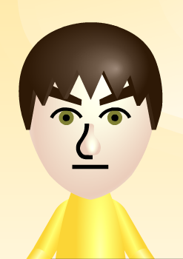
Representing Objects
Complex objects require lots of data
some of which may be other objects (parts)
MiiAvatar:
Name: (String)
CreatorName: (String)
FavoriteColour: (byte)
MonthBorn: (byte)
DayBorn: (byte)
Height: (byte)
Weight: (byte)
FaceShape: (byte)
...

Slide 23
Programming Languages
Programmers create programs
Programs are instructions to the computer
compare: recipes are instructions to cooks
Generally we write instructions
but computers don’t understand English
or any other natural language
many special languages for programming
programming languages

Slide 24
Example Languages
FORTRAN
LISP
ALGOL
COBOL
SNOBOL
PL/I
BASIC
APL
Pascal
Smalltalk
c
Prolog
Scheme
Modula
SQL
Ada
C++
Prograph
Perl
Python
Java
Javascript
C#
Ruby
and lots, lots more!

Slide 25
Translation
Human-usable languages = source code
computer CPU doesn’t understand them
need to be translated to machine language (on Wintel machines: .exe files)
translator program is called a compiler
#include <iostream>
using namespace std;
void main() {
cout << “Hi!”;
}
$^%#§&*^#½&Þ%^)J=®\|:”<± ₪ (*^&$%^ *(&T·¤Hi!•&^%$()&^&^^&^T^&”?+_)(“*(
Compiler
C++ compiler
Source Code
Machine Language
HiProg.cpp
HiProg.exe

Slide 26
Machine Language
Language of the CPU
very simple instructions
move a value from one place to another
add two values together
jump to a new location in the program
Different languages for different CPUs
PowerPC has different language from x86

Slide 27
Operating Systems
Program that starts & runs computer
Windows, MacOS, Linux, iOS, Android, …
each comes in multiple versions
Each has its own set of “system calls”
important things many program need to do
opening and closing files, waiting for resources, …
might be called by methods other programs use

Slide 28
Normal Compilation
Compiler normally translates source code into machine language for same computer
same CPU, same OS
won’t run on other computers
different CPU (e.g. PowerPC vs. x86)
different OS (e.g. Windows vs. Mac)
different version of OS (e.g. Windows 10 vs. Vista)
sometimes / often?
Sometimes even source code needs to be different for different computers!

Slide 29
Java Compilers
Java designed to be “run anywhere”
some source code on every computer
compiled code runs on every computer
Java Virtual Machine (JVM)
a make-believe computer
Java source code compiled to JVM language
Java Runtime Environment
a program that runs JVM machine code
an emulator

Slide 30
Java Programs
Source code in a .java file
GradeCalculatorApp.java
Compiled code in a .class file
GradeCalculatorApp.class
GUI program in a .jar file
GradeCalculatorApp.jar
can just click and run this file
if your computer has .jar default set properly!

Slide 31
Pre-History of Computers
The Jacquard programmable loom (1801)
weave designs encoded in punched cards
Babbage and Lovelace (1820s)
mathematical formulas encoded in punch cards
Difference engine, Analytical engine
Lovelace wrote algorithms for the machines
Hollerith (1880s)
punch cards for US 1890 census → IBM
Video of a working difference engine

Slide 32
Invention of Computers
Alan Turing
mathematical description of computation
machine to decipher German coded messages
test for “thinking” machines
Electronic computers
(unnamed) by Atanasoff & Berry (1941)
ENIAC by Mauchly & Eckert (1943)
UNIVAC by Mauchly & Presper (1946)
invention of the transistor (1947)

Slide 33
Evolution of Computers
Mechanical → vacuum tubes → transistors → integrated circuits (computer chips)
transistor: solid state electric switch (on-off)
IC: multiple components in one unit
Grace Hopper
1st programming language (FLOW-MATIC)
identification of “bug” as problem in computer

Slide 34
Evolution of Computers
Moore’s law:
computer power doubles every 18-24 months
Computers get smaller and faster
custom-built computers
mainframe computers
personal computers
cellphones
embedded systems

Slide 35
Limits to Moore’s Law?
Has been slowing down since about 2010
if transistors get too small…
and we’re getting close!
… electrons start leaking out…
uncertainty principle; electron tunnelling
…computer makes mistakes
Multi-processor CPUs
dual-core has 2 processors; quad-core has 4
speeds up by doing multiple things at once

Slide 36
Artificial Intelligence
The quest to build a machine with human-level intelligence (artificial = not natural)
Turing again – the imitation game / tournament
Symbolic methods: computers and logic
expert systems – clever but brittle (failure)
Neural simulation: artificial brains
very limited power – using old-time computers
modern computers bring lots of power

Slide 37
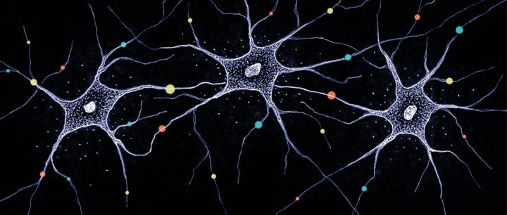
Artificial Neural Networks
Simulate neurons in animal brains
neuron “fires”
sends energy on
connections get stronger/weaker as learning occurs
system learns to classify inputs into groups
Need lots of neurons to do useful work

Slide 38
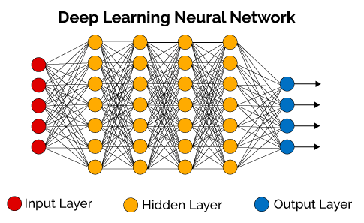
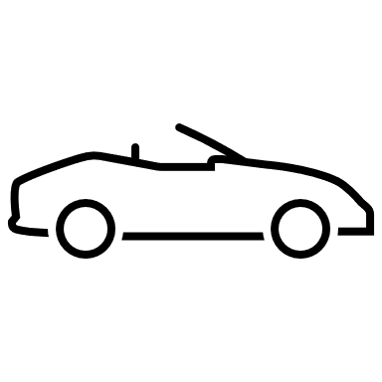
Deep Learning
Option #1
Car
Input
Option #2
Truck
Option #3
Train
(Repeat
many-many
times)
Option #4
Banana

Slide 39
Deep Learning Applications
Speech recognition
input = sounds; output = words
Language translation
input = sentence in L₁; output = sentence in L₂
Image recognition
input = image; output = object labels
e.g. tagging faces in photographs

Slide 40
Future of Computing?
Quantum computers
use quantum superposition to do calculations
qubit → quantum bit
0 or 1 or superposition of both
very good at some problems
factoring numbers (→ breaking codes)
searching (→ hacking passwords)
simulation of chemical processes
but not any better for most problems

Slide 41
Questions?

