Slide 1
Graphical User Interfaces (GUIs)

Slide 2
Overview
What is a GUI?
Creating GUIs in Java
GUI components & layout managers
GUI (sub)classes
Event control
(getting the GUI to do something)
NetBeans’ GUI design tool

Slide 3
What is a GUI?
Graphical User Interface
a graphical way to use the program
windows, icons, menus, pointing (WIMP)
Lots less typing for the user
Lots less things for them to remember
see options by looking
_
X
This is a GUI
File Edit Help
File Edit Help
Open
Save
——
Exit
Mrph
Blah
Yuck
Eeew
Gross
Dpbl
Xvgl

Slide 4
Getting Started
Java program that creates and shows a GUI
JFrame object with JLabels & more inside it
Program class has a main method
compile & run program as usual
GUI window will appear
we’ll need to do something special to make sure our program ends when it’s supposed to!

Slide 5
Java GUI
Java has two different GUI libraries
java.awt.* Frame, Label, …
javax.swing.* JFrame, JLabel, …
we need stuff from both of them
Another way to do GUI: JavaFX
various javafx libraries
not included in Java any more ☹
alternate slides available

Slide 6
The GUI Window
GUI starts with a window object
give a title for the window
JFrame win = new JFrame("My Win");
Nothing happened!
actually an invisible window was created
win.setVisible(true);
It’s tiny!
but you can resize it
See GUIStuff.java

Slide 7
The GUI Window
JFrame win = new JFrame("My Win");
win is a variable – will hold the window object
JFrame is the class we’re creating an instance of (class of windows)
title of window (in title bar): “My Win”
win.setVisible(true);
win is the window object
setVisible is the command
true is the argument → true = visible

Slide 8
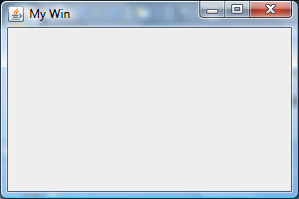
Making it Bigger at the Start
Don’t want to have to re-size every window
win.setSize(300, 200);
300 pixels wide
200 pixels tall
exactly how big that is depends on your screen resolution (number of pixels per inch)
NOTE: dimensions are of outer edges
200
300

Slide 9
Our Window So Far
Title bar
cup of java icon
title of window
min., max. & close buttons
otherwise empty
Note:
looks like other windows on your computer
will look like Mac window on Mac computer

Slide 10
Things to Add to Your Window
All in javax.swing:
JLabel – text for user to read
JTextField – box for user to type in
JButton – button for user to push
JCheckBox – box for user to check/uncheck
JRadioButton – one radio button
ButtonGroup – for grouping radio buttons
…many more…

Slide 11
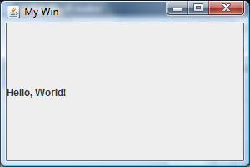
Labels
Label needs to know its text
need to tell the window to repaint itself
JLabel lbl1 = new JLabel("Hello, World!");
win.add(lbl1);
win.setVisible(true);
Didn’t say where to put the label, so it filled the pane
add method can be told where to put the object

Slide 12
Component Placement
Default “layout” gives you five places to put components:
PAGE_START (NORTH)
PAGE_END (SOUTH)
LINE_START (WEST)
LINE_END (EAST)
CENTER
Need to import java.awt.*;
use like: BorderLayout.NORTH
PAGE_START
LINE_START
CENTER
LINE_END
PAGE_END

Slide 13
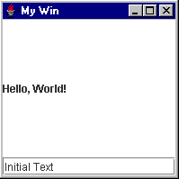
Text Fields
Labels don’t do anything
For text you can edit, use JTextField
JTextField tf = new JTextField("Initial Text");
win.add(tf, BorderLayout.SOUTH);
win.setVisible(true);
small amount of plain text
JTextPane for more text

Slide 14
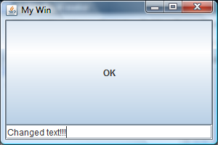
Buttons
Buttons can be clicked
lets the user select an action to carry out
JButton b1 = new JButton("OK");
win.add(b1);
win.setVisible(true);
computer put it CENTER, right over the label, because we didn’t say where it went

Slide 15
Window Layout Managers
It’s possible to tell the window exactly where you want each piece you add to it
how many pixels across, down
looks very nice if you do it right
generally gets messed up if user resizes window
Easier and more portable to use manager
default manager: BorderLayout
others available: we’ll look at two more

Slide 16
Window Layout Managers
Window layout managers in java.awt
BorderLayout
CardLayout
FlowLayout
GridBagLayout
GridLayout
Each has its own way of determining what goes where…
We’ll look at
BorderLayout
FlowLayout
GridLayout
See GUIStuff.java

Slide 17
BorderLayout
Five locations to place objects
objects in the same location are placed one on top of the other
objects are stretched or squashed in order to fill the space allotted
empty locations are not used (other objects expand)
PAGE_START
LINE_START
CENTER
LINE_END
PAGE_END

Slide 18
FlowLayout
FlowLayout just puts the objects into the window one after the other
if there’s not enough room across, it goes down to the next “line”
objects centred on each line
objects move around when window gets resized
FIRST
SECOND
THIRD
FOURTH
FIFTH

Slide 19
GridLayout
Creates a small table
each object goes in the next cell of the table
Need to say how many rows and/or columns
new GridLayout(5, 3) →
don’t put more than 15 things in the grid!
(0, 3) means 3 columns and as many rows as you need
1st
2nd
3rd
Fourth
Fifth

Slide 20
Choosing a Layout Manager
Create a new layout object and tell the content pane to use it (setLayout method)
flow layout
win.setLayout(new FlowLayout());
border layout
win.setLayout(new BorderLayout());
grid layout (2 rows, 3 columns)
win.setLayout(new GridLayout(2, 3));

Slide 21
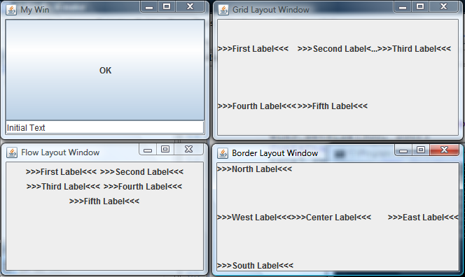
Some Windows

Slide 22
Putting it Together
We have created a lot of objects
window (JFrame), label (JLabel), text fields (JTextField), buttons (JButton)
Want them all to work together
but we’ve done it all in a very procedural way
should do it in an object oriented way
Create a class for this kind of window
create window objects as required
(use main to test: create an object and show it)

Slide 23
GUI Window Class
Create a window class that inherits from the Java window class (javax.swing.JFrame)
public class MyWinClass extends JFrame {
constructor sets the title using super
public MyWinClass(String title) {
super(title);
…
then constructor adds stuff to this window

Slide 24
GUI Window Class
The object created will be a window object (in the class JFrame)
use this — there is no variable named win here
this.add(new JLabel("Hello!"));
or use super – to get rid of NetBeans’ complaint
super.add(new JButton("OK"));
Don’t make it visible in the constructor
let client decide when to make it visible

Slide 25
Adder Dialog Mock-Up
Adding Numbers
Enter two numbers to add together:
First number:
10
Second number:
25
Result:
35
Calculate
Done

Slide 26
Adder Dialog Grid Mock-Up
Adding Numbers
Enter two numbers to add…
First number:
10
Second number:
25
Result:
35
Calculate
Done
note this empty cell…

Slide 27
Buttons and Fields
Need to talk to/about the buttons and fields
tell button what to do when it’s clicked
ask field what number it has typed in it
These objects need names
JButton doneButton = new JButton("Done");
JButton calculateButton = new JButton("Calculate");
JTextField input1 = new JTextField();
JTextField input2 = new JTextField();
JTextField output = new JTextField();
JLabels can be anonymous, still

Slide 28
Adder Dialog (version 1)
public class AdderDialog1 extends JFrame {
public AdderDialog1() {
super("Adding Numbers");
this.setSize(450, 250); // or super.setSize(450, 250);
this.setLayout( new GridLayout(0, 2, 10, 5) );
… // create JButton and JTextField variables/objects
… // add labels/fields/buttons to this window
}
}
? rows, 2 columns
10 pixels between columns
5 pixels between rows

Slide 29
Adder Dialog (version 1) main
public class AdderDialog1 extends JFrame {
…
public static void main(String[] args) {
AdderDialog1 ad1 = new AdderDialog1();
ad1.setVisible(true);
}
}
Create the window
Make it visible

Slide 30
Now Do Something!
Our windows do nothing
(other than resize)
Want actions to go with the buttons
read values from text boxes, maybe
add results & put back into another box
Need event controllers
methods that are called when something happens (e.g. button pushed)

Slide 31
Getting the Program to End
First we want the program to end when the adder dialog box is closed
JFrames have an easy way to do that
setDefaultCloseOperation(JFrame.EXIT_ON_CLOSE);
add that line to the constructor, and then closing the adder window ends the application
For other events, we need an ActionListener
button.addActionListener(…);

Slide 32
ActionListeners
We’ll use what’s called a lambda expression
e -> methodCall
that’s the letter e, a hyphen-and-greater-than-sign, and then a call to some method
you can replace e with any letter or word you want
the method you call is what you want to happen when the button gets clicked
for the done button, we want the program to end
so call System.exit(0)
doneButton.addActionListener(e -> System.exit(0));

Slide 33
ActionListeners
The important thing is the method call
doneButton.addActionListener(e -> System.exit(0));
but the e -> has to be there to get it to work!
we will explain what it’s for in a later course
NOTE: only one semi-colon – not after System.exit(0)
The button is clicked → the method is called
Done button is clicked → System.exit(0) is called
System.exit(0) ends the program
the window closes

Slide 34
The Calculate Button
We use this button to add the numbers
needs to get numbers from the two input fields
needs to put the answer in the output field
method call needs to be told those three fields
calculateButton.addActionListener(
e -> addTheNumbers(input1, input2, output)
);
NOTE AGAIN: only one semi-colon – after the call to addActionListener – not after addTheNumbers

Slide 35
Adding The Numbers
Method needs to get text out of two fields…
str1 = input1.getText();
…and change String to int…
n1 = Integer.parseInt(str1);
…add the numbers together…
sum = n1 + n2;
…and put the result into the output field
output.setText(Integer.toString(sum));

Slide 36
Adding The Numbers
public static void addTheNumbers( JTextField input1, JTextField input2, JTextField output) {
String str1, str2;
int n1, n2, sum;
str1 = input1.getText(); str2 = input2.getText();
n1 = Integer.parseInt(str1); n2 = Integer.parseInt(str2);
sum = n1 + n2;
output.setText(Integer.toString(sum));
}

Slide 37
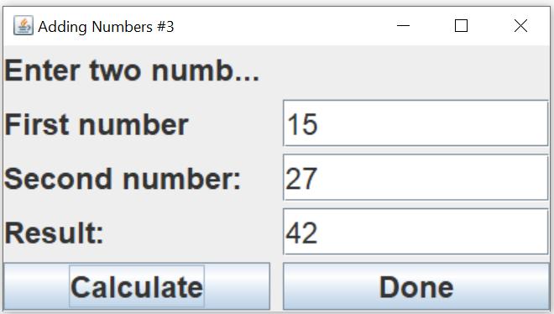
The AdderDialog in Action
Type numbers into the boxes, click Calculate
some issues it’d be nice to fix
numbers should be on right edge of box
shouldn’t be able to edit the result box
instructions are cut off

Slide 38
Formatting the Text Fields
Number fields should align to the right
input1.setHorizontalAlignment(JTextField.RIGHT);
Result field shouldn’t be editable
output.setEditable(false);
Make some space around the box edges
Insets object gives number of pixels to be blank
top, left, bottom, right
Insets margin = new Insets(5, 5, 5, 5);
input1.setMargin(margin);

Slide 39
Adder Dialog (version 3)
public class AdderDialog3 extends JFrame {
public AdderDialog3() {
super("Adding Numbers"); // MUST BE FIRST!
// set up the window
…
// create JButton and JTextField variables/objects
…
// format the fields
...
// add labels/fields/buttons to this window
…
}
}

Slide 40
Adding Sub-Panes
You can create a JPanel and put objects inside it…
using its own layout manager
JPanel top = new JPanel();
top.setLayout(new FlowLayout());
top.add(new JLabel("Enter two numbers to add…"));
…then put the JPanel into the window
using the window’s layout manager
super.add(top, BorderLayout.NORTH);

Slide 41
Exercise: Adding Sub-Panes
BorderLayout for full window
NORTH, CENTER, SOUTH
FlowLayout for top pane
already done!
GridLayout for middle
3 rows, 2 columns
FlowLayout for bottom
Enter two numbers to add together:
First number:
Second number:
Result:
Calculate
Done
Notes:
JPanel top = new JPanel();
top.setLayout(new FlowLayout());
jPanel middle = new JPanel();
middle.setLayout(new GridLayout(3, 2));
jPanel bottom = new JPanel();
bottom.setLayout(new FlowLayout());
super.add(top, BorderLayout.NORTH);
super.add(middle, BorderLayout.CENTER);
super.add(bottom, BorderLayout.SOUTH);

Slide 42
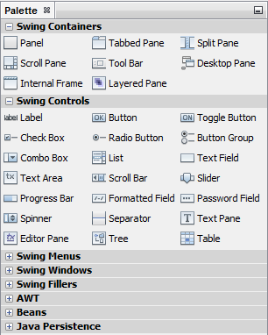
NetBeans GUI Designer
NetBeans provides a design tool
Add a new “JFrame Form…” to project
opens in “Design” view (instead of “Source”)
shows a “Palette” with containers & controls
and more, but collapsed
Sometimes NetBeans will switch to “Source” view.
Just click on the “Design” button to get back.

Slide 43
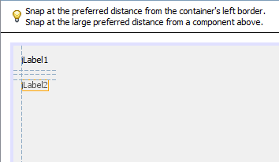
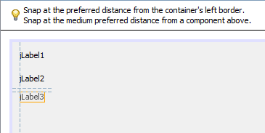
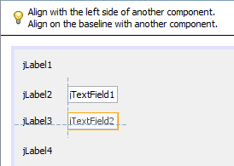
Adding Items to the Window
Drag and drop
watch guidelines for placement
wide space
medium space
align above and beside

Slide 44
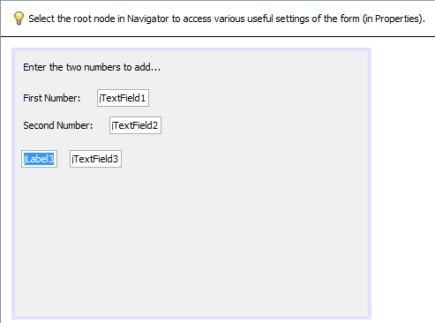
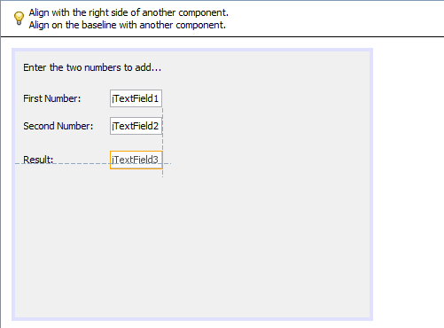
Setting Labels
Slow double-click label to set its text
other items may move relative to new label contents
fix them by dragging to line up with other text boxes

Slide 45
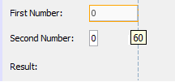
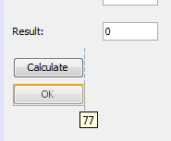
Sizing Text Boxes
Slow double click text fields to change text inside the box
box may resize
Select box and drag corner/edge to resize it
Similarly for buttons
I put it below “Calculate” so I could make them the same width
then I moved it to its final location

Slide 46
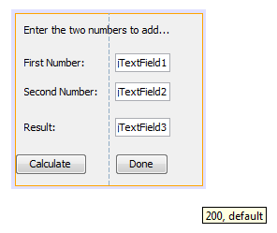
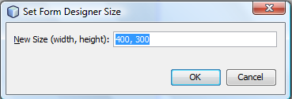
Resizing Window
Drag from bottom-right corner until you get the size you want
or double-click border and type in the dimensions you want

Slide 47
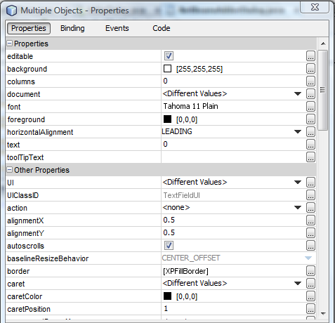
Changing Properties
Select the items to change
(e.g. all the text boxes)
Right-click to get properties
change as desired

Slide 48
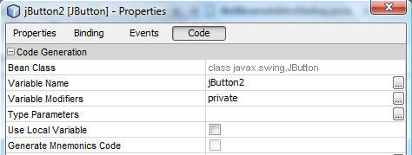
Changing Name
NetBeans gives blah names:
jTextField1, jTextField2, jButton1, jButton2
Should change to better names
variable name property in “Code” properties

Slide 49
Adding Actions
Double-click button to add an action
switches to “Source” mode…
...in the method that handles click of that button
Add code to do what you want
All fields/buttons/labels are instance variables
you won’t need them as parameters

Slide 50
Differences
Code generated by NetBeans will look different from what I told you before
what it writes inside there is the same as
evt -> calculateButtonActionPerformed(evt)
it’s just a longer and more complicated way to write it, and why would we want to use longer and more complicated code???

Slide 51
Exercise
Use NetBeans to make another adder form
use NetBeans’ layout tool
make the buttons work!
Notes:
(Sorry – you need to do this one yourself!)

Slide 52
Questions?

