Slide 1
GUI in Java
Using JavaFX Applications

Slide 2
Outline & Warning
What is GUI
Creating an Application Window
controls and layouts (arrangements; panes)
Activating Buttons in an Application Window
making it do something
Warning:
close old windows before running program again
you may need to use the Clean and Build Project command on the Run menu from time to time

Slide 3
What is a GUI?
Graphical User Interface
a graphical way to use the program
windows, icons, menus, pointing (WIMP)
Lots less typing for the user
Lots less things for them to remember
see options by looking
File Edit Help
_
X
Open
Save
——
Exit
Mrph
Blah
Yuck
Eeew
Gross
Dpbl
Xvgl

Slide 4
Evolving Standards
Ways of creating GUIs still evolving
new libraries are being created
still have old GUIs hanging around
Older standard called swing
Newer standard is JavaFX
what I’ll talk about today

Slide 5
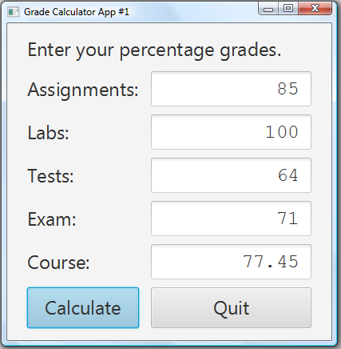
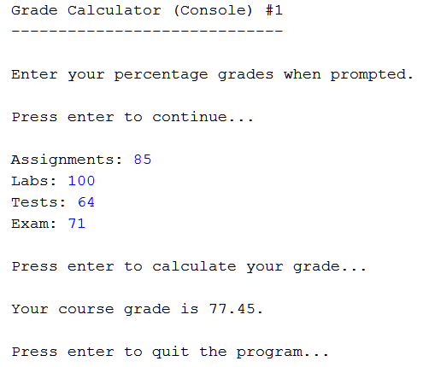
GUI vs. Console Program

Slide 6
Differences
Different kinds of objects involved
Scanner in console
text fields and buttons in app
Interaction is different
console needs you to enter numbers in order
can change numbers and recalculate in app

Slide 7
Similarities
Purpose of program is the same
calculate a final course grade for this course
Input is the same
user provides component grades
assignments, labs, tests, exam
Steps for doing calculation the same
read the numbers
calculate the result
show the result

Slide 8
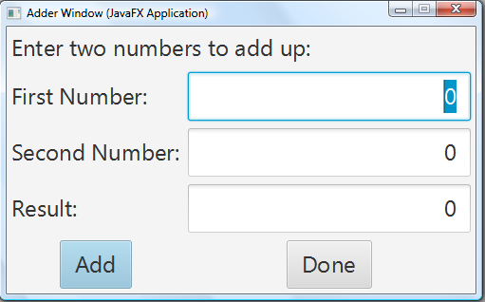
A Slightly Simpler Goal
Program opens up a window like this:
What can we do with it?
can enter numbers into the first and second number boxes
can click the “Add” button to put their sum into the result box
can click the “Done” button to end the program

Slide 9
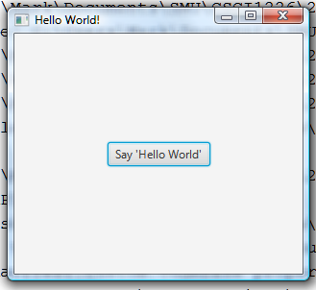
Creating an Application
New Project > JavaFX > JavaFX Application
We will call our program AdderApplication
NetBeans generates an Application
you can run it right away:
Click the button
“Hello World!ˮ printed in output window

Slide 10
Application Code
It’s a bit complicated!
import commands:
extends keyword
start method
lots of code in it
main method
one line of code
Most code is in the start method

Slide 11
The Methods main and start
Console programs have a main method
runs the whole program
Applications have a main method
just the one command: launch(args);
you don’t need to worry about where it comes from or what it does – just don’t change it!
Setting up the GUI is done in start method
@Override
public void start(Stage primaryStage)

Slide 12
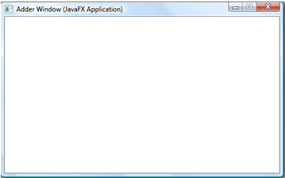
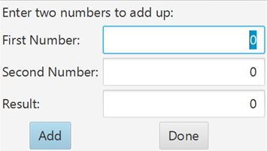
Stage and Scene
Two data types in javafx:
Stage is a window
primaryStage is the main window
Scene is an arrangement of stuff in a window
You can have more than one scene.
You can have more than one stage.
We will stick with one of each.

Slide 13
The Stage
Last part of start method is three lines long:
set the title bar on the window
primaryStage.setTitle("Hello World!");
we want our title to be Adder Window
(Java adds the “(JavaFX Application)ˮ part)
set the scene onto the stage
primaryStage.setScene(scene);
show the stage
primaryStage.show();
First part of start creates the scene

Slide 14
The Scene
Scene is an arrangement of stuff in a window
Stuff is mostly controls:
labels, text fields, buttons, menus, …
Arrangement
need to say where things are
StackPane → one pile of things in middle of stage
fine for Hello World! because there’s only one thing
GridPane → arranged in rows and columns
we want this kind of layout for Adder Window
There are other kinds of Panes, too!

Slide 15
Our Controls
We have three kinds of controls in our Scene
Labels: bits of text that don’t do anything
TextFields: boxes for users to type in
Buttons: things for users to click
something should happen after they get clicked
we’ll worry about that later
Other applications may need other things
CheckBoxes, RadioButtons, MenuBar, Menus, …
All controls imported from javafx.scene.control

Slide 16
Creating a Button
Sample application does that for us:
create the Button variable and object
Button btn = new Button();
set the text on the Button
btn.setText("Say 'Hello World!'");
Steps can be combined into one:
Button btn = new Button("Say 'Hello World!'");
We want two buttons:
Button addButton = new Button("Add");
Button doneButton = new Button("Done");

Slide 17
Creating a Label
Same as for a Button
variable, object, text
Label num1Label = new Label("First Number:");
Label num2Label = new Label("Second Number:");
Label result = new Label("Result:");
Label instructions;
instructions = new Label("Enter two numbers to add up:");
need to import from javafx.scene.control
don’t import the other kinds of Labels
many won’t work with an Application

Slide 18
Creating a TextField
Same as for Button and Label
variable, object, text
but the text is optional – no text = empty text field
TextField num1Field = new TextField("0");
TextField num2Field = new TextField("0");
TextField resultField = new TextField("0");
note that text is a String, not an int or double
we will need to convert that String to a number

Slide 19
Our Arrangement
Laid out as a grid:
two columns, five rows
numbered from zero (as usual in C.S.)
Column
0 1
Row
0
1
2
3
4
Enter two numbers to add up:
First Number: | (…………...Box for First Number)
Second Number: | (……...Box for Second Number)
Result: | (…………………..….Box for Result)
(Add Button) | (Done Button)

Slide 20
Creating a Grid Layout
Create the GridPane
GridPane root = new GridPane();
Add each object to its column and row
root.add(instructions, 0, 0);
root.add(num1Label, 0, 1);
root.add(num1Field, 1, 1);
…
root.add(addButton, 0, 4);
root.add(doneButton, 1, 4);
Enter two numbers to add up:
First Number: | (……..Box for 1st Number)
Second Number: | (…….Box for 2nd Number)
Result: | (…………….Box for Result)
(Add Button) | (Done Button)

Slide 21
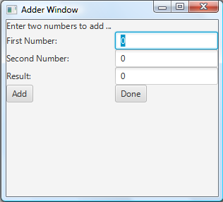
Creating a Scene
Sample Application has an example:
Scene scene = new Scene(root, 300, 250);
give it the laid out stuff, width and height
this works for us
Can now run the program:
…
…
doesn’t look very nice…
doesn’t do anything, either

Slide 22
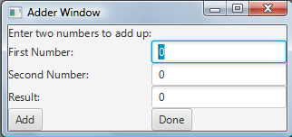
Sizing to Scene
Big blank space at bottom
made scene too tall and narrow
"Enter two numbers to add…"
window sized to fit scene
Don’t tell the Scene how big the layout is
Scene scene = new Scene(root);
scene will be just as big as it needs to be

Slide 23
Make Everything BIGGER
Use 18pt or 24pt font instead of default
tell each object to change its font
instructions.setFont(new Font(24));
num1Field.setFont(new Font(24));
addButton.setFont(new Font(24));
name that number FONT_SIZE
need to import java.scene.text.Font
NOT java.awt.Font
just need to do that for each label, field and button
better to make a method for each kind of control

Slide 24
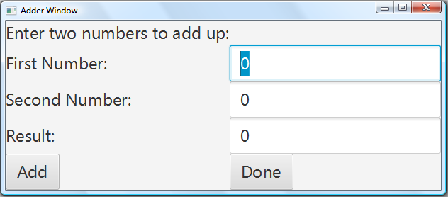
Control Methods
Create the control and set its font
private Button makeButton(String text) {
Button result = new Button(text);
result.setFont(new Font(FONT_SIZE));
return result;
}
similarly for Labels and TextFields

Slide 25
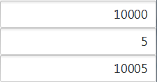
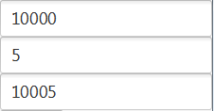
Alignment in TextFields
Want the numbers to be on the right
so they look like this:
instead of like this:
Add command to makeTextField method:
result.setAlignment(Pos.CENTER_RIGHT);
need to import javafx.geometry.Pos

Slide 26
Making Result Field Un-Editable
Result is calculated, not entered by user
prevent user from accidentally changing it
Other fields need to be editable
so user can enter numbers
don’t change makeTextField method!
resultField.setEditable(false);
can’t type in result field any more

Slide 27
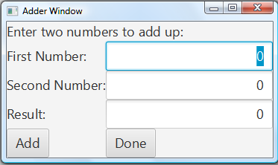
Spreading over Multiple Cells
Make instructions go all the way across the top
currently stuck in top-left cell of grid (0, 0)
want to make it go across two columns
but still only one row
add number of columns and rows to add command
root.add(instructions, 0, 0, 2, 1); // 2 cols, 1 row

Slide 28
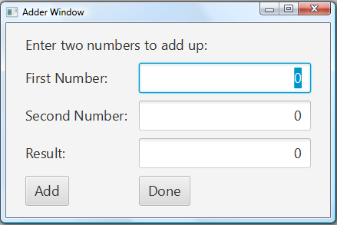
More Can Be Done
Add space around the outside
root.addSetPadding(new Insets(15, 25, 15, 25));
need to import javafx.geometry.Insets
Add space between rows and columns
root.setHgap(15);
root.setVgap(10);
And lots more!

Slide 29
Making it Work
Clicking the Buttons does nothing
no action associated with the button
Sample application had an example:
btn.setOnAction(new EventHandler<ActionEvent>() {
@Override
public void handle(ActionEvent event) {
System.out.println("Hello World!");
}
});
consider this a magic formula for now!

Slide 30
Use Lambda Expression
NetBeans has a yellow light-bulb suggestion:
This … can be changed into a lambda expression
Do that! It’ll look much simpler!
btn.setOnAction((ActionEvent event) -> {
System.out.println("Hello World!");
});
quicker and easier magic formula!
uses hyphen + greater-than sign as an arrow
put what you want the Button to do in the braces

Slide 31
The done Button’s Action
Want to end the program
could use System.exit(0);
better to use Platform.exit();
for later, when you make this Application Awesome!
doneButton.setOnAction((ActionEvent event) -> {
Platform.exit();
});
need to import javafx.application.Platform
also javafx.event.ActionEvent, if you deleted it before
NOT java.awt.ActionEvent!

Slide 32
The add Button’s Action
Needs to add the numbers from the two input TextFields and put answer in result TextField
TextFields give you a String, not an int/double
String num1Text = num1Field.getText();
need to translate into an int: Integer.parseInt
int num1 = Integer.parseInt(num1Text);
then need to change int to String: Integer.toString
String sumText = Integer.toString(sum);
and put that String into the result
resultField.setText(sumText);

Slide 33
The add Button’s Action
All together:
addButton.setOnAction((ActionEvent event) -> {
int num1, num2, sum;
String num1Text, num2Text, sumText;
num1Text = num1Field.getText();
num2Text = num2Field.getText();
num1 = Integer.parseInt(num1Text);
num2 = Integer.parseInt(num2Text);
sum = num1 + num2;
sumText = Integer.toString(sum);
resultField.setText(sumText);
});

Slide 34
The add Button’s Action
Better to put all that in a method
method needs to be told the three TextFields
addButton.setOnAction((ActionEvent event) -> {
addUp(num1Field, num2Field, resultField);
});
addUp method created in AdderApplication
does all the things we did on the previous slide
Run the program and watch it add up numbers

Slide 35
Creating an Icon for the GUI
Can create an icon to run your program!
Use the Clean and Build Project command
Open the project folder (AdderApplication)
Open the dist folder
Double-click AdderApplication.jar
note the extension! there are other files there!
Your program runs (I hope!)
You can give that file to other people

Slide 36
Summary
JavaFX > JavaFX Application
ignore main method; work on start method
create and lay out the controls
create helper methods as desired for this
add event handlers for buttons/menu items/…
create handler/helper methods as desired for this
create the scene (i.e. attach contents to screen)
set the stage (title, special properties)
show the stage

Slide 37
Questions
Last new material for the final exam
2:00 PM, Tuesday, December 17th
Homburg Centre “Field House” (HC FH)
check for changes before you go!
unlikely, but better safe than sorry!
Next week:
review session (both sections)
optional topics in section A
section B students may attend
send suggestions for topic(s) to myoung@cs.smu.ca

