Slide 1
Programming
Review of Principles

Slide 2
Overview
Computer Programming and Languages
  High-Level and Machine Languages
    Compilers, Emulators, Interpreters
Writing Programs
  PseudoCode
  Top-Down Design
IDEs

Slide 3
Computer Programming
Building code to control computers
Code must be designed …
  understand what the code is for
  figure out what it needs to do
  figure out how to get it to do that
… and written
  translate plan into meaningful code
  track down and correct errors

Slide 4
Lots of Different Languages
FORTRAN
LISP
ALGOL
COBOL
SNOBOL
PL/I
BASIC
APL
Pascal
Smalltalk
c
Prolog
Scheme
Modula
SQL
Ada
C++
Prograph
Perl
Python
Java
Javascript
C#
Ruby
and lots, lots more!

Slide 5
Kinds of Languages
Imperative (*)
  tell it what to do
Functional
  specify processes
Logical
  specify meanings
  say what you want
Object Oriented (*)
  data & process abstraction
Parallel
  process control
Graphical
  use pictures

Slide 6
Java
Java is object-oriented
  Source code arranged like objects
  Objects know how to do things that need doing
Java is also imperative
  Tell computer what to do
Java is ideal for internet applications
  Compile once, run anywhere

Slide 7
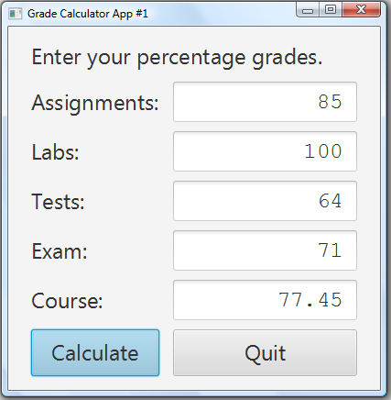
Object Oriented
Objects:
  the window
  the labels
  the fields
  the buttons
  more
Each object knows
how to show itself
and how to do things for itself and others

Slide 8
Imperative
Tell computer to do things
  When the “Calculateˮ button is clicked:
    get the numbers from the top four fields
    adjust them according to the component weights
    add them up
    put the result into the bottom field
Uses the objects
  get the numbers by asking the fields what’s in them

Slide 9
Modern Programming Languages
Most modern languages are similar
  object oriented and imperative
  use loops, conditionals, and methods
    usually even for and while loops
    usually even if and if-else controls
Few languages work on different principles
  learning Java prepares you to learn most other languages

Slide 10
Machine Languages
Humans write code in high-level languages
  like Java, C++, Python, Ruby, …
Computers only “understand” 0s and 1s
  machine language: bits that control the CPU
    each kind of CPU has its own binary language
High-level code must be compiled …
  i.e. translated into machine language
… or interpreted

Slide 11
Compiling Programs
Compile to native code = translate high-level code into bits the CPU understands
  different compilers for different CPUs
  programs won’t run on other computers
    can’t run IPhone apps on Android phones
Compiled code saved in another file
  high-level code: MyProg.cpp
  machine language code: MyProg.exe
    double-click MyProg.exe to run the program

Slide 12
Emulator
Special program that let you run a different computer’s programs
  pretends to be other computer’s CPU
    e.g. Windows emulator on a Macintosh computer
  other computer’s code is data for this program
    read MyProg.exe and simulate CPU running it
Generally much slower than running the code on its own computer

Slide 13
Java Machine Language
Java is both compiled …
  high-level code: MyProg.java
  compiled code: MyProg.class
… and emulated
  Java Runtime Environment (JRE) pretends to be a Java-specific CPU
Slower than native code …
…but can run on any computer with a JRE

Slide 14
Interpreted Code
Some languages are not (usually) compiled
Use a special program called an interpreter
  reads and follows the instructions line by line
  human can type in a command and see the result immediately
Java now has an interpreter
  allows you to try out code snippets quickly
  try it out at tryjshell.org

Slide 15
Creating Programs
Understand the purpose of the code
  if you don’t know what you’re supposed to be doing, how can you tell if you’re doing it right?
Figure out what needs to be done
  what is the input? where is it from?
  what output needs to be produced? where?
  are there special conditions that need to be handled (e.g. invalid input)?

Slide 16
Pseudocode / Algorithms
Program is instructions for computer
  recipe is instructions for cook
Can be in any programming language
  recipe can be in English, French, Korean, ...
Generally start in a mixture of English and some generic programming language
  called pseudocode (“almost code”)
  make an algorithm (steps to solve the problem)

Slide 17
Top-Down Design
Figure out how to do it: make a plan
  start with high-level goals
    getting started, going along, ending up
  break larger goals down into smaller ones
    to get started we need to …
  create methods for major steps
  create methods for common operations
  identify data that needs to be remembered

Slide 18
Grade Calculator Pseudo-Code
High-level description
  Step 1: Get all the component scores
  Step 2: Do the calculation
  Step 3: Show the result
Lower-level description
    Step 1a: get the assignment grade
    Step 1b: get the lab grade
    Step 1c: get the test grade
    Step 1d: get the exam grade

Slide 19
Keep Going
How to get the assignment grade?
  GUI? How to read number from a text field
  Console? How to ask user and get answer
Look for similarities
  same steps to get assignment/lab/test grades
    create a method to do those steps
Look for issues
  what if number entered is not correct?
  what if it’s not even a number?

Slide 20
Programming Programs
We use programs to write programs
  need to write the code (can use Notepad)
  need to compile (translate) the code (javac)
  need to run the code (java)
IDE: Integrated Development Environment
  use to write, compile and run
  JCreator, NetBeans, Eclipse, ...

Slide 21
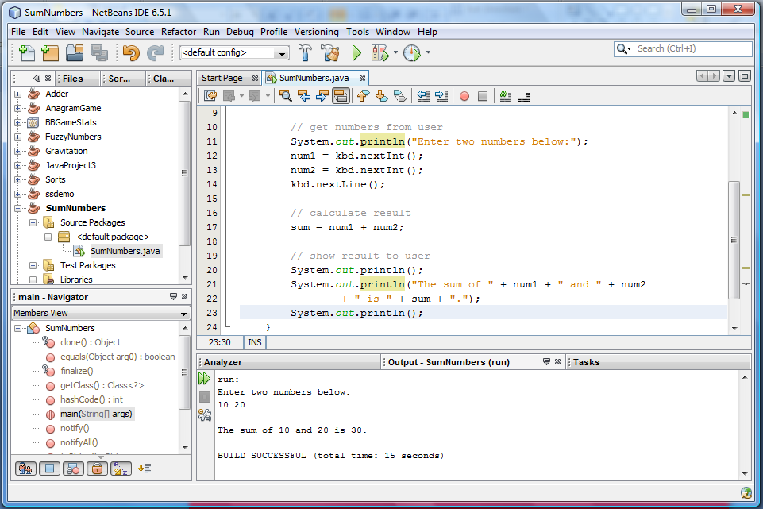
NetBeans IDE
List
of
projects
Program code
Program
parts
Program output

Slide 22
For This Course
Can use any IDE you like (or none)
  I will be using NetBeans
    version 8.2 on desktop
Can get NetBeans at home
  see instructions on-line
  can get later version
    some differences; mostly cosmetic

Slide 23
Questions?

