Slide 1
GUI in Java
Swing GUIs
as examples of
Inheritance and Polymorphism

Slide 2
Outline
What is GUI
Creating an Application Window
controls and layouts (arrangements; panes)
Activating Buttons in an Application Window
making it do something
What are polymorphism and inheritance?

Slide 3
What is a GUI?
Graphical User Interface
a graphical way to use the program
windows, icons, menus, pointing (WIMP)
Lots less typing for the user
Lots less things for them to remember
see options by looking
File Edit Help
_
X
Open
Save
——
Exit
Mrph
Blah
Yuck
Eeew
Gross
Dpbl
Xvgl

Slide 4
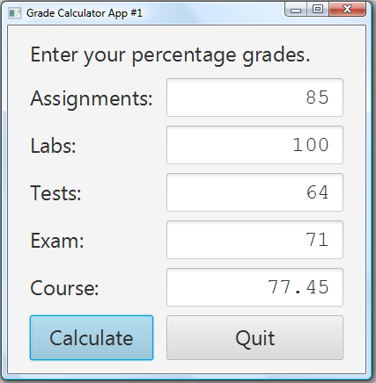
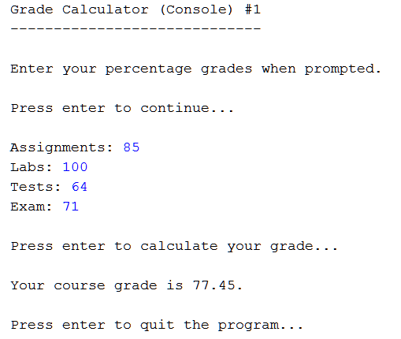
GUI vs. Console

Slide 5
Differences
Different kinds of objects involved
Scanner in console
text fields and buttons in app
Interaction is different
console needs you to enter numbers in order
can change numbers and recalculate in app

Slide 6
Similarities
Purpose of program is the same
calculate a final course grade for this course
Input is the same
user provides component grades
assignments, labs, tests, exam
Steps for doing calculation the same
read the numbers
calculate the result
show the result

Slide 7
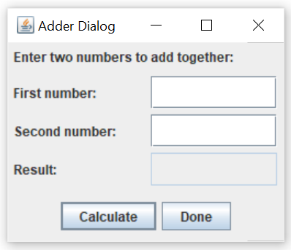
A Slightly Simpler GUI
Program opens up a window like this:
What can we do with it?
can enter numbers into the first and second number boxes
can click the “Calculate” button to put their sum into the result box
can click the “Done” button to end the program

Slide 8
Creating a GUI using Swing
New Project > Java > Java Application
We will call our program AdderDialog…
public class AdderDialog {
…but need more to make it a GUI
public class AdderDialog extends JFrame {
I’ll explain extends soon
JFrame imported from javax.swing
import javax.swing.JFrame;

Slide 9
The Method main
AdderDialog is a program
has a main method
creates and displays an AdderDialog object
public static void main(String[] args) { AdderDialog win = new AdderDialog();
win.setVisible(true); }
yes, AdderDialog is a data type, too!
Most of the work done in the constructor

Slide 10
The AdderDialog Constructor
Constructor sets up the GUI
sets title of window
creates objects to go into window
JLabels, JTextFields, JButtons, …
Title
JTextField
JLabel
JButton

Slide 11
The AdderDialog Constructor
Constructor sets up the GUI
sets layout of window
including sub-layouts
with extra spacing as desired
top
left-aligned
middle
3x2 grid
bottom
centred

Slide 12
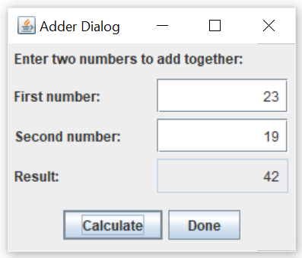
The AdderDialog Constructor
Constructor sets up the GUI
tells buttons what to do
Calculate button
read numbers
calculate sum
show sum
Done button
exit program

Slide 13
The Constructor
Get organized
initialize window
create top panel
left-justify; create and add instructions label
create middle panel
make grid; create & add (label + text field) times 3
create bottom panel
centre; create and add button x 2
add button actions
add panels to window

Slide 14
The Constructor Code
public AdderDialog() {
// initialize window
super("Adder Dialog");
setDefaultCloseOperation(JFrame.EXIT_ON_CLOSE);
// create top panel
JPanel top = new JPanel(new FlowLayout(FlowLayout.LEFT, 0, 0));
top.setBorder(new EmptyBorder(5, 5, 5, 5));
top.add(new JLabel("Enter two numbers to add together:"));
super sets the window title
setDefaultCloseOperation tells program to end when window closed
(FlowLayout.LEFT, left-justified objects, one after the other
0, 0) no extra space between elements
setBorder add space around outside
add add this control to the JPanel

Slide 15
The Constructor Code (cont.)
// create middle panel
JPanel middle = new JPanel(new GridLayout(3, 2, 0, 20));
middle.setBorder(new EmptyBorder(5, 5, 5, 5));
JTextField input1 = makeField();
JTextField input2 = makeField();
JTextField output = makeField();
output.setEditable(false);
middle.add(new JLabel("First Number:"));
middle.add(input1);
…
GridLayout objects laid out in a table
(3, 2 three rows, two columns in table
0, 20) twenty extra pixels between columns
makeField create a text field (user-defined, later)
setEditable(false) don’t let the user edit this field

Slide 16
The Constructor Code (cont.)
// create bottom panel
JPanel bottom = new JPanel();
JButton addButton = new JButton("Calculate");
JButton doneButton = new JButton("Done");
addButton.addActionListener(e ->
addTheNumbers(input1, input2, output)
);
doneButton.addActionListener(e -> System.exit(0));
bottom.add(addButton);
bottom.add(doneButton);
(no argument to JPanel) default: FlowLayout.CENTER + some space
addActionListener make this button do something
e -> MAGIC!!! Don’t forget the magic!
addTheNumbers add the numbers (user-defined, later)
System.exit(0) end the program

Slide 17
The Constructor Code (final)
// add panels to window
add(top, BorderLayout.NORTH); // or PAGE_START
add(middle, BorderLayout.CENTER); // or leave out (default)
add(bottom, BorderLayout.SOUTH); // or PAGE_END
pack();
}
BorderLayout place things at edges or middle of window
BorderLayout.NORTH place at the top of the window
BorderLayout.CENTER fill the center of the window
BorderLayout.SOUTH place at the bottom of the window
pack() make the window just large enuf to show everything

Slide 18
Making the Text Fields
Want the text fields to be right-justified
numbers should appear on right edge of box
Want a bit of space around the numbers
inside the box
public static JTextField makeField() {
JTextField result = new JTextField();
result.setHorizontalAlignment(JTextField.RIGHT);
result.setMargin(new Insets(5, 5, 5, 5));
return result;
}

Slide 19
Adding the Numbers
private static void addTheNumbers(
JTextField input1,
JTextField input2,
JTextField output) {
String numeral1 = input1.getText(); // "25"
int num1 = Integer.parseInt(numeral1); // "25" --> 25
String numeral2 = input2.getText(); // "10"
int num2 = Integer.parseInt(numeral2); // "10" --> 10
int sum = num1 + num2;
String result = Integer.toString(sum); // 35 --> "35"
output.setText(result);
}

Slide 20
So, What about extends JFrame?
Class header said extends JFrame
never had anything like that before
What does it mean?
it refers to an existing Java class, JFrame
imported from javax.swing
JFrame represents a GUI window
extends JFrame says that this class represents a GUI window, too!

Slide 21
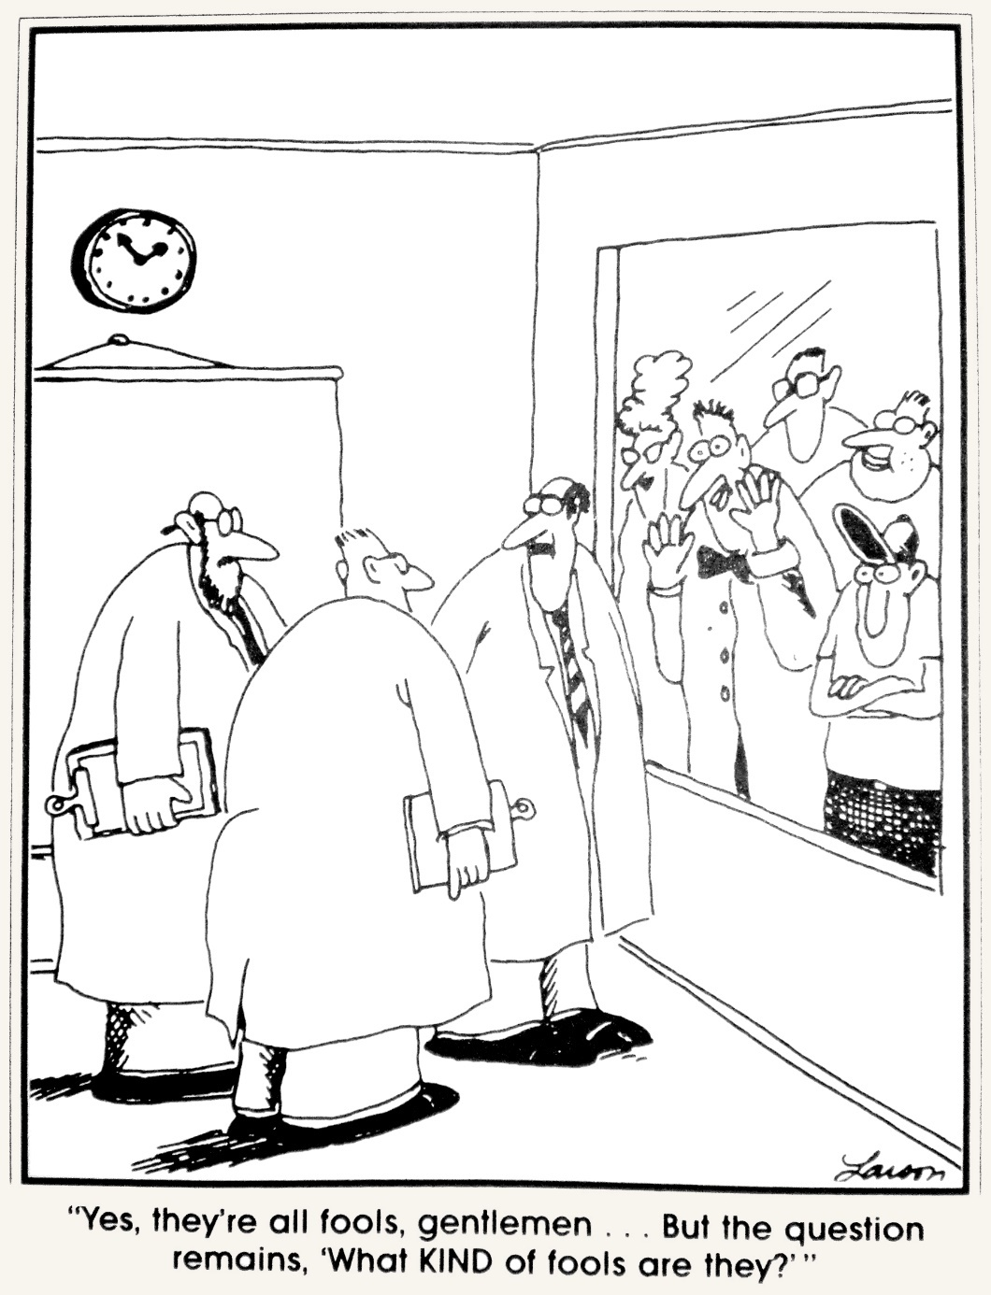

Slide 22
Inheritance
Inheritance
a way of using code that’s been written before
without copying it (copying is bad)
being a special version of another class
a self-driving car is a special kind of car
or a more specific kind of another class
a Nova Scotian is a specific kind of Canadian
This is what extends does

Slide 23
AdderDialog extends JFrame
JFrame is a data type
imported from javax.swing
it represents a GUI window
AdderDialog is a special kind of window
one that has all those adder dialog controls
JFrame has instance variables and methods
AdderDialog gets all of them for FREE!
we don’t need to write them all again

Slide 24
JFrame Methods We Used
We called these methods:
setDefaultCloseOperation
add
We used these instance variables:
defaultCloseOperation (used by setter)
set it to a value that means end-the-program
component (used by add)
added JLabels, JTextFields and JButtons to this List
We got all that (and more) from JFrame

Slide 25
So if we go to JFrame.java…
Find def^{n}s of those methods and fields?
we will find setDefaultCloseOperation
we will find defaultCloseOperation (an int)
But we won’t find add or component
why not?
because JFrame inherited them
JFrame extends Frame
so their def^{n}s are in Frame…?

Slide 26
Inheritance Hierarchy
Inheritance is used a lot in Java
JFrame extends Frame
Frame extends Window
Window extends Container
Container extends Component
Component extends Object
Object
Component
Container
Every class inherits methods from the class “above” it
including whatever methods it inherited
method add is defined in Container.java
Window
Frame
JFrame

Slide 27
Some Terminology
We draw the inheritance relationship using an arrow
Arrow points from subclass to superclass
the subclass extends the superclass
JFrame is (one of) Frame’s subclasses
Frame is JFrame’s only superclass
AdderDialog is (one of) JFrame’s subclasses
JFrame is AdderDialog’s only superclass
also sometimes called parent and child
Frame
JFrame
AdderDialog

Slide 28
Inheriting Methods
If B extends A, then B is an A
Thus, B can do anything A can do
because B is an A
The things A can do are its public methods
and B gets all of them!
AdderDialog can do anything JFrame can
because AdderDialog is a JFrame
JFrame can do anything Frame can
because JFrame is a Frame
and so AdderDialog is a Frame, too!

Slide 29
Inheriting Methods
public class A {
public void doThis() { System.out.println(“Hello!”); }
}
public class B extends A {}
public class MyProg {
public static void main(String[] args) {
A anA = new A();
B aB = new B();
anA.doThis(); // prints Hello!
aB.doThis(); // prints Hello! (!)
}
}

Slide 30
Adding Methods to Subclass
B is a subclass of A (B extends A)
B can do anything A can do
because B is a A
But B could do more
just have to tell Java extra things B can do
declare them just like any other method

Slide 31
Adding Methods
public class A {
public void doThis() { System.out.println(“Hello!”); }
}
public class B extends A {
public void doThat() { System.out.println(“Bye!”); }
}
anA.doThis(); // prints “Hello!”
aB.doThis(); // prints “Hello!”
aB.doThat(); // prints “Bye!”
anA.doThat(); // error!

Slide 32
Adding Methods
We added methods to AdderDialog
makeField, addTheNumbers
We call them when we need them
from our constructor
also from the addButton event handler
more on that soon

Slide 33
Why Such a Deep Hierarchy
Because of inheriting methods
class holds all methods that “go together”
all Object-y methods in Object
extra Component-y methods in Component
extra Container-y methods in Container
extra Window-y methods in Window
extra Frame-y methods in Frame
extra JFrame-y methods in JFrame
extra AdderDialog-y methods in AdderDialog

Slide 34
More Inheritance Hierarchy
Component
Container
Window
JComponent
Frame
JLabel
JPanel
JTextComponent
AbstractButton
JFrame
JTextArea
JTextField
JButton
JLabel, JTextField and JButton
are all Components
JPasswordField

Slide 35
JTextComponent
Has methods for user-editable text
JTextArea is a special kind of JTextComponent
so has user editable text, but also…
…multiple lines of input; wrapped text
JTextField is a different special kind of JT^{x}C^{pnt}
so has user editable text, but also…
…one line of input; no wrapping
JPasswordField is a special kind of JTextField
so, one line of user-editable text, no wrapping, but…
…doesn’t show the text that’s inside it

Slide 36
The add Method
add method defined in Container.java
inherited by Window, then by Frame, then by JFrame, then by AdderDialog
Added JLabels, JTextFields and JButtons
that’s three different kinds of things
so add is overloaded, right?
actually not, they are all the same kind of thing
just different versions of that kind of things
inheritance!

Slide 37
Arguments to Methods
add expects to be given a Component
JLabel is a Component
JLabel → JComponent → Container → Component
JTextField is a Component
JTextField → JTextComponent → JComponent …
JButton is a Component
JButton → AbstractButton → JComponent …
add accepts any kind of Component
including JLabels, JTextFields and JButtons

Slide 38
Is vs. Has
“Is” is not the same as “Has”
JLabel is a Component
JLabel doesn’t have a Component
JPanel top has a JLabel (inside it)
JPanel top is not a JLabel
Compare:
you are a person; you do not have a person
you have a kidney; you are not a kidney

Slide 39
Instance Variables vs. Inheritance
Instance variables: has
Rectangle has a colour
can change colour of myRectangle to myBlue
Inheritance: is
Rectangle isn’t a colour
Rectangle does not extend Color
can’t change colour of myButton to myRectangle
can change myButton’s colour to myRectangle’s colour
because both have a colour

Slide 40
“Is a” Means…
A JLabel is a Component
any method that is given a Component …
such as the add method
… can be given a JLabel …
… because a JLabel is a Component
But also:
any method that returns a Component …
… can return a JLabel …
… because a JLabel is a Component

Slide 41
Variables and Objects
Scanner object goes into a Scanner variable
Scanner kbd = new Scanner(System.in);
JLabel object goes into a JLabel variable
JLabel num1Label = new JLabel("First number:");
But JLabels are Components, so…
Component c1 = new JLabel("First number:");
NOTE: Can’t go the other way!
a Component isn’t necessarily a JLabel
JLabel num2Label = new Component("Second number:");

Slide 42
What does super do?
super is the way we call the constructor of the class we inherit from
Java allows only single inheritance
you can only extend one class
other languages allow multiple inheritance
it’s like this(…), which calls another constructor in this class
but it calls the constructor in this class’s superclass
the JFrame constructor sets the window’s title
so that’s what super(…) does

Slide 43
So What about Layouts?
GridLayout, FlowLayout, BorderLayout
these are all LayoutManagers
So, GridLayout extends LayoutManager?
uhhh, no.
it’s not actually inheritance
or it is, but it’s a different kind of inheritance
or it used to be a different kind of inheritance, then Java 8 came along and made it the same
except for how it’s still a bit different…
it’s complicated, OK?

Slide 44
And Dare I Ask…?
addActionListener expects to be given an ActionListener object
and so e -> System.exit(0) is…?
It’s a short-hand for an object that turns out to be (in this case) an ActionListener object
“in this case”?
it’s complicated
even more complicated than the LayoutManager
we’ll deal with all this in a couple of weeks

Slide 45
Briefly, Polymorphism
An ActionListener is any kind of thing that knows how to listen for an action!
i.e. it has an actionPerformed method
(also has to tell Java it’s an ActionListener)
Ditto for LayoutManagers
Any kind of thing that knows how!
poly-morphic = many-shapes
polymorphic methods don’t care what you are
they only care what you know how to do

Slide 46
Questions

