Slide 1
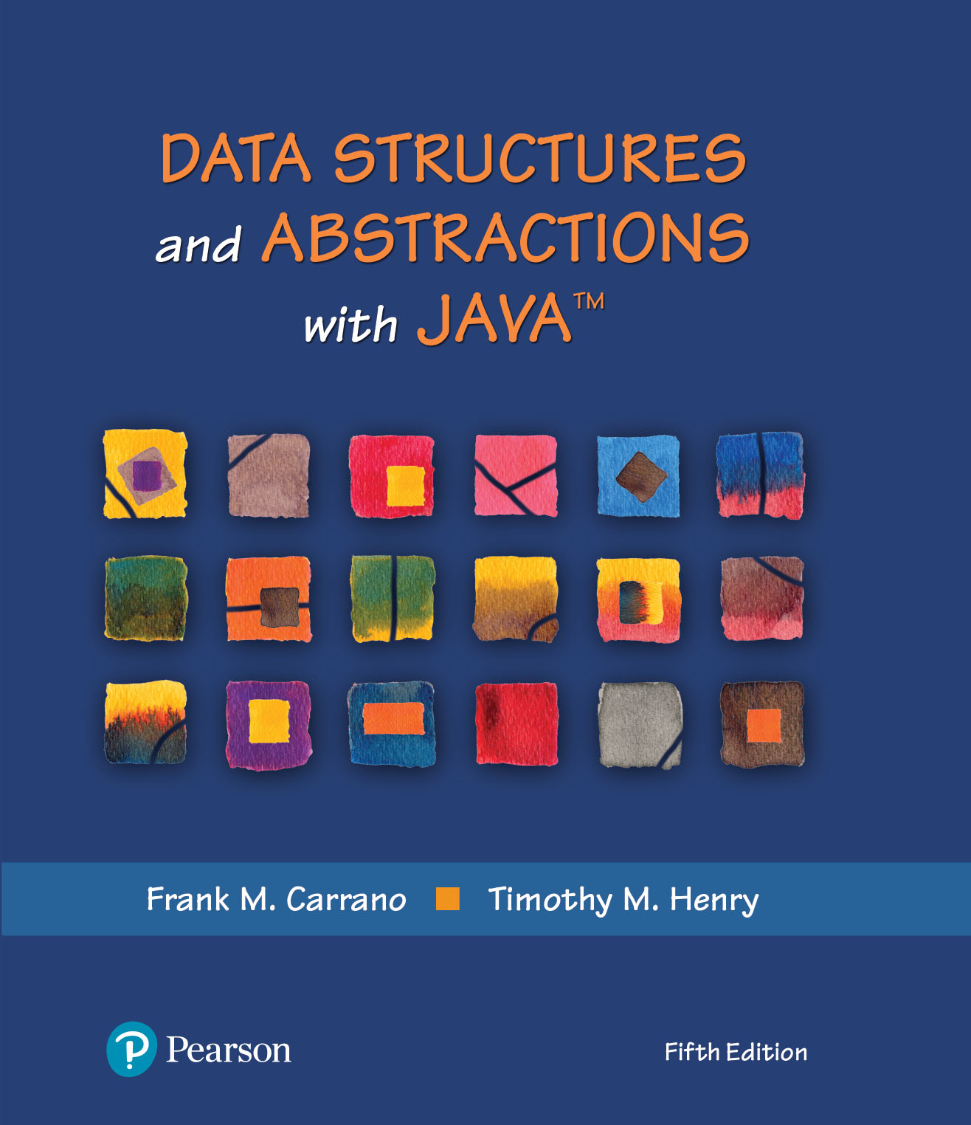
Data Structures and Abstractions with Java™
Introduction
5th Edition

Slide 2
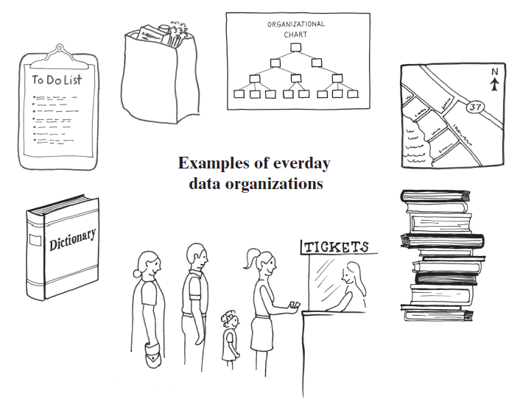
Data Organization in Life
Standing in a line
Stack of books
To-Do list
Dictionary
Folders, directories on your computer
Road map

Slide 3
Computer Data Organization
Abstract Data Type: ADT
Data Structure
Collection
Examples of containers
Bag
List
Stack
Queue
Dictionary
Tree
Graph
`

Slide 4
End
Introduction

