Slide 1
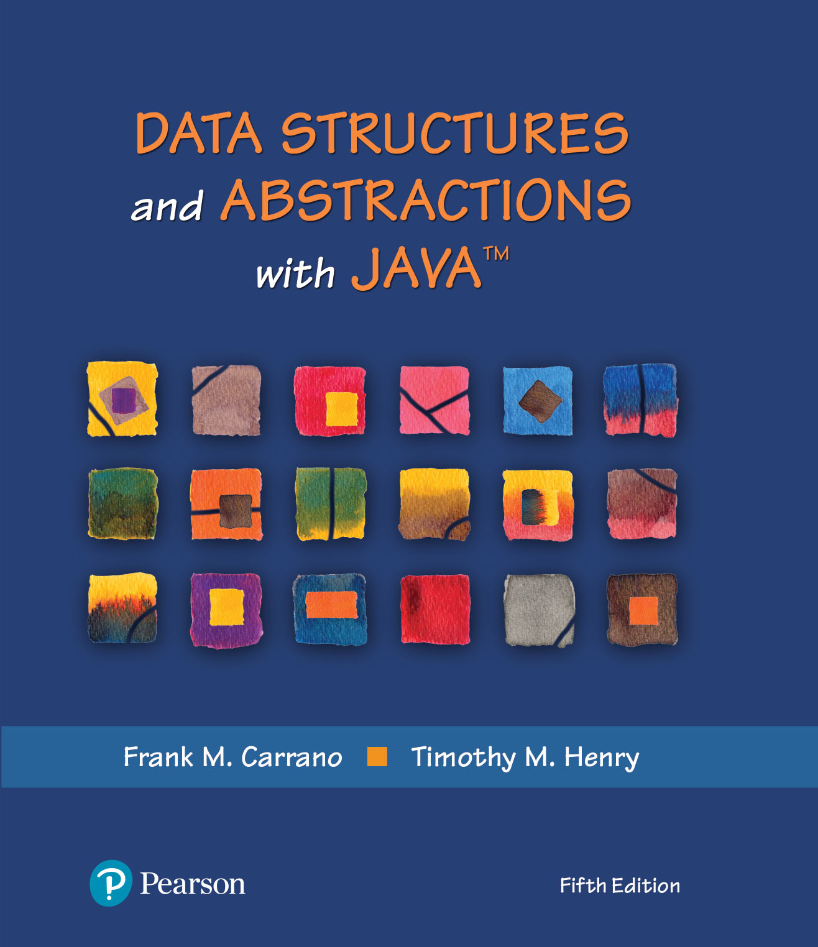
Data Structures and Abstractions with Java™
Chapter 1
5th Edition
Bags

Slide 2
What Is an Iterator?
An object that traverses a collection of data
During iteration, each data item is considered once
Possible to modify item as accessed
Should implement as a distinct class that interacts with the ADT

Slide 3
The ADT Bag
Definition
A finite collection of objects in no particular order
Can contain duplicate items
Possible behaviors
Get number of items
Check for empty
Add, remove objects

Slide 4
CRC Card
Bag
Responsibilities
Get the number of items currently in the bag
See whether the bag is empty
Add a given object to the bag
Remove an unspecified object from the bag
Remove a particular object from the bag, if possible
Remove all objects from the bag
Count the number of times a certain object occurs in the bag
Test whether the bag contains a particular object
Look at all objects that are in the bag
Collaborations
The class of objects that the bag can contain
FIGURE 1-1 A CRC card for a class Bag

Slide 5
Specifying a Bag
Describe its data and specify in detail the methods
Options that we can take when add cannot complete its task:
Do nothing
Leave bag unchanged, but signal client
Note which methods change the object or do not

Slide 6
Using UML Notation to Specify a Class
Bag
+getCurrentSize(): integer +isEmpty(): boolean +add(newEntry: T): boolean +remove(): T +remove(anEntry: T): boolean +clear(): void +getFrequencyOf(anEntry: T): integer +contains(anEntry: T): boolean +toArray(): T[]
FIGURE 1-2 UML notation for the class Bag

Slide 7
Design Decision
What to do for unusual conditions?
Assume it won’t happen
Ignore invalid situations
Guess at the client’s intention
Return value that signals a problem
Return a boolean
Throw an exception

Slide 8
An Interface (Part 1)
/** An interface that describes the operations of a bag of objects. */
public interface BagInterface<T>
{
/** Gets the current number of entries in this bag.
@return The integer number of entries currently in the bag. */
public int getCurrentSize();
/** Sees whether this bag is empty.
@return True if the bag is empty, or false if not. */
public boolean isEmpty();
/** Adds a new entry to this bag.
@param newEntry The object to be added as a new entry.
@return True if the addition is successful, or false if not. */
public boolean add(T newEntry);
/** Removes one unspecified entry from this bag, if possible.
@return Either the removed entry, if the removal.
was successful, or null. */
public T remove();
LISTING 1-1 A Java interface for a class of bags

Slide 9
An Interface (Part 2)
/** Removes one occurrence of a given entry from this bag, if possible.
@param anEntry The entry to be removed.
@return True if the removal was successful, or false if not. */
public boolean remove(T anEntry);
/** Removes all entries from this bag. */
public void clear();
/** Counts the number of times a given entry appears in this bag.
@param anEntry The entry to be counted.
@return The number of times anEntry appears in the bag. */
public int getFrequencyOf(T anEntry);
/** Tests whether this bag contains a given entry.
@param anEntry The entry to find.
@return True if the bag contains anEntry, or false if not. */
public boolean contains(T anEntry);
/** Retrieves all entries that are in this bag.
@return A newly allocated array of all the entries in the bag.
Note: If the bag is empty, the returned array is empty. */
public T[] toArray();
} // end BagInterface
LISTING 1-1 A Java interface for a class of bags

Slide 10
Using the ADT Bag
/** A class that maintains a shopping cart for an online store. */
public class OnlineShopper
{
public static void main(String[] args)
{
Item[] items = {new Item("Bird feeder", 2050),
new Item("Squirrel guard", 1547),
new Item("Bird bath", 4499),
new Item("Sunflower seeds", 1295)};
BagInterface<Item> shoppingCart = new Bag<>();
int totalCost = 0;
// Statements that add selected items to the shopping cart:
for (int index = 0; index < items.length; index++)
{
Item nextItem = items[index]; // Simulate getting item from shopper
shoppingCart.add(nextItem);
totalCost = totalCost + nextItem.getPrice();
} // end for
// Simulate checkout
while (!shoppingCart.isEmpty())
System.out.println(shoppingCart.remove());
System.out.println("Total cost: " + "\t$" + totalCost / 100 + "." +
totalCost % 100);
} // end main
} // end OnlineShopper
Program Output
Sunflower seeds $12.95
Bird bath $44.99
Squirrel guard $15.47
Bird feeder $20.50
Total cost: $93.91
LISTING 1-2 A program that maintains a bag for online shopping

Slide 11
Example: A Piggy Bank
/** A class that implements a piggy bank by using a bag. */
public class PiggyBank
{
private BagInterface<Coin> coins;
public PiggyBank()
{
coins = new ArrayBag<>();
} // end default constructor
public boolean add(Coin aCoin)
{
return coins.add(aCoin);
} // end add
public Coin remove()
{
return coins.remove();
} // end remove
public boolean isEmpty()
{
return coins.isEmpty();
} // end isEmpty
} // end PiggyBank
LISTING 1-3 A class of piggy banks

Slide 12
Example: Using A Piggy Bank (Part 1)
/** A class that demonstrates the class PiggyBank. */
public class PiggyBankExample
{
public static void main(String[] args)
{
PiggyBank myBank = new PiggyBank();
addCoin(new Coin(1, 2010), myBank);
addCoin(new Coin(5, 2011), myBank);
addCoin(new Coin(10, 2000), myBank);
addCoin(new Coin(25, 2012), myBank);
System.out.println("Removing all the coins:");
int amountRemoved = 0;
while (!myBank.isEmpty())
{
Coin removedCoin = myBank.remove();
System.out.println("Removed a " + removedCoin.getCoinName() + ".");
amountRemoved = amountRemoved + removedCoin.getValue();
} // end while
System.out.println("All done. Removed " + amountRemoved + " cents.");
} // end main
LISTING 1-4 A demonstration of the class PiggyBank

Slide 13
Example: Using A Piggy Bank (Part 2)
private static void addCoin(Coin aCoin, PiggyBank aBank)
{
if (aBank.add(aCoin))
System.out.println("Added a " + aCoin.getCoinName() + ".");
else
System.out.println("Tried to add a " + aCoin.getCoinName() +
", but couldn't");
} // end addCoin
} // end PiggyBankExample
Program Output
Added a PENNY.
Added a NICKEL.
Added a DIME.
Added a QUARTER.
Removing all the coins:
Removed a QUARTER.
Removed a DIME.
Removed a NICKEL.
Removed a PENNY.
All done. Removed 41 cents.
LISTING 1-4 A demonstration of the class PiggyBank

Slide 14
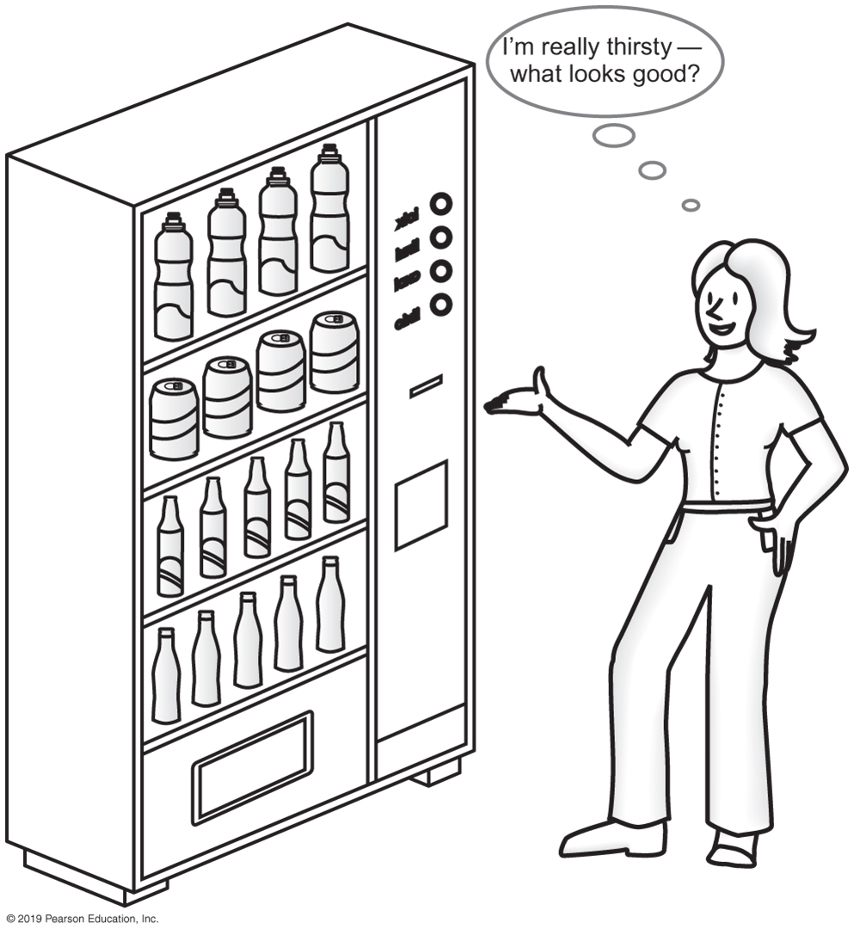
Observations about Vending Machines
Can perform only tasks machine’s interface presents.
You must understand these tasks
Cannot access the inside of the machine
You can use the machine even though you do not know what happens inside.
Usable even with new insides.
FIGURE 1-3 A vending machine

Slide 15
Observations about ADT Bag
Can perform only tasks specific to ADT
Must adhere to the specifications of the operations of ADT
Cannot access data inside ADT without ADT operations
Use the ADT, even if don’t know how data is stored
Usable even with new implementation.

Slide 16
Java Class Library: The Interface Set
/** An interface that describes the operations of a set of objects. */
public interface SetInterface<T>
{
public int getCurrentSize();
public boolean isEmpty();
/** Adds a new entry to this set, avoiding duplicates.
@param newEntry The object to be added as a new entry.
@return True if the addition is successful, or
false if the item already is in the set. */
public boolean add(T newEntry);
/** Removes a specific entry from this set, if possible.
@param anEntry The entry to be removed.
@return True if the removal was successful, or false if not. */
public boolean remove(T anEntry);
public T remove();
public void clear();
public boolean contains(T anEntry);
public T[] toArray();
} // end SetInterface
Listing 1-5 A Java interface for a class of sets

Slide 17
End
Chapter 1

