Slide 1
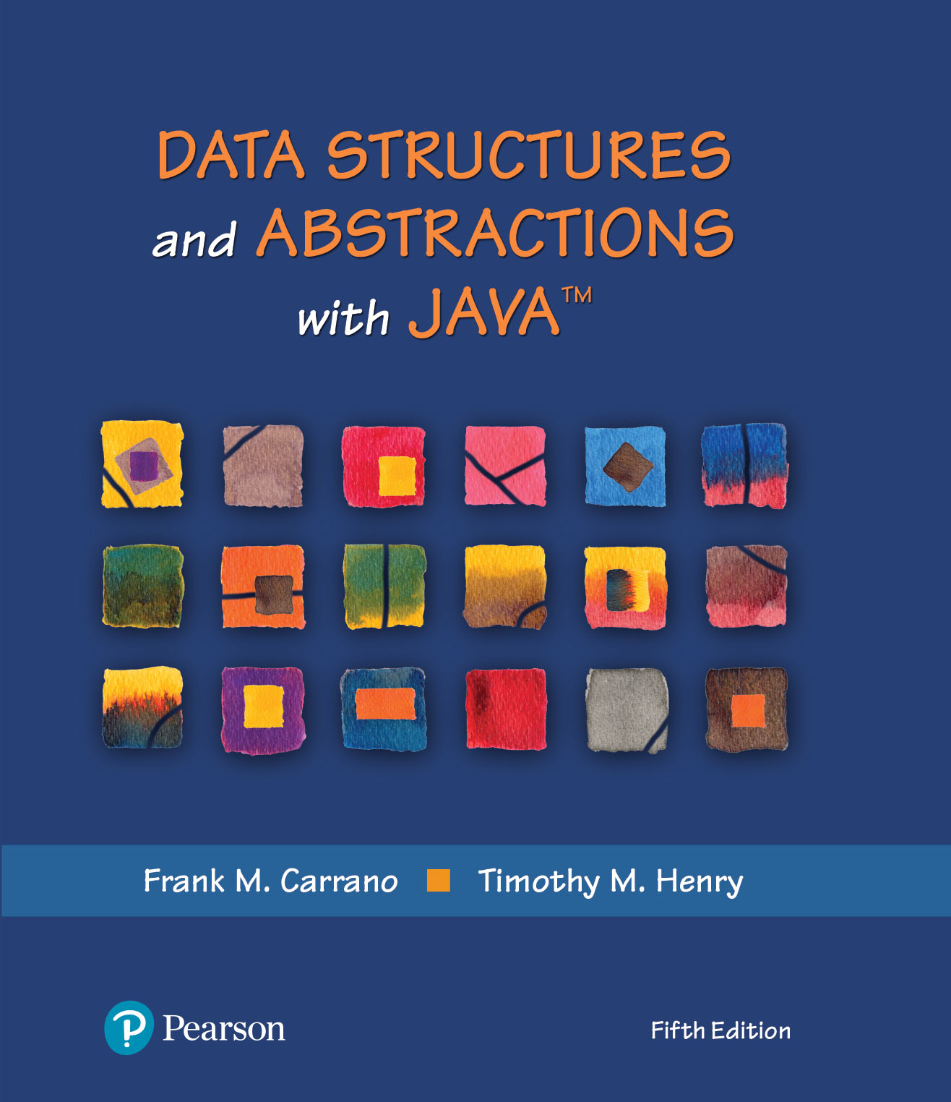
Data Structures and Abstractions with Java™
5th Edition
Java Interlude 1
Generics

Slide 2
Generic Data Types
Enable you to write a placeholder instead of an actual class type
The placeholder is
A generic data type
A type parameter
You define a generic class
Client chooses data type of the objects in collection.

Slide 3
Interface
/**
An interface for pairs of objects.
*/
public interface Pairable<T>
{
public T getFirst();
public T getSecond();
public void changeOrder();
} // end Pairable
LISTING JI1-1 The interface Pairable

Slide 4
Example Generic Class (Part 1)
/** A class of ordered pairs of objects having the same data type. */
public class OrderedPair<T> implements Pairable<T>
{
private T first, second;
public OrderedPair(T firstItem, T secondItem) // NOTE: no <T> after constructor name
{
first = firstItem;
second = secondItem;
} // end constructor
/** Returns the first object in this pair. */
public T getFirst()
{
return first;
} // end getFirst
LISTING JI1-2 The class OrderedPair

Slide 5
Example Generic Class (Part 2)
/** Returns the second object in this pair. */
public T getSecond()
{
return second;
} // end getSecond
/** Returns a string representation of this pair. */
public String toString()
{
return "(" + first + ", " + second + ")";
} // end toString
/** Interchanges the objects in this pair. */
public void changeOrder()
{
T temp = first;
first = second;
second = temp;
} // changeOrder
} // end OrderedPair
LISTING JI1-2 The class OrderedPair

Slide 6
End
Java Interlude 1

