Slide 1
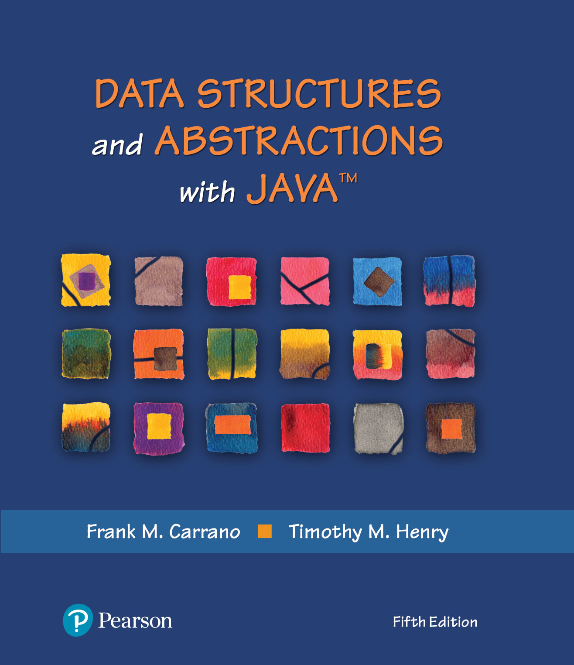
Data Structures and Abstractions with Java™
5th Edition
Java Interlude 2
Exceptions

Slide 2
The Basics
Method creates an exception object
We say “throws an exception”
Signal to program
Unexpected has happened
Handle the exception
Detect and react

Slide 3
The Basics
Checked exceptions in the Java Class Library
ClassNotFoundException
FileNotFoundException
IOException
NoSuchMethodException
WriteAbortedException

Slide 4
The Basics
Runtime exceptions in the Java Class Library
ArithmeticException
ArrayIndexOutOfBoundsException
ClassCastException
IllegalArgumentException
IllegalStateException
IndexOutOfBoundsException
NoSuchElementException
NullPointerException
StringIndexOutOfBoundsException
UnsupportedOperationException

Slide 5
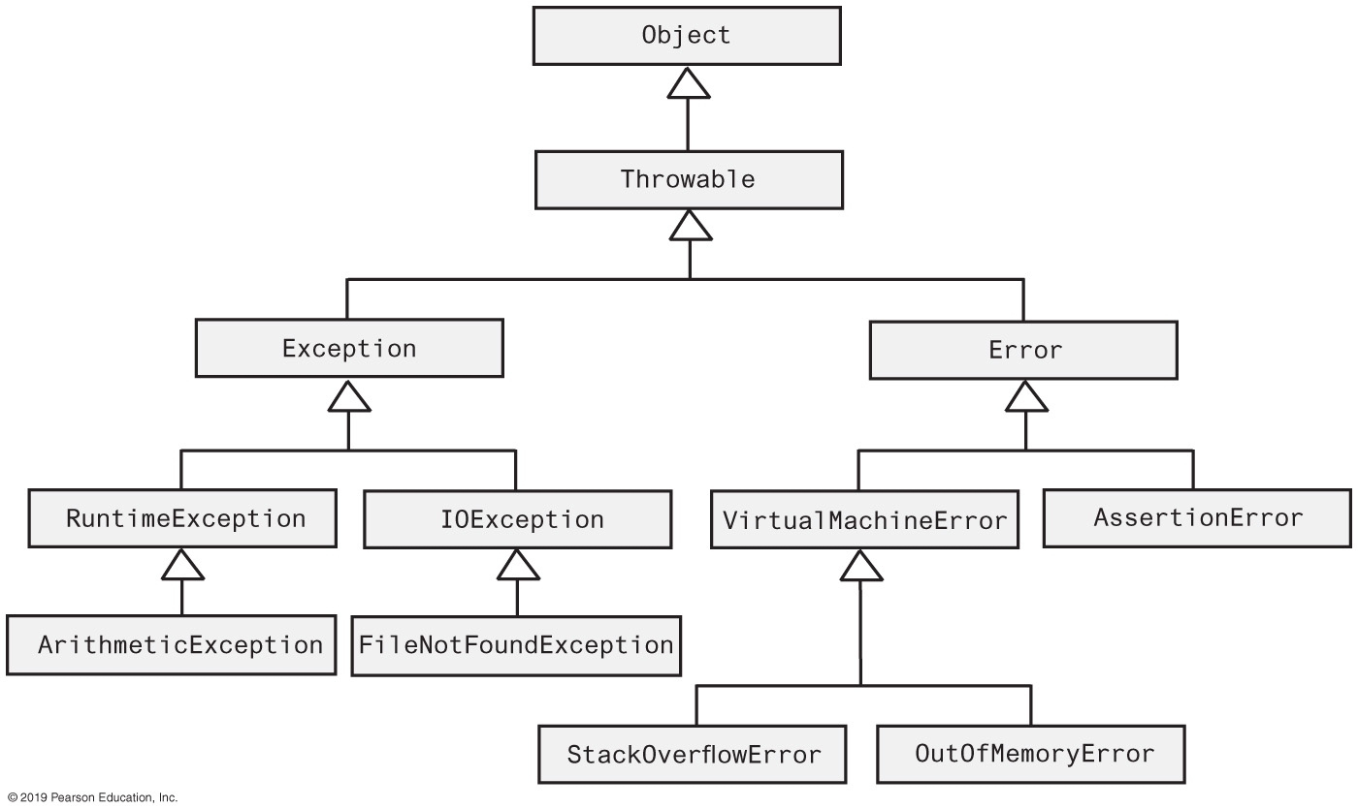
Java Class Exception and Error Hierarchy
FIGURE J2-1 The hierarchy of some standard exception and error classes

Slide 6
Handling an Exception
Postpone handling: The throws clause
If programmer not sure what action is best for a client when an exception occurs
Leave the handling of the exception to the method’s client
Method that can cause but does not handle checked exception must declare in its header
public String readString(. . .) throws IOException

Slide 7
Handle It Now: The try-catch Blocks
try
{
< Possibly some code >
anObject.readString(. . .); // Might throw an IOException
< Possibly some more code >
}
catch (IOException e)
{
< Code to react to the exception, probably including the following statement: >
System.out.println(e.getMessage());
}
Code to handle an IOException as a result of invoking the method readString

Slide 8
Multiple catch Blocks
catch (FileNotFoundException e)
{
. . .
}
catch (IOException e) // Handle all other IOExceptions
{
. . .
}
Good order for catch blocks

Slide 9
Throwing an Exception
A method intentionally throws an exception by executing a throw statement.
Programmers usually create the object within the throw statement
throw new IOException();

Slide 10
Throwing an Exception
If you can resolve unusual situation in a reasonable manner
likely can use a decision statement
If several resolutions to abnormal occurrence possible, and you want client to choose
Throw a checked exception
If a programmer makes a coding mistake by using your method incorrectly
Throw a runtime exception

Slide 11
End
Java Interlude 2

