Slide 1
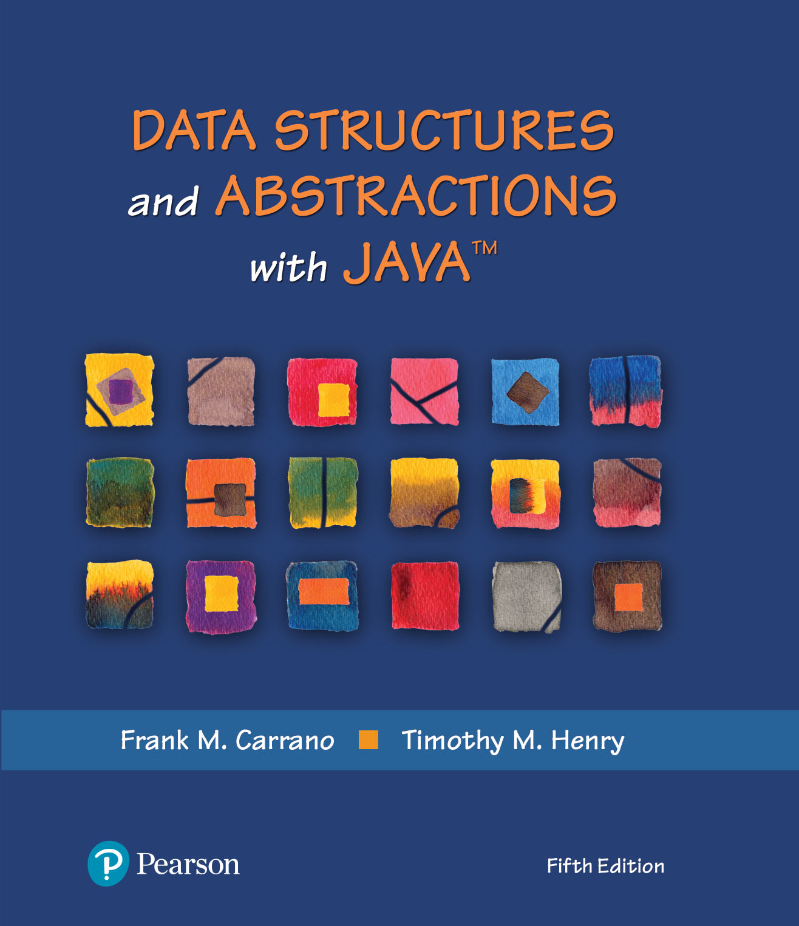
Data Structures and Abstractions with Java™
5th Edition
Chapter 3
A Bag Implementation
That Links Data

Slide 2
What Is an Iterator?
An object that traverses a collection of data
During iteration, each data item is considered once
  Possible to modify item as accessed
Should implement as a distinct class that interacts with the ADT

Slide 3
Problems with Array Implementation
Array has fixed size
May become full
Alternatively may have wasted space
Resizing is possible but requires overhead of time

Slide 4
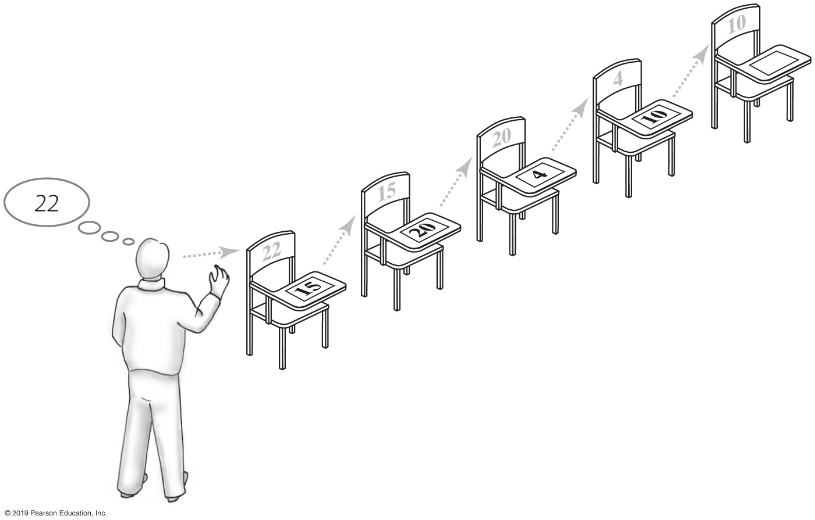
Analogy
Empty classroom
Numbered desks stored in hallway
  Number on back of desk is the “address”
Number on desktop references another desk in chain of desks
Desks are linked by the numbers
FIGURE 3-1 A chain of five desks

Slide 5
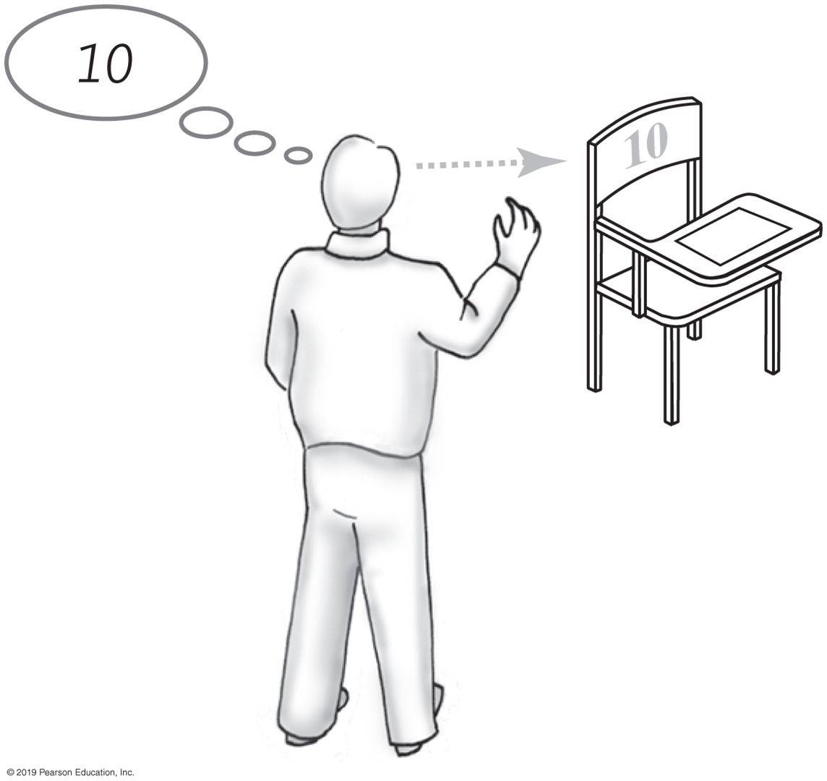
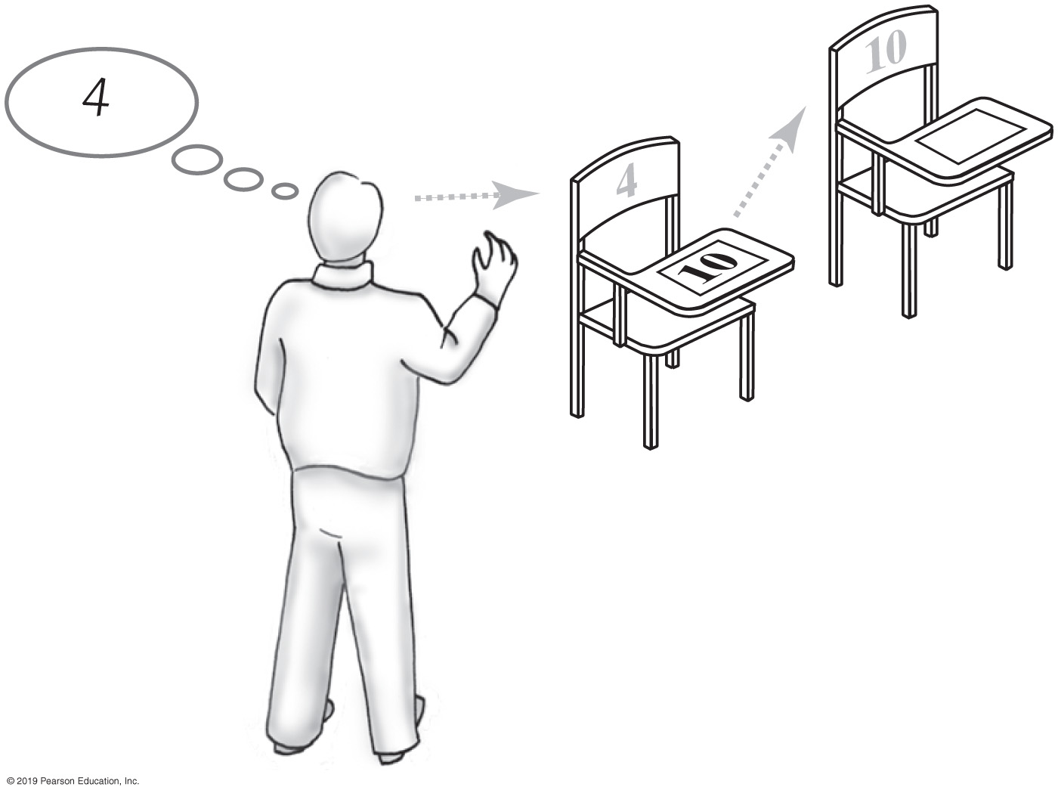
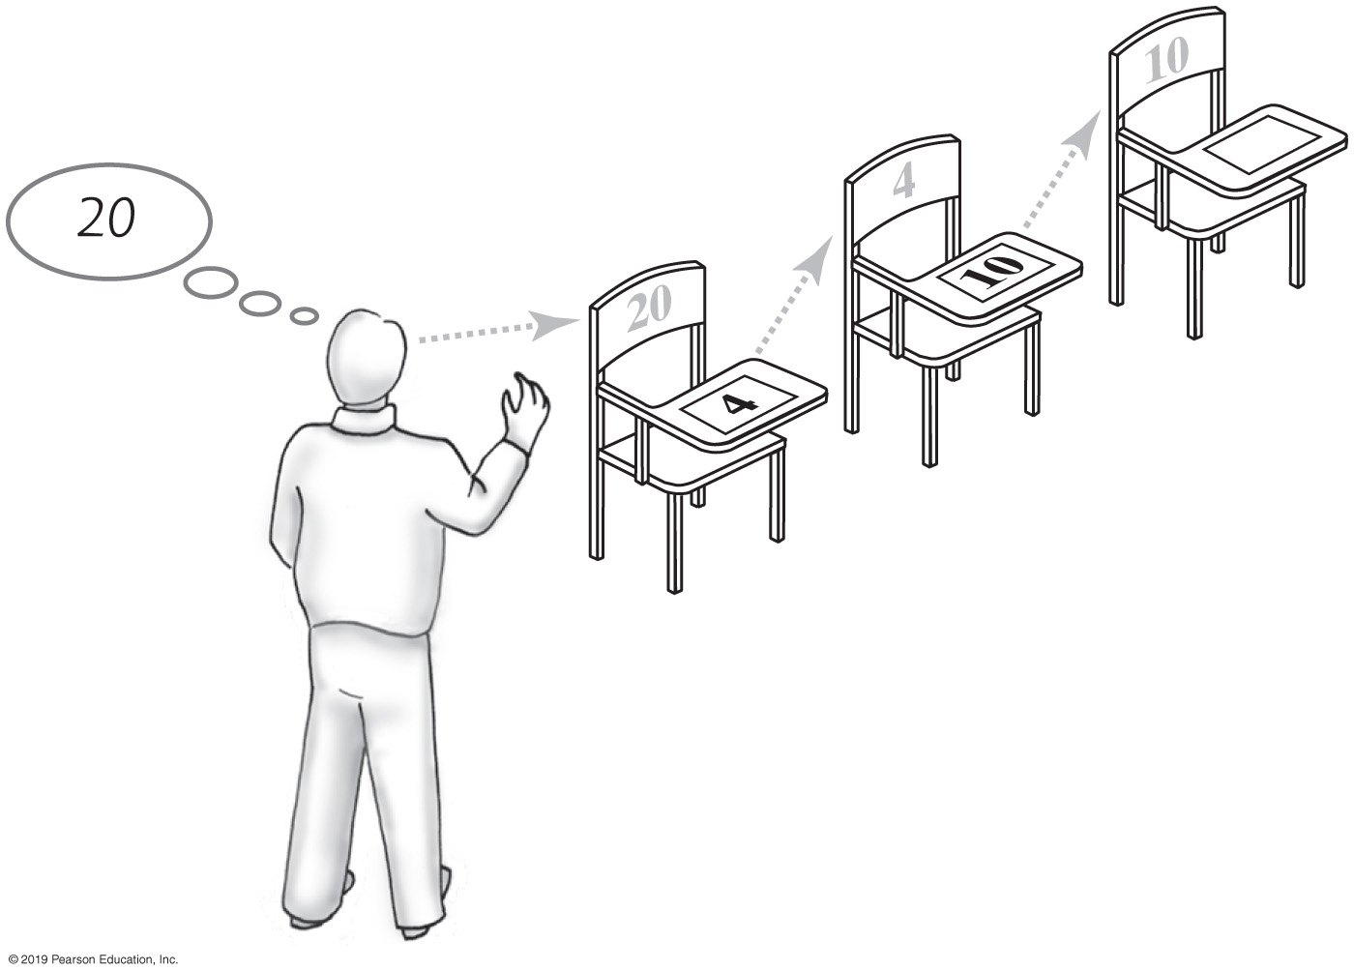
Forming a Chain by Adding to Its Beginning
FIGURE 3-2
One desk in the room
FIGURE 3-3
Two linked desks, with the newest desk first
FIGURE 3-4
Three linked desks, with the newest desk first

Slide 6
Forming a Chain by Adding to Its Beginning
// Process the first student
newDesk represents the new student’s desk New student sits at newDesk
Instructor memorizes the address of newDesk
// Process the remaining students
while (students arrive)
{
newDesk represents the new student’s desk New student sits at newDesk
Write the instructor’s memorized address on newDesk
Instructor memorizes the address of newDesk
}
Pseudocode detailing steps taken to form a chain of desks

Slide 7
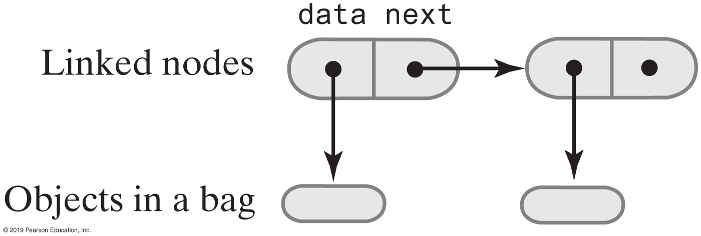
The Private Class Node
private class Node
{
private T data; // Entry in bag
private Node next; // Link to next node
private Node(T dataPortion)
{
this(dataPortion, null);
} // end constructor
private Node(T dataPortion, Node nextNode)
{
data = dataPortion;
next = nextNode;
} // end constructor
} // end Node
FIGURE 3-5
Two linked nodes that each reference object data
LISTING 3-1 The private inner class Node

Slide 8
An Outline of the Class LinkedBag (Part 1)
/** OUTLINE
    A class of bags whose entries are stored in a chain of linked nodes.
The bag is never full. */
public class LinkedBag<T> implements BagInterface<T>
{
private Node firstNode; // reference to first node
private int numberOfEntries;
public LinkedBag()
{
firstNode = null;
numberOfEntries = 0;
} // end default constructor
// . . .
LISTING 3-2 An outline of the class LinkedBag

Slide 9
An Outline of the Class LinkedBag (Part 2)
private class Node
{
private T data; // Entry in bag
private Node next; // Link to next node
private Node(T dataPortion)
{
this(dataPortion, null);
} // end constructor
private Node(T dataPortion, Node nextNode)
{
data = dataPortion;
next = nextNode;
} // end constructor
} // end Node
} // end LinkedBag
LISTING 3-2 An outline of the class LinkedBag

Slide 10
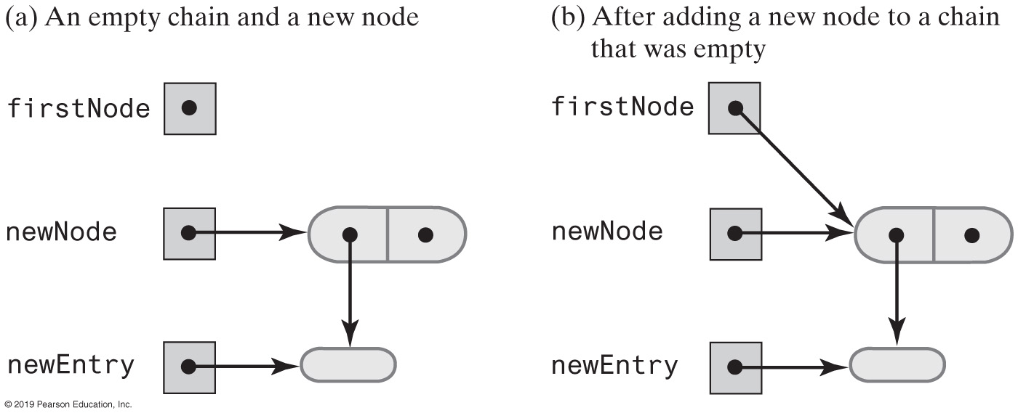
Beginning a Chain of Nodes
FIGURE 3-6 Adding a new node to an empty chain

Slide 11
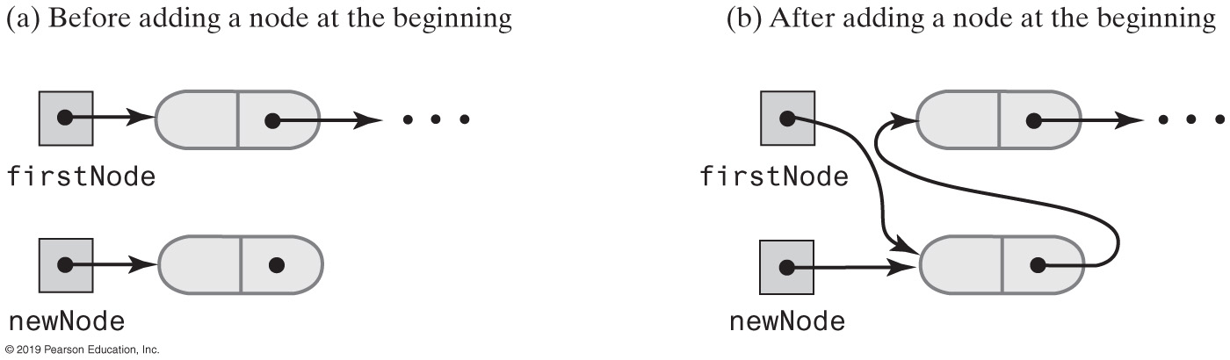
Beginning a Chain of Nodes
FIGURE 3-7 A chain of nodes just before and just after adding a node at the beginning

Slide 12
Beginning a Chain of Nodes
/** Adds a new entry to this bag.
@param newEntry The object to be added as a new entry.
@return True. */
public boolean add(T newEntry) // OutOfMemoryError possible
{
// Add to beginning of chain:
Node newNode = new Node(newEntry);
newNode.next = firstNode; // Make new node reference rest of chain
// (firstNode is null if chain is empty)
firstNode = newNode; // New node is at beginning of chain
numberOfEntries++;
return true;
} // end add
The method add

Slide 13
Method toArray
/** Retrieves all entries that are in this bag.
@return A newly allocated array of all the entries in the bag. */
public T[] toArray()
{
// The cast is safe because the new array contains null entries
@SuppressWarnings("unchecked")
T[] result = (T[])new Object[numberOfEntries]; // Unchecked cast
int index = 0;
Node currentNode = firstNode;
while ((index < numberOfEntries) && (currentNode != null))
{
result[index] = currentNode.data;
index++;
currentNode = currentNode.next;
} // end while
return result;
} // end toArray
The method toArray returns an array of the entries currently in a bag

Slide 14
LinkedBag Test Program (Part 1)
/** A test of the methods add, toArray, isEmpty, and getCurrentSize,
as defined in the first draft of the class LinkedBag. */
public class LinkedBagDemo1
{
public static void main(String[] args)
{
System.out.println("Creating an empty bag.");
BagInterface<String> aBag = new LinkedBag1<>();
testIsEmpty(aBag, true);
displayBag(aBag);
String[] contentsOfBag = {"A", "D", "B", "A", "C", "A", "D"};
testAdd(aBag, contentsOfBag);
testIsEmpty(aBag, false);
} // end main
LISTING 3-3 A sample program that tests some methods in the class LinkedBag

Slide 15
LinkedBag Test Program (Part 2)
// Tests the method isEmpty.
// Precondition: If bag is empty, the parameter empty should be true;
// otherwise, it should be false.
private static void testIsEmpty(BagInterface<String> bag,
boolean empty)
{
System.out.print("\nTesting isEmpty with ");
if (empty)
System.out.println("an empty bag:");
else
System.out.println("a bag that is not empty:");
System.out.print("isEmpty finds the bag ");
if (empty && bag.isEmpty())
System.out.println("empty: OK.");
else if (empty)
System.out.println("not empty, but it is: ERROR.");
else if (!empty && bag.isEmpty())
System.out.println("empty, but it is not empty: ERROR.");
else
System.out.println("not empty: OK.");
} // end testIsEmpty
LISTING 3-3 A sample program that tests some methods in the class LinkedBag

Slide 16
LinkedBag Test Program (Part 3)
// Tests the method add.
private static void testAdd(BagInterface<String> aBag,
String[] content)
{
System.out.print("Adding the following strings to the bag: ");
for (int index = 0; index < content.length; index++)
{
if (aBag.add(content[index]))
System.out.print(content[index] + " ");
else
System.out.print("\nUnable to add " + content[index] +
" to the bag.");
} // end for
System.out.println();
displayBag(aBag);
} // end testAdd
LISTING 3-3 A sample program that tests some methods in the class LinkedBag

Slide 17
LinkedBag Test Program (Part 4)
// Tests the method toArray while displaying the bag.
private static void displayBag(BagInterface<String> aBag)
{
System.out.println("The bag contains the following string(s):");
Object[] bagArray = aBag.toArray();
for (int index = 0; index < bagArray.length; index++)
{
System.out.print(bagArray[index] + " ");
} // end for
System.out.println();
} // end displayBag
} // end LinkedBagDemo1
Program Output
Creating an empty bag.
Testing isEmpty with an empty bag:
isEmpty finds the bag empty: OK.
The bag contains the following string(s):
Adding the following strings to the bag: A D B A C A D
The bag contains the following string(s):
D A C A B D A
Testing isEmpty with a bag that is not empty:
isEmpty finds the bag not empty: OK.
LISTING 3-3 A sample program that tests some methods in the class LinkedBag

Slide 18
Method getFrequencyOf
/** Counts the number of times a given entry appears in this bag.
@param anEntry The entry to be counted.
@return The number of times anEntry appears in the bag. */
public int getFrequencyOf(T anEntry)
{
int frequency = 0;
int loopCounter = 0;
Node currentNode = firstNode;
while ((loopCounter < numberOfEntries) && (currentNode != null))
{
if (anEntry.equals(currentNode.data))
{
frequency++;
} // end if
loopCounter++;
currentNode = currentNode.next;
} // end while
return frequency;
} // end getFrequencyOf
Counts the number of times a given entry appears

Slide 19
Method contains
/** Tests whether this bag contains a given entry.
@param anEntry The entry to locate.
@return True if the bag contains anEntry, or false otherwise */
  public boolean contains(T anEntry)
{
boolean found = false;
Node currentNode = firstNode;
while (!found && (currentNode != null))
{
if (anEntry.equals(currentNode.data))
found = true;
else
currentNode = currentNode.next;
} // end while
return found;
} // end contains
Determine whether a bag contains a given entry

Slide 20
Removing an Item from a Linked Chain
Case 1:
  Your desk is first in the chain of desks.
Case 2:
  Your desk is not first in the chain of desks.

Slide 21
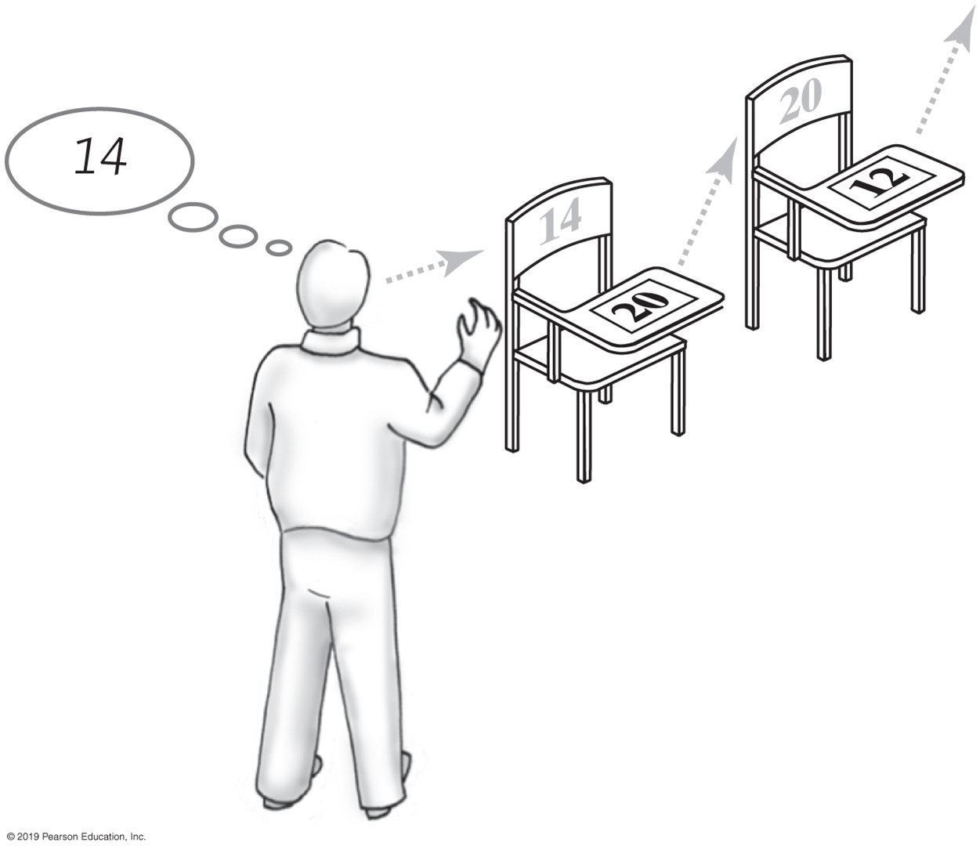
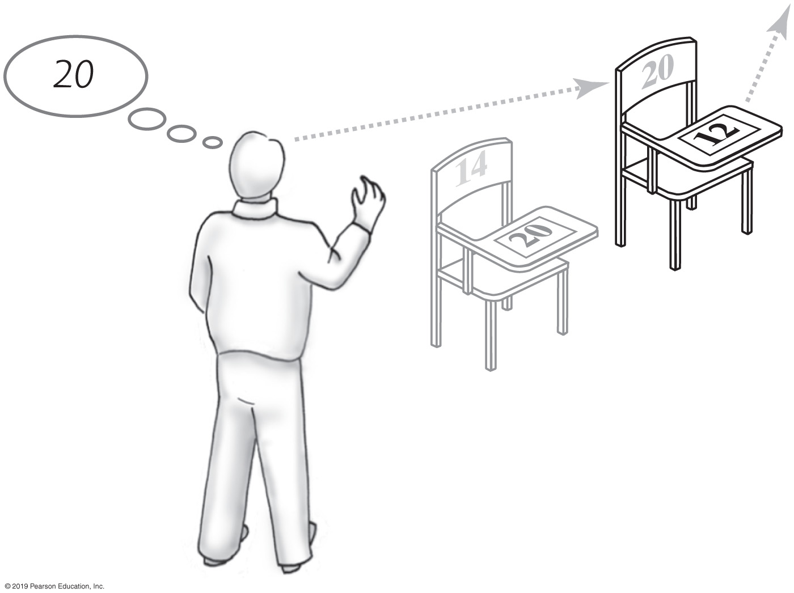
Removing an Item from a Linked Chain
Case 1
  Locate first desk by asking instructor for its address.
  Give address written on the first desk to instructor.
    This is address of second desk in chain.
  Return first desk to hallway.
FIGURE 3-8
A chain of desks just prior to removing its first desk
FIGURE 3-9
A chain of desks just after removing its first desk

Slide 22
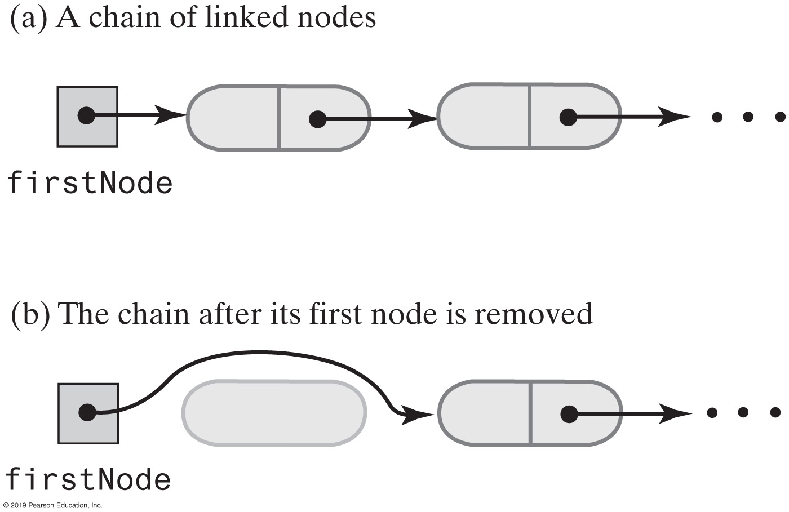
Removing an Item from a Linked Chain
FIGURE 3-10 A chain of nodes just before and just after its first node is removed

Slide 23
Removing an Item from a Linked Chain
Case 2
  Move the student in the first desk to your former desk.
  Remove the first desk using the steps described for Case 1.

Slide 24
Method remove
// Locates a given entry within this bag.
// Returns a reference to the node containing the entry, if located,
// or null otherwise.
private Node getReferenceTo(T anEntry)
{
boolean found = false;
Node currentNode = firstNode;
while (!found && (currentNode != null))
{
if (anEntry.equals(currentNode.data))
found = true;
else
currentNode = currentNode.next;
} // end while
return currentNode;
} // end getReferenceTo
Private helper method getReferenceTo

Slide 25
Method remove
/** Removes one unspecified entry from this bag, if possible.
@return Either the removed entry,
                if the removal was successful, or null */
public T remove()
{
T result = null;
if (firstNode != null)
{
result = firstNode.data;
firstNode = firstNode.next; // Remove first node from chain
numberOfEntries--;
} // end if
return result;
} // end remove
Uses private helper method getReferenceTo

Slide 26
Method clear
/** Removes all entries from this bag. */
public void clear()
{
while (!isEmpty())
remove();
} // end clear
As in previous implementations, uses isEmpty and remove

Slide 27
Class Node That Has Set and Get Methods
private class Node
{
private T data; // Entry in bag
private Node next; // Link to next node
private Node(T dataPortion)
{
this(dataPortion, null);
} // end constructor
private Node(T dataPortion, Node nextNode)
{
data = dataPortion;
next = nextNode;
} // end constructor
private T getData()
{
return data;
} // end getData
private void setData(T newData)
{
data = newData;
} // end setData
private Node getNextNode()
{
return next;
} // end getNextNode
private void setNextNode(Node nextNode)
{
next = nextNode;
} // end setNextNode
} // end Node
LISTING 3-4 The inner class Node with set and get methods

Slide 28
A Class within A Package
package BagPackage;
class Node<T>
{
private T data;
private Node<T> next;
Node(T dataPortion)
{
this(dataPortion, null);
} // end constructor
Node(T dataPortion, Node<T> nextNode)
{
data = dataPortion;
next = nextNode;
} // end constructor
T getData()
{
return data;
} // end getData
void setData(T newData)
{
data = newData;
} // end setData
Node<T> getNextNode()
{
return next;
} // end getNextNode
void setNextNode(Node<T> nextNode)
{
next = nextNode;
} // end setNextNode
} // end Node
LISTING 3-5 The class Node with package access

Slide 29
When Node Is in Same Package
package BagPackage;
public class LinkedBag<T> implements BagInterface<T>
{
private Node<T> firstNode;
public boolean add(T newEntry)
{
Node<T> newNode = new Node<T>(newEntry);
newNode.setNextNode(firstNode);
firstNode = newNode;
numberOfEntries++;
return true;
} // end add
// . . .
} // end LinkedBag
LISTING 3-6 The class LinkedBag when Node is in the same package

Slide 30
Pros of Using a Chain
Bag can grow and shrink in size as necessary.
Remove and recycle nodes that are no longer needed
Adding new entry to end of array or to beginning of chain both relatively simple
Similar for removal

Slide 31
Cons of Using a Chain
Removing specific entry requires search of array or chain
Chain requires more memory than array of same length

Slide 32
End
Chapter 3

