Slide 1
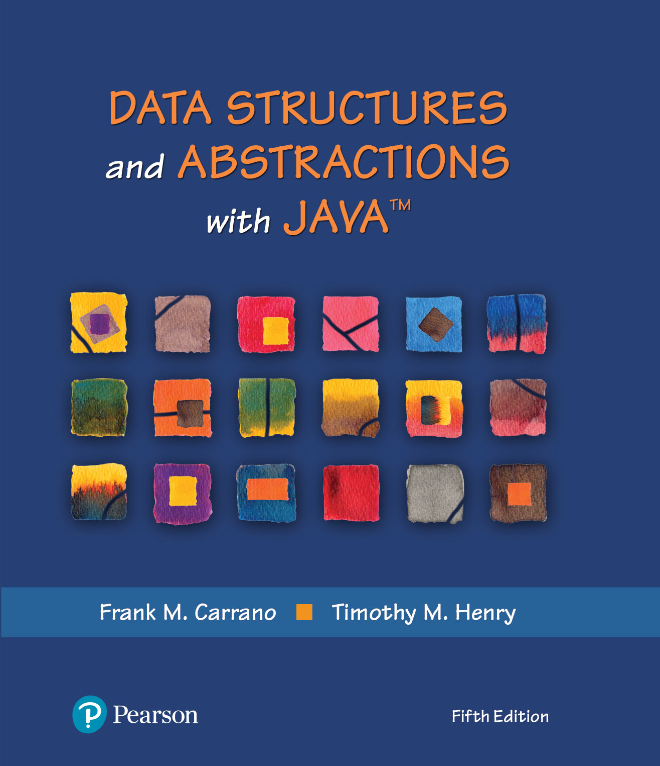
Data Structures and Abstractions with Java™
5th Edition
Chapter 4
The Efficiency of Algorithms

Slide 2
Why Efficient Code?
Computers are faster, have larger memories
So why worry about efficient code?
And … how do we measure efficiency?

Slide 3

Importance of Efficiency
Consider the problem of summing
Algorithm A | Algorithm B | Algorithm C
long sum = 0; for (long i = 1; i <= n; i++) sum = sum + i; | sum = 0; for (long i = 1; i <= n; i++) { for (long j = 1; j <= i; j++) sum = sum + 1; } // end for | sum = n * (n + 1) / 2;
FIGURE 4-1
Three algorithms for computing the sum 1 + 2 + . . . + n for an integer n > 0

Slide 4
What is “best”?
An algorithm has both time and space constraints – that is complexity
Time complexity
Space complexity
This study is called analysis of algorithms

Slide 5
Counting Basic Operations
A basic operation of an algorithm
Most significant contributor to its total time requirement
 | Algorithm A | Algorithm B | Algorithm C
 | long sum = 0; for (long i = 1; i <= n; i++) sum = sum + i; | sum = 0; for (long i = 1; i <= n; i++) { for (long j = 1; j <= i; j++) sum = sum + 1; } // end for | sum = n * (n + 1) / 2;
Additons | n | n(n + 1)/2 | 1
Multiplications | 0 | 0 | 1
Divisions | 0 | 0 | 1
Total Basic Operations | n | (n² + n)/2 | 3
FIGURE 4-2 The number of basic operations required by the algorithms

Slide 6
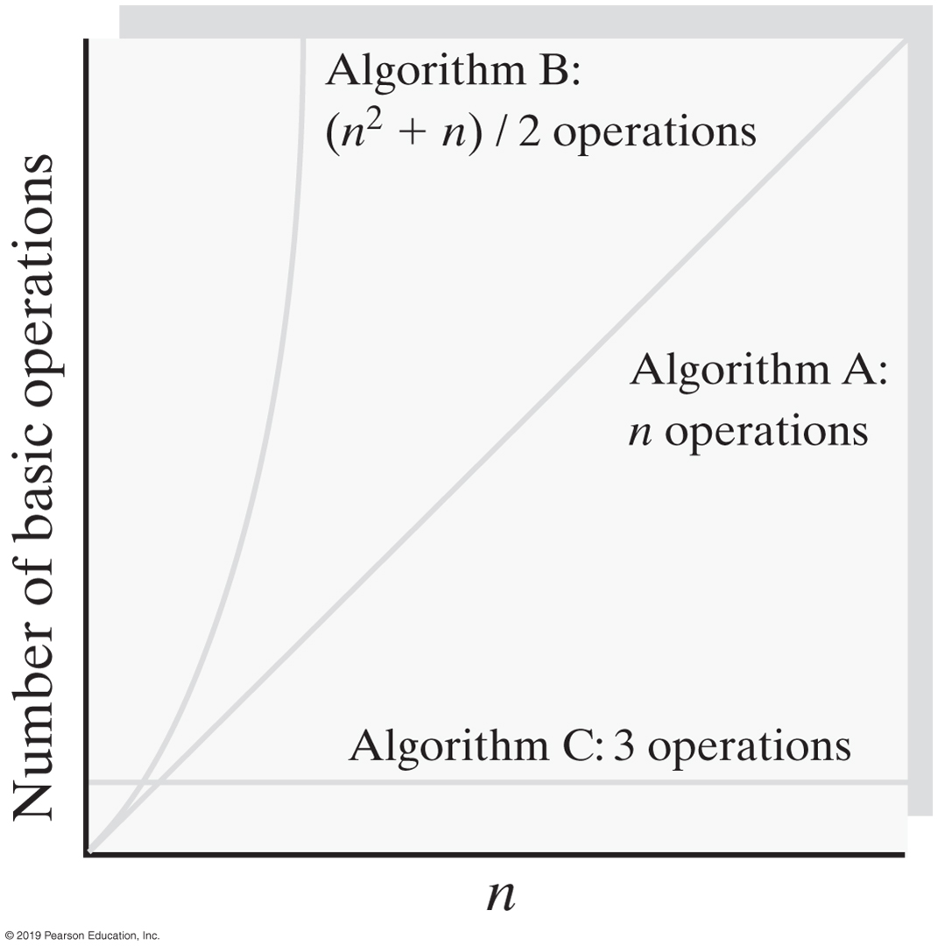
Counting Basic Operations
FIGURE 4-3 Number of basic operations required by the algorithms as a function of n

Slide 7
Counting Basic Operations
n | (log(log n) | log n | log² n | n | n log n | n² | n³ | 2^{n} | n!
10 | 2 | 3 | 11 | 10 | 33 | 10² | 10³ | 10³ | 10⁵
10² | 3 | 7 | 44 | 100 | 664 | 10⁴ | 10⁶ | 10³⁰ | 10⁹⁴
10³ | 3 | 10 | 99 | 1,000 | 9,966 | 10⁶ | 10⁹ | 10³⁰¹ | 10¹⁴³⁵
10⁴ | 4 | 13 | 177 | 10,000 | 132,877 | 10⁸ | 10¹² | 10³⁰¹⁰ | 10^{19,335}
10⁵ | 4 | 17 | 276 | 100,00 | 1,660,964 | 10¹⁰ | 10¹⁵ | 10^{30,103} | 10^{243,338}
10⁶ | 4 | 20 | 397 | 1,000,000 | 19,931,569 | 10¹² | 10¹⁸ | 10^{301,301} | 10^{2,933,369}
FIGURE 4-4 Typical growth-rate functions evaluated at increasing values of n

Slide 8
Best, Worst, and Average Cases
For some algorithms, execution time depends only on size of data set
Other algorithms depend on the nature of the data itself
Goal is to know best case, worst case, average case

Slide 9
Big Oh Notation
A function f(n) is of order at most g(n)
That is, f(n) is O(g(n)) — if
A positive real number c and positive integer N exist …
Such that f(n) ≤ c x g(n) for all n ≥ N
That is:
c x g(n) is an upper bound on f(n) when n is sufficiently large

Slide 10
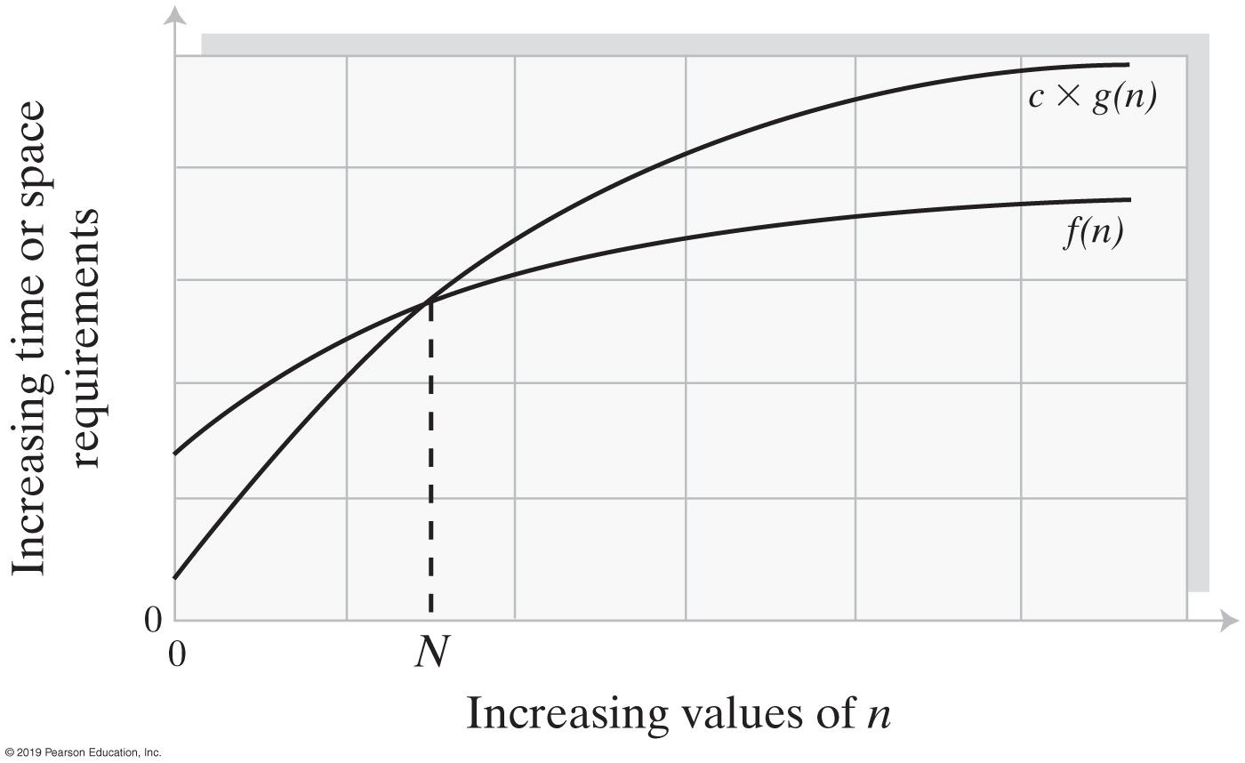
Big Oh Notation
FIGURE 4-5 An illustration of the values of two growth-rate functions

Slide 11
Big Oh Notation
O(k g(n)) = O(g(n)) for a constant k
O(g 1 (n)) + O(g 2 (n)) = O(g 1 (n) + g 2 (n))
O(g 1 (n)) * O(g 2 (n)) = O(g 1 (n) * g 2 (n))
O(g 1 (n) + g 2 (n) + . . . + g m (n)) =
O(max(g 1 (n), g 2 (n), . . ., g m (n))
O(max(g 1 (n), g 2 (n), . . ., g m (n)) =
max(O(g 1 (n)), O(g 2 (n)), . . ., O(g m (n)))
Identities for Big Oh Notation

Slide 12
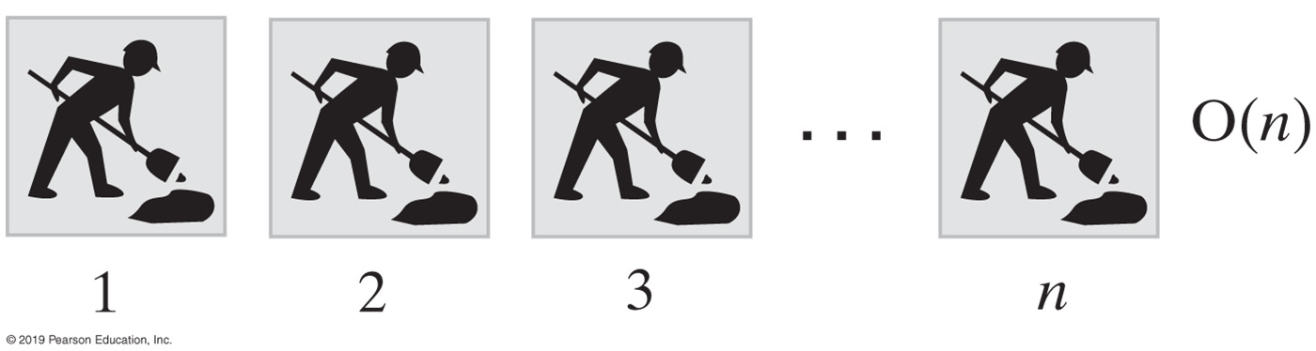
Picturing Efficiency
long sum = 0;
for (long i = 1; i <= n; i++)
sum = sum + i;
FIGURE 4-6 An O(n) algorithm

Slide 13
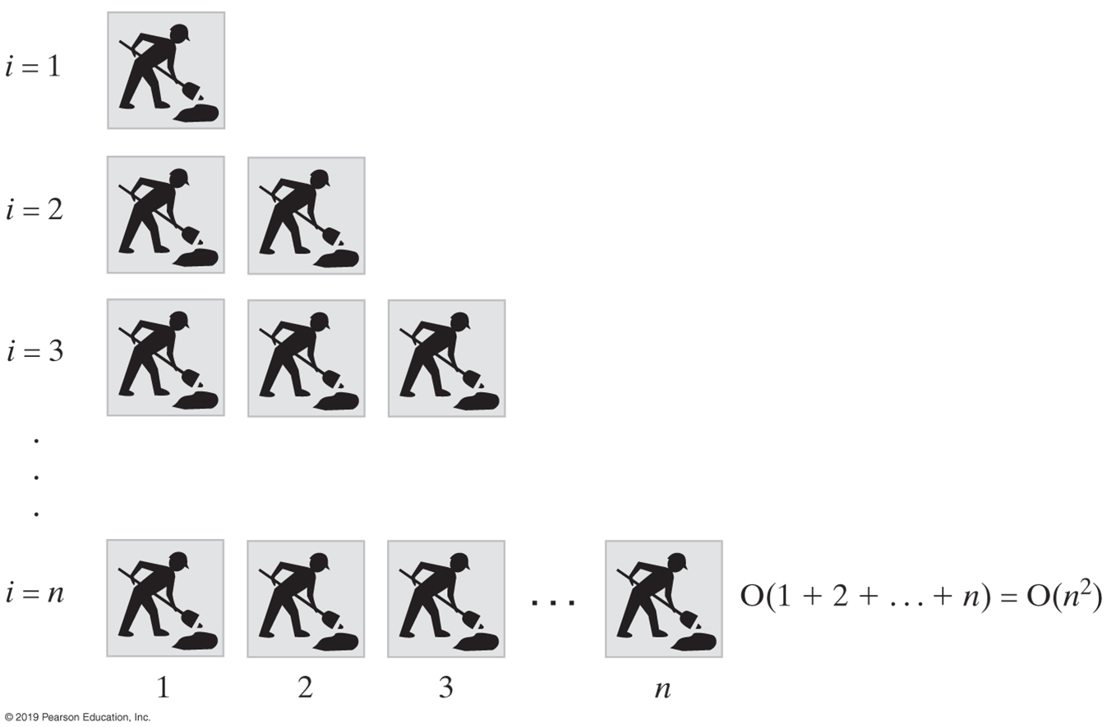
Picturing Efficiency
sum = 0;
for (long i = 1; i <= n; i++)
{
for (long j = 1; j <= i; j++)
sum = sum + 1;
} // end for
FIGURE 4-7 An O(n²) algorithm

Slide 14
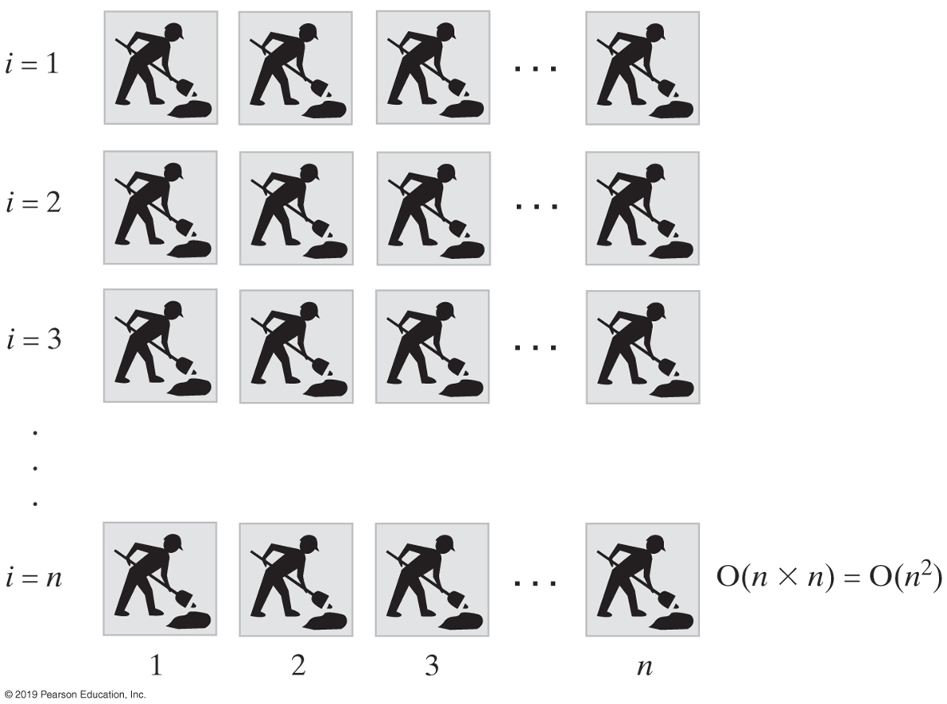
Picturing Efficiency
sum = 0;
for (long i = 1; i <= n; i++)
{
for (long j = 1; j <= n; j++)
sum = sum + 1;
} // end for
FIGURE 4-8 Another O(n²) algorithm

Slide 15
Picturing Efficiency
Growth-Rate Function for Size n Problems | Growth-Rate Function for Size 2n Problems | Effect on Time Requirement
1 | 1 | None
log n | 1 + log n | Negligible
n | 2n | Doubles
n log n | 2n log n + 2n | Doubles and then adds 2n
n² | (2n)² | Quadruples
n³ | (2n)³ | Multiples by 8
2^{n} | 2^{2n} | Squares
FIGURE 4-9 The effect of doubling the problem size on an algorithm’s time requirement

Slide 16
Picturing Efficiency
Growth-Rate Function g | g(10⁶) / 10⁶
log n | 0.0000199 seconds
n | 1 second
n log n | 19.9 seconds
n² | 11.6 days
n³ | 31,709.8 years
2^{n} | 10^{301,016} years
FIGURE 4-10 The time required to process one million items by algorithms of various orders at the rate of one million operations per second

Slide 17
Efficiency of ADT Bag Implementations
Operation | Fixed-Size Array | Linked
add(newEntry) | O(1) | O(1)
remove() | O(1) | O(1)
remove(anEntry) | O(1), O(n), O(n) | O(1), O(n), O(n)
clear() | O(n) | O(n)
getFrequencyOf(anEntry) | O(n) | O(n)
contains(anEntry) | O(1), O(n), O(n) | O(1), O(n), O(n)
toArray() | O(n) | O(n)
getCurrentSize(), isEmpty() | O(1) | O(1)
FIGURE 4-11 The time efficiencies of the ADT bag operations for two implementations, expressed in Big Oh notation

Slide 18
End
Chapter 4

