Slide 1
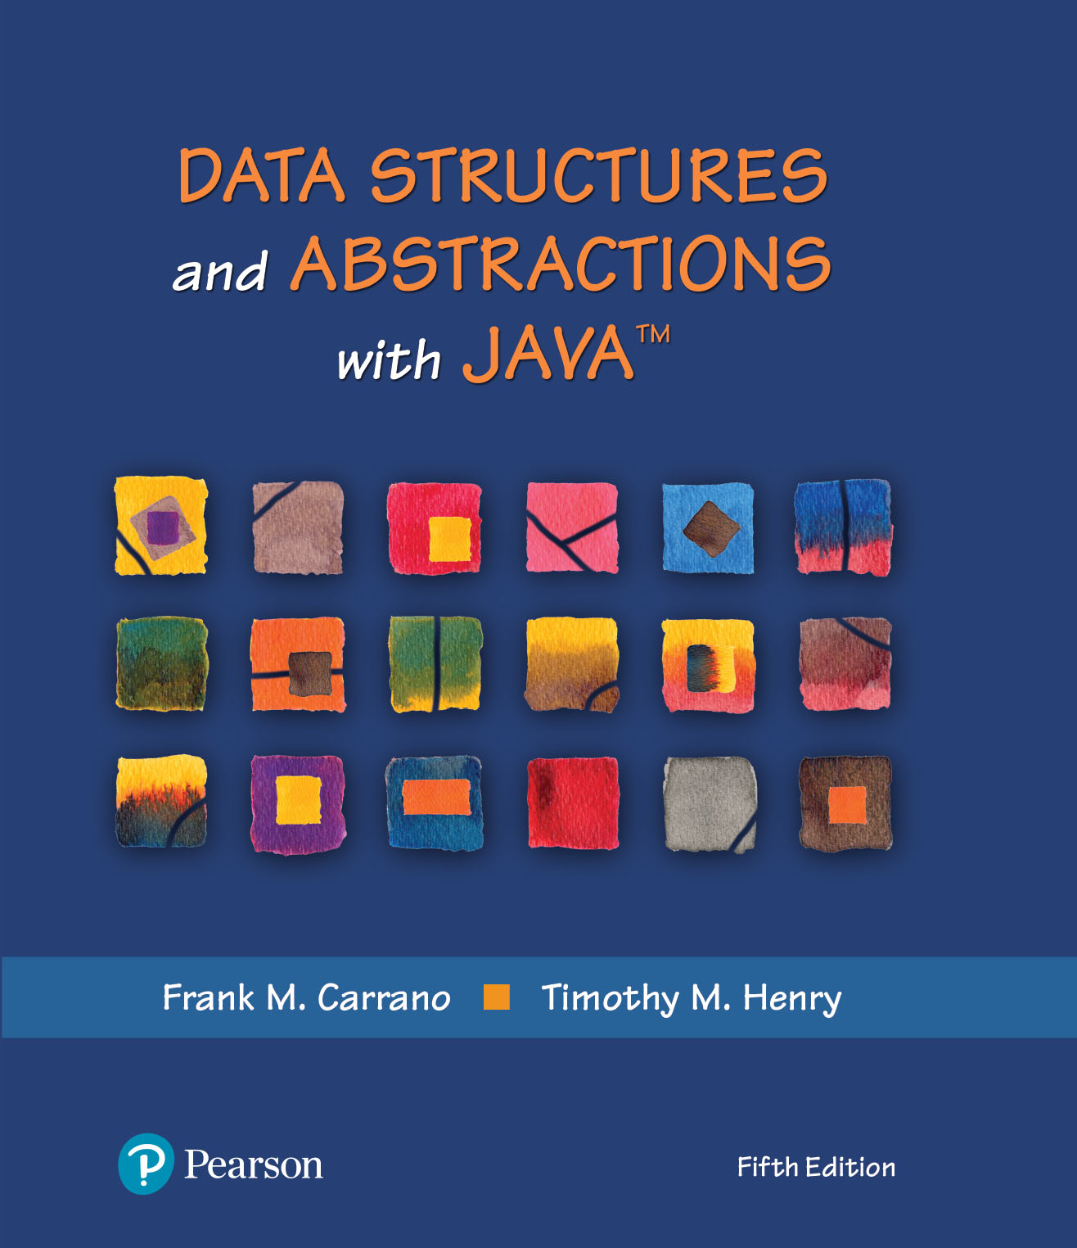
Data Structures and Abstractions with Java™
5th Edition
Chapter 5
Stacks

Slide 2
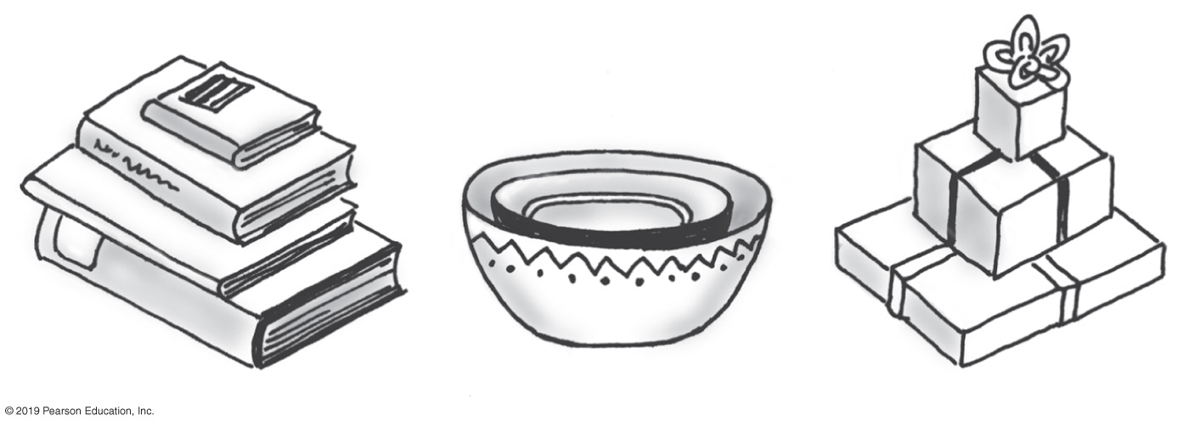
Stacks
Add item on top of stack
Remove item that is topmost
  Last In, First Out … LIFO
FIGURE 5-1 Some familiar stacks

Slide 3
Specifications of the ADT Stack
Data
  A collection of objects in reverse chronological order and having the same data type
Pseudocode | UML | Description
push(newEntry) | +push(newEntry: T): void | Task: Adds a new entry to the top of the stack. Input: newEntry is the new entry. Output: None.
pop() | +pop(): T | Task: Removes and returns the stack’s top entry. Input: None. Output: Returns the stack’s top entry. Throws an exception if the stack is empty before the operation.
peek() | +peek(): T | Task: Retrieves the stack’s top entry without changing the stack in any way. Input: None. Output: Returns the stack’s top entry. Throws an exception if the stack is empty.
isEmpty() | +isEmpty(): boolean | Task: Detects whether the stack is empty. Input: None. Output: Returns true if the stack is empty.
clear() | +clear(): void | Task: Removes all entries from the stack. Input: None. Output: None.

Slide 4
Design Decision
When stack is empty
  What to do with pop and peek?
Possible actions
  Assume that the ADT is not empty;
  Return null.
  Throw an exception (which type?).

Slide 5
Interface for the ADT Stack
/** An interface for the ADT stack. */
public interface StackInterface<T>
{
/** Adds a new entry to the top of this stack.
@param newEntry An object to be added to the stack. */
public void push(T newEntry);
/** Removes and returns this stack's top entry.
@return The object at the top of the stack.
@throws EmptyStackException if the stack is empty before the operation. */
public T pop();
/** Retrieves this stack's top entry.
@return The object at the top of the stack.
@throws EmptyStackException if the stack is empty. */
public T peek();
/** Detects whether this stack is empty.
@return True if the stack is empty. */
public boolean isEmpty();
/** Removes all entries from this stack. */
public void clear();
} // end StackInterface
LISTING 5-1 An interface for the ADT stack

Slide 6
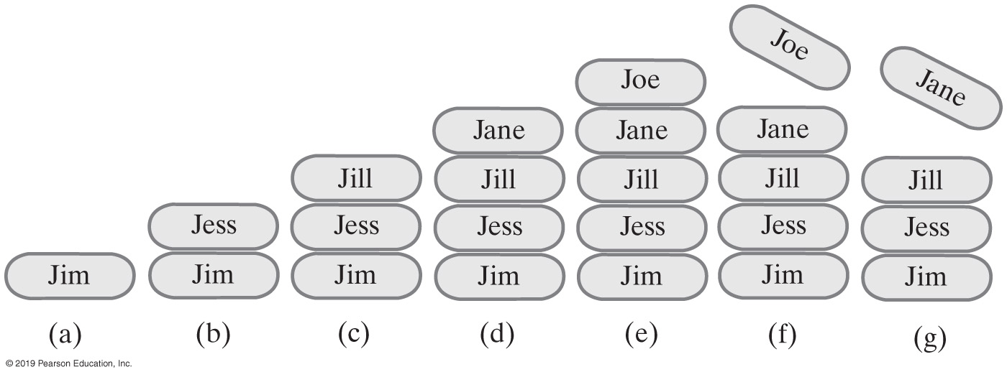
Example of a Stack
StackInterface<String> stringStack = new OurStack<>();
(a) stringStack.push(“Jim”);
(b) stringStack.push("Jess");
(c) stringStack.push("Jill");
(d) stringStack.push("Jane");
(e) stringStack.push("Joe");
(f) stringStack.pop();
(g) stringStack.pop();
FIGURE 5-2 A stack of strings
Notes:
FIGURE 5-2
A stack of strings after (a) push adds Jim; (b) push adds Jess; (c) push adds Jill; (d) push adds Jane; (e) push adds Joe; (f ) pop retrieves and removes Joe; (g) pop retrieves and removes Jane

Slide 7
Security Note
Design guidelines
  Use preconditions and postconditions to document assumptions.
  Do not trust client to use public methods correctly.
  Avoid ambiguous return values.
  Prefer throwing exceptions instead of returning values to signal problem.

Slide 8
Processing Algebraic Expressions
Infix:
  each binary operator appears between its operands
  a + b
Prefix:
  each binary operator appears before its operands
  + a b
Postfix:
  each binary operator appears after its operands
  a b +
Balanced expressions: delimiters paired correctly

Slide 9
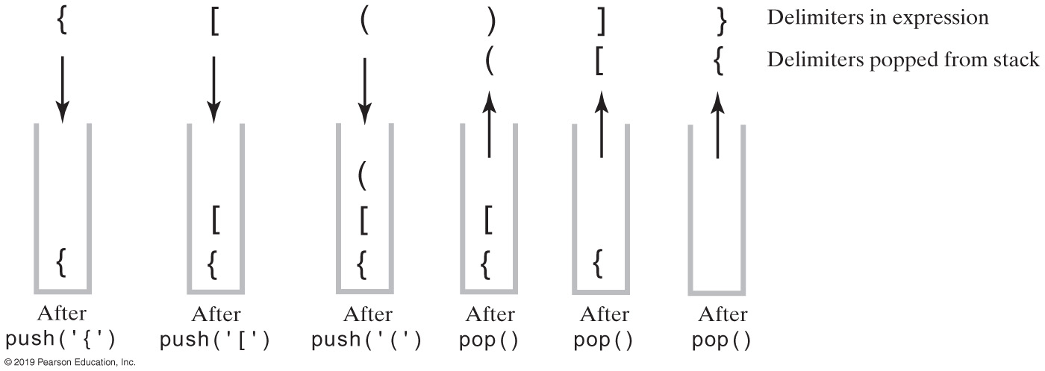
Processing Algebraic Expressions
FIGURE 5-3 The contents of a stack during the scan of an expression that contains the balanced delimiters{ [ ( ) ] }

Slide 10
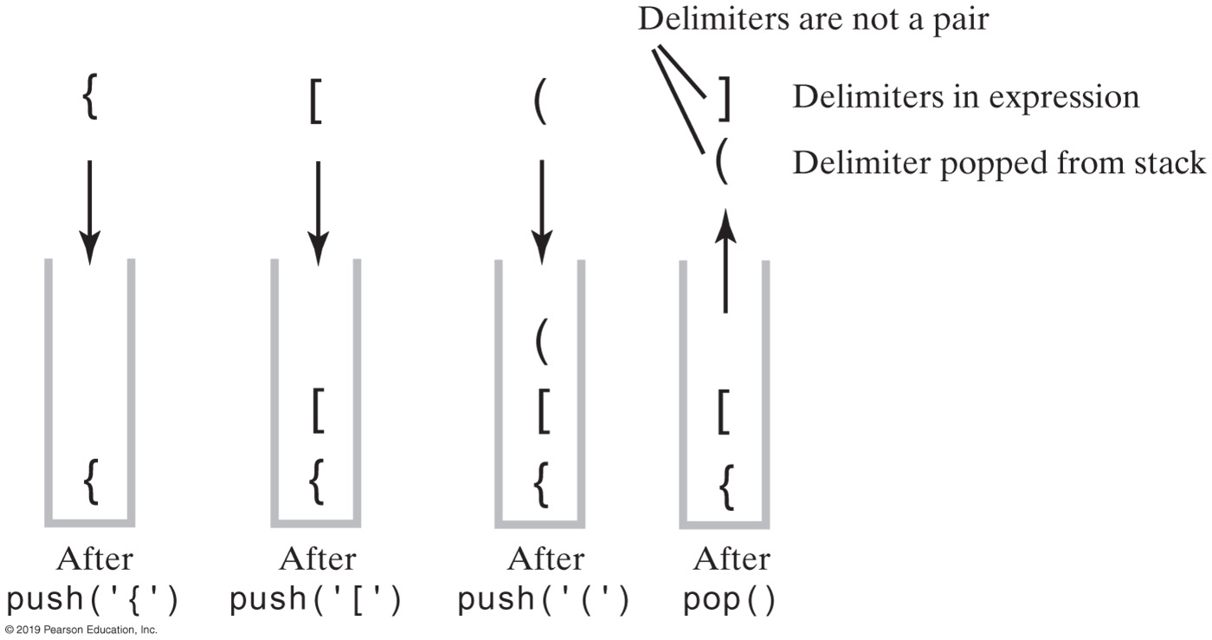
Processing Algebraic Expressions
FIGURE 5-4 The contents of a stack during the scan of an expression that contains the unbalanced delimiters { [ ( ] ) }

Slide 11
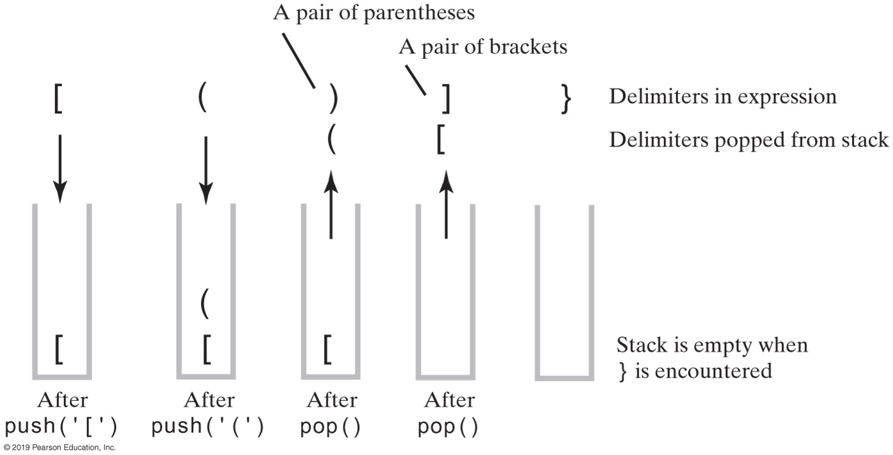
Processing Algebraic Expressions
FIGURE 5-5 The contents of a stack during the scan of an expression that contains the unbalanced delimiters [ ( ) ] }

Slide 12
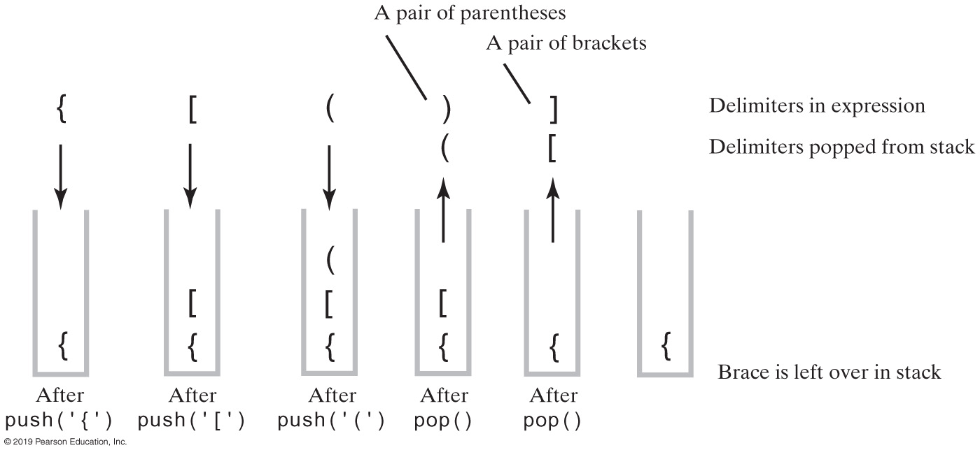
Processing Algebraic Expressions
FIGURE 5-6 The contents of a stack during the scan of an expression that contains the unbalanced delimiters { [ ( ) ]

Slide 13
Processing Algebraic Expressions
Algorithm checkBalance(expression)
// Returns true if the parentheses, brackets, and braces in an expression are paired correctly.
isBalanced = true // The absence of delimiters is balanced
while ((isBalanced == true) and not at end of expression)
{
nextCharacter = next character in expression
switch (nextCharacter)
{
case '(': case '[': case '{':
      Push nextCharacter onto stack
      break
case ')': case ']': case '}':
if (stack is empty)
isBalanced = false
else
{
openDelimiter = top entry of stack
Pop stack
isBalanced = true or false according to whether openDelimiter and
nextCharacter are a pair of delimiters
}
break
}
}
if (stack is not empty)
isBalanced = false
return isBalanced
Algorithm to process for balanced expression.

Slide 14
Implementation of Algorithm (Part 1)
/** A class that checks whether the parentheses, brackets, and braces
in a string occur in left/right pairs. */
public class BalanceChecker
{
// Returns true if the given characters, open and close, form a pair
// of parentheses, brackets, or braces.
private static boolean isPaired(char open, char close)
{
return (open == '(' && close == ')') ||
(open == '[' && close == ']') ||
(open == '{' && close == '}');
} // end isPaired
/** Decides whether the parentheses, brackets, and braces
in a string occur in left/right pairs.
@param expression A string to be checked.
@return True if the delimiters are paired correctly. */
public static boolean checkBalance(String expression)
{
          [ SEE NEXT SLIDE FOR IMPLEMENTATION]
} // end checkBalance
} // end BalanceChecker
LISTING 5-2 The class BalanceChecker

Slide 15
Implementation of Algorithm (Part 2)
StackInterface<Character> openDelimiterStack = new LinkedStack<>();
int characterCount = expression.length();
boolean isBalanced = true;
int index = 0;
char nextCharacter = ' ';
while (isBalanced && (index < characterCount)) {
nextCharacter = expression.charAt(index);
switch (nextCharacter) {
case '(': case '[': case '{':
openDelimiterStack.push(nextCharacter);
break;
case ')': case ']': case '}':
if (openDelimiterStack.isEmpty())
isBalanced = false;
else {
char openDelimiter = openDelimiterStack.pop();
isBalanced = isPaired(openDelimiter, nextCharacter);
} // end if
break;
default: break; // Ignore unexpected characters
} // end switch
index++;
} // end while
if (!openDelimiterStack.isEmpty())
isBalanced = false;
return isBalanced;
} // end checkBalance

Slide 16
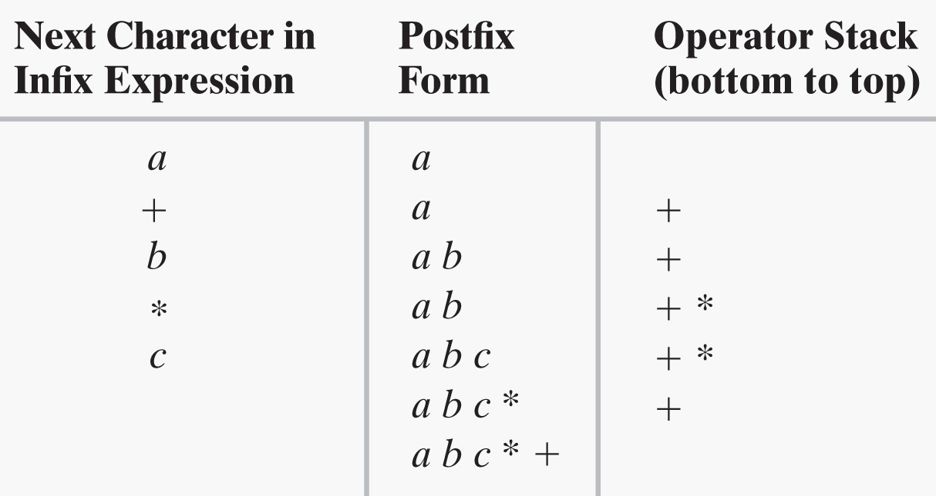
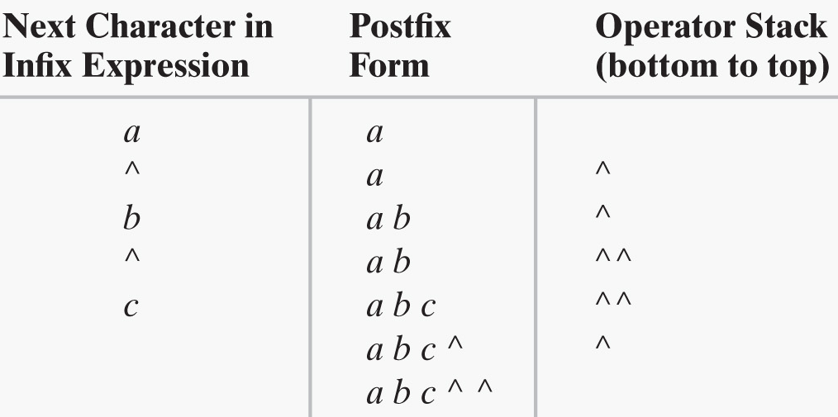

Converting Infix to Postfix
a + b * c
a ^ b ^ c
a - b + c
FIGURES 5-7 & 5-8 Converting the infix expressions to postfix form

Slide 17
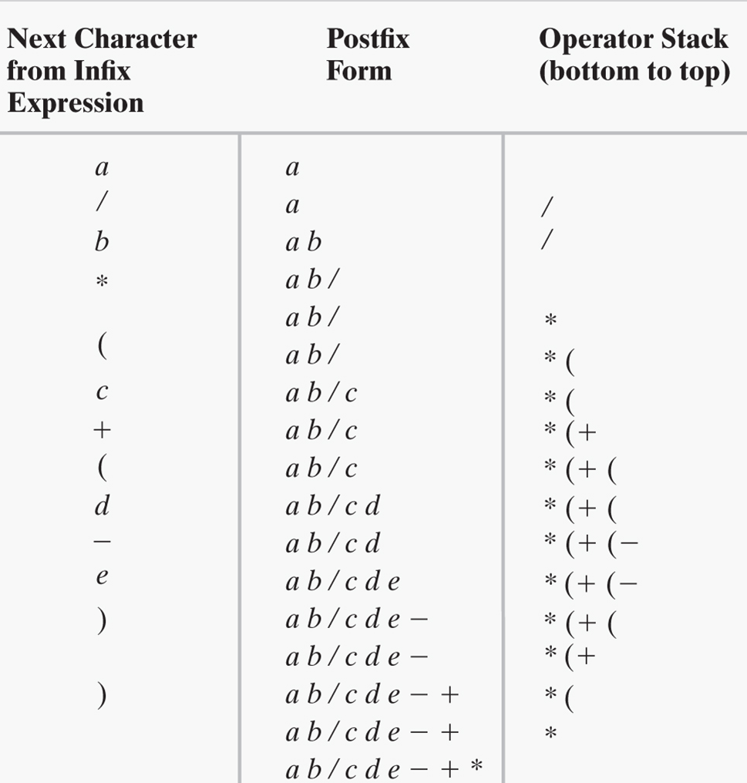
Converting Infix to Postfix
a / b * (c + (d - e))
FIGURE 5-9 Steps in converting an infix expression to postfix form

Slide 18
Infix-to-postfix Conversion
To convert an infix expression to postfix form, you take the following actions, according to the symbols you encounter, as you process the infix expression from left to right:
Operand | Append each operand to the end of the output expression.
Operator ^ | Push ^ onto the stack.
Operator +, -, *, or / | Pop operators from the stack, appending them to the output expression, until either the stack is empty or its top entry has a lower precedence than the newly encountered operator. Then push the new operator onto the stack.
Open parenthesis | Push ( onto the stack.
Close parenthesis | Pop operators from the stack and append them to the output expression until an open parenthesis is popped. Discard both parentheses.

Slide 19
Infix-to-postfix Algorithm (Part 1)
Algorithm convertToPostfix(infix)
// Converts an infix expression to an equivalent postfix expression.
operatorStack = a new empty stack
postfix = a new empty string
while (infix has characters left to parse)
{
nextCharacter = next nonblank character of infix
switch (nextCharacter)
{
case variable:
Append nextCharacter to postfix
break
case '^' :
operatorStack.push(nextCharacter)
break
case '+' : case '-' : case '*' : case '/' :
while (!operatorStack.isEmpty() and
precedence of nextCharacter <= precedence of operatorStack.peek())
{
Append operatorStack.peek() to postfix
operatorStack.pop()
}
operatorStack.push(nextCharacter)
break
Algorithm for converting infix to postfix expressions.

Slide 20
Infix-to-postfix Algorithm (Part 2)
case '( ' :
operatorStack.push(nextCharacter)
break
case ')' : // Stack is not empty if infix expression is valid
topOperator = operatorStack.pop()
while (topOperator != '(')
{
Append topOperator to postfix
topOperator = operatorStack.pop()
}
break
default:
break // Ignore unexpected characters
}
}
while (!operatorStack.isEmpty())
{
topOperator = operatorStack.pop()
Append topOperator to postfix
}
return postfix
Algorithm for converting infix to postfix expressions.

Slide 21
Evaluating Postfix Expressions
Algorithm evaluatePostfix(postfix)
// Evaluates a postfix expression.
valueStack = a new empty stack
while (postfix has characters left to parse)
{
nextCharacter = next nonblank character of postfix
switch (nextCharacter)
{
case variable:
valueStack.push(value of the variable nextCharacter)
break
case '+' : case '-' : case '*' : case '/' : case '^' :
operandTwo = valueStack.pop()
operandOne = valueStack.pop()
result = the result of the operation in nextCharacter and
its operands operandOne and operandTwo
valueStack.push(result)
break
default: break // Ignore unexpected characters
}
}
return valueStack.peek()
Algorithm for evaluating postfix expressions.

Slide 22
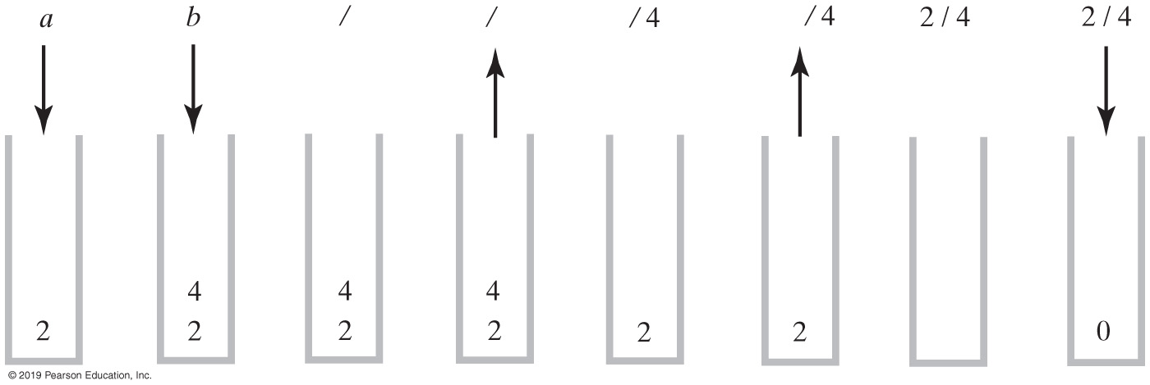
Evaluating Infix Expressions
FIGURE 5-10 The stack during the evaluation of the postfix expression a b / when a is 2 and b is 4

Slide 23
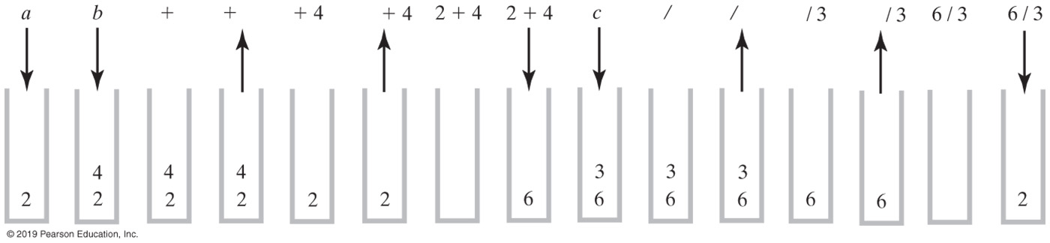
Evaluating Infix Expressions
FIGURE 5-11 The stack during the evaluation of the postfix expression a b + c / when a is 2, b is 4, and c is 3

Slide 24
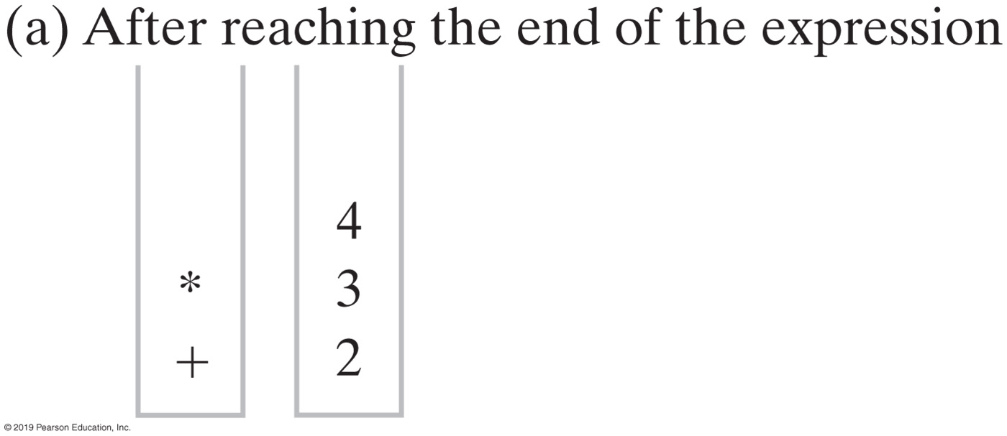
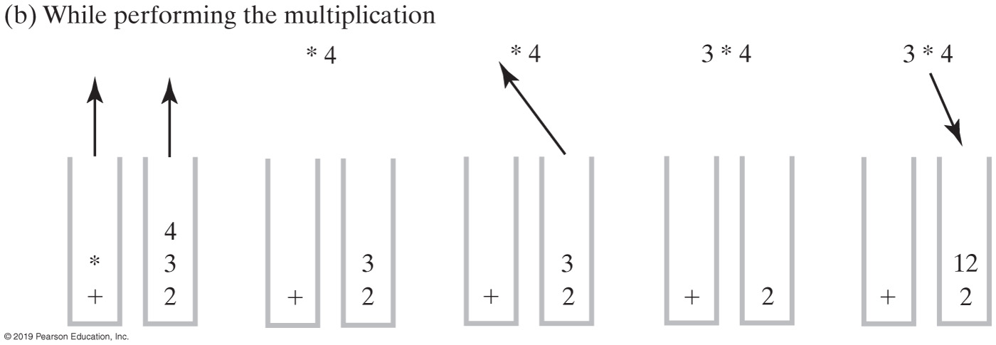
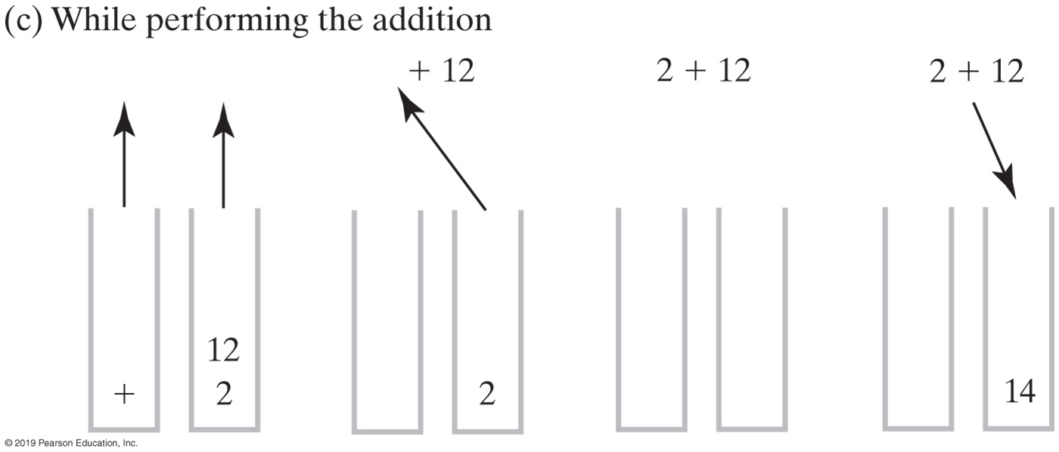
Evaluating Infix Expressions
FIGURE 5-12
Two stacks during the evaluation of
a + b * c when a is 2, b is 3, and c is 4

Slide 25
Evaluating Infix Expressions (Part 1)
Algorithm evaluateInfix(infix) // Evaluates an infix expression.
operatorStack = a new empty stack
valueStack = a new empty stack
while (infix has characters left to process)
{
nextCharacter = next nonblank character of infix
switch (nextCharacter)
{
case variable:
valueStack.push(value of the variable nextCharacter)
break
case '^' :
operatorStack.push(nextCharacter)
break
case '+' : case '-' : case '*' : case '/' :
while (!operatorStack.isEmpty() and
precedence of nextCharacter <= precedence of operatorStack.peek())
{
// Execute operator at top of operatorStack
topOperator = operatorStack.pop()
operandTwo = valueStack.pop()
operandOne = valueStack.pop()
result = the result of the operation in
topOperator and its operands operandOne and operandTwo
valueStack.push(result)
}
operatorStack.push(nextCharacter)
break

Slide 26
Evaluating Infix Expressions (Part 2)
case '(' :
operatorStack.push(nextCharacter)
break
case ')' : // Stack is not empty if infix expression is valid
topOperator = operatorStack.pop()
while (topOperator != ‘(')
{
operandTwo = valueStack.pop()
operandOne = valueStack.pop()
result = the result of the operation in
topOperator and its operands operandOne and operandTwo
valueStack.push(result)
topOperator = operatorStack.pop()
}
break
default: break // Ignore unexpected characters
}
}
while (!operatorStack.isEmpty())
{
topOperator = operatorStack.pop()
operandTwo = valueStack.pop()
operandOne = valueStack.pop()
result = the result of the operation in
topOperator and its operands operandOne and operandTwo
valueStack.push(result)
}
return valueStack.peek()

Slide 27
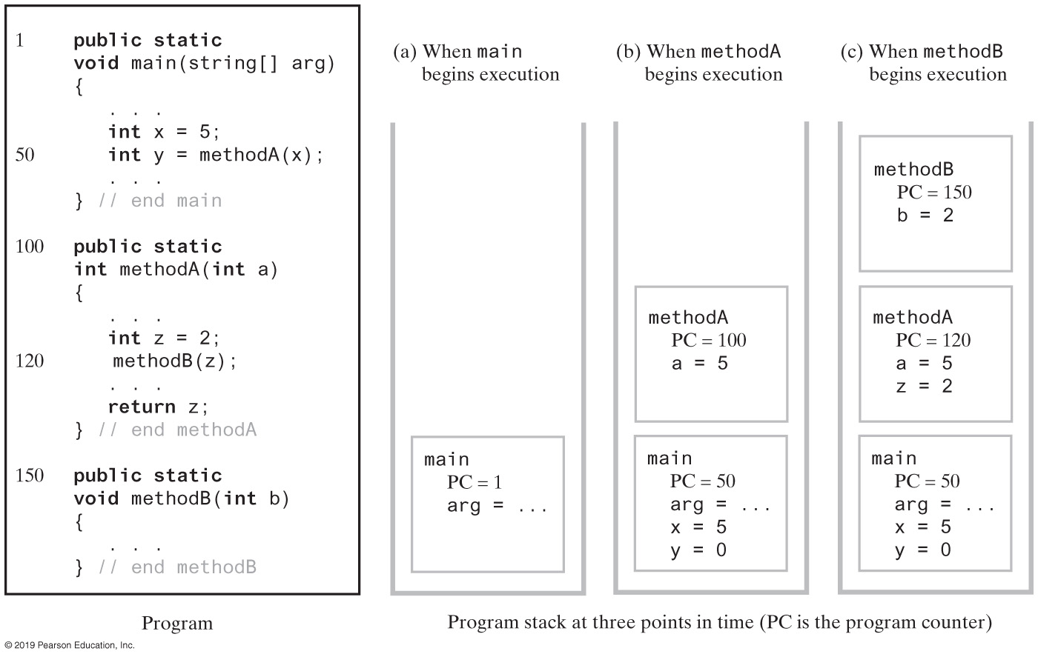
The Application Program Stack
FIGURE 5-13 The program stack as a program executes

Slide 28
Java Class Library: The Class Stack
Found in java.util
Methods
  A constructor – creates an empty stack
  public T push(T item);
  public T pop();
  public T peek();
  public boolean empty();

Slide 29
End
Chapter 5

