Slide 1
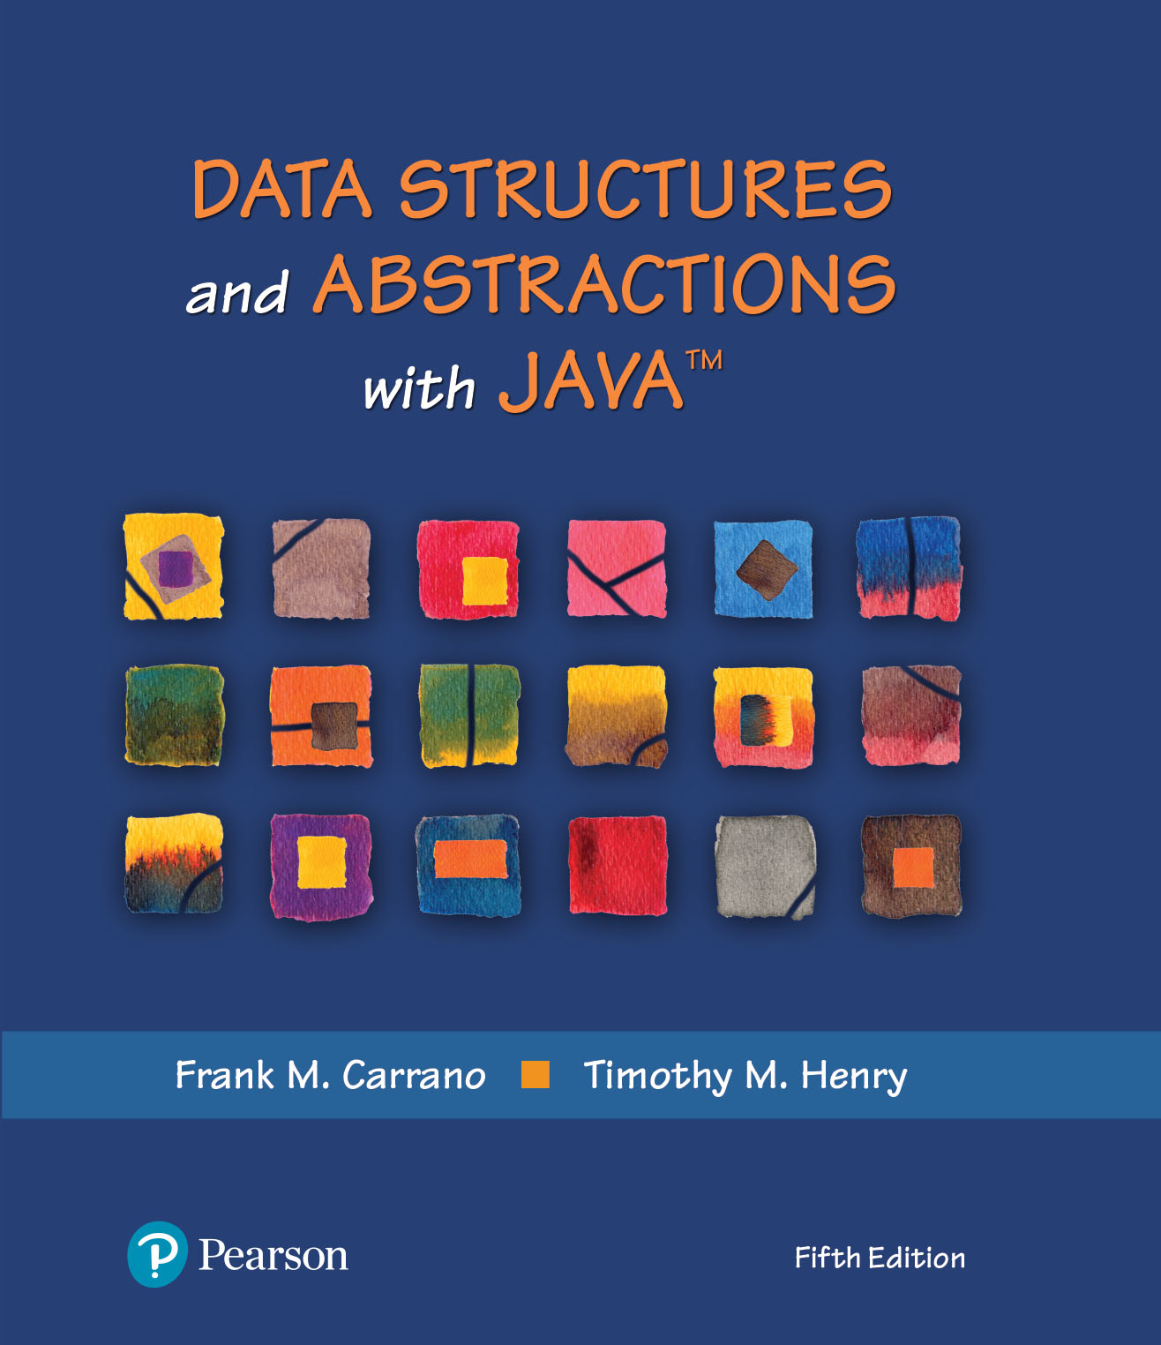
Data Structures and Abstractions with Java™
5th Edition
Chapter 6
Stack Implementations

Slide 2
Linked Implementation
Each operation involves top of stack
push
pop
peek
Head of linked list easiest, fastest to access
Let this be the top of the stack

Slide 3
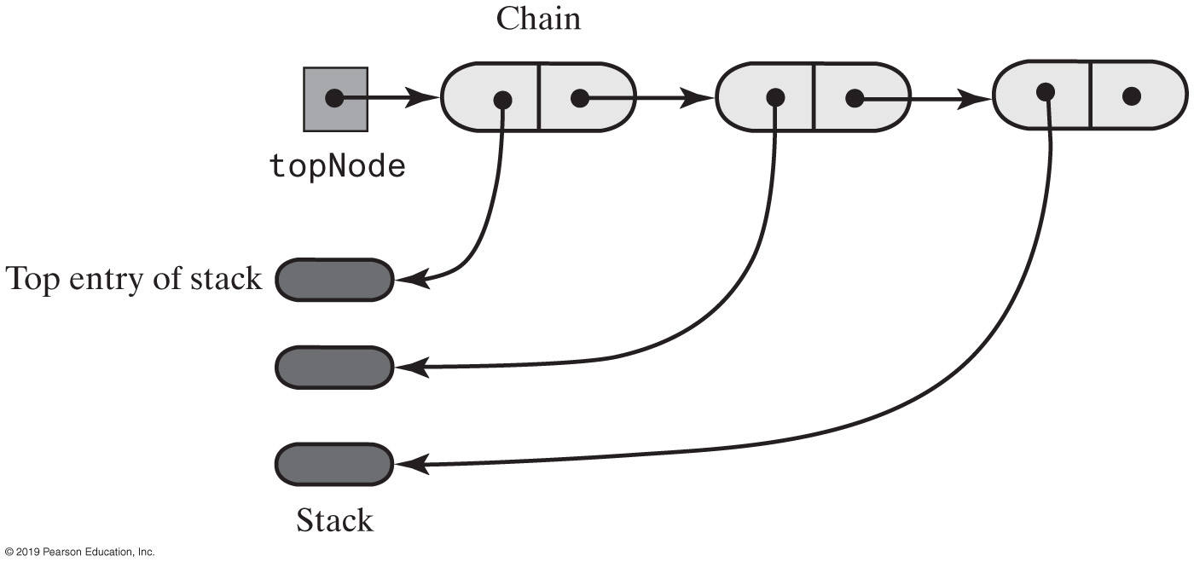
Linked Implementation
FIGURE 6-1 A chain of linked nodes that implements a stack

Slide 4
Linked Implementation of a Stack
/** A class of stacks whose entries are stored in a chain of nodes. */
public final class LinkedStack<T> implements StackInterface<T>
{
private Node topNode; // References the first node in the chain
public LinkedStack()
{
topNode = null;
} // end default constructor
// < Implementations of the stack operations go here. >
// . . .
private class Node
{
private T data; // Entry in stack
private Node next; // Link to next node
// < Implementations of the node operations go here. >
} // end Node
} // end LinkedStack
LISTING 6-1 An outline of a linked implementation of the ADT stack

Slide 5
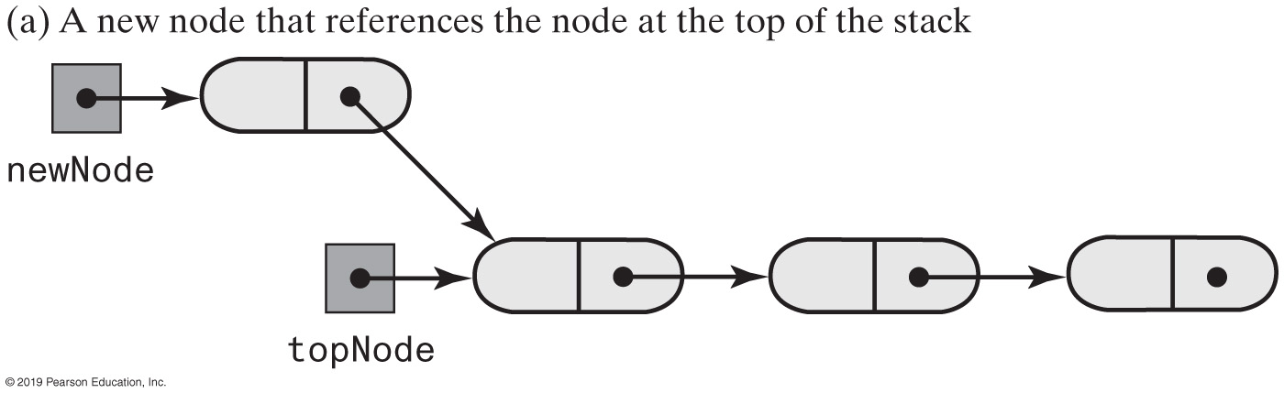
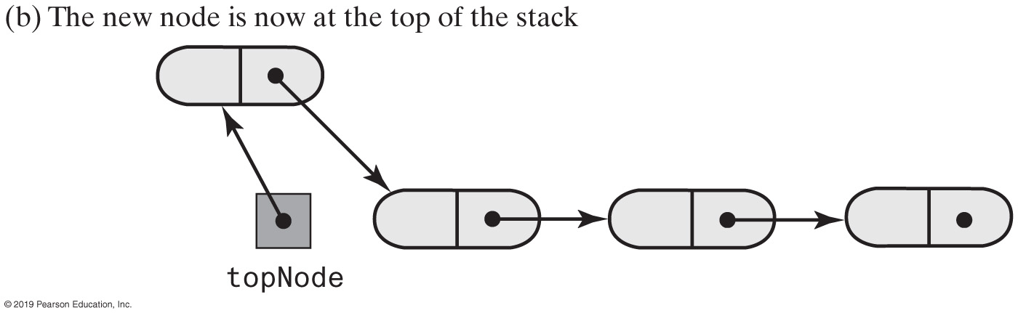
Linked Implementation of a Stack
FIGURE 6-2 Adding a new node to the top of a linked stack

Slide 6
Linked Implementation of a Stack
public void push(T newEntry)
{
Node newNode = new Node(newEntry, topNode);
topNode = newNode;
} // end push
Definition of push

Slide 7
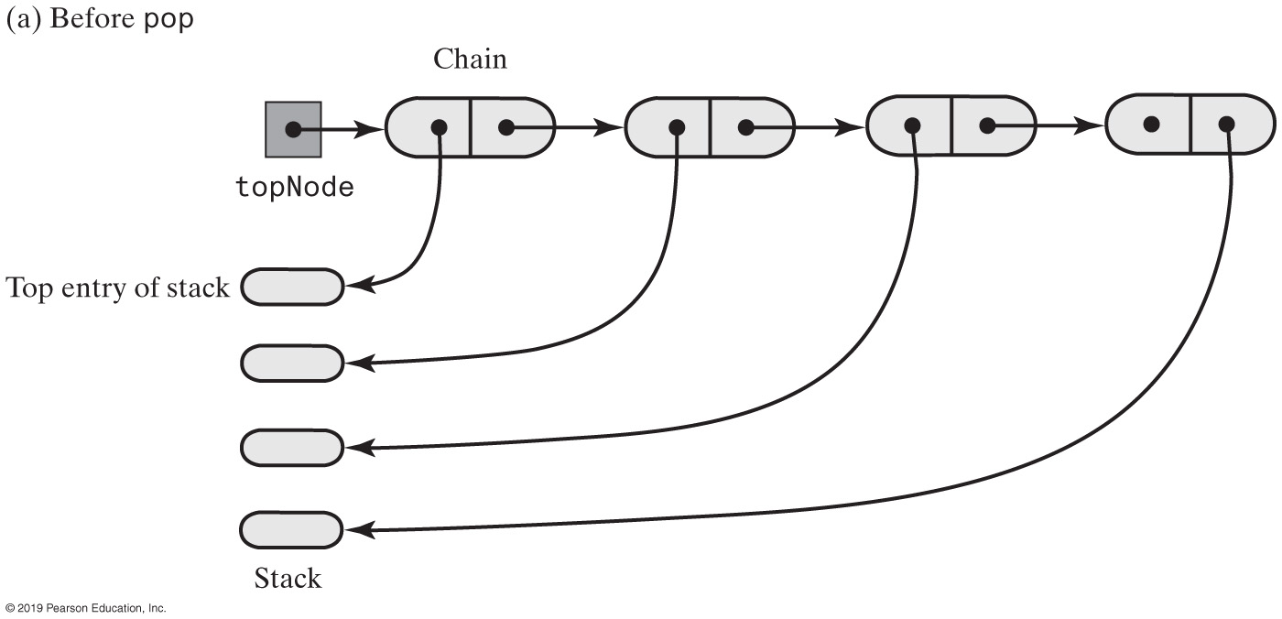
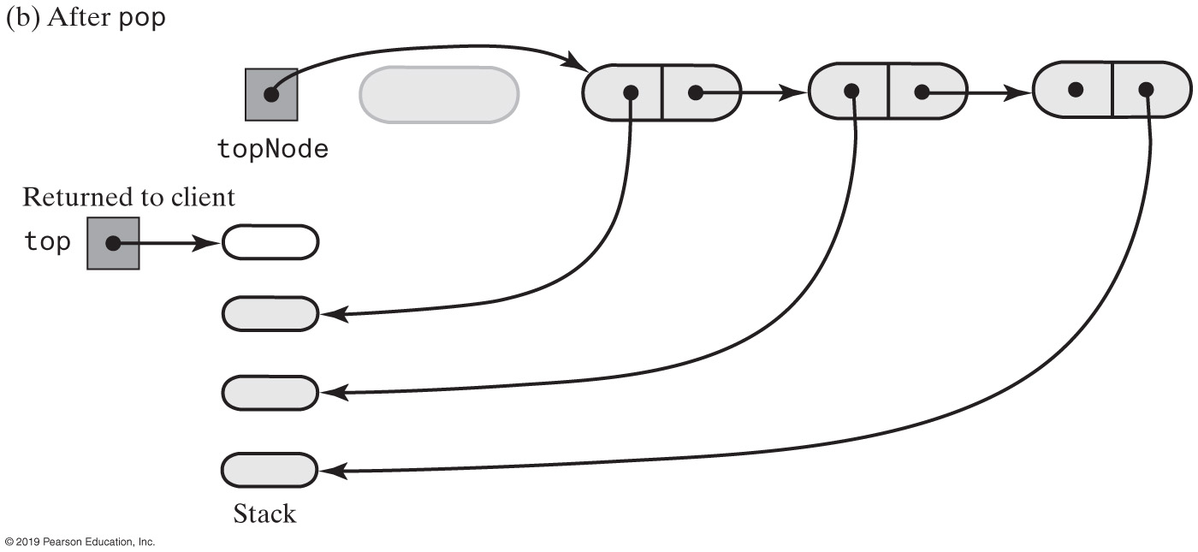
Linked Implementation of a Stack
FIGURE 6-3 The stack before and after pop deletes the first node in the chain

Slide 8
Linked Implementation
public T peek()
{
if (isEmpty())
throw new EmptyStackException();
else
return topNode.getData();
} // end peek
public T pop()
{
T top = peek(); // Might throw EmptyStackException
// Assertion: topNode != null
topNode = topNode.getNextNode();
return top;
} // end pop
Definition of peek and pop

Slide 9
Linked Implementation
public boolean isEmpty()
{
return topNode == null;
} // end isEmpty
public void clear()
{
topNode = null;
} // end clear
Definition of isEmpty and clear.

Slide 10
Array-Based Stack Implementation
Each operation involves top of stack
push
pop
peek
End of the array easiest to access
Let this be top of stack
Let first entry be bottom of stack

Slide 11
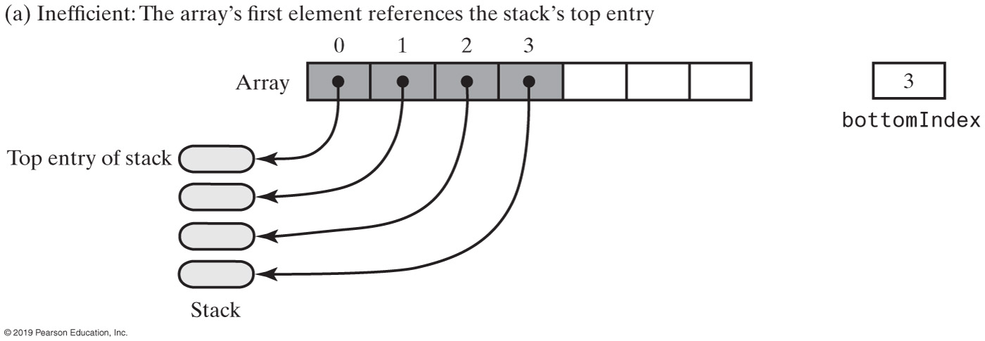
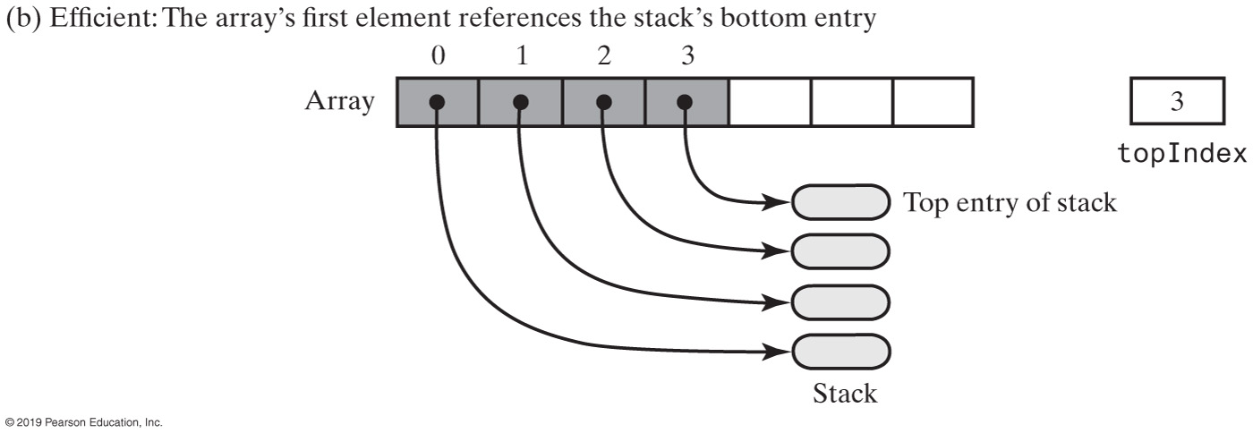
Array-Based Stack Implementation
FIGURE 6-4 Two array representations of a stack

Slide 12
Array-Based Stack Implementation
/** A class of stacks whose entries are stored in an array. */
public final class ArrayStack<T> implements StackInterface<T>
{
private T[] stack; // Array of stack entries
private int topIndex; // Index of top entry
private boolean integrityOK = false;
private static final int DEFAULT_CAPACITY = 50;
private static final int MAX_CAPACITY = 10000;
public ArrayStack()
{
this(DEFAULT_CAPACITY);
} // end default constructor
public ArrayStack(int initialCapacity)
{
integrityOK = false;
checkCapacity(initialCapacity);
// The cast is safe because the new array contains null entries
@SuppressWarnings("unchecked")
T[] tempStack = (T[])new Object[initialCapacity];
stack = tempStack;
topIndex = -1;
integrityOK = true;
} // end constructor
// < Implementations of the stack operations go here. >
// . . .
} // end ArrayStack
LISTING 6-2 An outline of an array-based implementation of the ADT stack

Slide 13
Array-Based Stack Implementation
public void push(T newEntry)
{
checkInyegrity();
ensureCapacity();
stack[topIndex + 1] = newEntry;
topIndex++;
} // end push
private void ensureCapacity()
{
if (topIndex >= stack.length - 1) // If array is full, double its size
{
int newLength = 2 * stack.length;
checkCapacity(newLength);
stack = Arrays.copyOf(stack, newLength);
} // end if
} // end ensureCapacity
Adding to the top.

Slide 14
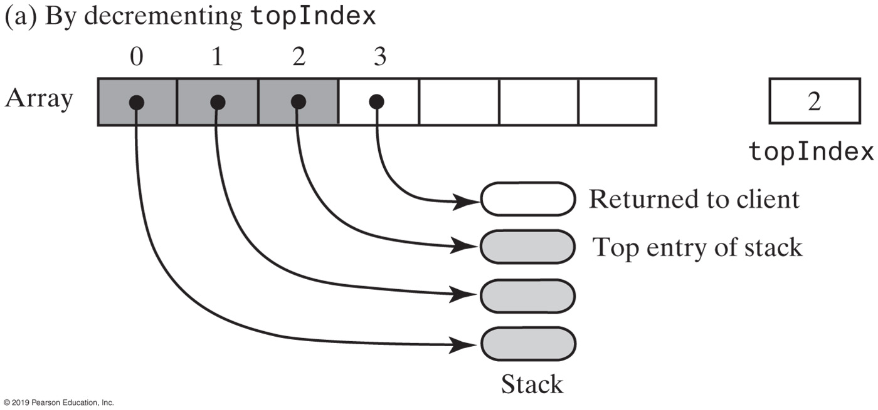
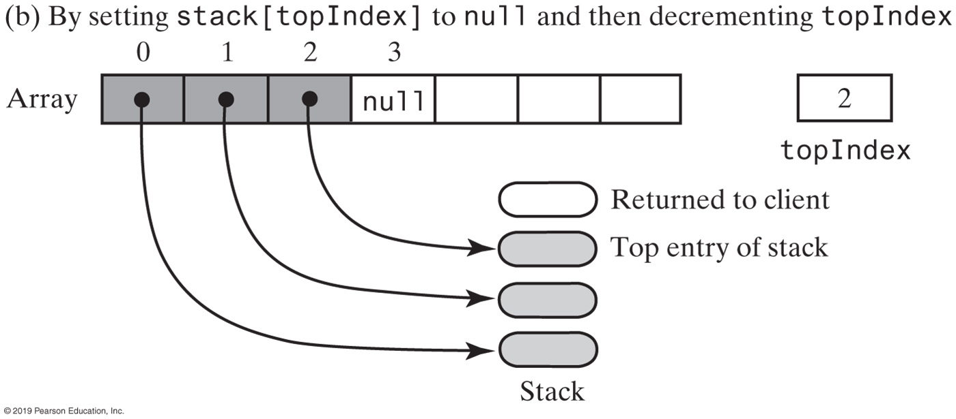
Array-Based Stack Implementation
FIGURE 6-5 An array-based stack after its top entry is removed in two different ways

Slide 15
Array-Based Stack Implementation
public T peek()
{
checkIntegrity();
if (isEmpty())
throw new EmptyStackException();
else
return stack[topIndex];
} // end peek
public T pop()
{
checkIntegrity();
if (isEmpty())
throw new EmptyStackException();
else
{
T top = stack[topIndex];
stack[topIndex] = null;
topIndex--;
return top;
} // end if
} // end pop
Retrieving the top, operation is O(1)

Slide 16
Vector-Based Stack Implementation
The class Vector
An object that behaves like a high-level array
Index begins with 0
Methods to access or set entries
Size will grow as needed
Has methods to add, remove, clear
Also methods to determine
Last element
Is the vector empty
Number of entries
Use vector’s methods to manipulate stack

Slide 17
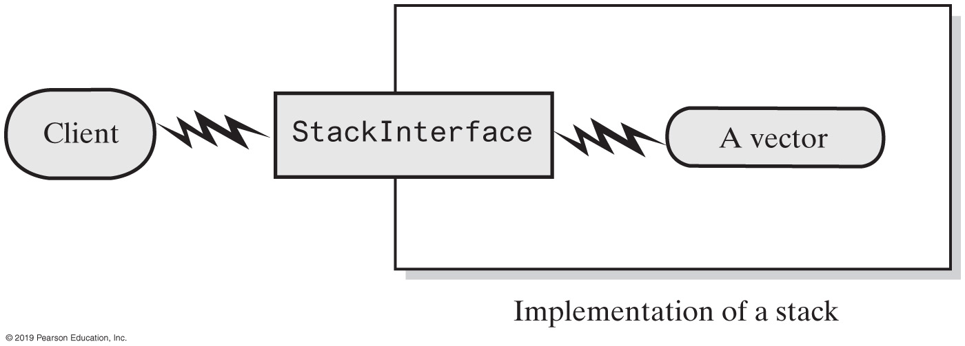
Vector-Based Stack Implementation
FIGURE 6-6 A client using the methods given in StackInterface; these methods interact with a vector’s methods to perform stack operations

Slide 18
Vector-Based Stack Implementation
import java.util.Vector;
/** A class of stacks whose entries are stored in a vector. */
public final class VectorStack<T> implements StackInterface<T>
{
private Vector<T> stack; // Last element is the top entry in stack
private boolean integrityOK;
private static final int DEFAULT_CAPACITY = 50;
private static final int MAX_CAPACITY = 10000;
public VectorStack()
{
this(DEFAULT_CAPACITY);
} // end default constructor
public VectorStack(int initialCapacity)
{
integrityOK = false;
checkCapacity(initialCapacity);
stack = new Vector<>(initialCapacity); // Size doubles as needed
integrityOK = true;
} // end constructor
// < Implementations of checkIntegrity, checkCapacity, and the stack
// operations go here. >
// . . .
} // end VectorStack
LISTING 6-3 An outline of a vector-based implementation of the ADT stack

Slide 19
Vector-Based Stack Implementation
public void push(T newEntry)
{
checkIntegrity();
stack.add(newEntry);
} // end push
Adding to the top

Slide 20
Vector-Based Stack Implementation
public T peek()
{
checkIntegrity();
if (isEmpty())
throw new EmptyStackException();
else
return stack.lastElement();
} // end peek
Retrieving the top

Slide 21
Vector-Based Stack Implementation
public T pop()
{
checkInitegrity();
if (isEmpty())
throw new EmptyStackException();
else
return stack.remove(stack.size() - 1);
} // end pop
Removing the top

Slide 22
Vector-Based Stack Implementation
public boolean isEmpty()
{
checkIntegrity();
return stack.isEmpty();
} // end isEmpty
public void clear()
{
checkIntegrity();
stack.clear();
} // end clear
The rest of the class.

Slide 23
Stack Implementations
Chapter 6

