Slide 1
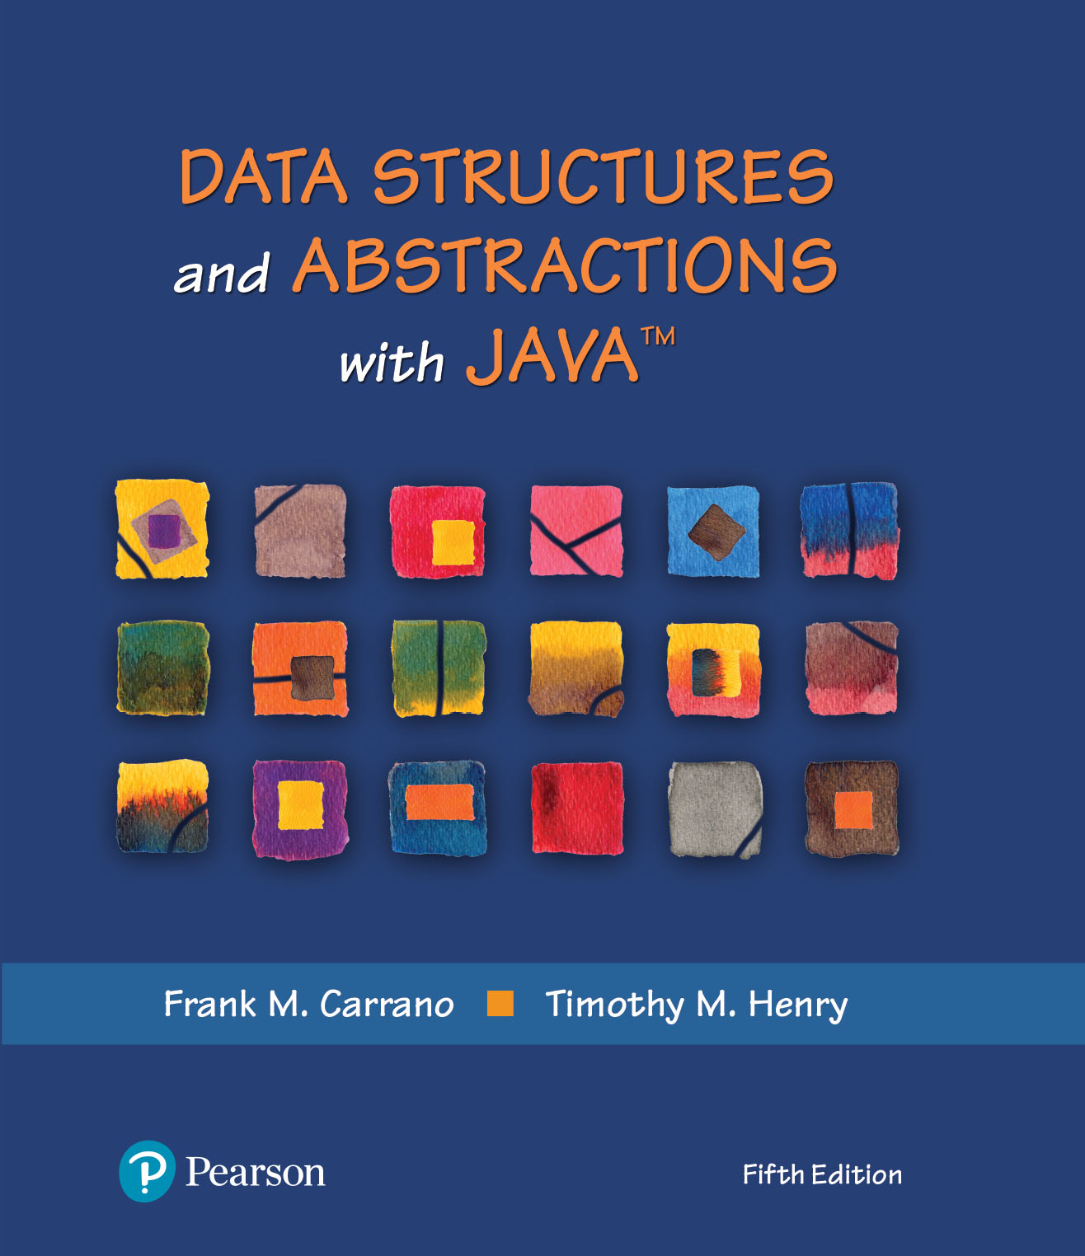
Data Structures and Abstractions with Java™
5th Edition
Java Interlude 3
More About Exceptions

Slide 2
Programmer-Defined Exception Classes
Define your own exception classes by extending existing exception classes
Existing superclass could be one in the Java Class Library or one of your own
Constructors in an exception subclass are the most important
Often the only methods you need to define

Slide 3
Programmer-Defined Exception Classes
/** A class of runtime exceptions thrown when an attempt
is made to find the square root of a negative number. */
public class SquareRootException extends RuntimeException
{
public SquareRootException()
{
super("Attempted square root of a negative number.");
} // end default constructor
public SquareRootException(String message)
{
super(message);
} // end constructor
} // end SquareRootException
LISTING JI3 -1 The exception class SquareRootException

Slide 4
Programmer-Defined Exception Classes
public class OurMath
{
/** Computes the square root of a nonnegative real number.
@param value A real value whose square root is desired.
@return The square root of the given value.
@throws SquareRootException if value < 0. */
public static double squareRoot(double value) throws SquareRootException
{
if (value < 0)
throw new SquareRootException();
else
return Math.sqrt(value);
} // end squareRoot
// < Other methods not relevant to this discussion are here. >
} // end OurMath
LISTING JI3-2 The class OurMath and its static method squareRoot

Slide 5
Programmer-Defined Exception Classes
/** A demonstration of a runtime exception using the class OurMath. */
public class OurMathDriver
{
public static void main(String[] args)
{
System.out.print("The square root of 9 is ");
System.out.println(OurMath.squareRoot(9.0));
System.out.print("The square root of -9 is ");
System.out.println(OurMath.squareRoot(-9.0));
System.out.print("The square root of 16 is ");
System.out.println(OurMath.squareRoot(16.0));
} // end main
} // end OurMathDriver
Program Output
The square root of 9 is 3.0
The square root of -9 is Exception in thread "main" SquareRootException:
Attempted square root of a negative number.
at OurMath.squareRoot(OurMath.java:14)
at OurMathDriver.main(OurMathDriver.java:12)
LISTING JI3 -3 A driver for the class OurMath

Slide 6
Programmer-Defined Exception Classes
/** A class of static methods to perform various mathematical
computations, including the square root. */
public class JoeMath
{
/** Computes the square root of a real number.
@param value A real value whose square root is desired.
@return A string containing the square root. */
public static String squareRoot(double value)
{
String result = "";
try
{
Double temp = OurMath.squareRoot(value);
result = temp.toString();
}
catch (SquareRootException e)
{
Double temp = OurMath.squareRoot(-value);
result = temp.toString() + "i";
}
return result;
} // end squareRoot
// < Other methods not relevant to this discussion could be here. >
} // end JoeMath
LISTING JI3 -4 The class JoeMath

Slide 7
Programmer-Defined Exception Classes
/** A demonstration of a runtime exception using the class JoeMath. */
public class JoeMathDriver
{
public static void main(String[] args)
{
System.out.print("The square root of 9 is ");
System.out.println(JoeMath.squareRoot(9.0));
System.out.print("The square root of -9 is ");
System.out.println(JoeMath.squareRoot(-9.0));
System.out.print("The square root of 16 is ");
System.out.println(JoeMath.squareRoot(16.0));
System.out.print("The square root of -16 is ");
System.out.println(JoeMath.squareRoot(-16.0));
} // end main
} // end JoeMathDriver
Program Output
The square root of 9 is 3.0
The square root of −9 is 3.0i
The square root of 16 is 4.0
The square root of −16 is 4.0i
LISTING JI3 -5 A driver for the class JoeMath

Slide 8
Inheritance and Exceptions
public class SuperClass
{
public void someMethod() throws Exception1
{
} // end someMethod
} // end SuperClass
public class SubClass extends SuperClass
{
public void someMethod() throws Exception1, Exception2 // ERROR!
{
} // end someMethod
} // end SubClass
Consider this superclass and subclass — cannot override someMethod in a subclass and list additional checked exceptions in its throws clause

Slide 9
Inheritance and Exceptions
public class Driver
{
public static void main(String[] args)
{
SuperClass superObject = new SubClass();
try
{
superObject.someMethod();
}
catch (Exception1 e)
{
System.out.println(e.getMessage());
}
} // end main
} // end Driver
Only Exception1 is caught. If the throws clause in SubClass was legal, we could call SubClass’s someMethod without catching Exception2.

Slide 10
Inheritance and Exceptions
public class SuperClass
{
public void someMethod() throws Exception1
{
} // end someMethod
} // end SuperClass
public class SubClass extends SuperClass
{
public void someMethod() throws Exception2 // OK, assuming Exception2
{ // extends Exception1
} // end someMethod
} // end SubClass
If Exception2 extends Exception1, the above is legal

Slide 11
The finally Block
try
{
< Code that might throw an exception, either by executing a throw statement or by calling a method that throws an exception >
}
catch (AnException e)
{
< Code that handles exceptions of type AnException or a subclass of AnException >
}
< Possibly other catch blocks to handle other types of exceptions >
finally
{
< Code that executes after either the try block or an executing catch block ends >
}
This code shows the placement of the finally block

Slide 12
The finally Block
public static void main(String[] args)
{
try
{
openRefrigerator();
takeOutMilk();
pourMilk();
putBackMilk();
}
catch (NoMilkException e)
{
System.out.println(e.getMessage());
}
finally
{
closeRefrigerator();
}
} // end main
Whether an exception occurs or not, closeRefrigerator is called within the finally block.

Slide 13
The finally Block
public static void openRefrigerator()
{
System.out.println("Open the refrigerator door.");
} // end openRefrigerator
public static void takeOutMilk() throws NoMilkException
{
if (Math.random() < 0.5)
System.out.println("Take out the milk.");
else
throw new NoMilkException("Out of Milk!");
} // end openRefrigerator
// < The methods pourMilk, putBackMilk, and closeRefrigerator are analogous to
// openRefrigerator and are here. >
// . . .
} // end GetMilk
LISTING JI3-6 A demonstration of a finally block

Slide 14
The finally Block
Sample Output 1 (no exception is thrown)
Open the refrigerator door. Take out the milk.
Pour the milk.
Put the milk back.
Sample Output 2 (exception is thrown)
Open the refrigerator door. Out of milk!
Close the refrigerator door.
LISTING JI3-6 A demonstration of a finally block output

Slide 15
End
Java Interlude 3

