Slide 1
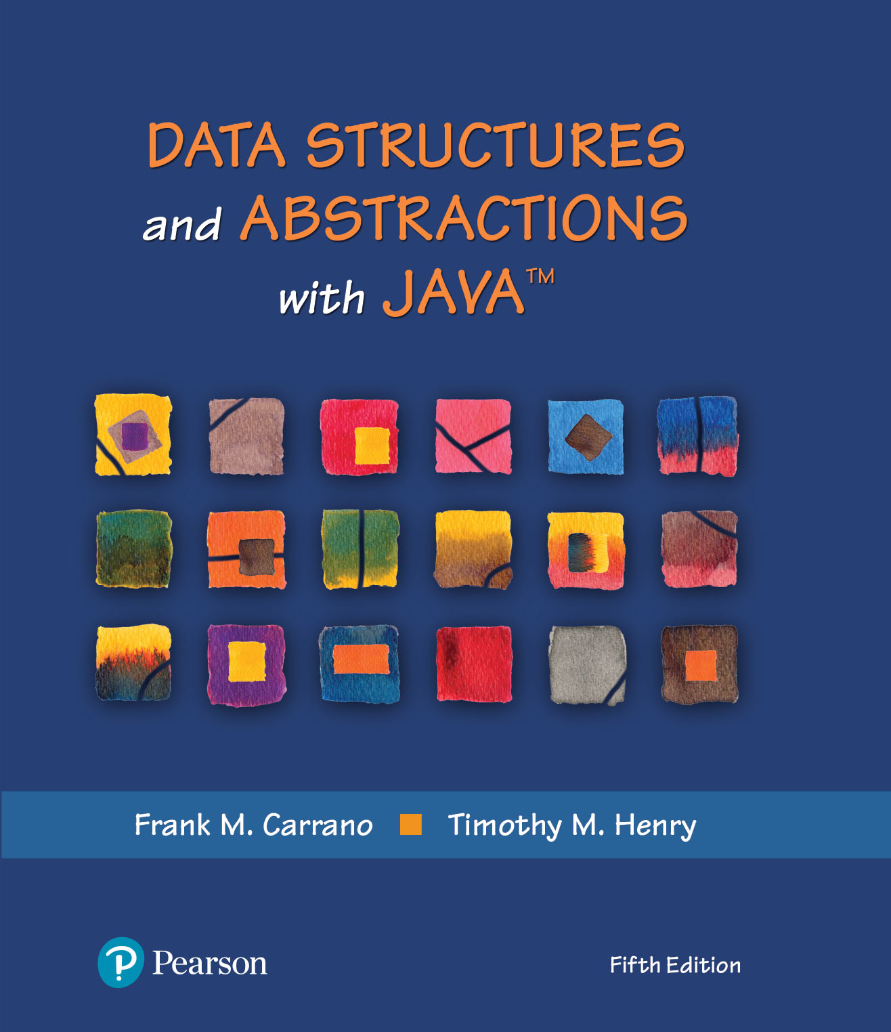
Data Structures and Abstractions with Java™
5th Edition
Chapter 8
Queue, Deque, and Priority Queue Implementations

Slide 2
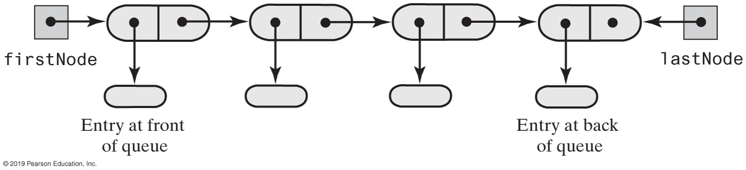
Linked Implementation of a Queue
FIGURE 8-1 A chain of linked nodes that implements a queue

Slide 3
Linked Implementation of a Queue
/** A class that implements a queue of objects by using
a chain of linked nodes that has both head and tail references. */
public final class LinkedQueue<T> implements QueueInterface<T>
{
private Node firstNode; // References node at front of queue
private Node lastNode; // References node at back of queue
public LinkedQueue()
{
firstNode = null;
lastNode = null;
} // end default constructor
// < Implementations of the queue operations go here. >
// . . .
private class Node
{
    // < Implementation of the inner class Node goes here. >
} // end Node
} // end LinkedQueue
LISTING 8-1 An outline of a linked implementation of the ADT queue

Slide 4
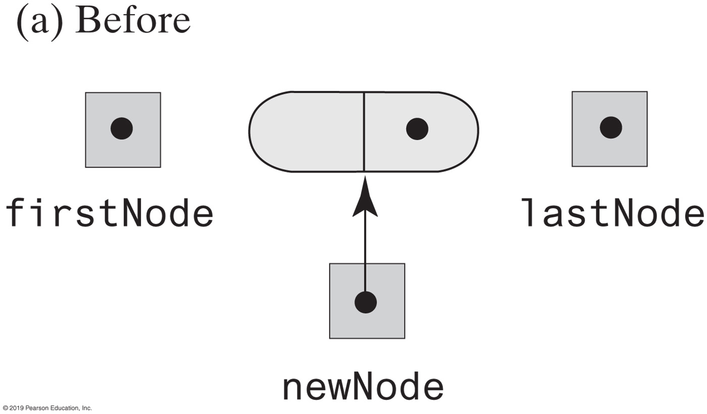
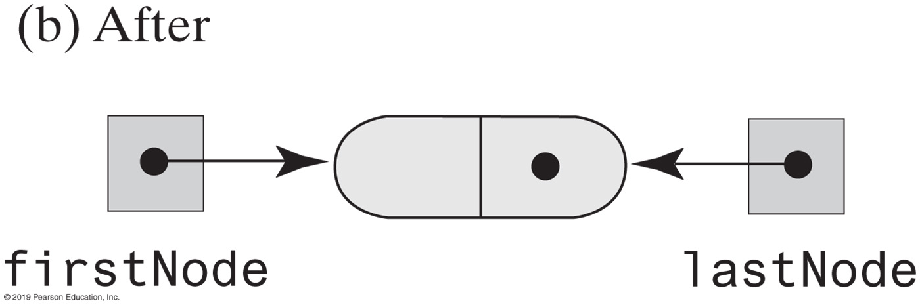
Linked Implementation of a Queue
FIGURE 8-2 Before and after adding a new node to an empty chain

Slide 5
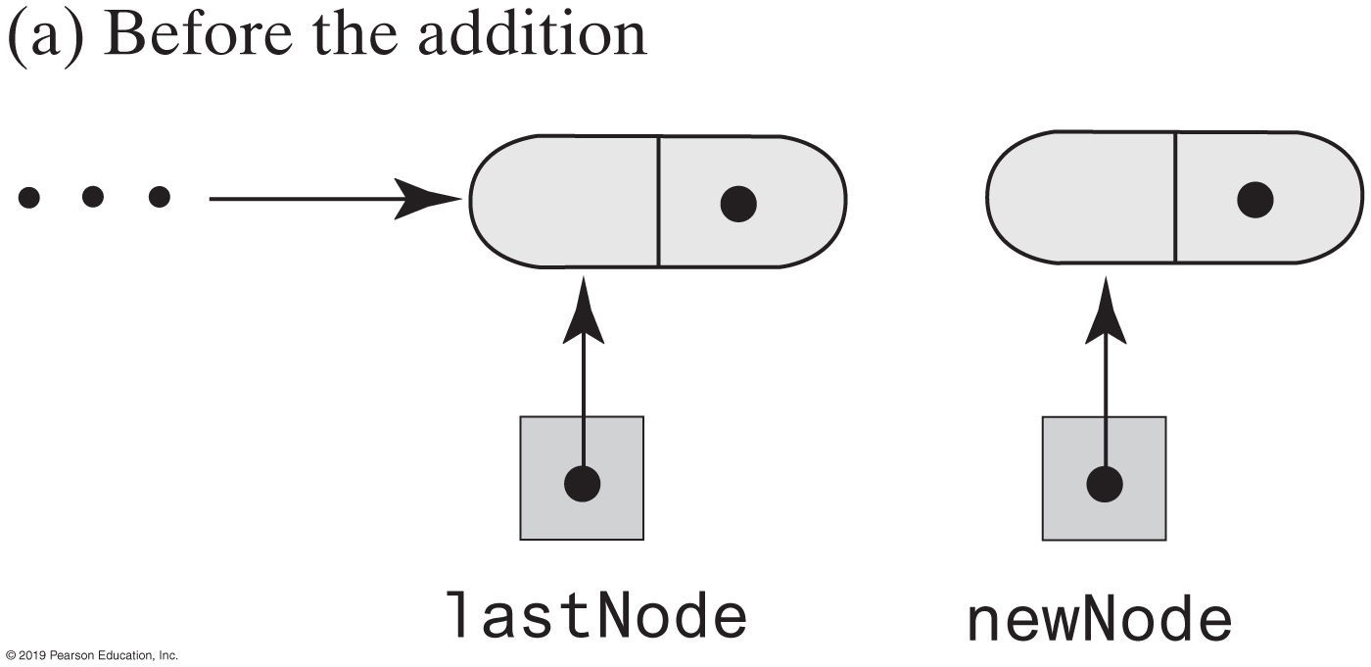
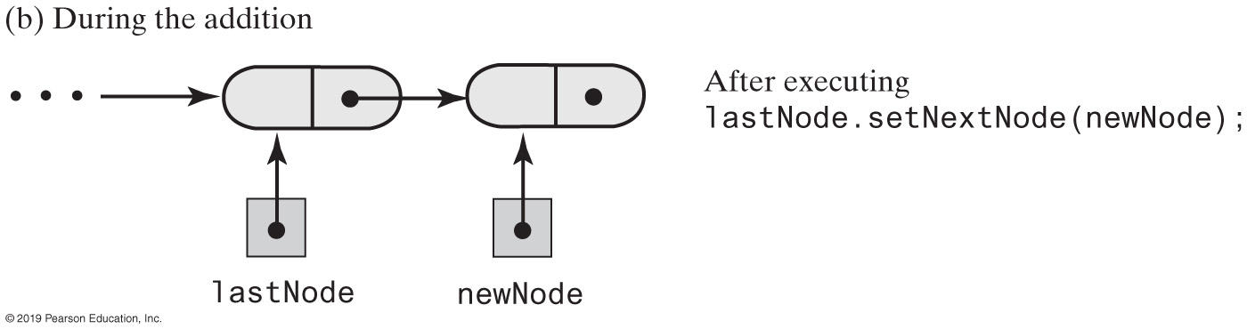
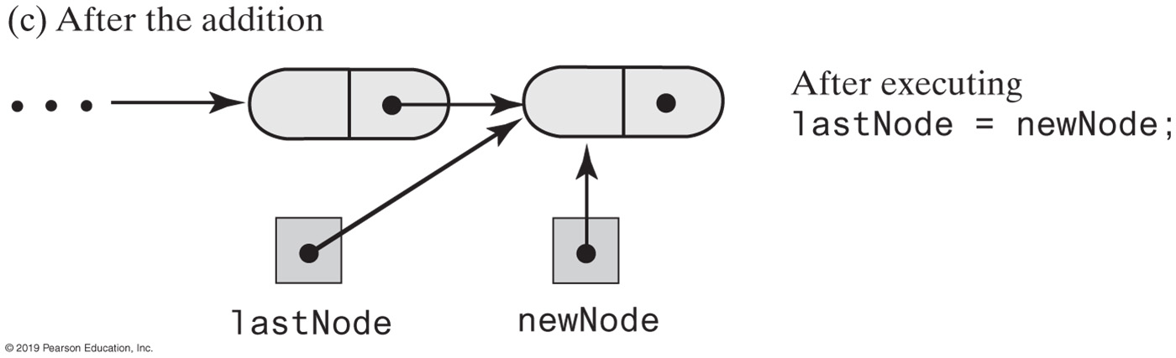
FIGURE 8-3 Adding a new node to the end of a nonempty chain that has a tail reference
FIGURE 8-3 Adding a new node to the end of a nonempty chain that has a tail reference

Slide 6
Linked Implementation of a Queue
public void enqueue(T newEntry)
{
Node newNode = new Node(newEntry, null);
if (isEmpty())
firstNode = newNode;
else
lastNode.setNextNode(newNode);
lastNode = newNode;
} // end enqueue
The definition of enqueue Performance is O(1)

Slide 7
Linked Implementation of a Queue
public T getFront()
{
if (isEmpty())
throw new EmptyQueueException();
else
return firstNode.getData();
} // end getFront
Retrieving the front entry

Slide 8
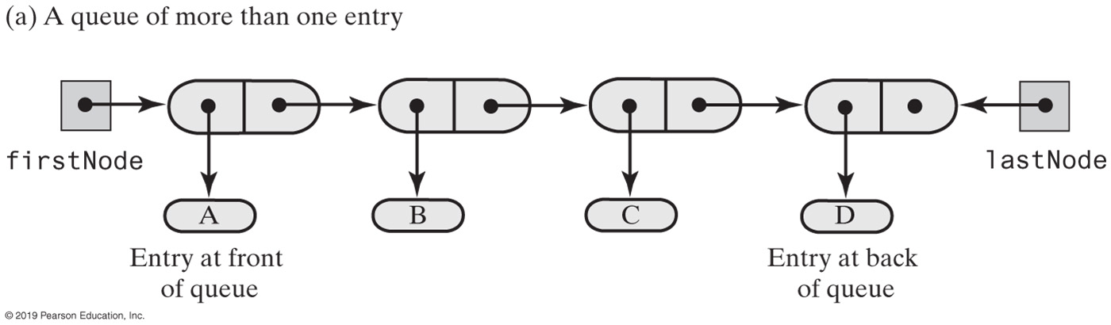
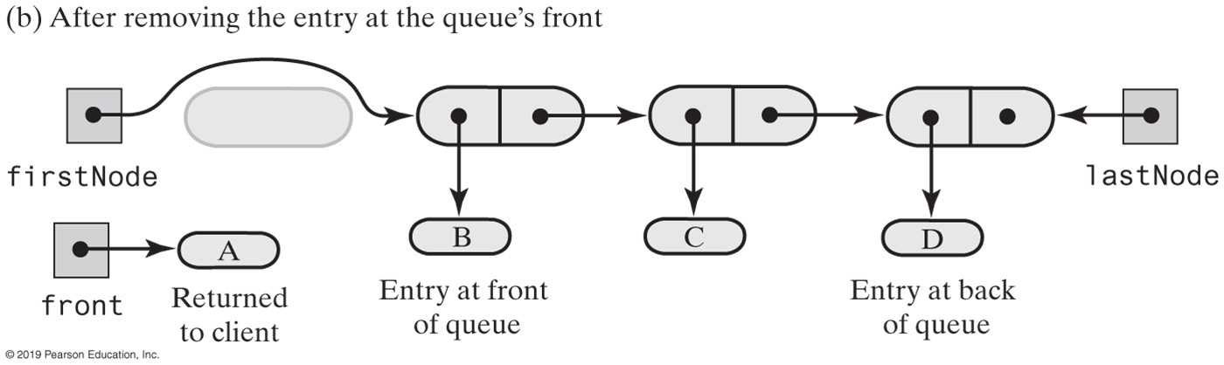
FIGURE 8-4 Before and after removing the entry at the front of a queue that has more than one entry
FIGURE 8-4 Before and after removing the entry at the front of a queue that has more than one entry

Slide 9
Linked Implementation of a Queue
public T dequeue()
{
T front = getFront(); // Might throw EmptyQueueException
// Assertion: firstNode != null
firstNode.setData(null);
firstNode = firstNode.getNextNode();
if (firstNode == null)
lastNode = null;
return front;
} // end dequeue
Removing the front entry

Slide 10
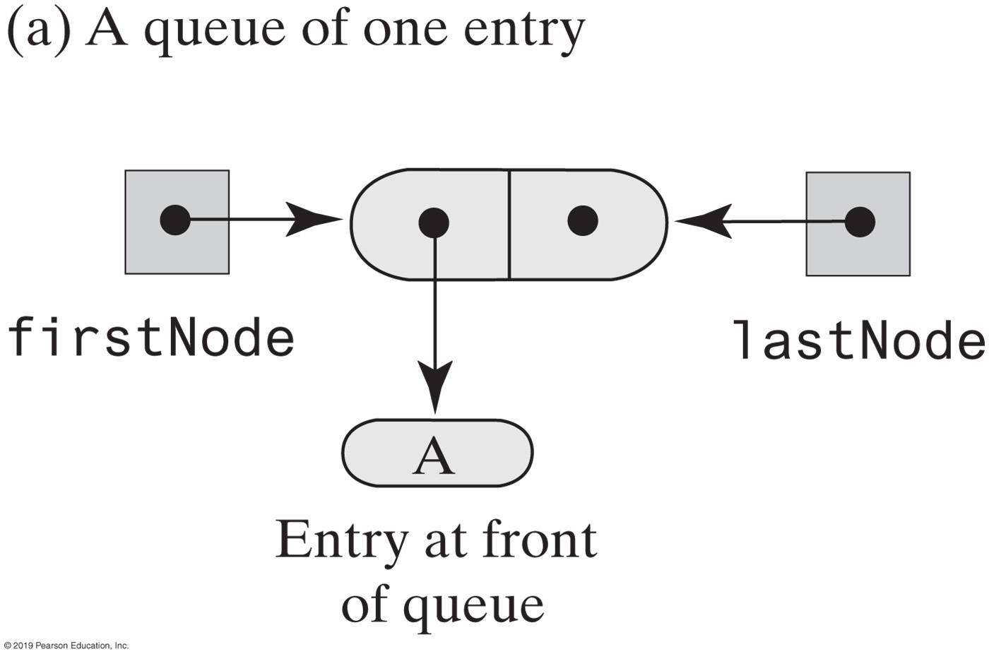
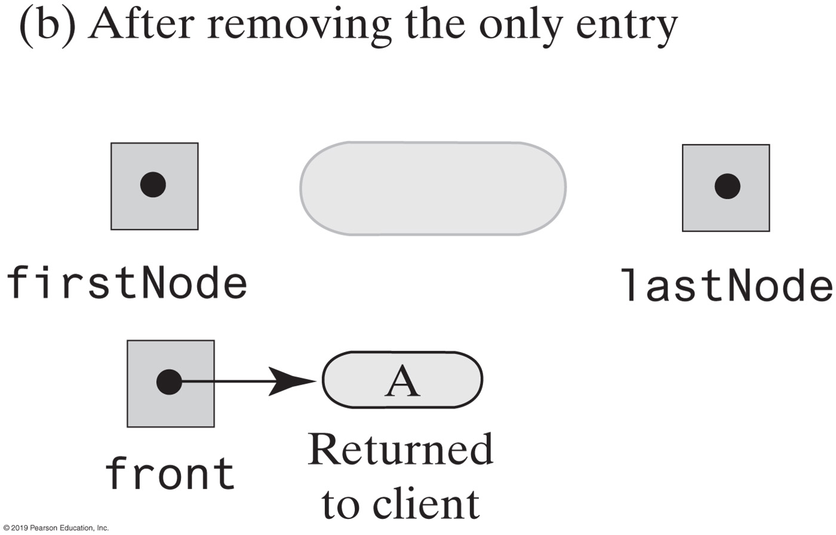
Linked Implementation of a Queue
FIGURE 8-5 Before and after removing the only entry from a queue

Slide 11
Linked Implementation of a Queue
public boolean isEmpty()
{
return (firstNode == null) && (lastNode == null);
} // end isEmpty
public void clear()
{
firstNode = null;
lastNode = null;
} // end clear
Public methods isEmpty and clear

Slide 12
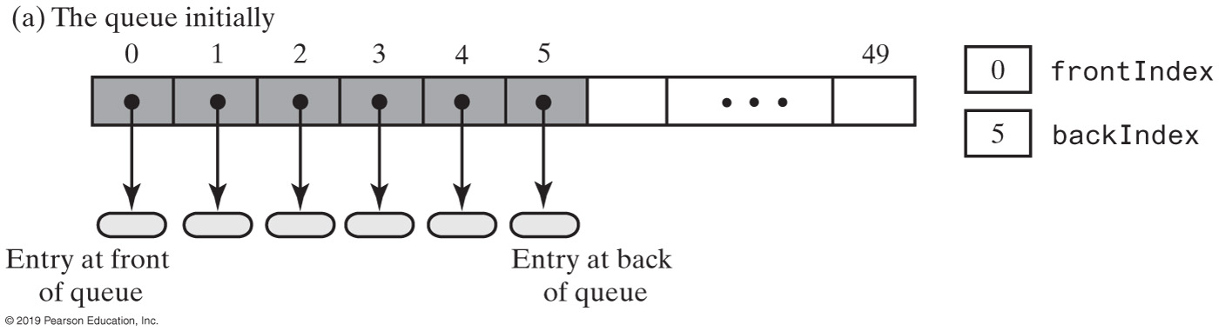
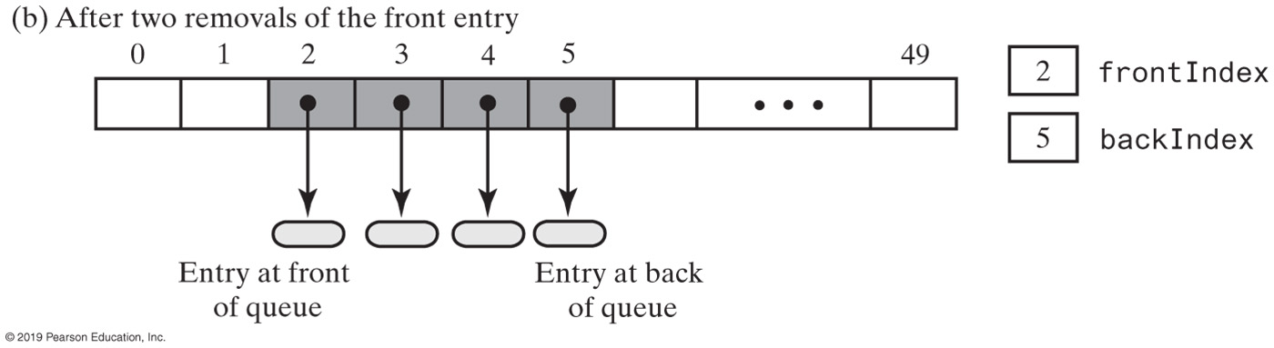
Array-Based Implementation of a Queue: Circular Array
FIGURE 8-6 An array that represents a queue without moving any entries during additions and removals

Slide 13
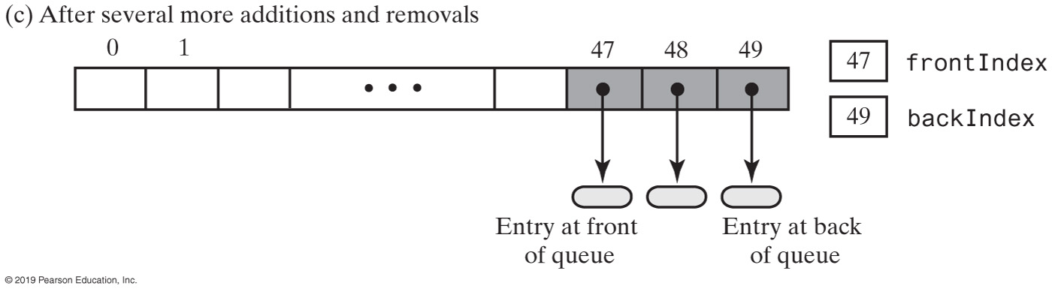
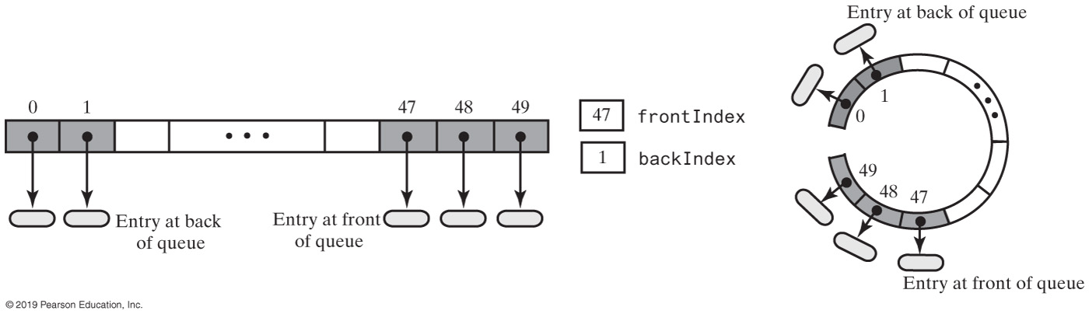
Circular Array
FIGURE 8-7 A circular array that represents the queue in Figure 8-6c after adding two more entries

Slide 14
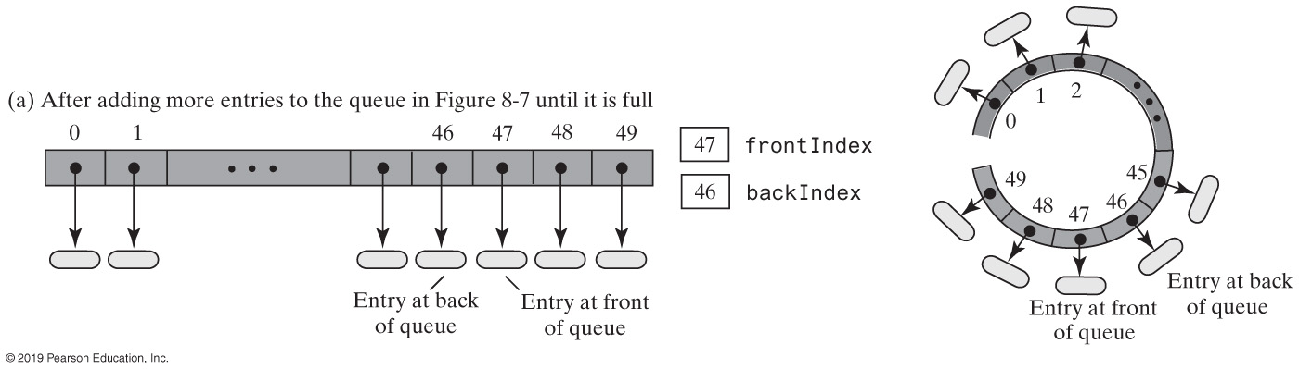
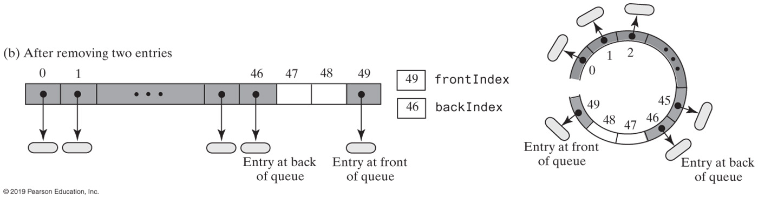
Circular Array
FIGURE 8-8a&b A circular array representation of a queue as entries are removed

Slide 15
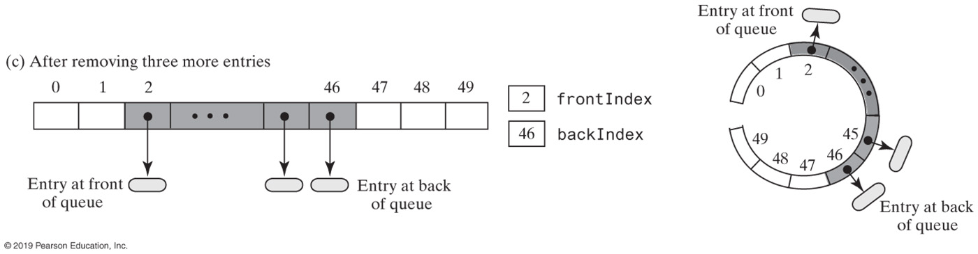
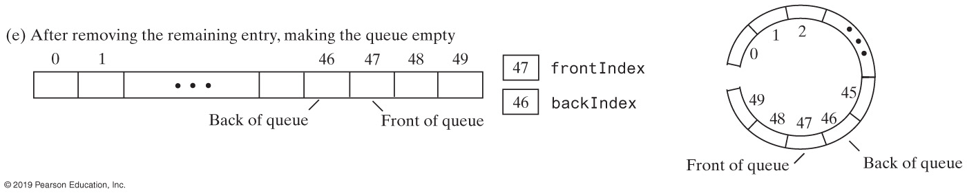
Circular Array
FIGURE 8-8c&d A circular array representation of a queue as entries are removed

Slide 16
Circular Array with One Unused Location
public T getFront()
{
checkIntegrity();
if (isEmpty())
throw new EmptyQueueException();
else
return queue[frontIndex];
} // end getFront
Retrieving the front entry

Slide 17
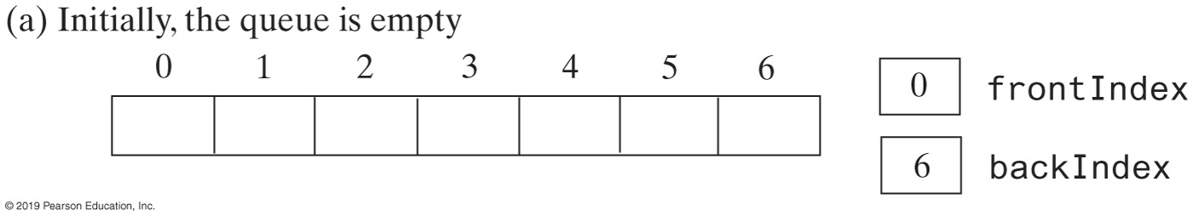
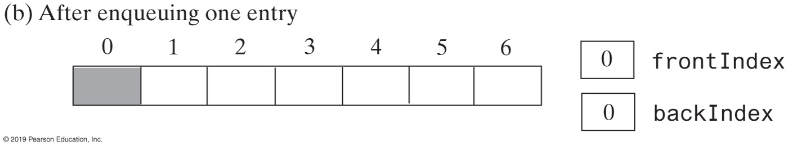
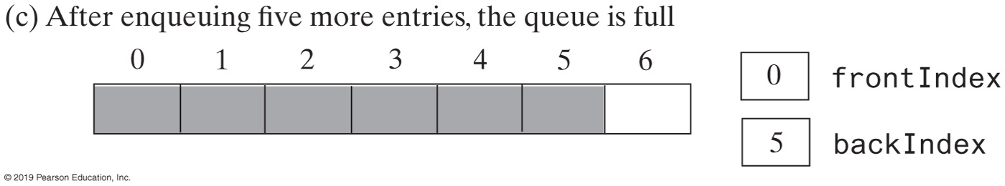
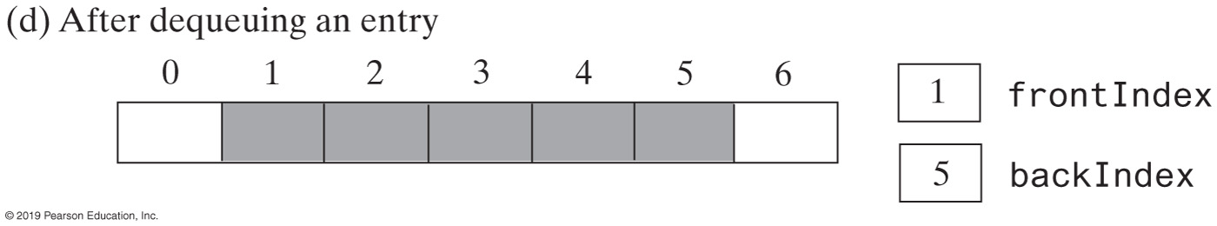
Circular Array (Part 1)
FIGURE 8-9 A seven-element circular array that contains at most six entries of a queue

Slide 18
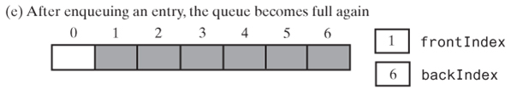
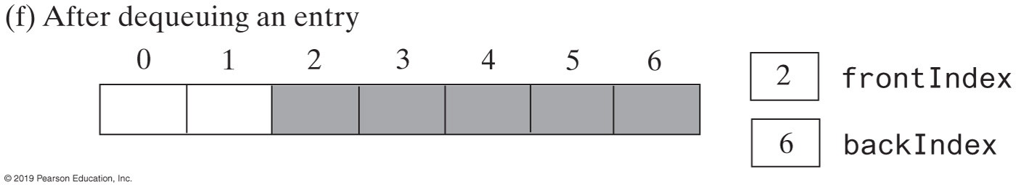
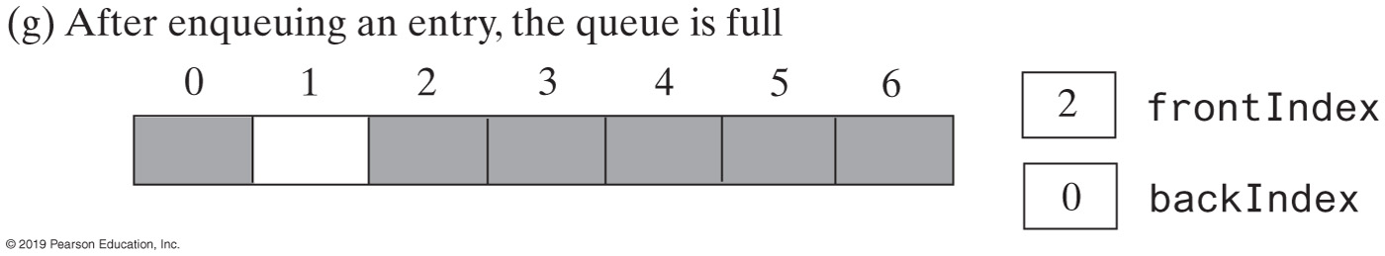
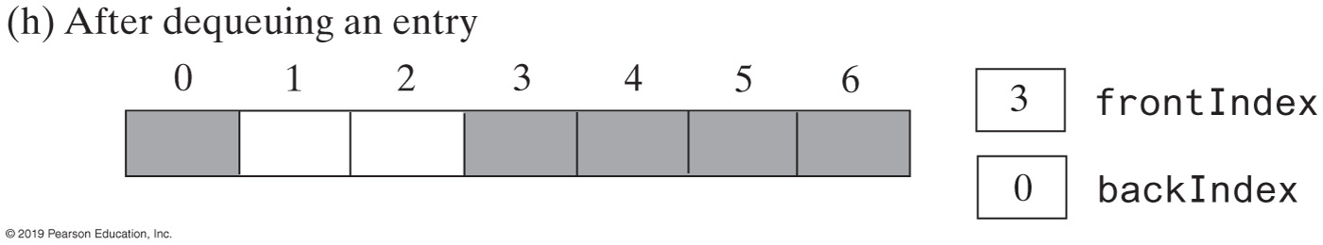
Circular Array (Part 2)
FIGURE 8-9 A seven-element circular array that contains at most six entries of a queue

Slide 19
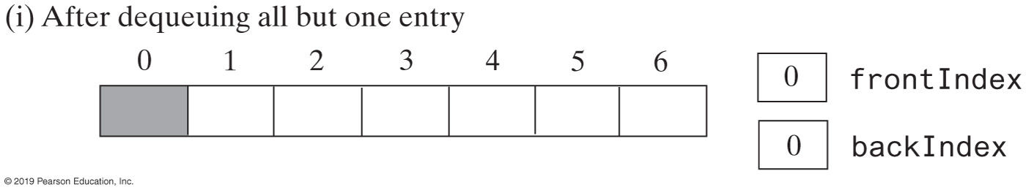
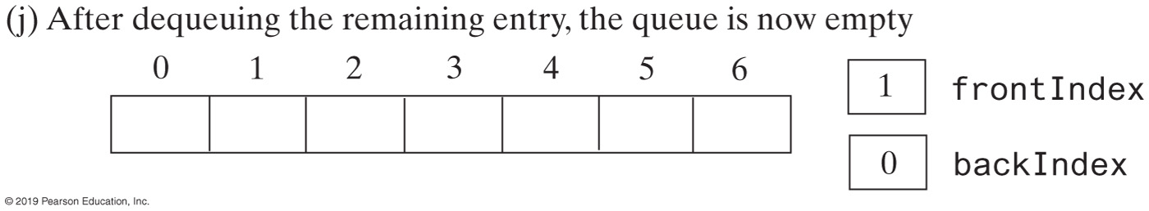
Circular Array (Part 3)
FIGURE 8-9 A seven-element circular array that contains at most six entries of a queue

Slide 20
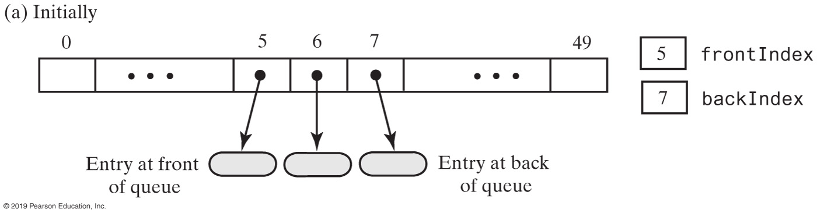
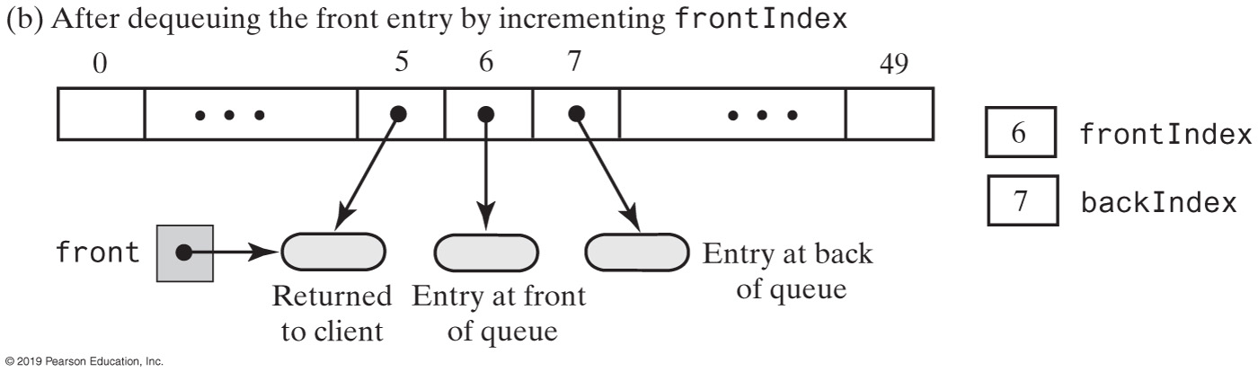
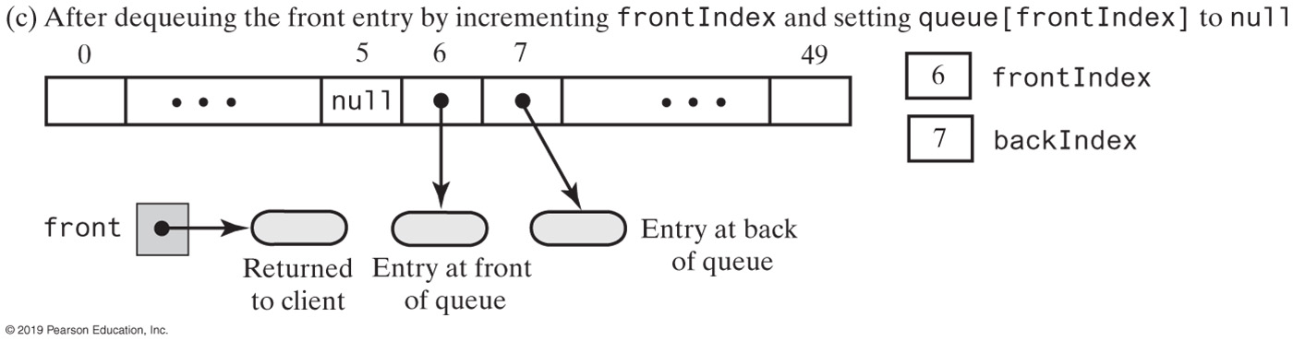
Circular Array with One Unused Location
FIGURE 8-10 An array-based queue and two ways to remove its front entry

Slide 21
Circular Array with One Unused Location
public T dequeue()
{
checkIntegrity();
if (isEmpty())
throw new EmptyQueueException();
else
{
T front = queue[frontIndex];
queue[frontIndex] = null;
frontIndex = (frontIndex + 1) % queue.length;
return front;
} // end if
} // end dequeue
Implementation of dequeue

Slide 22
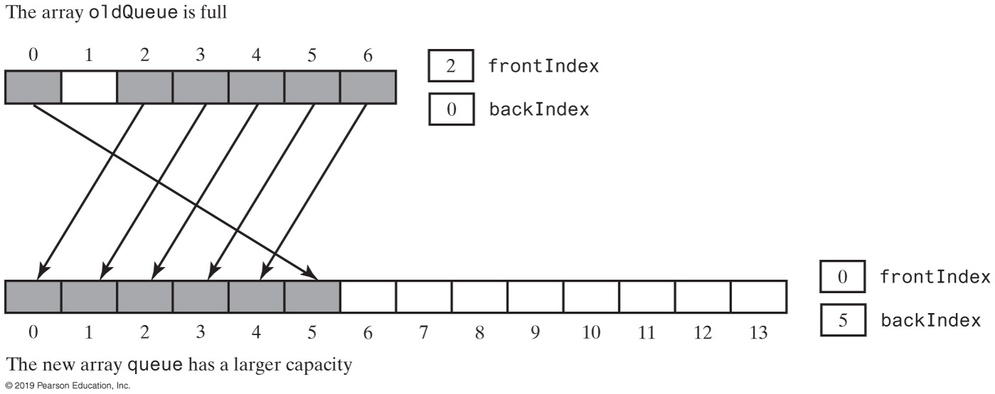
Circular Array with One Unused Location
FIGURE 8-11 Doubling the size of an array-based queue

Slide 23
Circular Array with One Unused Location
// Doubles the size of the array queue if it is full.
// Precondition: checkIntegrity has been called.
private void ensureCapacity()
{
if (frontIndex == ((backIndex + 2) % queue.length)) // If array is full,
{ // double size of array
T[] oldQueue = queue;
int oldSize = oldQueue.length;
int newSize = 2 * oldSize;
checkCapacity(newSize);
integrityOK = false;
// The cast is safe because the new array contains null entries
@SuppressWarnings("unchecked")
T[] tempQueue = (T[]) new Object[newSize];
queue = tempQueue;
for (int index = 0; index < oldSize - 1; index++)
{
queue[index] = oldQueue[frontIndex];
frontIndex = (frontIndex + 1) % oldSize;
} // end for
frontIndex = 0;
backIndex = oldSize - 2;
integrityOK = true;
} // end if
} // end ensureCapacity
Definition of ensureCapacity

Slide 24
Circular Array with One Unused Location
public boolean isEmpty()
{
checkIntegrity():
return frontIndex == ((backIndex + 1) % queue.length);
} // end isEmpty
Implementation of isEmpty

Slide 25
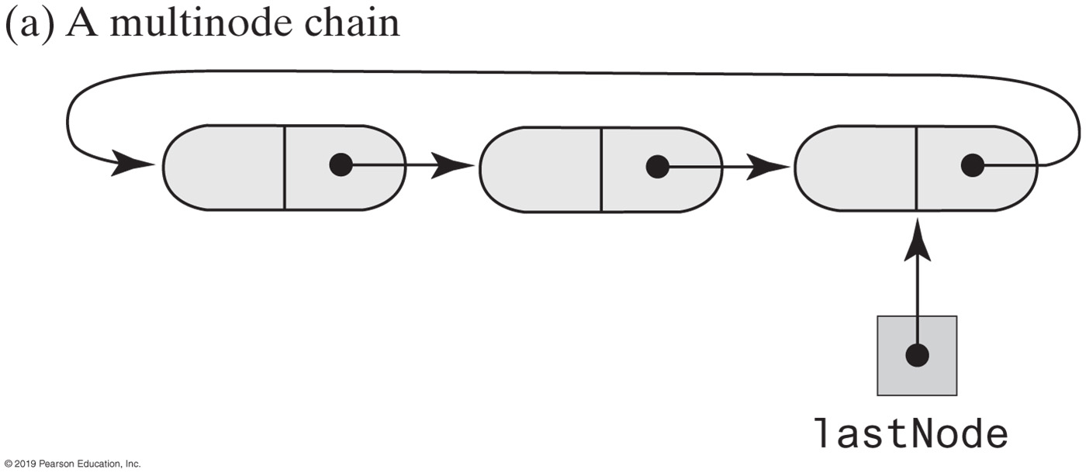
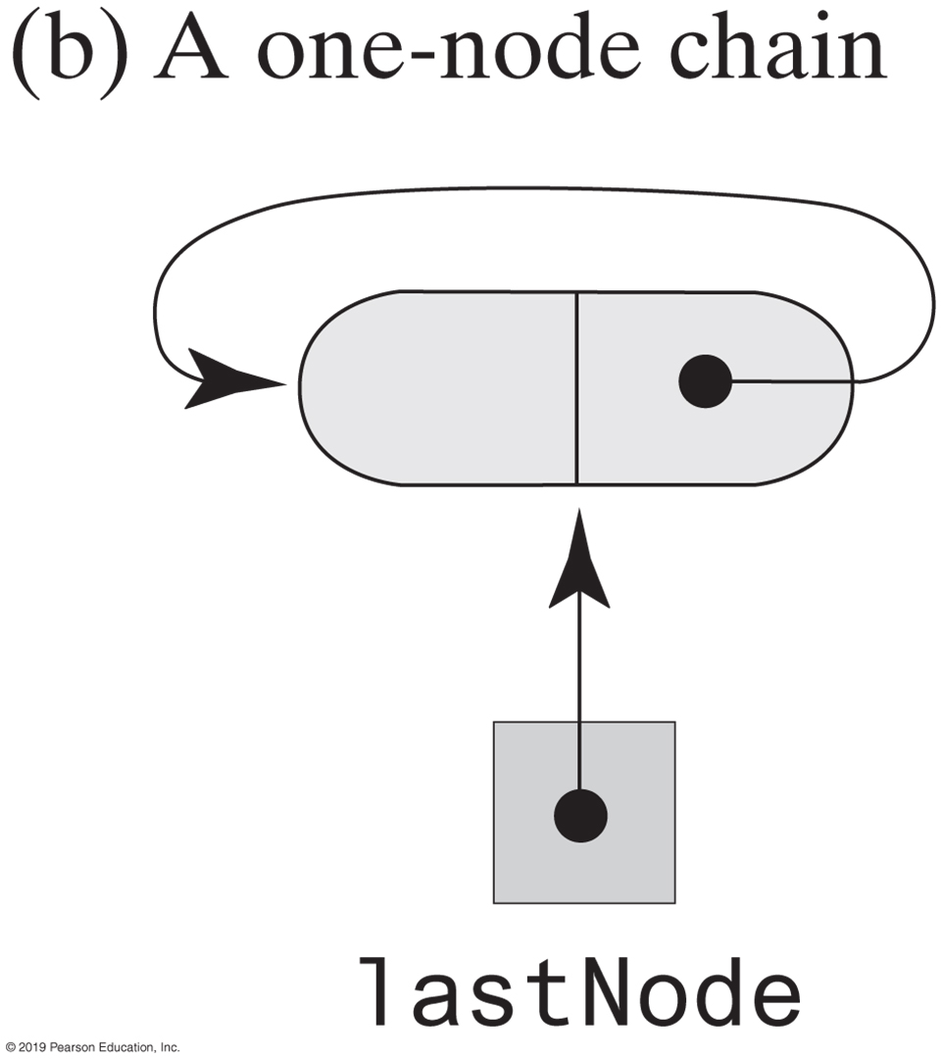
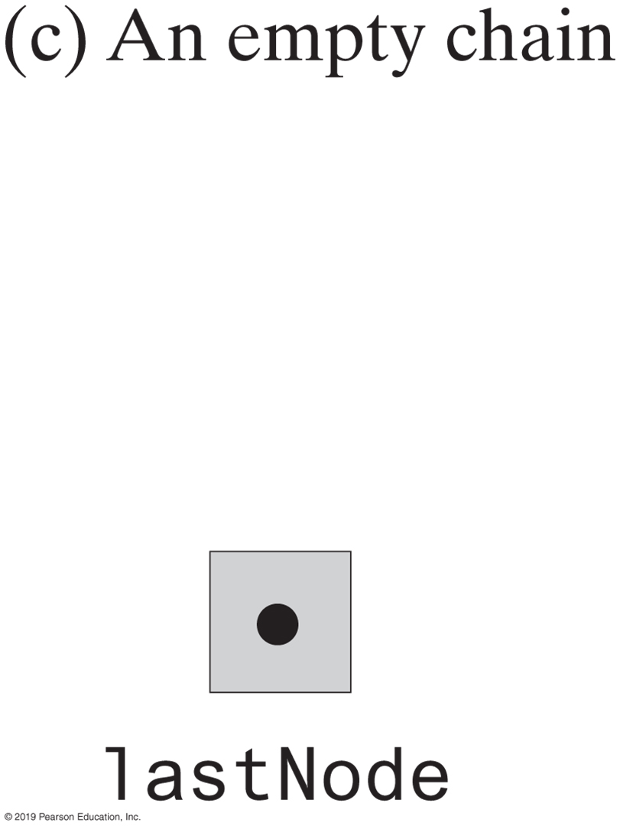
Circular Linked Implementations of a Queue
FIGURE 8-12 Circular linked chains, each with an external reference to its last node

Slide 26
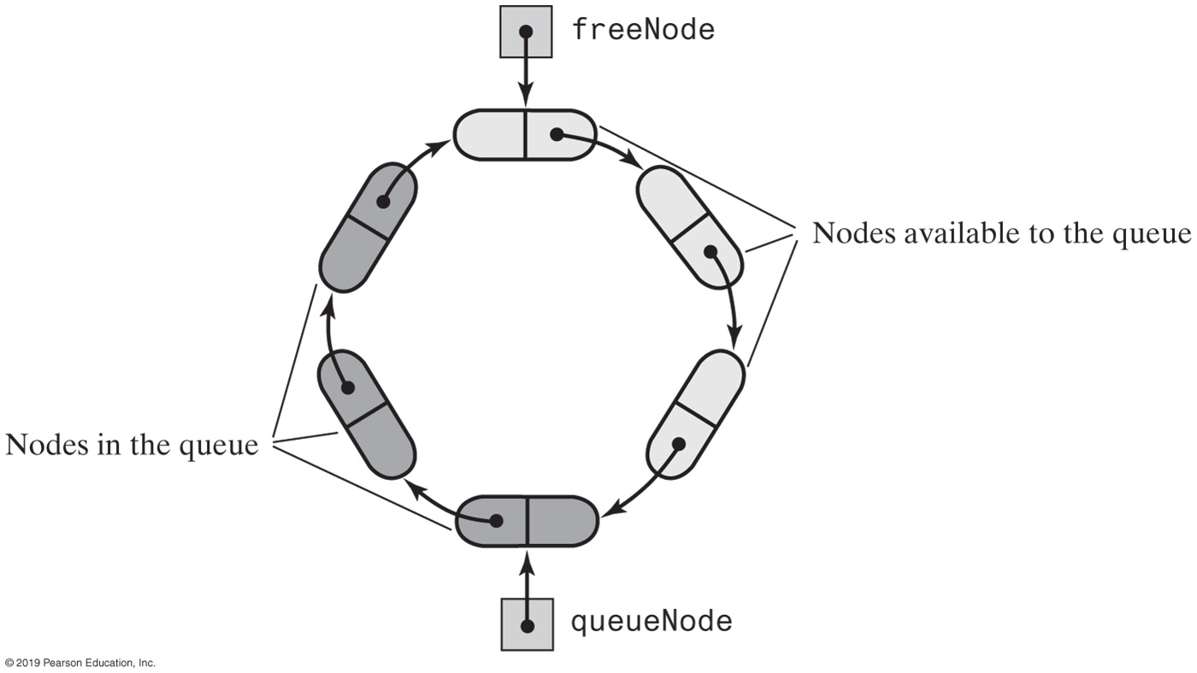
Two-Part Circular Linked Chain
FIGURE 8-13 A two-part circular linked chain that represents both a queue and the nodes available to the queue

Slide 27
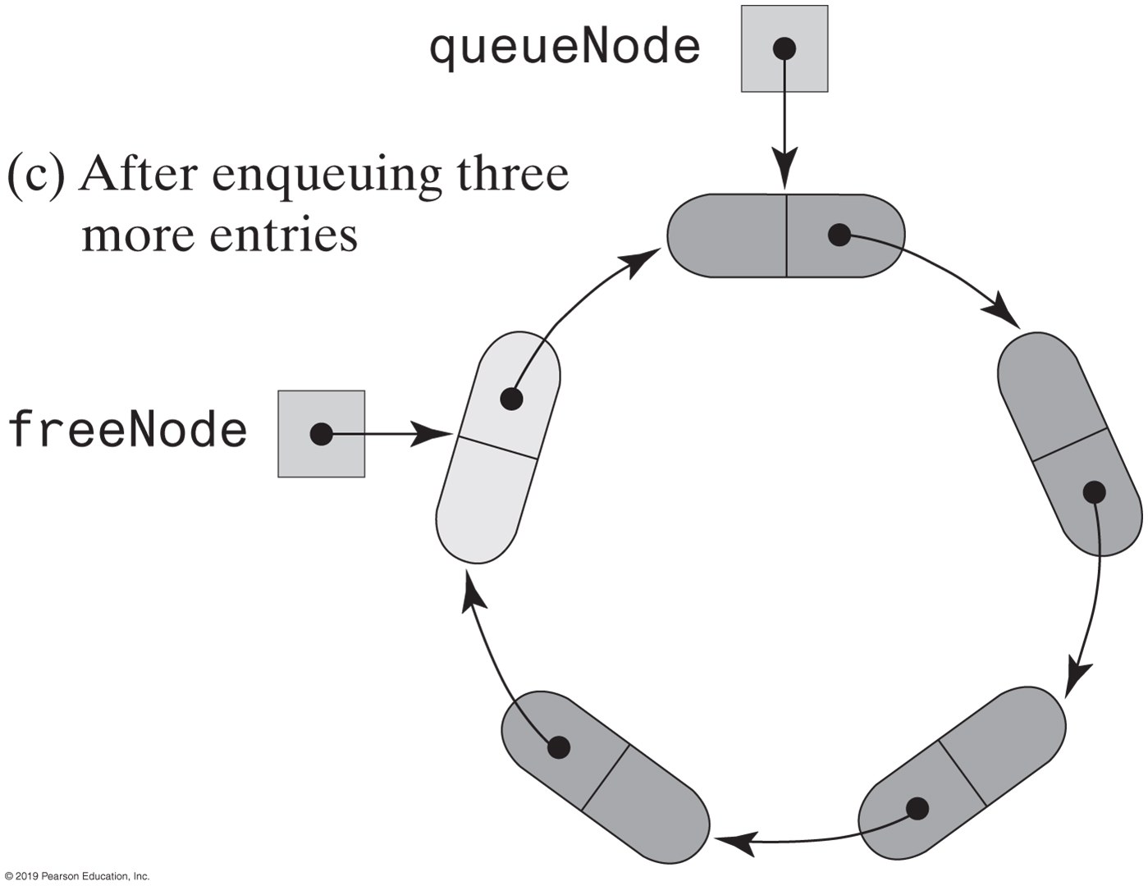
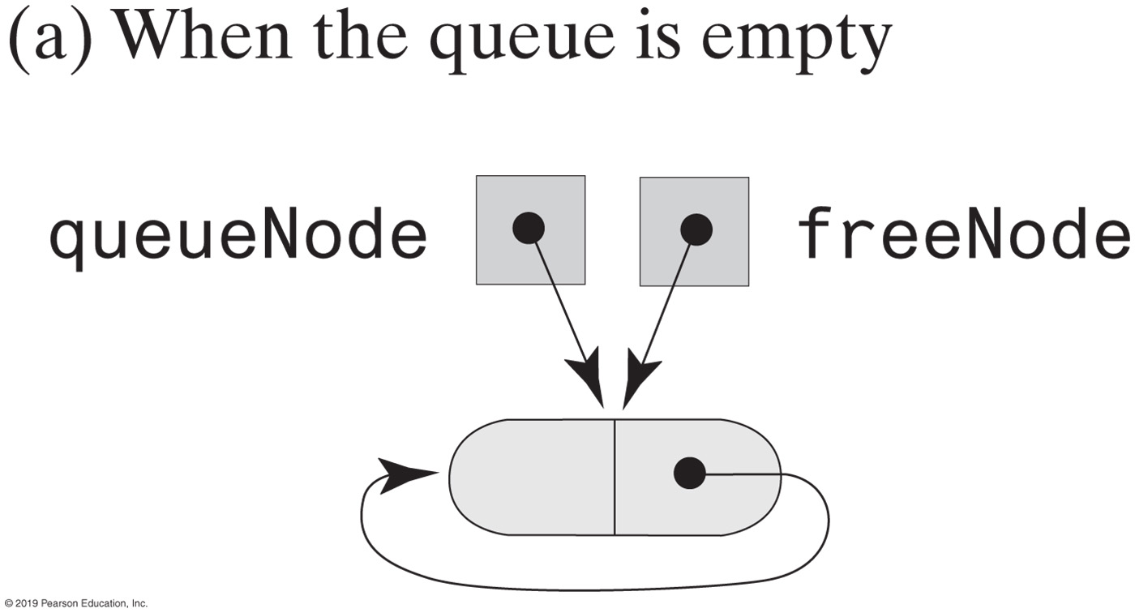
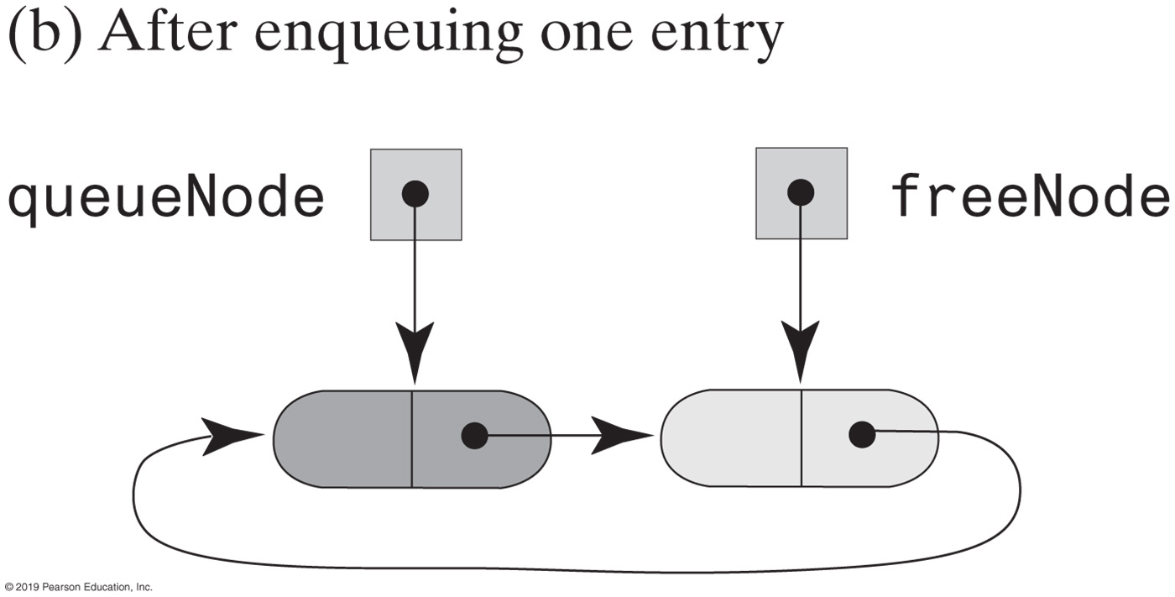
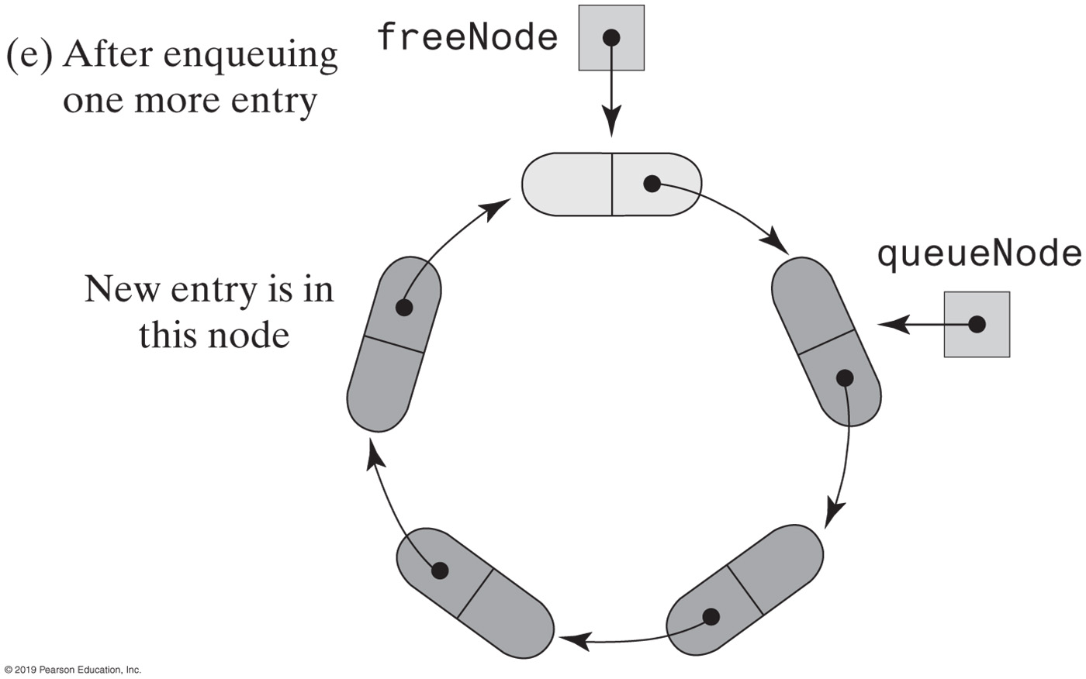
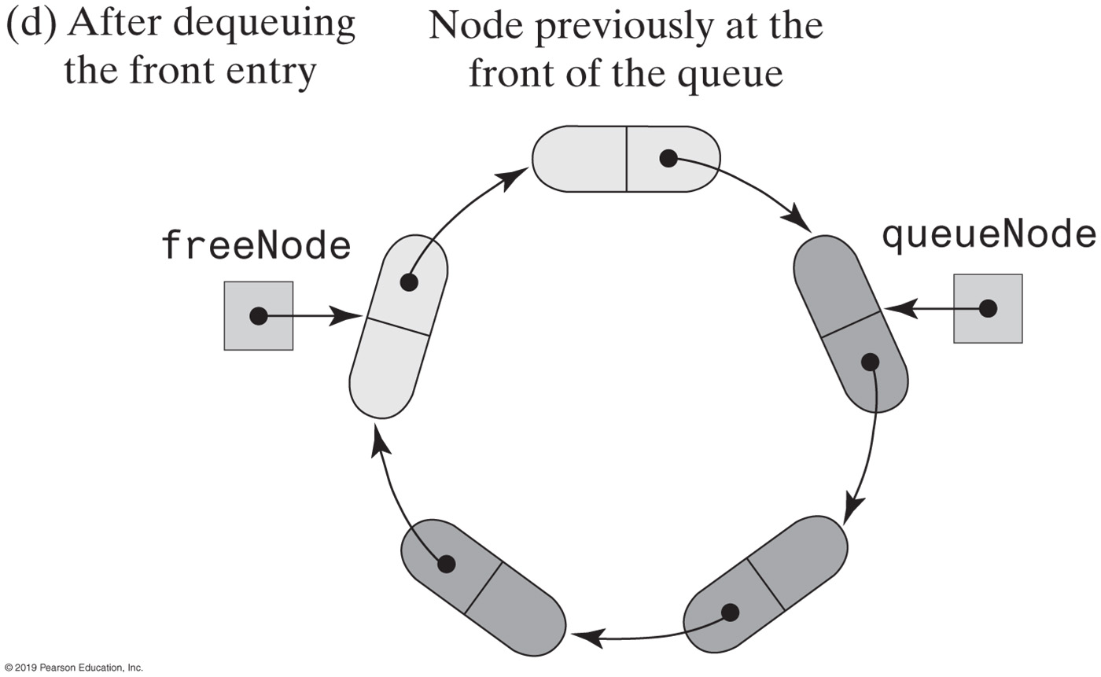
Two-Part Circular Linked Chain
FIGURE 8-14 Various states of a two-part circular linked chain that represents a queue

Slide 28
Two-Part Circular Linked Chain
/** A class that implements the ADT queue by using
a two-part circular chain of linked nodes. */
public final class TwoPartCircularLinkedQueue<T> implements QueueInterface<T>
{
private Node queueNode; // References first node in queue
private Node freeNode; // References node after back of queue
public TwoPartCircularLinkedQueue()
{
freeNode = new Node(null, null);
freeNode.setNextNode(freeNode);
queueNode = freeNode;
} // end default constructor
// < Implementations of the queue operations go here. >
// . . .
private class Node
{
      // < Implementation of the nine Node class god here. >
} // end Node
} // end TwoPartCircularLinkedQueue
LISTING 8-3 An outline of a two-part circular linked implementation of the ADT queue

Slide 29
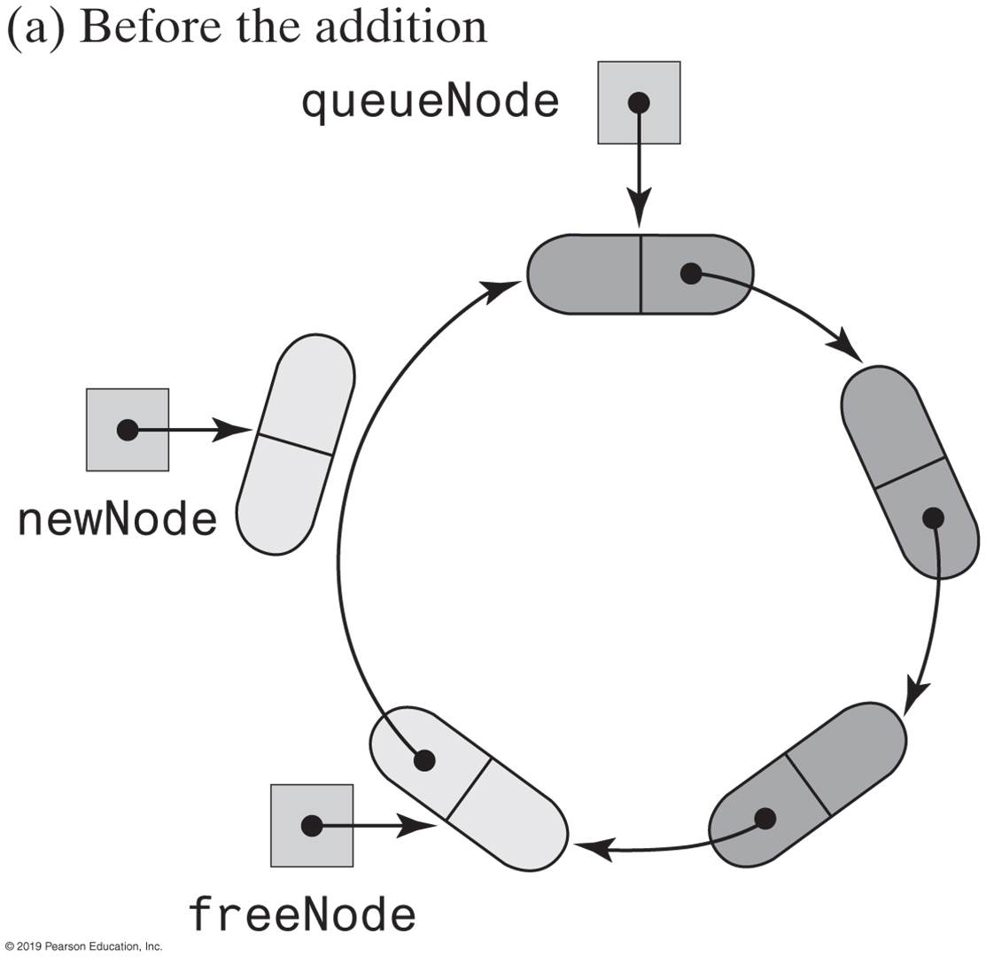
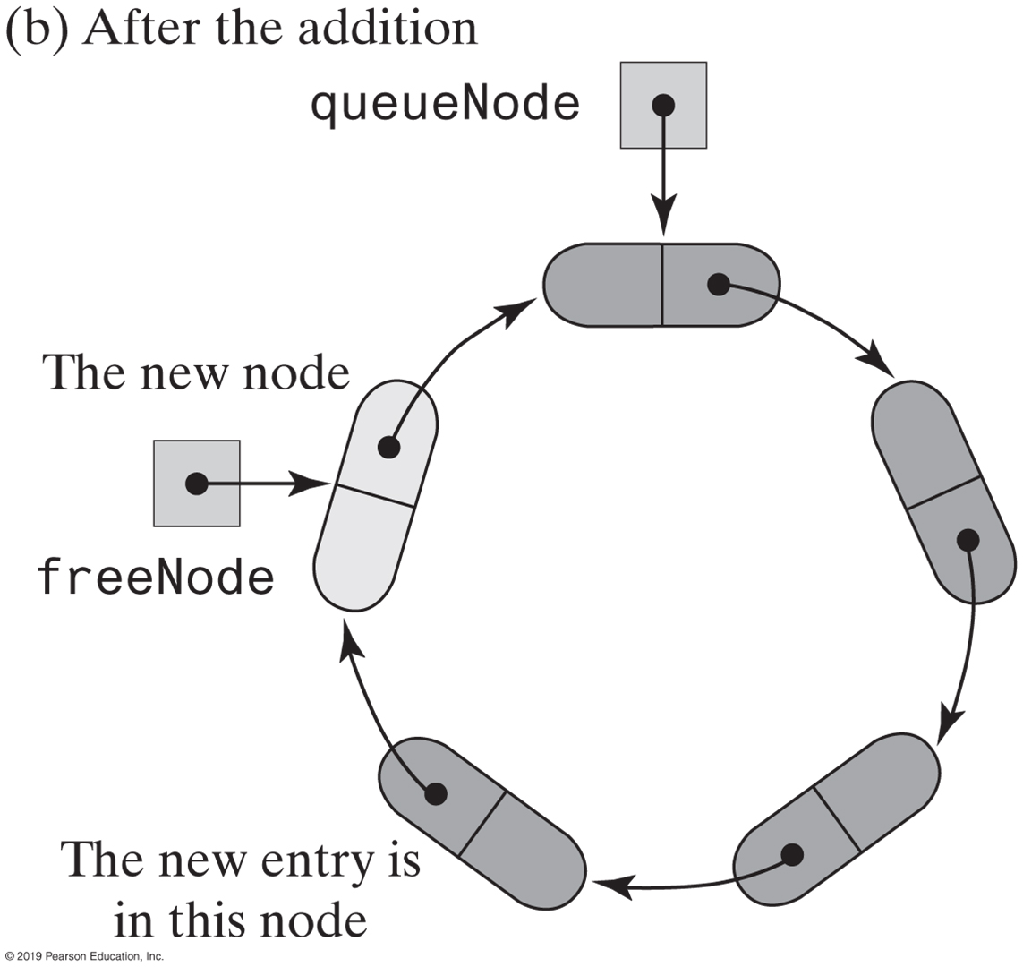
Two-Part Circular Linked Chain
FIGURE 8-15a A two-part circular chain that requires a new node for an addition to a queue

Slide 30
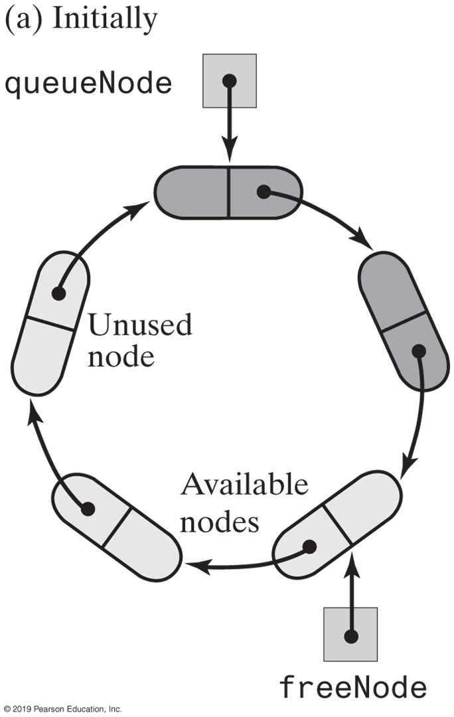
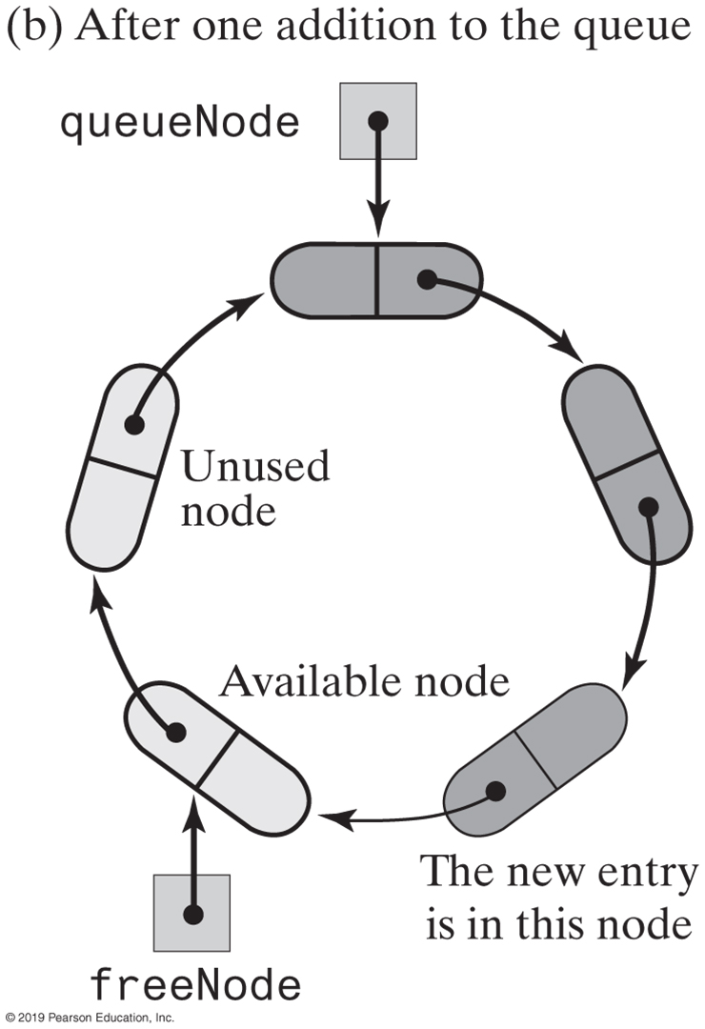
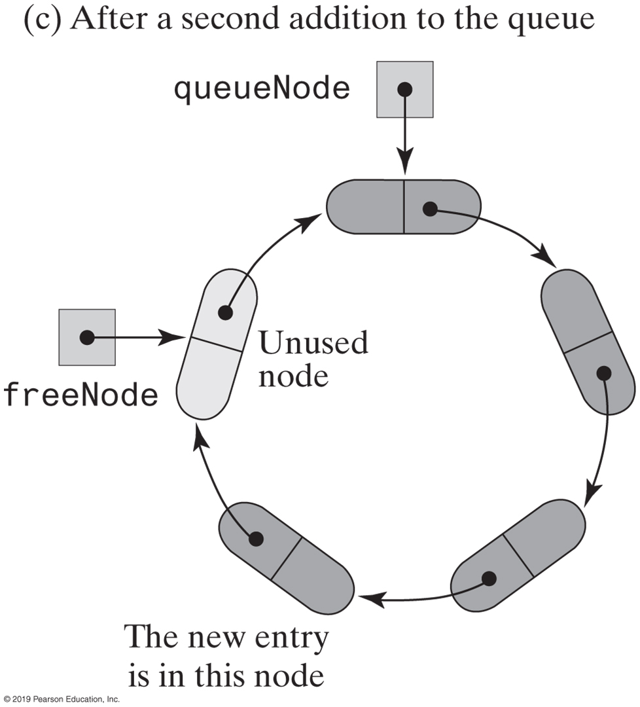
Two-Part Circular Linked Chain
FIGURE 8-16 A two-part circular linked chain with nodes available for addition to a queue

Slide 31
Two-Part Circular Linked Chain
public void enqueue(T newEntry)
{
freeNode.setData(newEntry);
if (isNewNodeNeeded())
{
// Allocate a new node and insert it after the node that
// freeNode references
Node newNode = new Node(null, freeNode.getNextNode());
freeNode.setNextNode(newNode);
} // end if
freeNode = freeNode.getNextNode();
} // end enqueue
Implementation of enqueue is an O(1) operation

Slide 32
Two-Part Circular Linked Chain
public T getFront()
{
if (isEmpty())
throw new EmptyQueueException();
else
return queueNode.getData();
} // end getFront
Implementation of getFront is an O(1) operation

Slide 33
Two-Part Circular Linked Chain
public T dequeue()
{
T front = getFront(); // Might throw EmptyQueueException
// Assertion: Queue is not empty
queueNode.setData(null);
queueNode = queueNode.getNextNode();
return front;
} // end dequeue
Implementation of dequeue is an O(1) operation

Slide 34
Two-Part Circular Linked Chain
public boolean isEmpty()
{
return queueNode == freeNode;
} // end isEmpty
private boolean isNewNodeNeeded()
{
return queueNode == freeNode.getNextNode();
} // end isNewNodeNeeded
Methods isEmpty an isNewNodeNeeded

Slide 35
Java Class Library: The Class AbstractQueue
public boolean add(T newEntry)
public boolean offer(T newEntry)
public T remove()
public T poll()
public T element()
public T peek()
public boolean isEmpty()
public void clear()
public int size()
Methods in this interface

Slide 36
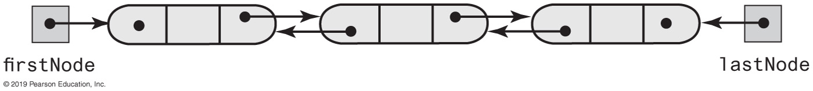
Doubly Linked Implementation of a Deque
FIGURE 8-17 A doubly linked chain with head and tail references

Slide 37
Doubly Linked Implementation of a Deque
/** A class that implements the a deque of objects by using
a chain of doubly linked nodes. */
public final class LinkedDeque<T> implements DequeInterface<T>
{
private DLNode firstNode; // References node at front of deque
private DLNode lastNode; // References node at back of deque
public LinkedDeque()
{
firstNode = null;
lastNode = null;
} // end default constructor
// < Implementations of the deque operations go here. >
// . . .
private class DLNode
{
private T data; // Deque entry
private DLNode next; // Link to next node
private DLNode previous; // Link to previous node
// < Constructors and the methods getData, setData, getNextNode, setNextNode,
// getPreviousNode, and setPreviousNode are here. >
// . . .
} // end DLNode
} // end LinkedDeque
LISTING 8-4 An outline of a linked implementation of the ADT deque

Slide 38
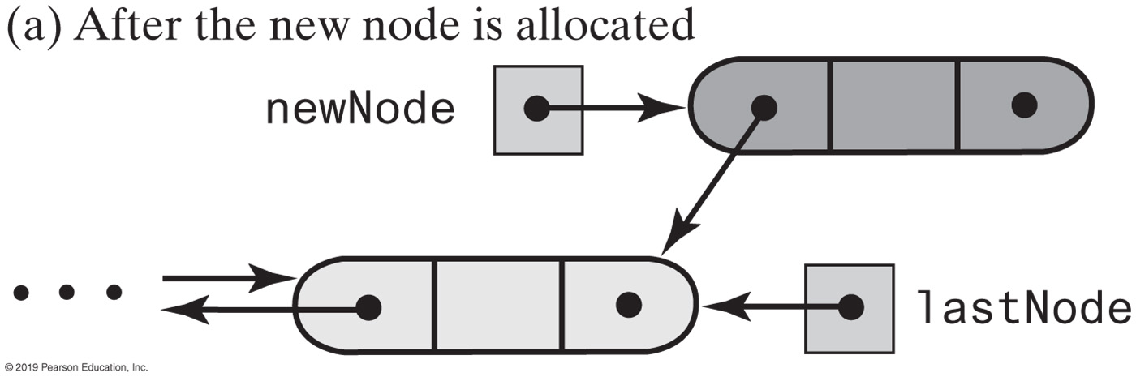
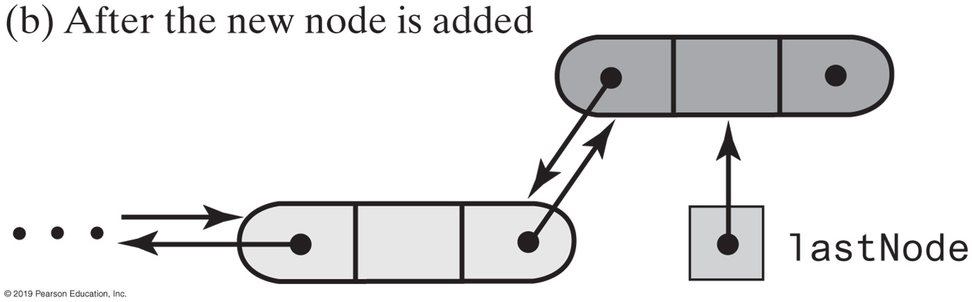
Doubly Linked Implementation of a Deque
FIGURE 8-18 Adding to the back of a nonempty deque

Slide 39
Doubly Linked Implementation of a Deque
public void addToBack(T newEntry)
{
DLNode newNode = new DLNode(lastNode, newEntry, null);
if (isEmpty())
firstNode = newNode;
else
lastNode.setNextNode(newNode);
lastNode = newNode;
} // end addToBack
LISTING 8-4 An outline of a linked implementation of the ADT deque

Slide 40


FIGURE 8-19a Adding to the front of a nonempty deque
FIGURE 8-19 Adding to the front of a nonempty deque

Slide 41
Doubly Linked Implementation of a Deque
public void addToFront(T newEntry)
{
DLNode newNode = new DLNode(null, newEntry, firstNode);
if (isEmpty())
lastNode = newNode;
else
firstNode.setPreviousNode(newNode);
firstNode = newNode;
} // end addToFront
Implementation of addToFront, an O(1) operation.

Slide 42


Doubly Linked Implementation of a Deque
FIGURE 8-20 Removing the front of a deque containing at least two entries

Slide 43
Doubly Linked Implementation of a Deque
public T removeFront()
{
T front = getFront(); // Might throw EmptyQueueException
// Assertion: firstNode != null
firstNode = firstNode.getNextNode();
if (firstNode == null)
lastNode = null;
else
firstNode.setPreviousNode(null);
return front;
} // end removeFront
Implementation of removeFront.

Slide 44
Doubly Linked Implementation of a Deque
public T removeBack()
{
T back = getBack(); // Might throw EmptyQueueException
// Assertion: lastNode != null
lastNode = lastNode.getPreviousNode();
if (lastNode == null)
firstNode = null;
else
lastNode.setNextNode(null);
} // end if
return back;
} // end removeBack
Implementation of removeBack, an O(1) operation.

Slide 45


Possible Implementations of a Priority Queue
FIGURE 8-21 Two possible implementations of a priority queue

Slide 46
End
Chapter 8

