Slide 1
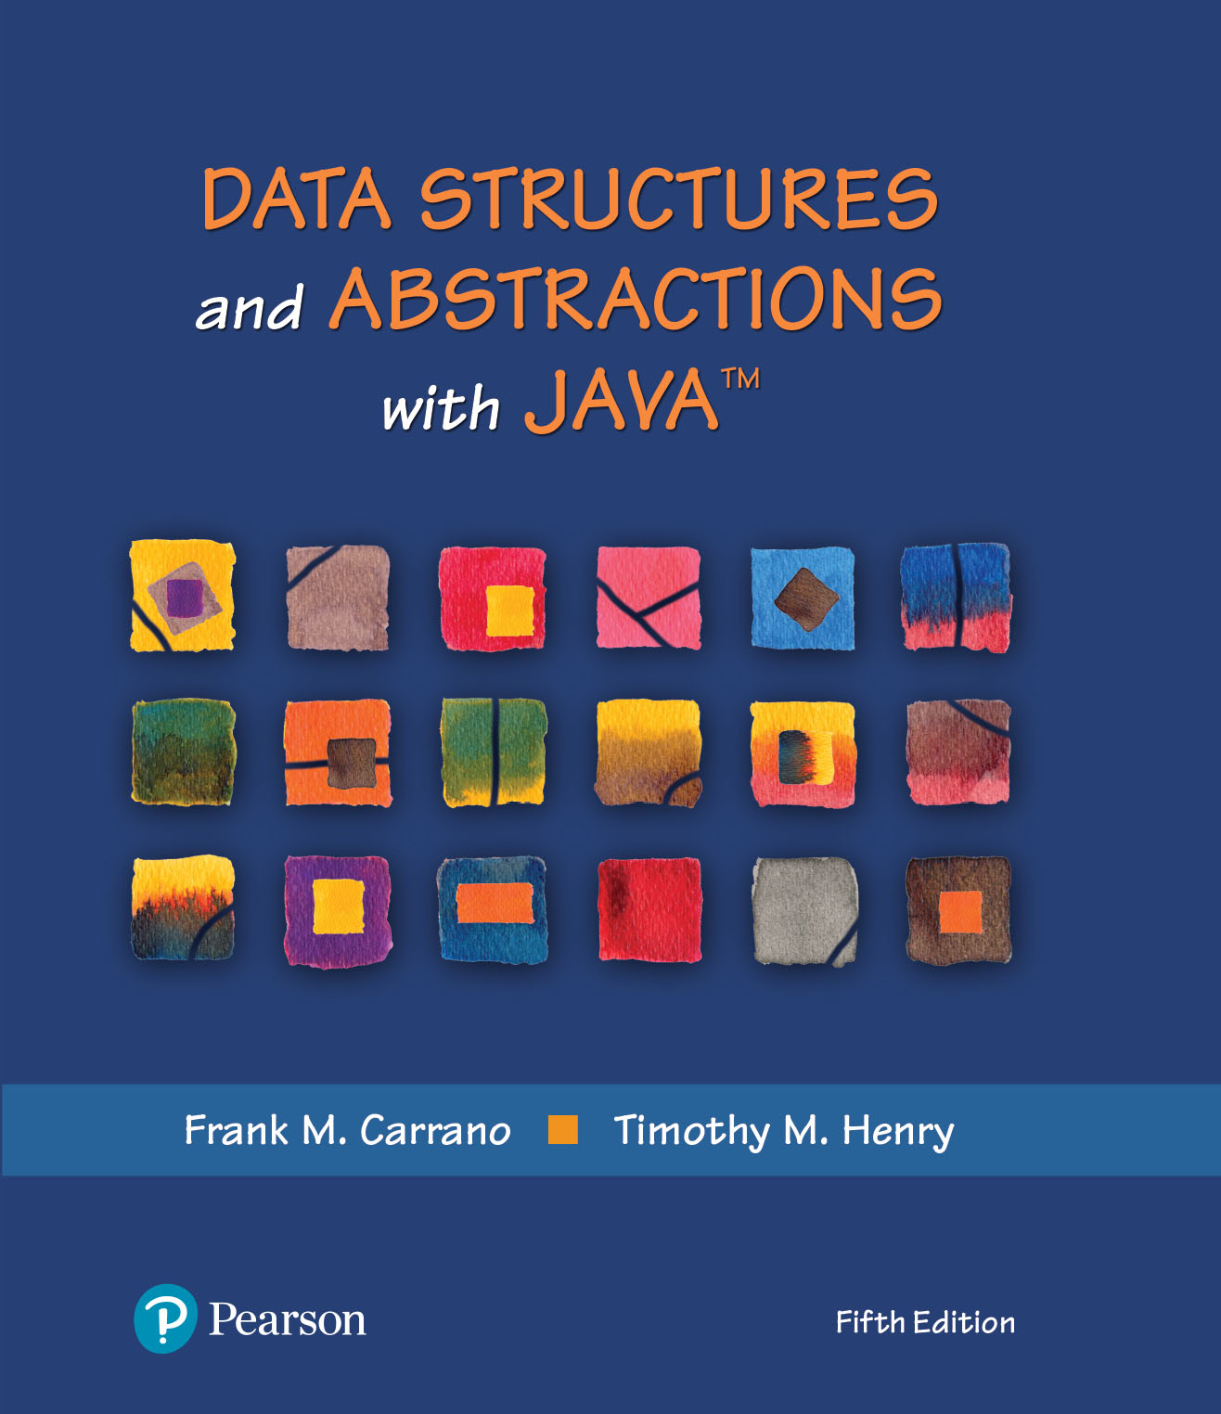
Data Structures and Abstractions with Java™
5th Edition
Chapter 9
Recursion

Slide 2
What Is Recursion?
Consider hiring a contractor to build
  He hires a subcontractor for a portion of the job
  That subcontractor hires a sub-subcontractor to do a smaller portion of job
The last sub-sub- … subcontractor finishes
  Each one finishes and reports “done” up the line

Slide 3
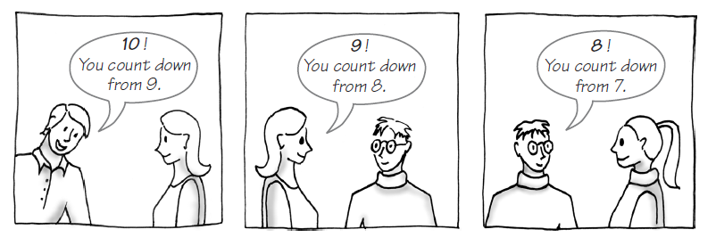
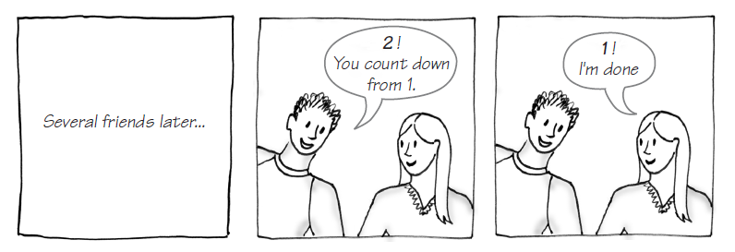
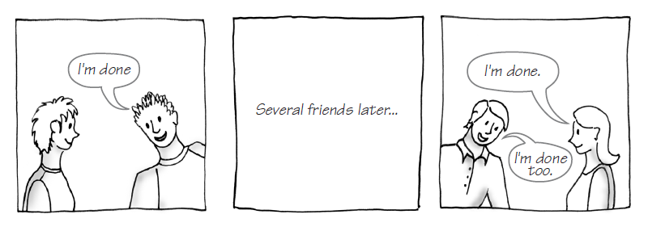
Example: The Countdown
FIGURE 9-1 Counting down from 10

Slide 4
Example: The Countdown
/** Counts down from a given positive integer.
@param integer An integer > 0.
*/
public static void countDown(int integer)
{
System.out.println(integer);
if (integer > 1)
countDown(integer - 1);
} // end countDown
Recursive Java method to do countDown.

Slide 5
Definition
Recursion is a problem-solving process
  Breaks a problem into identical but smaller problems.
A method that calls itself is a recursive method.
  The invocation is a recursive call or recursive invocation.

Slide 6
Design Guidelines
Method must be given an input value
Method definition must contain logic that involves this input, leads to different cases
One or more cases should provide solution that does not require recursion
  Else infinite recursion
One or more cases must include a recursive invocation

Slide 7
Programming Tip
Iterative method contains a loop
Recursive method calls itself
Some recursive methods contain a loop and call themselves
  If the recursive method with loop uses while, make sure you did not mean to use an if statement

Slide 8
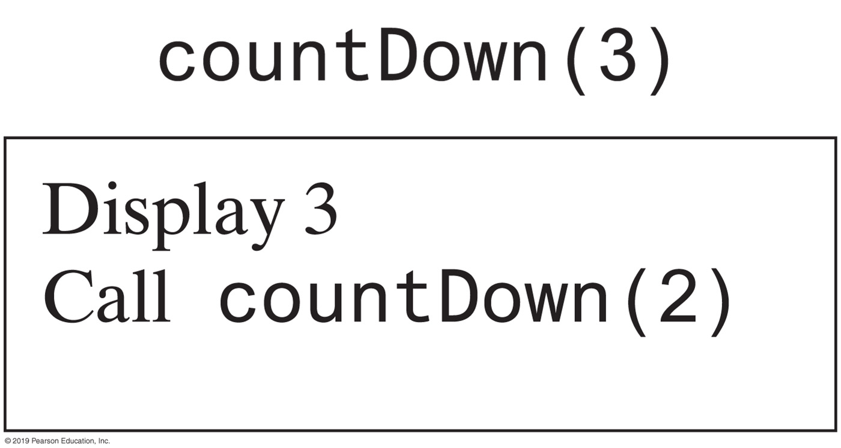
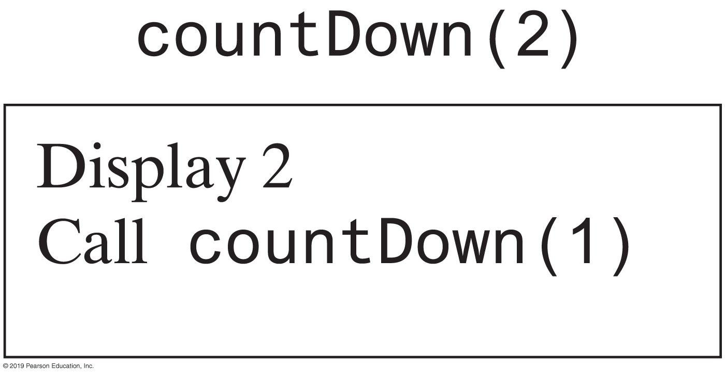
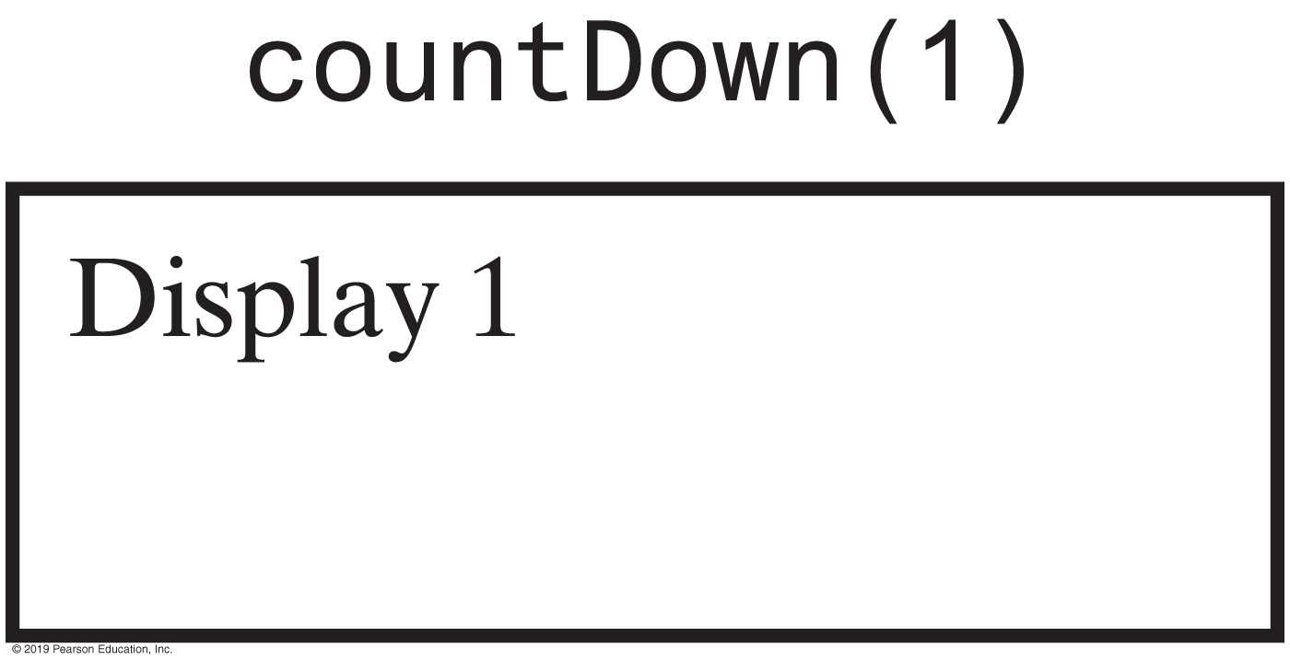
Tracing a Recursive Method
FIGURE 9-2 The effect of the method call countDown(3)

Slide 9
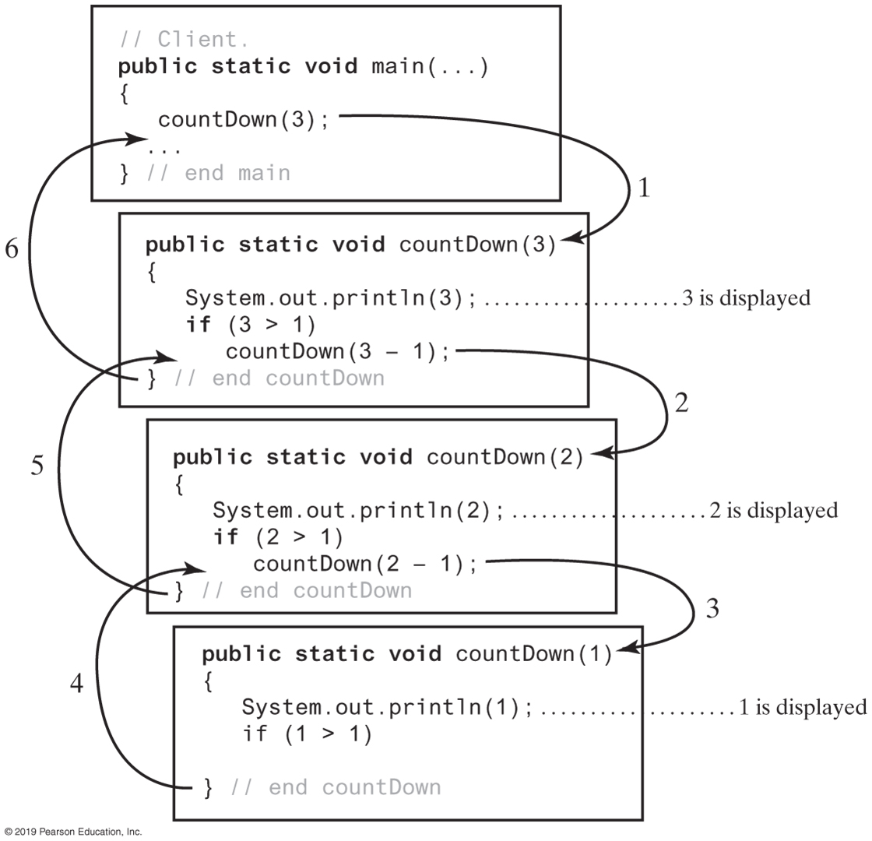
Tracing a Recursive Method
FIGURE 9-3 Tracing the execution of countDown(3)

Slide 10
Stack of Activation Records
Each call to a method generates an activation record
Recursive method uses more memory than an iterative method
  Each recursive call generates an activation record
If recursive call generates too many activation records, could cause stack overflow

Slide 11
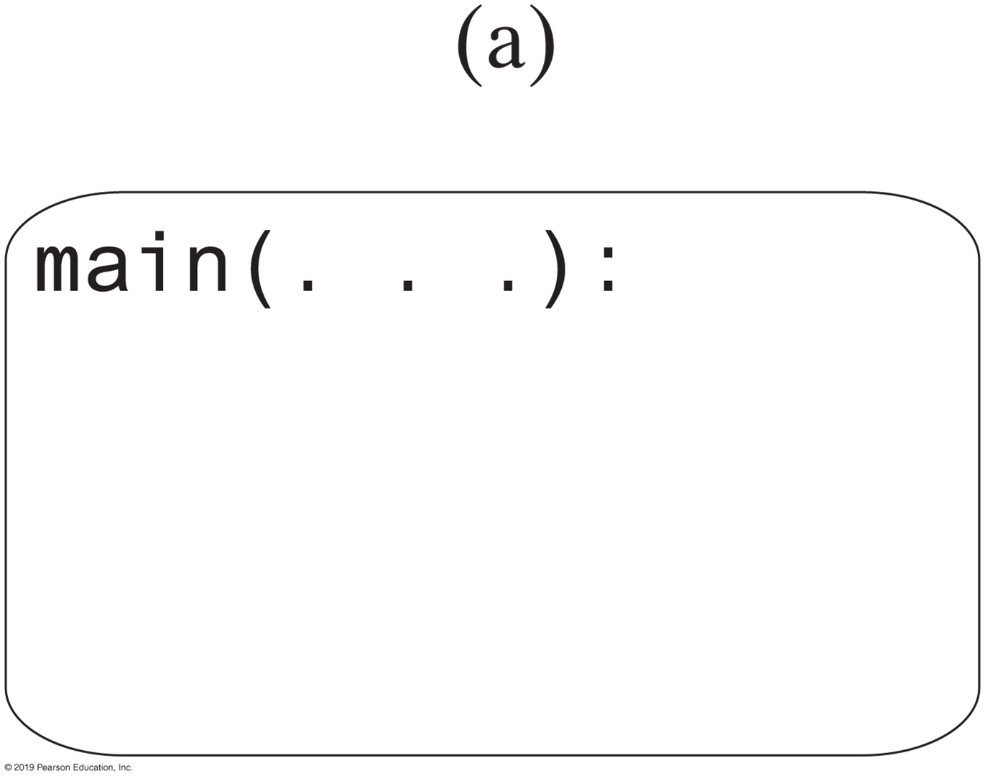
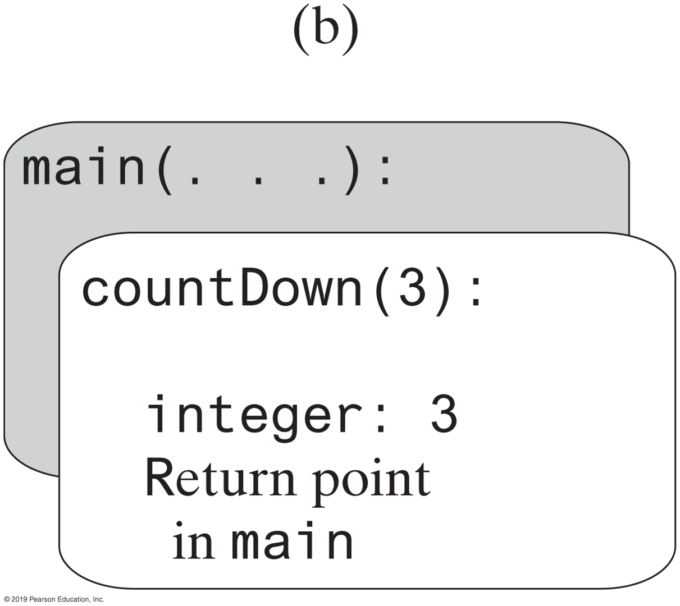
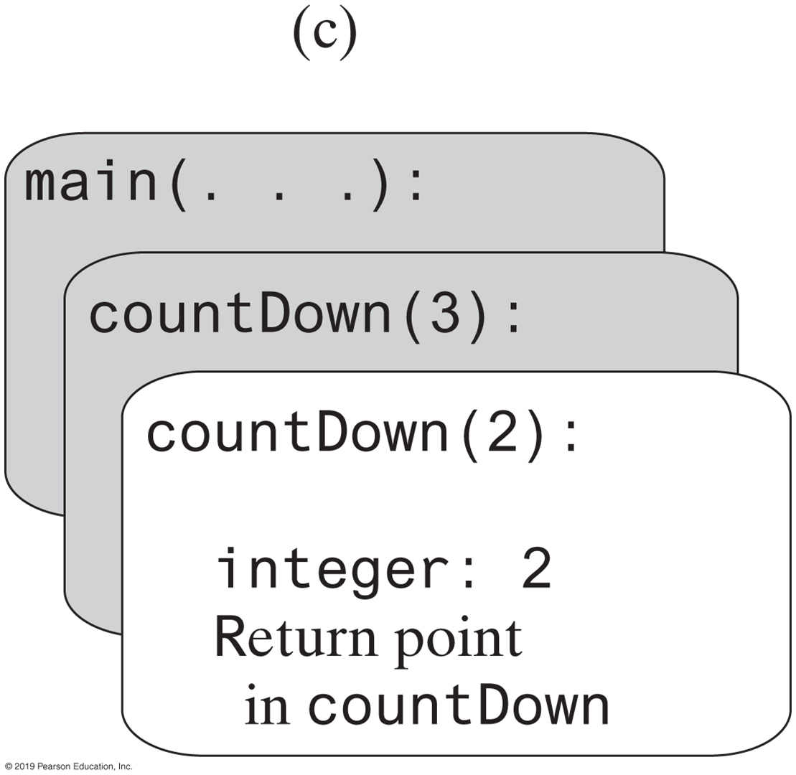
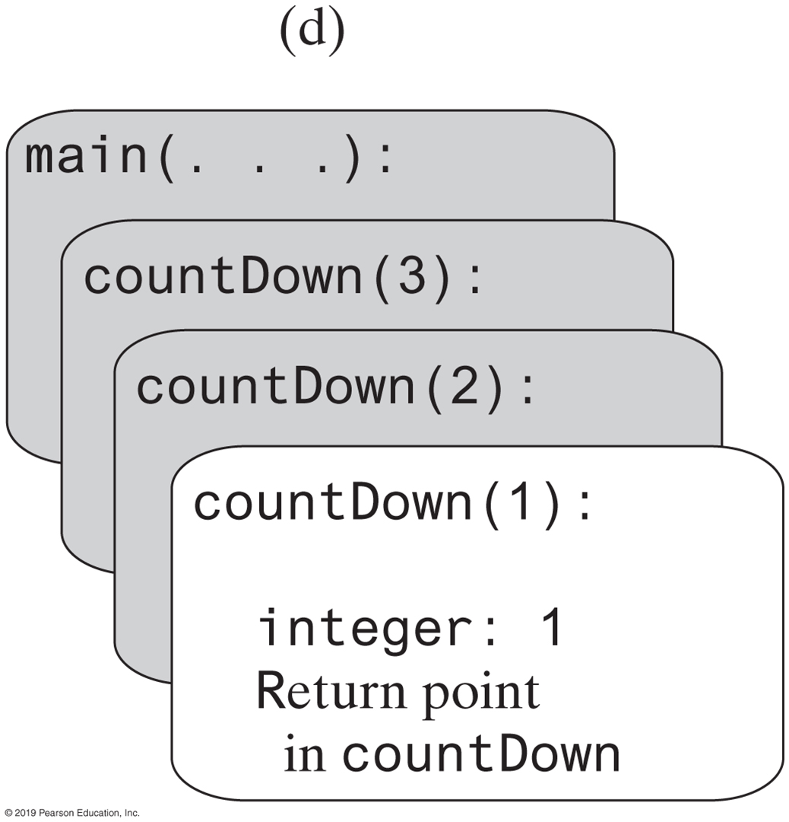

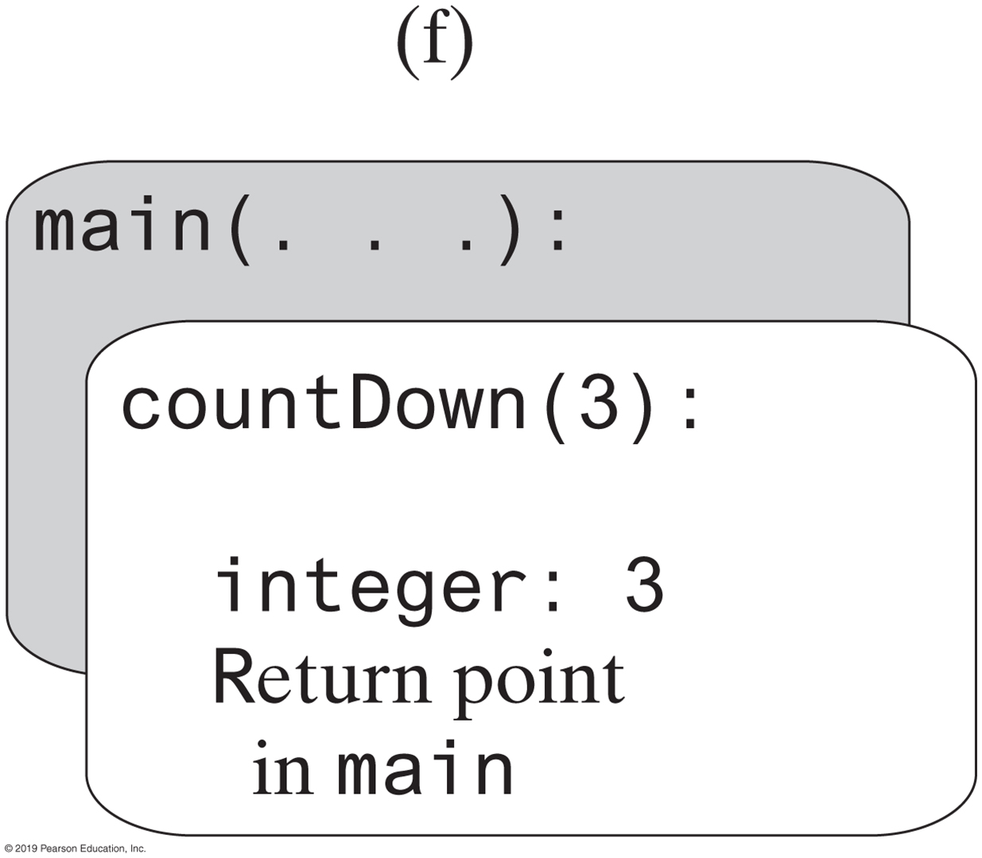
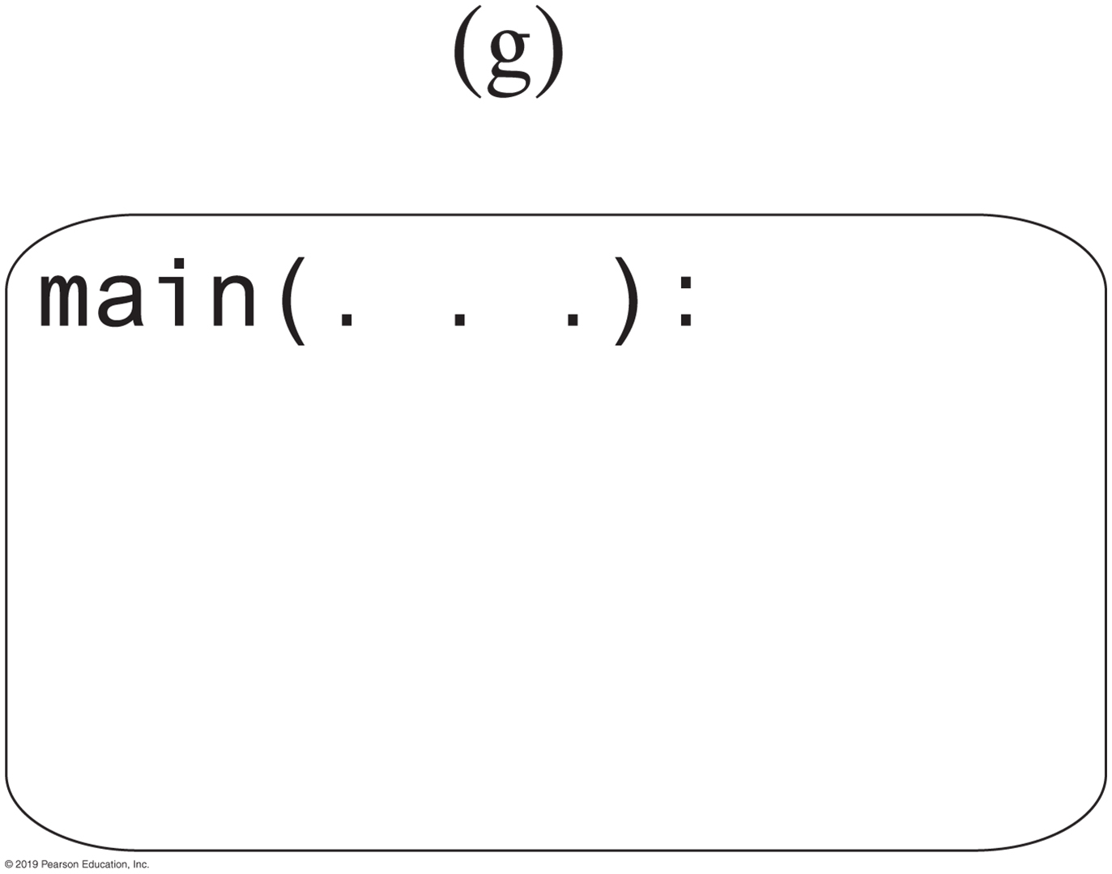
Stack of Activation Records
FIGURE 9-4 The stack of activation records during the execution of the call countDown(3)

Slide 12

Recursive Methods That Return a Value
/** @param n An integer > 0.
@return The sum 1 + 2 + ... + n. */
public static int sumOf(int n)
{
int sum;
if (n == 1)
sum = 1; // Base case
else
sum = sumOf(n - 1) + n; // Recursive call
return sum;
} // end sumOf
Recursive method to calculate

Slide 13
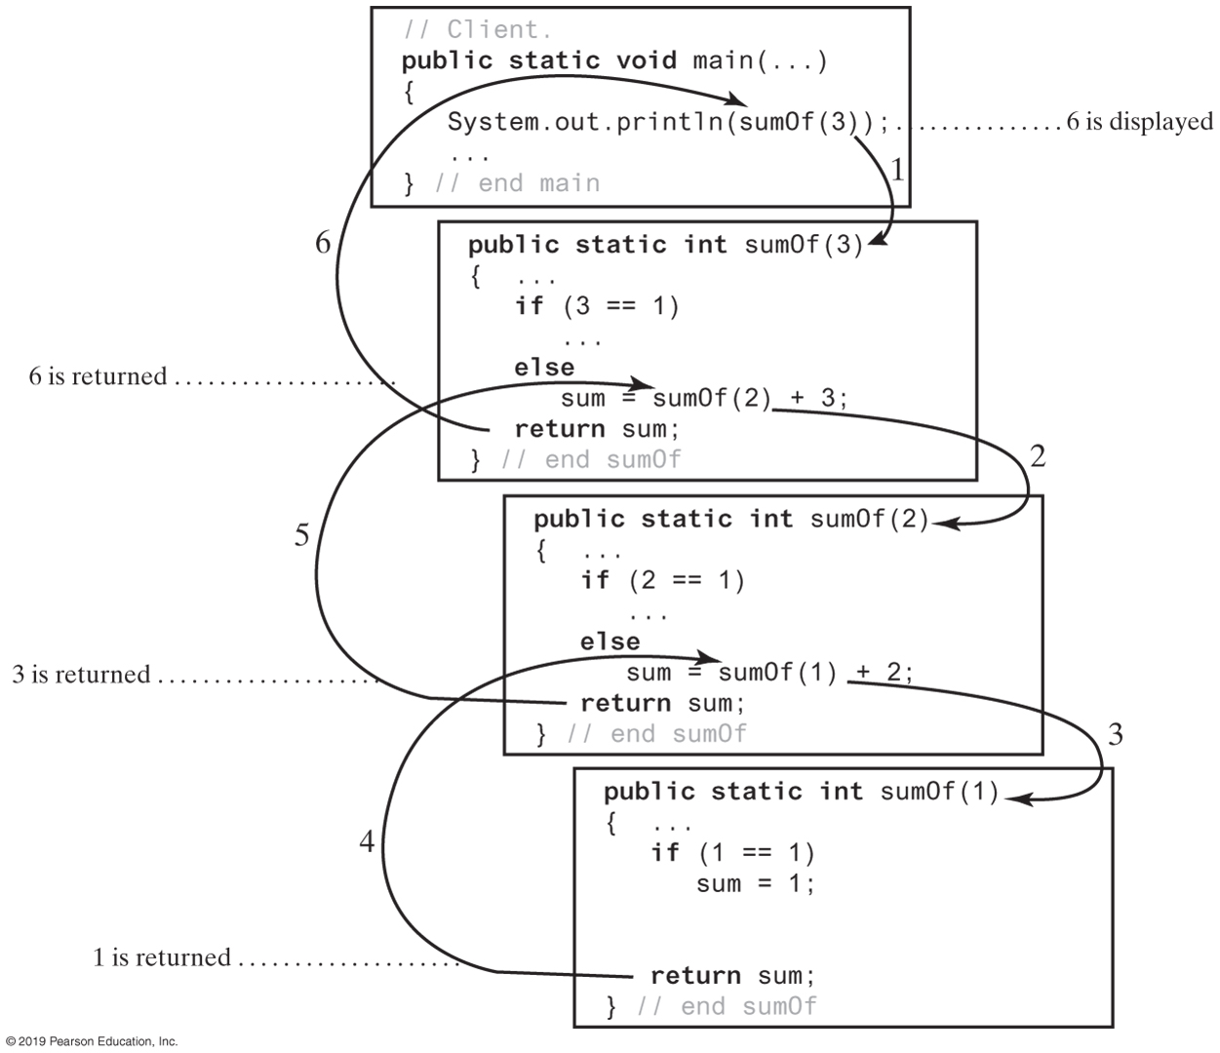
FIGURE 9-5 Tracing the execution of sumOf(3)
FIGURE 9-5 Tracing the execution of sumOf(3)

Slide 14
Recursively Processing an Array
/** Displays the integers in an array.
@param array An array of integers.
@param first The index of the first integer displayed.
@param last The index of the last integer displayed,
0 <= first <= last < array.length. */
public static void displayArray(int[] array, int first, int last)
Given definition of a recursive method to display array.

Slide 15
Recursively Processing an Array
public static void displayArray(int array[], int first, int last)
{
System.out.print(array[first] + " ");
if (first < last)
displayArray(array, first + 1, last);
} // end displayArray
Starting with array[first]

Slide 16
Recursively Processing an Array
public static void displayArray(int array[], int first, int last)
{
if (first <= last)
{
displayArray(array, first, last - 1);
System.out.print(array[last] + " ");
} // end if
} // end displayArray
Starting with array[last]

Slide 17
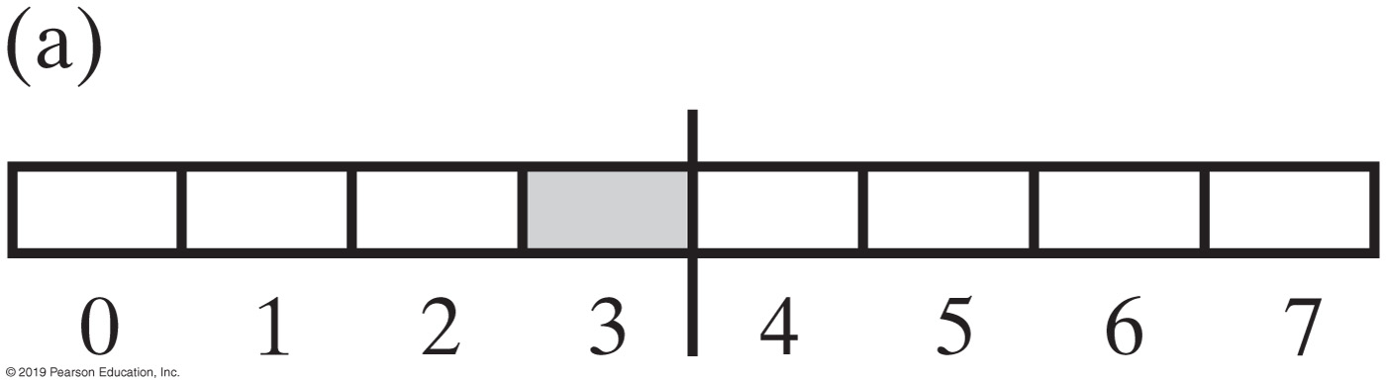
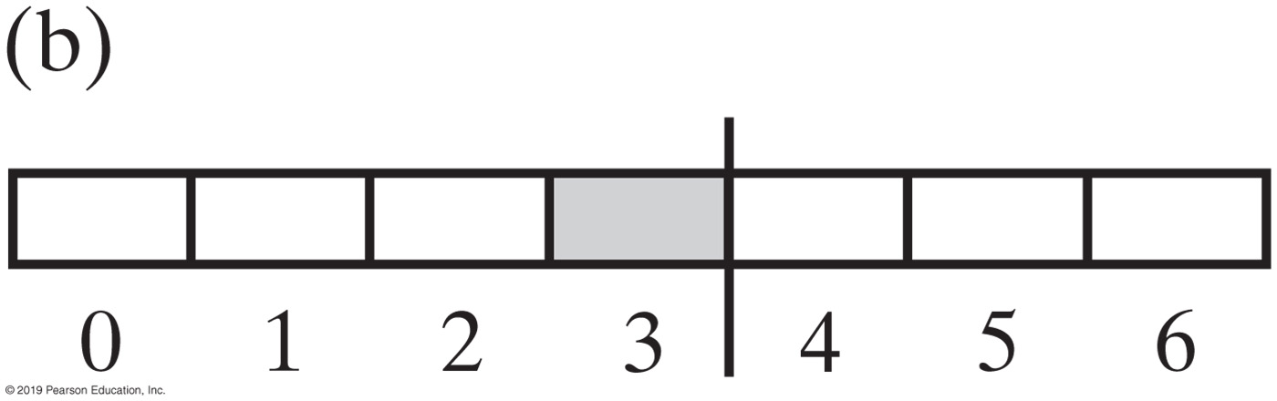
Recursively Processing an Array
FIGURE 9-6 Two arrays with their middle elements within their left halves

Slide 18
Recursively Processing an Array
public static void displayArray(int array[], int first, int last)
{
if (first == last)
System.out.print(array[first] + " ");
else
{
int mid = (first + (last - first) / 2;
displayArray(array, first, mid);
displayArray(array, mid + 1, last);
} // end if
} // end displayArray
Why?
Processing array from middle.

Slide 19
Displaying a Bag
public void display()
{
displayArray(0, numberOfEntries - 1);
} // end display
private void displayArray(int first, int last)
{
System.out.println(bag[first]);
if (first < last)
displayArray(first + 1, last);
} // end displayArray
Recursive method that is part of an implementation of an ADT often is private.

Slide 20
Recursively Processing a Linked Chain
public void display()
{
displayChain(firstNode);
} // end display
private void displayChain(Node nodeOne)
{
if (nodeOne != null)
{
System.out.println(nodeOne.getData()); // Display data in first node
displayChain(nodeOne.getNextNode()); // Display rest of chain
} // end if
} // end displayChain
Display data in first node and recursively display data in rest of chain.

Slide 21
Recursively Processing a Linked Chain
public void displayBackward()
{
displayChainBackward(firstNode);
} // end displayBackward
private void displayChainBackward(Node nodeOne)
{
if (nodeOne != null)
{
displayChainBackward(nodeOne.getNextNode());
System.out.println(nodeOne.getData());
} // end if
} // end displayChainBackward
Displaying a chain backwards. Traversing chain of linked nodes in reverse order easier when done recursively.

Slide 22
Time Efficiency of Recursive Methods
public static void countDown(int n)
{
System.out.println(n);
if (n > 1)
countDown(n - 1);
} // end countDown
Using proof by induction, we conclude method is O(n).

Slide 23
Time Efficiency of Computing x^{n}
x^{n} = (x^{n/2})² when n is even and positive
x^{n} = x (x ^{(n - 1)/2})² when n is odd and positive
x⁰ = 1
Efficiency of algorithm is O(log n)

Slide 24
Tail Recursion
When the last action performed by a recursive
method is a recursive call.
In a tail-recursive method, the last action is a recursive call
This call performs a repetition that can be done by using iteration.
Converting a tail-recursive method to an iterative one is usually a straightforward process.
public static void countDown(int n)
{
System.out.println(n);
if (n > 1)
countDown(n - 1);
} // end countDown

Slide 25
Using a Stack Instead of Recursion
Converting a recursive method to an iterative one
public static void countDown(int integer)
{
if (integer >= 1)
{
System.out.println(integer);
countDown(integer - 1);
} // end if
} // end countDown
An iterative version
public static void countDown(int integer)
{
while (integer >= 1)
{
System.out.println(integer);
integer = integer − 1;
} // end while
} // end countDown

Slide 26
Using a Stack Instead of Recursion
An iterative displayArray to maintain its own stack
public void displayArray(int first, int last)
{
boolean done = false;
StackInterface<Record> programStack = new LinkedStack<>();
programStack.push(new Record(first, last));
while (!done && !programStack.isEmpty())
{
Record topRecord = programStack.pop();
first = topRecord.first;
last = topRecord.last;
if (first == last)
System.out.println(array[first] + " ");
else
{
int mid = first + (last - first) / 2;
// Note the order of the records pushed onto the stack
programStack.push(new Record(mid + 1, last));
programStack.push(new Record(first, mid));
} // end if
} // end while
} // end displayArray

Slide 27
End
Chapter 9

