Slide 1
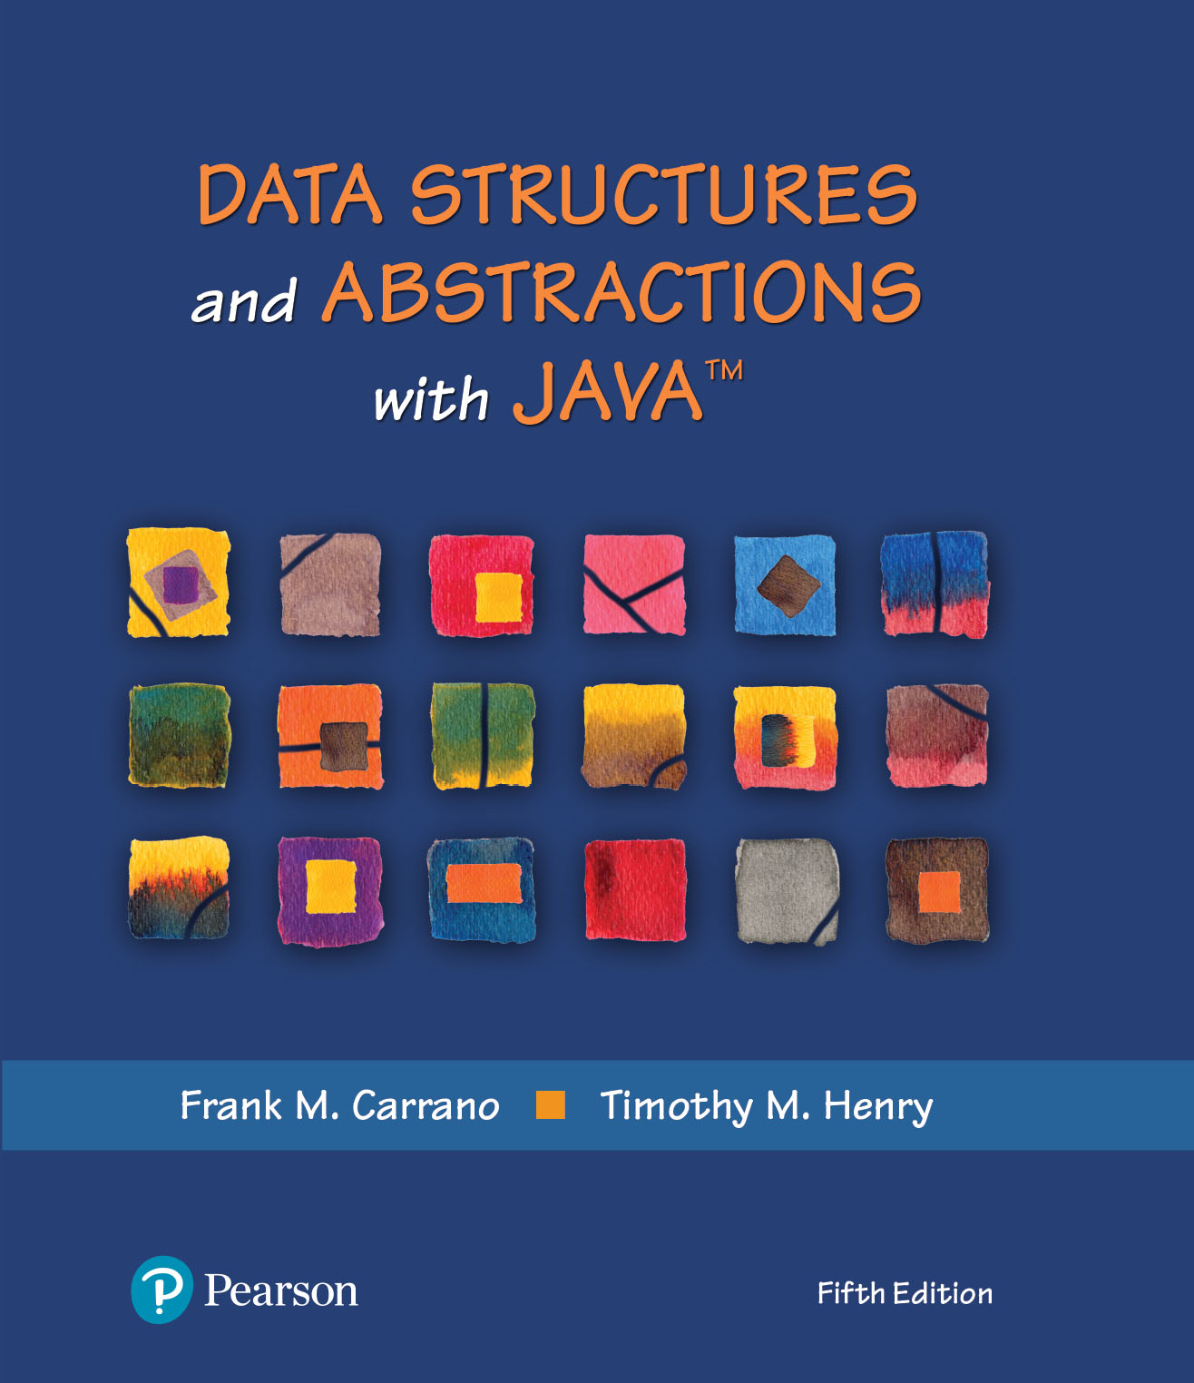
Data Structures and Abstractions with Java™
5th Edition
Chapter 12
A List Implementation
That Links Data

Slide 2
Advantages of Linked Implementation
Uses memory only as needed
When entry removed, unneeded memory returned to system
Avoids moving data when adding or removing entries

Slide 3
Adding a Node at Various Positions
Possible cases:
  Chain is empty
  Adding node at chain’s beginning
  Adding node between adjacent nodes
  Adding node to chain’s end

Slide 4
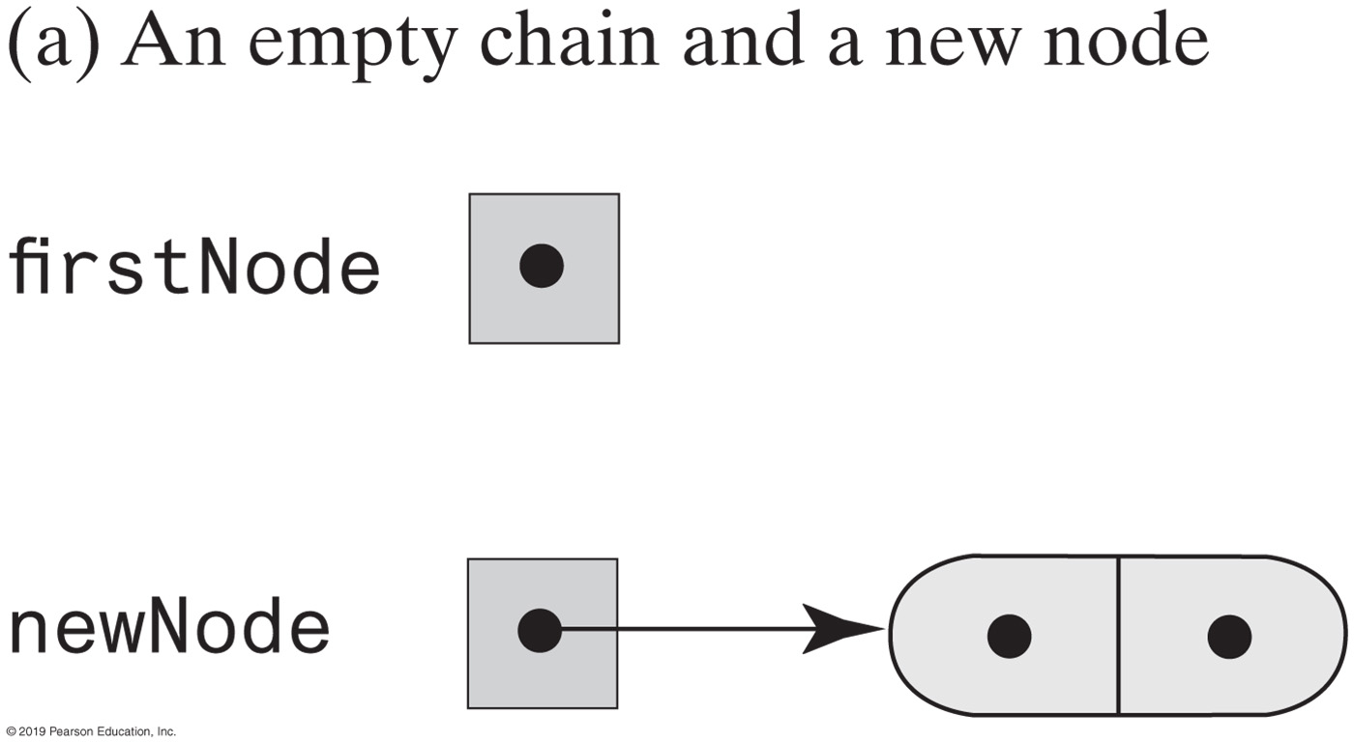
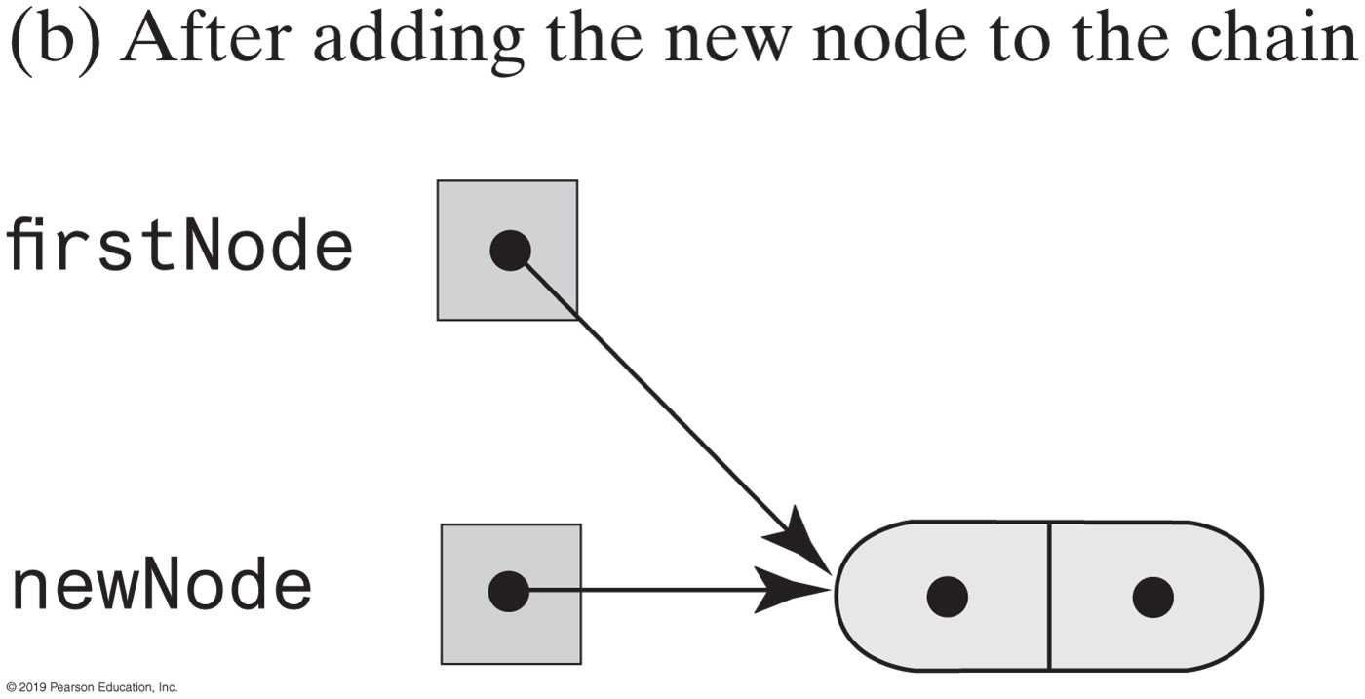
Adding a Node
This pseudocode establishes a new node for the given data
newNode references a new instance of Node
Place newEntry in newNode
firstNode = address of newNode
FIGURE 12-1 Adding a node to an empty chain

Slide 5
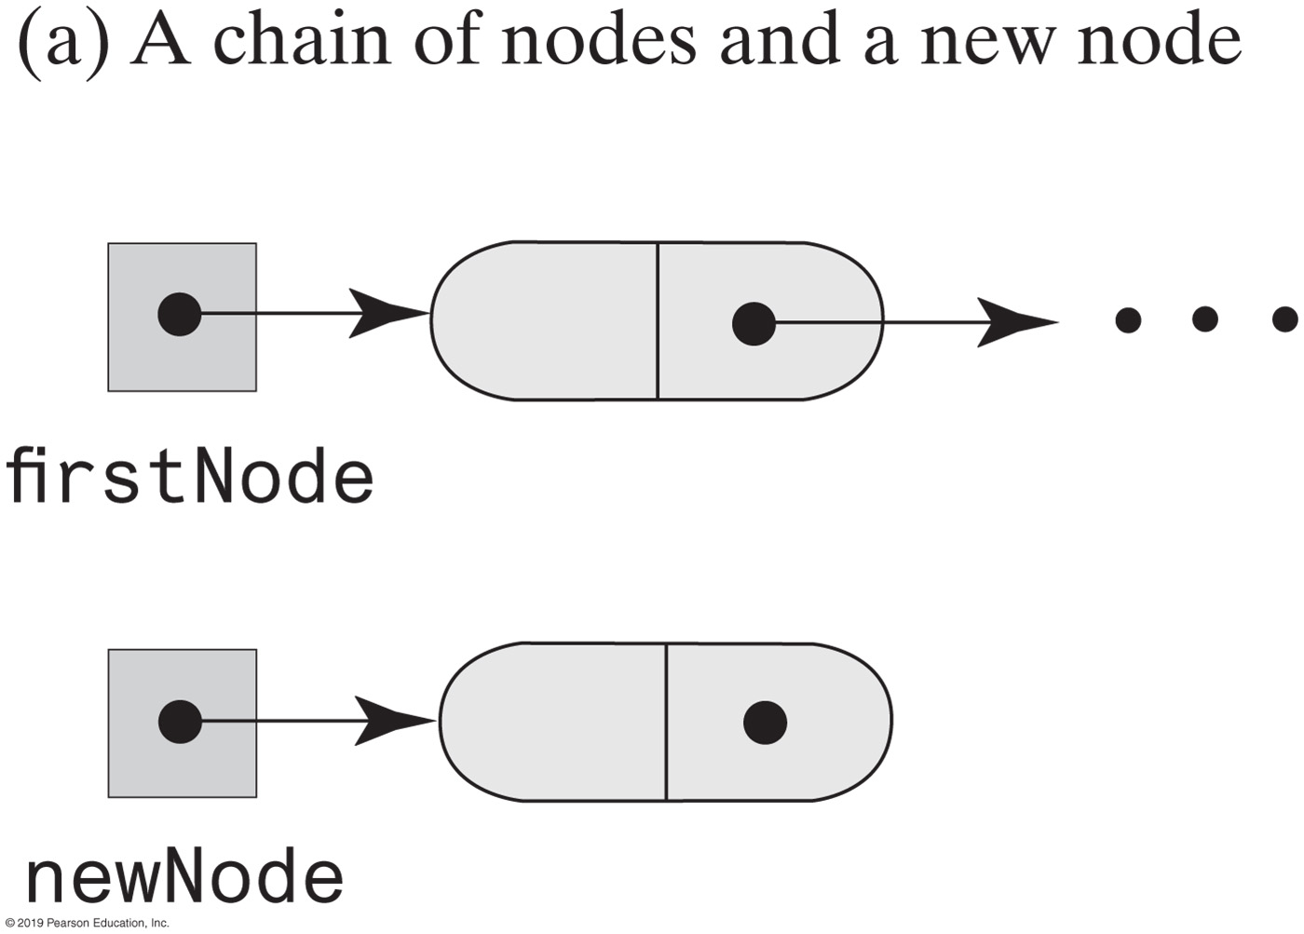
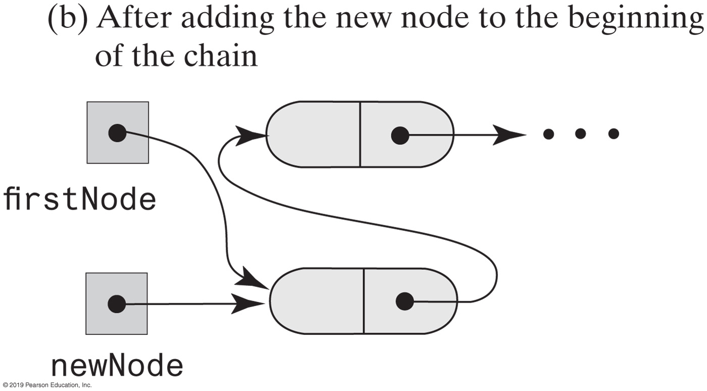
Adding a Node
This pseudocode describes the steps needed to add a node to the beginning of a chain.
newNode references a new instance of Node
Place newEntry in newNode
Set newNode’s link to firstNode
Set firstNode to newNode
FIGURE 12-2 Adding a node to the beginning of a chain

Slide 6
Adding a Node
Pseudocode to add a node to a chain between two existing, consecutive nodes
newNode references the new node
Place newEntry in newNode
Let nodeBefore reference the node that will be before the new node
Set nodeAfter to nodeBefore’s link
Set newNode’s link to nodeAfter
Set nodeBefore’s link to newNode

Slide 7
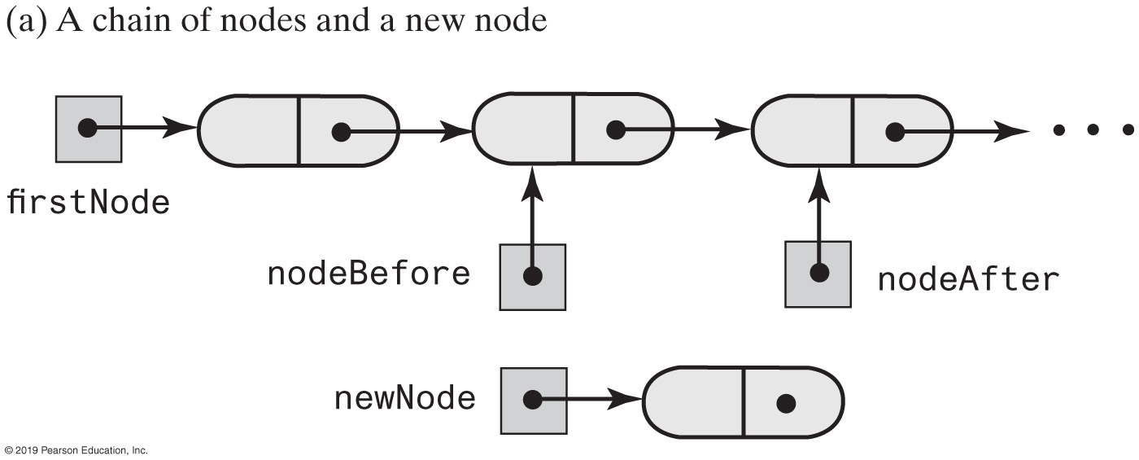
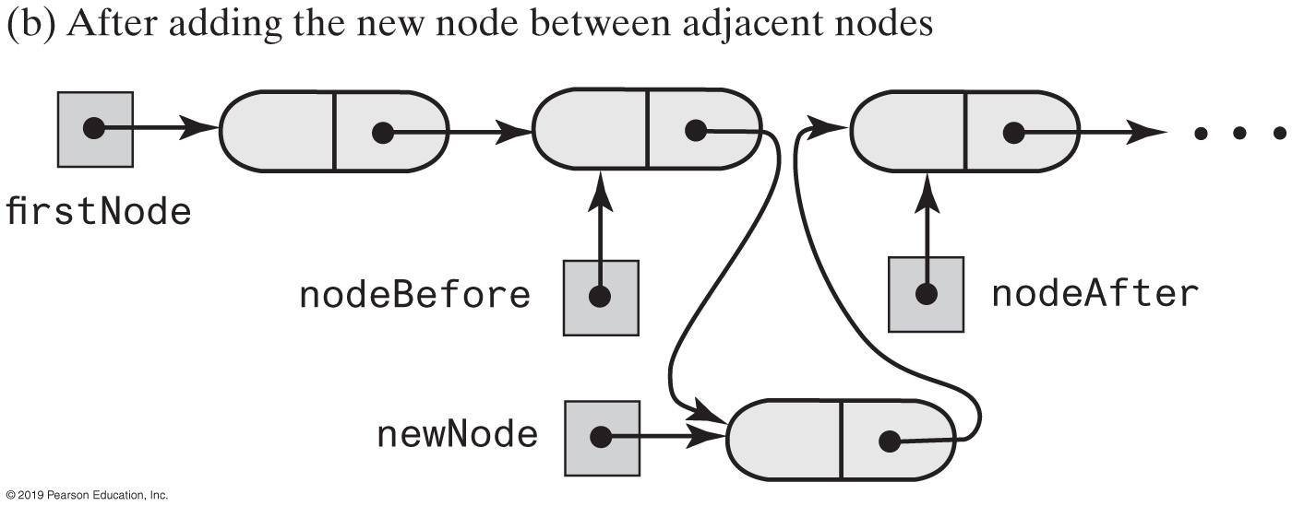
Adding a Node
FIGURE 12-3 Adding a node between two adjacent nodes

Slide 8
Adding a Node
Steps to add a node at the end of a chain.
newNode references a new instance of Node
Place newEntry in newNode
Locate the last node in the chain
Place the address of newNode in this last node

Slide 9
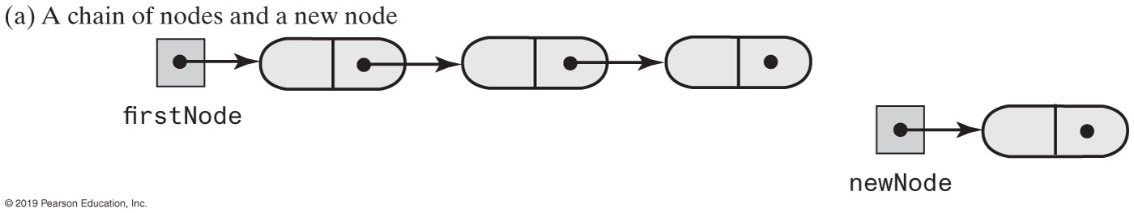
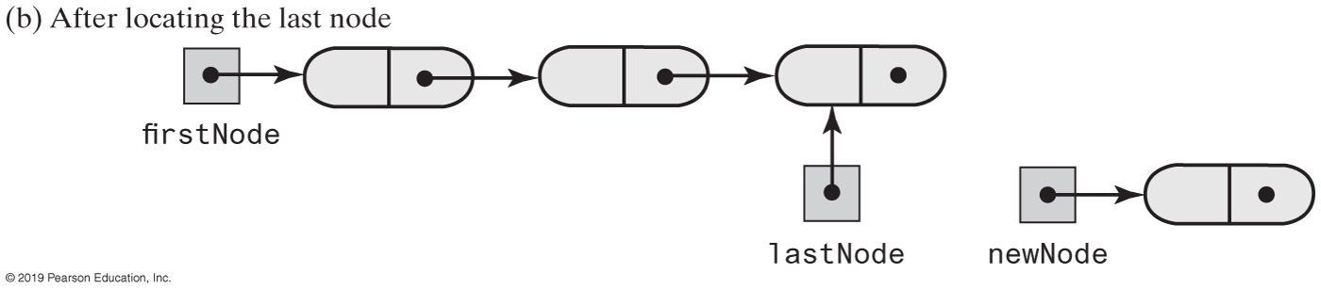
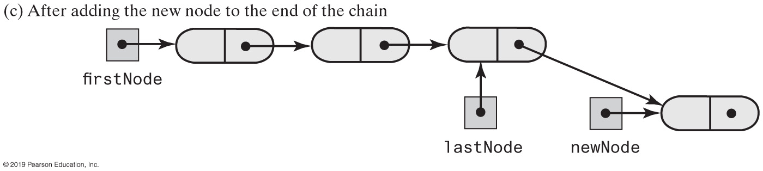
Adding a Node
FIGURE 12-4 Adding a node to the end of a chain

Slide 10
Removing a Node
Possible cases
  Removing the first node
  Removing a node other than first one

Slide 11
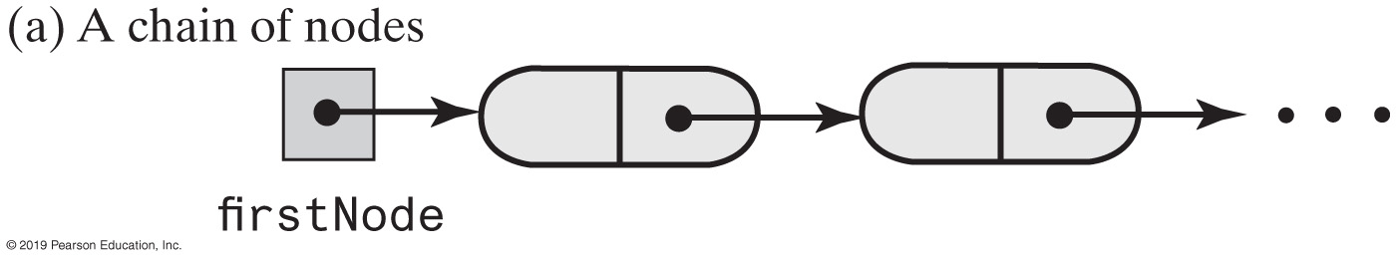
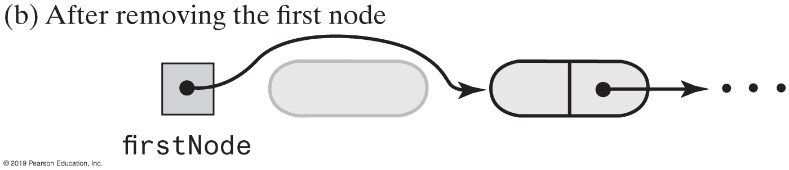
Removing a Node
Steps for removing the first node.
Set firstNode to the link in the first node; firstNode now either references the second node or is null if the chain had only one node.
Since all references to the first node no longer exist, the system automatically recycles the first node’s memory.
FIGURE 12-5 Removing the first node from a chain

Slide 12
Removing a Node
Removing a node other than the first one.
Let nodeBefore reference the node before the one to be removed.
Set nodeToRemove to nodeBefore’s link; nodeToRemove now references the node to be removed.
Set nodeAfter to nodeToRemove’s link; nodeAfter now either references the node after the one to be removed or is null.
Set nodeBefore’s link to nodeAfter. (nodeToRemove is now disconnected from the chain.)
Set nodeToRemove to null.
Since all references to the disconnected node no longer exist, the system automatically recycles the node’s memory.

Slide 13
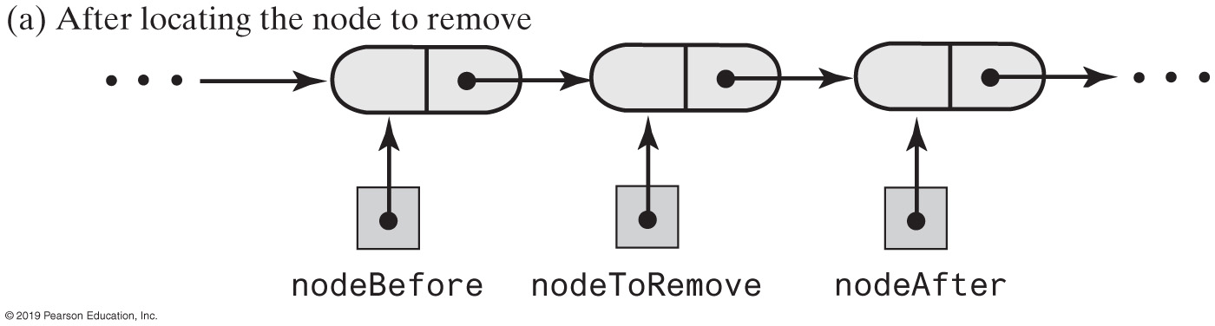
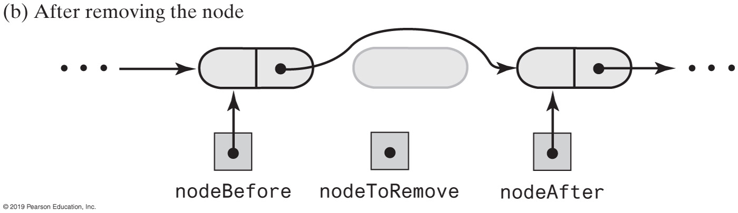
Removing a Node
FIGURE 12-6 Removing an interior node from a chain

Slide 14
Removing a Node
// Returns a reference to the node at a given position.
// Precondition: The chain is not empty;
// 1 <= givenPosition <= numberOfEntries.
private Node getNodeAt(int givenPosition)
{
// Assertion: (firstNode != null) &&
// (1 <= givenPosition) && (givenPosition <= numberOfEntries)
Node currentNode = firstNode;
// Traverse the chain to locate the desired node
// (skipped if givenPosition is 1)
for (int counter = 1; counter < givenPosition; counter++)
currentNode = currentNode.getNextNode();
// Assertion: currentNode != null
return currentNode;
} // end getNodeAt
Operations on a chain depended on the method getNodeAt

Slide 15
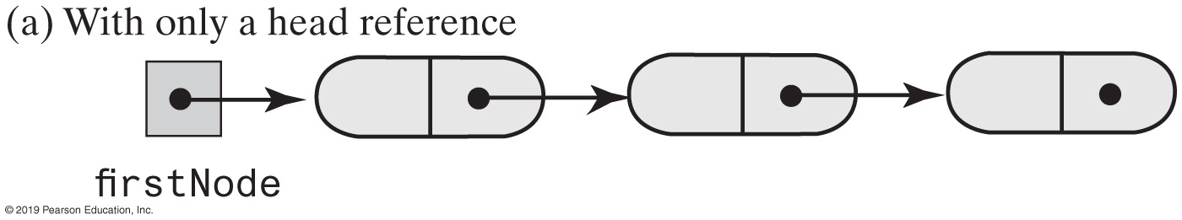
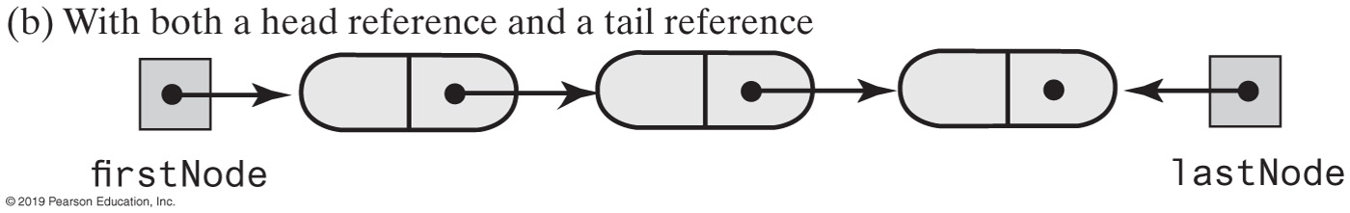
Using a Tail Reference
FIGURE 12-7 Two linked chains

Slide 16
Data Fields and Constructor (Part 1)
/** A linked implemention of the ADT list. */
public class LList<T> implements ListInterface<T>
{
private Node firstNode; // Reference to first node of chain
private int numberOfEntries;
public LList()
{
initializeDataFields();
} // end default constructor
public void clear()
{
initializeDataFields();
} // end clear
/* < Implementations of the public methods add, remove, replace, getEntry, contains,
getLength, isEmpty, and toArray go here. >
. . . */
// Initializes the class's data fields to indicate an empty list.
private void initializeDataFields()
{
firstNode = null;
numberOfEntries = 0;
} // end initializeDataFields
LISTING 12-1 An outline of the class LList

Slide 17
Data Fields and Constructor (Part 2)
// Returns a reference to the node at a given position.
// Precondition: The chain is not empty;
// 1 <= givenPosition <= numberOfEntries.
private Node getNodeAt(int givenPosition)
{
// Assertion: (firstNode != null) &&
// (1 <= givenPosition) && (givenPosition <= numberOfEntries)
Node currentNode = firstNode;
// Traverse the chain to locate the desired node
// (skipped if givenPosition is 1)
for (int counter = 1; counter < givenPosition; counter++)
currentNode = currentNode.getNextNode();
// Assertion: currentNode != null
return currentNode;
} // end getNodeAt
private class Node
{
      // < Implementation of private inner class Node >
  } // end Node
} // end LList
LISTING 12-1 An outline of the class LList

Slide 18
Adding to the End of the List
public void add(T newEntry)
{
Node newNode = new Node(newEntry);
if (isEmpty())
firstNode = newNode;
else // Add to end of nonempty list
{
Node lastNode = getNodeAt(numberOfEntries);
lastNode.setNextNode(newNode); // Make last node reference new node
} // end if
numberOfEntries++;
} // end add
The method add assumes method getNodeAt

Slide 19
Adding at a Given Position
public void add(int givenPosition, T newEntry)
{
if ((givenPosition >= 1) && (givenPosition <= numberOfEntries + 1))
{
Node newNode = new Node(newEntry);
if (givenPosition == 1) // Case 1
{
newNode.setNextNode(firstNode);
firstNode = newNode;
}
else // Case 2: list is not empty
{ // and givenPosition > 1
Node nodeBefore = getNodeAt(givenPosition - 1);
Node nodeAfter = nodeBefore.getNextNode();
newNode.setNextNode(nodeAfter);
nodeBefore.setNextNode(newNode);
} // end if
numberOfEntries++;
}
else
throw new IndexOutOfBoundsException(
"Illegal position given to add operation.");
} // end add
add method.

Slide 20
Method isEmpty
public boolean isEmpty()
{
boolean result;
if (numberOfEntries == 0) // Or getLength() == 0
{
// Assertion: firstNode == null
result = true;
}
else
{
// Assertion: firstNode != null
result = false;
} // end if
return result;
} // end isEmpty

Slide 21
Method toArray
public T[] toArray()
{
// The cast is safe because the new array contains null entries
@SuppressWarnings("unchecked")
T[] result = (T[])new Object[numberOfEntries];
int index = 0;
Node currentNode = firstNode;
while ((index < numberOfEntries) && (currentNode != null))
{
result[index] = currentNode.getData();
currentNode = currentNode.getNextNode();
index++;
} // end while
return result;
} // end toArray
Traverses chain, loads an array.

Slide 22
Testing Core Methods
public static void main(String[] args)
{
System.out.println("Create an empty list.");
ListInterface<String> myList = new LList<String>();
System.out.println("List should be empty; isEmpty returns " +
myList.isEmpty() + ".");
System.out.println("\nTesting add to end:");
myList.add("15");
myList.add("25");
myList.add("35");
myList.add("45");
System.out.println("List should contain 15 25 35 45.");
displayList(myList);
System.out.println("List should not be empty; isEmpty() returns " +
myList.isEmpty() + ".");
System.out.println("\nTesting clear():");
myList.clear();
System.out.println("List should be empty; isEmpty returns " +
myList.isEmpty() + ".");
} // end main
LISTING 12-2 A main method that tests part of the implementation of the ADT list

Slide 23
Testing Core Methods
Program Output
Create an empty list.
List should be empty; isEmpty returns true.
Testing add to end:
List should contain 15 25 35 45.
The list contains 4 entries, as follows:
15 25 35 45
List should not be empty; isEmpty() returns false.
Testing clear():
List should be empty; isEmpty returns true.
LISTING 12-2 A main method that tests part of the implementation of the ADT list

Slide 24
remove method returns entry it deletes from list
public T remove(int givenPosition)
{
T result = null; // Return value
if ((givenPosition >= 1) && (givenPosition <= numberOfEntries))
{
// Assertion: !isEmpty()
if (givenPosition == 1) // Case 1: Remove first entry
{
result = firstNode.getData(); // Save entry to be removed
firstNode = firstNode.getNextNode(); // Remove entry
}
else // Case 2: Not first entry
{
Node nodeBefore = getNodeAt(givenPosition - 1);
Node nodeToRemove = nodeBefore.getNextNode();
result = nodeToRemove.getData(); // Save entry to be removed
Node nodeAfter = nodeToRemove.getNextNode();
nodeBefore.setNextNode(nodeAfter); // Remove entry
} // end if
numberOfEntries--; // Update count
return result; // Return removed entry
}
else
throw new IndexOutOfBoundsException(
"Illegal position given to remove operation.");
} // end remove

Slide 25
Continuing the Implementation
public T replace(int givenPosition, T newEntry)
{
if ((givenPosition >= 1) && (givenPosition <= numberOfEntries))
{
// Assertion: !isEmpty()
Node desiredNode = getNodeAt(givenPosition);
T originalEntry = desiredNode.getData();
desiredNode.setData(newEntry);
return originalEntry;
}
else
throw new IndexOutOfBoundsException(
"Illegal position given to replace operation.");
} // end replace
Replacing a list entry requires us to replace the data portion of a node with other data.

Slide 26
Continuing the Implementation
public T getEntry(int givenPosition)
{
if ((givenPosition >= 1) && (givenPosition <= numberOfEntries))
{
// Assertion: !isEmpty()
return getNodeAt(givenPosition).getData();
}
else
throw new IndexOutOfBoundsException(
"Illegal position given to getEntry operation.");
} // end getEntry
Retrieving a list entry is straightforward.

Slide 27
Continuing the Implementation
public boolean contains(T anEntry)
{
boolean found = false;
Node currentNode = firstNode;
while (!found && (currentNode != null))
{
if (anEntry.equals(currentNode.getData()))
found = true;
else
currentNode = currentNode.getNextNode();
} // end while
return found;
} // end contains
Checking to see if an entry is in the list, the method contains.

Slide 28
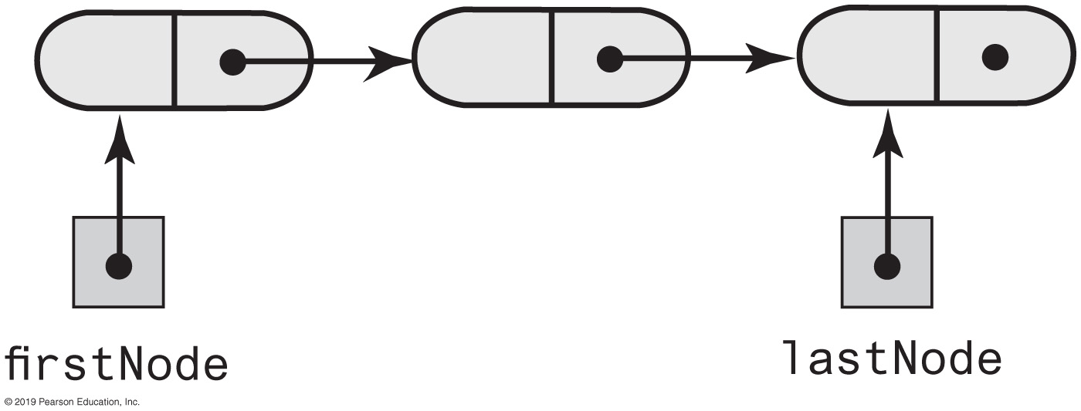
A Refined Linked Implementation
private Node firstNode; // Head reference to first node
private Node lastNode; // Tail reference to last node
private int numberOfEntries; // Number of entries in list
FIGURE 12-8 A linked chain with both a head reference and a tail reference

Slide 29
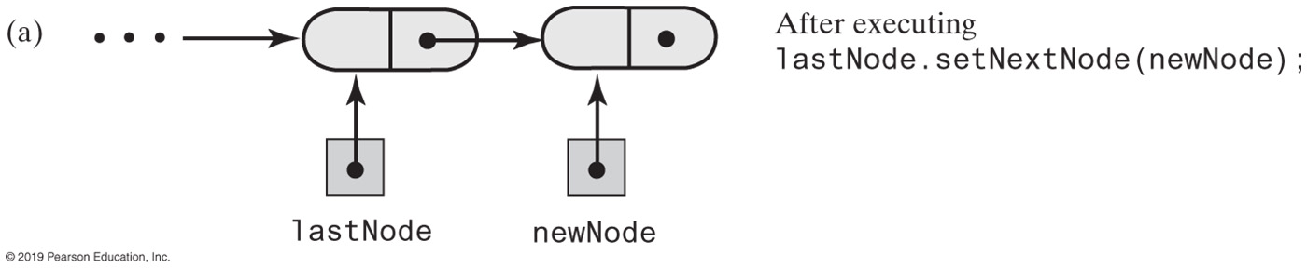
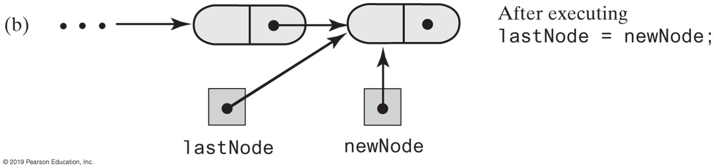
A Refined Linked Implementation
FIGURE 12-9 Adding a node to the end of a nonempty chain that has a tail reference

Slide 30
A Refined Linked Implementation
public void add(T newEntry)
{
Node newNode = new Node(newEntry);
if (isEmpty())
firstNode = newNode;
else
lastNode.setNextNode(newNode);
lastNode = newNode;
numberOfEntries++;
} // end add
Revision of the first add method

Slide 31
  A Refined Linked Implementation - refined add by position
public void add(int givenPosition, T newEntry) {
if ((givenPosition >= 1) && (givenPosition <= numberOfEntries + 1))
{
Node newNode = new Node(newEntry);
if (isEmpty())
{
firstNode = newNode;
lastNode = newNode;
}
else if (givenPosition == 1)
{
newNode.setNextNode(firstNode);
firstNode = newNode;
}
else if (givenPosition == numberOfEntries + 1)
{
lastNode.setNextNode(newNode);
lastNode = newNode;
}
else {
Node nodeBefore = getNodeAt(givenPosition - 1);
Node nodeAfter = nodeBefore.getNextNode();
newNode.setNextNode(nodeAfter);
nodeBefore.setNextNode(newNode);
} // end if
numberOfEntries++;
}
else
throw new IndexOutOfBoundsException(
"Illegal position given to add operation.");
} // end add

Slide 32
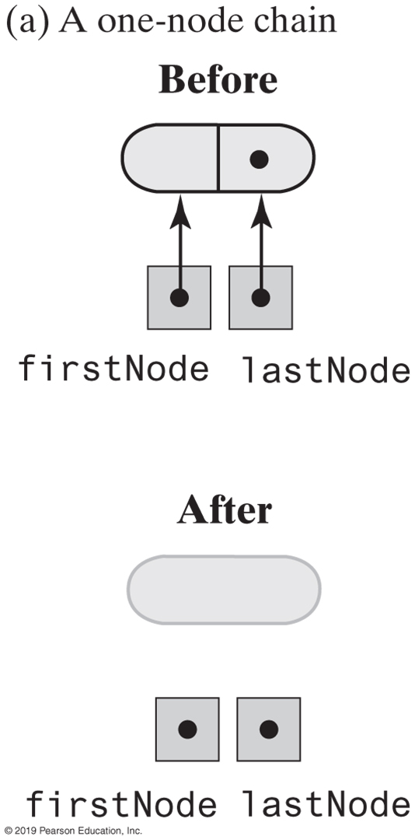
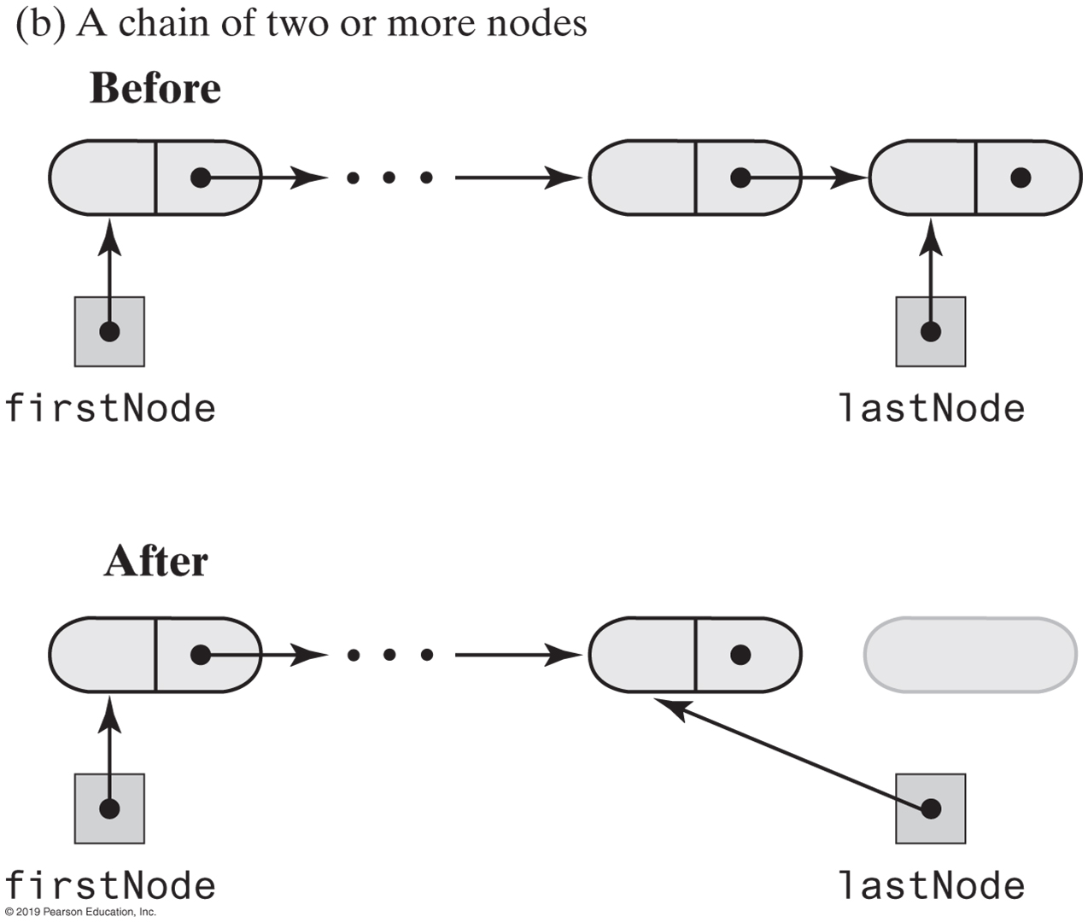
A Refined Linked Implementation
FIGURE 12-10 Before and after removing the last node from a chain that has both head and tail references and contains one or more nodes

Slide 33
A Refined Linked Implementation — refined remove
public T remove(int givenPosition) {
T result = null; // Return value
if ((givenPosition >= 1) && (givenPosition <= numberOfEntries))
{
// Assertion: !isEmpty()
if (givenPosition == 1) // Case 1: Remove first entry
{
result = firstNode.getData(); // Save entry to be removed
firstNode = firstNode.getNextNode();
if (numberOfEntries == 1)
lastNode = null; // Solitary entry was removed
}
else // Case 2: Not first entry
{
Node nodeBefore = getNodeAt(givenPosition - 1);
Node nodeToRemove = nodeBefore.getNextNode();
Node nodeAfter = nodeToRemove.getNextNode();
nodeBefore.setNextNode(nodeAfter);
result = nodeToRemove.getData();
if (givenPosition == numberOfEntries)
lastNode = nodeBefore; // Last node was removed
} // end if
numberOfEntries--;
}
else
throw new IndexOutOfBoundsException(
"Illegal position given to remove operation.");
return result; // Return removed entry
} // end remove

Slide 34
Efficiency of Using a Chain
Operation | Alist | LList | LListWithTail
add(newEntry) | O(1) | O(n) | O(1)
add(givenPosition, newEntry) | O(n); O(n); O(1) | O(1); O(n) | O(1); O(n); O(1)
toArray() | O(n) | O(n) | O(n)
remove(givenPosition) | O(n); O(n); O(1) | O(1); O(n) | O(1); O(n)
replace(givenPosition, newEntry) | O(1) | O(1); O(n) | O(1); O(n); O(1)
getEntry(givenPosition) | O(1) | O(1); O(n) | O(1); O(n); O(1)
contains(anEntry) | O(n) | O(n) | O(n)
clear(), getLength(), isEmpty() | O(1) | O(1) | O(1)
FIGURE 12-11 The time efficiencies of the ADT list operations for three implementations, expressed in Big Oh notation

Slide 35
Java Class Library: The Class LinkedList
Implements the interface List
LinkedList defines more methods than are in the interface List
You can use the class LinkedList as implementation of ADT
  queue
  deque
  or list.

Slide 36
End
Chapter 12

