Slide 1
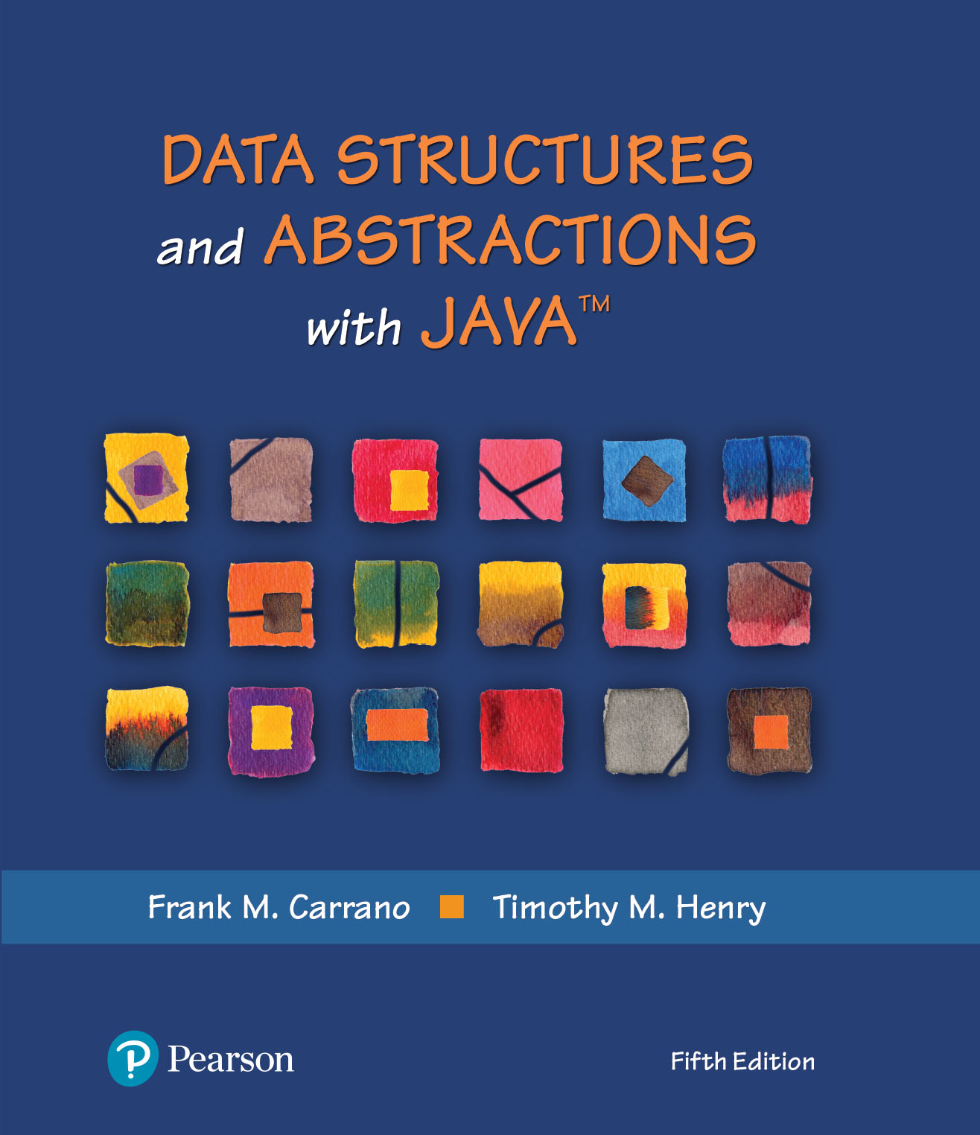
Data Structures and Abstractions with Java™
5th Edition
Java Interlude 4
Iterators

Slide 2
What Is an Iterator?
An object that traverses a collection of data
During iteration, each data item is considered once
Possible to modify item as accessed
Should implement as a distinct class that interacts with the ADT

Slide 3
The Java Interface Iterator
package java.util;
public interface Iterator<T>
{
/** Detects whether this iterator has completed its traversal
and gone beyond the last entry in the collection of data.
@return True if the iterator has another entry to return. */
public boolean hasNext();
/** Retrieves the next entry in the collection and
advances this iterator by one position.
@return A reference to the next entry in the iteration,
if one exists.
@throws NoSuchElementException if the iterator had reached the
end already, that is, if hasNext() is false. */
public T next();
/** Removes from the collection of data the last entry that
next() returned. A subsequent call to next() will behave
as it would have before the removal.
Precondition: next() has been called, and remove() has not
been called since then. The collection has not been altered
during the iteration except by calls to this method.
@throws IllegalStateException if next() has not been called, or
if remove() was called already after the last call to next().
@throws UnsupportedOperationException if the iterator does
not permit a remove operation. */
public void remove(); // Optional method
} // end Iterator

Slide 4
The Java Interface Iterator
FIGURE J4-1 Possible positions of an iterator’s cursor within a collection

Slide 5
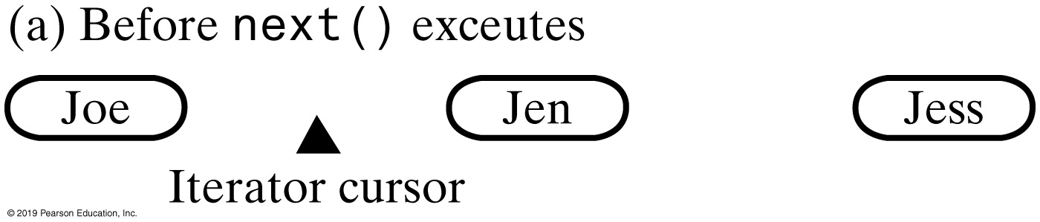
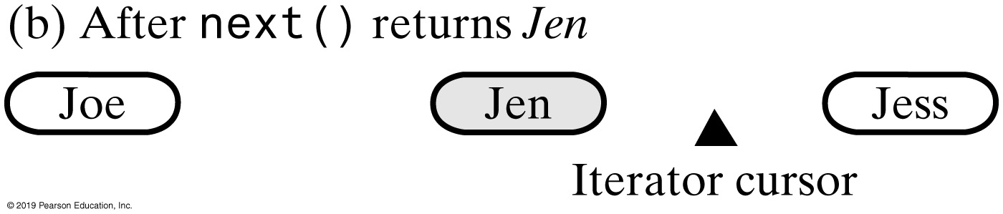
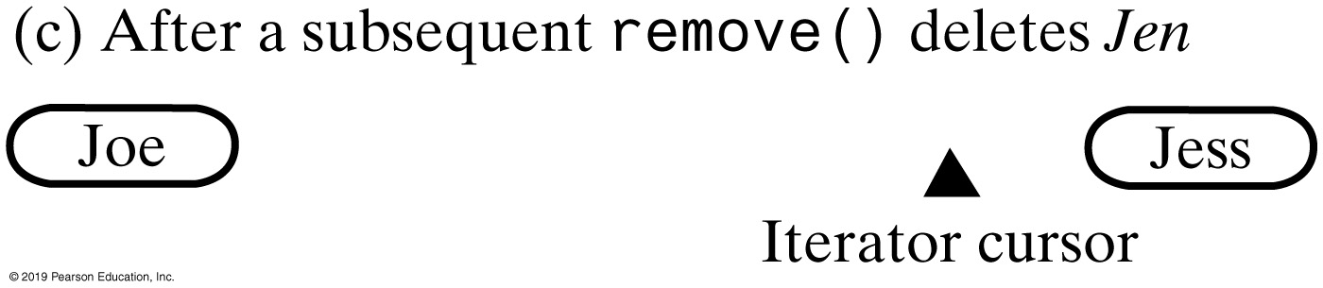
The Java Interface Iterator
FIGURE J4-2 Effect on a collection’s iterator by a call to next and subsequent call to remove

Slide 6
The Interface Iterable
package java.lang;
public interface Iterable<T>
{
/** @return An iterator for a collection of objects of type T. */
Iterator<T> iterator();
} // end Iterable
LISTING JI5-2 The interface java.lang.Iterable

Slide 7
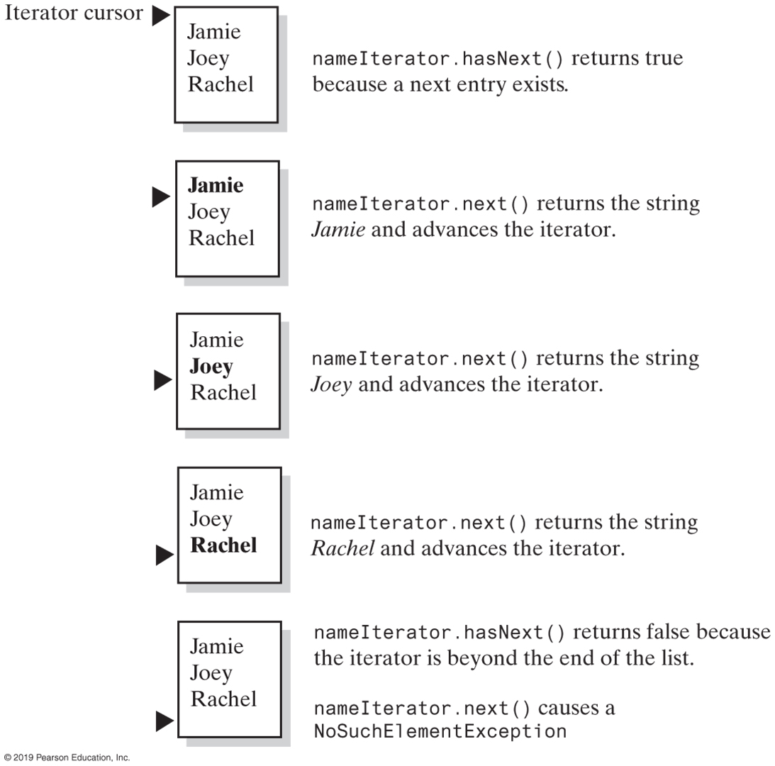
Using the Java Interface Iterator
FIGURE J4-3 The effect of the iterator methods hasNext and next on a list

Slide 8
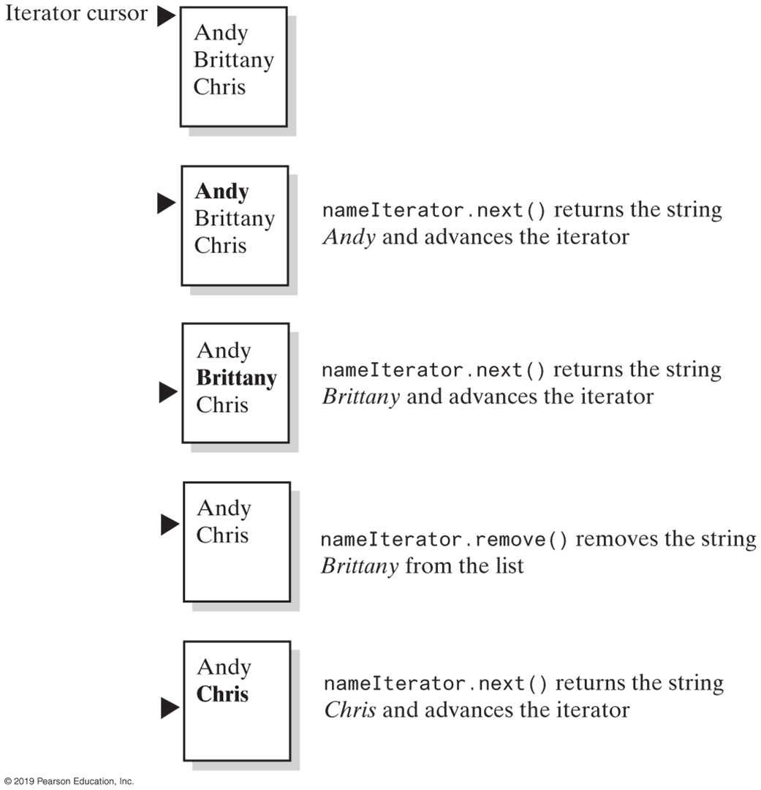
Using the Java Interface Iterator
FIGURE J4-4 The effect of the iterator methods next and remove on a list

Slide 9
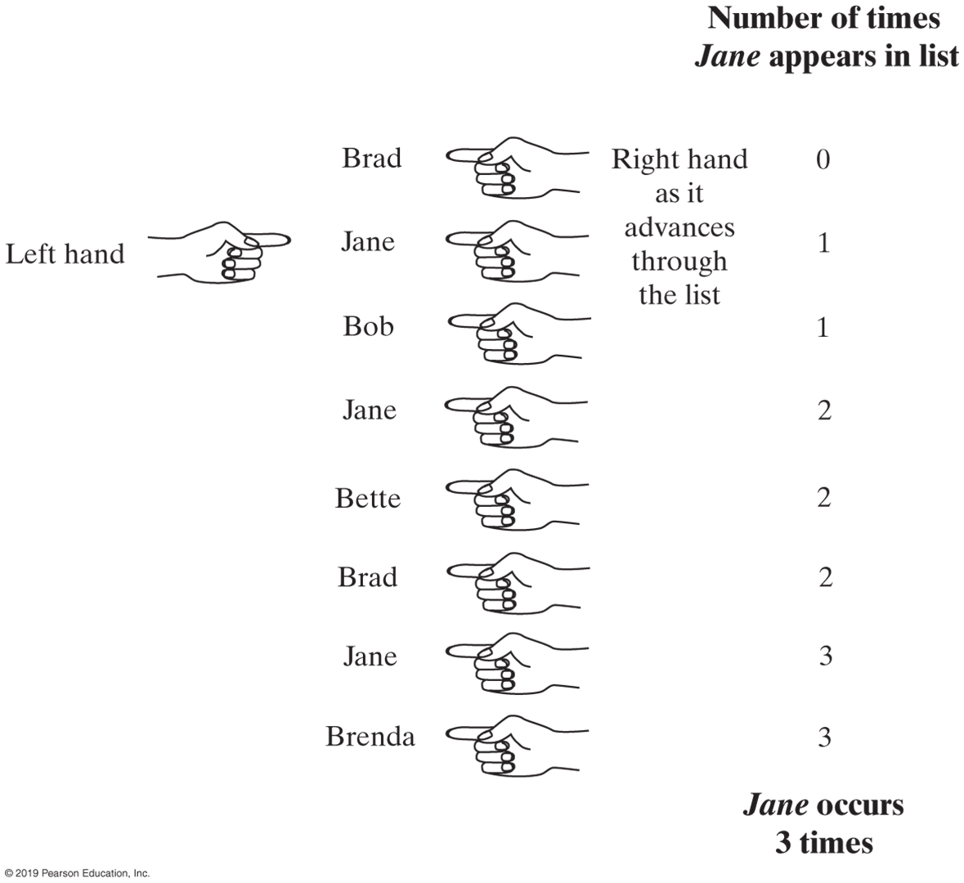
Using the Java Interface Iterator
FIGURE J4-5 Counting the number of times that Jane appears in a list of names

Slide 10
Multiple Iterators
Iterator<String> nameIterator = namelist.iterator();
while (nameIterator.hasNext())
{
String currentName = nameIterator.next();
int nameCount = 0;
Iterator<String> countingIterator = namelist.iterator();
while (countingIterator.hasNext())
{
String nextName = countingIterator.next();
if (currentName.equals(nextName))
nameCount++;
} // end while
System.out.println(currentName + " occurs " + nameCount + " times.");
} // end while
Code that counts the occurrences of each name

Slide 11
LISTING JI4-3 Java’s interface java.util.ListIterator (Part 1)
package java.util;
public interface ListIterator<T> extends Iterator<T>
{
/** Detects whether this iterator has gone beyond the last
entry in the list.
@return True if the iterator has another entry to return when
traversing the list forward; otherwise returns false. */
public boolean hasNext();
/** Retrieves the next entry in the list and
advances this iterator by one position.
@return A reference to the next entry in the iteration,
if one exists.
@throws NoSuchElementException if the iterator is at the end,
that is, if hasNext() is false. */
public T next();
/** Removes from the list the last entry that either next()
or previous() has returned.
Precondition: next() or previous() has been called, but the
iterator's remove() or add() method has not been called
since then. That is, you can call remove only once per
call to next() or previous(). The list has not been altered
during the iteration except by calls to the iterator's
remove(), add(), or set() methods.
@throws IllegalStateException if next() or previous() has not
been called, or if remove() or add() has been called
already after the last call to next() or previous().
@throws UnsupportedOperationException if the iterator does not
permit a remove operation. */
public void remove(); // Optional method
These three methods are in the interface Iterator; they are duplicated here for reference and to show new behavior for remove.

Slide 12
LISTING JI4-3 Java’s interface java.util.ListIterator (Part 2)
/** Detects whether this iterator has gone before the first
entry in the list.
@return True if the iterator has another entry to visit when
traversing the list backward; otherwise returns false. */
public boolean hasPrevious();
/** Retrieves the previous entry in the list and moves this
iterator back by one position.
@return A reference to the previous entry in the iteration, if
one exists.
@throws NoSuchElementException if the iterator has no previous
entry, that is, if hasPrevious() is false. */
public T previous();
/** Gets the index of the next entry.
@return The index of the list entry that a subsequent call to
next() would return. If next() would not return an entry
because the iterator is at the end of the list, returns
the size of the list. Note that the iterator numbers
the list entries from 0 instead of 1. */
public int nextIndex();
/** Gets the index of the previous entry.
@return The index of the list entry that a subsequent call to
previous() would return. If previous() would not return
an entry because the iterator is at the beginning of the
list, returns −1. Note that the iterator numbers the
list entries from 0 instead of 1. */
public int previousIndex();

Slide 13
LISTING JI4-3 Java’s interface java.util.ListIterator (Part 3)
/** Adds an entry to the list just before the entry, if any,
that next() would have returned before the addition. This
addition is just after the entry, if any, that previous()
would have returned. After the addition, a call to
previous() will return the new entry, but a call to next()
will behave as it would have before the addition.
Further, the addition increases by 1 the values that
nextIndex() and previousIndex() will return.
@param newEntry An object to be added to the list.
@throws ClassCastException if the class of newEntry prevents the
addition to the list.
@throws IllegalArgumentException if some other aspect of
newEntry prevents the addition to the list.
@throws UnsupportedOperationException if the iterator does not
permit an add operation. */
public void add(T newEntry); // Optional method
/** Replaces the last entry in the list that either next()
or previous() has returned.
Precondition: next() or previous() has been called, but the
iterator's remove() or add() method has not been called since then.
@param newEntry An object that is the replacement entry.
@throws ClassCastException if the class of newEntry prevents the
addition to the list.
@throws IllegalArgumentException if some other aspect of newEntry
prevents the addition to the list.
@throws IllegalStateException if next() or previous() has not been called,
or if remove() or add() has been called already
after the last call to next() or previous().
@throws UnsupportedOperationException if the iterator does not permit a set operation. */
public void set(T newEntry); // Optional method
} // end ListIterator

Slide 14
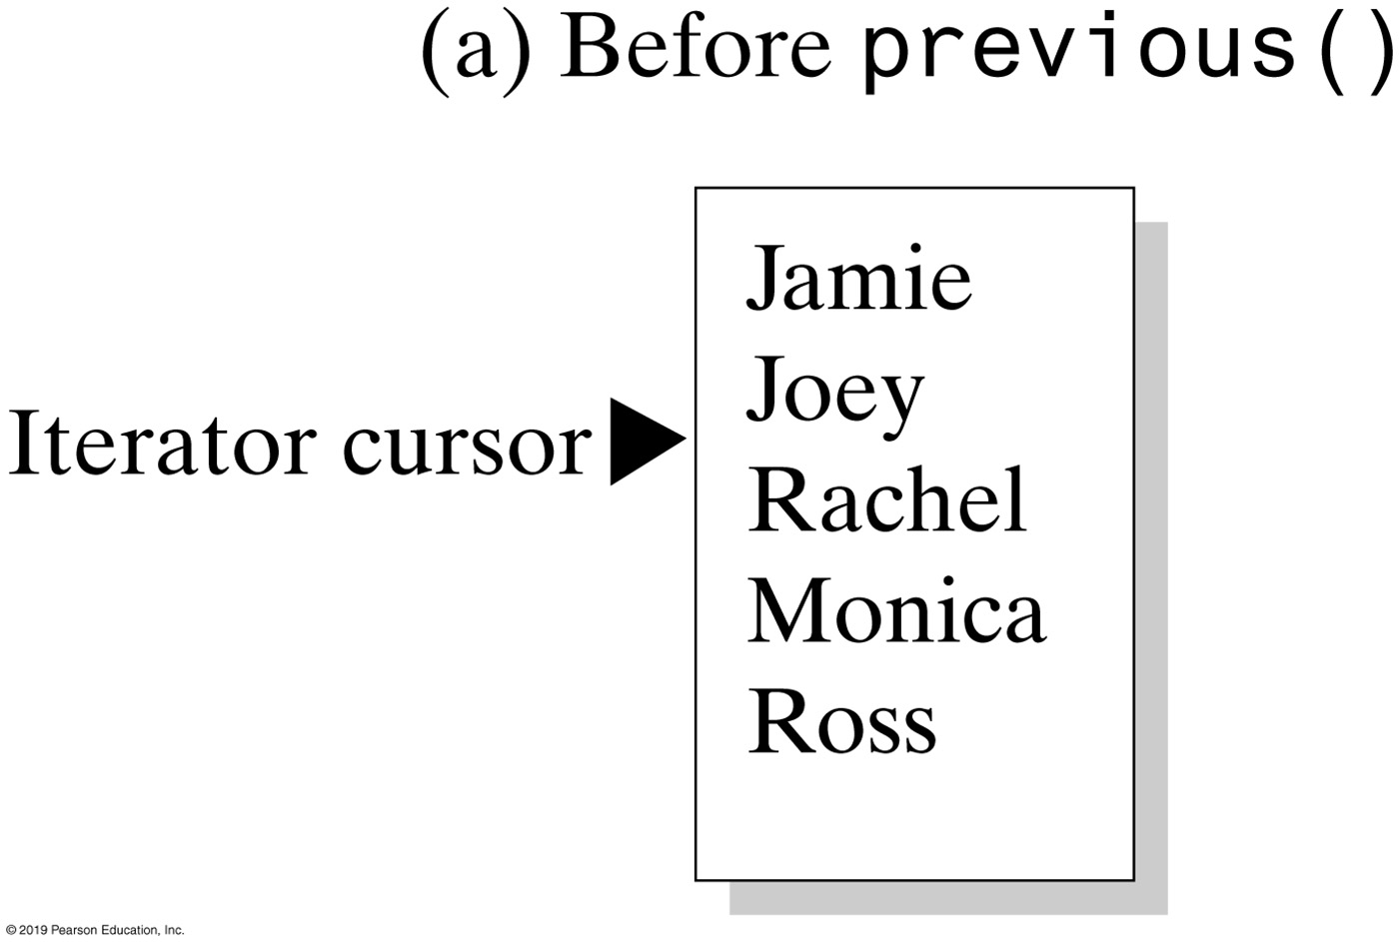
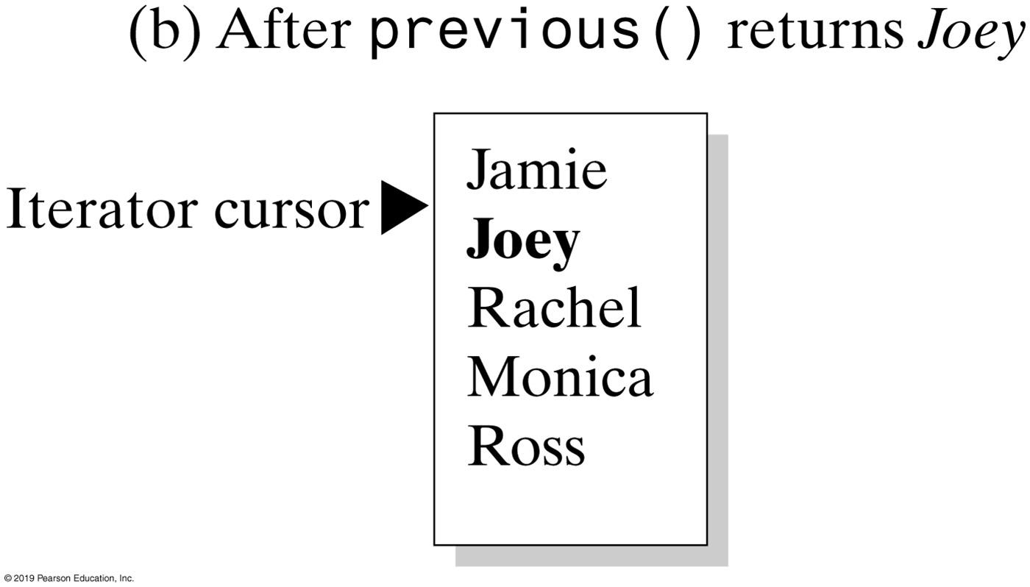
Using the Java Interface ListIterator
FIGURE J4-6 The effect of a call to previous on a list

Slide 15
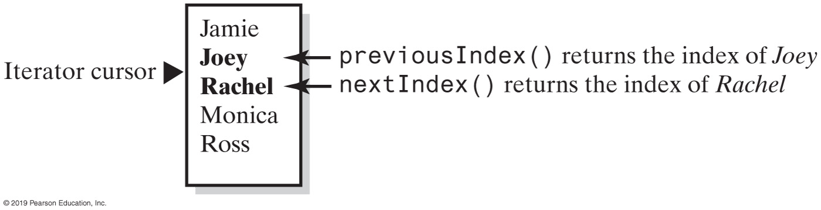
Using the Java Interface ListIterator
FIGURE J4-7 The indices returned by the methods nextIndex and previousIndex

Slide 16
The Interface List Revisited
Method set replaces entry that either next or previous just returned.
Method add inserts an entry into list just before iterator’s current position
Method remove removes list entry that last call to either next or previous returned

Slide 17
End
Java Interlude 4

