Slide 1
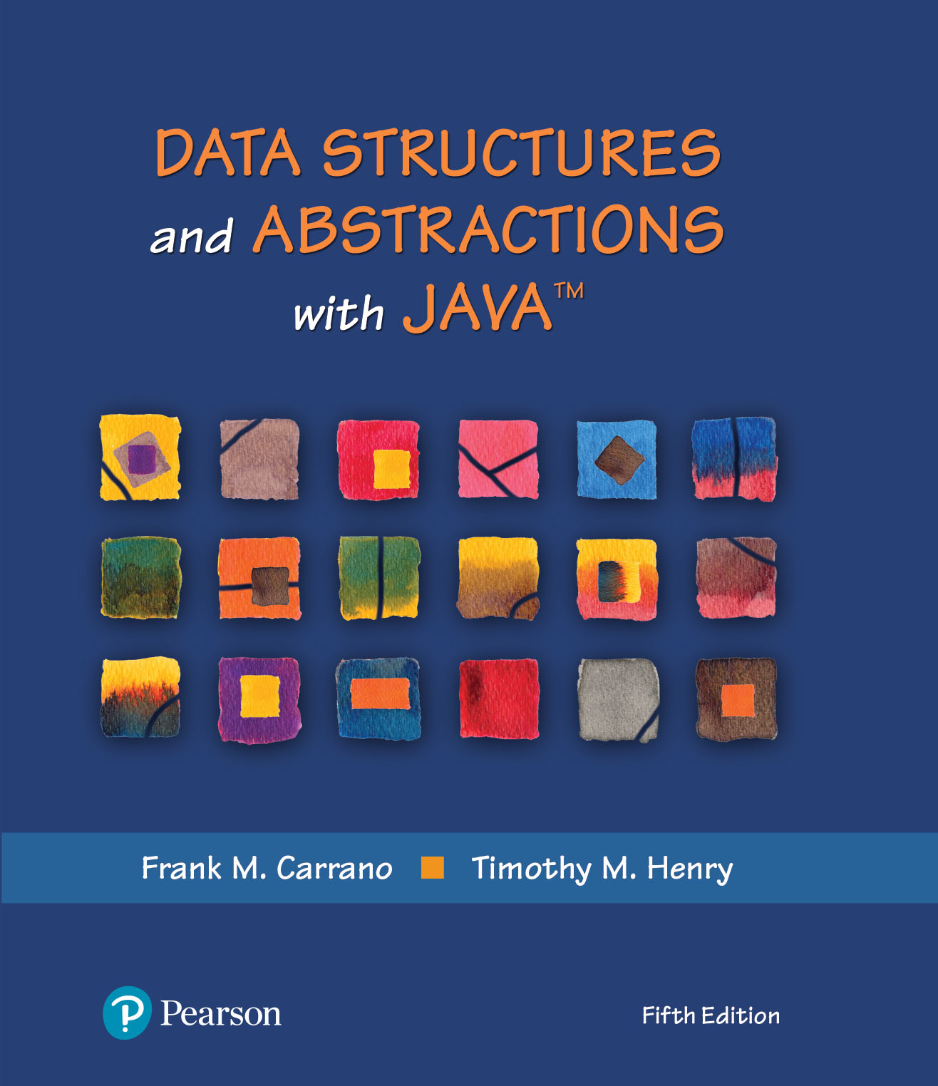
Data Structures and Abstractions with Java™
5th Edition
Chapter 14
Problem Solving
with Recursion

Slide 2
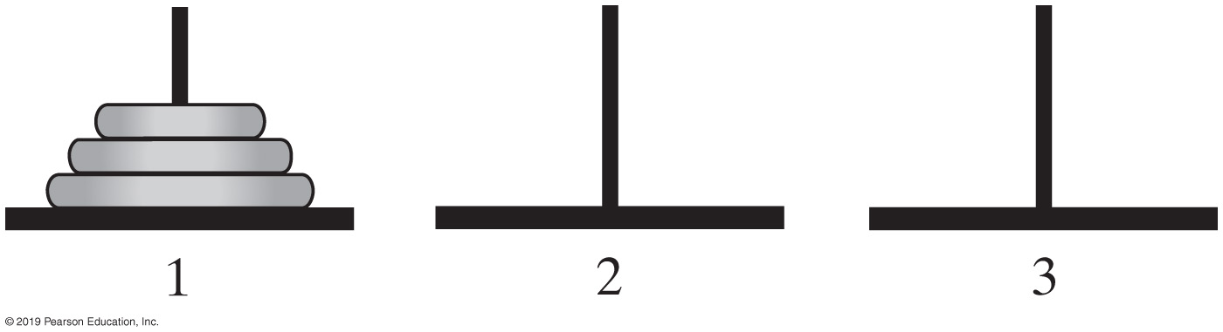
Simple Solution to a Difficult Problem
FIGURE 14-1 The initial configuration of the Towers of Hanoi for three disks

Slide 3
Simple Solution to a Difficult Problem
Rules:
Move one disk at a time. Each disk moved must be the topmost disk.
No disk may rest on top of a disk smaller than itself.
You can store disks on the second (extra) pole temporarily, as long as you observe the previous two rules.
© 2015 Pearson Education, Inc., Upper Saddle River, NJ. All rights reserved.

Slide 4
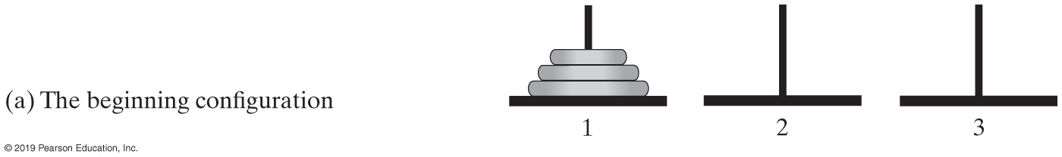
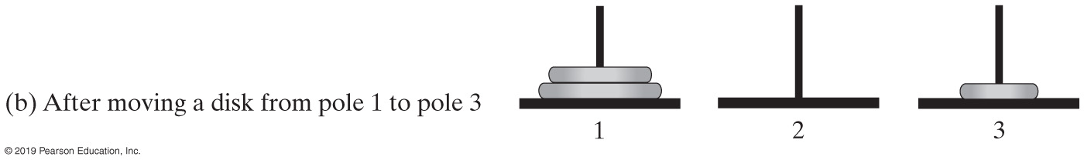
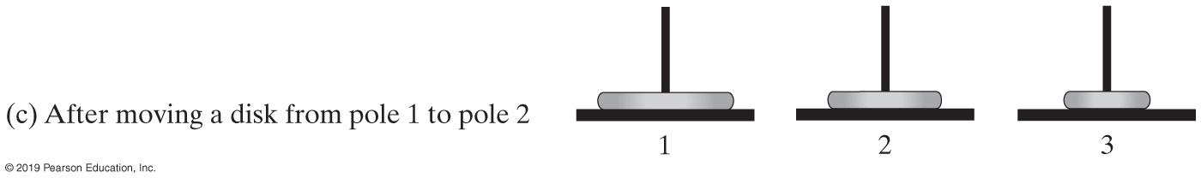
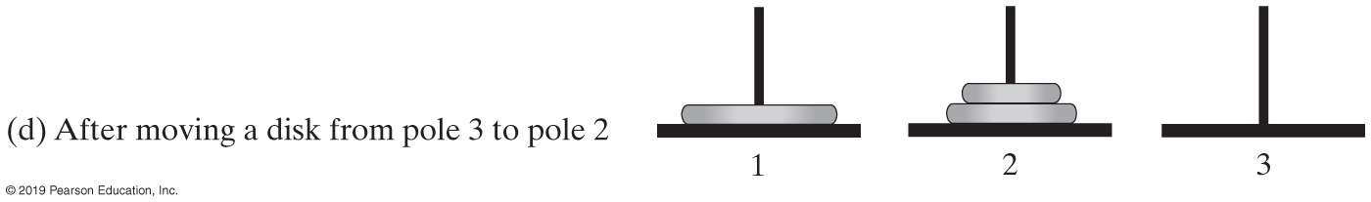
Simple Solution to a Difficult Problem (Part 1)
FIGURE 14-2 Sequence of moves for solving Towers of Hanoi problem with 3 disks

Slide 5
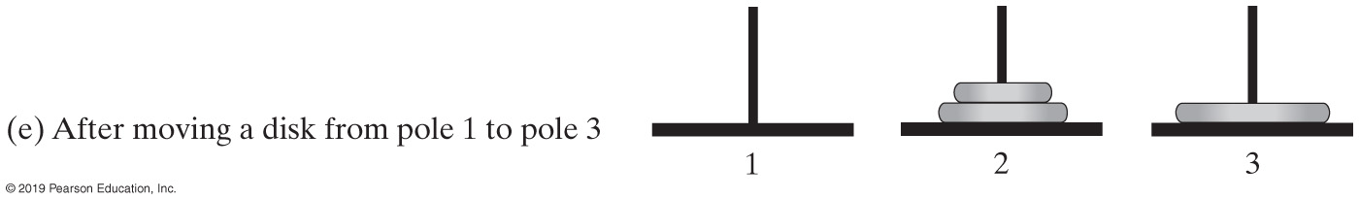
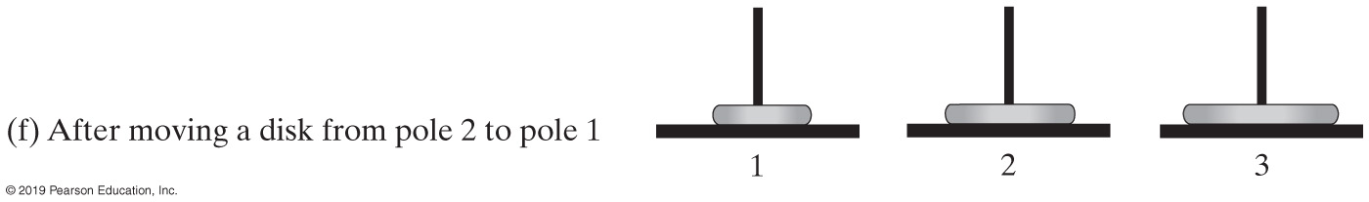
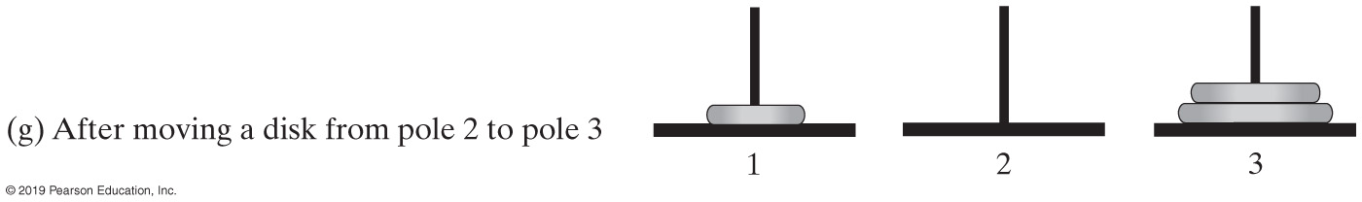
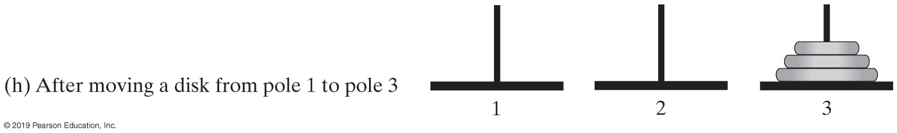
Simple Solution to a Difficult Problem (Part 2)
FIGURE 14-2 Sequence of moves for solving Towers of Hanoi problem with 3 disks

Slide 6
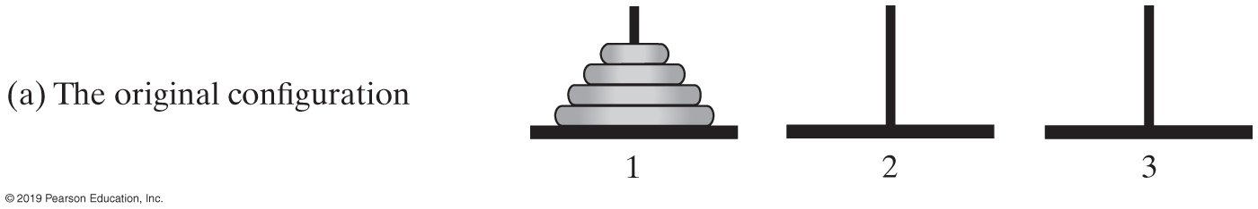
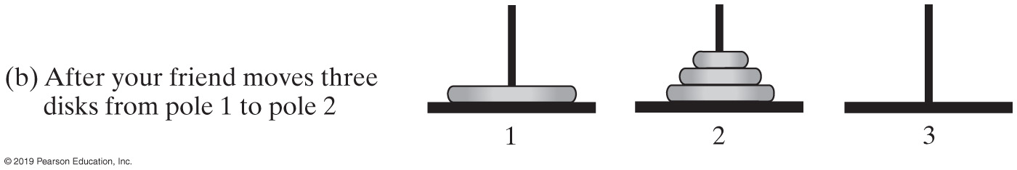
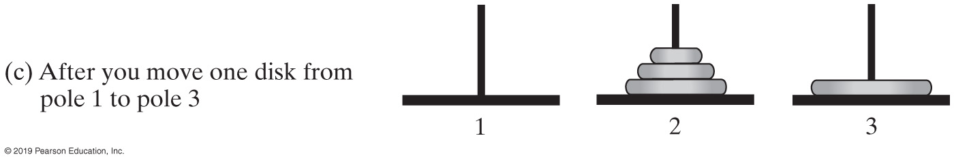
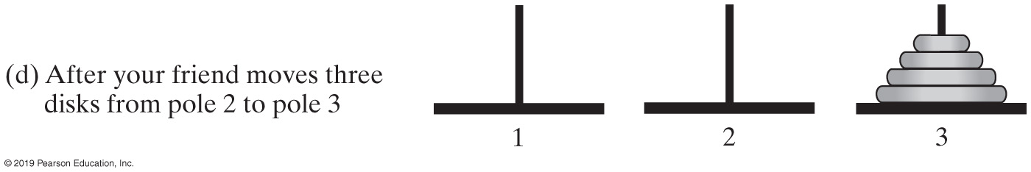
A Smaller Problem
FIGURE 14-3 The smaller problems in a recursive solution for four disks

Slide 7
Solutions
Algorithm to move numberOfDisks disks from startPole to endPole using tempPole
as a spare according to the rules of the Towers of Hanoi problem
if (numberOfDisks == 1)
Move disk from startPole to endPole
else
{
Move all but the bottom disk from startPole to tempPole
Move disk from startPole to endPole
Move all disks from tempPole to endPole
}
Recursive algorithm to solve any number of disks. Note: for n disks, solution will be 2^{n} – 1 moves

Slide 8
Poor Solution to a Simple Problem
F0 = 1
F1 = 1
Fn = Fn - 1 + Fn - 2 when n ≥ 2
Algorithm Fibonacci(n) if (n <= 1)
return 1
else
return Fibonacci(n − 1) + Fibonacci(n − 2)
Algorithm to generate Fibonacci numbers.
Why is this inefficient?

Slide 9
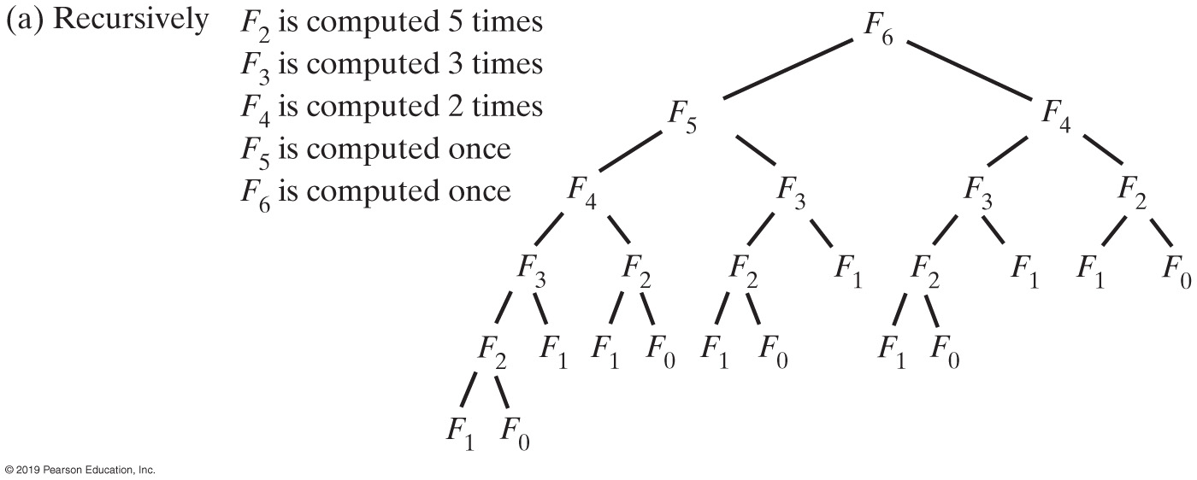
Poor Solution to a Simple Problem
FIGURE 14-4a The computation of the Fibonacci number F6

Slide 10
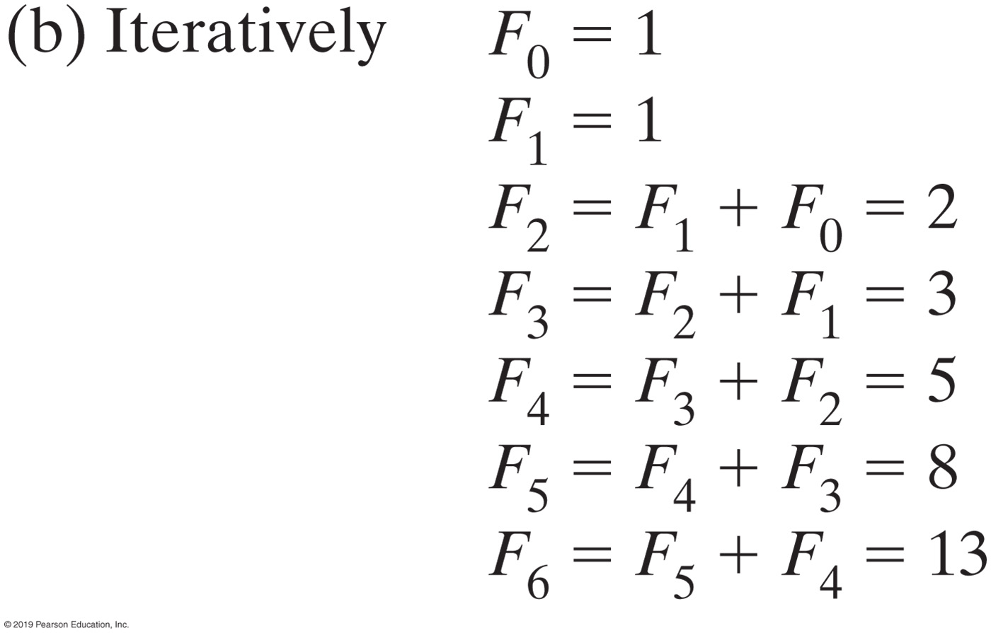
Poor Solution to a Simple Problem
FIGURE 14-4b The computation of the Fibonacci number F6

Slide 11
Indirect Recursion
Example
Method A calls Method B
Method B calls Method C
Method C calls Method A
Difficult to understand and trace
But does happen occasionally

Slide 12
Indirect Recursion
Consider evaluation of validity of an algebraic expression
Algebraic expression is either a term or two terms separated by a + or – operator
Term is either a factor or two factors separated by a * or / operator
Factor is either a variable or an algebraic expression enclosed in parentheses
Variable is a single letter

Slide 13
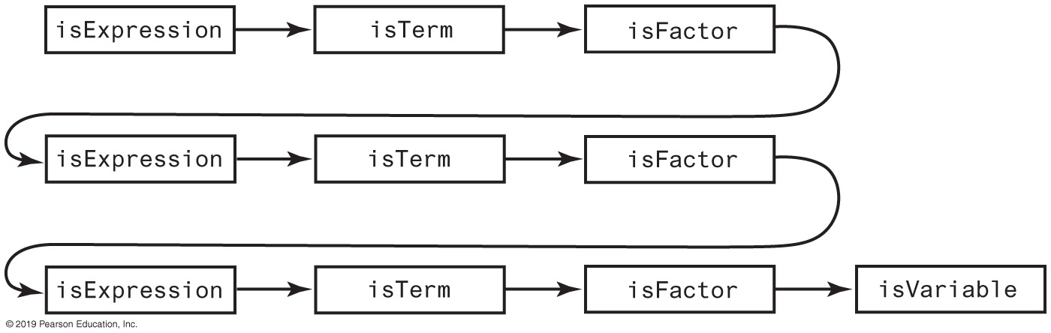
Indirect Recursion
FIGURE 14-5 An example of indirect recursion

Slide 14
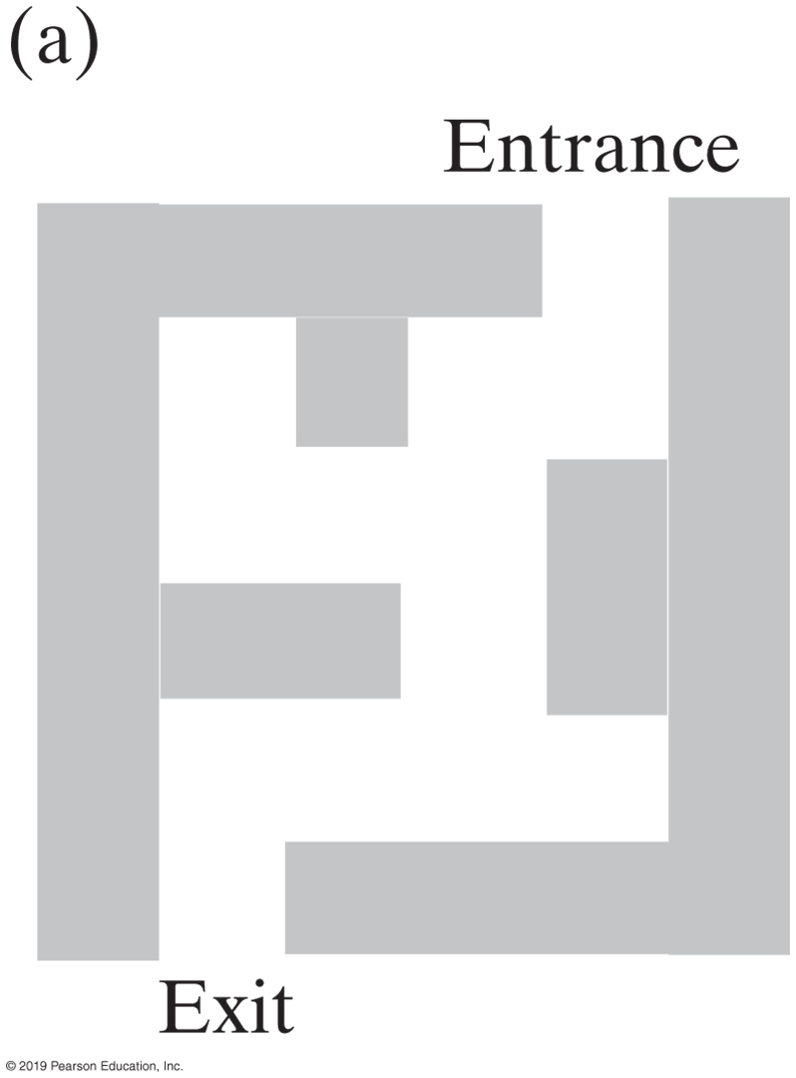
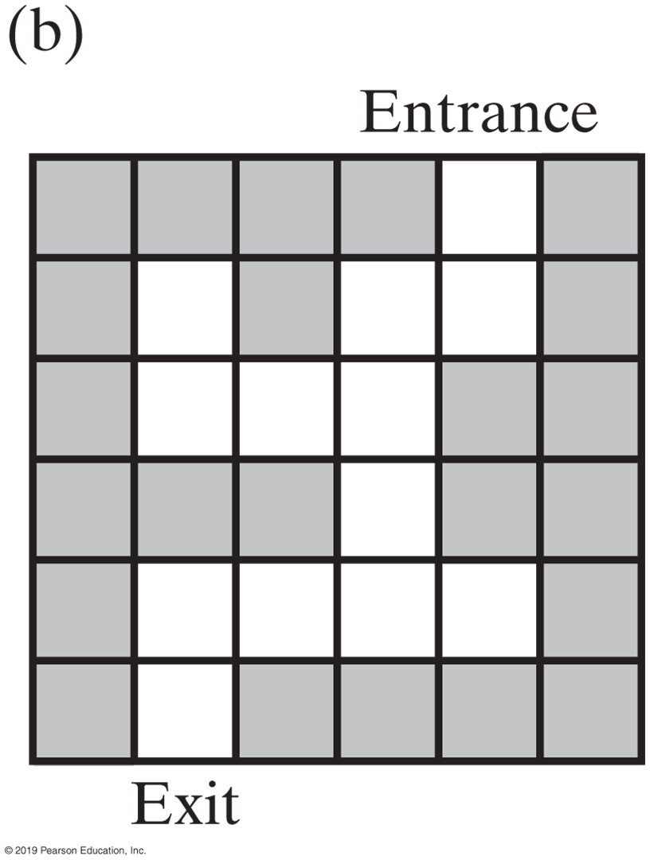
Backtracking
FIGURE 14-6 A two-dimensional maze with one entrance and one exit

Slide 15
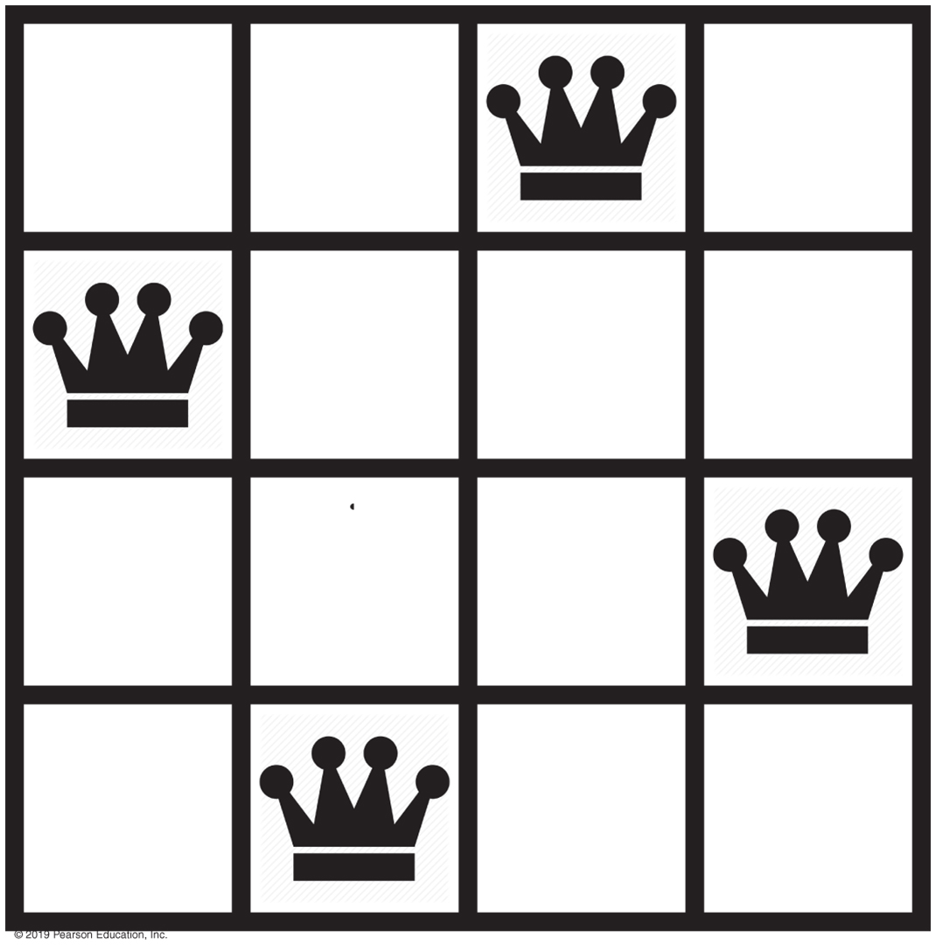
Backtracking
FIGURE 14-7 A solution to the four-queens problem

Slide 16
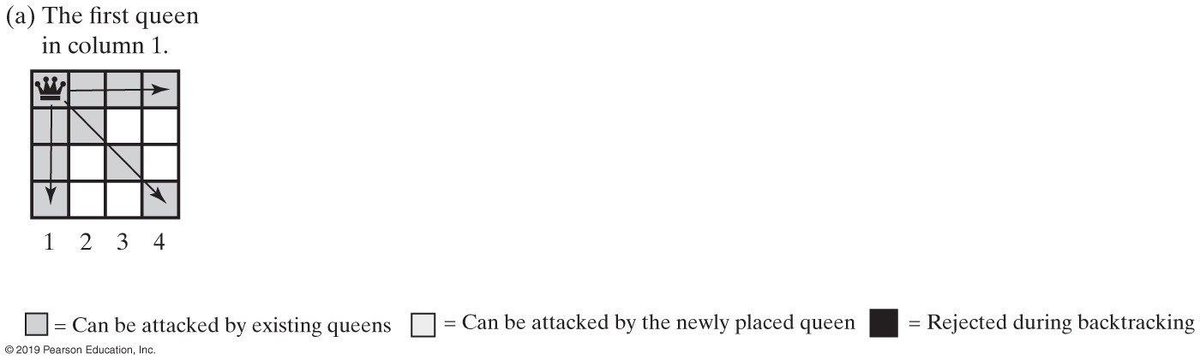
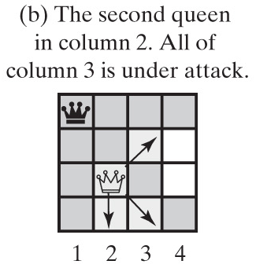
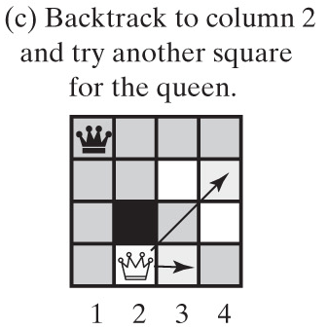
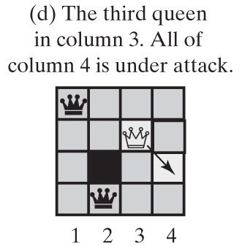
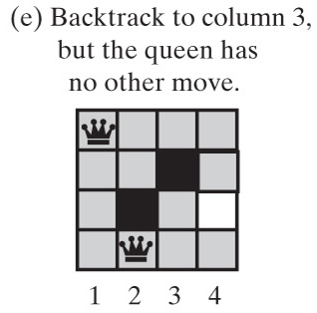
Backtracking - Queens Solution (Part 1)
FIGURE 14-8 Solving the four-queens problem by placing one queen at a time in each column

Slide 17
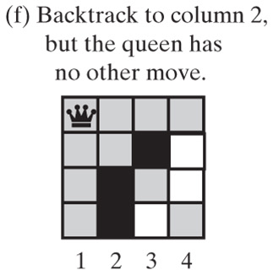
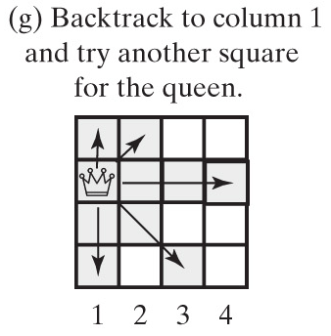
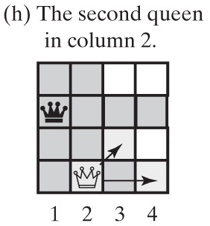
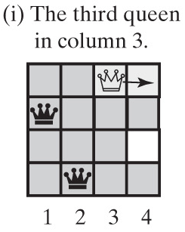
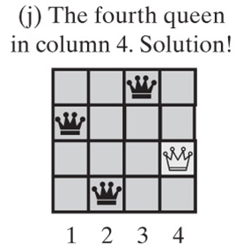
Backtracking - Queens Solution (Part 2)
FIGURE 14-8 Solving the four-queens problem by placing one queen at a time in each column

Slide 18
End
Chapter 14

