Slide 1
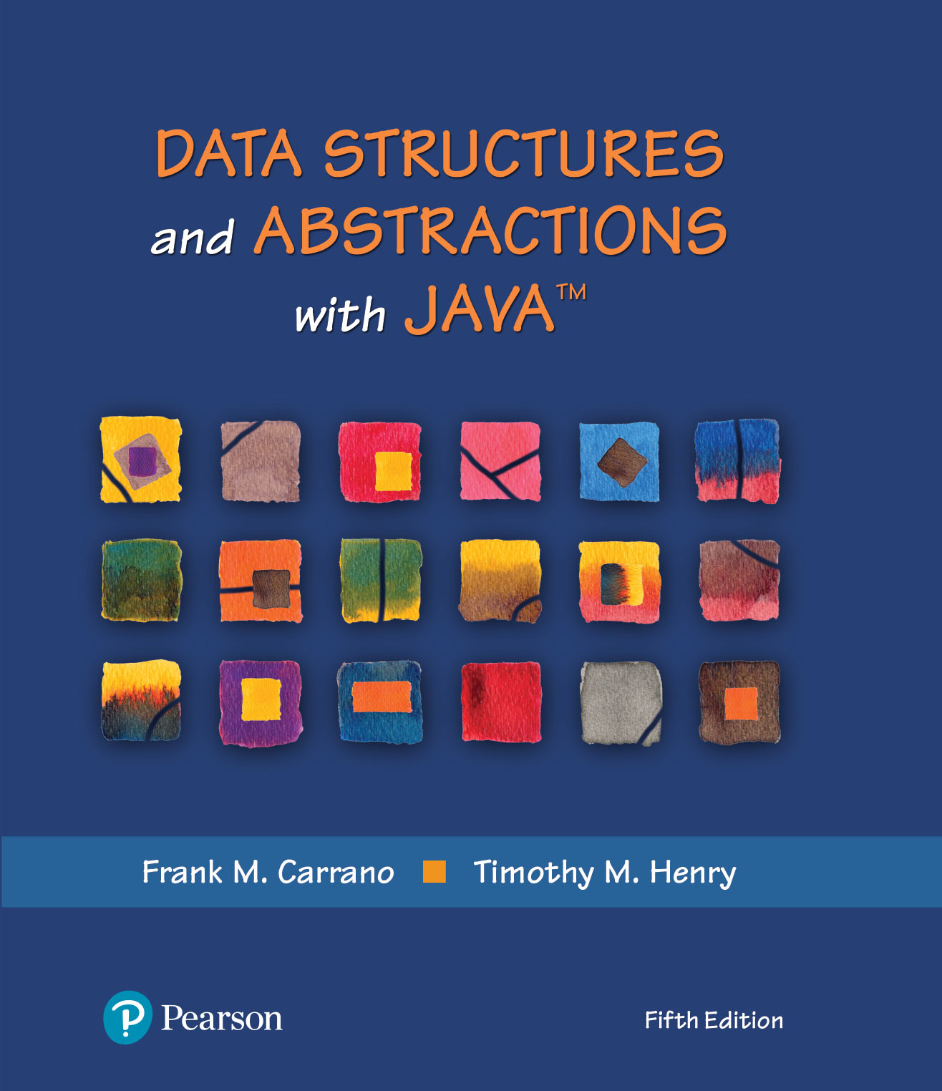
Data Structures and Abstractions with Java™
5th Edition
Java Interlude 5
More About Generics

Slide 2
The Interface Comparable
Consider the method compareTo for class String
if s and t are strings, s.compareTo(t) is
Negative if s comes before t
Zero if s and t are equal
Positive if s comes after t

Slide 3
The Interface Comparable
By invoking compareTo, you compare two objects of the class T.
LISTING JI5-3 The interface java.lang.Comparable
public interface Comparable<T>
{
public int compareTo(T other);
} // end Comparable

Slide 4
The Interface Comparable
Create a class Circle, define compareTo
public class Circle implements Comparable<Circle>, Measurable
{
private double radius;
// Definitions of constructors and methods are here.
// . . .
public int compareTo(Circle other)
{
int result;
if (this.equals(other))
result = 0;
else if (radius < other.radius)
result = -1;
else
result = 1;
return result;
} // compareTo
} // end Circle

Slide 5
Generic Methods
public class Example
{
public static <T> void displayArray(T[] anArray)
{
for (T arrayEntry : anArray)
{
System.out.print(arrayEntry);
System.out.print(' ');
} // end for
System.out.println();
} // end displayArray
public static void main(String args[])
{
String[] stringArray = {"apple", "banana", "carrot", "dandelion"};
System.out.print("stringArray contains ");
displayArray(stringArray);
Character[] characterArray = {'a', 'b', 'c', 'd'};
System.out.print("characterArray contains ");
displayArray(characterArray);
} // end main
} // end Example
Listing JI5-2 An example of a generic method

Slide 6
Bounded Type Parameters
Consider this simple class of squares:
public class Square<T>
{
private T side;
public Square(T initialSide)
{
side = initialSide;
} // end constructor
public T getSide()
{
return side;
} // end getSide
} // end Square
Different types of square objects possible.
Square<Integer> intSquare = new Square<>(5);
Square<Double> realSquare = new Square<>(2.1);
Square<String> stringSquare= new Square<>("25");

Slide 7
Bounded Type Parameters
Imagine that we want to write a static method that returns the smallest object in an array. Suppose that we wrote our method shown here:
public MyClass
{
// First draft and INCORRECT:
public static <T> T arrayMinimum(T[] anArray)
{
T minimum = anArray[0];
for (T arrayEntry : anArray)
{
if (arrayEntry.compareTo(minimum) < 0)
minimum = arrayEntry;
} // end for
return minimum;
} // end arrayMinimum
} // end MyClass

Slide 8
Bounded Type Parameters
Header really should be as shown
public MyClass
{
public static <T extends Comparable<T>> T arrayMinimum(T[] anArray)
{
T minimum = anArray[0];
for (T arrayEntry : anArray)
{
if (arrayEntry.compareTo(minimum) < 0)
minimum = arrayEntry;
} // end for
return minimum;
} // end arrayMinimum
// . . .
} // end MyClass

Slide 9
Wildcards
Question mark, ?, is used to represent an unknown class type
Referred to as a wildcard
Consider following method and objects
public static void displayPair(OrderedPair<?> pair)
{
System.out.println(pair);
} // end displayPair
OrderedPair<String> aPair = new OrderedPair<>("apple", "banana");
OrderedPair<Integer> anotherPair = new OrderedPair<>(1, 2);
Method displayPair will accept as an argument a pair of objects whose data type is any one class
displayPair(aPair);
displayPair(anotherPair);

Slide 10
Bounded Wildcards
<<interface>> Comparable<T>
+compareTo(other: T): integer
Widget
+compareTo(other: Widget): integer
Gadget
FIGURE J5-1 The class Gadget is derived from the class Widget, which implements the interface Comparable

Slide 11
End
Java Interlude 5

