Slide 1
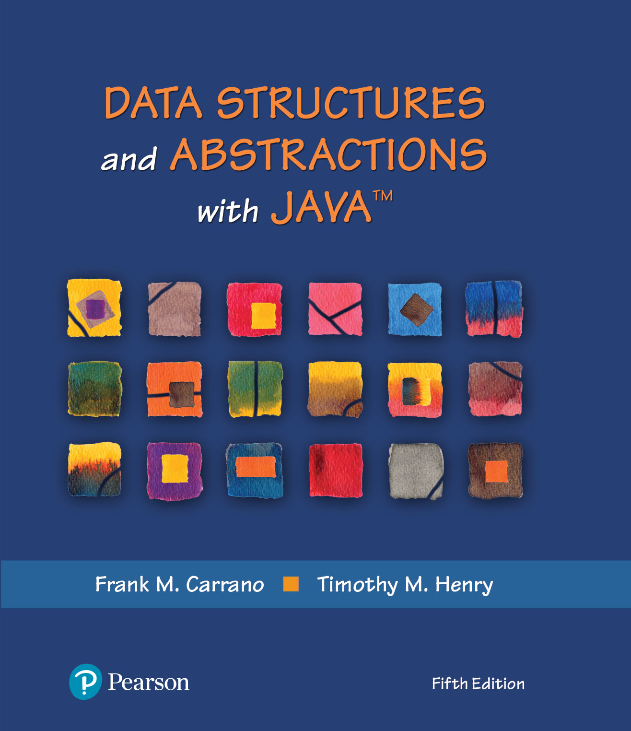
Data Structures and Abstractions with Java™
5th Edition
Chapter 15
An Introduction
to Sorting

Slide 2
Sorting
We seek algorithms to arrange items, ai such that:
entry 1 ≤ entry 2 ≤ . . . ≤ entry n
Sorting an array is usually easier than sorting a chain of linked nodes
Efficiency of a sorting algorithm is significant

Slide 3
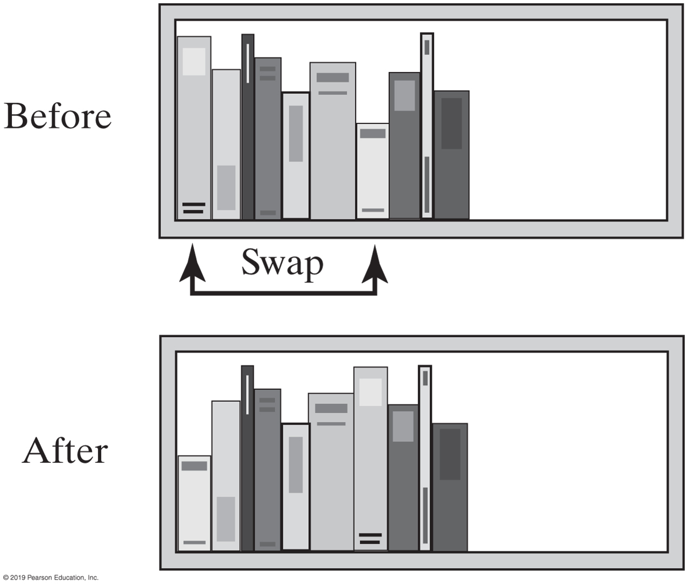
Selection Sort
FIGURE 15-1 Before and after exchanging the shortest book and the first book

Slide 4
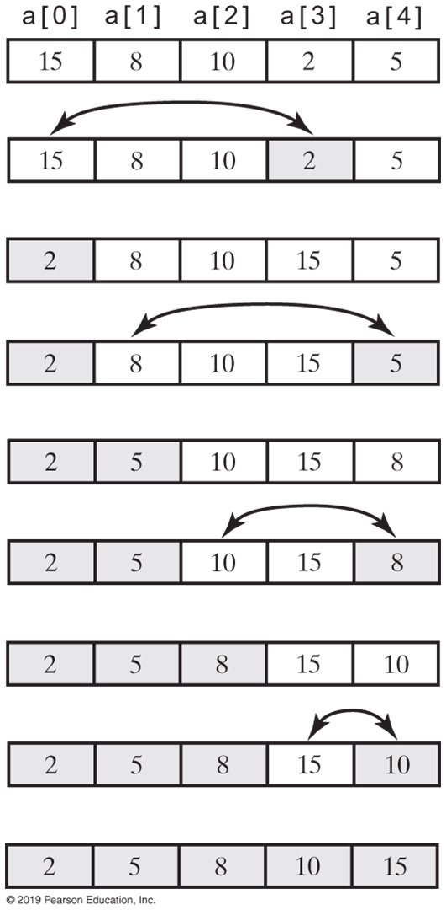
Selection Sort
FIGURE 15-2 A selection sort of an array of integers into ascending order

Slide 5
Iterative Selection Sort
Algorithm selectionSort(a, n)
// Sorts the first n entries of an array a.
for (index = 0; index < n − 1; index++)
{
  indexOfNextSmallest = the index of the smallest value among
  a[index], a[index + 1], . . . , a[n − 1]
  Interchange the values of a[index] and a[indexOfNextSmallest]
  // Assertion: a[0] ≤ a[1] ≤ . . . ≤ a[index], and these are the smallest
  // of the original array entries. The remaining array entries begin at a[index + 1].
}
This pseudocode describes an iterative algorithm for the selection sort

Slide 6
Iterative Selection Sort (Part 1)
/** A class of static, iterative methods for sorting an array of
Comparable objects from smallest to largest. */
public class SortArray
{
/** Sorts the first n objects in an array into ascending order.
@param a An array of Comparable objects.
@param n An integer > 0. */
public static <T extends Comparable<? super T>>
void selectionSort(T[] a, int n)
{
for (int index = 0; index < n - 1; index++)
{
int indexOfNextSmallest = getIndexOfSmallest(a, index, n - 1);
swap(a, index, indexOfNextSmallest);
// Assertion: a[0] <= a[1] <= . . . <= a[index] <= all other a[i]
} // end for
} // end selectionSort
LISTING 15-1 A class for sorting an array using selection sort

Slide 7
Iterative Selection Sort (Part 2)
// Finds the index of the smallest value in a portion of an array a.
// Precondition: a.length > last >= first >= 0.
// Returns the index of the smallest value among
// a[first], a[first + 1], . . . , a[last].
private static <T extends Comparable<? super T>>
int getIndexOfSmallest(T[] a, int first, int last)
{
T min = a[first];
int indexOfMin = first;
for (int index = first + 1; index <= last; index++)
{
if (a[index].compareTo(min) < 0)
{
min = a[index];
indexOfMin = index;
} // end if
// Assertion: min is the smallest of a[first] through a[index].
} // end for
return indexOfMin;
} // end getIndexOfSmallest
LISTING 15-1 A class for sorting an array using selection sort

Slide 8
Iterative Selection Sort (Part 3)
// Swaps the array entries a[i] and a[j].
private static void swap(Object[] a, int i, int j)
{
Object temp = a[i];
a[i] = a[j];
a[j] = temp;
} // end swap
} // end SortArray
LISTING 15-1 A class for sorting an array using selection sort

Slide 9
Recursive Selection Sort
Algorithm selectionSort(a, first, last)
// Sorts the array entries a[first] through a[last] recursively.
if (first < last)
{
  indexOfNextSmallest = the index of the smallest value among
  a[first], a[first + 1], . . . , a[last]
  Interchange the values of a[first] and a[indexOfNextSmallest]
  // Assertion: a[0] ≤ a[1] ≤ . . . ≤ a[first] and these are the smallest
  // of the original array entries. The remaining array entries begin at a[first + 1].
  selectionSort(a, first + 1, last)
}
Recursive selection sort algorithm

Slide 10
Efficiency of Selection Sort
Selection sort is O(n²) regardless of the initial order of the entries.
  Requires O(n²) comparisons
  Does only O(n) swaps

Slide 11
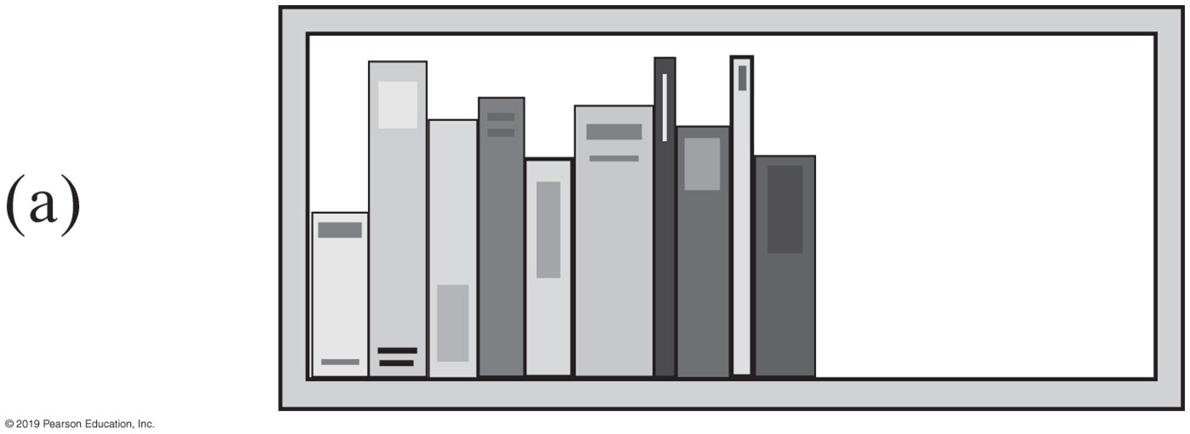
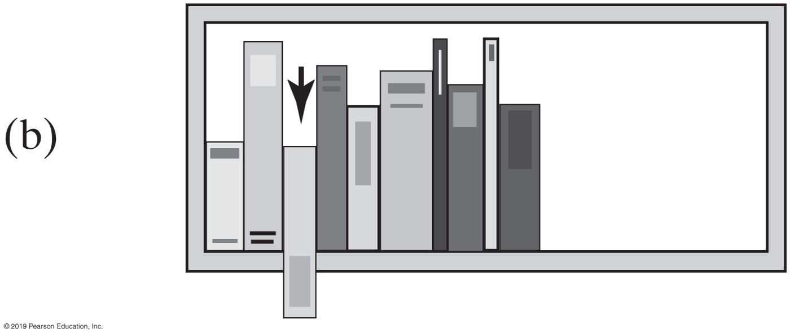
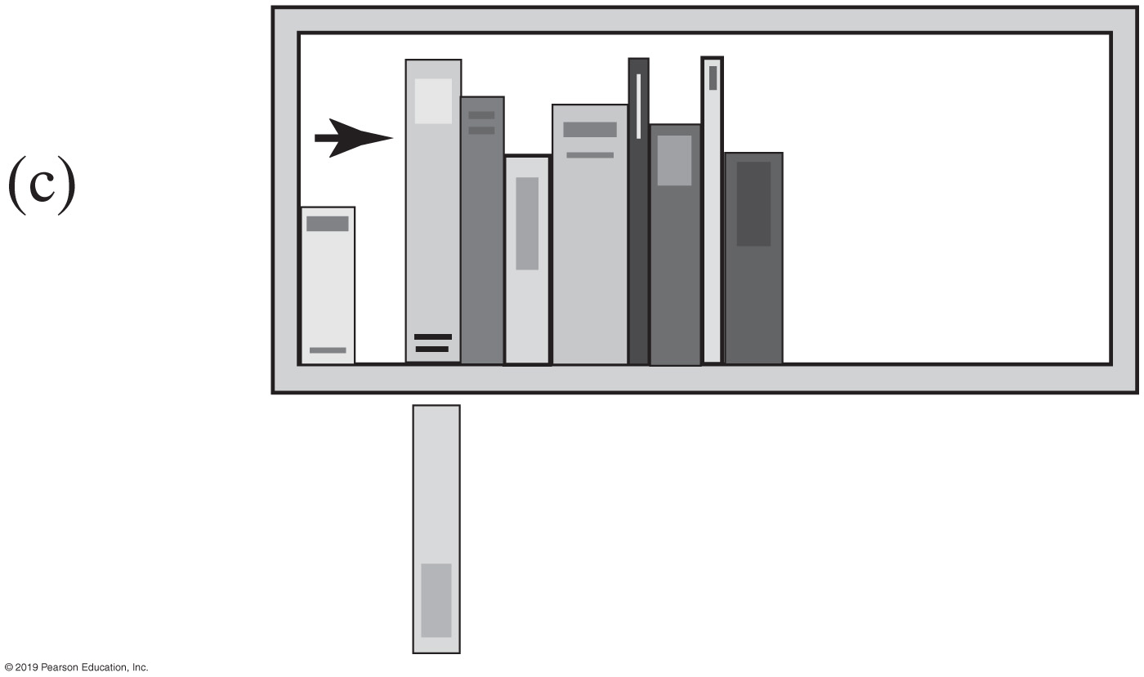
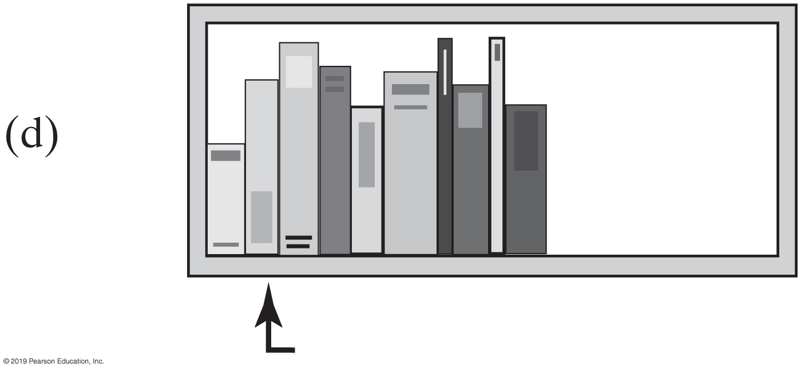
Insertion Sort
FIGURE 15-3 The placement of the third book during an insertion sort

Slide 12
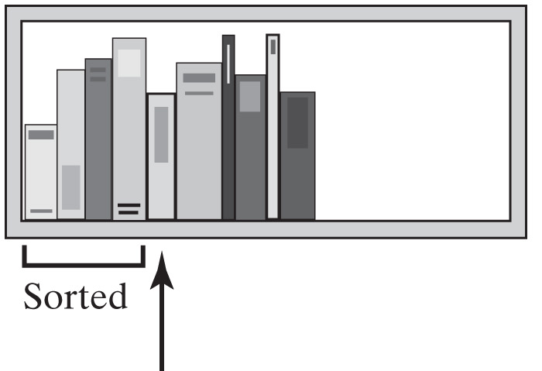
Insertion Sort
Remove the next unsorted book.
Slide the sorted books to the right one by one until you find the right spot for the removed book.
Insert the book into its new position
FIGURE 15-4 An insertion sort of books

Slide 13
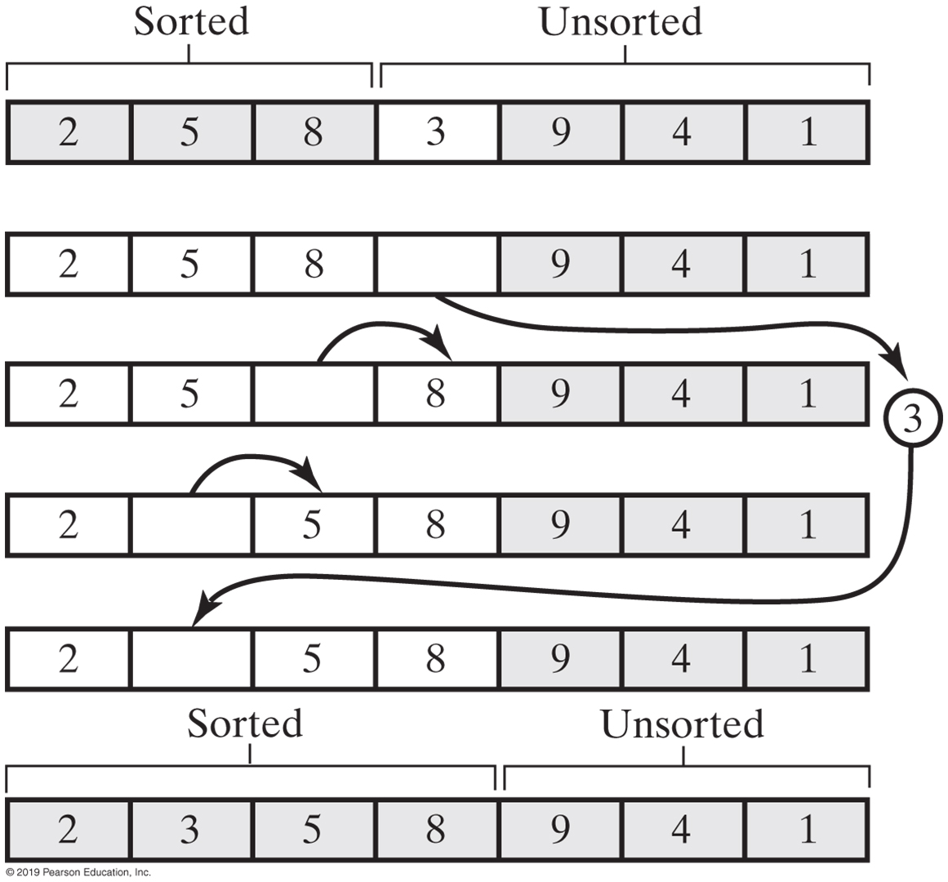
Insertion Sort
FIGURE 15-5 Inserting the next unsorted entry into its proper location within the sorted portion of an array during an insertion sort

Slide 14
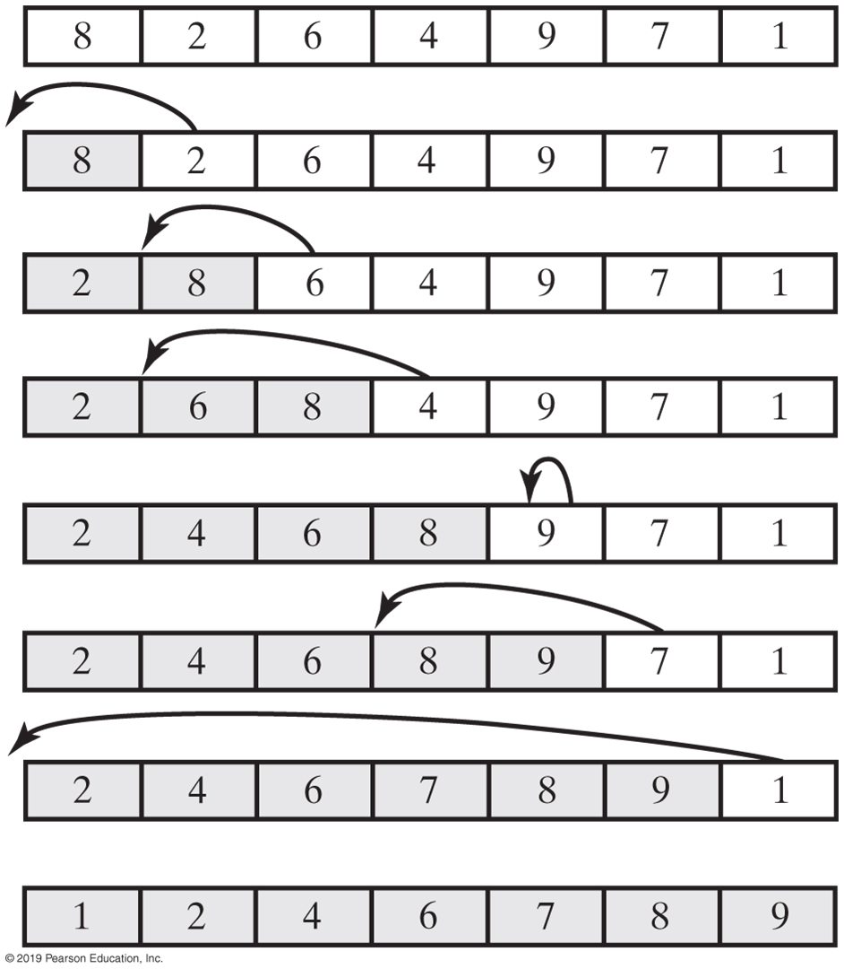
Insertion Sort
FIGURE 15-6 An insertion sort of an array of integers into ascending order

Slide 15
Iterative Insertion Sort
Algorithm insertionSort(a, first, last)
// Sorts the array entries a[first] through a[last] iteratively.
for (unsorted = first + 1 through last)
{
    nextToInsert = a[unsorted] insertInOrder(nextToInsert, a, first, unsorted − 1)
}
Iterative algorithm describes an insertion sort of the entries at indices first through last of the array a

Slide 16
Iterative Insertion Sort
Algorithm insertInOrder(anEntry, a, begin, end)
// Inserts anEntry into the sorted entries a[begin] through a[end].
index = end // Index of last entry in the sorted portion
// Make room, if needed, in sorted portion for another entry
while ( (index >= begin) and (anEntry < a[index]) )
{
    a[index + 1] = a[index] // Make room
    index−−
}
// Assertion: a[index + 1] is available.
a[index + 1] = anEntry // Insert
Pseudocode of method, insertInOrder, to perform the insertions.

Slide 17
Recursive Insertion Sort
Algorithm insertionSort(a, first, last)
// Sorts the array entries a[first] through a[last] recursively.
if (the array contains more than one entry)
{
    Sort the array entries a[first] through a[last − 1]
    Insert the last entry a[last] into its correct sorted position within the rest of the array
}
This pseudocode describes a recursive insertion sort.

Slide 18
Recursive Insertion Sort
public static <T extends Comparable<? super T>>
void insertionSort(T[] a, int first, int last)
{
if (first < last)
{
// Sort all but the last entry
insertionSort(a, first, last - 1);
// Insert the last entry in sorted order
insertInOrder(a[last], a, first, last - 1);
} // end if
} // end insertionSort
Implementing the algorithm in Java

Slide 19
Recursive Insertion Sort
Algorithm insertInOrder(anEntry, a, begin, end)
// Inserts anEntry into the sorted array entries a[begin] through a[end].
// First draft.
if (anEntry >= a[end])
    a[end + 1] = anEntry
else
{
    a[end + 1] = a[end] insertInOrder(anEntry, a, begin, end − 1)
}
First draft of insertInOrder algorithm.

Slide 20
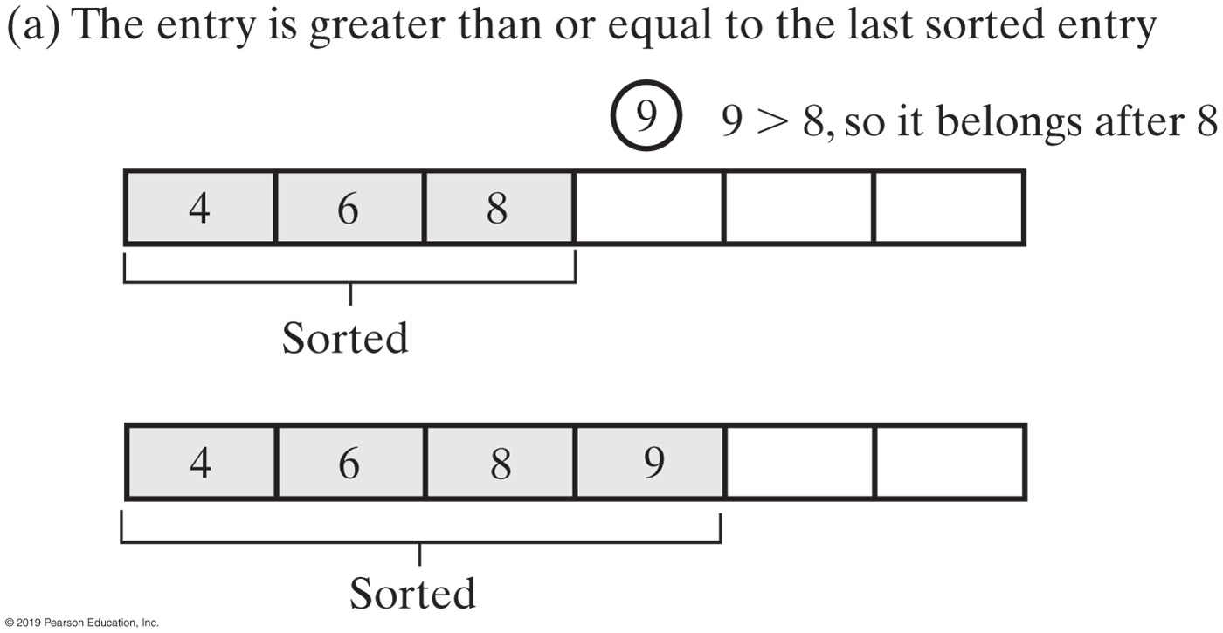
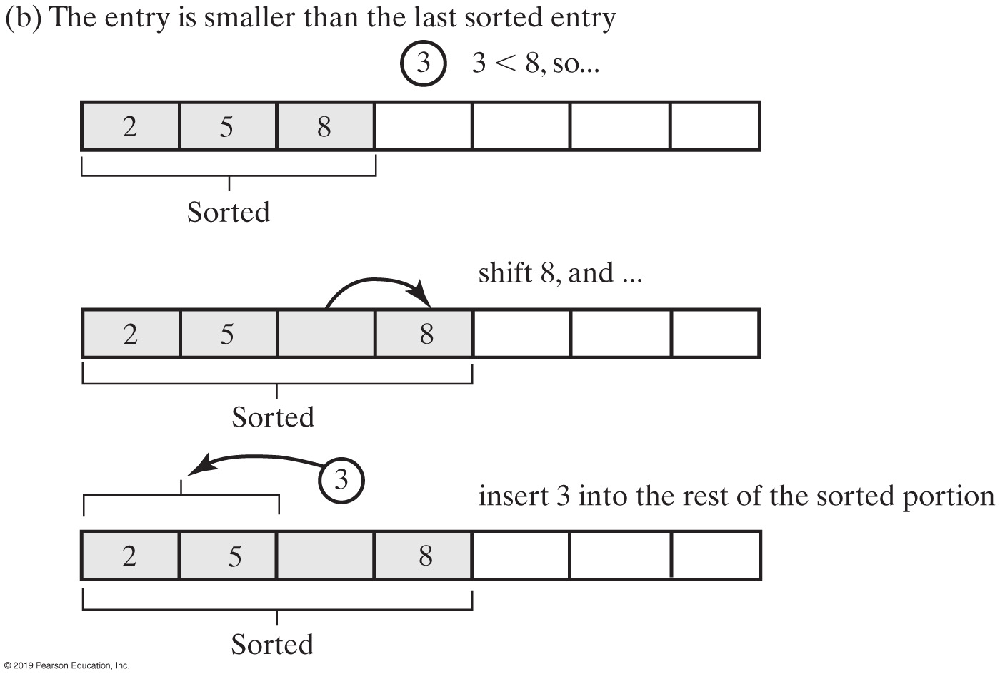
Insertion Sort
FIGURE 15-7 Inserting the first unsorted entry into the sorted portion of the array

Slide 21
Recursive Insertion Sort
Algorithm insertInOrder(anEntry, a, begin, end)
// Inserts anEntry into the sorted array entries a[begin] through a[end].
// Revised draft.
if (anEntry >= a[end])
    a[end + 1] = anEntry
else if (begin < end)
{
    a[end + 1] = a[end] insertInOrder(anEntry, a, begin, end − 1)
}
else // begin == end and anEntry < a[end]
{
    a[end + 1] = a[end]
    a[end] = anEntry
}
The algorithm insertInOrder: final draft.
Note: insertion sort efficiency (worst case) is O(n²)

Slide 22

Insertion Sort with a Linked Chain
FIGURE 15-8 A chain of integers sorted into ascending order

Slide 23
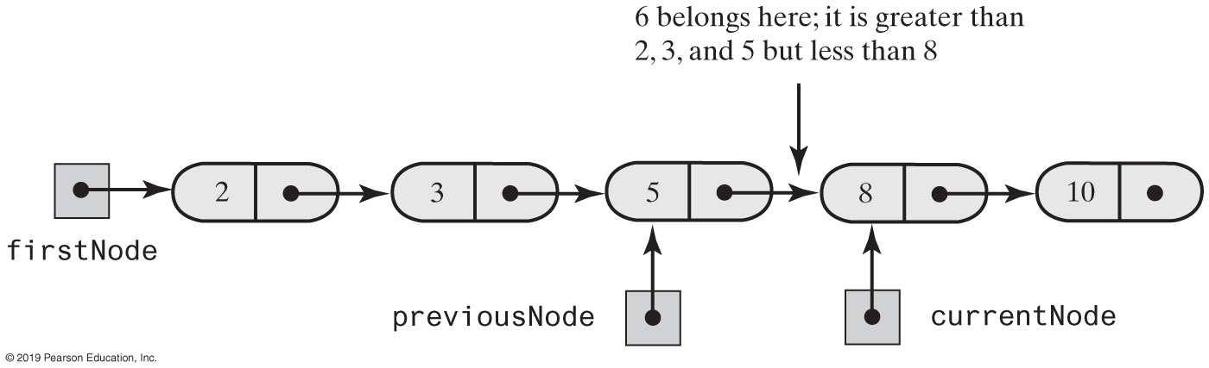
Insertion Sort with a Linked Chain
FIGURE 15-9 During the traversal of a chain to locate the insertion point, save a reference to the node before the current one

Slide 24
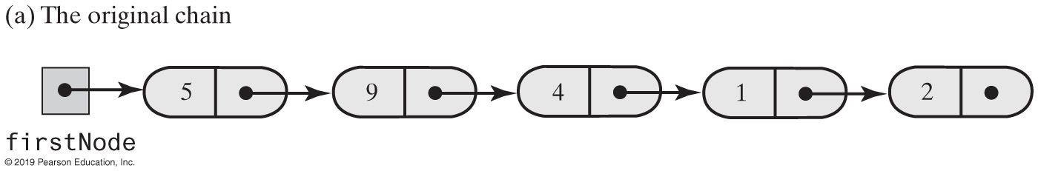
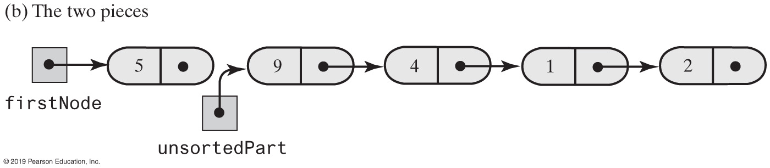
Insertion Sort with a Linked Chain
FIGURE 15-10 Breaking a chain of nodes into two pieces as the first step in an insertion sort

Slide 25
Insertion Sort with a Linked Chain
public class LinkedGroup<T extends Comparable<? super T>>
{
private Node firstNode;
int length; // Number of objects in the group
// . . .
private class Node
{
// private inner class Node is implemented here.
}
Add a sort method to a class LinkedGroup that uses a linked chain to represent a certain collection

Slide 26
Insertion Sort with a Linked Chain
private void insertInOrder(Node nodeToInsert)
{
T item = nodeToInsert.getData();
Node currentNode = firstNode;
Node previousNode = null;
// Locate insertion point
while ( (currentNode != null) &&
(item.compareTo(currentNode.getData()) > 0) )
{
previousNode = currentNode;
currentNode = currentNode.getNextNode();
} // end while
// Make the insertion
if (previousNode != null)
{ // Insert between previousNode and currentNode
previousNode.setNextNode(nodeToInsert);
nodeToInsert.setNextNode(currentNode);
}
else // Insert at beginning
{
nodeToInsert.setNextNode(firstNode);
firstNode = nodeToInsert;
} // end if
} // end insertInOrder
Class has an inner class Node with set and get methods

Slide 27
Insertion Sort with a Linked Chain
public void insertionSort()
{
// If fewer than two items are in the list, there is nothing to do
if (length > 1)
{
// Assertion: firstNode != null
// Break chain into 2 pieces: sorted and unsorted
Node unsortedPart = firstNode.getNextNode();
// Assertion: unsortedPart != null
firstNode.setNextNode(null);
while (unsortedPart != null)
{
Node nodeToInsert = unsortedPart;
unsortedPart = unsortedPart.getNextNode();
insertInOrder(nodeToInsert);
} // end while
} // end if
} // end insertionSort
Insertion sort method

Slide 28
Shell Sort
Algorithms so far are simple
      but inefficient for large arrays at O(n²)
The more sorted an array is, the less work insertInOrder must do
Improved insertion sort developed by Donald Shell

Slide 29
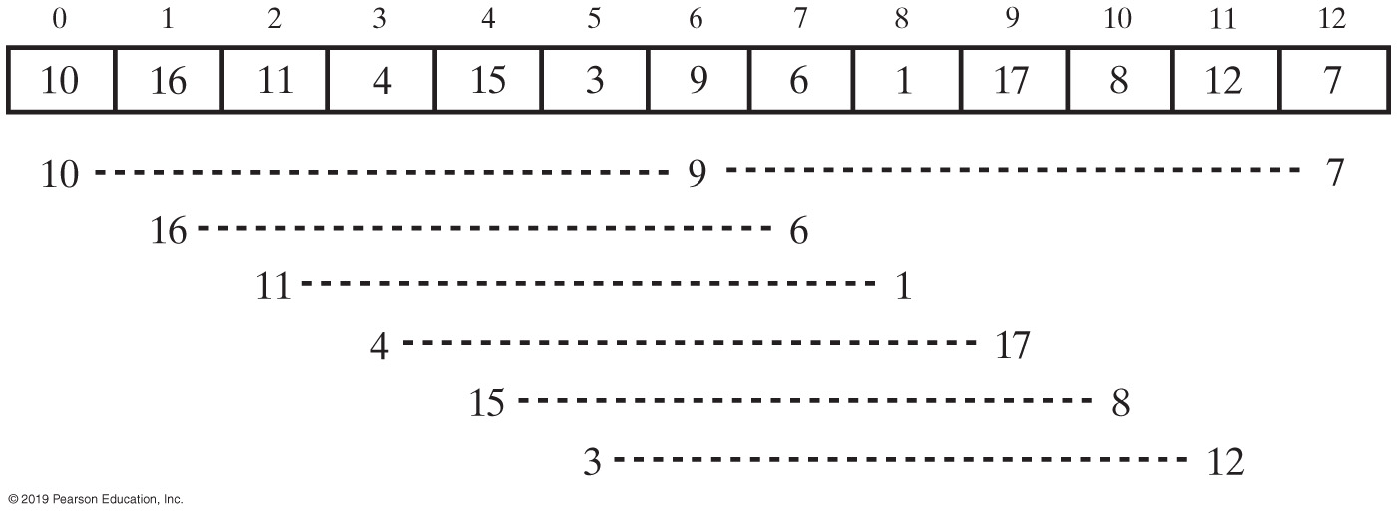
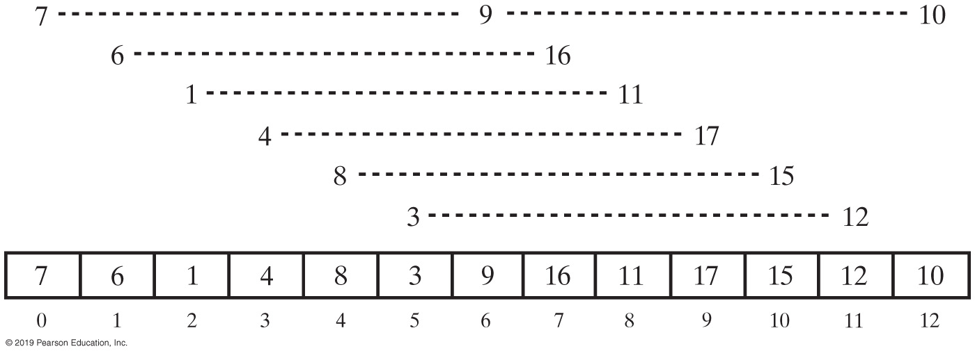
Shell Sort
Before Ordering
After Ordering
FIGURE 15-11 An array and the groups of entries whose indices are 6 apart before and after ordering groups

Slide 30
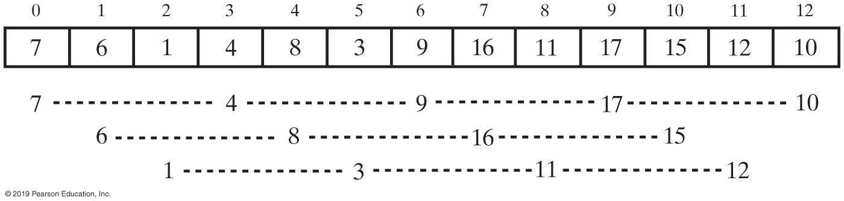
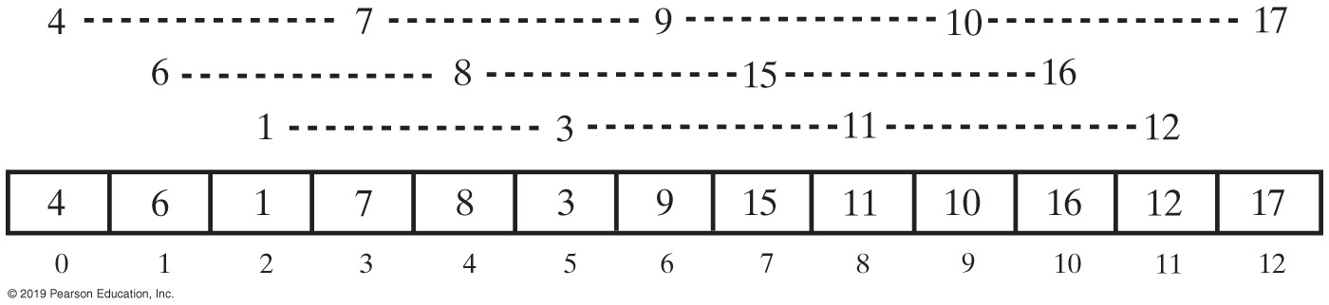
Shell Sort
Before Ordering
After Ordering
Grouped entries in the array in Figure 15-12 whose indices are 3 apart before and after ordering groups

Slide 31
Comparing Algorithms
 | Best Case | Average Case | Worst Case
Selection Sort | O(n²) | O(n²) | O(n²)
Insertion Sort | O(n) | O(n²) | O(n²)
Shell Sort | O(n) | O(n^{1.5}) | O(n^{1.5})
FIGURE 15-15 The time efficiencies of three sorting algorithms, expressed in Big Oh notation

Slide 32
End
Chapter 15

