Slide 1
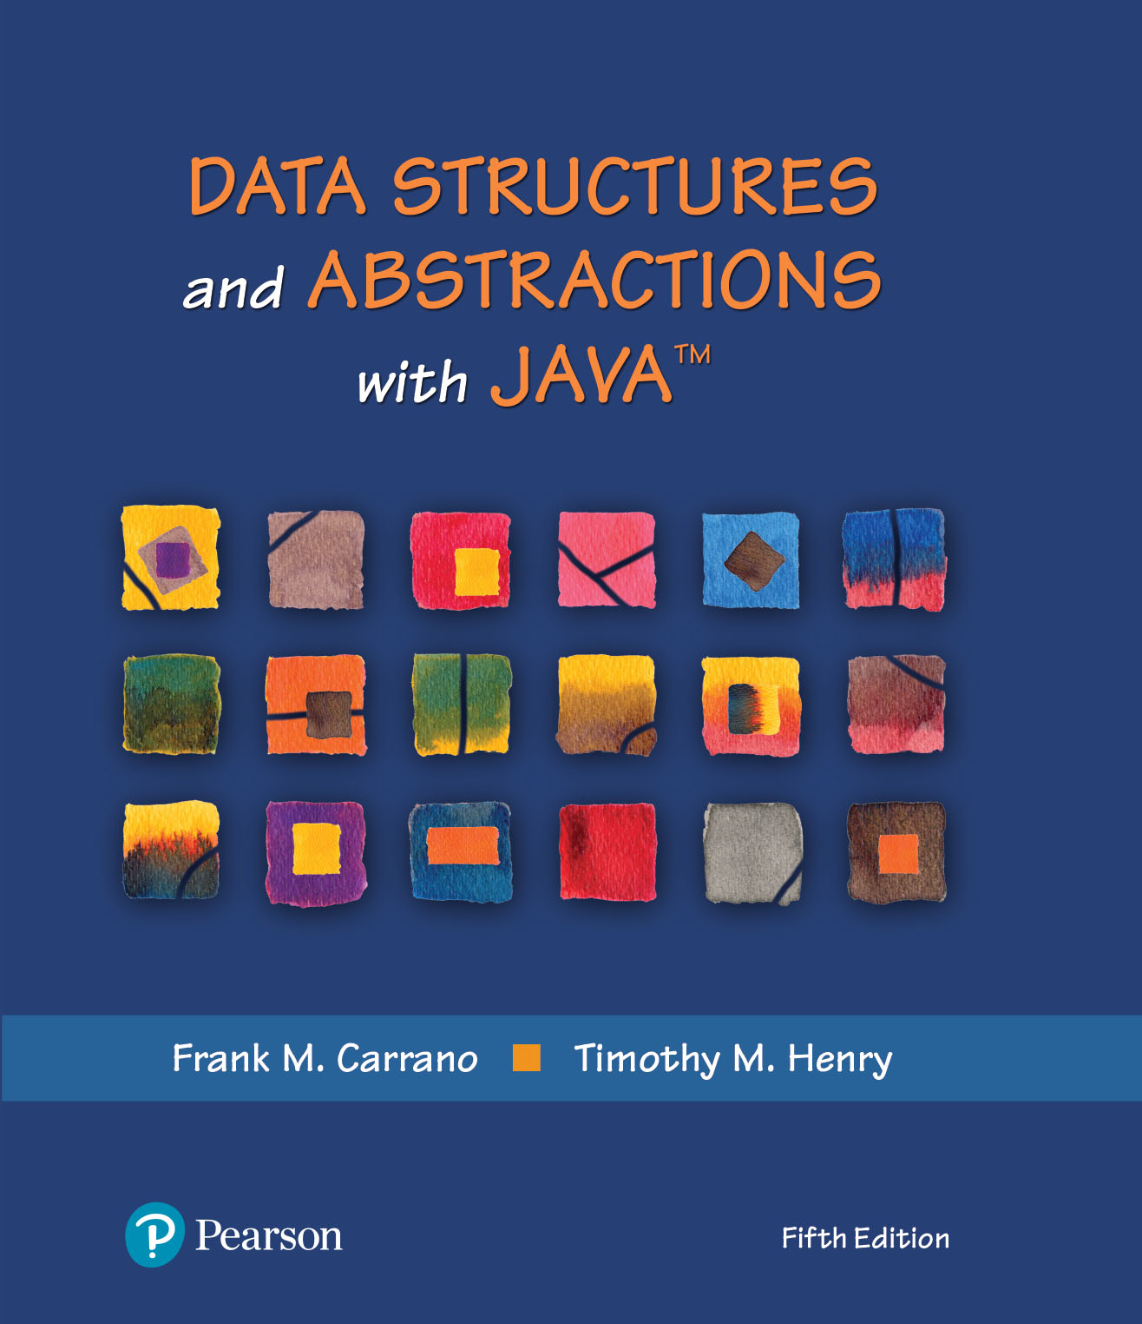
Data Structures and Abstractions with Java™
5th Edition
Chapter 16
Faster Sorting Methods

Slide 2
Merge Sort
Divides an array into halves
Sorts the two halves,
Then merges them into one sorted array.
The algorithm for merge sort is usually stated recursively.
Major programming effort is in the merge process

Slide 3
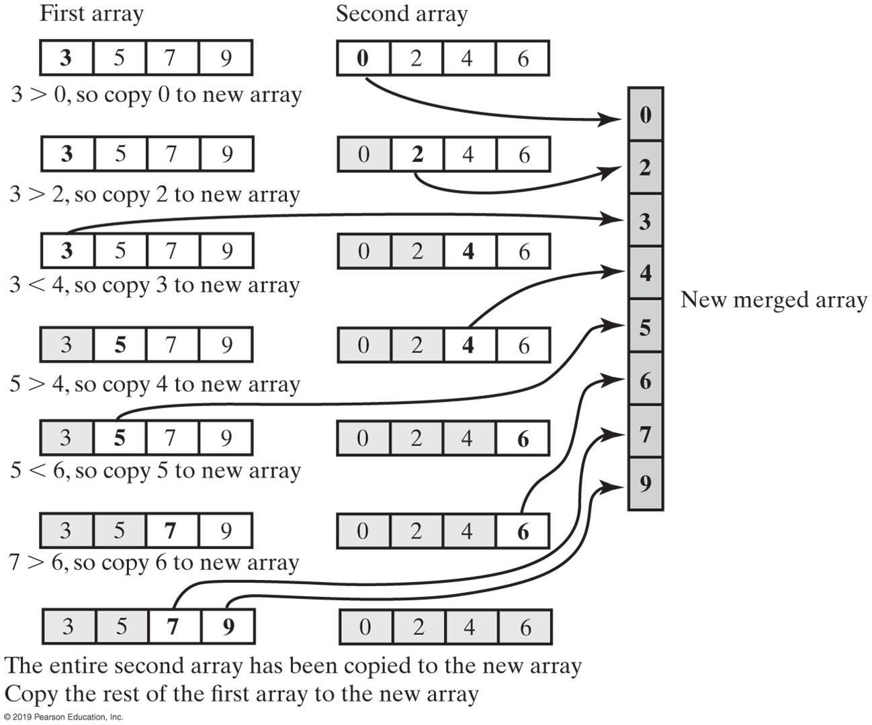
Merge Sort
FIGURE 16-1 Merging two sorted arrays into one sorted array

Slide 4
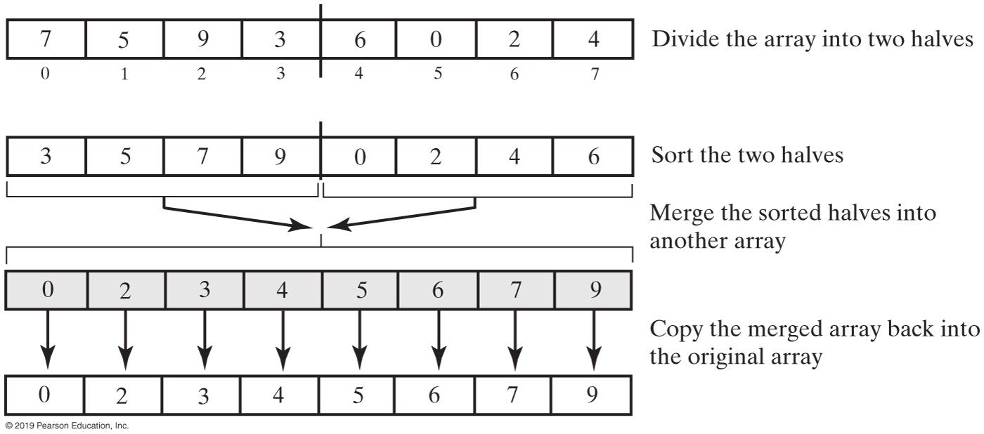
Marge Sort
FIGURE 16-2 The major steps in a merge sort

Slide 5
Recursive Merge Sort
Algorithm mergeSort(a, tempArray, first, last)
// Sorts the array entries a[first..last] recursively.
if (first < last)
{
mid = approximate midpoint between first and last
mergeSort(a, tempArray, first, mid)
mergeSort(a, tempArray, mid + 1, last)
Merge the sorted halves a[first..mid] and a[mid + 1..last] using the array tempArray
}
Recursive algorithm for merge sort.

Slide 6
Recursive Merge Sort
Algorithm merge(a, tempArray, first, mid, last)
// Merges the adjacent subarrays a[first..mid] and a[mid + 1..last].
beginHalf1 = first endHalf1 = mid beginHalf2 = mid + 1 endHalf2 = last
// While both subarrays are not empty, compare an entry in one subarray with
// an entry in the other; then copy the smaller item into the temporary array
index = 0 // Next available location in tempArray
while ( (beginHalf1 <= endHalf1) and (beginHalf2 <= endHalf2) )
{
if (a[beginHalf1] <= a[beginHalf2])
{
tempArray[index] = a[beginHalf1] beginHalf1++
}
else
{
tempArray[index] = a[beginHalf2] beginHalf2++
}
index++
}
// Assertion: One subarray has been completely copied to tempArray.
Copy remaining entries from other subarray to tempArray
Copy entries from tempArray to array a
Pseudocode which describes the merge step.

Slide 7
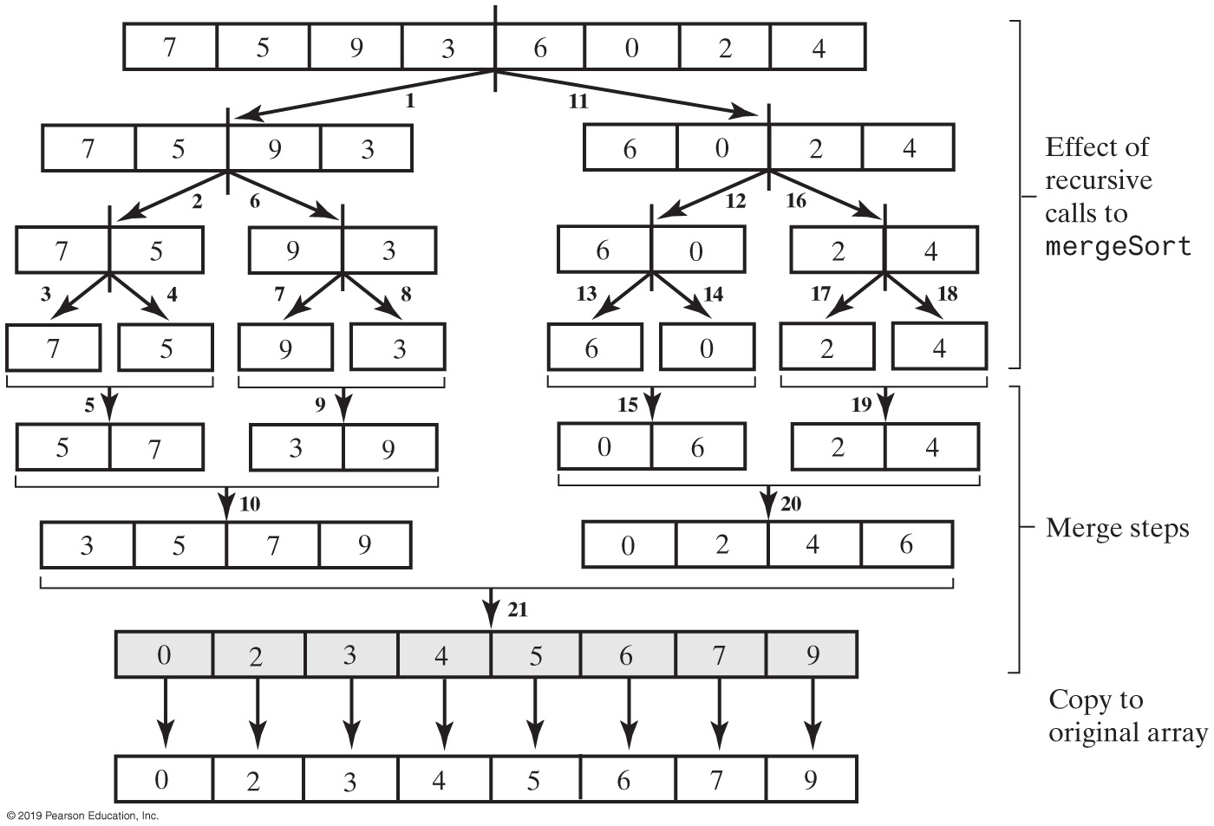
Merge Sort
FIGURE 16-3 The effect of the recursive calls and the merges during a merge sort

Slide 8
Recursive Merge Sort
public static <T extends Comparable<? super T>>
void mergeSort(T[] a, int first, int last)
{
// The cast is safe because the new array contains null entries
@SuppressWarnings("unchecked")
T[] tempArray = (T[])new Comparable<?>[a.length]; // Unchecked cast
mergeSort(a, tempArray, first, last);
} // end mergeSort
Be careful to allocate the temporary array only once.

Slide 9
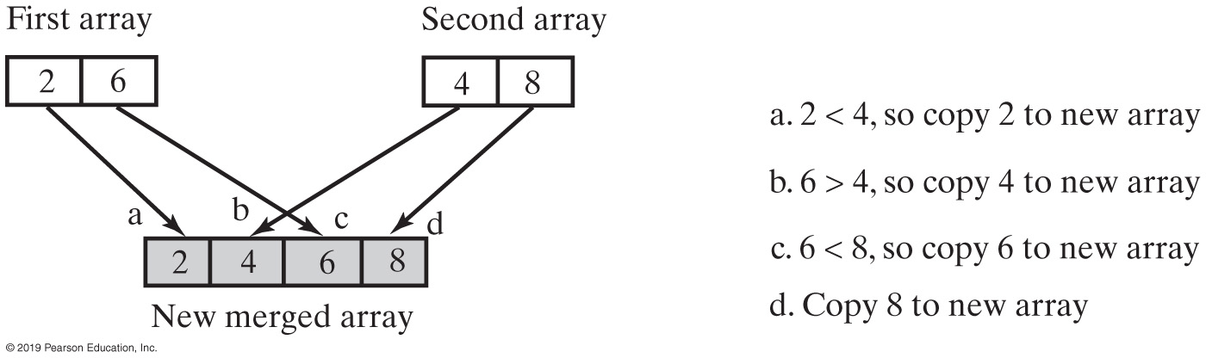
Merge Sort
Efficiency is O(n log n)
FIGURE 16-4 A worst-case merge of two sorted arrays

Slide 10
Iterative Merge Sort
Less simple than recursive version.
Need to control the merges.
Will be more efficient of both time and space.
But, trickier to code without error.

Slide 11
Iterative Merge Sort
Starts at beginning of array
Merges pairs of individual entries to form two-entry subarrays
Returns to the beginning of array and merges pairs of the two-entry subarrays to form four-entry subarrays
And so on
After merging all pairs of subarrays of a particular length, might have entries left over.

Slide 12
Merge Sort in the Java Class Library
Class Arrays in the package java.util defines versions of a static method sort
public static void sort(Object[] a)
public static void sort(Object[] a, int first, int after)

Slide 13
Quick Sort
Divides an array into two pieces
Pieces are not necessarily halves of the array
Chooses one entry in the array—called the pivot
Partitions the array

Slide 14
Quick Sort
When pivot chosen, array rearranged such that:
Pivot is in position that it will occupy in final sorted array
Entries in positions before pivot are less than or equal to pivot
Entries in positions after pivot are greater than or equal to pivot

Slide 15
Quick Sort
Algorithm quickSort(a, first, last)
// Sorts the array entries a[first..last] recursively.
if (first < last)
{
Choose a pivot
Partition the array about the pivot
pivotIndex = index of pivot
quickSort(a, first, pivotIndex − 1) // Sort Smaller
quickSort(a, pivotIndex + 1, last) // Sort Larger
}
Algorithm that describes our sorting strategy

Slide 16
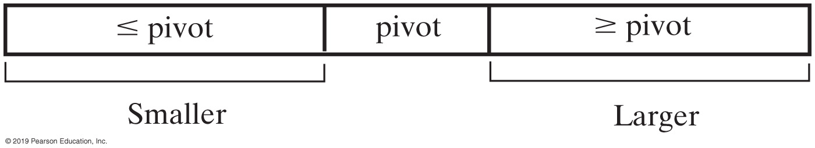
Quick Sort
FIGURE 16-5 A partition of an array during a quick sort

Slide 17
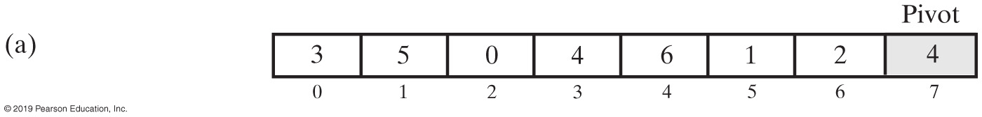
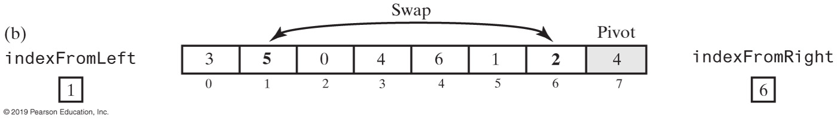
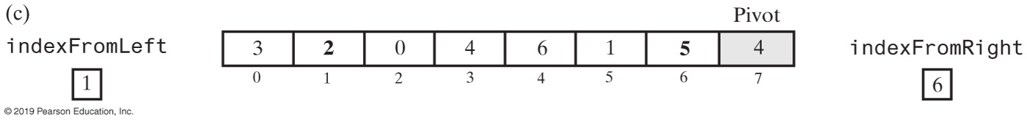
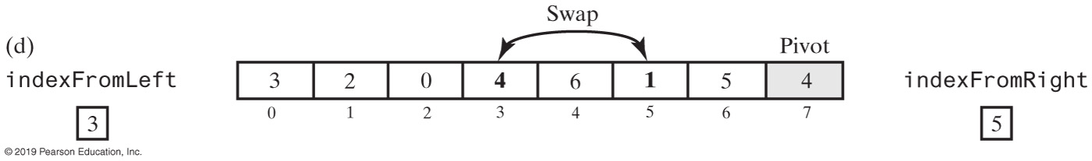
Quick Sort Partitioning (Part 1)
FIGURE 16-6 A partitioning strategy for quick sort

Slide 18
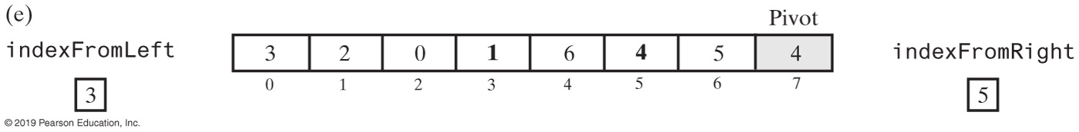
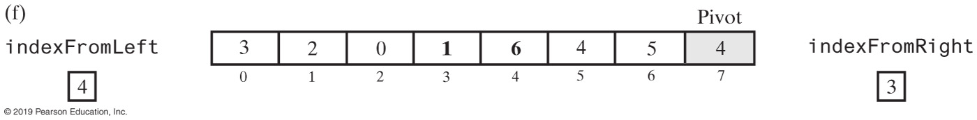
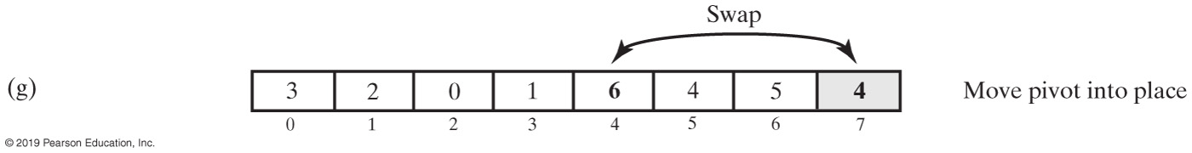
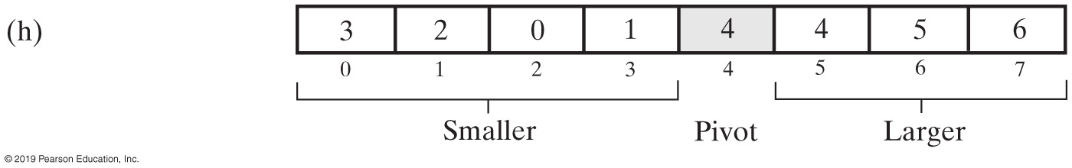
Quick Sort Partitioning (Part 2)
FIGURE 16-6 A partitioning strategy for quick sort

Slide 19
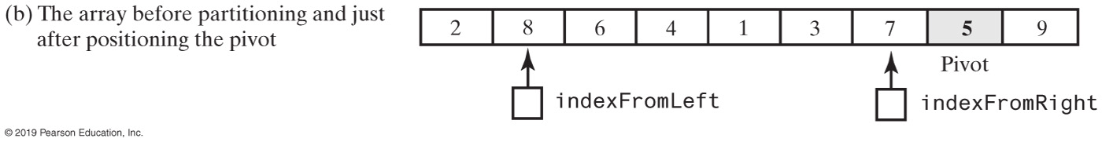
Quick Sort Partitioning
FIGURE 16-7 Median-of-three pivot selection

Slide 20
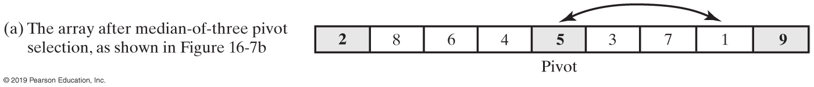
Quick Sort Partitioning
FIGURE 16-8 The array after selecting and positioning the pivot and just before partitioning

Slide 21
Quick Sort Partitioning (Part 1)
Algorithm partition(a, first, last)
// Partitions an array a[first..last] as part of quick sort into two subarrays named
// Smaller and Larger that are separated by a single entry—the pivot—named pivotValue.
// Entries in Smaller are <= pivotValue and appear before pivotValue in the array.
// Entries in Larger are >= pivotValue and appear after pivotValue in the array.
// Precondition: first >= 0; first < a.length; last – first >= 3; last < a.length.
// Returns the index of the pivot.
mid = index of the array’s middle entry
sortFirstMiddleLast(a, first, mid, last)
// Assertion: a[mid] is the pivot, that is, pivotValue;
// a[first] <= pivotValue and a[last] >= pivotValue, so do not compare these two
// array entries with pivotValue.
// Move pivotValue to next-to-last position in array Exchange a[mid] and a[last – 1]
pivotIndex = last – 1 pivotValue = a[pivotIndex]
Adjusting the Partition Algorithm

Slide 22
Quick Sort Partitioning (Part 2)
// Determine two subarrays:
// Smaller = a[first..endSmaller] and
// Larger = a[endSmaller+1..last–1]
// such that entries in Smaller are <= pivotValue and entries in Larger are >= pivotValue.
// Initially, these subarrays are empty.
indexFromLeft = first + 1 indexFromRight = last − 2
done = false
while (!done)
{
// Starting at the beginning of the array, leave entries that are < pivotValue and
// locate the first entry that is >= pivotValue. You will find one, since the last
// entry is >= pivotValue.
while (a[indexFromLeft] < pivotValue)
indexFromLeft++
// Starting at the end of the array, leave entries that are > pivotValue and
// locate the first entry that is <= pivotValue. You will find one, since the first
// entry is <= pivotValue.
while (a[indexFromRight] > pivotValue)
indexFromRight−−
Adjusting the Partition Algorithm

Slide 23
Quick Sort Partitioning (Part 3)
// Assertion: a[indexFromLeft] >= pivotValue and
// a[indexFromRight] <= pivotValue
if (indexFromLeft < indexFromRight)
{
Exchange a[indexFromLeft] and a[indexFromRight]
indexFromLeft++
indexFromRight−−
}
else
done = true
} // while (!done)
// Place pivotValue between the subarrays Smaller and Larger
Exchange a[pivotIndex] and a[indexFromLeft]
pivotIndex = indexFromLeft
// Assertion: Smaller = a[first..pivotIndex–1]
// pivotValue = a[pivotIndex]
// Larger = a[pivotIndex+1..last]
return pivotIndex
Adjusting the Partition Algorithm

Slide 24
The Quick Sort Method
public static <T extends Comparable<? super T>>
void quickSort(T[] a, int first, int last)
{
if (last - first + 1 < MIN_SIZE)
{
insertionSort(a, first, last);
}
else
{
// Create the partition: Smaller | Pivot | Larger
int pivotIndex = partition(a, first, last);
// Sort subarrays Smaller and Larger
quickSort(a, first, pivotIndex - 1);
quickSort(a, pivotIndex + 1, last);
} // end if
} // end quickSort
Implementation of the quick sort.

Slide 25
Quick Sort in the Java Class Library
Class Arrays in the package java.util defines versions of a static method sort
public static void sort(type[] a)
public static void sort(type[] a, int first, int after)

Slide 26
Radix Sort
Does not use comparison
Treats array entries as if they were strings that have the same length.
Group integers according to their rightmost character (digit) into “buckets”
Repeat with next character (digit), etc.

Slide 27
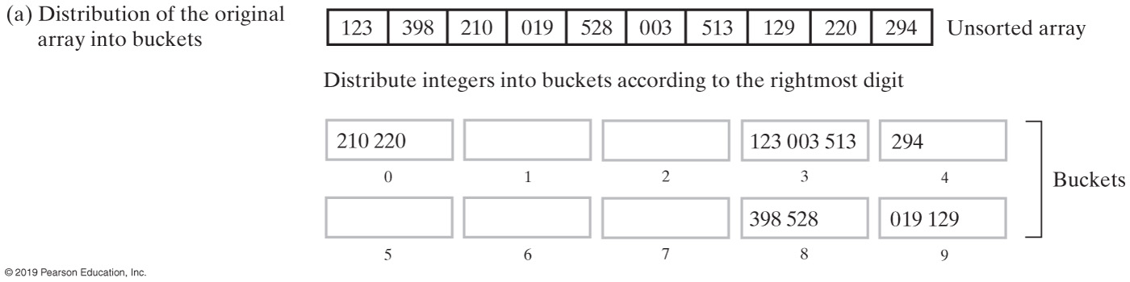
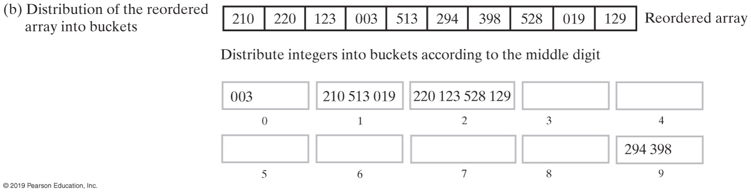
Radix Sort (Part 1)
FIGURE 16-9 The steps of a radix sort

Slide 28
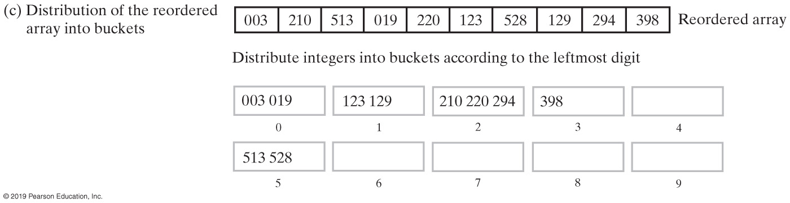
Radix Sort (Part 2)
FIGURE 16-9 The steps of a radix sort

Slide 29
Algorithm Comparison
 | Best Case | Average Case | Worst Case
Radix Sort | O(n) | O(n) | O(n)
Merge Sort | O(n log n) | O(n log n) | O(n log n)
Quick Sort | O(n log n) | O(n log n) | O(n²)
Shell Sort | O(n) | O(n^{1.5}) | O(n^{1.5})
Insertion Sort | O(n) | O(n²) | O(n²)
Selection Sort | O(n²) | O(n²) | O(n²)
FIGURE 16-10 The time efficiency of various sorting algorithms, expressed in Big Oh notation

Slide 30
Comparing Function Growth Rates
 | 10 | 10² | 10³ | 10⁴ | 10⁵ | 10⁶
n | 10 | 100 | 1,000 | 10,000 | 100,000 | 1,000,000
n log n | 33 | 664 | 9,966 | 132,877 | 1,660,964 | 19,931,569
n^{1.5} | 32 | 1,000 | 31,623 | 1,000,000 | 319,622,777 | 109
n² | 100 | 10,000 | 1,000,000 | 108 | 1,010 | 1,012
FIGURE 16-11 A comparison of growth-rate functions as n increases

Slide 31
End
Chapter 16

