Slide 1
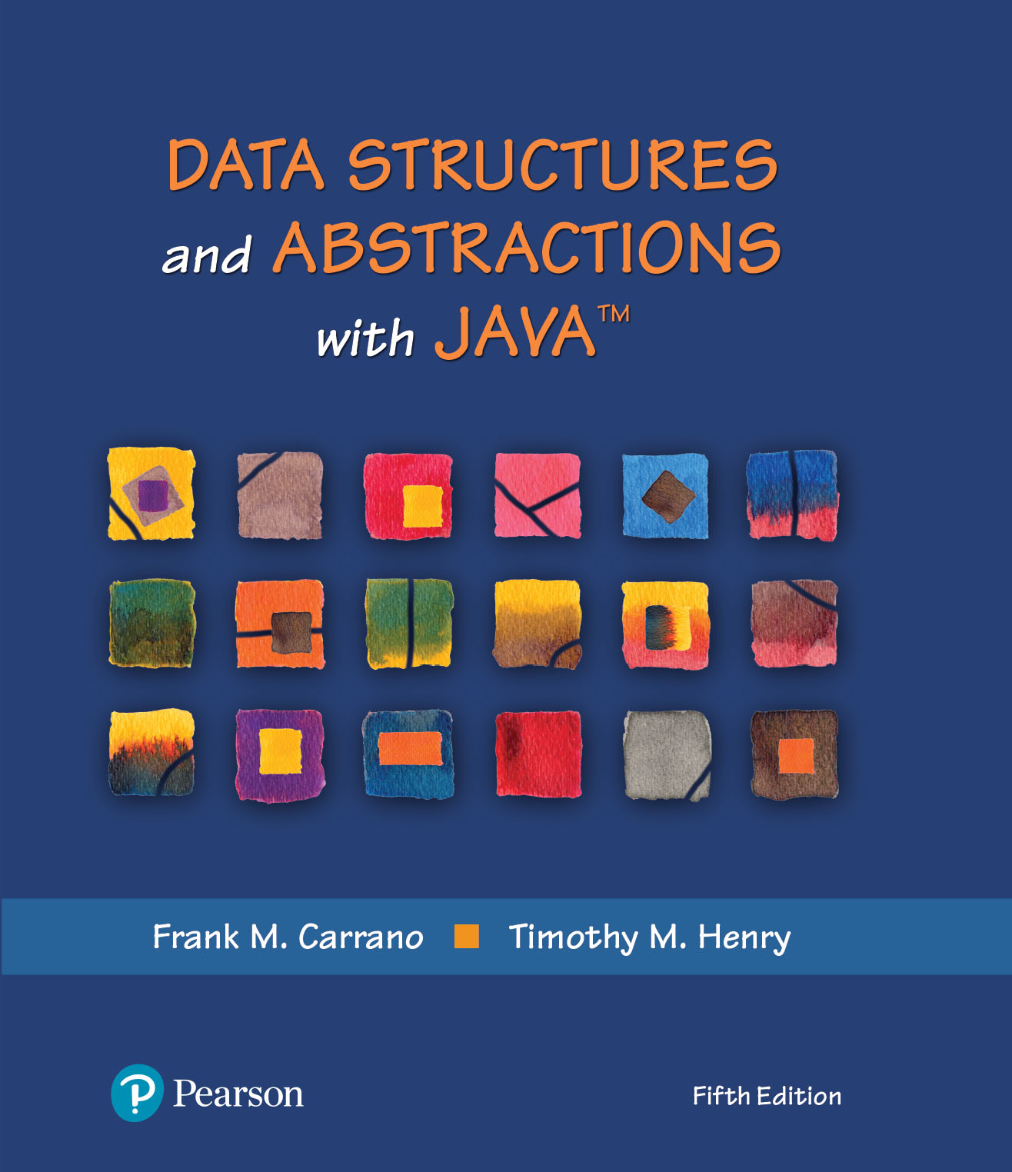
Data Structures and Abstractions with Java™
5th Edition
Java Interlude 6
Mutable and
Immutable Objects

Slide 2
Mutable Objects
Consider classes studied that have private data fields and public methods that either look at or change these fields
  Such methods called accessor methods and mutator methods
An object that belongs to a class that has public mutator methods said to be mutable

Slide 3
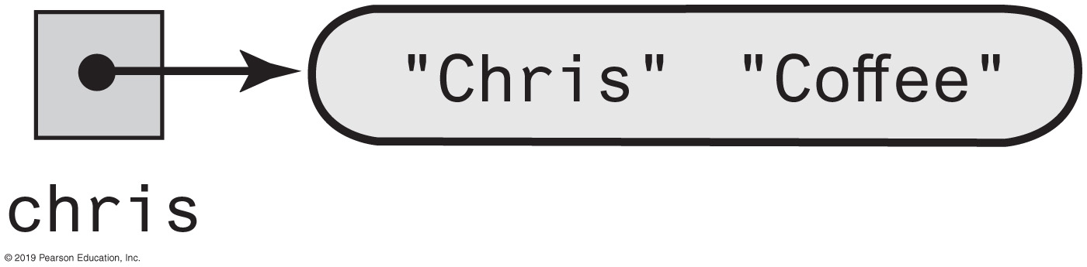
Mutable Objects
FIGURE J6-1 An object and its reference variable chris

Slide 4
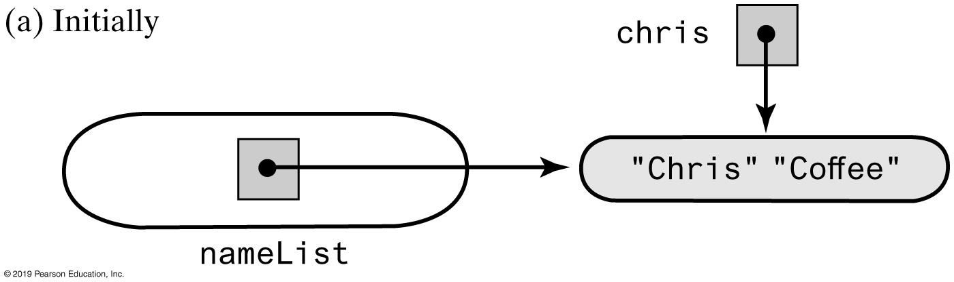
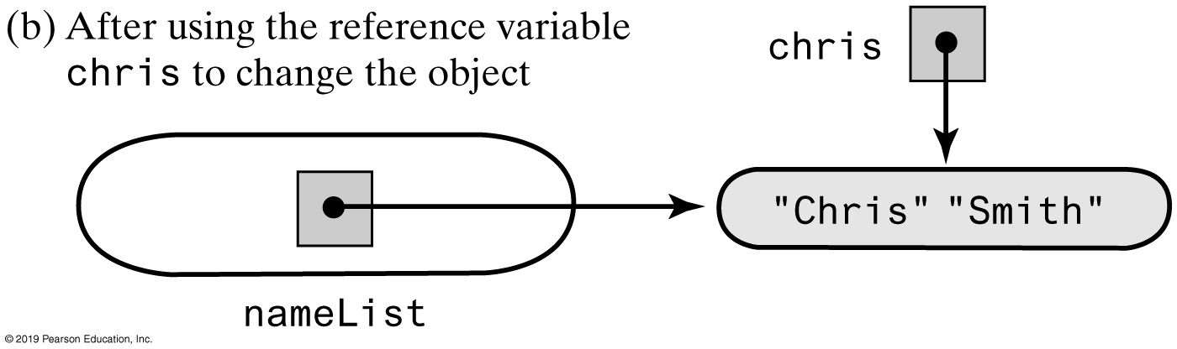
Mutable Objects
FIGURE J6-2 An object in the list nameList before and after the object is changed

Slide 5
FIGURE J6-3 The classes Name and ImmutableName
Name
first last
getFirst() getLast() getName() setFirst(firstName) setLast(lastName) setName(firstName, lastName) giveLastNameTo(aName) toString() getImmutable()
ImmutableName
first last
getFirst() getLast() getName() toString() getMutable()

Slide 6
End
Java Interlude 6

