Slide 1

Data Structures and Abstractions with Java™
5th Edition
Chapter 17
Sorted Lists

Slide 2
List
Entries in a list are ordered simply by positions within list
Can add a sort operation to the ADT list
Add an entry to, remove an entry from sorted list
Provide only the entry.
No specification where entry belongs or exists

Slide 3
Specifications for ADT Sorted List
DATA
A collection of objects in sorted order and having the same data type
The number of objects in the collection
Operations requiring special consideration
add(newEntry)
remove(anEntry)
getPosition(anEntry)

Slide 4
Specifications for ADT Sorted List
Additional Operations
These behave as they do for the ADT List
getEntry(givenPosition)
contains(anEntry)
remove(givenPosition)
clear()
getLength()
isEmpty()
toArray()

Slide 5
Specifications for ADT Sorted List (Part 1)
/** An interface for the ADT sorted list.
Entries in the list have positions that begin with 1. */
public interface SortedListInterface<T extends Comparable<? super T>>
{
/** Adds a new entry to this sorted list in its proper order.
The list's size is increased by 1.
@param newEntry The object to be added as a new entry. */
public void add(T newEntry);
/** Removes the first or only occurrence of a specified entry
from this sorted list.
@param anEntry The object to be removed.
@return True if anEntry was located and removed;
otherwise returns false. */
public boolean remove(T anEntry);
/** Gets the position of an entry in this sorted list.
@param anEntry The object to be found.
@return The position of the first or only occurrence of anEntry
if it occurs in the list; otherwise returns the position
where anEntry would occur in the list, but as a negative
integer. */
public int getPosition(T anEntry);
LISTING 17-1 The interface SortedListInterface

Slide 6
Specifications for ADT Sorted List (Part 2)
// The following methods are described in Segment 10.9 of Chapter 10
// as part of the ADT list:
public T getEntry(int givenPosition);
public boolean contains(T anEntry);
public T remove(int givenPosition);
public void clear();
public int getLength();
public boolean isEmpty();
public T[] toArray();
} // end SortedListInterface
LISTING 17-1 The interface SortedListInterface

Slide 7
Linked Sorted List Implementation
/** A class that implements the ADT sorted list by using a chain of linked nodes.
Duplicate entries are allowed. */
public class LinkedSortedList<T extends Comparable<? super T>>
implements SortedListInterface<T>
{
private Node firstNode; // Reference to first node of chain
private int numberOfEntries;
public LinkedSortedList()
{
firstNode = null;
numberOfEntries = 0;
} // end default constructor
/* < Implementations of the sorted list operations go here.>
. . . */
private class Node
{
/* < Implementations of the Node operations go here.>
} // end Node
} // end LinkedSortedList
LISTING 17-2 An outline of a linked implementation of the ADT sorted list

Slide 8
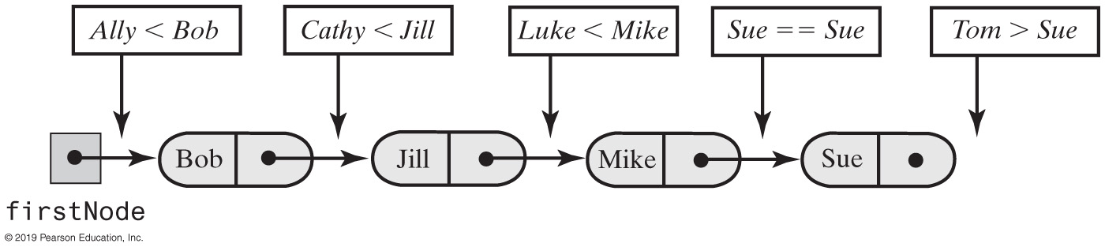
Linked Sorted List Implementation
FIGURE 17-1 Places to insert additional names into a sorted chain of linked nodes

Slide 9
Linked Sorted List Implementation
Algorithm add(newEntry)
// Adds a new entry to the sorted list.
Allocate a new node containing newEntry
Search the chain until either you find a node containing newEntry or you pass the point where it should be
Let nodeBefore reference the node before the insertion point
if (the chain is empty or the new node belongs at the beginning of the chain)
Add the new node to the beginning of the chain
else
Insert the new node after the node referenced by nodeBefore
Increment the length of the sorted list
Algorithm for add method.

Slide 10
Linked Sorted List Implementation
public void add(T newEntry)
{
Node newNode = new Node(newEntry);
Node nodeBefore = getNodeBefore(newEntry);
if (isEmpty() || (nodeBefore == null))
{
// Add at beginning
newNode.setNextNode(firstNode);
firstNode = newNode;
}
else
{
// Add after nodeBefore
Node nodeAfter = nodeBefore.getNextNode();
newNode.setNextNode(nodeAfter);
nodeBefore.setNextNode(newNode);
} // end if
numberOfEntries++;
} // end add
An iterative implementation of add

Slide 11
Linked Sorted List Implementation
// Finds the node that is before the node that should or does
// contain a given entry.
// Returns either a reference to the node that is before the node
// that contains--or should contain--anEntry,
// or null if no prior node exists
// (that is, if anEntry is or belongs at the beginning of the list).
private Node getNodeBefore(T anEntry)
{
Node currentNode = firstNode;
Node nodeBefore = null;
while ( (currentNode != null) &&
(anEntry.compareTo(currentNode.getData()) > 0) )
{
nodeBefore = currentNode;
currentNode = currentNode.getNextNode();
} // end while
return nodeBefore;
} // end getNodeBefore
The private method getNodeBefore

Slide 12
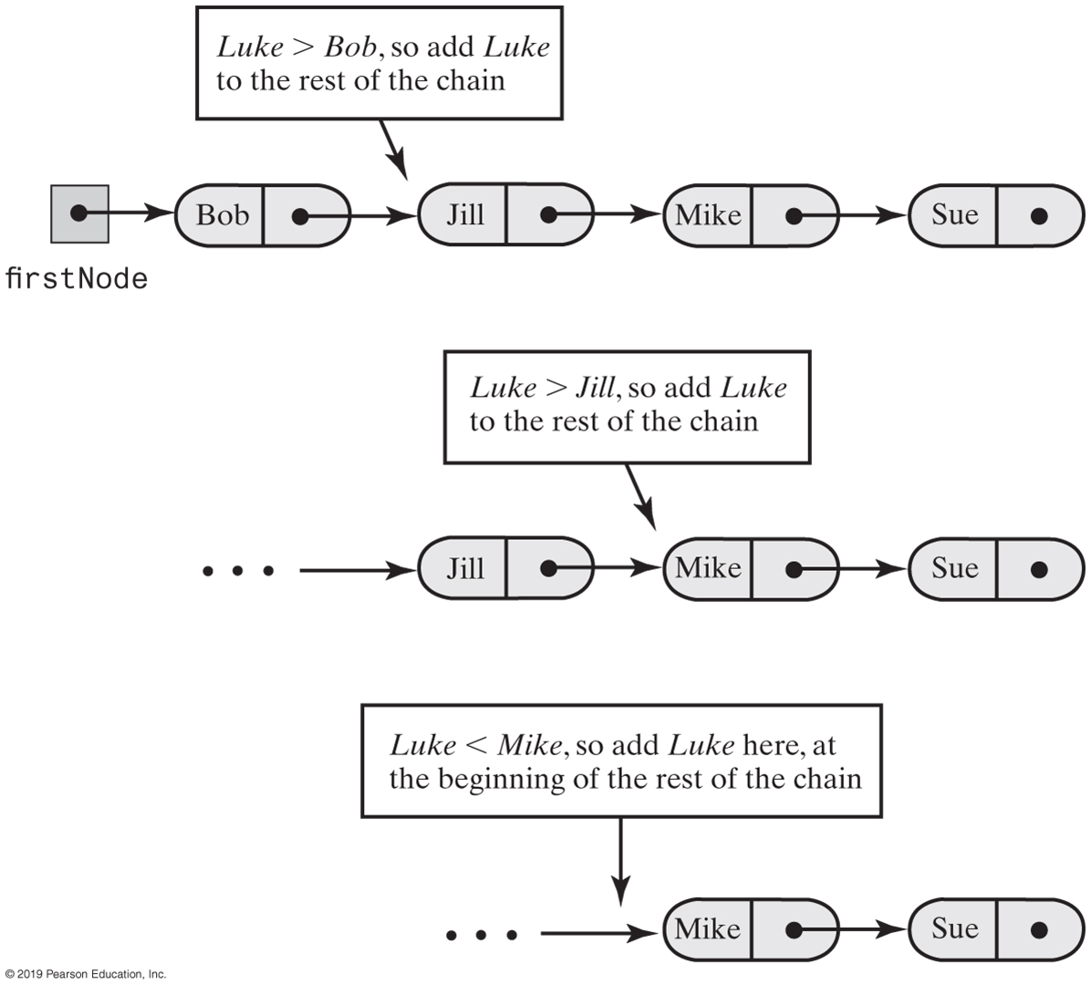
Recursive Add to Sorted List
FIGURE 17-2 Recursively adding Luke to a sorted chain of names

Slide 13

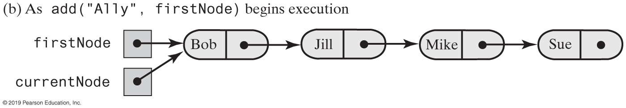
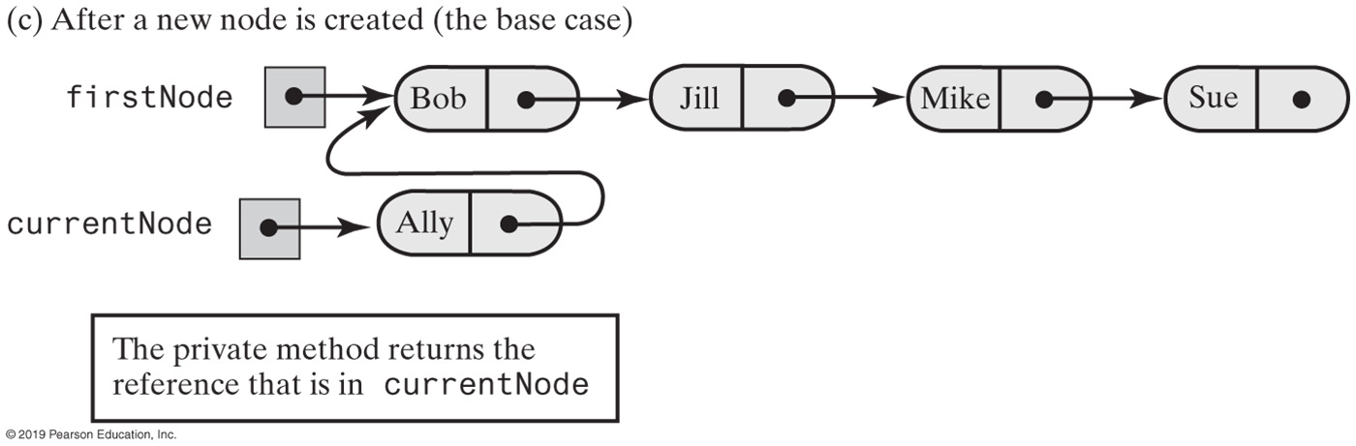
Recursive Add to Sorted List (Part 1)
FIGURE 17-3 Recursively adding a node at the beginning of a chain

Slide 14
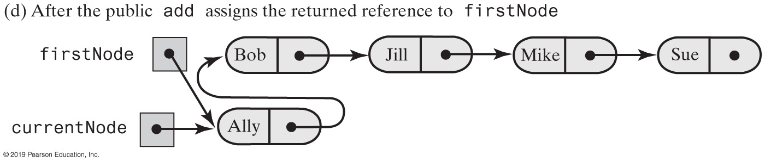
Recursive Add to Sorted List (Part 2)
[from previous slide]
FIGURE 17-3 Recursively adding a node at the beginning of a chain

Slide 15
Linked Sorted List Implementation
public void add(T newEntry)
{
firstNode = add(newEntry, firstNode);
numberOfEntries++;
} // end add
private Node add(T newEntry, Node currentNode)
{
if ( (currentNode == null) ||
(newEntry.compareTo(currentNode.getData()) <= 0) )
{
currentNode = new Node(newEntry, currentNode);
}
else
{
Node nodeAfter = add(newEntry, currentNode.getNextNode());
currentNode.setNextNode(nodeAfter);
} // end if
return currentNode;
} // end add
A recursive implementation of add

Slide 16
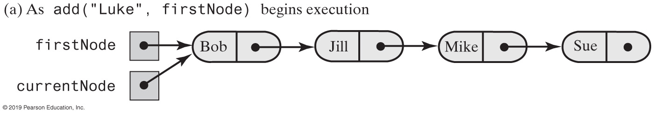
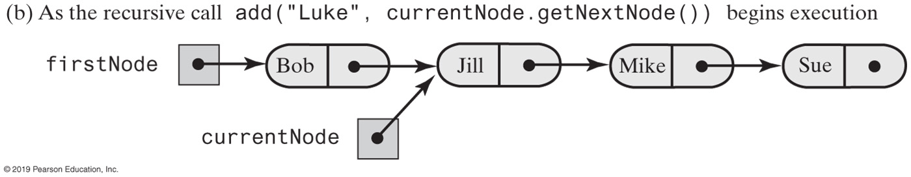
Recursive Add to Sorted List (Part 1)
FIGURE 17-4 Recursively adding a node between existing nodes in a chain

Slide 17
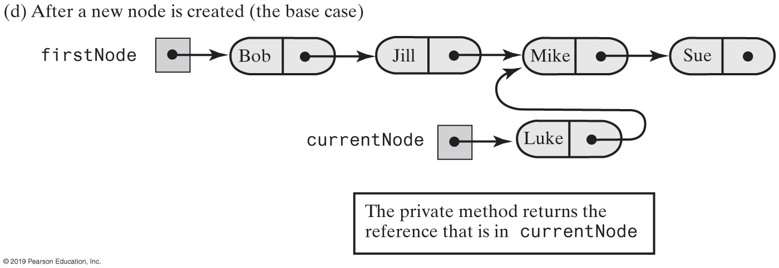
Recursive Add to Sorted List (Part 2)
[from previous slide]
FIGURE 17-4 Recursively adding a node between existing nodes in a chain

Slide 18
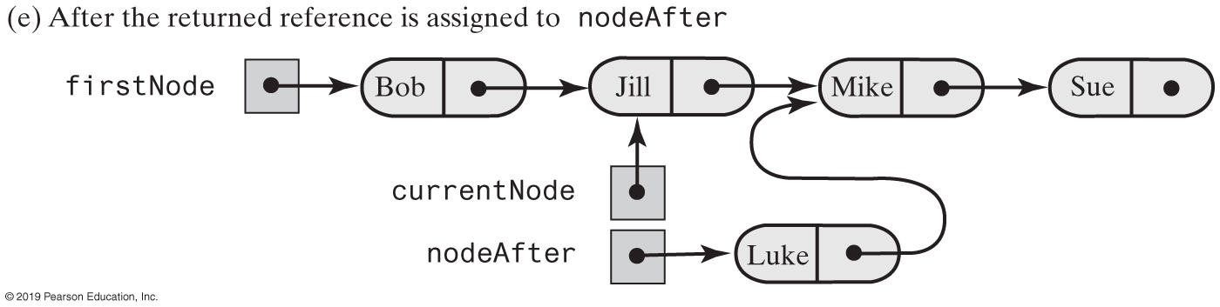
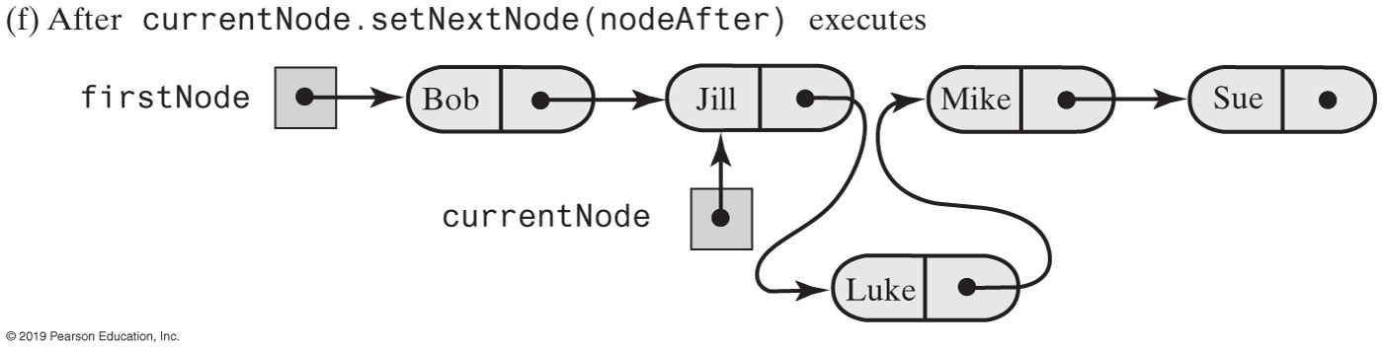
Recursive Add to Sorted List (Part 2)
[from previous slide]
FIGURE 17-4 Recursively adding a node between existing nodes in a chain

Slide 19
Comparison of Implementations
Operation | Array | Linked
add(newEntry) | O(n) | O(n)
remove(anEntry) | O(n) | O(n)
getPosition(anEntry) | O(n) | O(n)
getEntry(givenPosition) | O(1) | O(n)
contains(anEntry) | O(n) | O(n)
remove(givenPosition) | O(n) | O(n)
display() | O(n) | O(n)
clear(), getLength(), isEmpty() | O(1) | O(1)
FIGURE 17-5 The worst-case efficiencies of the operations on the ADT sorted list for two implementations

Slide 20
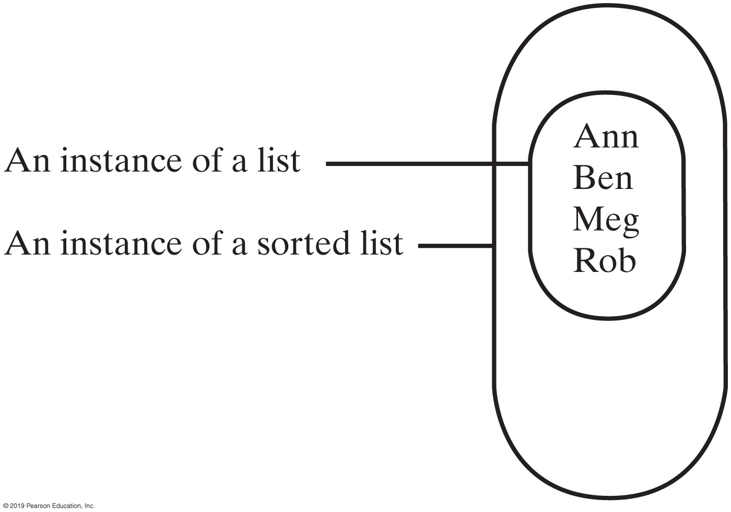
Implementation that uses ADT List
FIGURE 17-6 An instance of a sorted list that contains a list of its entries

Slide 21
Implementation That Uses the ADT List
/** A class that implements the ADT sorted list by
using an instance of LList. */
public class SortedList<T extends Comparable<? super T>>
implements SortedListInterface<T>
{
private ListInterface<T> list;
public SortedList()
{
list = new LList<T>();
} // end default constructor
// . . .
} // end SortedList
Our class SortedList will implement the interface SortedListInterface

Slide 22
Implementation That Uses the ADT List
public void add(T newEntry)
{
int newPosition = Math.abs(getPosition(newEntry));
list.add(newPosition, newEntry);
} // end add
The method add.

Slide 23
Implementation That Uses the ADT List
public boolean remove(T anEntry)
{
boolean result = false;
int position = getPosition(anEntry);
if (position > 0)
{
list.remove(position);
result = true;
} // end if
return result;
} // end remove
The method remove.

Slide 24
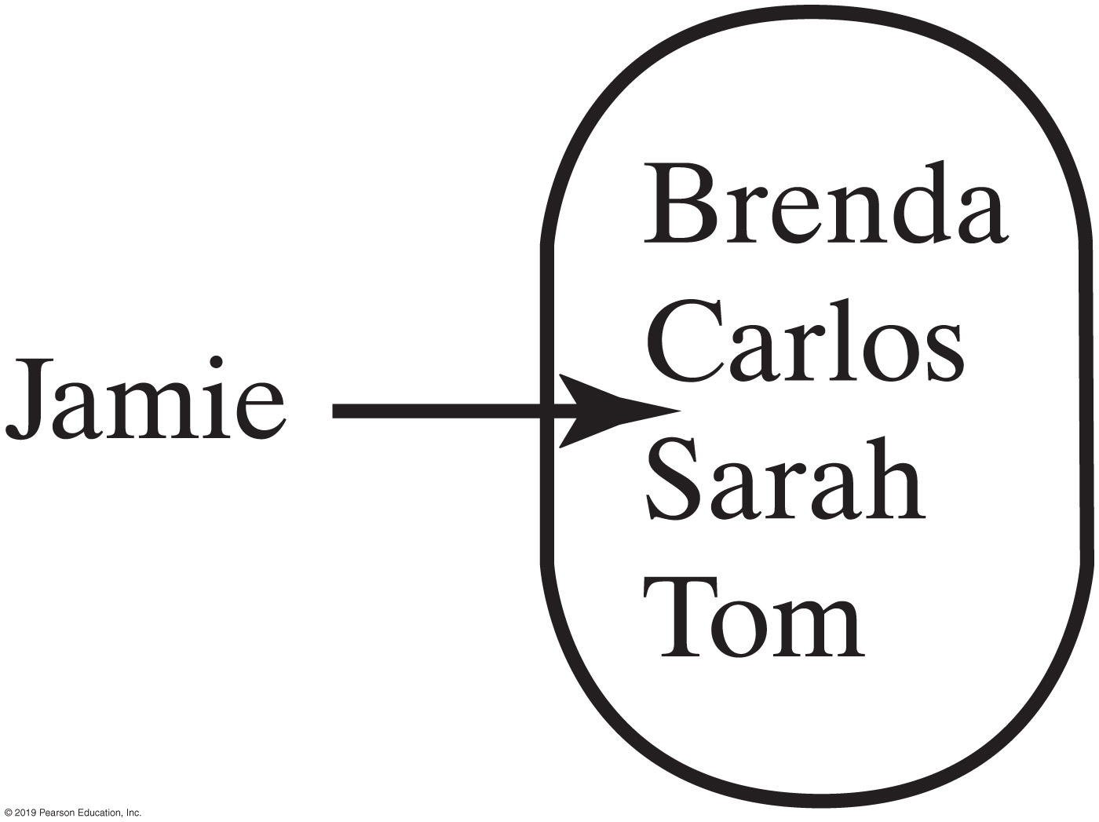
Implementation That Uses the ADT List
FIGURE 17-7 A sorted list in which Jamie belongs after Carlos but before Sarah

Slide 25
Implementation That Uses the ADT List
public int getPosition(T anEntry)
{
int position = 1;
int length = list.getLength();
// Find position of anEntry
while ( (position <= length) &&
(anEntry.compareTo(list.getEntry(position)) > 0) )
{
position++;
} // end while
// See whether anEntry is in list
if ( (position > length) ||
(anEntry.compareTo(list.getEntry(position)) != 0) )
{
position = -position; // anEntry is not in list
} // end if
return position;
} // end getPosition
The implementation of getPosition

Slide 26
Comparison of Implementations
Operation | Array | Linked
add(newEntry) | O(n) | O(n)
remove(anEntry) | O(n) | O(n)
getPosition(anEntry) | O(n) | O(n)
getEntry(givenPosition) | O(1) | O(n)
contains(anEntry) | O(n) | O(n)
remove(givenPosition) | O(n) | O(n)
display() | O(n) | O(n)
clear(), getLength(), isEmpty() | O(1) | O(1)
FIGURE 17-8 The worst-case efficiencies of the operations on the ADT sorted list for two implementations

Slide 27
Comparison of Implementations
Operation | Array | Linked | ArraryList | LList
add(newEntry) | O(n) | O(n) | O(n) | O(n²)
remove(anEntry) | O(n) | O(n) | O(n) | O(n²)
getPosition(anEntry) | O(n) | O(n) | O(n) | O(n²)
getEntry(givenPosition) | O(1) | O(n) | O(1) | O(n)
contains(anEntry) | O(n) | O(n) | O(n) | O(n)
remove(givenPosition) | O(n) | O(n) | O(n) | O(n)
display() | O(n) | O(n) | O(n) | O(n)
clear(), getLength(), isEmpty() | O(1) | O(1) | O(1) | O(1)
FIGURE 17-9 The worst-case efficiencies of the ADT sorted list operations when implemented using an instance of the ADT list

Slide 28
End
Chapter 17

