Slide 1
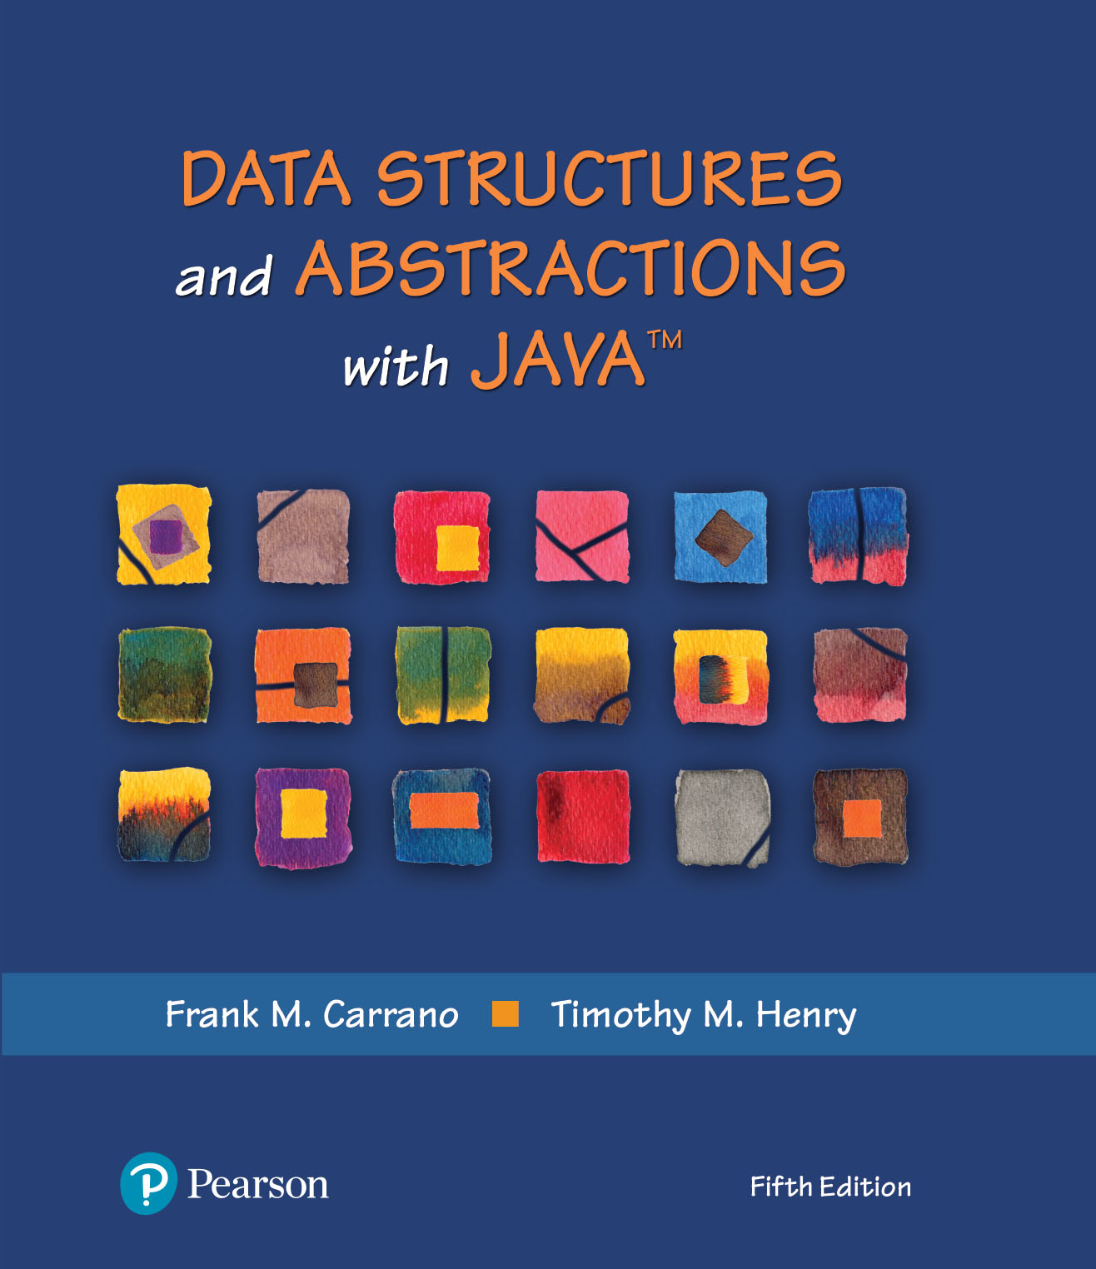
Data Structures and Abstractions with Java™
5th Edition
Java Interlude 7
Inheritance and
Polymorphism

Slide 2
When to Use Inheritance
Given the class VectorStack
public final class VectorStack<T> implements StackInterface<T>
{
private Vector<T> stack;
. . .
Use inheritance to derive VectorStack from Vector
public final class VectorStack<T> extends Vector<T>
implements StackInterface<T>
{ . . .

Slide 3
When to Use Inheritance
Resulting class has all methods of Vector in addition to those in StackInterface
However, these Vector methods enable a client to add or remove entries anywhere within the stack,
Thus violating the premise of the ADT stack.
Instead of a stack, we would have an enhanced vector
Since no “is-a” relationship, should not use inheritance this way

Slide 4
When to Use Inheritance
Security issues
Limit your use of inheritance
Realize that a superclass can affect the behavior of a subclass

Slide 5
Protected Access
You can use the access modifier protected for methods and data fields.
Method or data field modified by protected can be accessed by name only within:
Its own class definition C
Any class derived from C
Any class within the same package as C

Slide 6
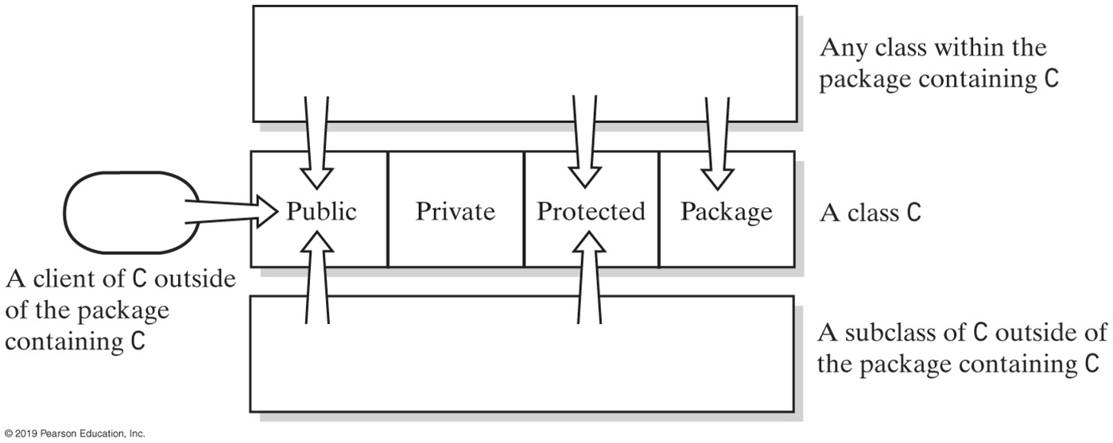
Access Modifiers
FIGURE J7-1 Public, private, protected, and package access of the data fields and methods of class C

Slide 7
Abstract Classes and Methods
An abstract class will be the superclass of another class
Thus, an abstract class is sometimes called an abstract superclass.
Declare abstract method by including reserved word abstract in header
public abstract void display();

Slide 8
Abstract Classes and Methods
Abstract method cannot be private, static, or final.
Class with at least one abstract method must be declared as an abstract class
Abstract methods can appear only within an abstract class.
Constructors cannot be abstract

Slide 9
Polymorphism
Polymorphism allows same program instruction to mean different things in different contexts
Context (which version of a method) determined at run time
Java uses an object’s dynamic type, not its name, to see which method to invoke

Slide 10
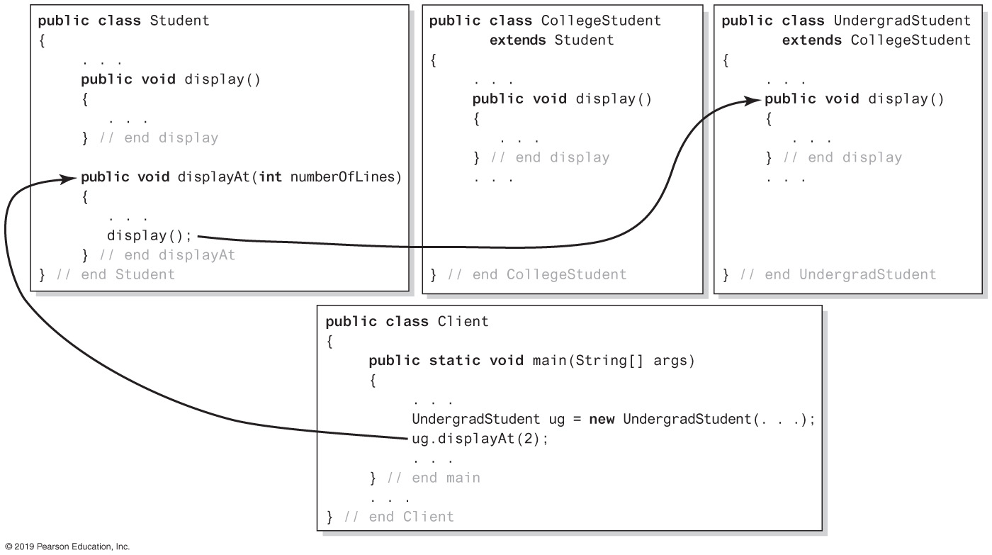
Polymorphism
FIGURE J7-2 The method displayAt calls the correct version of display

Slide 11
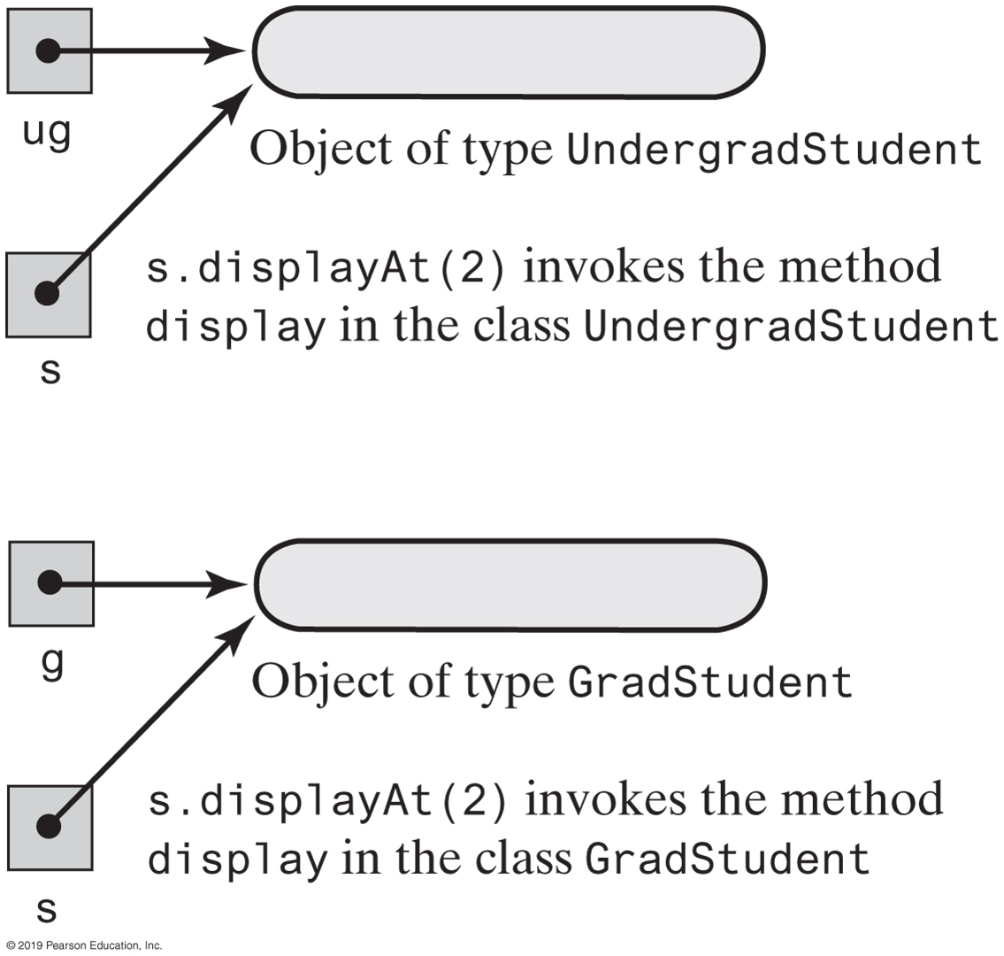
Polymorphism
FIGURE J7-3 An object, not its name, determines its behavior

Slide 12
End
Java Interlude 7

