Slide 1
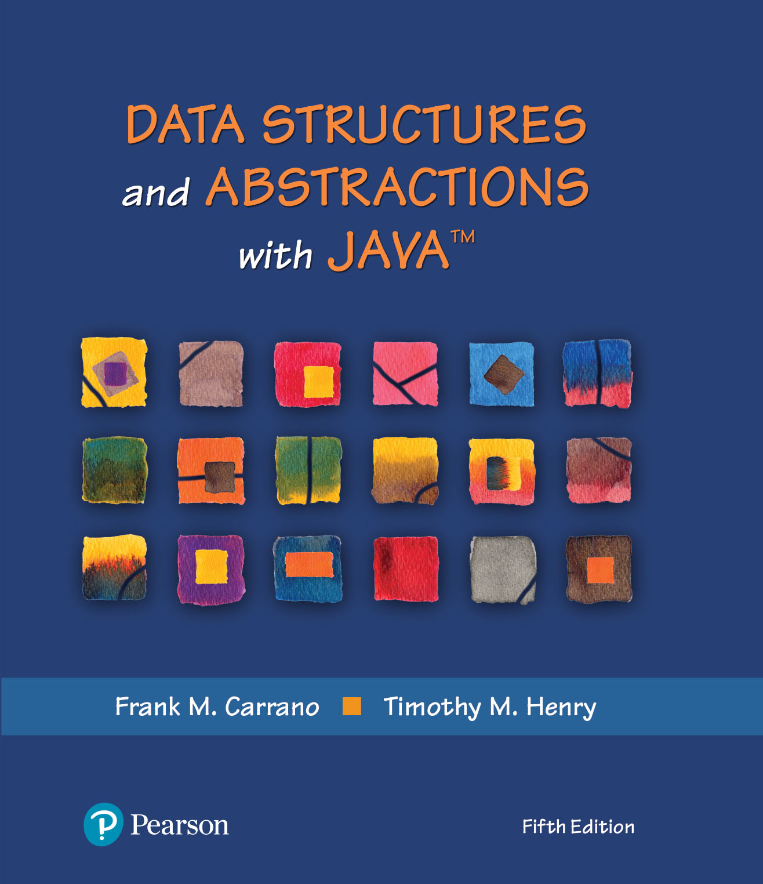
Data Structures and Abstractions with Java™
5th Edition
Chapter 19
Searching

Slide 2

The Problem
FIGURE 19-1 Searching is an everyday occurrence

Slide 3
Iterative Sequential Search of an Unsorted Array
public static <T> boolean inArray(T[] anArray, T anEntry)
{
boolean found = false;
int index = 0;
while (!found && (index < anArray.length))
{
if (anEntry.equals(anArray[index]))
found = true;
index++;
} // end while
return found;
} // end inArray
Using a loop to search for a specific valued entry.

Slide 4
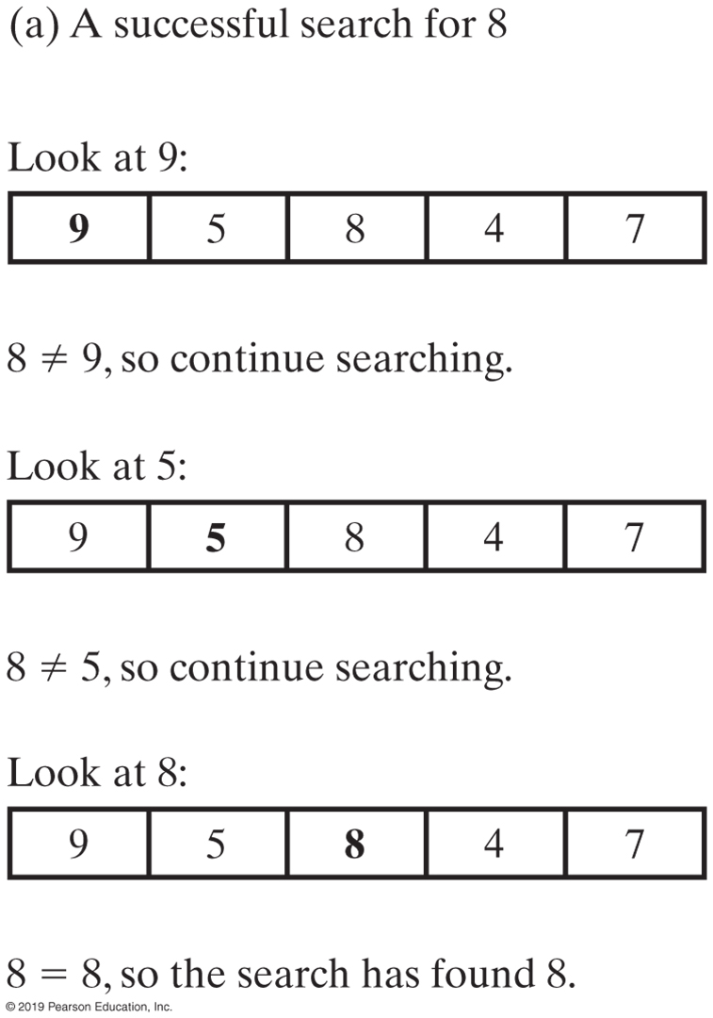
Iterative Sequential Search of an Unsorted Array
FIGURE 19-2a An iterative sequential search of an array

Slide 5
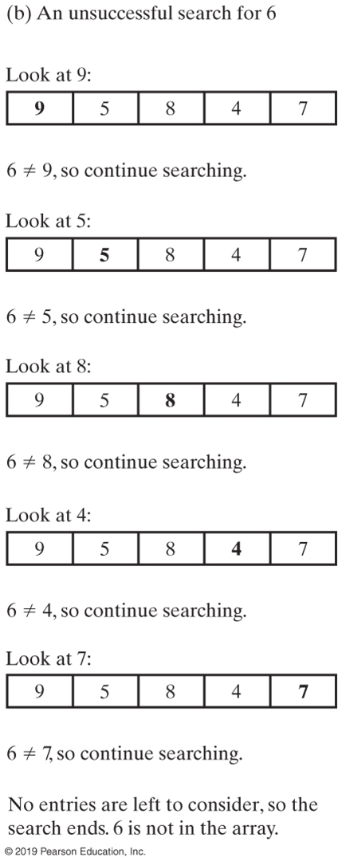
Iterative Sequential Search of an Unsorted Array
FIGURE 19-2b An iterative sequential search of an array

Slide 6
Recursive Sequential Search of an Unsorted Array
Algorithm to search a[first] through a[last] for desiredItem
if (there are no elements to search)
return false
else if (desiredItem equals a[first])
return true else
return the result of searching a[first + 1] through a[last]
Pseudocode of the logic of our recursive algorithm.

Slide 7
Recursive Sequential Search of an Unsorted Array
/** Searches an array for anEntry. */
public static <T> boolean inArray(T[] anArray, T anEntry)
{
return search(anArray, 0, anArray.length - 1, anEntry);
} // end inArray
// Searches anArray[first] through anArray[last] for desiredItem.
// first >= 0 and < anArray.length.
// last >= 0 and < anArray.length.
private static <T> boolean search(T[] anArray, int first, int last, T desiredItem)
{
boolean found;
if (first > last)
found = false; // No elements to search
else if (desiredItem.equals(anArray[first]))
found = true;
else
found = search(anArray, first + 1, last, desiredItem);
return found;
} // end search
Method that implements this algorithm will need parameters first and last.

Slide 8
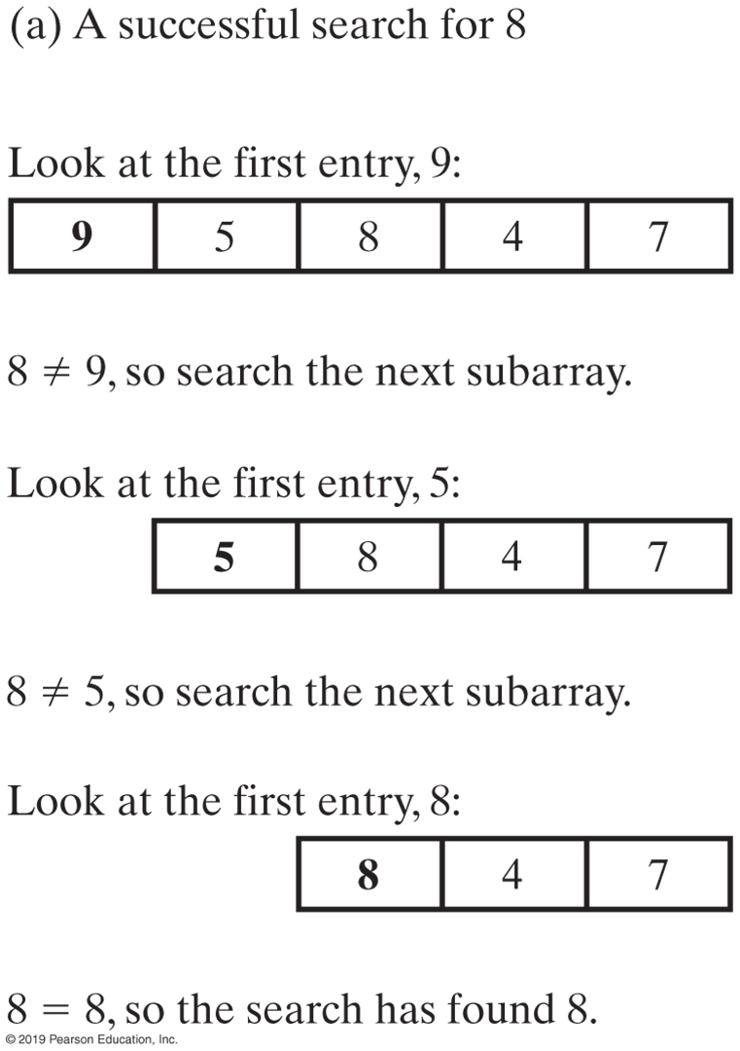
Recursive Sequential Search of an Unsorted Array
FIGURE 19-3a A recursive sequential search of an array

Slide 9
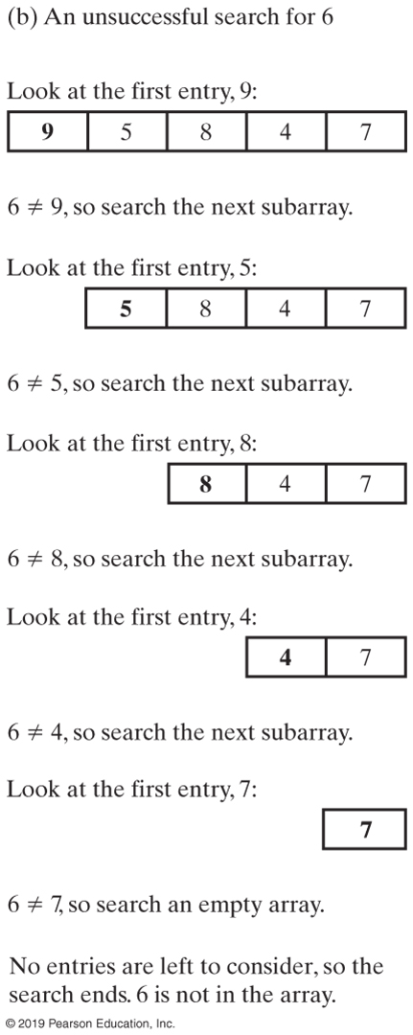
Recursive Sequential Search of an Unsorted Array
FIGURE 19-3b A recursive sequential search of an array

Slide 10
Efficiency of a Sequential Search of an Array
The time efficiency of a sequential search of an array.
Best case O(1)
Worst case: O(n)
Average case: O(n)

Slide 11

Sequential Search of a Sorted Array
FIGURE 19-4 Coins sorted by their mint dates

Slide 12

Binary Search of a Sorted Array
FIGURE 19-5 Ignoring one half of the data when the data is sorted

Slide 13
Binary Search of a Sorted Array
Algorithm to search a[0] through a[n − 1] for desiredItem
mid = approximate midpoint between 0 and n – 1
if (desiredItem equals a[mid])
return true
else if (desiredItem < a[mid])
return the result of searching a[0] through a[mid – 1]
else if (desiredItem > a[mid])
return the result of searching a[mid + 1] through a[n – 1]
First draft of an algorithm for a binary search of an array

Slide 14
Binary Search of a Sorted Array
Algorithm binarySearch(a, first, last, desiredItem)
mid = approximate midpoint between first and last
if (desiredItem equals a[mid])
return true
else if (desiredItem < a[mid])
return binarySearch(a, first, mid − 1, desiredItem)
else if (desiredItem > a[mid])
return binarySearch(a, mid + 1, last, desiredItem)
Revision of binary search algorithm as method

Slide 15
Binary Search of a Sorted Array
Algorithm binarySearch(a, first, last, desiredItem)
mid = (first + last) / 2 // Approximate midpoint
if (first > last)
return false
else if (desiredItem equals a[mid])
return true
else if (desiredItem < a[mid])
return binarySearch(a, first, mid − 1, desiredItem)
else // desiredItem > a[mid]
return binarySearch(a, mid + 1, last, desiredItem)
Refine the logic a bit, get a more complete algorithm

Slide 16
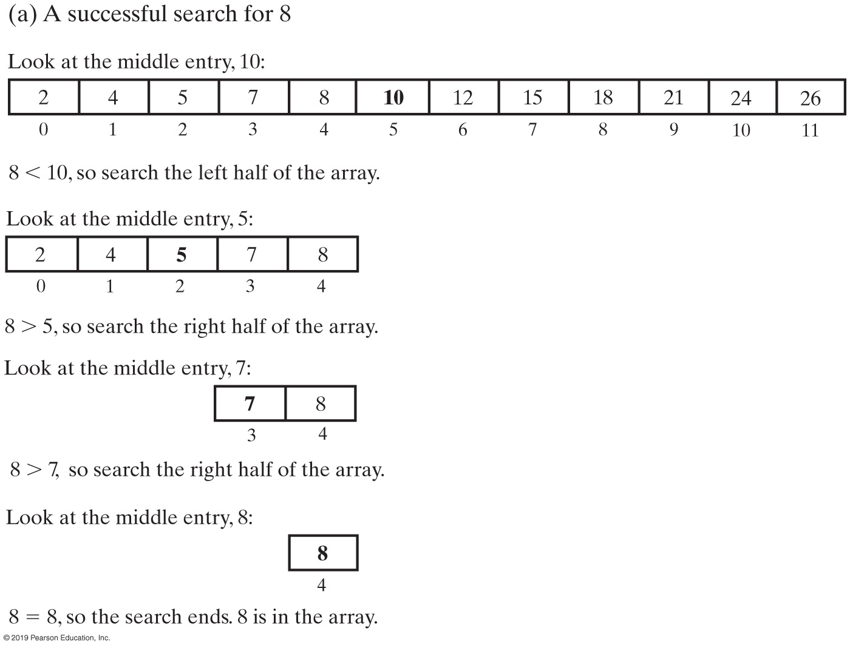
Binary Search of a Sorted Array
FIGURE 19-6a A recursive binary search of a sorted array

Slide 17
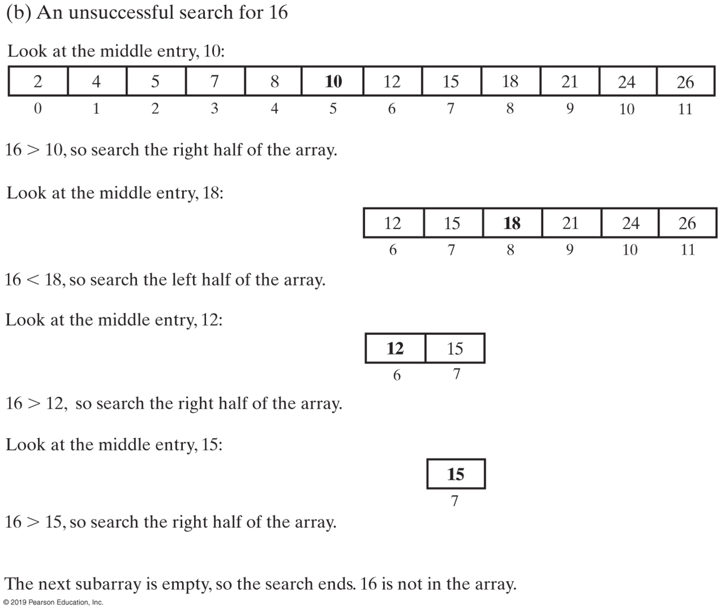
Binary Search of a Sorted Array
FIGURE 19-6b A recursive binary search of a sorted array

Slide 18
Binary Search of a Sorted Array
private static <T extends Comparable<? super T>>
boolean binarySearch(T[] anArray, int first, int last, T desiredItem)
{
boolean found;
int mid = first + (last - first) / 2;
if (first > last)
found = false;
else if (desiredItem.equals(anArray[mid]))
found = true;
else if (desiredItem.compareTo(anArray[mid]) < 0)
found = binarySearch(anArray, first, mid - 1, desiredItem);
else
found = binarySearch(anArray, mid + 1, last, desiredItem);
return found;
} // end binarySearch
public static <T extends Comparable<? super T>> boolean inArray(T anEntry)
{
return binarySearch(anArray, 0, anArray.length - 1, anEntry);
} // end inArray
Implementation of the method binarySearch

Slide 19
Java Class Library: The Method binarySearch
/** Searches an entire array for a given item.
@param array An array sorted in ascending order.
@param desiredItem The item to be found in the array.
@return Index of the array entry that equals desiredItem;
otherwise returns –belongsAt – 1, where belongsAt is
the index of the array element that should contain desiredItem. */
public static int binarySearch(type[] array, type desiredItem);
Static method binarySearch specification

Slide 20
Efficiency of a Binary Search of an Array
The time efficiency of a binary search of an array
Best case: O(1)
Worst case: O(log n)
Average case: O(log n)

Slide 21

Iterative Sequential Search of an Unsorted Chain
FIGURE 19-7 A chain of linked nodes that contain the entries in a list

Slide 22
Iterative Sequential Search of an Unsorted Chain
public boolean contains(T anEntry)
{
boolean found = false;
Node currentNode = firstNode;
while (!found && (currentNode != null))
{
if (anEntry.equals(currentNode.getData()))
found = true;
else
currentNode = currentNode.getNextNode();
} // end while
return found;
} // end contains
Implementation of iterative search in contains

Slide 23
Recursive Sequential Search of an Unsorted Chain
private boolean search(Node currentNode, T desiredItem)
{
boolean found;
if (currentNode == null)
found = false;
else if (desiredItem.equals(currentNode.getData()))
found = true;
else
found = search(currentNode.getNextNode(), desiredItem);
return found;
} // end search
public boolean contains(T anEntry)
{
return search(firstNode, anEntry);
} // end contains
Implementation of recursive search in search

Slide 24
Iterative Sequential Search of a Sorted Chain
public boolean contains(T anEntry)
{
Node currentNode = firstNode;
while ( (currentNode != null) &&
(anEntry.compareTo(currentNode.getData()) > 0) )
{
currentNode = currentNode.getNextNode();
} // end while
return (currentNode != null) &&
anEntry.equals(currentNode.getData());
} // end contains
Implementation of iterative search in contains

Slide 25
Binary Search of a Sorted Chain
First find middle of the chain:
You must traverse the whole chain
Then traverse one of the halves to find the middle of that half
Conclusion
Hard to implement
Less efficient than sequential search

Slide 26
Choosing between Iterative Search and Recursive Search
Operation | Best Case | Average Case | Linked
Sequential Search (unsorted data) | O(1) | O(n) | O(n)
Sequential Search (sorted data) | O(1) | O(n) | O(n)
Binary Search (sorted array) | O(1) | O(log n) | O(log n)
FIGURE 19-8 The time efficiency of searching, expressed in Big Oh notation

Slide 27
Choosing between Iterative Search and Recursive Search
Iterative Searches
Can save some time and space
Recursive Searches
Will not require much additional space for the recursive calls
Coding binary search recursively is easier

Slide 28
End
Chapter 19

