Slide 1
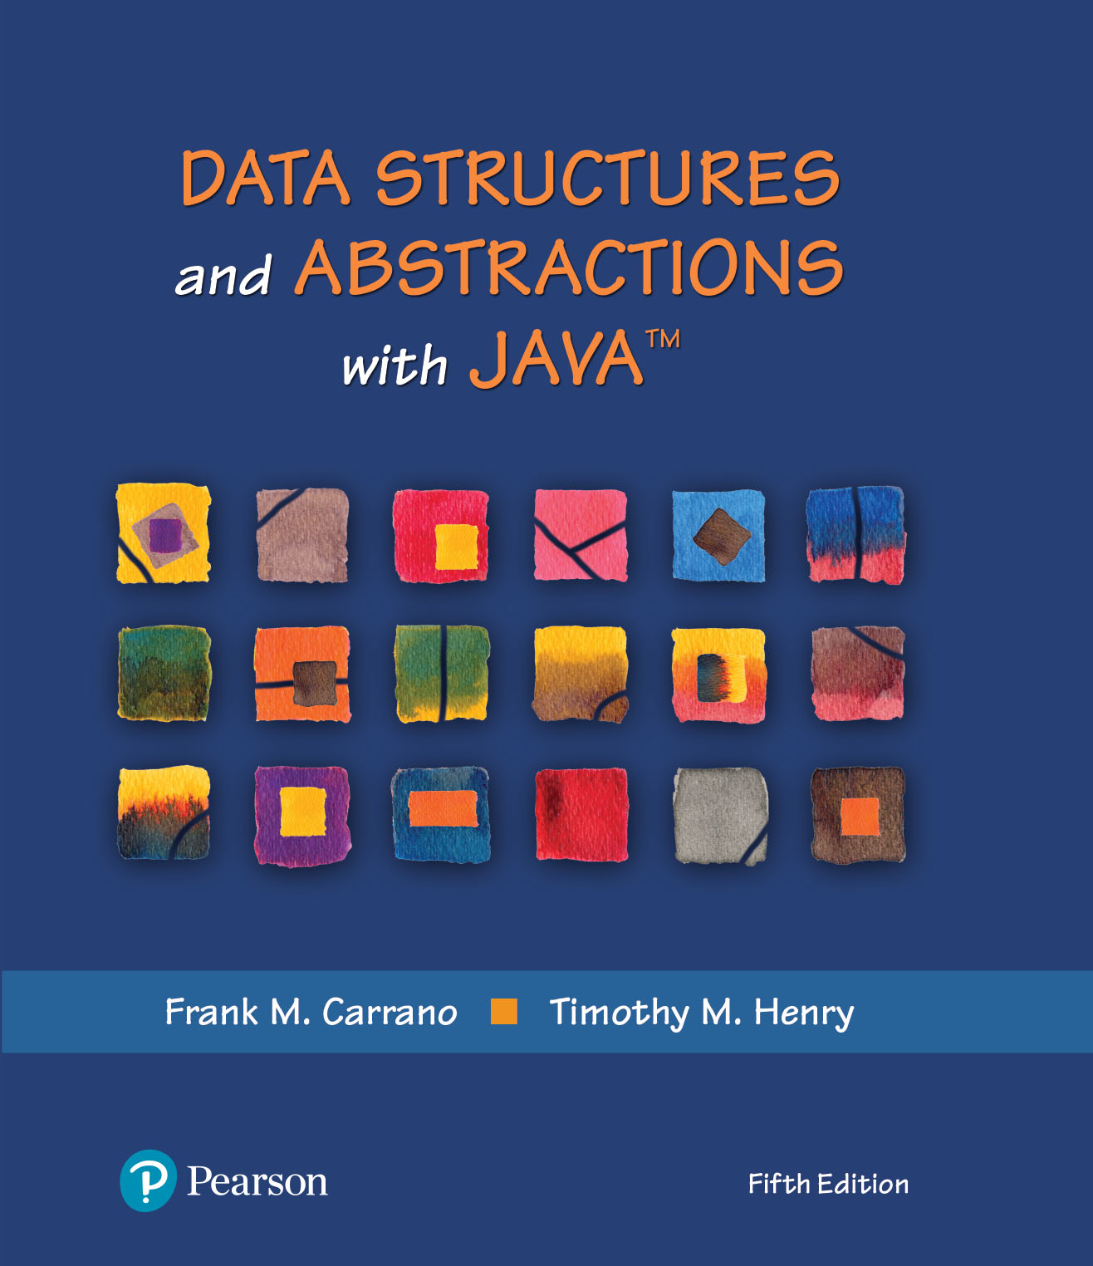
Data Structures and Abstractions with Java™
5th Edition
Java Interlude 8
Generics Once Again

Slide 2
More Than One Generic Type
public class OrderedPair<T> implements Pairable<T>
{
private T first, second;
// The constructor and the methods
// getFirst, getSecond, toString, and changeOrder are here.
// . . .
} // end OrderedPair
Recall the class OrderedPair in Listing JI1-2 of Java Interlude 1

Slide 3
More Than One Generic Type
Possible to define more than one generic type within a class definition
Write identifiers, separated by commas, within angle brackets after class’s name
Each represents actual data type specified by the client when it instantiates object of the class

Slide 4
More Than One Generic Type
public class Pair<S, T>
{
private S first;
private T second;
public Pair(S firstItem, T secondItem)
{
first = firstItem;
second = secondItem;
} // end constructor
public String toString()
{
return "(" + first + ", " + second + ")";
} // end toString
} // end Pair
LISTING JI8-1 The class Pair

Slide 5
Using the class Pair
Name joe = new Name("Joe", "Java");
String joePhone = "(401) 555-1234";
Pair<Name, String> joeEntry = new Pair<>(joe, joePhone);
System.out.println(joeEntry);

Slide 6
End
Java Interlude 8

