Slide 1
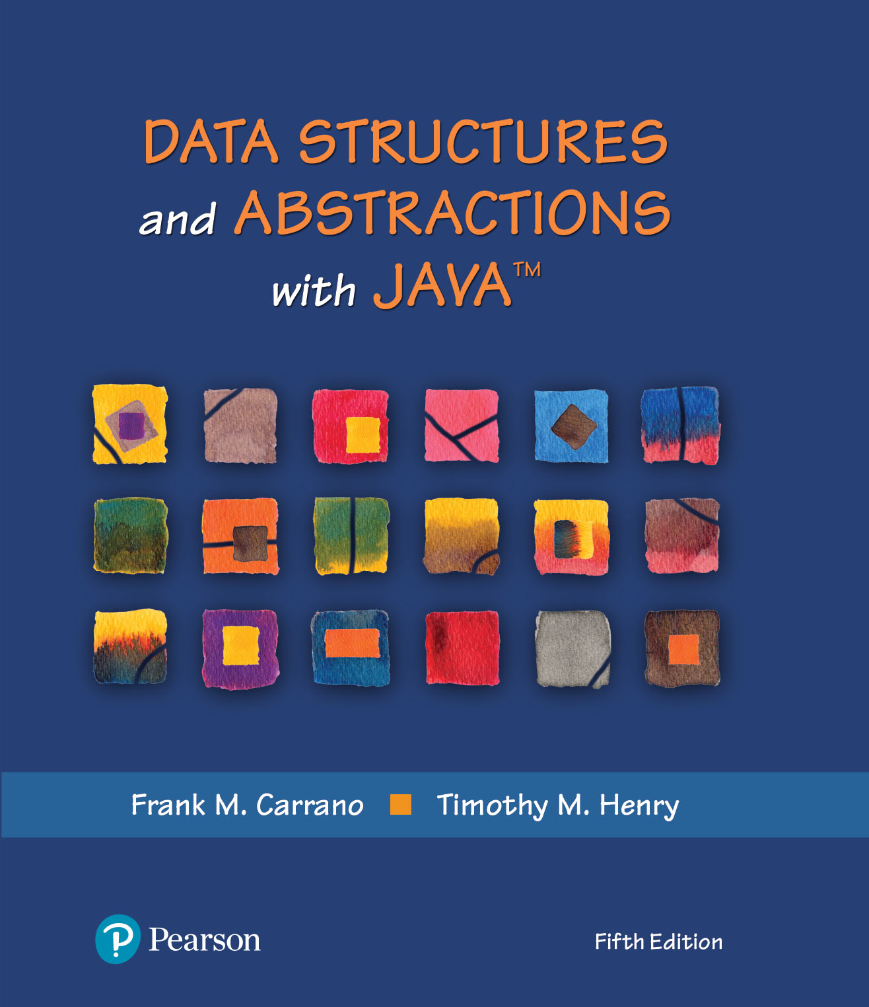
Data Structures and Abstractions with Java™
5th Edition
Chapter 21
Dictionary
Implementations

Slide 2
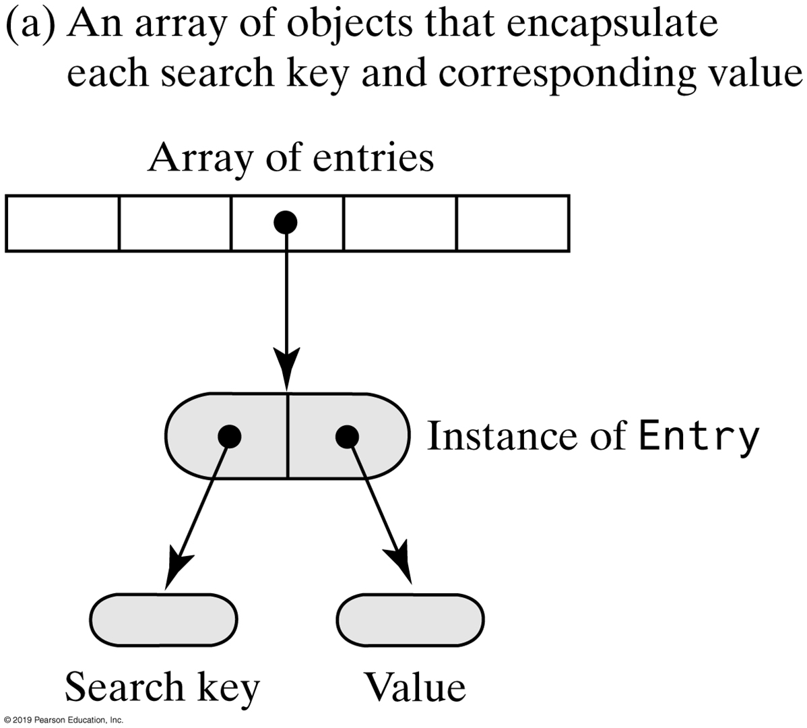
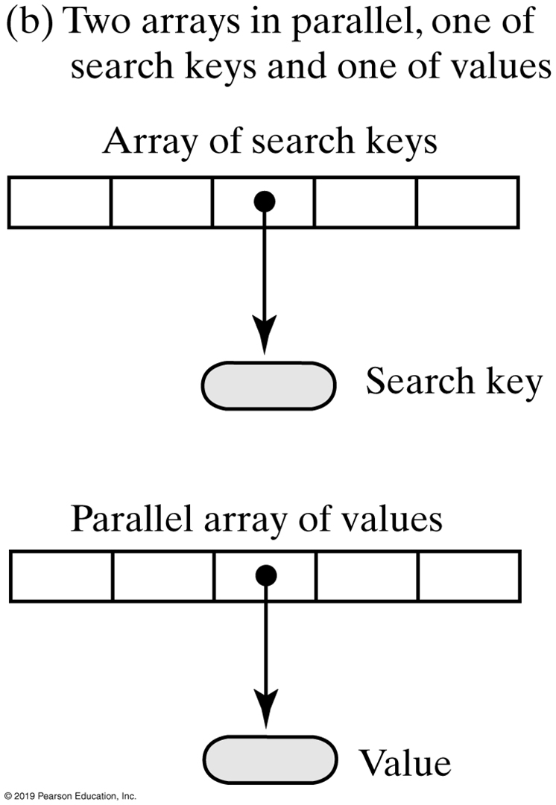
Array-Based Dictionaries
FIGURE 21-1 Two possible ways to use arrays to represent the entries in a dictionary

Slide 3
Array-Based Implementations (Part 1)
/** A class that implements the ADT dictionary by using a resizable array.
The dictionary is unsorted and has distinct search keys.
Search keys and associated values are not null. */
public class ArrayDictionary<K, V> implements DictionaryInterface<K, V>
{
private Entry<K, V>[] dictionary; // Array of unsorted entries
private int numberOfEntries;
vprivate boolean integrityOK = false;
private final static int DEFAULT_CAPACITY = 25;
private static final int MAX_CAPACITY = 10000;
public ArrayDictionary() {
this(DEFAULT_CAPACITY);
} // end default constructor
public ArrayDictionary(int initialCapacity)
{
checkCapacity(initialCapacity);
// The cast is safe because the new array contains null entries
@SuppressWarnings("unchecked")
Entry<K, V>[] tempDictionary = (Entry<K, V>[])new Entry[initialCapacity];
dictionary = tempDictionary;
numberOfEntries = 0;
integrityOK = true;
} // end constructor
/* < Implementations of methods in DictionaryInterface. > . . . */
LISTING 20-1 The class ArrayDictionary

Slide 4
Array-Based Implementations (Part 2)
private class Entry<K, V>
{
private K key;
private V value;
private Entry(K searchKey, V dataValue)
{
key = searchKey;
value = dataValue;
} // end constructor
private K getKey()
{
return key;
} // end getKey
private V getValue()
{
return value;
} // end getValue
private void setValue(V dataValue)
{
value = dataValue;
} // end setValue
} // end Entry
} // end ArrayDictionary
LISTING 21-1 The class ArrayDictionary and its private inner class Entry

Slide 5
Array-Based Implementations
Algorithm add(key, value)
// Adds a new key-value entry to the dictionary and returns null. If key already exists
// in the dictionary, returns the corresponding value and replaces it with value.
// key and value are not null.
result = null
Search the dictionary for an entry containing key
if (an entry containing key is found)
{
result = value currently associated with key
Replace key's associated value with value
}
else // Insert new entry
{
if (array is full)
Double size of array
Insert a new entry containing key and value after the last entry in the array
Increment the size of the dictionary
}
return result
Algorithm to add an entry.

Slide 6
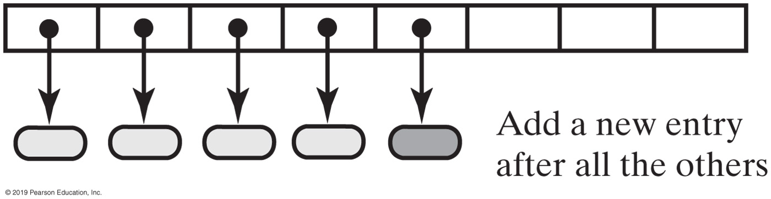
Unsorted Array-Based Implementations
FIGURE 21-2 Adding a new entry to an unsorted array-based dictionary

Slide 7
Unsorted Array-Based Implementations
public V add(K key, V value)
{
checkIntegrity();
if ((key == null) || (value == null))
throw new IllegalArgumentException("Cannot add null to this dictionary.");
else
{
V result = null;
int keyIndex = locateIndex(key);
if (keyIndex < numberOfEntries)
{
// Key found, return and replace entry's value
result = dictionary[keyIndex].getValue(); // Get old value
dictionary[keyIndex].setValue(value); // Replace value
}
else // Key not found; add new entry to dictionary
{
// Add at end of array
dictionary[numberOfEntries] = new Entry<>(key, value);
numberOfEntries++;
ensureCapacity(); // Ensure enough room for next add
} // end if
return result;
} // end if
} // end add
Implementation of the method add

Slide 8
Unsorted Array-Based Implementations
private int locateIndex(K key)
{
// Sequential search
int index = 0;
while ( (index < numberOfEntries) &&
!key.equals(dictionary[index].getKey()) )
index++;
return index;
}
Method locate used by add

Slide 9
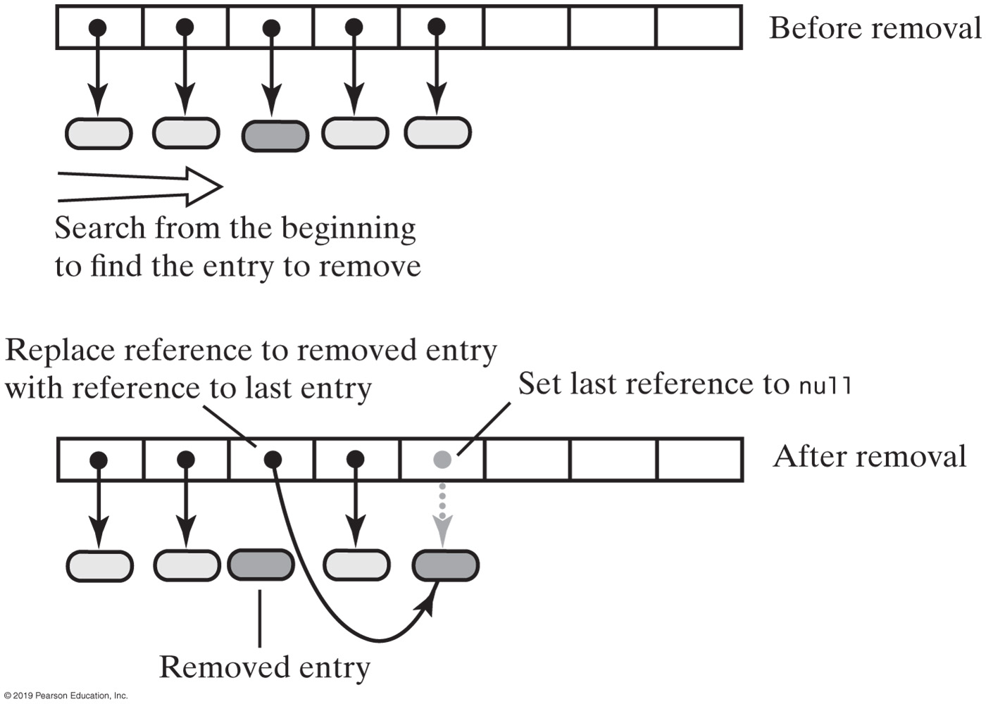
Unsorted Array-Based Implementations
FIGURE 21-3 Removing an entry from an unsorted array-based dictionary

Slide 10
Unsorted Array-Based Implementations
Algorithm remove(key)
// Removes an entry from the dictionary, given its search key, and returns its value.
// If no such entry exists in the dictionary, returns null.
result = null
Search the array for an entry containing key
if (an entry containing key is found in the array)
{
result = value currently associated with key
Replace the entry with the last entry in the array
Set array element containing last entry to null
Decrement the size of the dictionary
}
// Else result is null
return result
Algorithm to describe the remove operation.

Slide 11
Unsorted Array-Based Implementations
For this implementation, worst-case efficiencies of the operations are:
Addition: O(n)
Removal: O(n)
Retrieval: O(n)
Traversal: O(n)

Slide 12
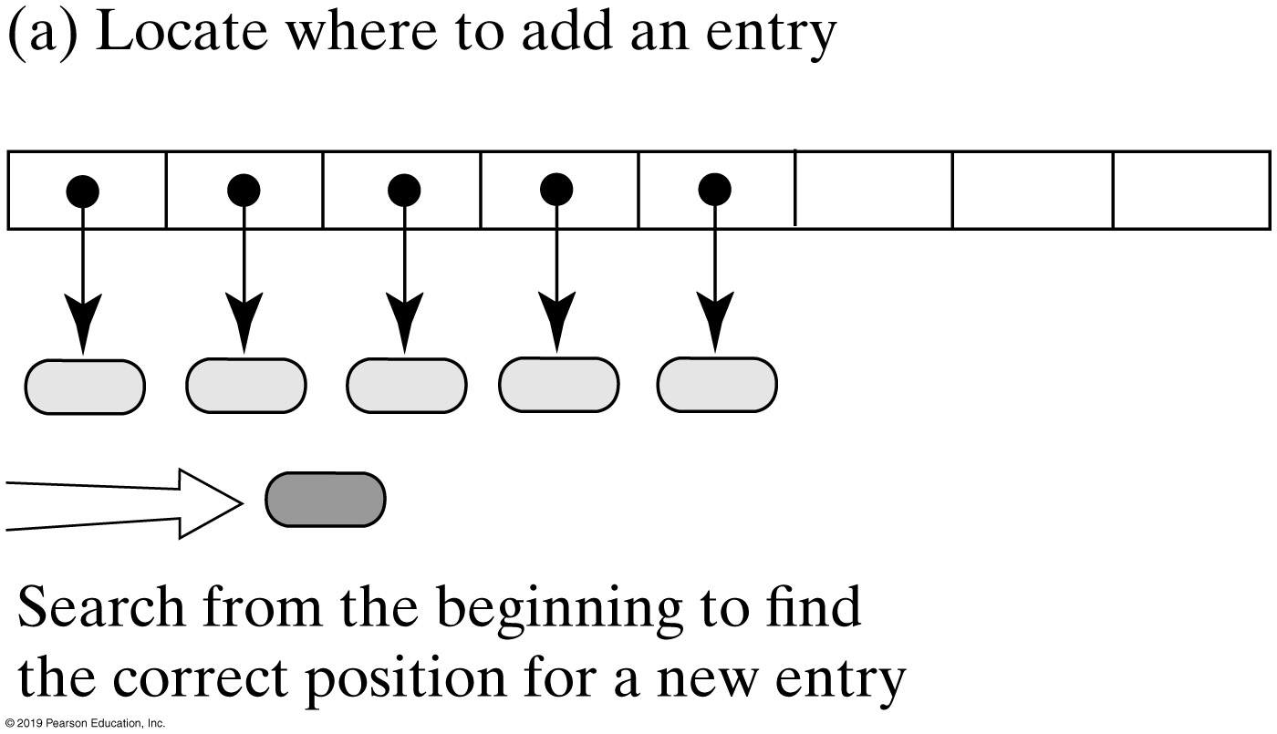
Sorted Array-Based Implementations
FIGURE 21-4a Adding an entry to a sorted array-based dictionary

Slide 13
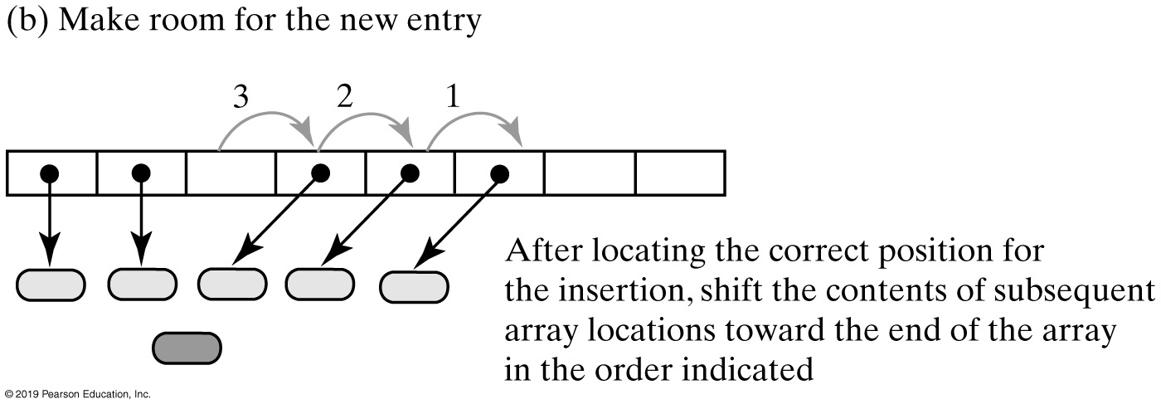
Sorted Array-Based Implementations
FIGURE 21-4b Adding an entry to a sorted array-based dictionary

Slide 14
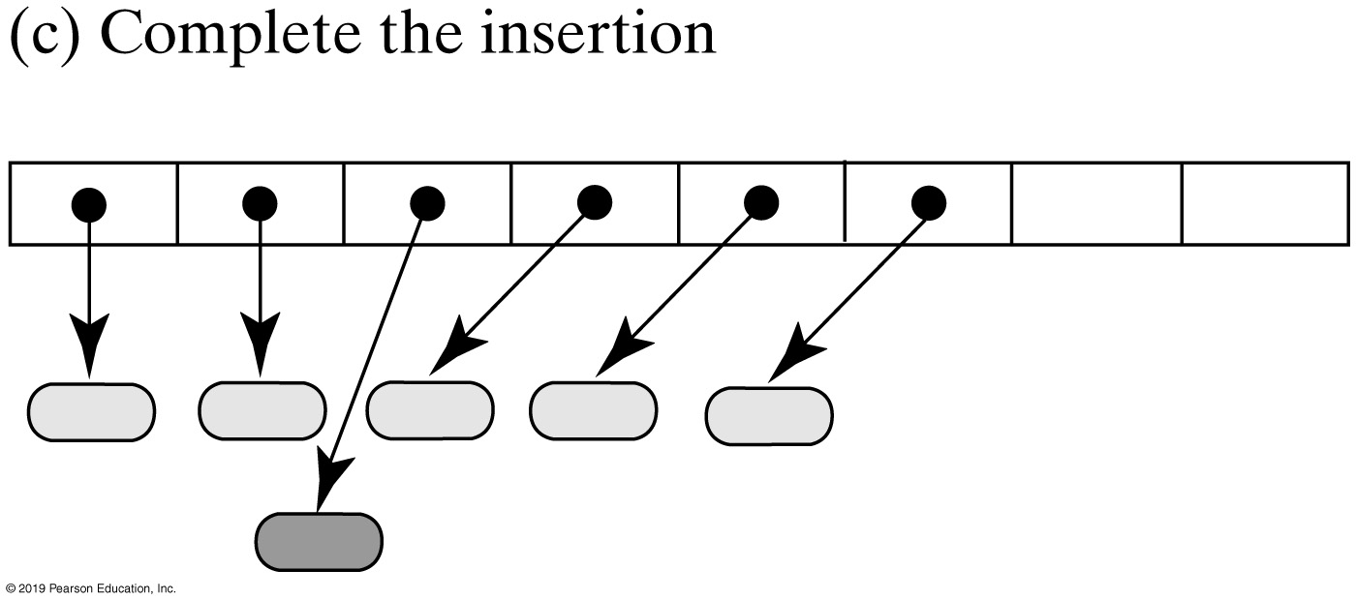
Sorted Array-Based Implementations
FIGURE 21-4c Adding an entry to a sorted array-based dictionary

Slide 15
Sorted Array-Based Dictionary
/** A class that implements the ADT dictionary by using a resizable array.
The dictionary is sorted and has distinct search keys. Search keys and
associated values are not null. */
public class SortedArrayDictionary<K extends Comparable<? super K>, V>
implements DictionaryInterface<K, V>
{
// Array of entries sorted by search key
private Entry<K, V>[] dictionary;
private int numberOfEntries;
private boolean integrityOK = false;
private final static int DEFAULT_CAPACITY = 25;
private static final int MAX_CAPACITY = 10000;
/* < Constructors analogous to those in Listing 21-1.
. . .
Implementations of methods in DictionaryInterface.
. . .
The private class Entry, as shown in Listing 21-1.
. . .
*/
} // end SortedArrayDictionary
LISTING 21-2 An outline of the class SortedArrayDictionary

Slide 16
Sorted Array-Based Dictionary
Algorithm add(key, value)
// Adds a new key-value entry to the dictionary and returns null. If key already exists
// in the dictionary, returns the corresponding value and replaces it with value.
If either key or value is null, throw an exception
result = null
Search the array until you either find an entry containing key or locate the point where it should be
if (an entry containing key is found in the array)
{
result = value currently associated with key
Replace key’s associated value with value
}
else // Insert new entry
{
Make room in the array for a new entry at the index indicated by the previous search
Insert a new entry containing key and value into the vacated location of the array
Increment the size of the dictionary
if (array is full)
Double size of array
}
return result
Algorithm for adding an entry

Slide 17
Sorted Array-Based Dictionary
public V add(K key, V value)
{
checkIntegrity();
if ((key == null) || (value == null))
throw new IllegalArgumentException("Cannot add null to this dictionary.");
else
{
V result = null;
int keyIndex = locateIndex(key);
if ( (keyIndex < numberOfEntries) &&
key.equals(dictionary[keyIndex].getKey()) )
{
// Key found, return and replace entry's value
result = dictionary[keyIndex].getValue(); // Get old value
dictionary[keyIndex].setValue(value); // Replace value
}
else // Key not found; add new entry to dictionary
{
makeRoom(keyIndex); // Make room for new entry
dictionary[keyIndex] = new Entry<>(key, value); // Insert new entry in array
numberOfEntries++;
ensureCapacity(); // Ensure enough room for next add
} // end if
return result;
} // end if
} // end add
Implementation of method add.

Slide 18
Sorted Array-Based Dictionary
// Returns the index of either the entry that contains key or
// the location that should contain key, if no such entry exists.
private int locateIndex(K key)
{
// Search until you either find an entry containing key or
// pass the point where it should be
int index = 0;
while ( (index < numberOfEntries) &&
key.compareTo(dictionary[index].getKey()) > 0 )
{
index++;
} // end while
return index;
} // end locateIndex
Definition of the private method locateIndex

Slide 19
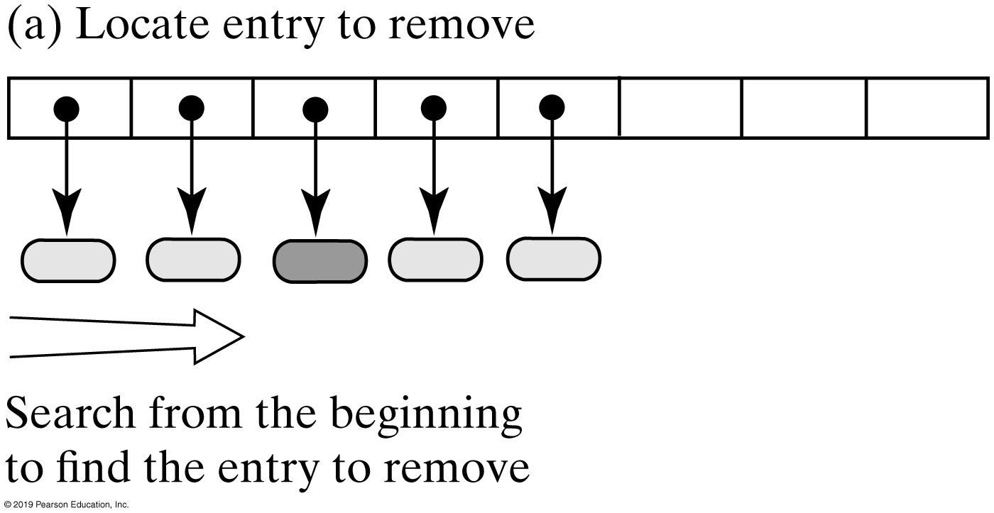
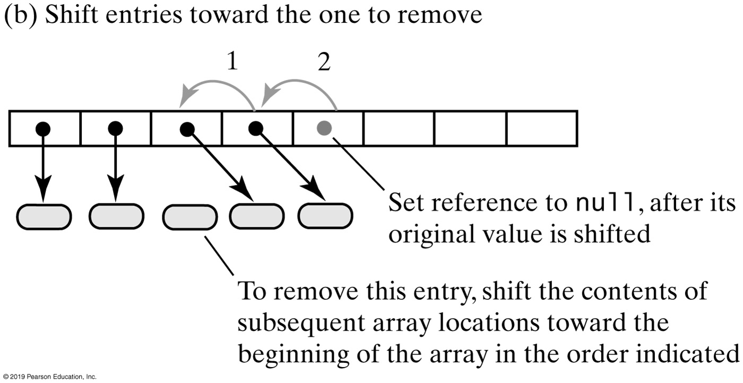
Sorted Array-Based Dictionary
FIGURE 21-5 Removing an entry from a sorted array-based dictionary

Slide 20
Sorted Array-Based Dictionary
Algorithm remove(key)
// Removes an entry from the dictionary, given its search key, and returns its value.
// If no such entry exists in the dictionary, returns null.
result = null
Search the array for an entry containing key
if (an entry containing key is found in the array)
{
result = value currently associated with key
Shift any entries that are after the located one to the next lower position in the array
Set array element that had contained last entry to null
Decrement the size of the dictionary
}
return result
Algorithm that describes the remove operation

Slide 21
Sorted Array-Based Dictionary
Efficiency of sorted array-based dictionary.
When locateIndex uses a binary search in the sorted array-based implementation, the worst-case efficiencies are:
Addition: O(n)
Removal: O(n)
Retrieval: O(log n)
Traversal: O(n)

Slide 22
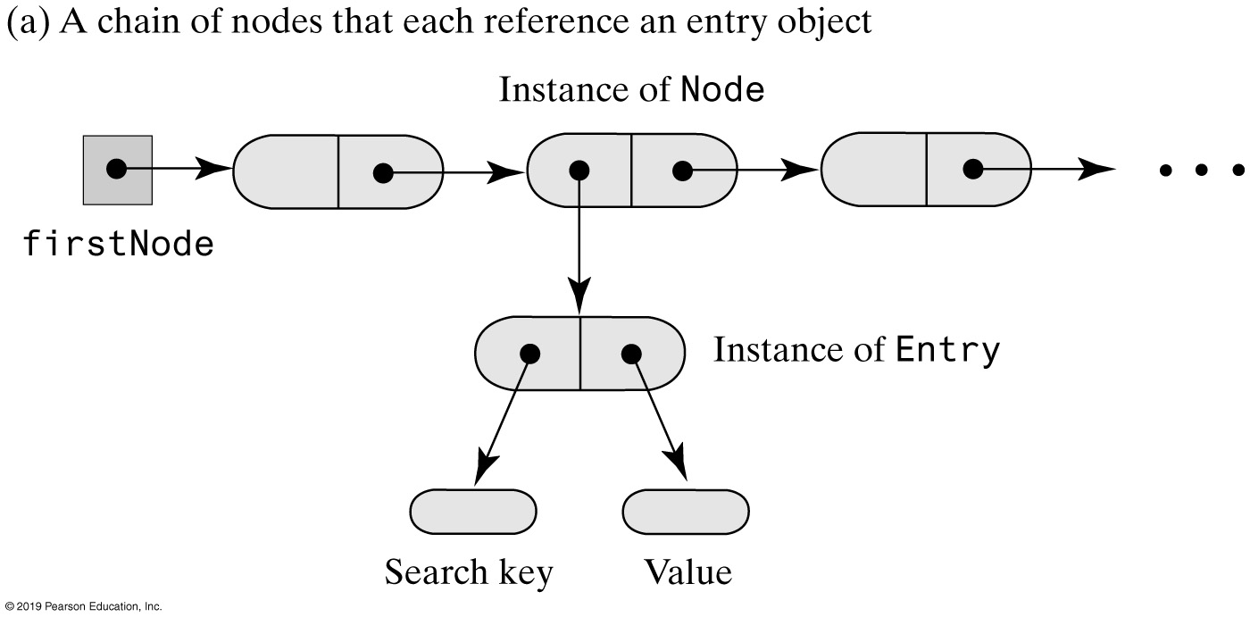
Linked Dictionary Implementations
FIGURE 21-6a Representing the entries in a dictionary

Slide 23
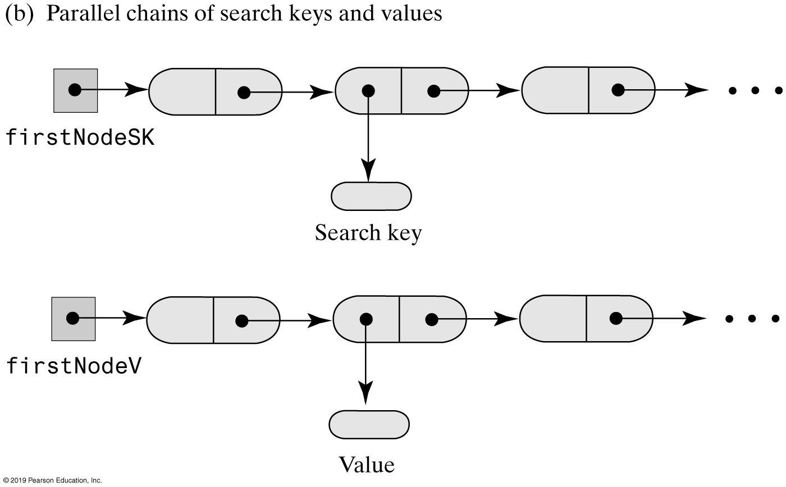
Linked Dictionary Implementations
FIGURE 21-6b Representing the entries in a dictionary

Slide 24
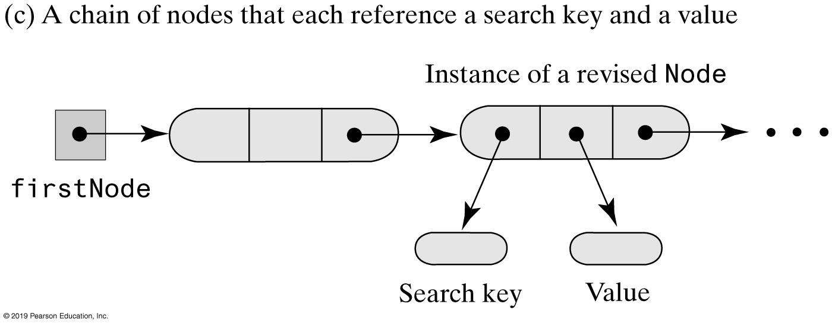
Linked Dictionary Implementations
FIGURE 21-6c Representing the entries in a dictionary

Slide 25
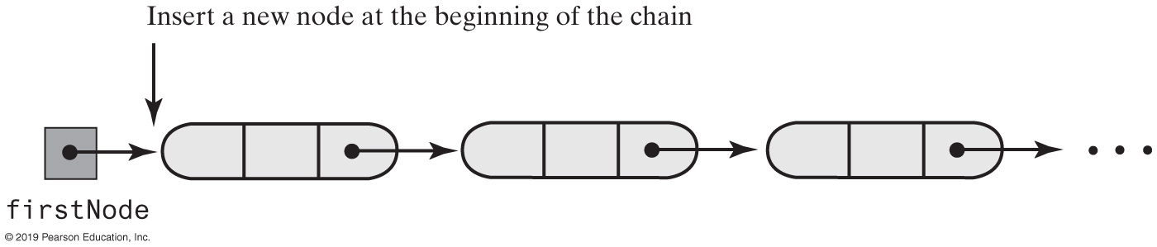
Linked Dictionary Implementations
FIGURE 21-7 Adding to an unsorted linked dictionary

Slide 26
An Unsorted Linked Dictionary
Efficiency of an unsorted linked dictionary:
The worst-case efficiencies of the operations.
Addition: O(n)
Removal: O(n)
Retrieval: O(n)
Traversal: O(n)

Slide 27
Sorted Linked Dictionary
Algorithm add(key, value)
// Adds a new key-value entry to the dictionary and returns null. If key already exists
// in the dictionary, returns the corresponding value and replaces that value with value.
If either key or value is null, throw an exception
result = null
Search the chain until either you find a node containing key or you pass the point where it should be
if (a node containing key is found in the chain)
{
result = value currently associated with key
Replace key’s associated value with value
}
else
{
Allocate a new node containing key and value
if (the chain is empty or the new entry belongs at the beginning of the chain)
Add the new node to the beginning of the chain
else
Insert the new node before the last node that was examined during the search Increment the size of the dictionary
}
return result
Algorithm for adding new entry to sorted linked dictionary

Slide 28
Sorted Linked Dictionary (Part 1)
/** A class that implements the ADT dictionary by using a chain of linked nodes.
The dictionary is sorted and has distinct search keys.
Search keys and associated values are not null. */
public class SortedLinkedDictionary<K extends Comparable<? super K>, V>
implements DictionaryInterface<K, V>
{
private Node firstNode; // Reference to first node of chain
private int numberOfEntries;
public SortedLinkedDictionary()
{
initializeDataFields();
} // end default constructor
private class Node
{
private K key;
private V value;
private Node next;
/* Constructors and the methods getKey, getValue, setValue, getNextNode,
and setNextNode are here. There is no setKey.
. . . */
} // end Node
} // end SortedLinkedDictionary
LISTING 21-5 The class SortedLinkedDictionary

Slide 29
Sorted Linked Dictionary (Part 2)
public V add(K key, V value)
{
V result = null;
if ((key == null) || (value == null))
throw new IllegalArgumentException("Cannot add null to a dictionary.");
else
{
// Search chain until you either find a node containing key
// or locate where it should be
Node currentNode = firstNode;
Node nodeBefore = null;
while ( (currentNode != null) && (key.compareTo(currentNode.getKey()) > 0))
{
nodeBefore = currentNode;
currentNode = currentNode.getNextNode();
} // end while
if ( (currentNode != null) && key.equals(currentNode.getKey()) )
{
// Key in dictionary; replace corresponding value
result = currentNode.getValue(); // Get old value
currentNode.setValue(value); // Replace value
}
else // Key not in dictionary; add new node in proper order
LISTING 21-5 Method add of class SortedLinkedDictionary

Slide 30
Sorted Linked Dictionary (Part 3)
{
// Assertion: key and value are not null
Node newNode = new Node(key, value); // Create new node
if (nodeBefore == null)
{ // Add at beginning (includes empty chain)
newNode.setNextNode(firstNode);
firstNode = newNode;
}
else // Add elsewhere in non-empty chain
{
newNode.setNextNode(currentNode); // currentNode is after new node
nodeBefore.setNextNode(newNode); // nodeBefore is before new node
} // end if
numberOfEntries++; // Increase length for both cases
} // end if
} // end if
return result;
} // end add
LISTING 21-5 Method add of class SortedLinkedDictionary

Slide 31
Sorted Linked Dictionary
Efficiency of a sorted linked dictionary:
The worst-case efficiencies of the operations.
Addition: O(n)
Removal: O(n)
Retrieval: O(n)
Traversal: O(n)

Slide 32
Implementation Comparison
Operation | Array-based Unsorted | Array-based Sorted | Linked Unsorted | Linked Sorted
Addition | O(n) | O(n) | O(n) | O(n)
Removal | O(n) | O(n) | O(n) | O(n)
Retrieval | O(n) | O(log n) | O(n) | O(n)
Traversal | O(n) | O(n) | O(n) | O(n)

Slide 33
End
Chapter 21

