Slide 1
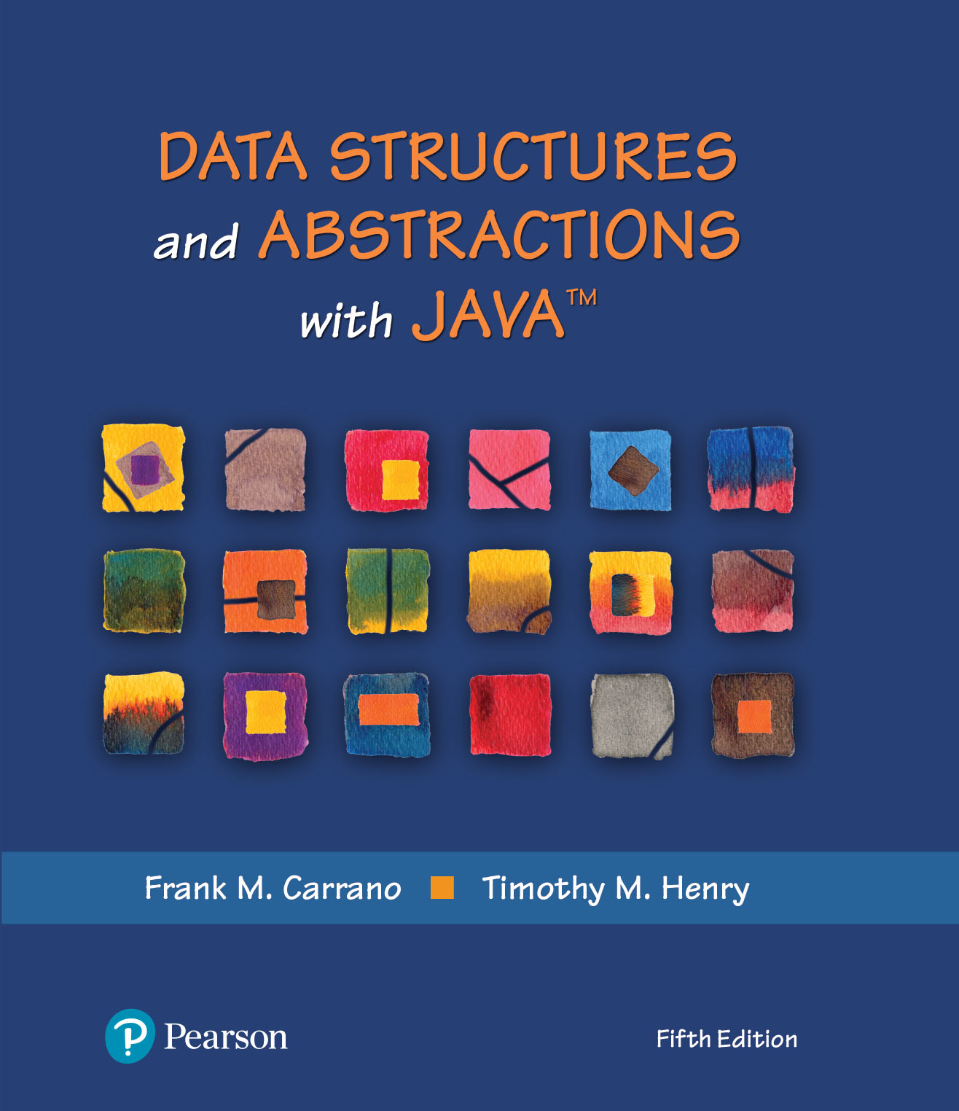
Data Structures and Abstractions with Java™
5th Edition
Chapter 22
Introducing Hashing

Slide 2
Hashing
A technique that determines an index into a table using only an entry’s search key
Hash function
  Takes a search key and produces the integer index of an element in the hash table
  Search key is mapped, or hashed, to the index

Slide 3
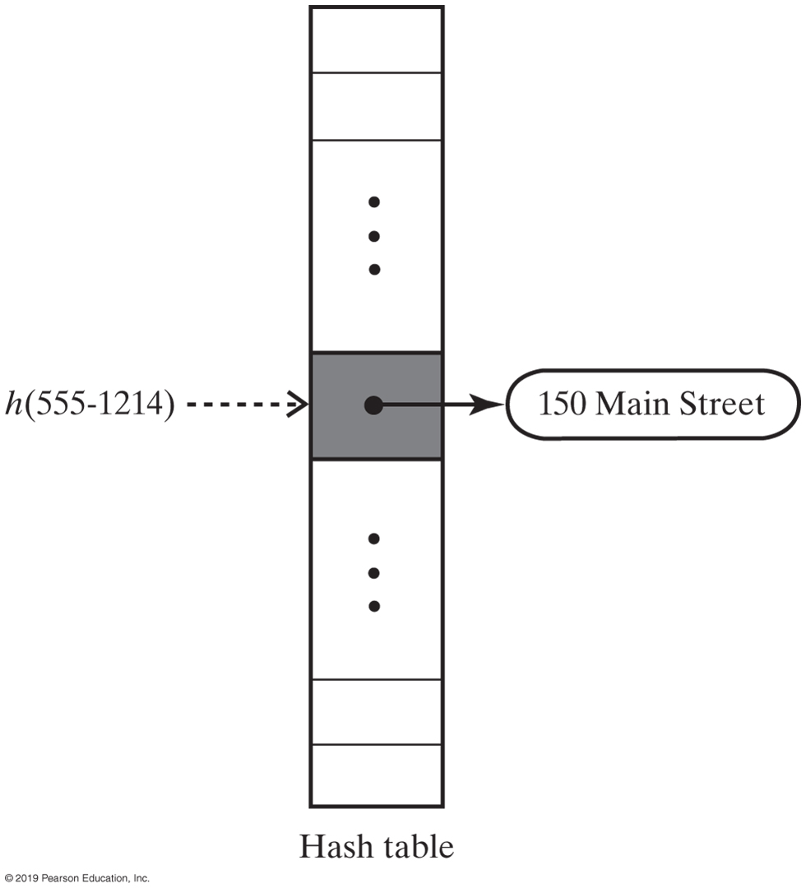
Hash Table
FIGURE 22-1 A hash function indexes its hash table

Slide 4
Ideal Hashing
Algorithm add(key, value)
index = h(key)
hashTable[index] = value
Algorithm getValue(key)
index = h(key)
return hashTable[index]
Simple algorithms for the dictionary operations that add and retrieve

Slide 5
Typical Hashing
Typical hash functions perform two steps:
  Convert search key to an integer
    Called the hash code.
  Compress hash code into the range of indices for hash table.
Algorithm getHashIndex(phoneNumber)
// Returns an index to an array of tableSize elements.
i = last four digits of phoneNumber
return i % tableSize

Slide 6
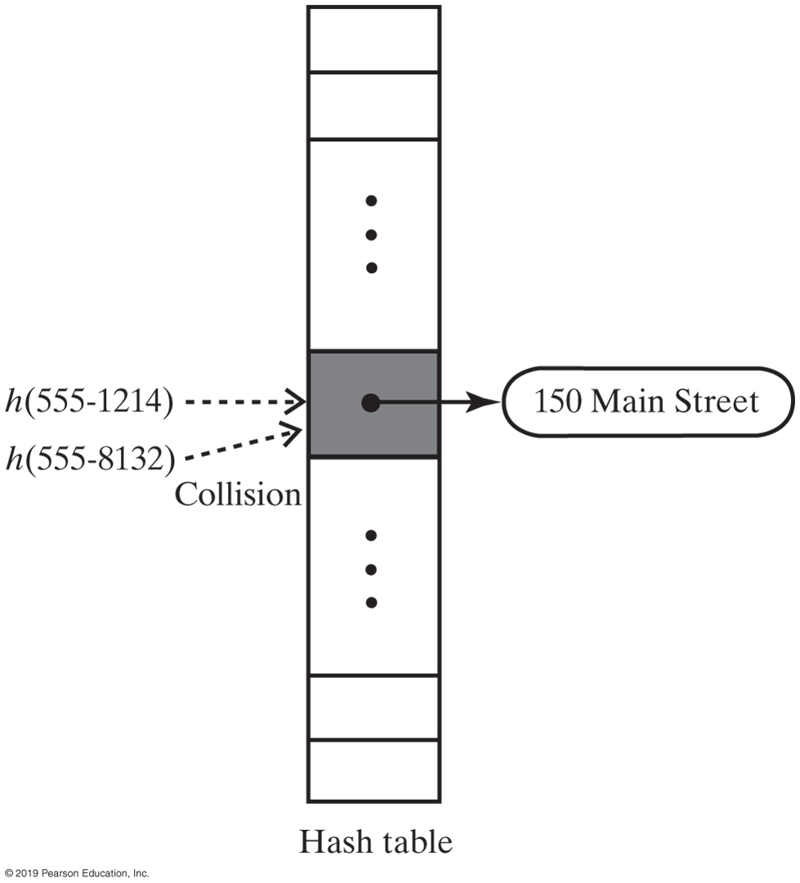
Typical Hashing
Most hash functions are not perfect,
  Can allow more than one search key to map into a single index
  Causes a collision in the hash table
Consider tableSize = 101
getHashIndex(555-1214) = 52
getHashIndex(555-8132) = 52 also!!!
FIGURE 22-2 A collision caused by the hash function h

Slide 7
Hash Functions
A good hash function should
  Minimize collisions
  Be fast to compute
To reduce the chance of a collision
  Choose a hash function that distributes entries uniformly throughout hash table.

Slide 8
Computing Hash Codes
Java’s base class Object has a method hashCode that returns an integer hash code
  A class should define its own version of hashCode
A hash code for a string
  Using a character’s Unicode integer is common
  Better approach:
    Multiply Unicode value of each character by factor based on character’s position,
    Then sum values

Slide 9
Computing Hash Codes
Hash code for a string example:
Java code to do this:
u0g^{n-1} + u1g^{n-2} + … + u^{n-2}g + un-1
int hash = 0;
int n = s.length();
for (int i = 0; i < n; i++)
hash = g * hash + s.charAt(i);

Slide 10
Hash Code for a Primitive type
If data type is int,
  Use the key itself
For byte, short, char:
  Cast as int
Other primitive types
  Manipulate internal binary representations

Slide 11
Compressing a Hash Code
Common way to scale an integer
  Use Java mod operator %: code % n
Best to use an odd number for n
Prime numbers often give good distribution of hash values

Slide 12
Compressing a Hash Code
private int getHashIndex(K key)
{
int hashIndex = key.hashCode() % hashTable.length;
if (hashIndex < 0)
hashIndex = hashIndex + hashTable.length;
return hashIndex;
} // end getHashIndex
Hash function for the ADT dictionary

Slide 13
Resolving Collisions
Collision:
  Hash function maps search key into a location in hash table already in use
Two choices:
  Use another location in the hash table
  Change the structure of the hash table so that each array location can represent more than one value

Slide 14
Resolving Collisions
Linear probing
  Resolves a collision during hashing by examining consecutive locations in hash table
  Beginning at original hash index
  Find the next available one
Table locations checked make up probe sequence
If probe sequence reaches end of table, go to beginning of table (circular hash table)

Slide 15
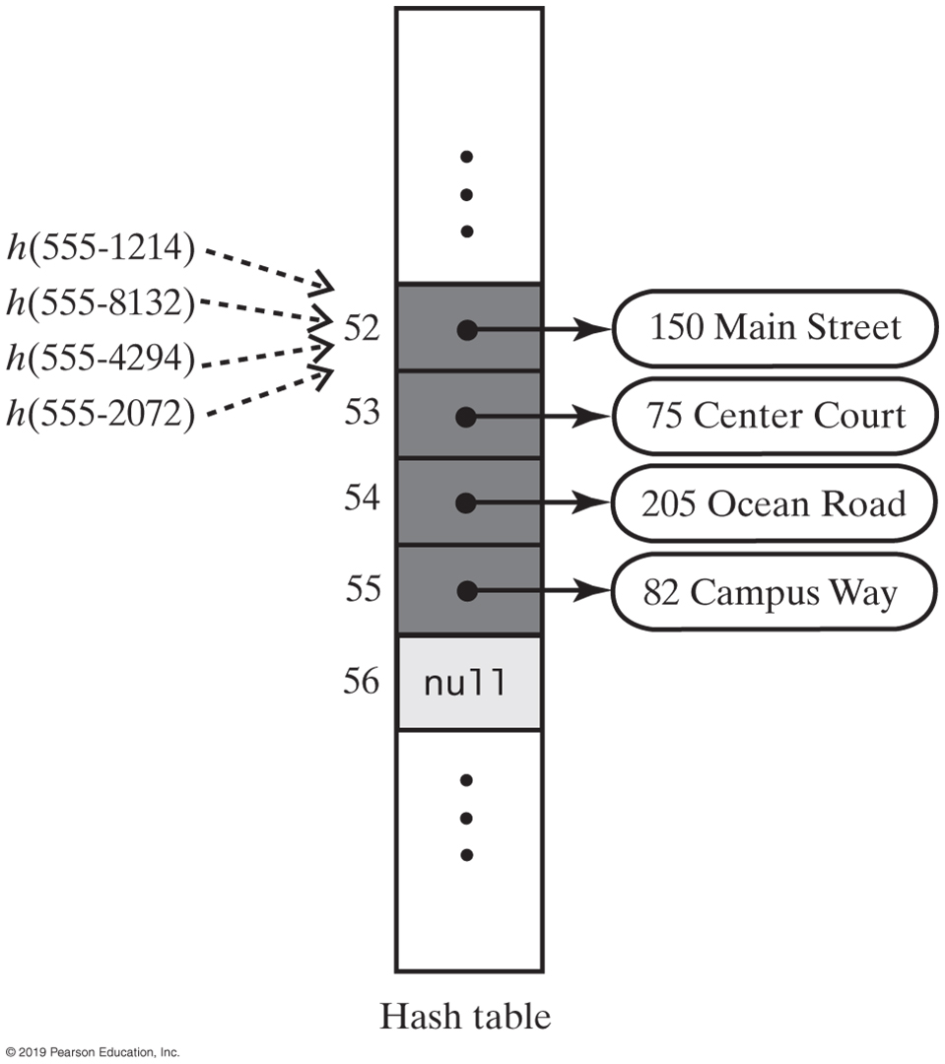
Linear Probing
FIGURE 22-3 The effect of linear probing after adding four entries whose search keys hash to the same index

Slide 16
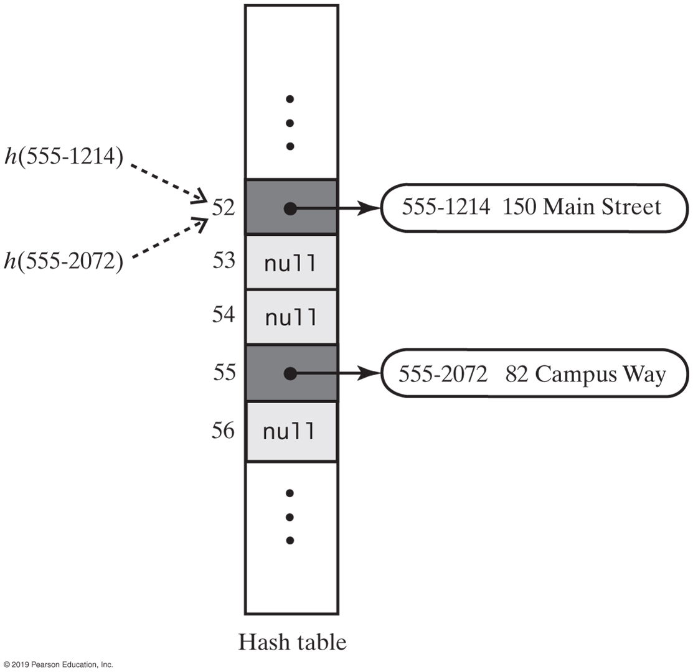
Linear Probing
FIGURE 22-5 A hash table if remove used null to remove entries

Slide 17
Resolving Collisions
Need to distinguish among three kinds of locations in the hash table
  Occupied
    location references an entry in the dictionary
  Empty
    location contains null and always has
  Available
    location’s entry was removed from the dictionary

Slide 18
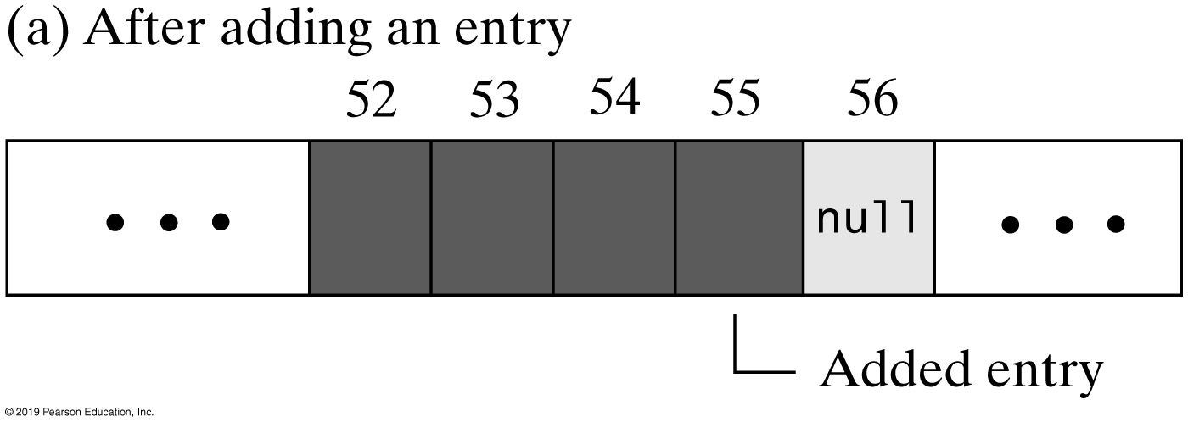
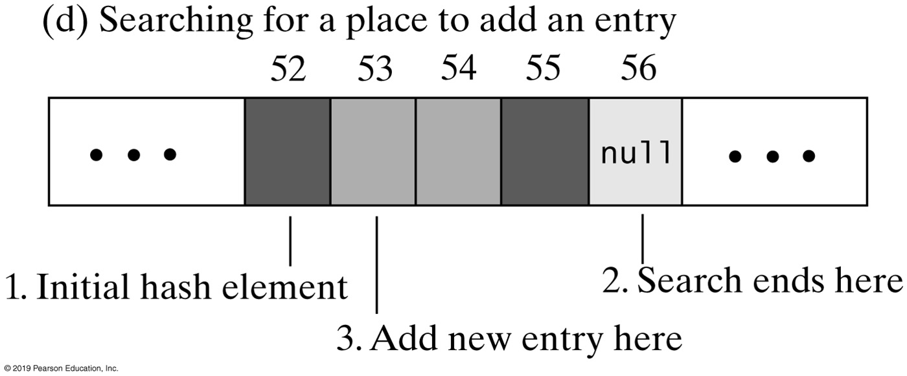
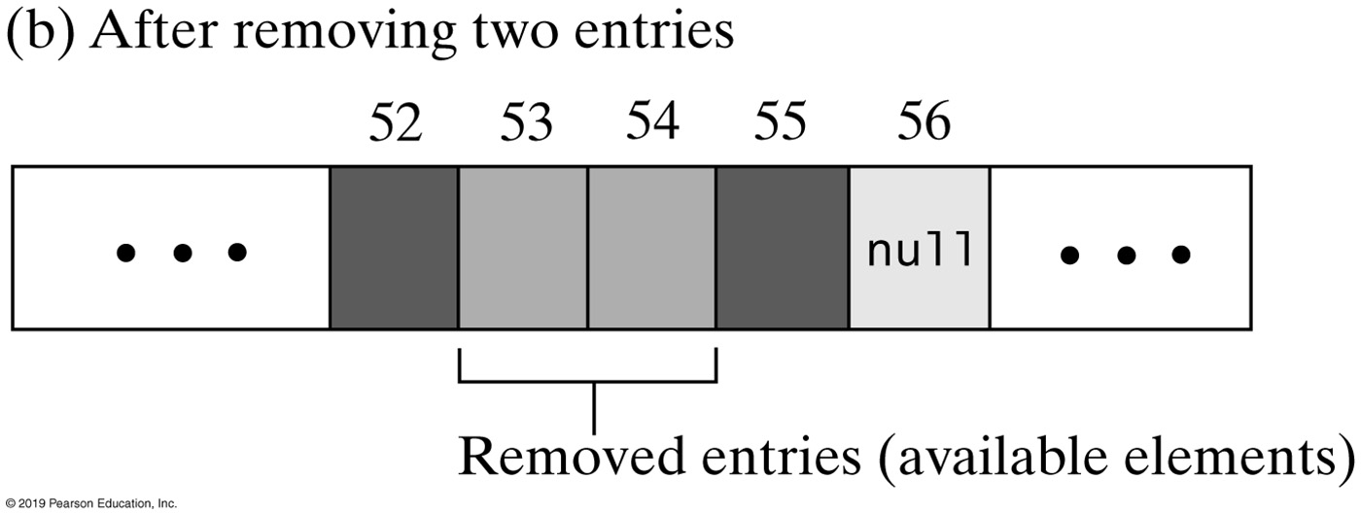
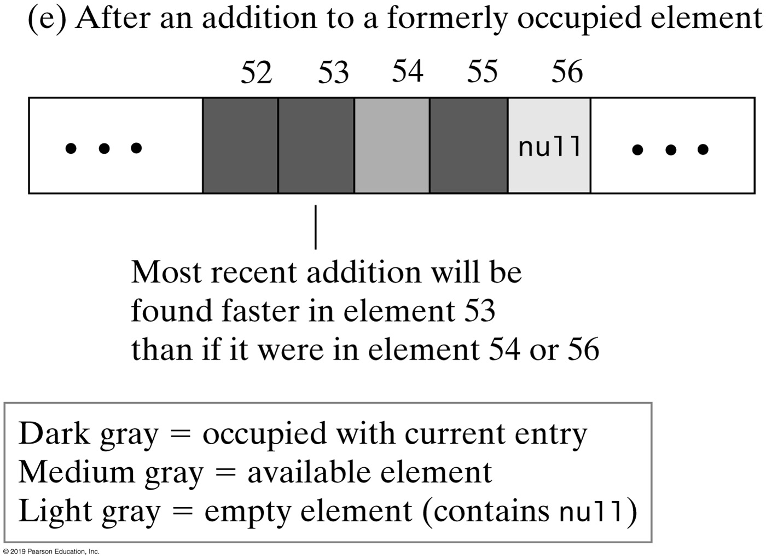
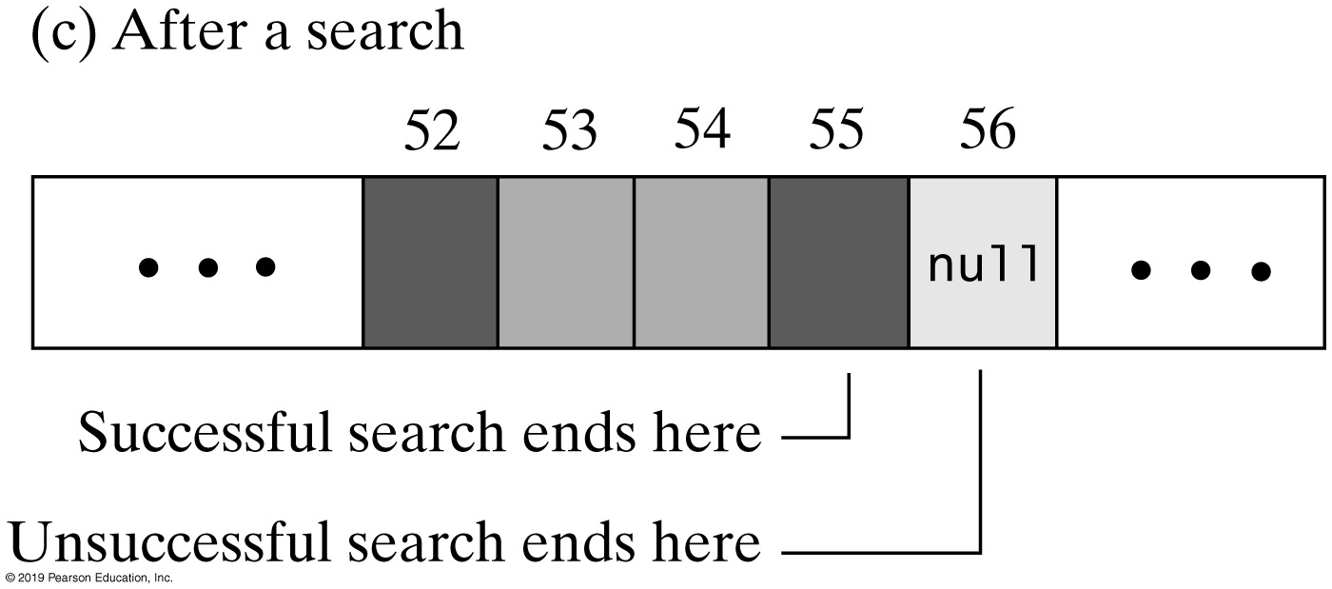
Linear Probing
FIGURE 22-6 The linear probe sequence in various situations

Slide 19
Linear Probing - Probe Algorithm
Algorithm probe(index, key)
// Searches the probe sequence that begins at index. Returns the index of either the element
// containing key or an available element in the hash table.
while (key is not found and hashTable[index] is not null)
{
    if (hashTable[index] references an entry in the dictionary)
    {
        if (the entry in hashTable[index] contains key)
            Exit loop
        else
            index = next probe index
    }
    else // hashTable[index] is available
    {
        if (this is the first available element encountered)
            availableStateIndex = index
        index = next probe index
    }
}
if (key is found or an available element was not encountered)
    return index
else
    return availableStateIndex // Index of first entry removed

Slide 20
Linear Probe Algorithm
// Precondition: checkIntegrity has been called.
private int linearProbe(int index, K key)
{
  boolean found = false;
  int availableStateIndex = −1; // Index of first element in available state
  while ( !found && (hashTable[index] != null) )
  {
    if (hashTable[index] != AVAILABLE)
    {
        if (key.equals(hashTable[index].getKey()))
          found = true; // Key found
        else // Follow probe sequence
          index = (index + 1) % hashTable.length; // Linear probing
    }
    else // Element in available state; skip it, but mark the first one encountered
    {
        // Save index of first element in available state
        if (availableStateIndex == −1) availableStateIndex = index;
            index = (index + 1) % hashTable.length; // Linear probing
    } // end if
  } // end while
  // Assertion: Either key or null is found at hashTable[index]
  if (found || (availableStateIndex == −1) )
      return index; // Index of either key or null
  else
      return availableStateIndex; // Index of an available element
} // end linearProbe

Slide 21
Clustering
Collisions resolved with linear probing cause groups of consecutive locations in hash table to be occupied
  Each group is called a cluster
Bigger clusters mean longer search times following collision

Slide 22
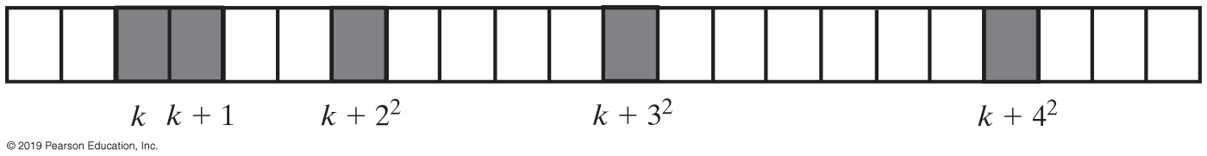
Open Addressing with Quadratic Probing
Linear probing looks at consecutive locations beginning at index k
Quadratic probing:
  Considers the locations at indices k + j²
  Uses the indices k, k + 1, k + 4, k + 9, …
FIGURE 22-7 A probe sequence of length five using quadratic probing

Slide 23
Open Addressing with Double Hashing
Linear probing and quadratic probing add increments to k to define a probe sequence
  Both are independent of the search key
Double hashing uses a second hash function to compute these increments
  This is a key-dependent method.

Slide 24
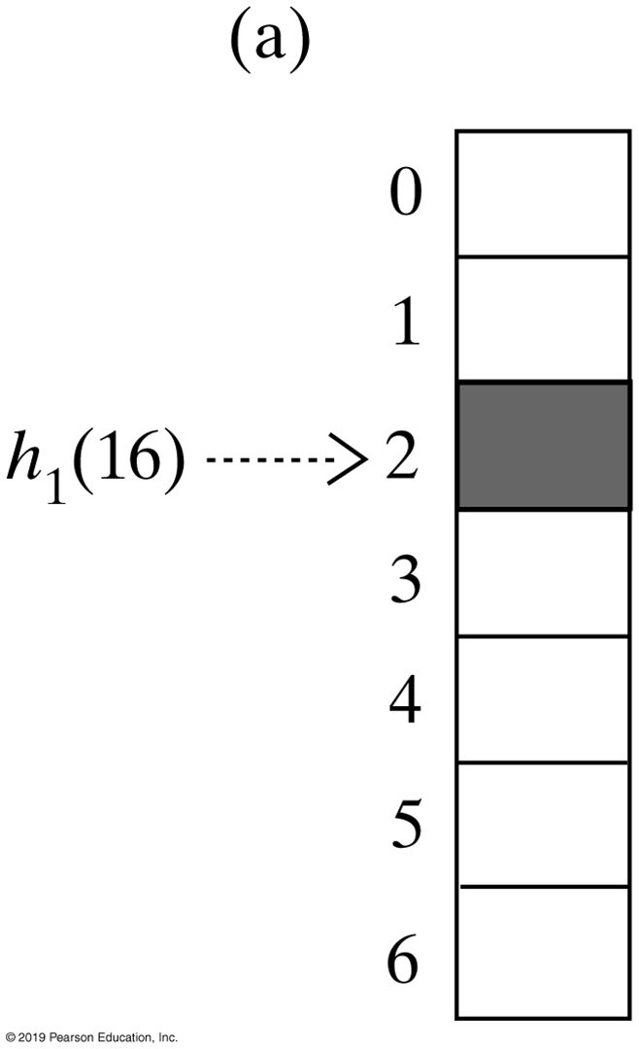
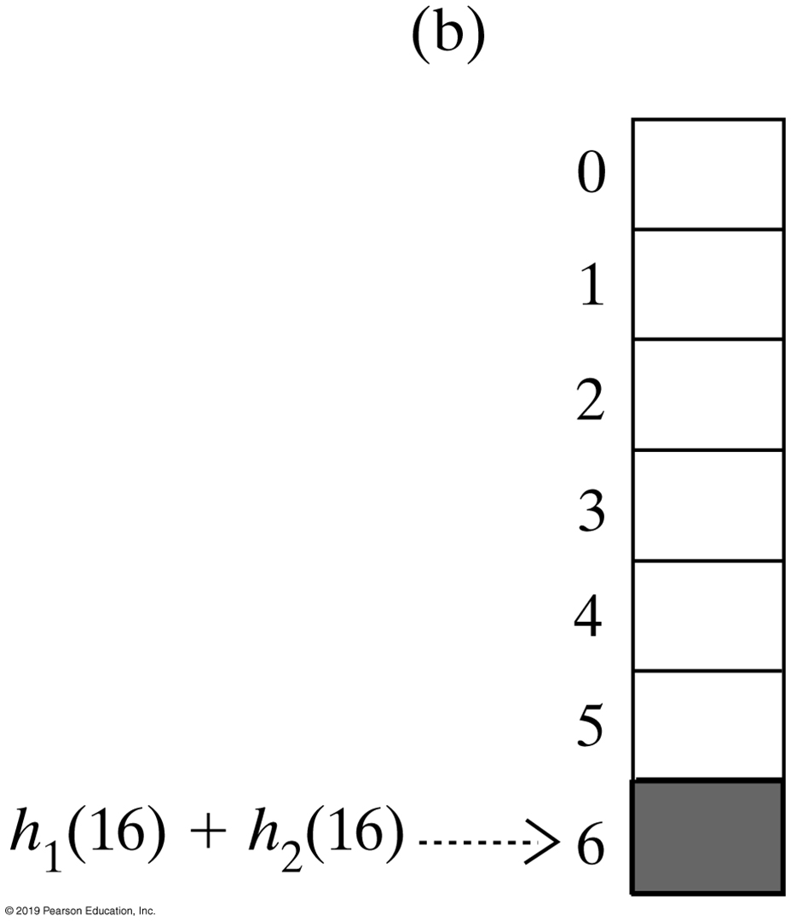
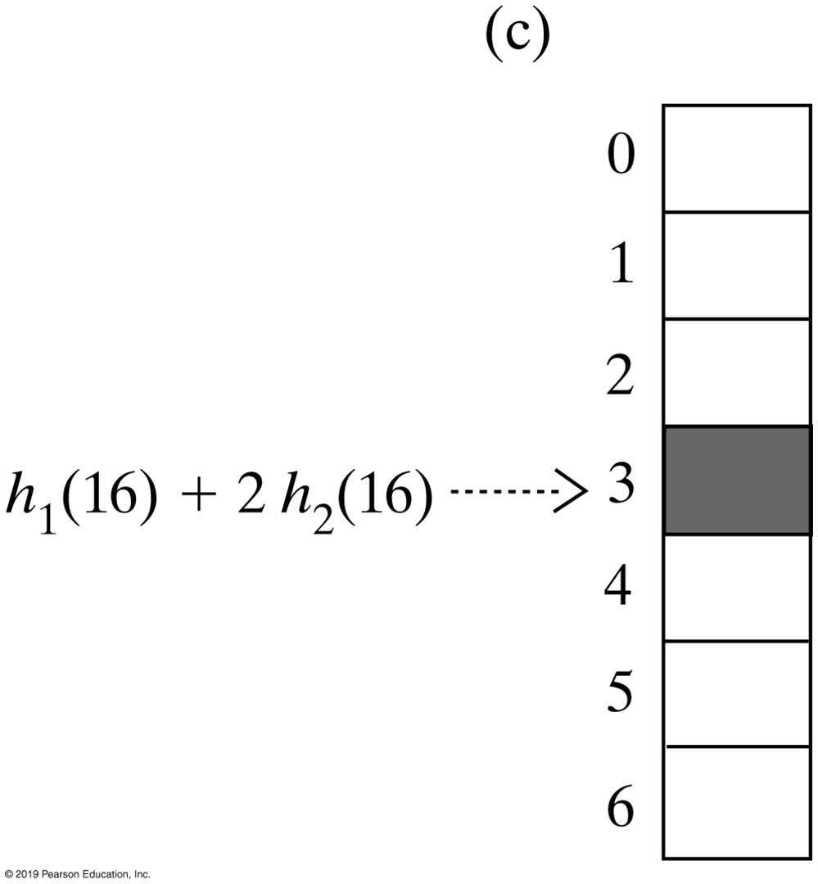
Open Addressing with Double Hashing
FIGURE 22-8 The first three elements in a probe sequence generated by double hashing for the search key 16

Slide 25
Potential Problem with Open Addressing
Recall each location is either occupied, empty, or available
  Frequent additions and removals can result in no locations that are null
Thus searching a probe sequence will not work
Consider separate chaining as a solution

Slide 26
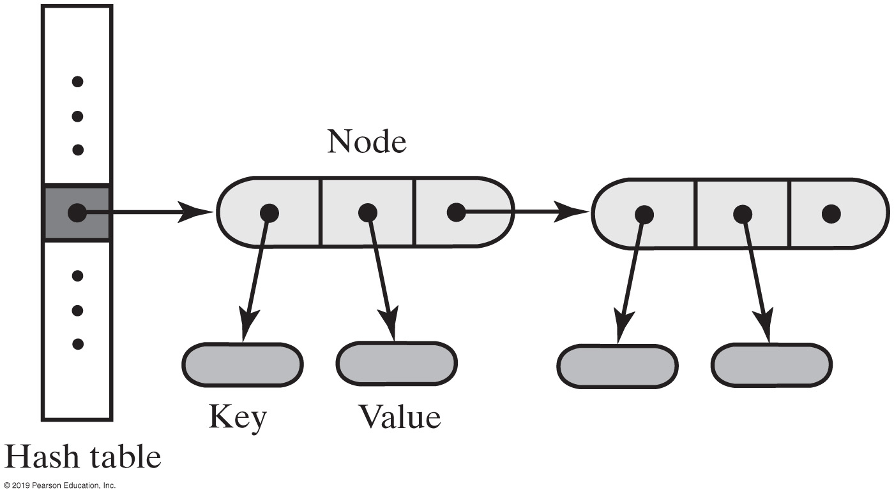
Separate Chaining
Alter the structure of the hash table
  Each location can represent more than one value.
  Such a location is called a bucket
Decide how to represent a bucket
  list, sorted list
  array
  linked nodes
  vector
FIGURE 22-9 A hash table for use with separate chaining; each bucket is a chain of linked nodes

Slide 27
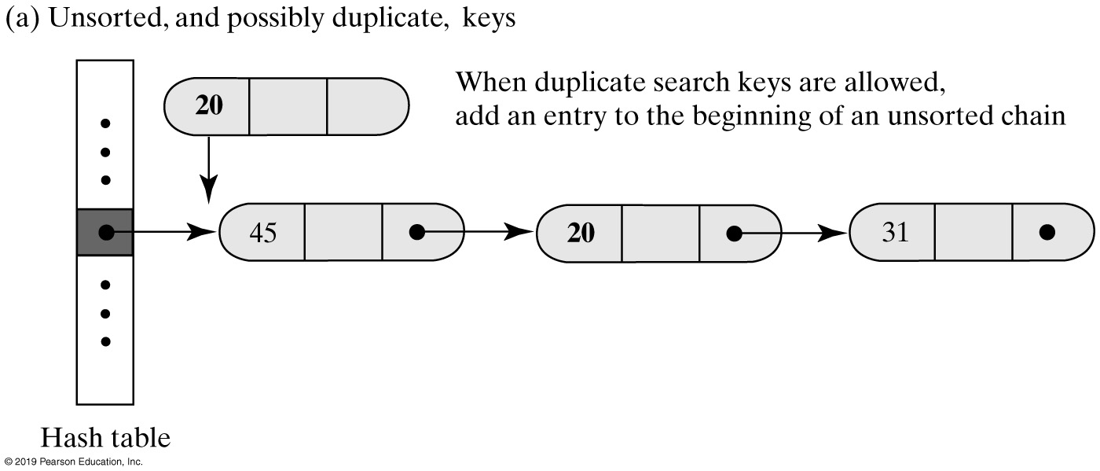
Separate Chaining
FIGURE 22-10a Inserting a new entry into a linked bucket according to the nature of the integer search keys

Slide 28
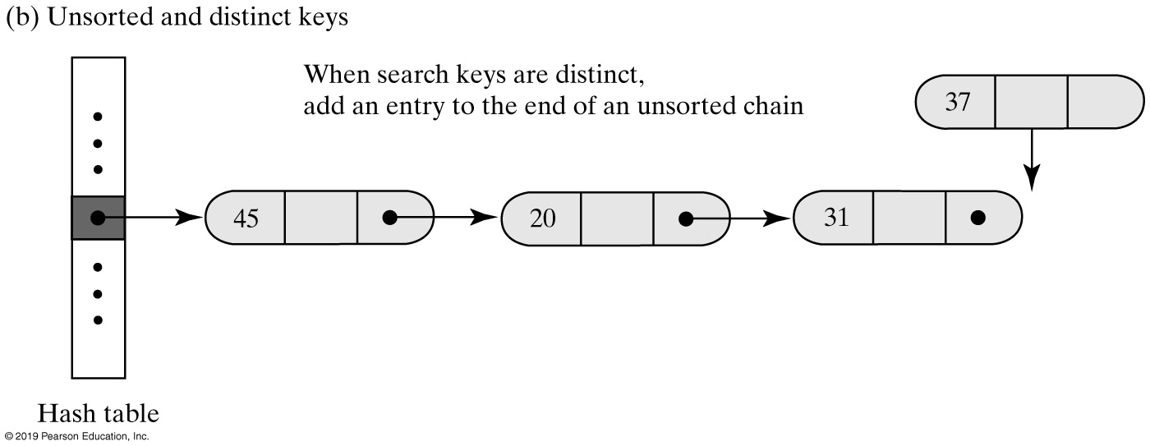
Separate Chaining
FIGURE 22-10b Inserting a new entry into a linked bucket according to the nature of the integer search keys

Slide 29
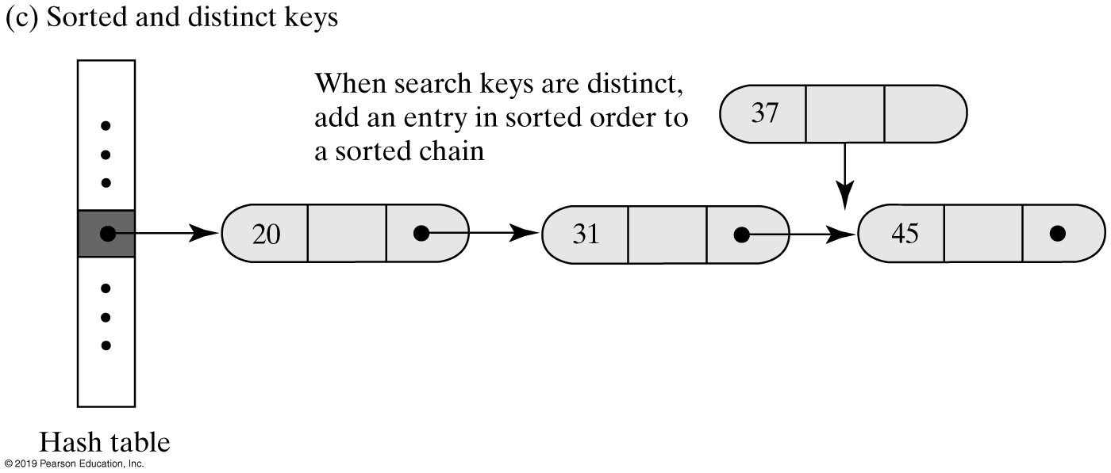
Separate Chaining
FIGURE 22-10c Inserting a new entry into a linked bucket according to the nature of the integer search keys

Slide 30
Separate Chaining
Algorithm add(key, value)
index = getHashIndex(key)
if (hashTable[index] == null)
{
    hashTable[index] = new Node(key, value)
    numberOfEntries++
    return null
}
else
{
  Search the chain that begins at hashTable[index] for a node that contains key
  if (key is found)
  { // Assume currentNode references the node that contains
      key oldValue = currentNode.getValue()
      currentNode.setValue(value)
      return oldValue
  }
  else // Add new node to end of chain
  { // Assume nodeBefore references the last node
      newNode = new Node(key, value)
      nodeBefore.setNextNode(newNode) numberOfEntries++
      return null
  }
}
Algorithm for the dictionary’s add method.

Slide 31
Separate Chaining
Algorithm remove(key)
index = getHashIndex(key)
Search the chain that begins at hashTable[index] for a node that contains key
if (key is found)
{
    Remove the node that contains key from the chain
    numberOfEntries−−
    return value in removed node
}
else
    return null
Algorithm for the dictionary’s remove method.

Slide 32
Separate Chaining
Algorithm getValue(key)
index = getHashIndex(key)
Search the chain that begins at hashTable[index] for a node that contains key
if (key is found)
    return value in found node
else
    return null
Algorithm for the dictionary’s getValue method.

Slide 33
End
Chapter 22

