Slide 1
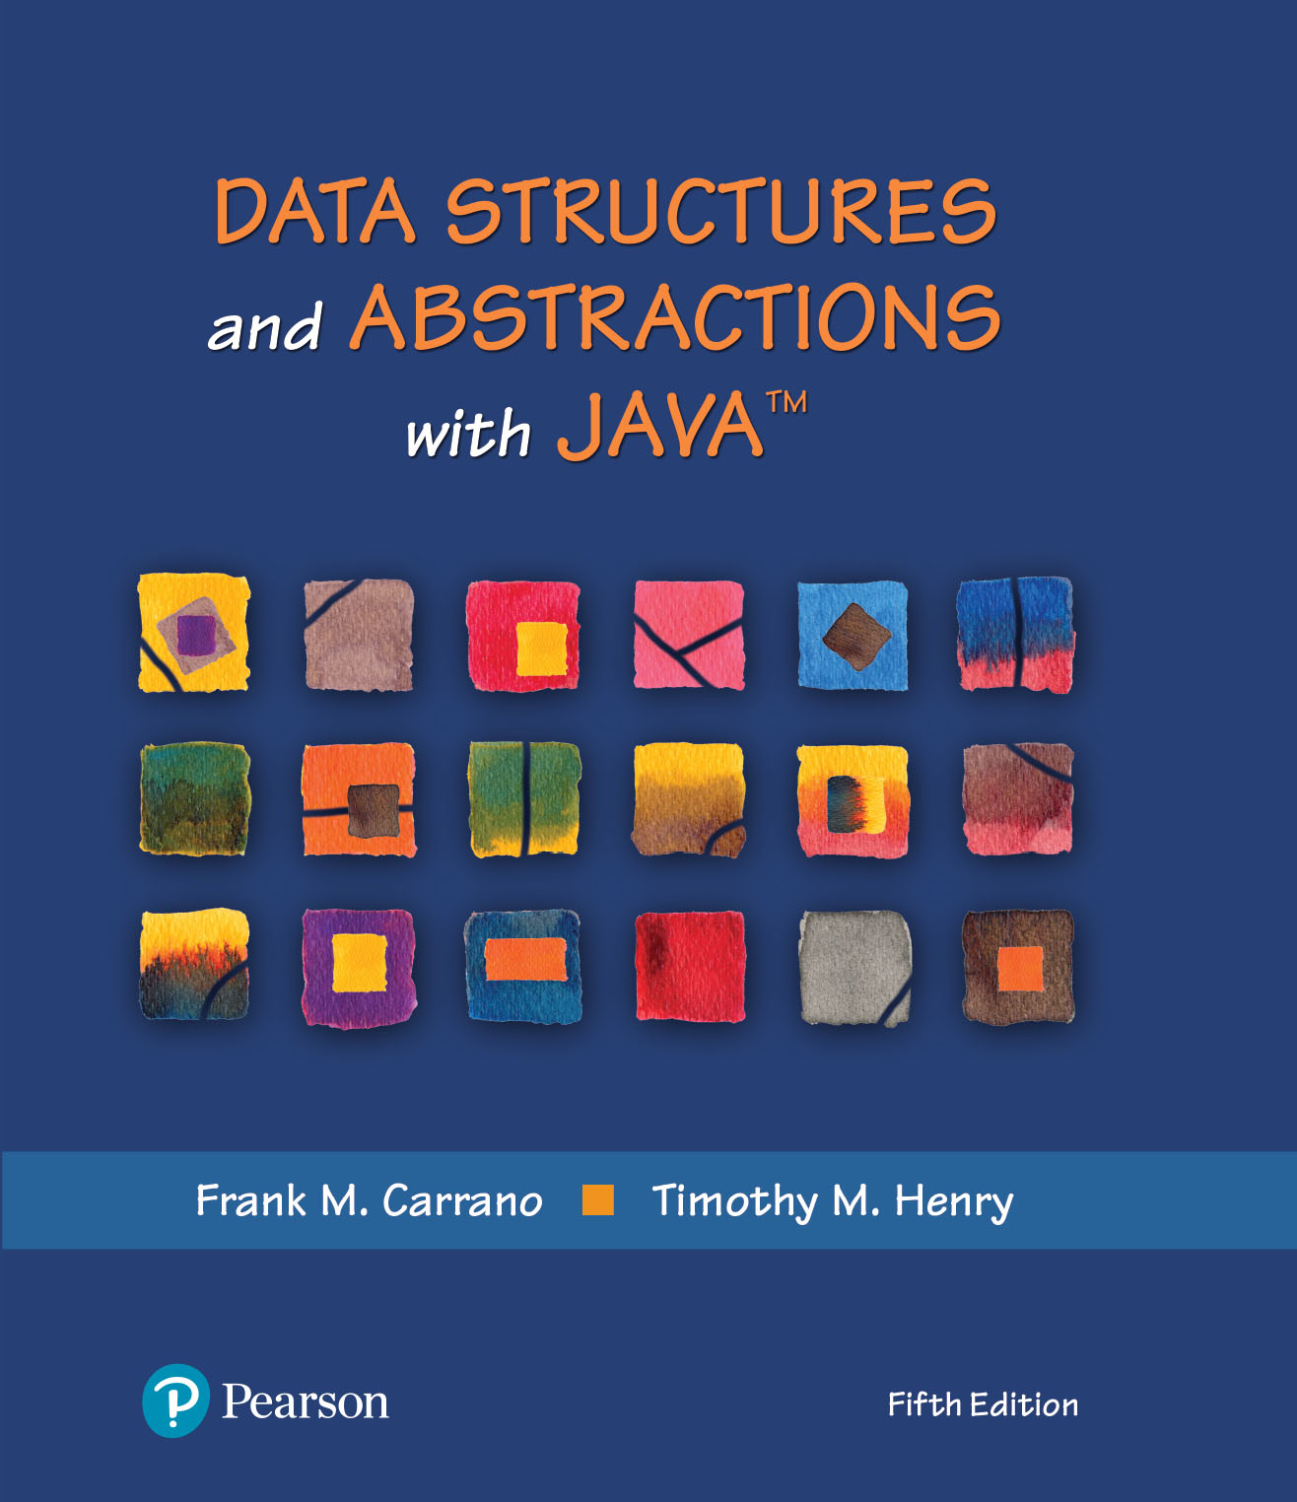
Data Structures and Abstractions with Java™
5th Edition
Chapter 23
Hashing as a Dictionary Implementation

Slide 2
Efficiency of Hashing
Observations about the time efficiency of these operations
Successful retrieval/removal has same efficiency as successful search
Unsuccessful retrieval/removal has same efficiency as unsuccessful search
Successful addition has same efficiency as unsuccessful search
Unsuccessful addition has same efficiency as successful search

Slide 3
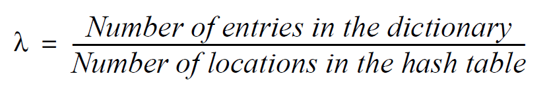
Load Factor
Definition of load factor:
Never negative
For open addressing, 1 ≥ λ
For separate chaining, λ has no maximum value
Restricting size of λ improves performance

Slide 4
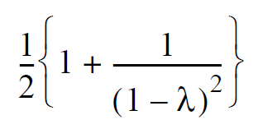
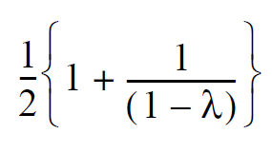
Cost of Open Addressing
Average number of searches for linear probing
For unsuccessful search:
For successful search:

Slide 5
Cost of Open Addressing
𝝀 | Unsuccessful Search | Successful Search
0.1 | 1.1 | 1.1
0.3 | 1.5 | 1.2
0.5 | 2.5 | 1.5
0.7 | 6.1 | 2.2
0.9 | 50.5 | 5.5
FIGURE 23-1 The average number of comparisons required by a search of the hash table for given values of the load factor λ when using linear probing

Slide 6
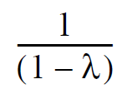
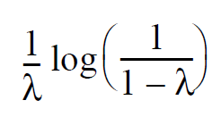
Quadratic Probing and Double Hashing
Average number of comparisons needed
For unsuccessful search:
For successful search:

Slide 7
Quadratic Probing and Double Hashing
𝝀 | Unsuccessful Search | Successful Search
0.1 | 1.1 | 1.1
0.3 | 1.5 | 1.2
0.5 | 2.0 | 1.4
0.7 | 3.3 | 1.7
0.9 | 10.0 | 2.6
FIGURE 23-2 The average number of comparisons required by a search of the hash table for given values of the load factor λ when using either quadratic probing or double hashing

Slide 8


Cost of Separate Chaining
Average number of comparisons during a search when separate chaining is used
For unsuccessful search:
For successful search:
To maintain reasonable efficiency, you should keep λ < 1.

Slide 9
Cost of Separate Chaining
𝝀 | Unsuccessful Search | Successful Search
0.1 | 0.1 | 1.1
0.3 | 0.3 | 1.2
0.5 | 0.5 | 1.3
0.7 | 0.7 | 1.4
0.9 | 0.9 | 1.5
1.1 | 1.1 | 1.6
1.3 | 1.3 | 1.7
1.5 | 1.5 | 1.8
1.7 | 1.7 | 1.9
1.9 | 1.9 | 2.0
2.0 | 2.0 | 2.0
FIGURE 23-3 The average number of comparisons required by a search of the hash table for given values of the load factor λ when using separate chaining

Slide 10
Maintaining the Performance of Hashing
To maintain efficiency, restrict the size of λ as follows:
λ < 0.5 for open addressing
λ < 1.0 for separate chaining
Should the load factor exceed these bounds
Increase the size of the hash table

Slide 11
Rehashing
When the load factor λ becomes too large must resize the hash table
Compute the table’s new size
Double its present size
Increase the result to the next prime number
Use method add to add the current entries in dictionary to new hash table

Slide 12
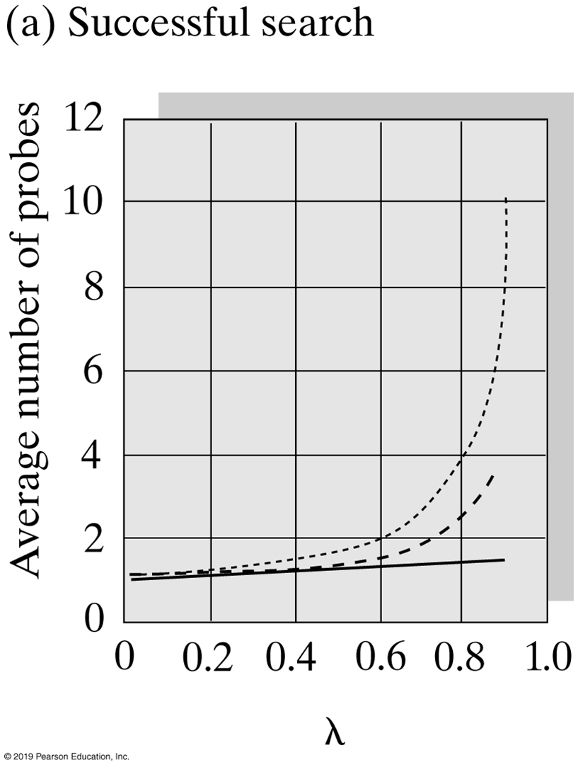
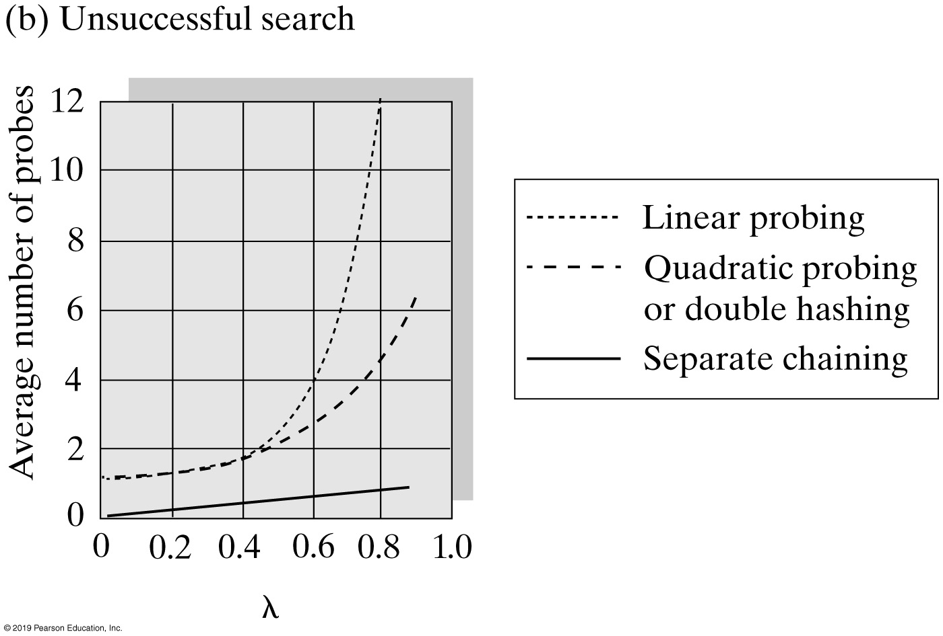
Comparing Schemes for Collision Resolution
FIGURE 23-4 The average number of comparisons required by a search of the hash table versus the load factor λ for four collision resolution techniques

Slide 13
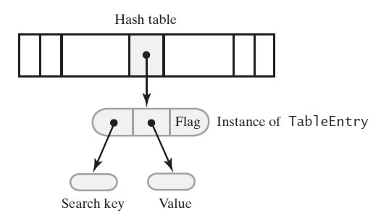
Dictionary Implementation That Uses Hashing
FIGURE 23-5 A hash table and one of its entry objects

Slide 14
Dictionary Implementation That Uses Hashing
private static class TableEntry<S, T>
{
private S key;
private T value;
private States state; // Flags whether this entry is in the hash table
private enum States {CURRENT, REMOVED} // Possible values of state
private TableEntry(S searchKey, T dataValue)
{
key = searchKey;
value = dataValue;
state = States.CURRENT;
} // end constructor
// method implementations go here
} // end TableEntry
Private class TableEntry, make it internal to the dictionary class.

Slide 15
A Dictionary that Uses Hashing (Part 1)
public class HashedDictionary<K, V> implements DictionaryInterface<K, V>
{
// The dictionary:
private int numberOfEntries;
private static final int DEFAULT_CAPACITY = 5; // Must be prime
private static final int MAX_CAPACITY = 10000;
// The hash table:
private Entry<K, V>[] hashTable;
private int tableSize; // Must be prime
private static final int MAX_SIZE = 2 * MAX_CAPACITY;
private boolean integrityOK = false;
private static final double MAX_LOAD_FACTOR = 0.5; // Fraction of
// hash table that can be filled
protected final Entry<K, V> AVAILABLE = new Entry<>(null, null);
public HashedDictionary()
{
this(DEFAULT_CAPACITY); // Call next constructor
} // end default constructor
LISTING 23-1 An outline of the class HashedDictionary

Slide 16
A Dictionary that Uses Hashing (Part 2)
public HashedDictionary(int initialCapacity)
{
initialCapacity = checkCapacity(initialCapacity);
numberOfEntries = 0; // Dictionary is empty
// Set up hash table:
// Initial size of hash table is same as initialCapacity if it is prime;
// otherwise increase it until it is prime size
int tableSize = getNextPrime(initialCapacity);
checkSize(tableSize); // Check that size is not too large
// The cast is safe because the new array contains null entries
@SuppressWarnings("unchecked")
Entry<K, V>[] temp = (Entry<K, V>[])new Entry[tableSize];
hashTable = temp;
integrityOK = true;
} // end constructor
/* Implementations of methods in DictionaryInterface are here. . . .
Implementations of private methods are here. . . . */
protected final class Entry<S, T>
{
/* . . . */
} // end Entry
} // end HashedDictionary
LISTING 23-1 An outline of the class HashedDictionary

Slide 17
Required Methods
Algorithm getValue(key)
// Returns the value associated with the given search key, if it is in the dictionary.
// Otherwise, returns null.
if (key is found)
return value in found entry
else
return null
Algorithm for the retrieval method getValue

Slide 18
Required Methods
public V getValue(K key)
{
checkIntegrity();
V result = null;
int index = getHashIndex(key);
if ((hashTable[index] != null) && (hashTable[index] != AVAILABLE))
result = hashTable[index].getValue(); // Key found; get value
// Else key not found; return null
return result;
} // end getValue
Implementation of method getValue

Slide 19
Required Methods
Algorithm remove(key)
// Removes a specific entry from the dictionary, given its search key.
// Returns either the value that was associated with the search key or null if no such object
// exists.
removedValue = null
index = getHashIndex(key)
if (key is found) // hashTable[index] is not null and does not equal AVAILABLE
{
removedValue = hashTable[index].getValue()
hashTable[index] = AVAILABLE
numberOfEntries--
}
return removedValue
Pseudocode for method remove

Slide 20
Required Methods
Algorithm add(key, value)
// Adds a new key-value entry to the dictionary. If key is already in the dictionary,
// returns its corresponding value and replaces it in the dictionary with value.
if ((key == null) or (value == null))
Throw an exception
index = getHashIndex(key)
if (key is not found)
{ // Add entry to hash table
hashTable[index] = new Entry(key, value)
numberOfEntries++
oldValue = null
}
else // Search key is in table; replace and return entry’s value
{
oldValue = hashTable[index].getValue()
hashTable[index].setValue(value)
}
// Ensure that hash table is large enough for another addition
if (hash table is too full)
Enlarge hash table
return oldValue
Algorithm for adding a new entry

Slide 21
Required Methods
private void enlargeHashTable()
{
Entry<K, V>[] oldTable = hashTable;
int oldSize = hashTable.length;
int newSize = getNextPrime(oldSize + oldSize);
checkSize(newSize);
// The cast is safe because the new array contains null entries
@SuppressWarnings("unchecked")
Entry<K, V>[] temp = (Entry<K, V>[])new Entry[newSize];
hashTable = temp;
numberOfEntries = 0; // Reset number of dictionary entries, since
// it will be incremented by add during rehash
// Rehash dictionary entries from old array to the new and bigger array;
// skip elements that contain null or AVAILABLE
for (int index = 0; index < oldSize; index++)
{
if ( (oldTable[index] != null) && oldTable[index] != AVAILABLE )
add(oldTable[index].getKey(), oldTable[index].getValue());
} // end for
} // end enlargeHashTable
Private method enlargeHashTable

Slide 22
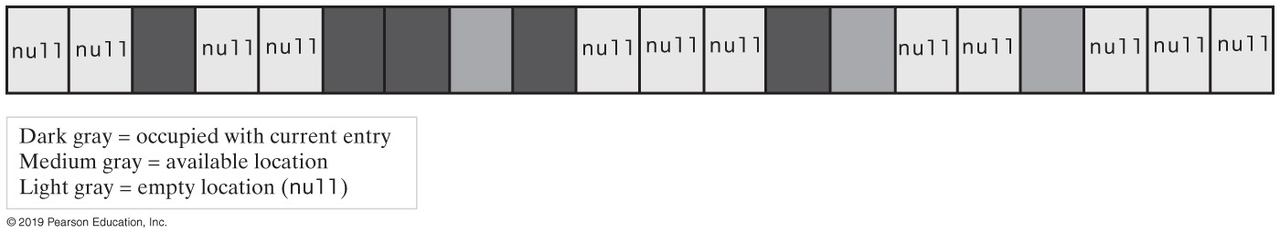
Hash Tables and Iterators
FIGURE 23-5 A hash table containing occupied elements, available elements, and null values

Slide 23
Hash Tables and Iterators (Part 1)
private class KeyIterator implements Iterator<K>
{
private int currentIndex; // Current position in hash table
private int numberLeft; // Number of entries left in iteration
private KeyIterator()
{
currentIndex = 0;
numberLeft = numberOfEntries;
} // end default constructor
public boolean hasNext()
{
return numberLeft > 0;
} // end hasNext
public void remove()
{
throw new UnsupportedOperationException();
} // end remove
Implementation of KeyIterator

Slide 24
Hash Tables and Iterators (Part 2)
public K next()
{
K result = null;
if (hasNext())
{
// Skip table locations that do not contain a current entry
while ( (hashTable[currentIndex] == null) ||
(hashTable[currentIndex] == AVAILABLE) )
{
currentIndex++;
} // end while
result = hashTable[currentIndex].getKey();
numberLeft--;
currentIndex++;
}
else
throw new NoSuchElementException();
return result;
} // end next
} // end KeyIterator
Implementation of KeyIterator

Slide 25
Java Class Library: The Class HashMap
Hash table is a collection of buckets
Each bucket contains several entries
Variety of constructors provided
Default maximum load factor of 0.75
When limit exceeded, size of table increased by rehashing
Possible to avoid rehashing by setting number of buckets initially larger

Slide 26
Java Class Library: The Class HashSet
Implements the interface java.util.Set
HashSet uses an instance of the class HashMap
Variety of constructors provided in class

Slide 27
End
Chapter 23

