Slide 1
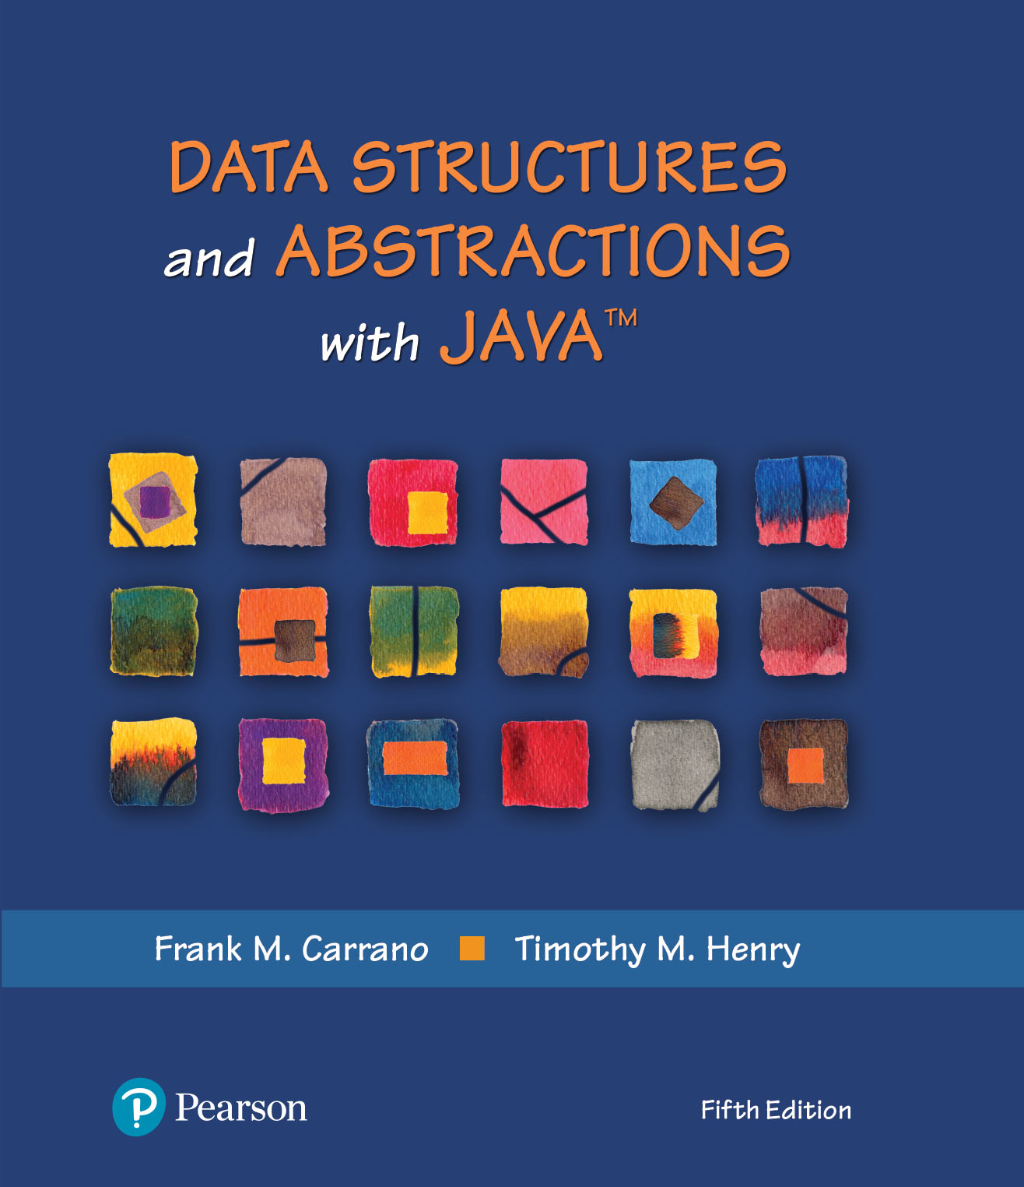
Data Structures and Abstractions with Java™
5th Edition
Chapter 24
Trees

Slide 2
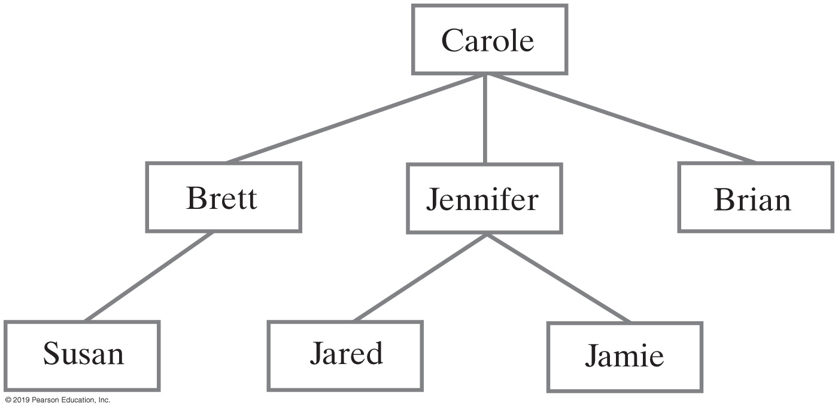
Hierarchical Organizations
FIGURE 24-1 Carole’s children and grandchildren

Slide 3
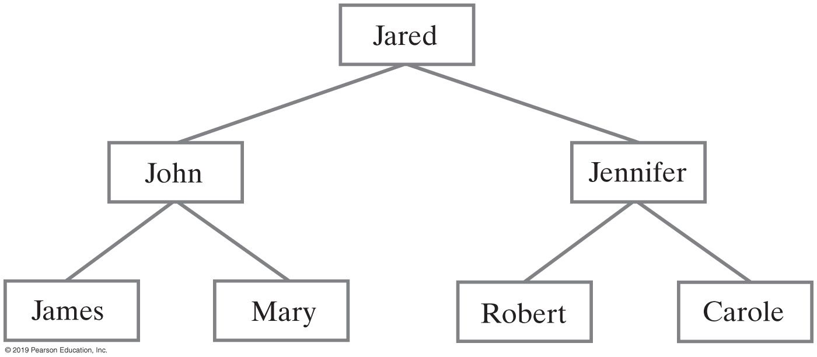
Hierarchical Organizations
FIGURE 24-2 Jared’s parents and grandparents

Slide 4
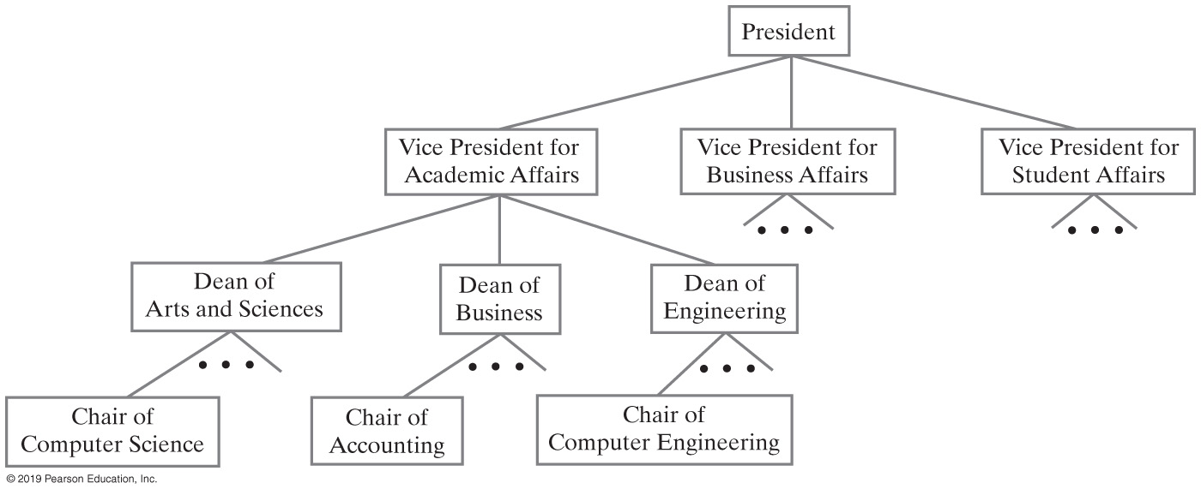
Hierarchical Organizations
FIGURE 24-3 A portion of a university’s administrative structure

Slide 5
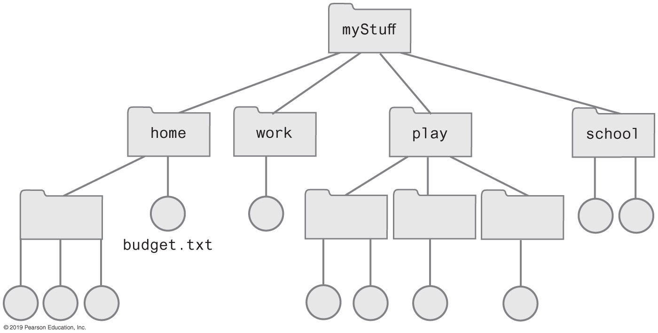
Hierarchical Organizations
FIGURE 24-4 Computer files organized into folders

Slide 6
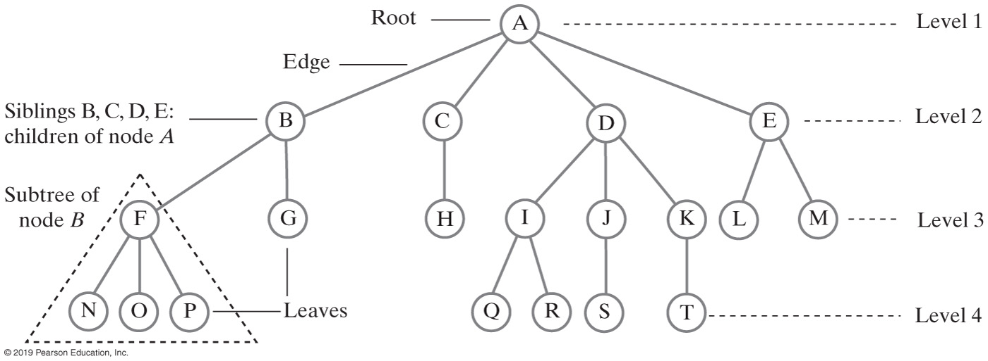
Tree Terminology
FIGURE 24-5 A tree equivalent to the tree in Figure 24-4

Slide 7
Tree Terminology
Contrast plants with root at bottom
ADT tree with root at top
Root is only node with no parent
A tree can be empty
Any node and its descendants form a subtree of the original tree
The height of a tree is the number of levels in the tree

Slide 8
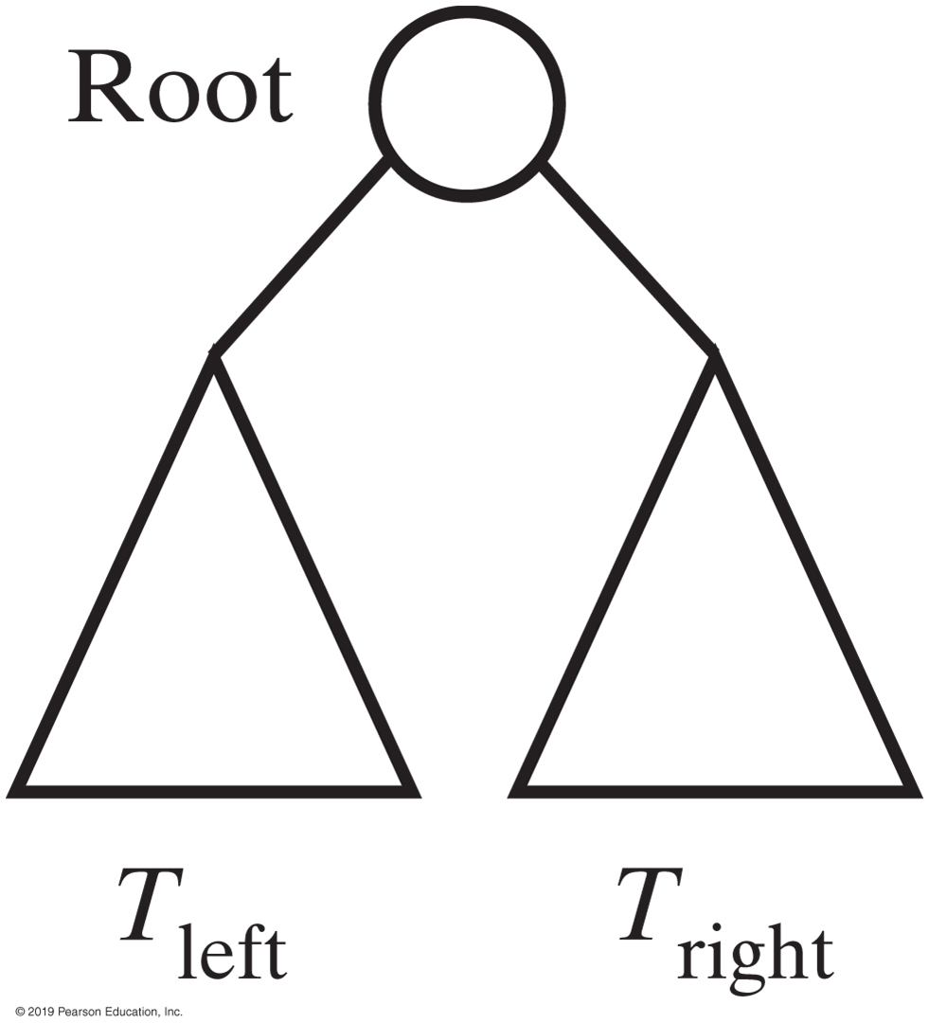
Binary trees

Slide 9
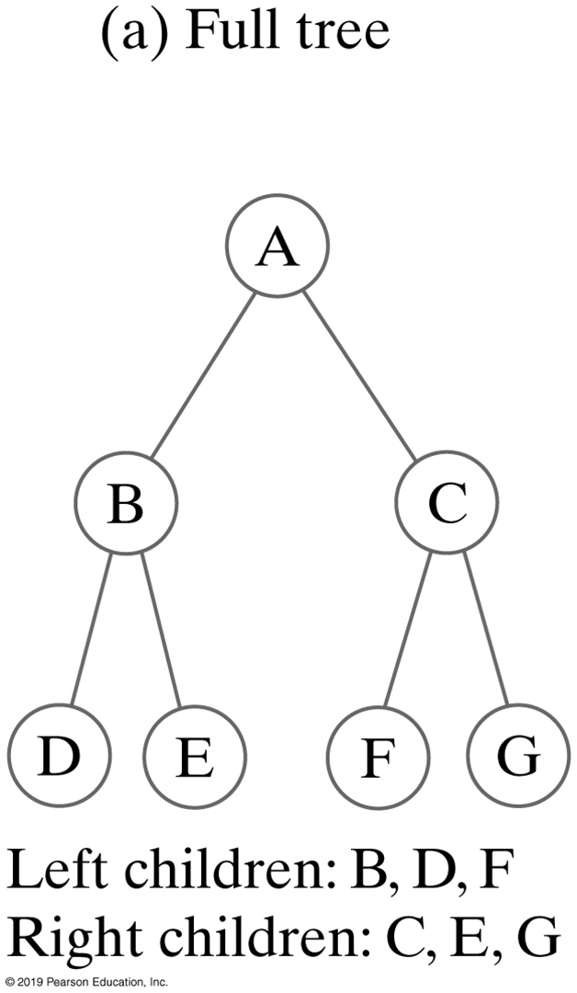
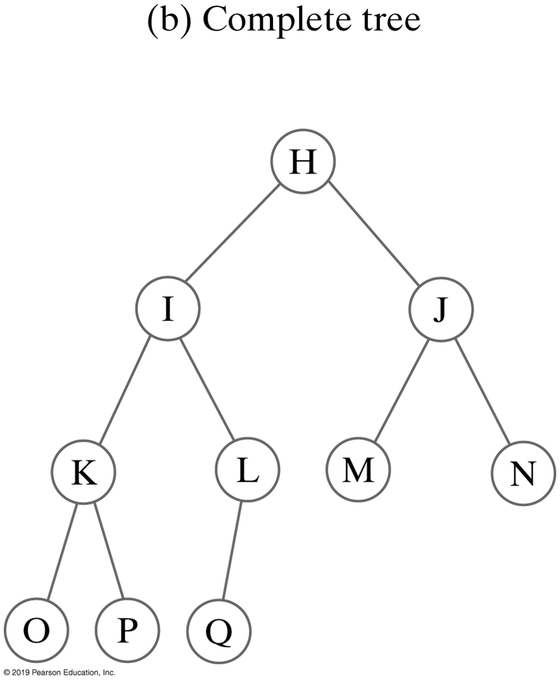
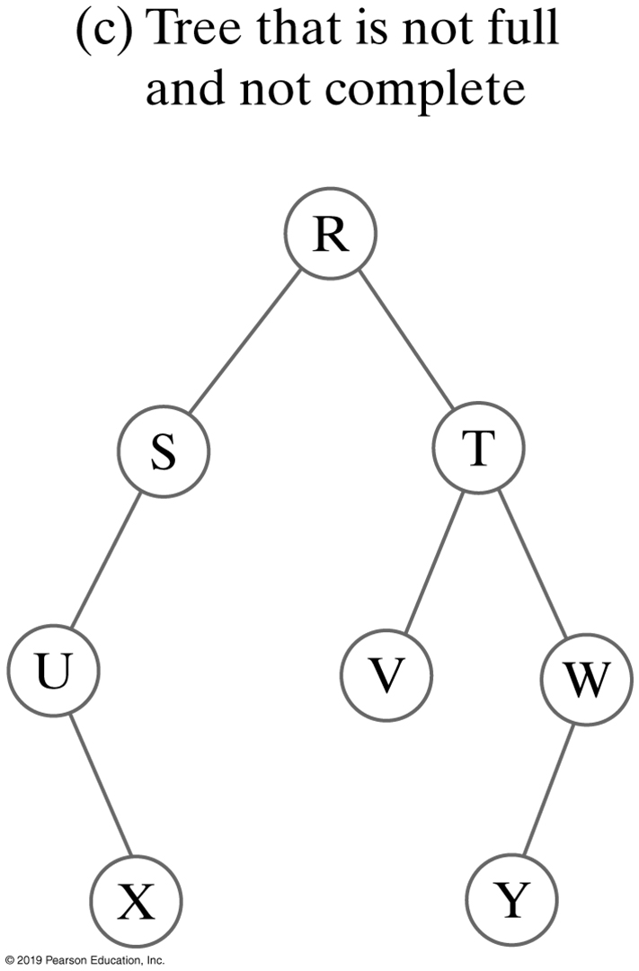
Binary Trees
FIGURE 24-6 Three binary trees

Slide 10
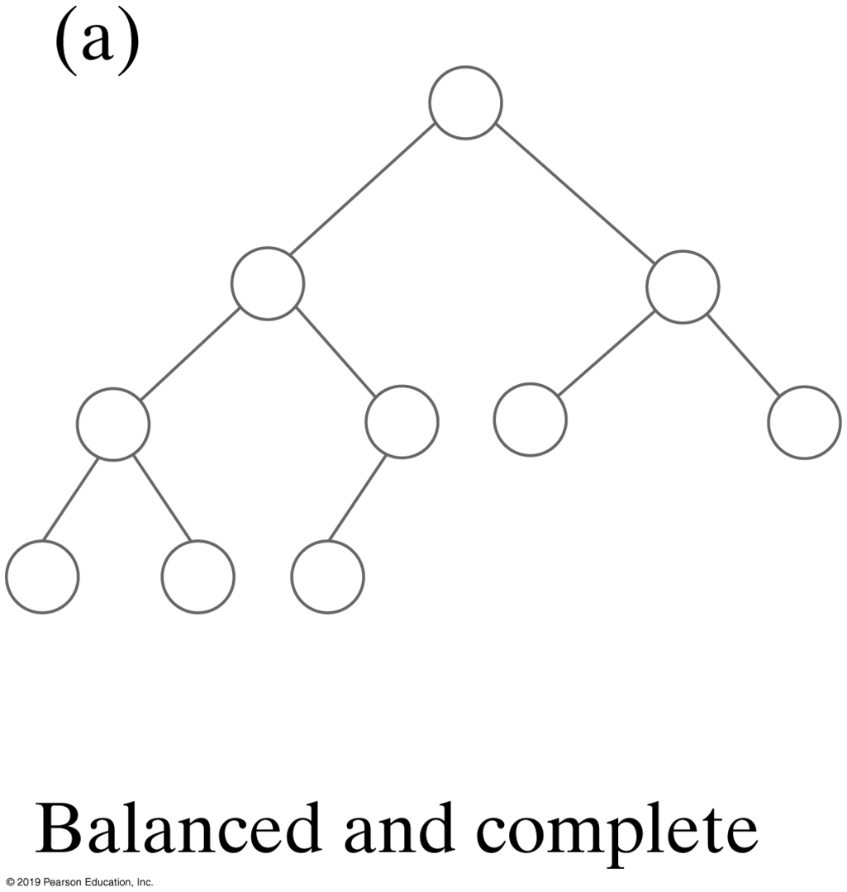
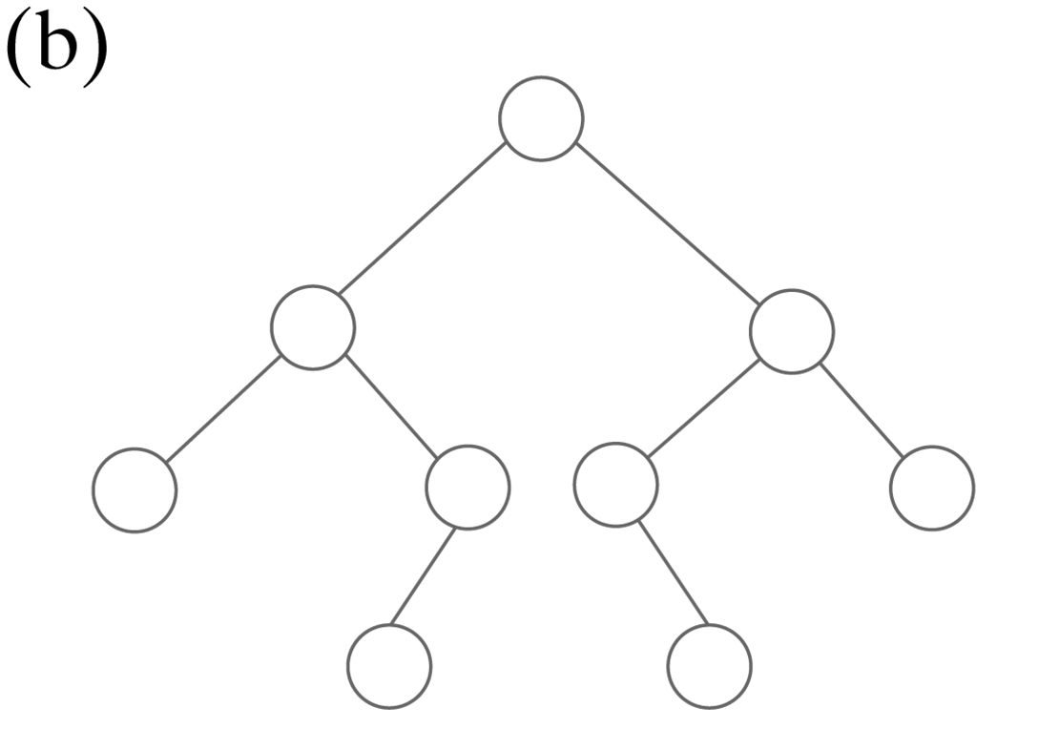
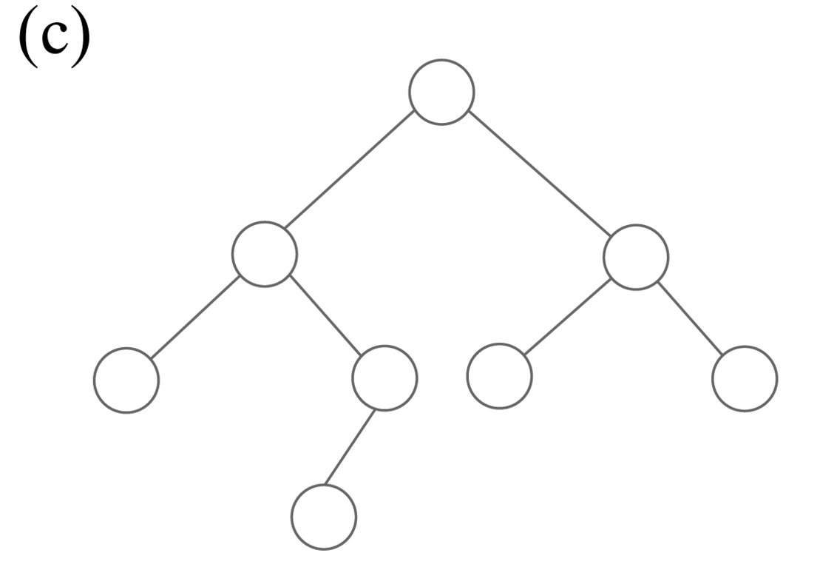
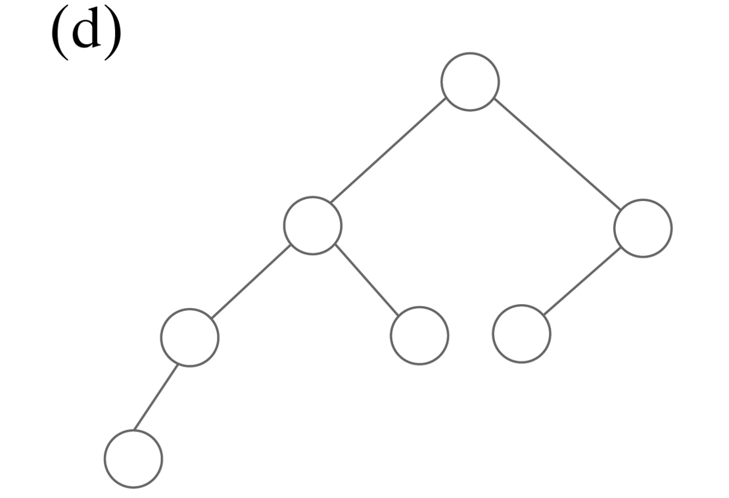
Binary Trees
Balanced, but not complete
FIGURE 24-7 Some binary trees that are height balanced

Slide 11
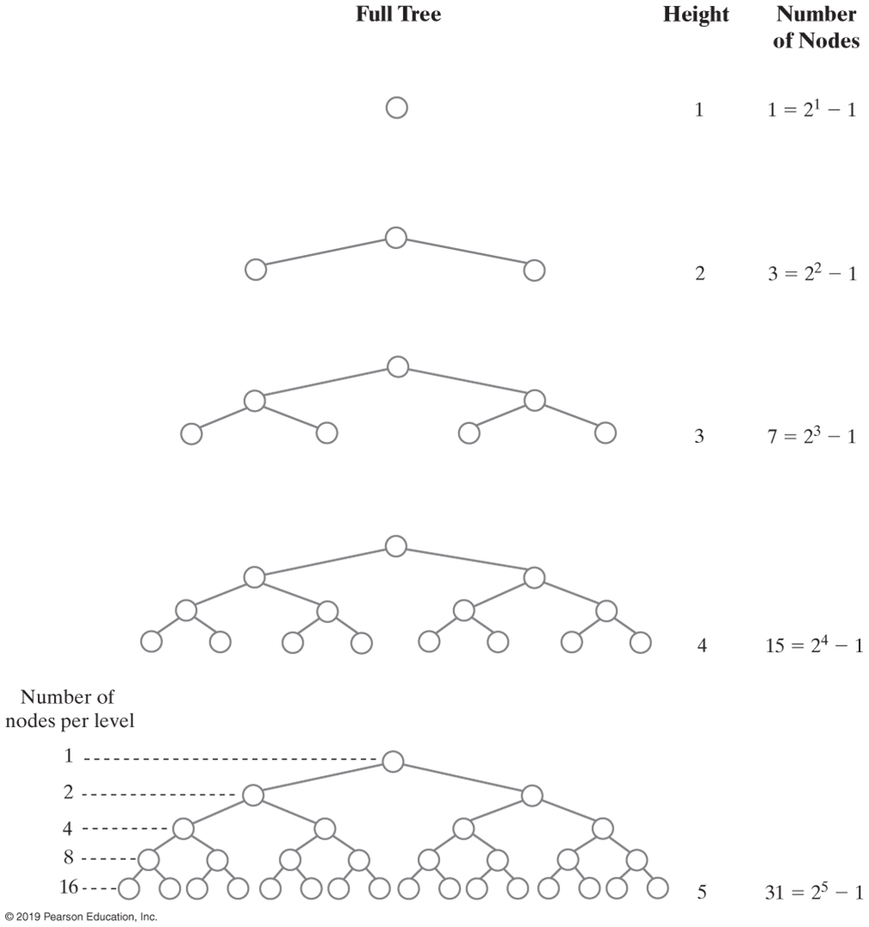
Binary Tree Height (Part 1)
FIGURE 24-8 The number of nodes in a full binary tree as a function of the tree’s height

Slide 12
Binary Tree Height (Part 2)
FIGURE 24-8 The number of nodes in a full binary tree as a function of the tree’s height

Slide 13
Traversals of A Tree
Traversal:
Visit, or process, each data item exactly once
We will say that traversal can pass through a node without visiting it at that moment.
Order in which we visit items is not unique
Traversals of a binary tree are somewhat easy to understand

Slide 14
Traversals of a Binary Tree
We use recursion
To visit all the nodes in a binary tree, we must
Visit the root
Visit all the nodes in the root’s left subtree
Visit all the nodes in the root’s right subtree

Slide 15
Traversals of a Binary Tree
Preorder traversal
Visit root before we visit root’s subtrees
Inorder traversal
Visit root of a binary tree between visiting nodes in root’s subtrees.
Postorder traversal
Visit root of a binary tree after visiting nodes in root’s subtrees
Level-order traversal
Begin at root and visit nodes one level at a time

Slide 16
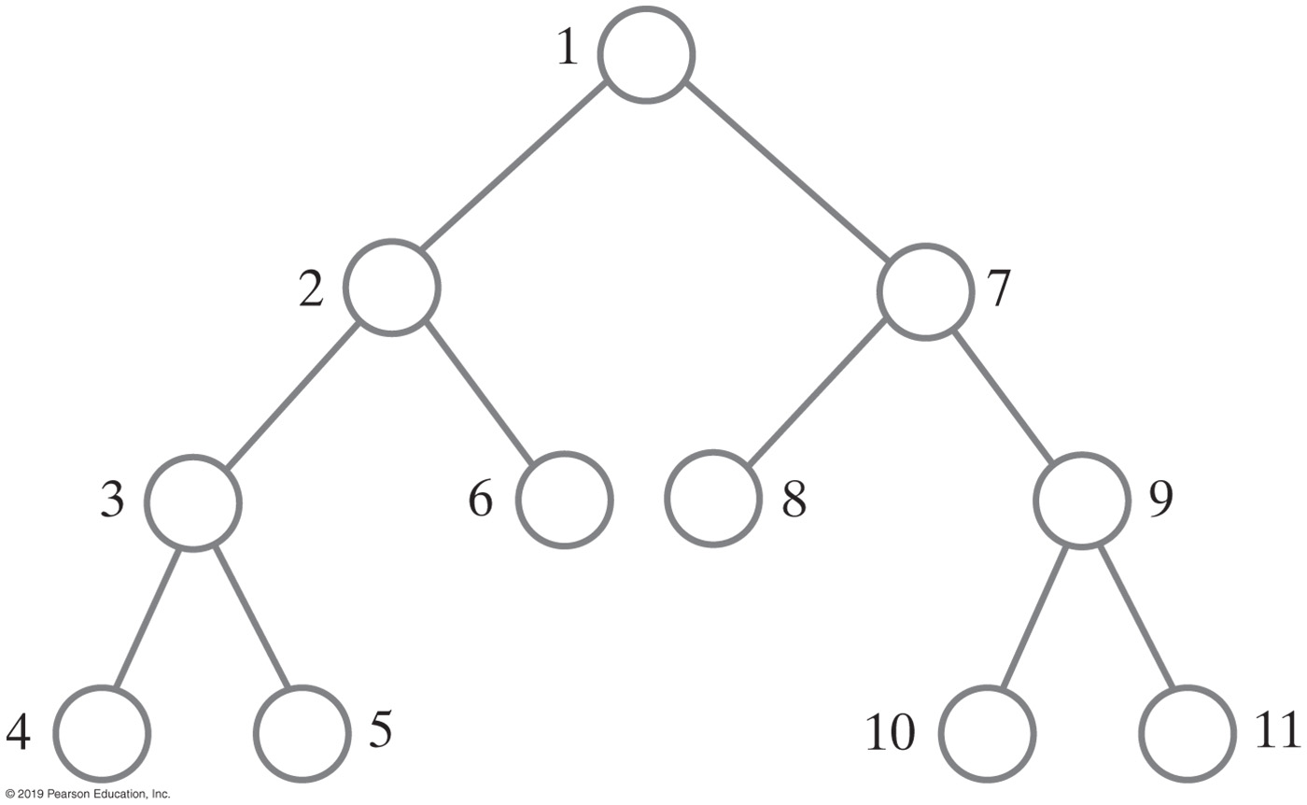
Traversals of a Binary Tree
FIGURE 24-9 The visitation order of a preorder traversal

Slide 17
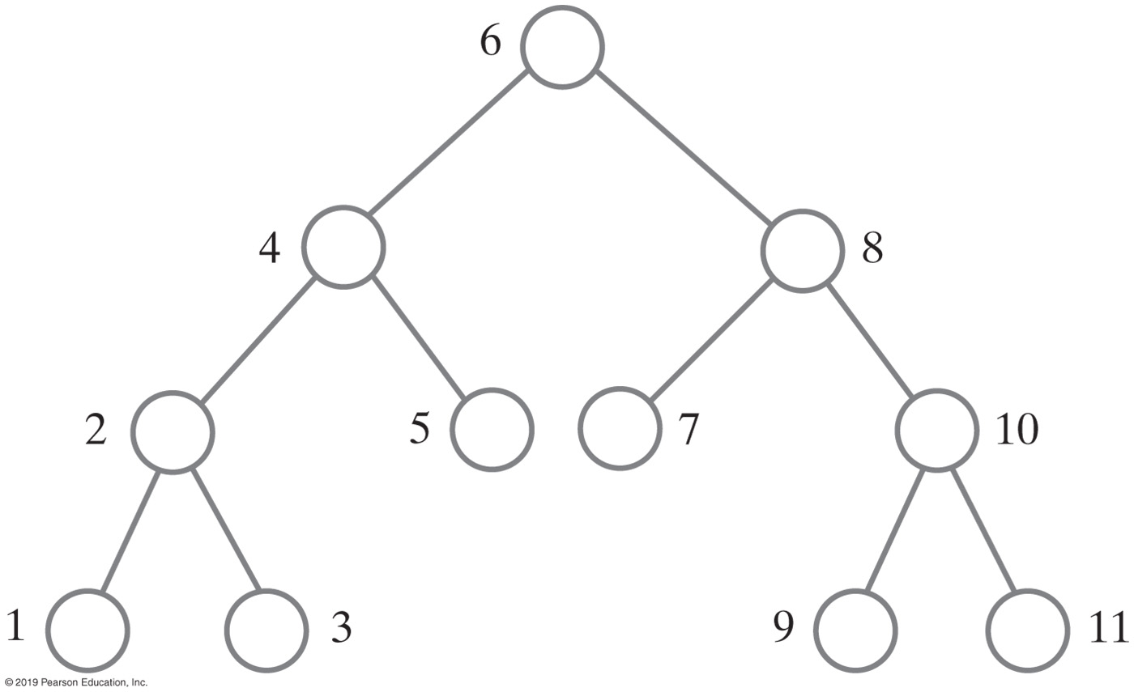
Traversals of a Binary Tree
FIGURE 24-10 The visitation order of an in-order traversal

Slide 18
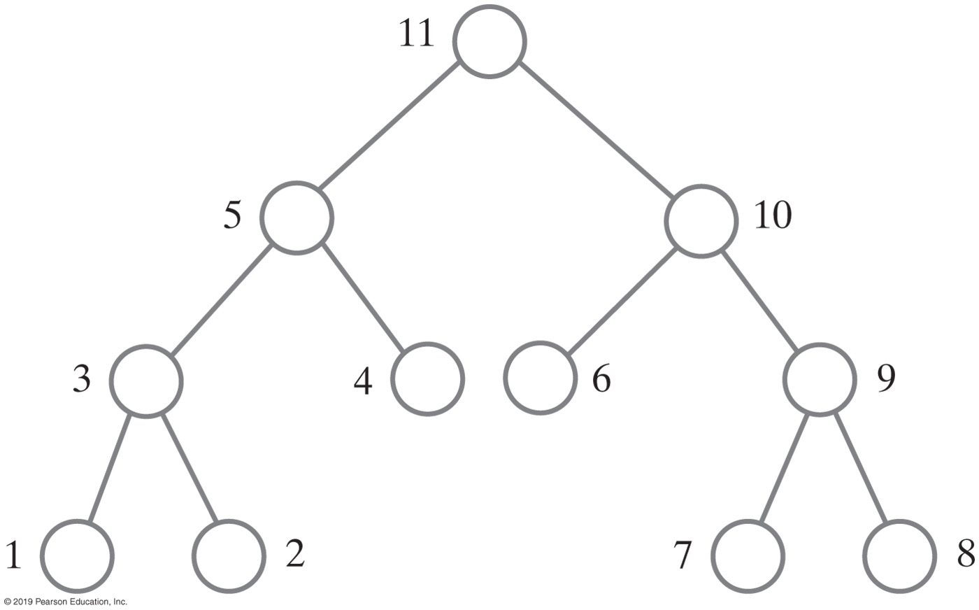
Traversals of a Binary Tree
FIGURE 24-11 The visitation order of a postorder traversal

Slide 19
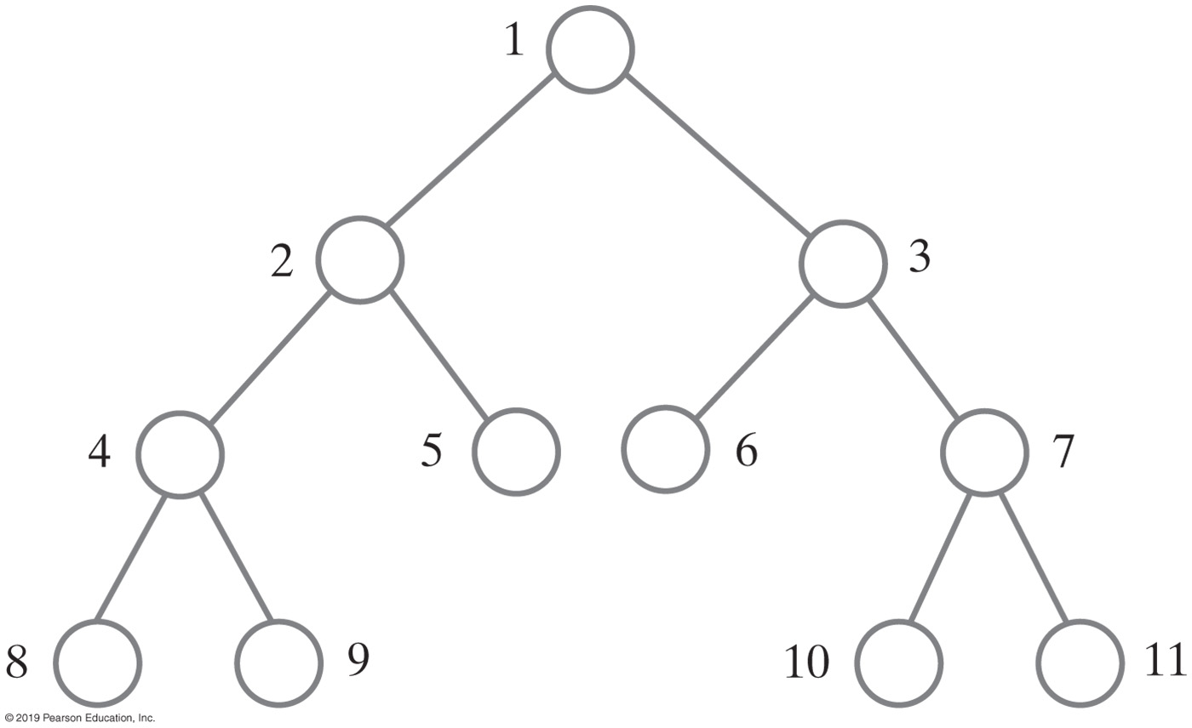
Traversals of a Binary Tree
FIGURE 24-12 The visitation order of a level-order traversal

Slide 20
Traversals of a General Tree
Types of traversals for general tree
Level order
Preorder
Postorder
Not suited for general tree traversal
Inorder

Slide 21
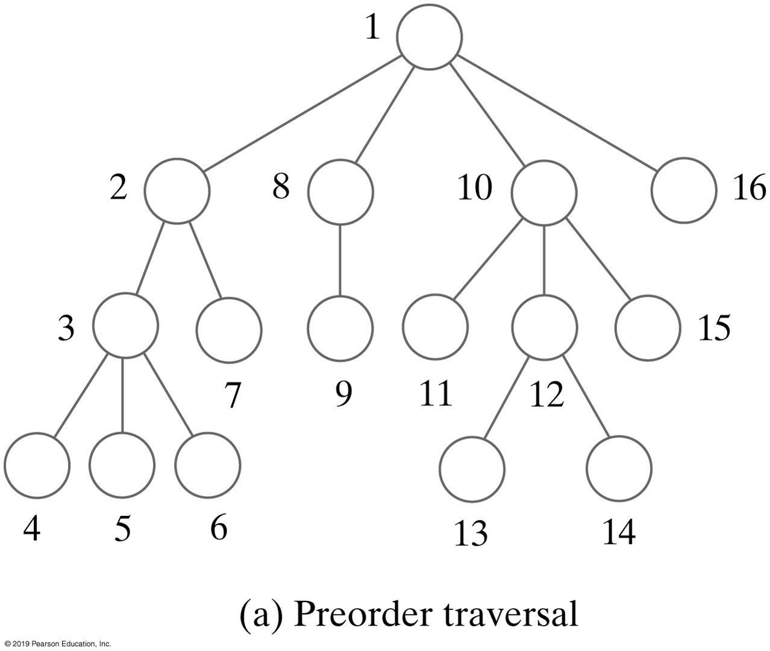
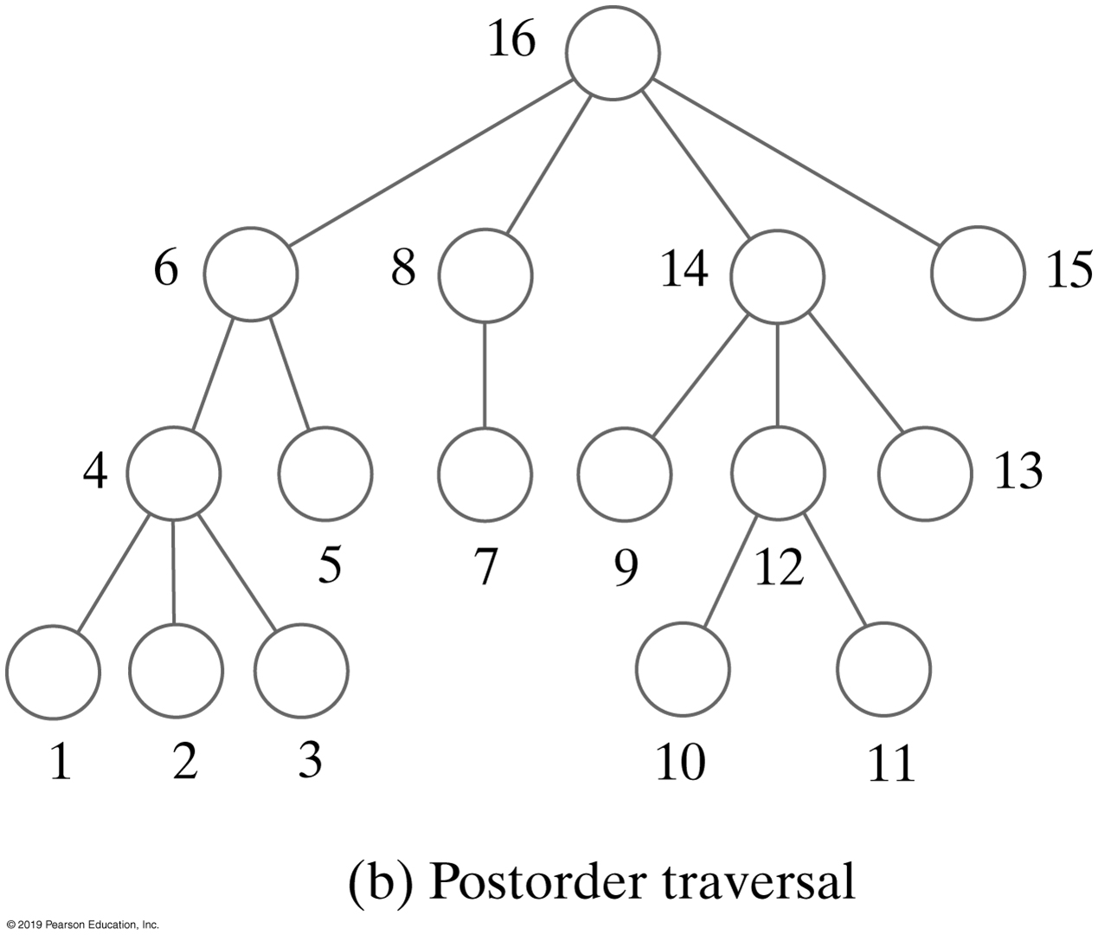
Traversals of a General Tree
FIGURE 24-13 The visitation order of two traversals of a general tree

Slide 22
Interfaces for All Trees
package TreePackage;
/** An interface of basic methods for the ADT tree. */
public interface TreeInterface<T>
{
public T getRootData();
public int getHeight();
public int getNumberOfNodes();
public boolean isEmpty();
public void clear();
} // end TreeInterface
LISTING 24-1 An interface of methods common to all trees

Slide 23
Traversals
package TreePackage;
import java.util.Iterator;
/** An interface of iterators for the ADT tree. */
public interface TreeIteratorInterface<T>
{
public Iterator<T> getPreorderIterator();
public Iterator<T> getPostorderIterator();
public Iterator<T> getInorderIterator();
public Iterator<T> getLevelOrderIterator();
} // end TreeIteratorInterface
LISTING 24-2 An interface of traversal methods for a tree

Slide 24
Interface for Binary Trees
package TreePackage;
/* An interface for the ADT binary tree. */
public interface BinaryTreeInterface<T> extends TreeInterface<T>,
TreeIteratorInterface<T>
{
/** Sets the data in the root of this binary tree.
@param rootData The object that is the data for the tree's root.
*/
public void setRootData(T rootData);
/** Sets this binary tree to a new binary tree.
@param rootData The object that is the data for the new tree's root.
@param leftTree The left subtree of the new tree.
@param rightTree The right subtree of the new tree. */
public void setTree(T rootData, BinaryTreeInterface<T> leftTree,
BinaryTreeInterface<T> rightTree);
} // end BinaryTreeInterface
LISTING 24-3 An interface for a binary tree

Slide 25
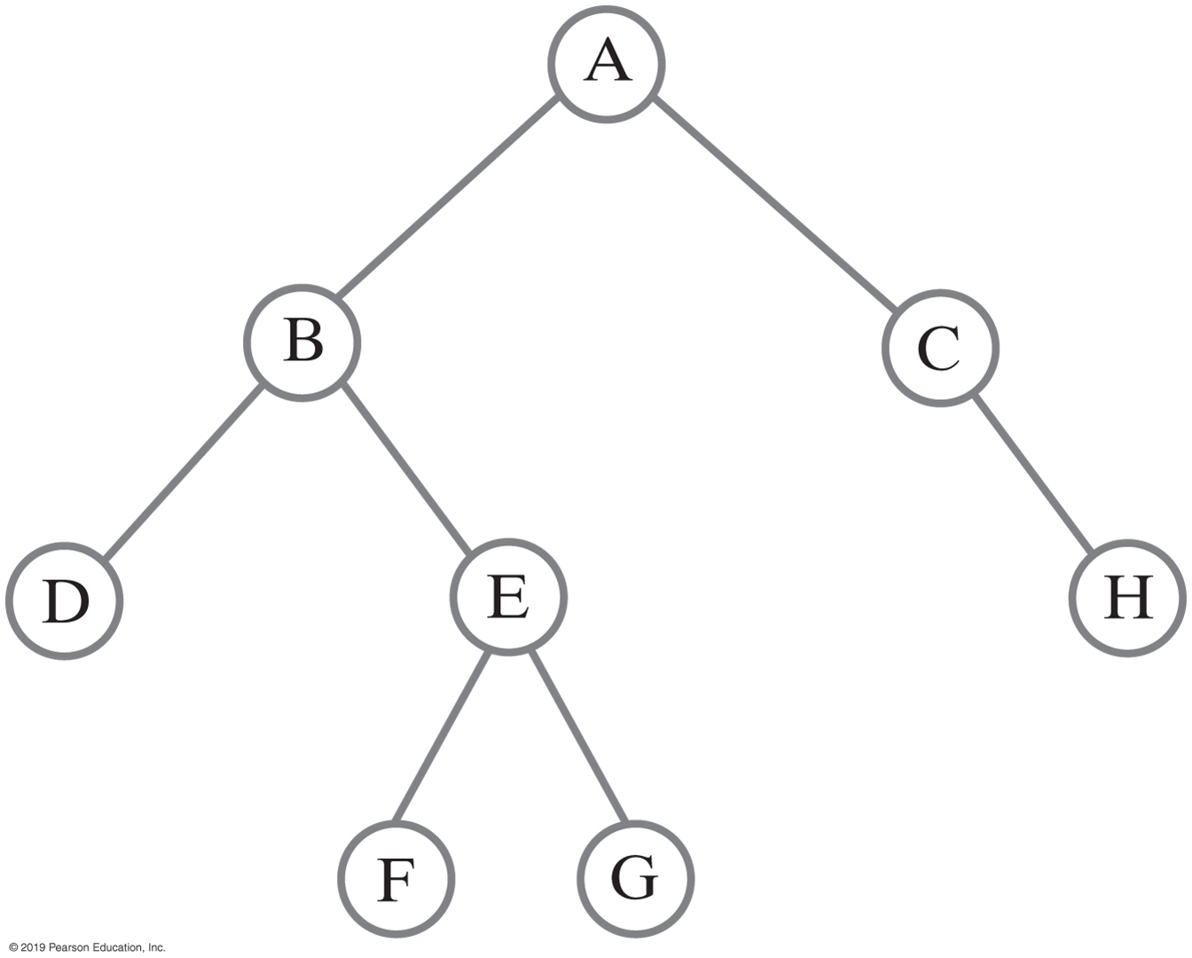
Building a Binary Tree
BinaryTreeInterface<String> dTree = new BinaryTree<>();
dTree.setTree("D", null, null);
BinaryTreeInterface<String> fTree = new BinaryTree<>();
fTree.setTree("F", null, null);
BinaryTreeInterface<String> gTree = new BinaryTree<>();
gTree.setTree("G", null, null);
BinaryTreeInterface<String> hTree = new BinaryTree<>();
hTree.setTree("H", null, null);
BinaryTreeInterface<String> emptyTree = new BinaryTree<>();
// Form larger subtrees
BinaryTreeInterface<String> eTree = new BinaryTree<>();
eTree.setTree("E", fTree, gTree); // Subtree rooted at E
BinaryTreeInterface<String> bTree = new BinaryTree<>();
bTree.setTree("B", dTree, eTree); // Subtree rooted at B
BinaryTreeInterface<String> cTree = new BinaryTree<>();
cTree.setTree("C", emptyTree, hTree); // Subtree rooted at C
BinaryTreeInterface<String> aTree = new BinaryTree<>();
aTree.setTree("A", bTree, cTree); // Desired tree rooted at A
FIGURE 24-14 A binary tree whose nodes contain one-letter strings
Java statements that build a tree

Slide 26
Building a Binary Tree
// Display root, height, number of nodes
System.out.println("Root of tree contains " + aTree.getRootData());
System.out.println("Height of tree is " + aTree.getHeight());
System.out.println("Tree has " + aTree.getNumberOfNodes() + " nodes");
// Display nodes in preorder
System.out.println("A preorder traversal visits nodes in this order:");
Iterator<String> preorder = aTree.getPreorderIterator();
while (preorder.hasNext())
System.out.print(preorder.next() + " ");
System.out.println();
FIGURE 24-14 A binary tree whose nodes contain one-letter strings
Java statements that build a tree and then display some of its characteristics:

Slide 27
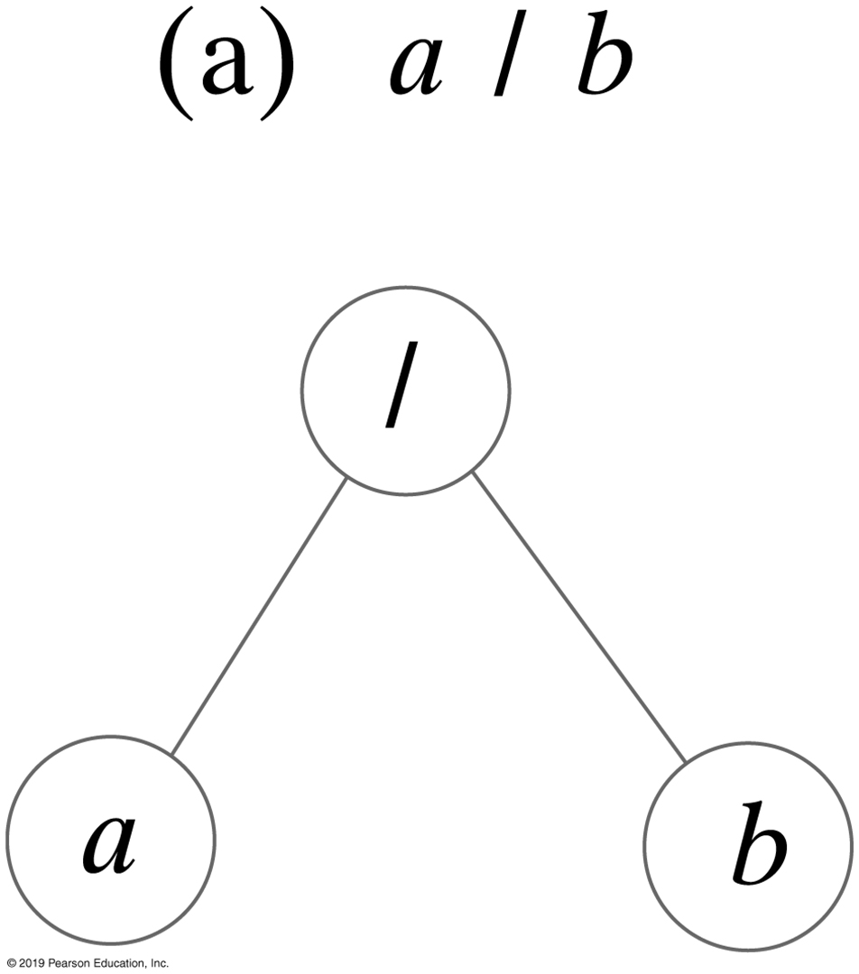
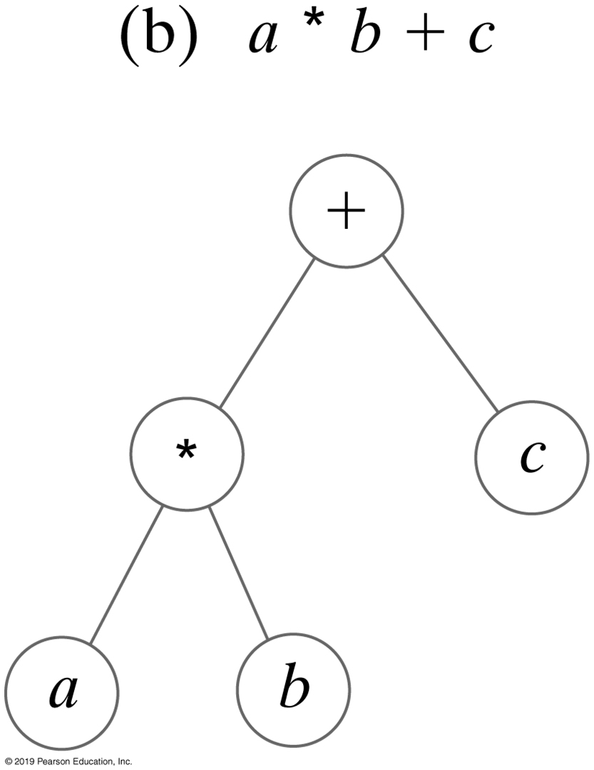
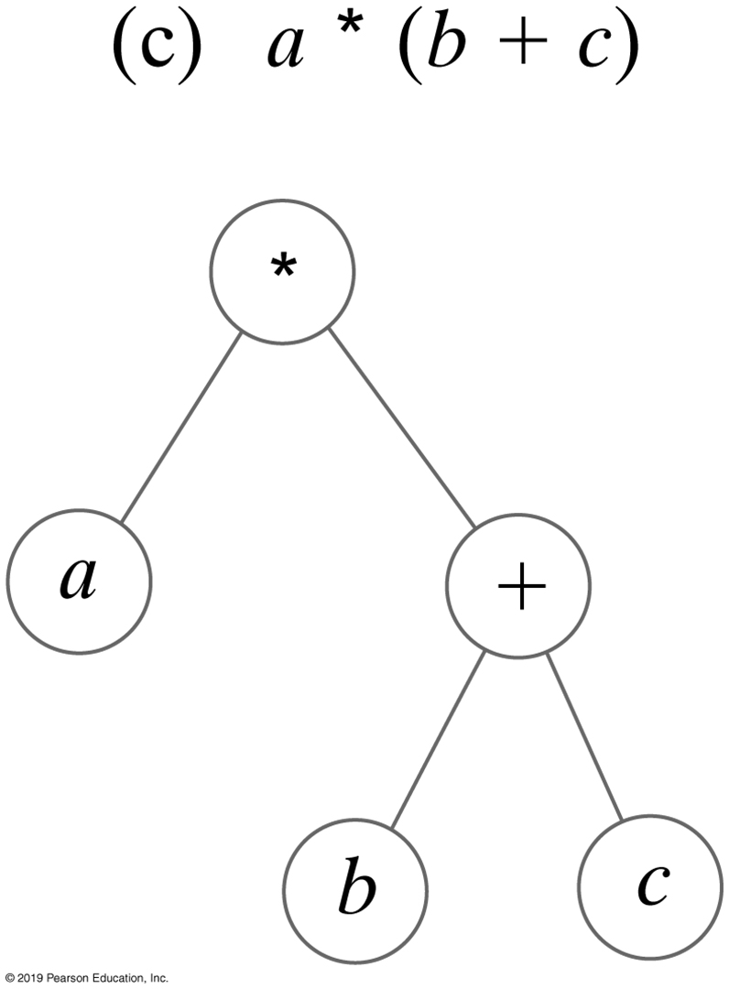
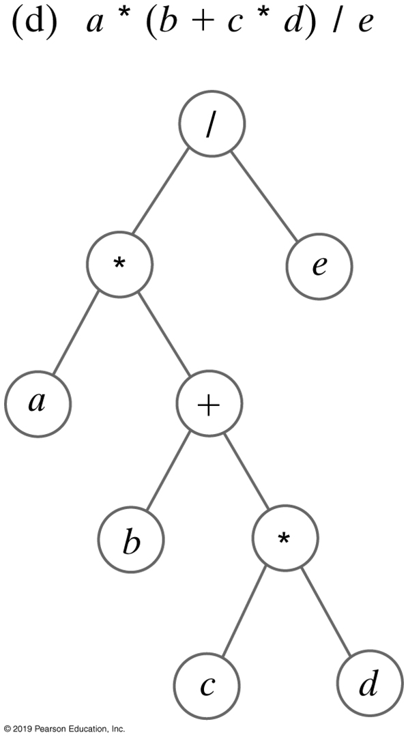
Expression Trees
FIGURE 24-15 Expression trees for four algebraic expressions

Slide 28
Expression Trees
Algorithm evaluate(expressionTree)
if (expressionTree is empty)
return 0
else
{
firstOperand = evaluate(left subtree of expressionTree)
secondOperand = evaluate(right subtree of expressionTree)
operator = the root of expressionTree
return the result of the operation operator and its operands firstOperand
and secondOperand
}
Algorithm for postorder traversal of an expression tree.

Slide 29
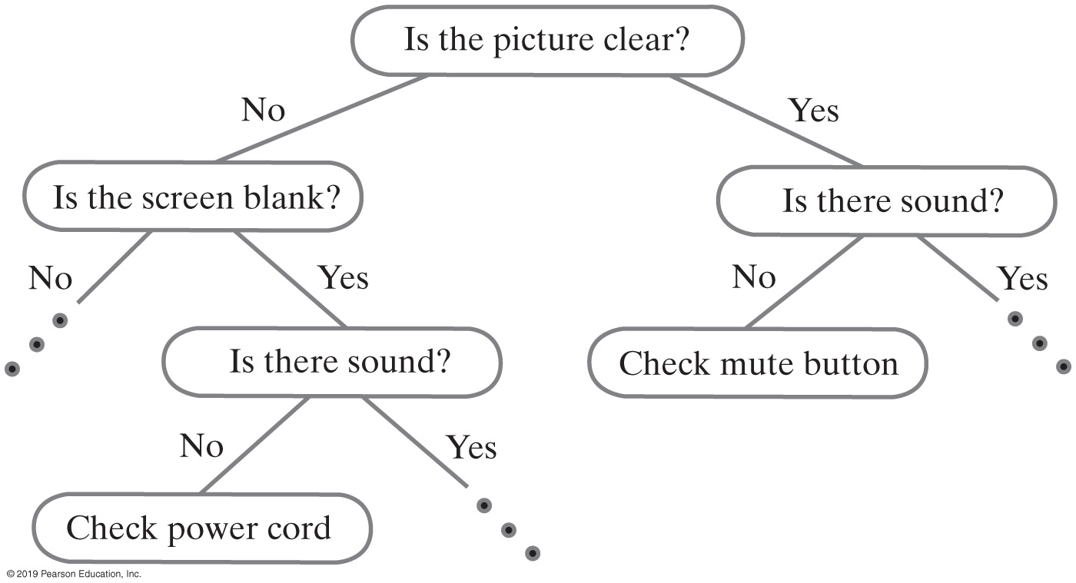
Expert System Using A Decision Tree
FIGURE 24-16 A portion of a binary decision tree

Slide 30
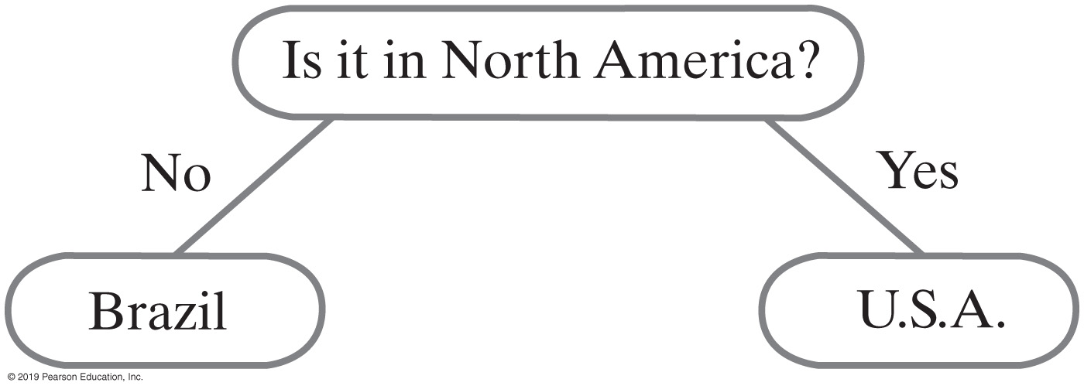
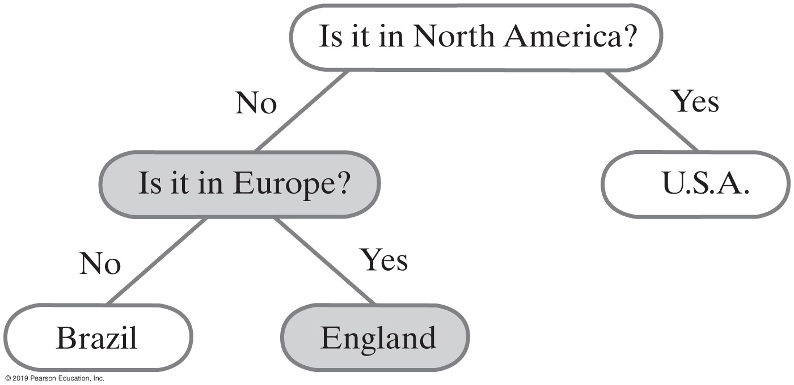
Expert System Using A Decision Tree
FIGURE 24-17 An initial decision tree for a guessing game
FIGURE 24-18 The decision tree for a guessing game after acquiring another fact

Slide 31
Expert System Using A Decision Tree (Part 1)
package TreePackage;
/** An interface for a decision tree. */
public interface DecisionTreeInterface<T> extends BinaryTreeInterface<T>
{
/** Gets the data in the current node.
@return The data object in the current node, or
null if the current node is null. */
public T getCurrentData();
/** Sets the data in the current node.
Precondition: The current node is not null.
@param newData The new data object. */
public void setCurrentData(T newData);
/** Sets the data in the children of the current node,
creating them if they do not exist.
Precondition: The current node is not null.
@param responseForNo The new data object for the left child.
@param responseForYes The new data object for the right child. */
public void setResponses(T responseForNo, T responseForYes);
LISTING 24-4 An interface for a binary decision tree

Slide 32
Expert System Using A Decision Tree (Part 2)
/** Sees whether the current node contains an answer.
@return True if the current node is a leaf, or
false if it is a nonleaf. */
public boolean isAnswer();
/** Sets the current node to its left child.
If the child does not exist, sets the current node to null. */
public void advanceToNo();
/** Sets the current node to its right child.
If the child does not exist, sets the current node to null. */
public void advanceToYes();
/** Sets the current node to the root of the tree. */
public void resetCurrentNode();
} // end DecisionTreeInterface
LISTING 24-4 An interface for a binary decision tree

Slide 33
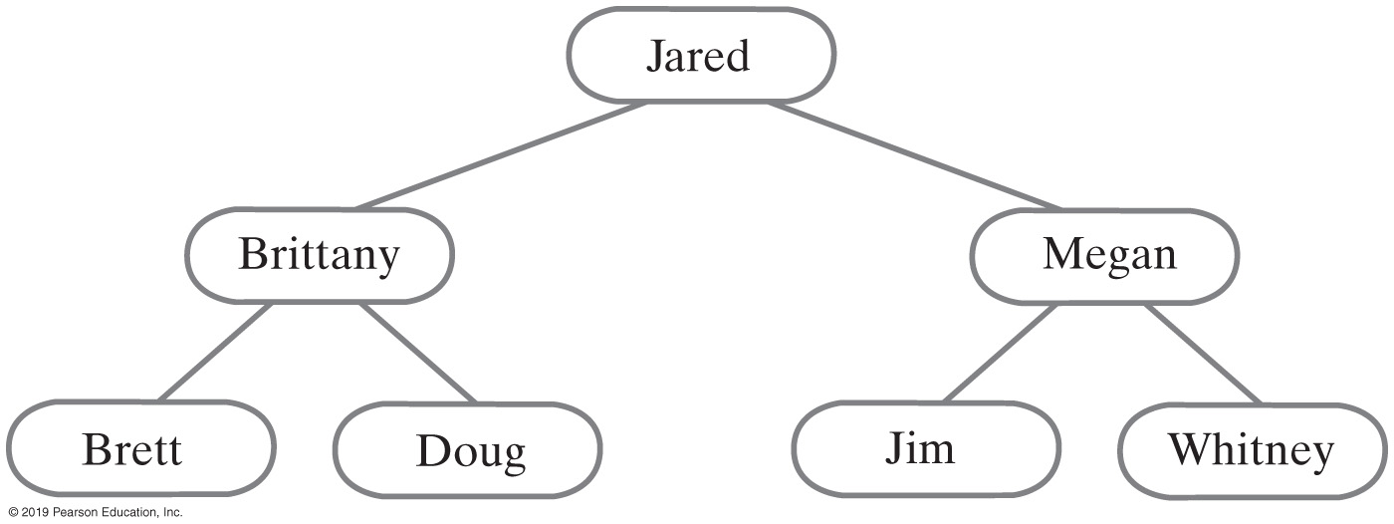
Binary Search Tree
For each node in a binary search tree
Node’s data is greater than all data in node’s left subtree
Node’s data is less than all data in node’s right subtree
Every node in a binary search tree is the root of a binary search tree
FIGURE 24-19 A binary search tree of names

Slide 34
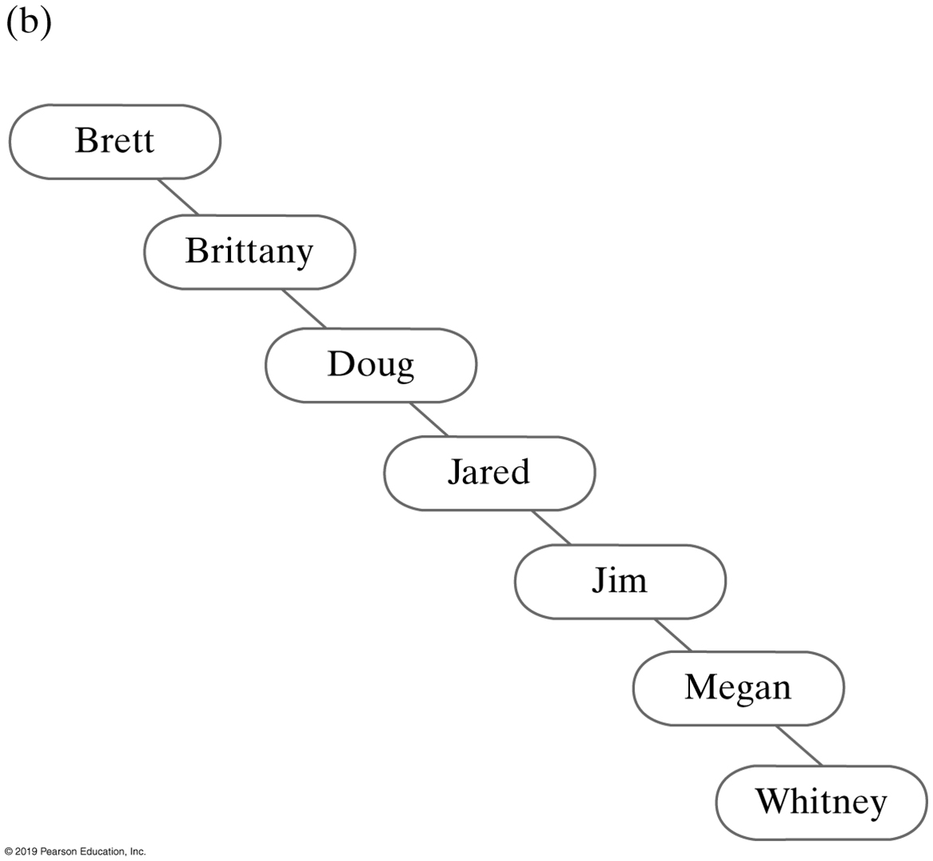
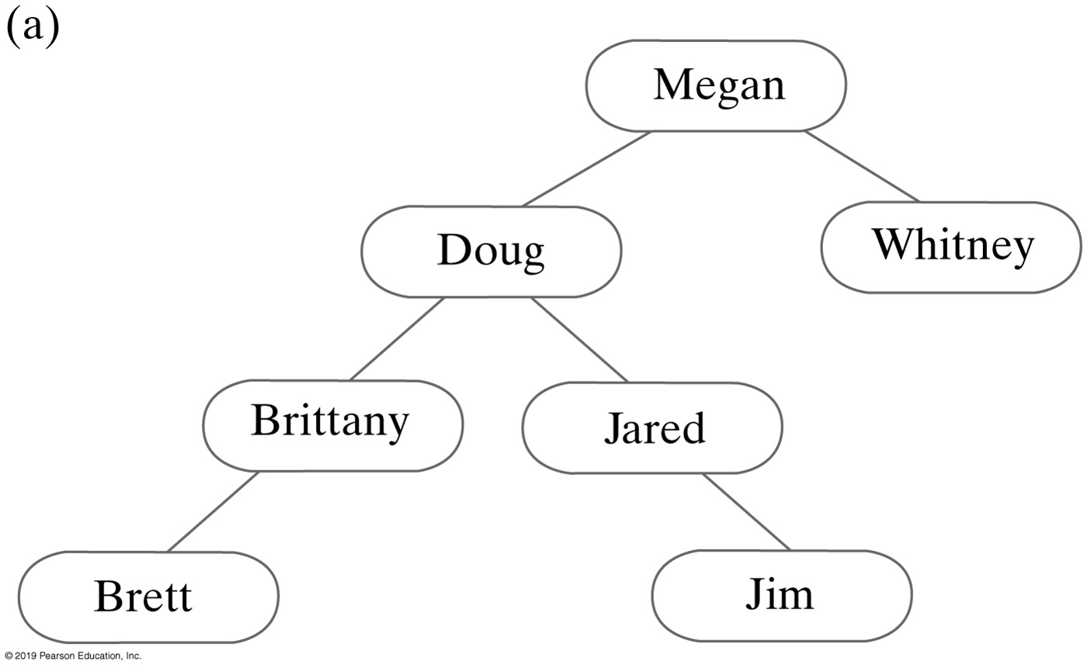
Binary Search Tree
FIGURE 24-20 Two binary search trees containing the same data as the tree in Figure 24-19

Slide 35
Binary Search Tree
Algorithm bstSearch(binarySearchTree, desiredObject)
// Searches a binary search tree for a given object.
// Returns true if the object is found.
if (binarySearchTree is empty)
return false
else if (desiredObject == object in the root of binarySearchTree)
return true
else if (desiredObject < object in the root of binarySearchTree)
return bstSearch(left subtree of binarySearchTree, desiredObject)
else
return bstSearch(right subtree of binarySearchTree, desiredObject)
Pseudocode for recursive search algorithm

Slide 36
Binary Search Tree
Efficiency of a search
Searching a binary search tree of height h is O(h)
To make searching a binary search tree efficient:
Tree must be as short as possible.

Slide 37
Heaps
Complete binary tree whose nodes contain Comparable objects and are organized as follows:
Each node contains an object no smaller/larger than objects in its descendants
Maxheap: object in node greater than or equal to its descendant objects
Minheap: object in node less than or equal to its descendant objects

Slide 38
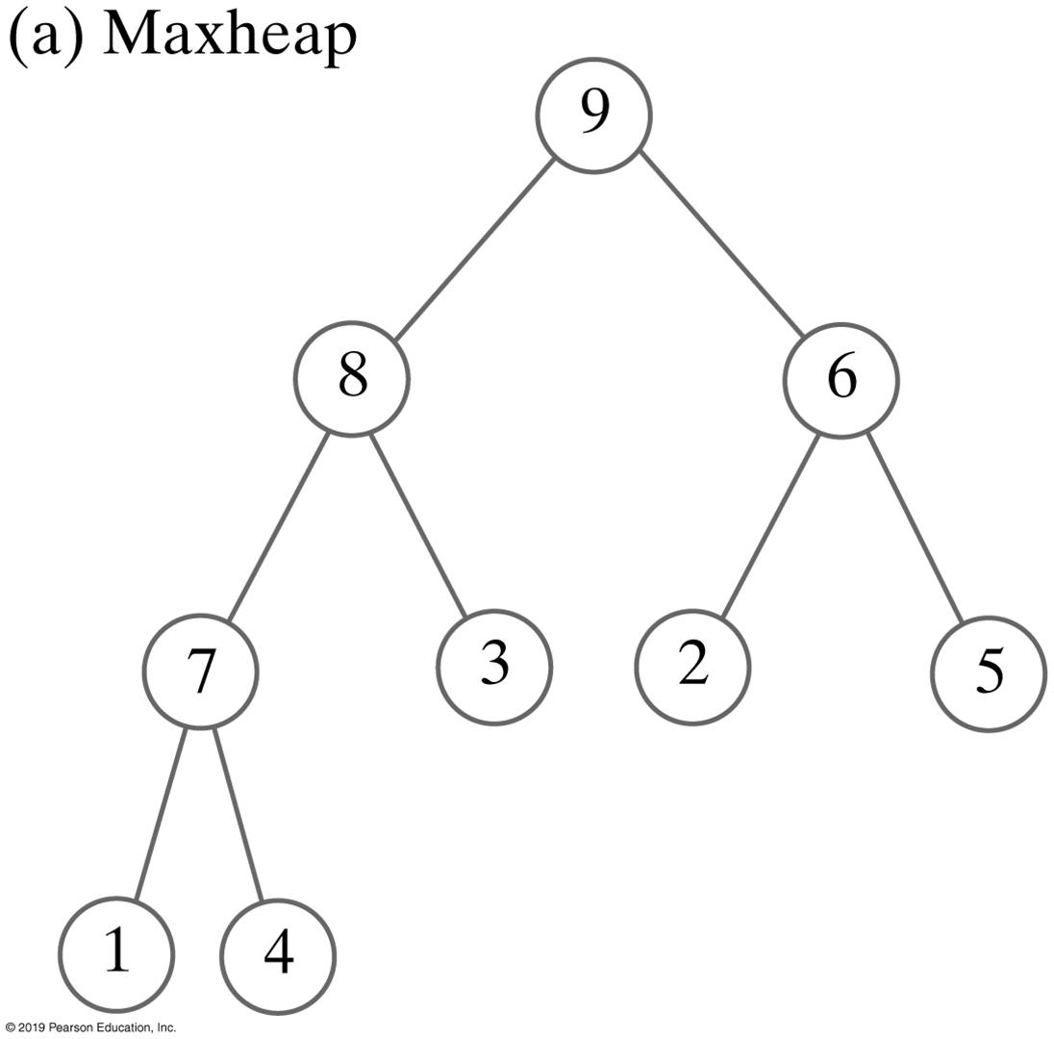

Heaps
FIGURE 24-21 Two heaps that contain the same values

Slide 39
Heaps
/** An interface for the ADT maxheap. */
public interface MaxHeapInterface<T extends Comparable<? super T>>
{
/** Adds a new entry to this heap.
@param newEntry An object to be added. */
public void add(T newEntry);
/** Removes and returns the largest item in this heap.
@return Either the largest object in the heap or,
if the heap is empty before the operation, null. */
public T removeMax();
/** Retrieves the largest item in this heap.
@return Either the largest object in the heap or,
if the heap is empty, null. */
public T getMax();
/** Detects whether this heap is empty.
@return True if the heap is empty, or false otherwise. */
public boolean isEmpty();
/** Gets the size of this heap.
@return The number of entries currently in the heap. */
public int getSize();
/** Removes all entries from this heap. */
public void clear();
} // end MaxHeapInterface
LISTING 24-6 An interface for a maxheap

Slide 40
More on General Trees
Parse tree
Check syntax of a string for valid algebraic expression
If valid can be expressed as a parse tree
Parse tree must be a general tree
So it can accommodate any expression
Compilers use parse trees
Check syntax, produce code

Slide 41
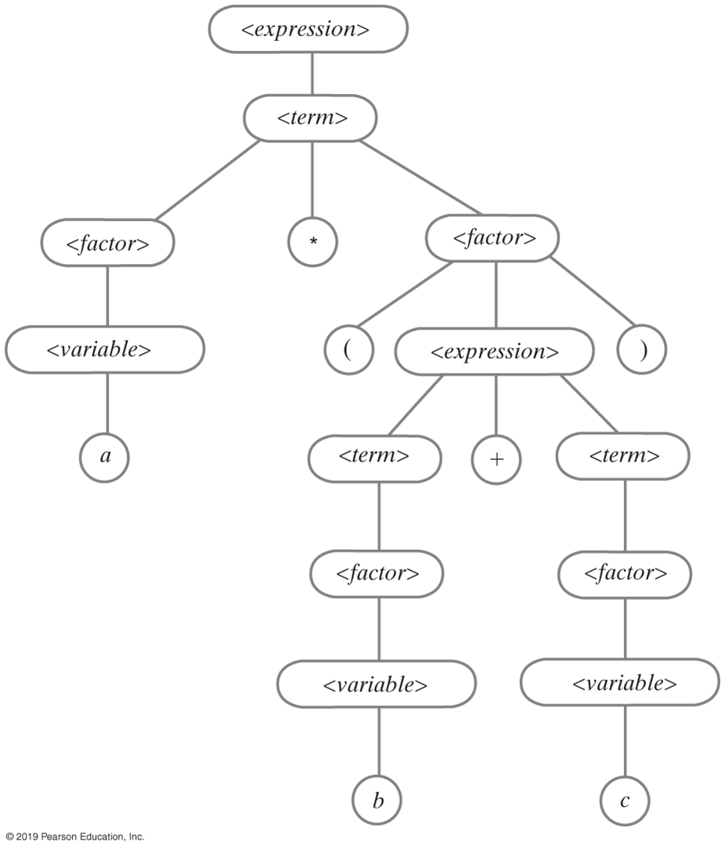
Parse Tree for an Equation
FIGURE 24-22 A parse tree for the algebraic expression a * (b + c)

Slide 42
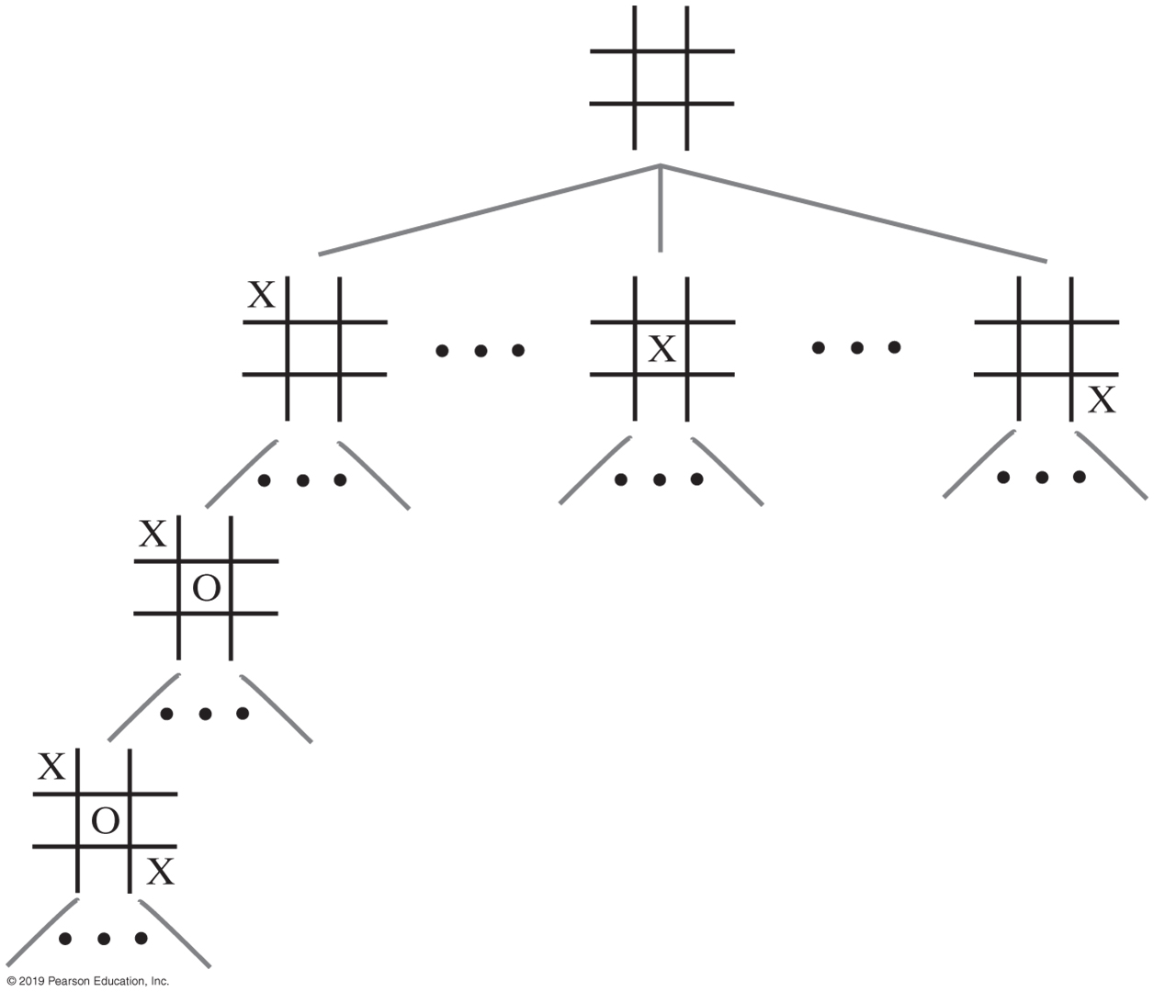
Parse Tree for a Game
FIGURE 24-23 A portion of a game tree for tic-tac-toe

Slide 43
End
Chapter 24

