Slide 1

Data Structures and Abstractions with Java™
5th Edition
Chapter 26
A Binary Search Tree
Implementation

Slide 2
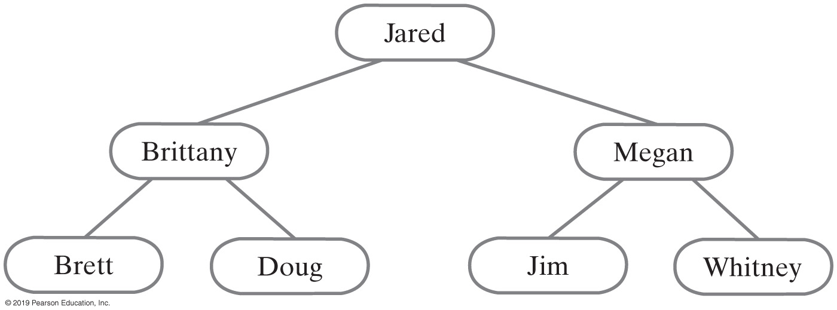
Binary Search Tree
For each node in a binary search tree
Node’s data is greater than all data in node’s left subtree
Node’s data is less than all data in node’s right subtree
Every node in a binary search tree is the root of a binary search tree
FIGURE 26-1 A binary search tree of names

Slide 3
Interface for the Binary Search Tree (Part 1)
/** An interface for a search tree. */
public interface SearchTreeInterface<T extends Comparable<? super T>>
extends TreeInterface<T>
{
/** Searches for a specific entry in this tree.
@param anEntry An object to be found.
@return True if the object was found in the tree. */
public boolean contains(T anEntry);
/** Retrieves a specific entry in this tree.
@param anEntry An object to be found.
@return Either the object that was found in the tree or
null if no such object exists. */
public T getEntry(T anEntry);
/** Adds a new entry to this tree, if it does not match an existing
object in the tree. Otherwise, replaces the existing object with
the new entry.
@param anEntry An object to be added to the tree.
@return Either null if anEntry was not in the tree but has been added, or
the existing entry that matched the parameter anEntry
and has been replaced in the tree. */
public T add(T anEntry);
LISTING 26-1 An interface for a search tree

Slide 4
Interface for the Binary Search Tree (Part 2)
/** Removes a specific entry from this tree.
@param anEntry An object to be removed.
@return Either the object that was removed from the tree or
null if no such object exists. */
public T remove(T anEntry);
/** Creates an iterator that traverses all entries in this tree.
@return An iterator that provides sequential and ordered access
to the entries in the tree. */
public Iterator<T> getInorderIterator();
} // end SearchTreeInterface
LISTING 26-1 An interface for a search tree

Slide 5
Understanding the Specifications
Methods will use return values instead of exceptions to indicate whether an operation has failed
getEntry, returns same entry it is given to find
getEntry returns an object in tree and matches given entry according to the entry’s compareTo method

Slide 6
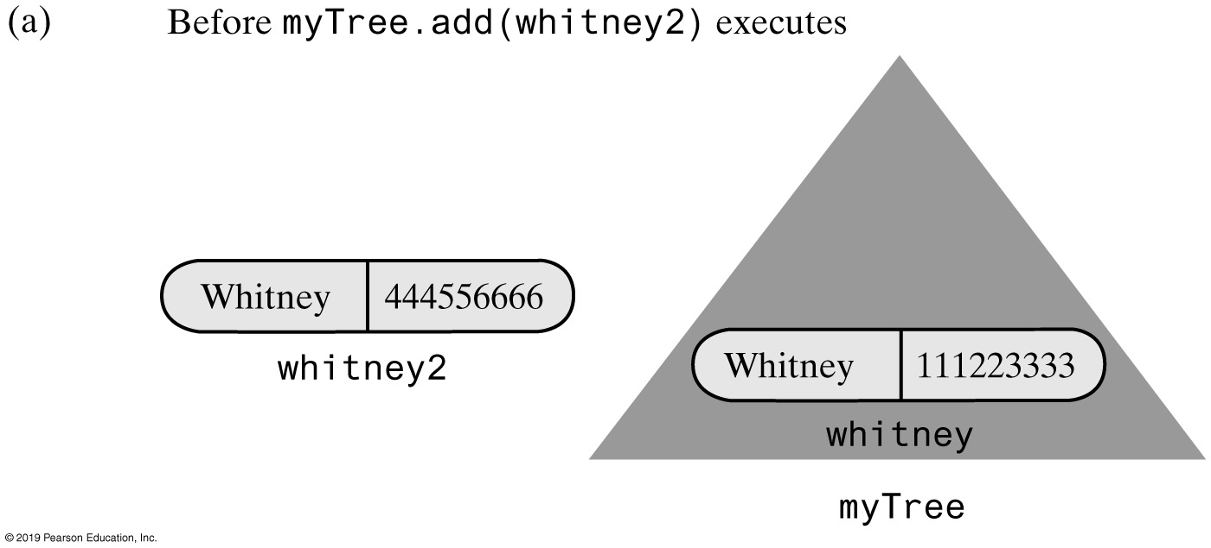

Adding to a Binary Search Tree
FIGURE 26-2 Adding an entry that matches an entry already in a binary search tree

Slide 7
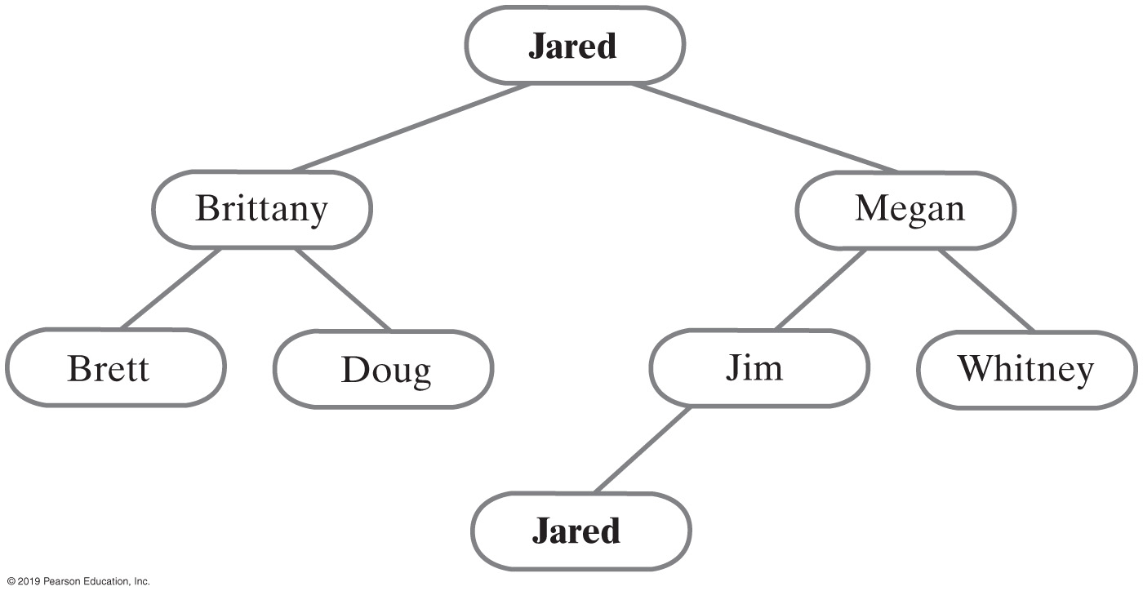
Duplicate Entries
If any entry e has a duplicate entry d, we arbitrarily require that d occur in the right subtree of e’s node
For each node in a binary search tree:
Data in a node is greater than data in node’s left subtree
Data in a node is less than or equal to data in node’s right subtree
FIGURE 26-3 A binary search tree with duplicate entries

Slide 8
Beginning the Class Definition
package TreePackage;
import java.util.Iterator;
/** A class that implements ADT binary search tree by extending BinaryTree. */
public class BinarySearchTree<T extends Comparable<? super T>>
extends BinaryTree<T> implements SearchTreeInterface<T>
{
public BinarySearchTree()
{
super();
} // end default constructor
public BinarySearchTree(T rootEntry)
{
super();
setRootNode(new BinaryNode<T>(rootEntry));
} // end constructor
// Disable setTree (see Segment 26.6)
public void setTree(T rootData, BinaryTreeInterface<T> leftTree,
BinaryTreeInterface<T> rightTree)
{
throw new UnsupportedOperationException();
} // end setTree
/* Implementations of other methods goes here. */
} // end BinarySearchTree
LISTING 26-2 An outline of the class BinarySearchTree

Slide 9
Searching and Retrieving
Algorithm bstSearch(binarySearchTree, desiredObject)
// Searches a binary search tree for a given object.
// Returns true if the object is found.
if (binarySearchTree is empty)
return false
else if (desiredObject == object in the root of binarySearchTree)
return true
else if (desiredObject < object in the root of binarySearchTree)
return bstSearch(left subtree of binarySearchTree, desiredObject)
else
return bstSearch(right subtree of binarySearchTree, desiredObject)
Recursive algorithm to search a binary search tree

Slide 10
Searching and Retrieving
Algorithm bstSearch(binarySearchTreeRoot, desiredObject)
// Searches a binary search tree for a given object.
// Returns true if the object is found.
if (binarySearchTreeRoot is null)
return false
else if (desiredObject == object in binarySearchTreeRoot)
return true
else if (desiredObject < object in binarySearchTreeRoot)
return bstSearch(left child of binarySearchTreeRoot, desiredObject)
else
return bstSearch(right child of binarySearchTreeRoot, desiredObject)
Algorithm that describes actual implementation more closely

Slide 11
Searching and Retrieving
public T getEntry(T anEntry)
{
return findEntry(getRootNode(), anEntry);
} // end getEntry
private T findEntry(BinaryNode<T> rootNode, T anEntry)
{
T result = null;
if (rootNode != null)
{
T rootEntry = rootNode.getData();
if (anEntry.equals(rootEntry))
result = rootEntry;
else if (anEntry.compareTo(rootEntry) < 0)
result = findEntry(rootNode.getLeftChild(), anEntry);
else
result = findEntry(rootNode.getRightChild(), anEntry);
} // end if
return result;
} // end findEntry
The method getEntry uses findEntry

Slide 12
Searching and Retrieving
public boolean contains(T anEntry)
{
return getEntry(anEntry) != null;
} // end contains
Method contains can simply call getEntry to see whether a given entry is in the tree

Slide 13
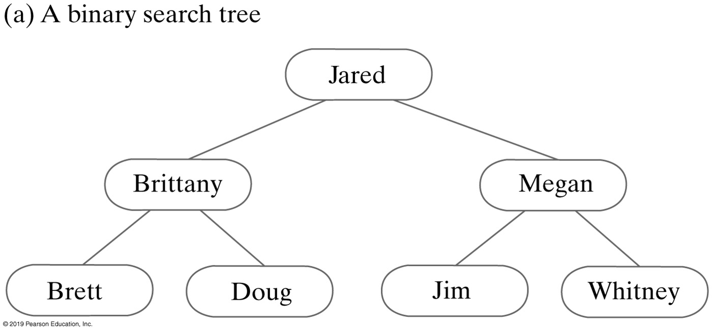
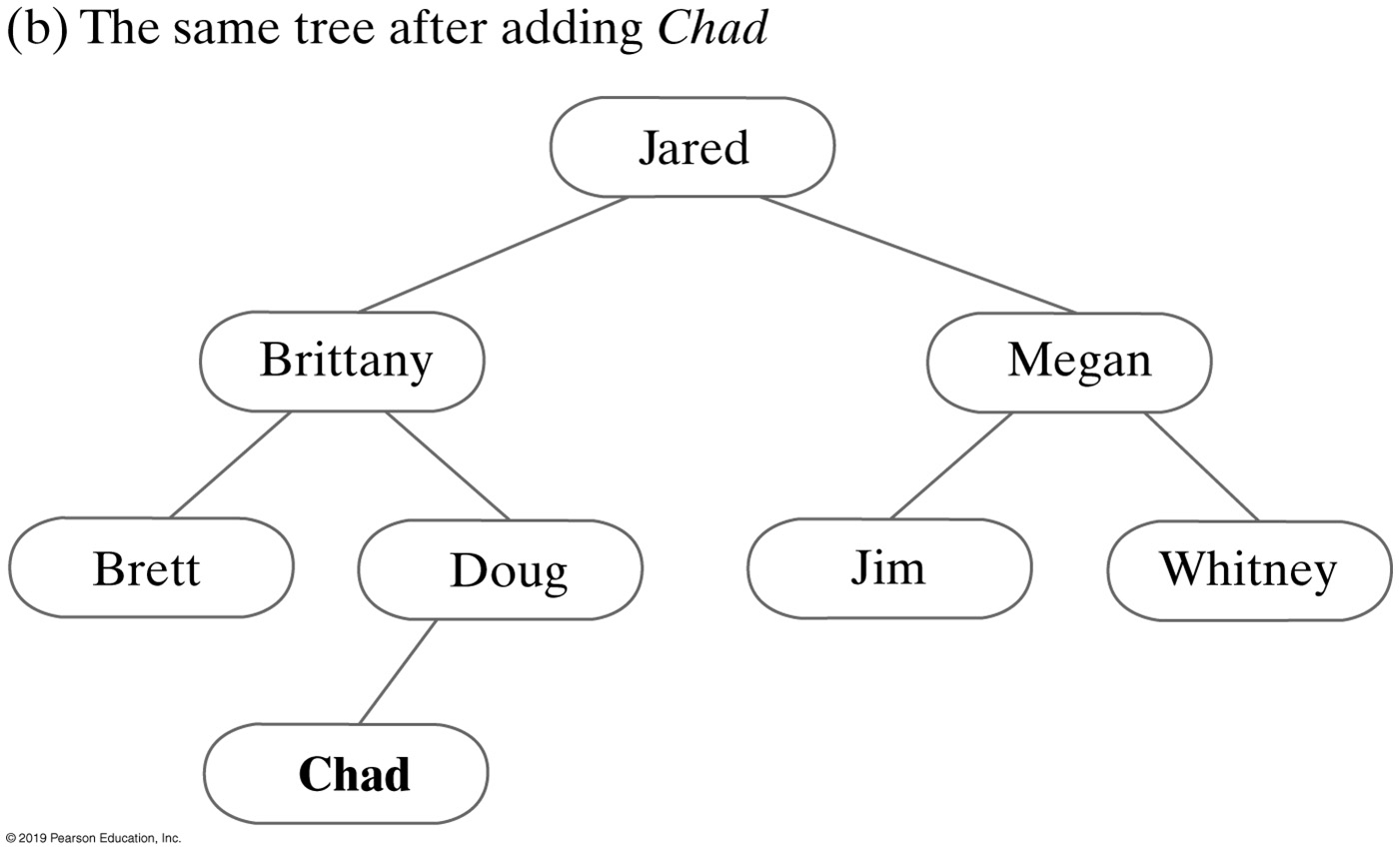
Adding to a Binary Search Tree
FIGURE 26-4 A binary search tree before and after adding Chad

Slide 14
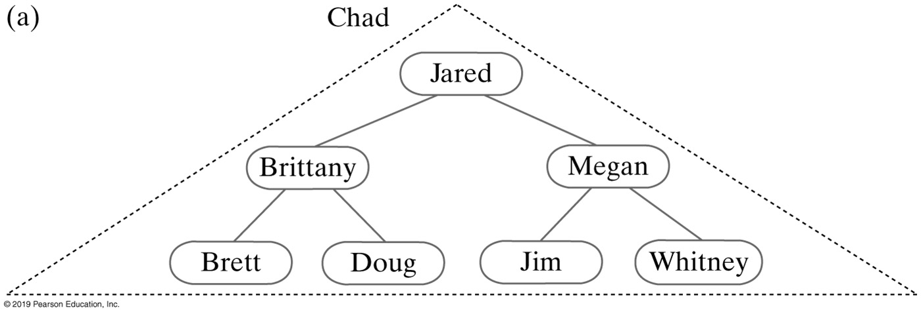
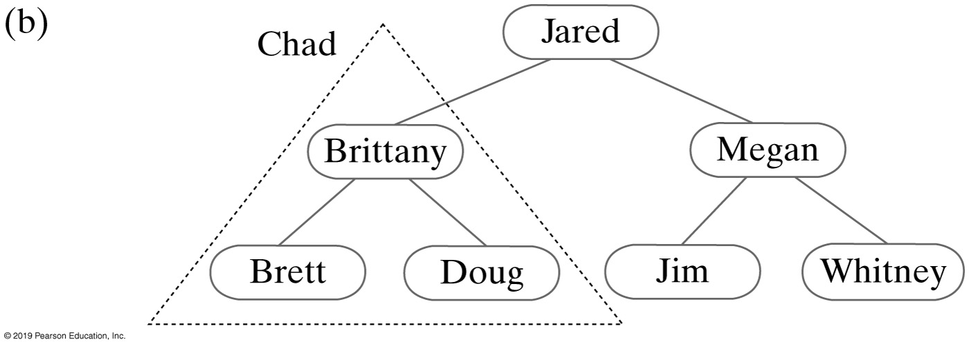
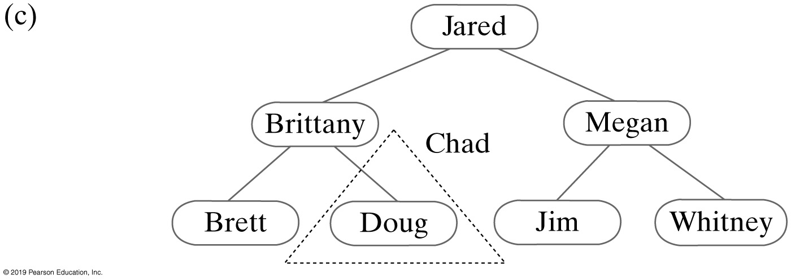
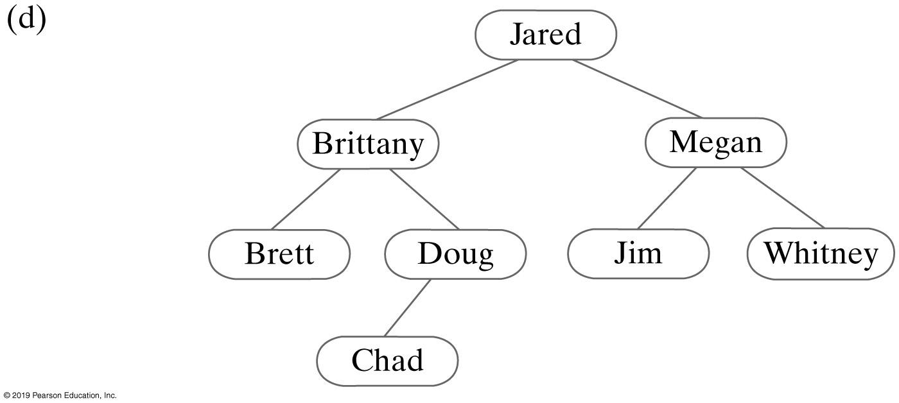
Adding to a Binary Search Tree
FIGURE 26-5 Recursively adding Chad to smaller subtrees of a binary search tree

Slide 15
Recursive Add Implementation (Part 1)
Algorithm addEntry(binarySearchTree, anEntry)
// Adds an entry to a binary search tree that is not empty.
// Returns null if anEntry did not exist already in the tree. Otherwise, returns the
// tree entry that matched and was replaced by anEntry.
result = null
if (anEntry matches the entry in the root of binarySearchTree)
{
result = entry in the root
Replace entry in the root with anEntry
}
else if (anEntry < entry in the root of binarySearchTree)
{
if (the root of binarySearchTree has a left child)
result = addEntry(left subtree of binarySearchTree, anEntry)
else
Give the root a left child containing anEntry
}
Recursive algorithm for adding a new entry

Slide 16
Recursive Add Implementation
Algorithm addEntry(binarySearchTree, anEntry)
// Adds an entry to a binary search tree that is not empty.
// Returns null if anEntry did not exist already in the tree. Otherwise, returns the
// tree entry that matched and was replaced by anEntry.
result = null
if (anEntry matches the entry in the root of binarySearchTree)
{
result = entry in the root
Replace entry in the root with anEntry
}
else if (anEntry < entry in the root of binarySearchTree)
{
if (the root of binarySearchTree has a left child)
result = addEntry(left subtree of binarySearchTree, anEntry)
else
Give the root a left child containing anEntry
}
else // anEntry > entry in the root of binarySearchTree
{
if (the root of binarySearchTree has a right child)
result = addEntry(right subtree of binarySearchTree, anEntry)
else
Give the root a right child containing anEntry
}
return result
Recursive algorithm for adding a new entry

Slide 17
Recursive Implementation
Algorithm add(binarySearchTree, anEntry)
// Adds an entry to a binary search tree.
// Returns null if anEntry did not exist already in the tree. Otherwise, returns the
// tree entry that matched and was replaced by anEntry.
result = null
if (binarySearchTree is empty)
Create a node containing anEntry and make it the root of binarySearchTree
else
result = addEntry(binarySearchTree, anEntry)
return result;
Handle the addition to an empty binary search tree as a special case

Slide 18
Recursive Implementation
public T add(T anEntry)
{
T result = null;
if (isEmpty())
setRootNode(new BinaryNode<>(anEntry));
else
result = addEntry(getRootNode(), anEntry);
return result;
} // end add
The public method add

Slide 19
Recursive Implementation — method addEntry
// Adds anEntry to the nonempty subtree rooted at rootNode.
private T addEntry(BinaryNode<T> rootNode, T anEntry)
{
// Assertion: rootNode != null
T result = null;
int comparison = anEntry.compareTo(rootNode.getData());
if (comparison == 0)
{
result = rootNode.getData();
rootNode.setData(anEntry);
}
else if (comparison < 0)
{
if (rootNode.hasLeftChild())
result = addEntry(rootNode.getLeftChild(), anEntry);
else
rootNode.setLeftChild(new BinaryNode<>(anEntry));
}
else
{
if (rootNode.hasRightChild())
result = addEntry(rootNode.getRightChild(), anEntry);
else
rootNode.setRightChild(new BinaryNode<>(anEntry));
} // end if
return result;
} // end addEntry

Slide 20
Iterative Implementation (Part 1)
Algorithm addEntry(binarySearchTree, anEntry)
// Adds a new entry to a binary search tree that is not empty.
// Returns null if anEntry did not exist already in the tree. Otherwise, returns the
// tree entry that matched and was replaced by anEntry.
result = null
currentNode = root node of binarySearchTree found = false
while (found is false)
{
if (anEntry matches the entry in currentNode)
{
found = true
result = entry in currentNode
Replace entry in currentNode with anEntry
}
else if (newEntry < entry in currentNode)
{
Iterative algorithm for adding a new entry

Slide 21
Iterative Implementation (Part 2)
if (currentNode has a left child)
currentNode = left child of currentNode
else
{
found = true
Give currentNode a left child containing anEntry
}
} // end if-else
else // anEntry > entry in currentNode
{
if (currentNode has a right child)
currentNode = right child of currentNode
else
{
found = true
Give currentNode a right child containing anEntry
}
} // end if
} // end while
return result
Iterative algorithm for adding a new entry

Slide 22
Iterative Implementation— method addEntry (Part 1)
private T addEntry(T anEntry) {
BinaryNode<T> currentNode = getRootNode();
// Assertion: currentNode != null
T result = null;
boolean found = false;
while (!found)
{
T currentEntry = currentNode.getData();
int comparison = anEntry.compareTo(currentEntry);
if (comparison == 0)
{ // anEntry matches currentEntry;
// return and replace currentEntry
found = true;
result = currentEntry;
currentNode.setData(anEntry);
}
else if (comparison < 0)
{
if (currentNode.hasLeftChild())
currentNode = currentNode.getLeftChild();
else
{
found = true;
currentNode.setLeftChild(new BinaryNode<>(anEntry));
} // end if
}

Slide 23
Iterative Implementation— method addEntry (Part 2)
{
// Assertion: comparison > 0
if (currentNode.hasRightChild())
currentNode = currentNode.getRightChild();
else
{
found = true;
currentNode.setRightChild(new BinaryNode<>(anEntry));
} // end if
} // end if
} // end while
return result;
} // end addEntry

Slide 24
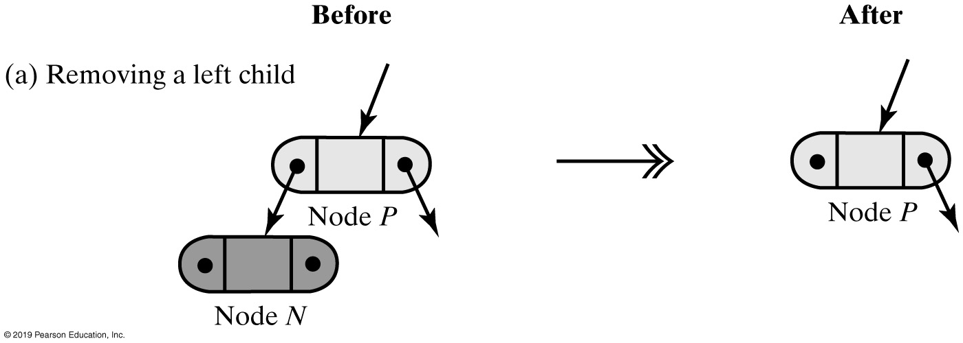
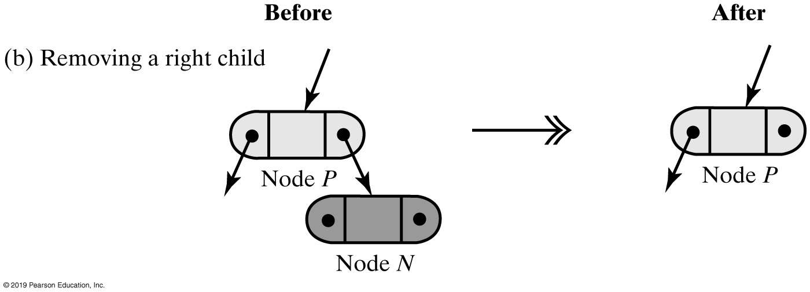
Removing a Value
FIGURE 26-6 Removing a leaf node N from its parent node P

Slide 25
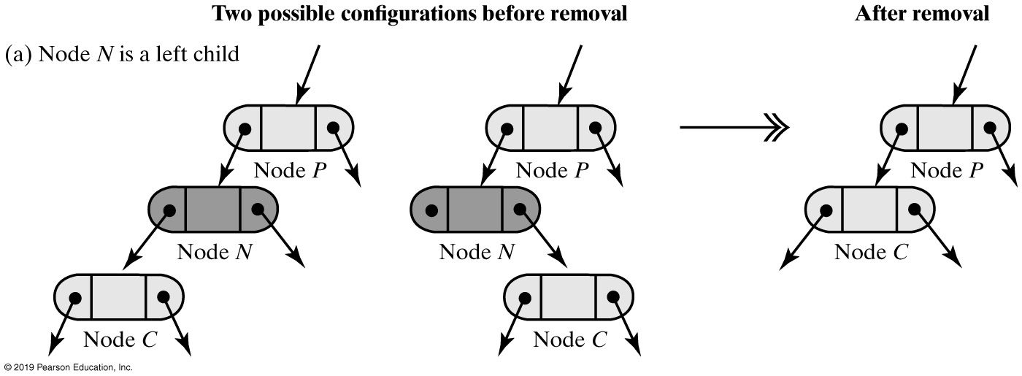
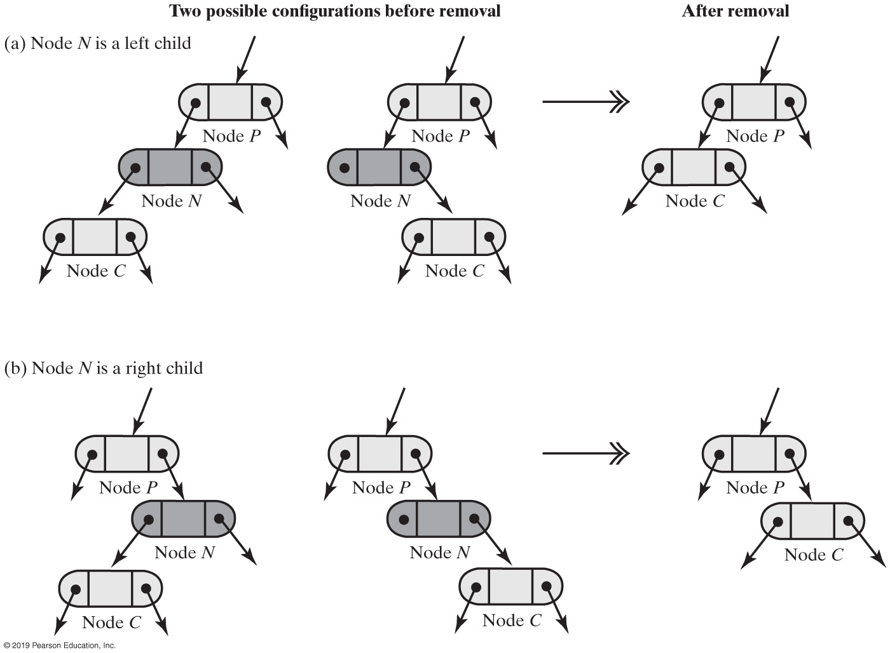
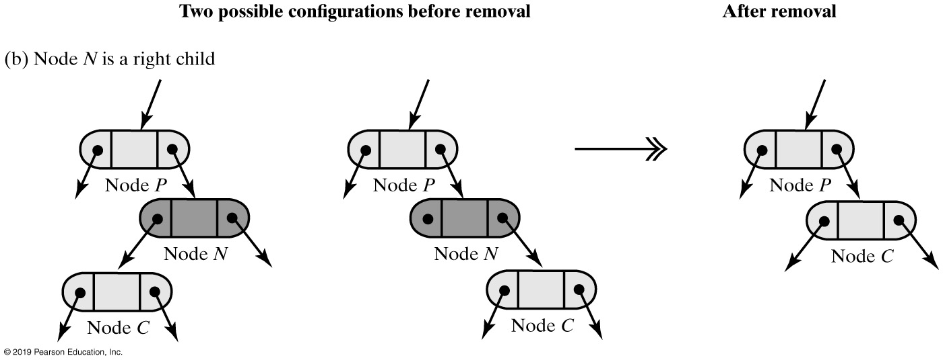
Removing a Value
FIGURE 26-7 Removing a node N from its parent node P when N has one child

Slide 26
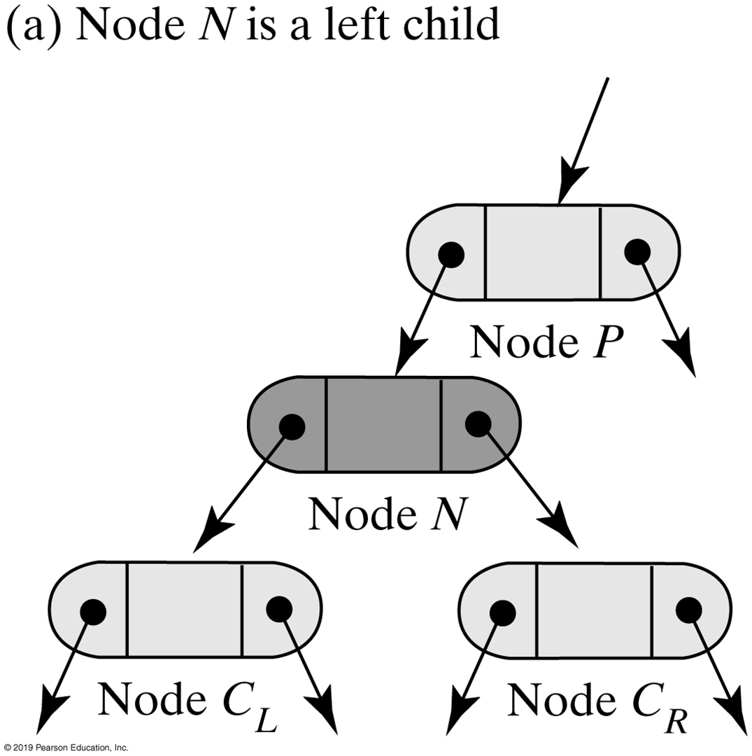
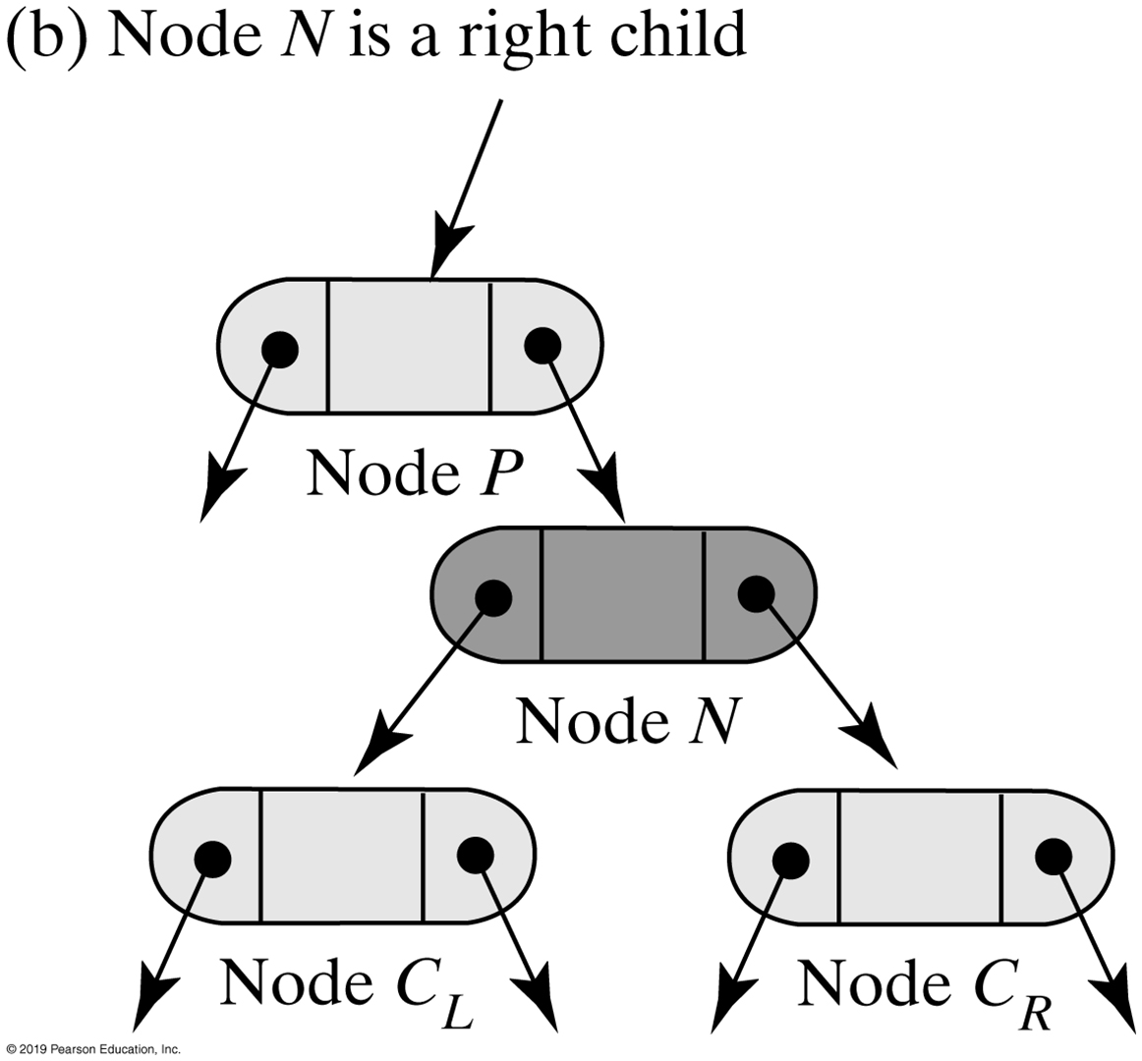
Removing a Value
FIGURE 26-8 Two possible configurations of a node N that has two children

Slide 27
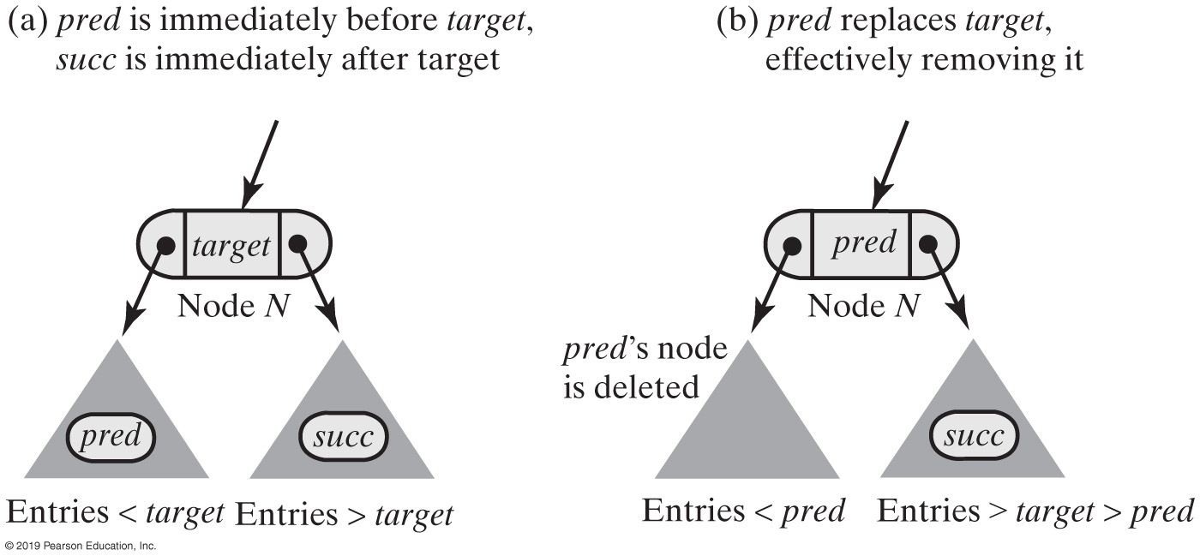
Removing a Value
FIGURE 26-9 Node N and its subtrees before and after removing target

Slide 28
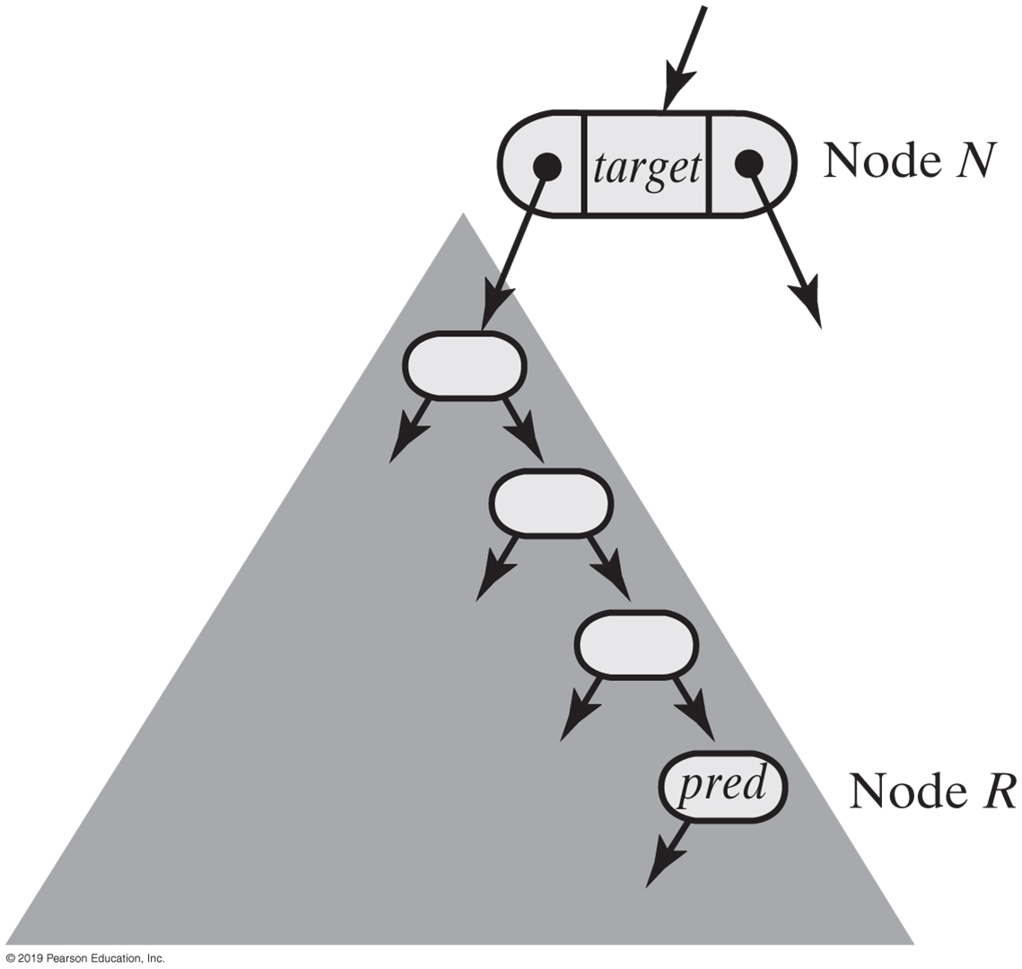
Removing a Value
FIGURE 26-10 The largest entry pred in node N’s left subtree occurs in the subtree’s rightmost node R

Slide 29
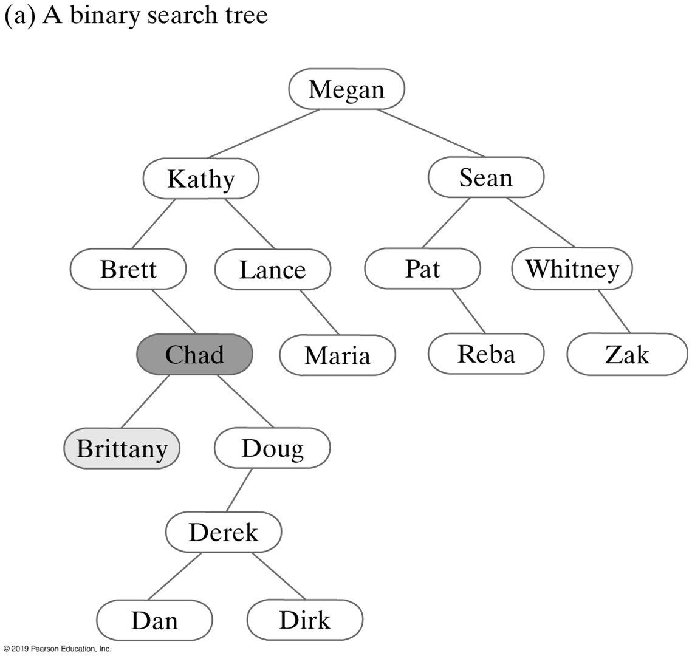
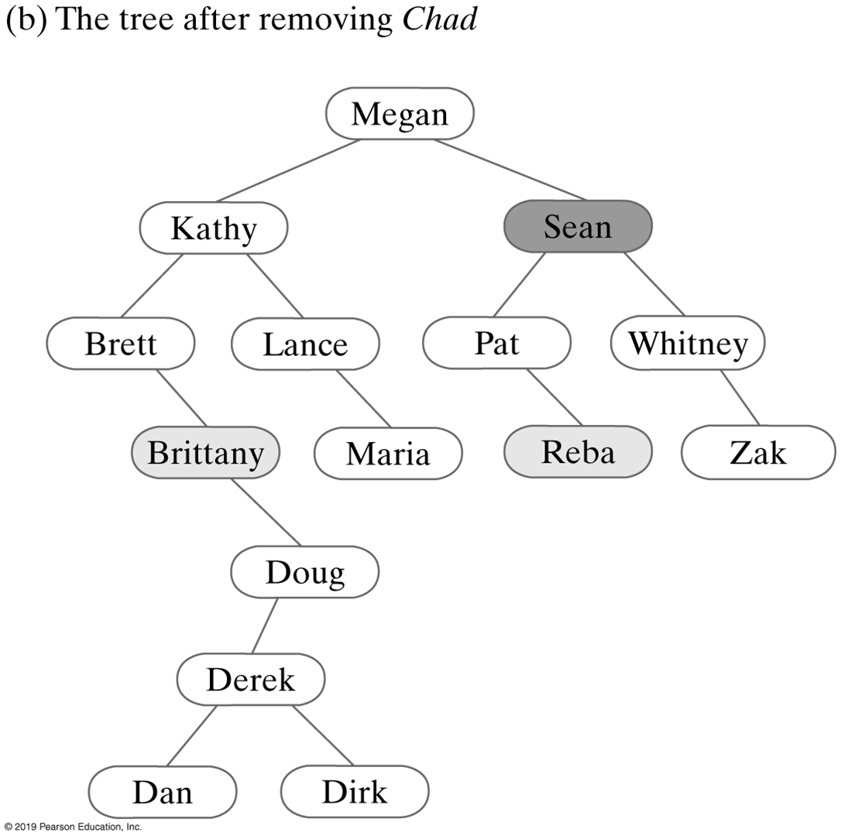
FIGURE 26-11 Successive removals from a binary search tree (Part 1)

Slide 30
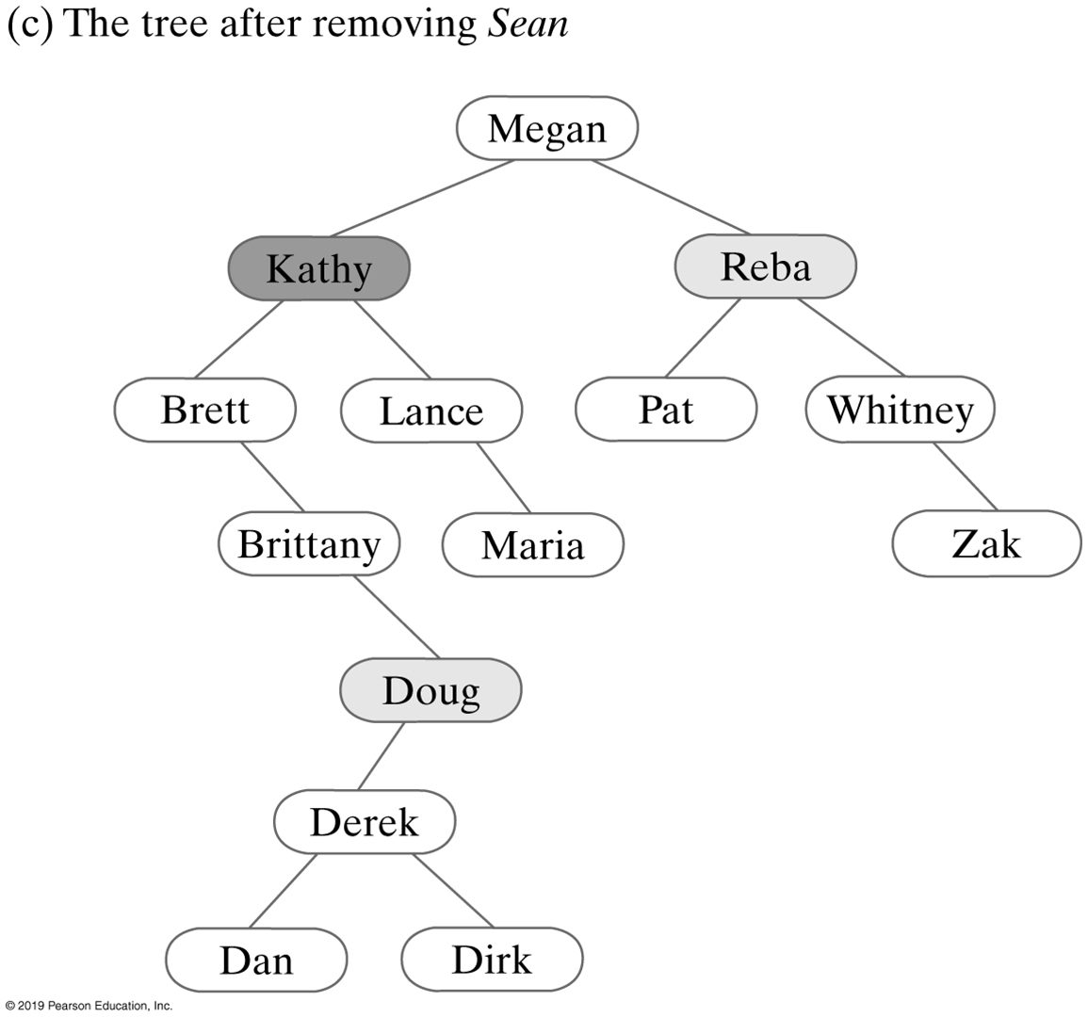
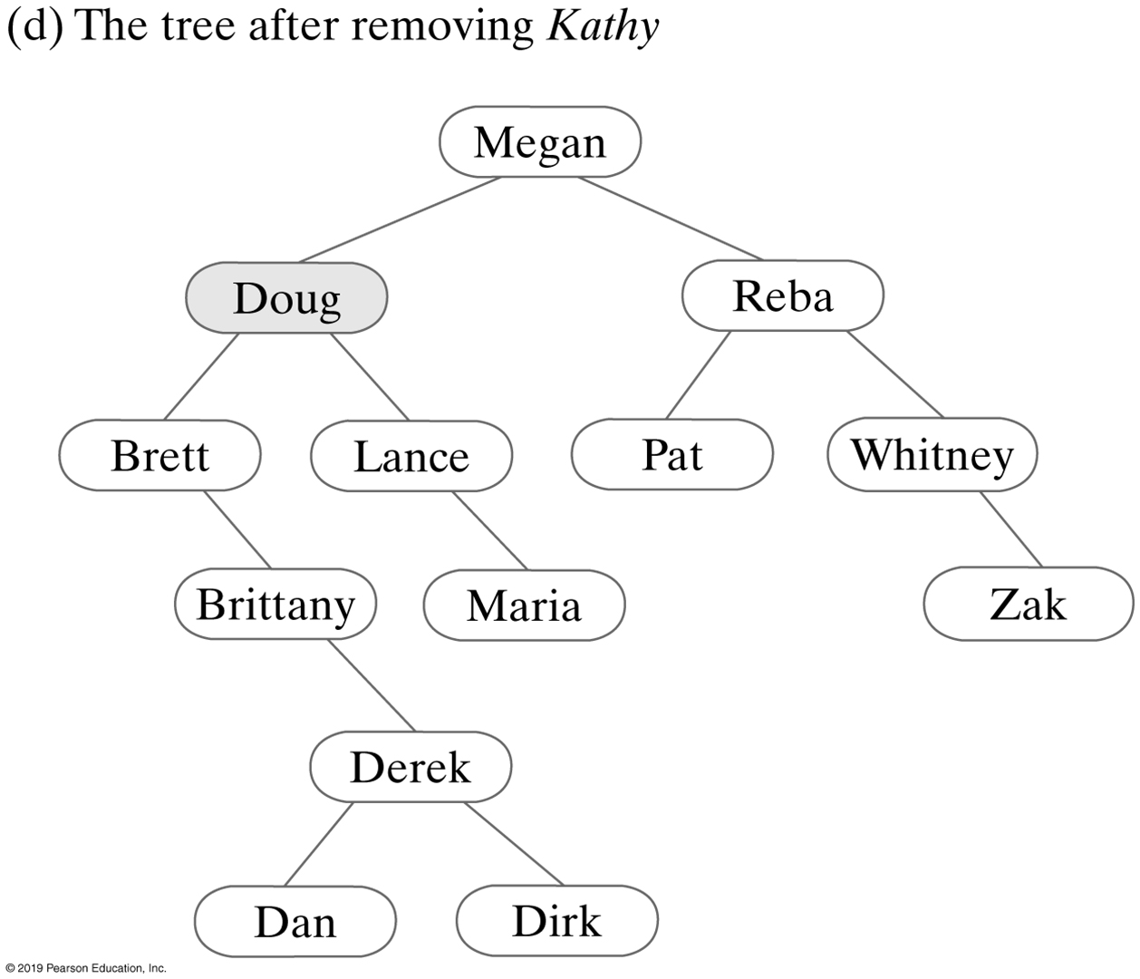
FIGURE 26-11 Successive removals from a binary search tree (Part 2)

Slide 31
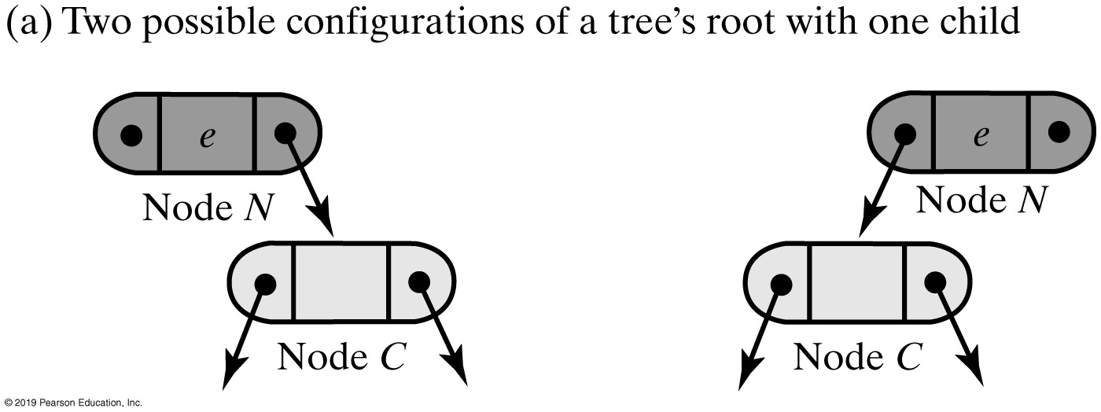
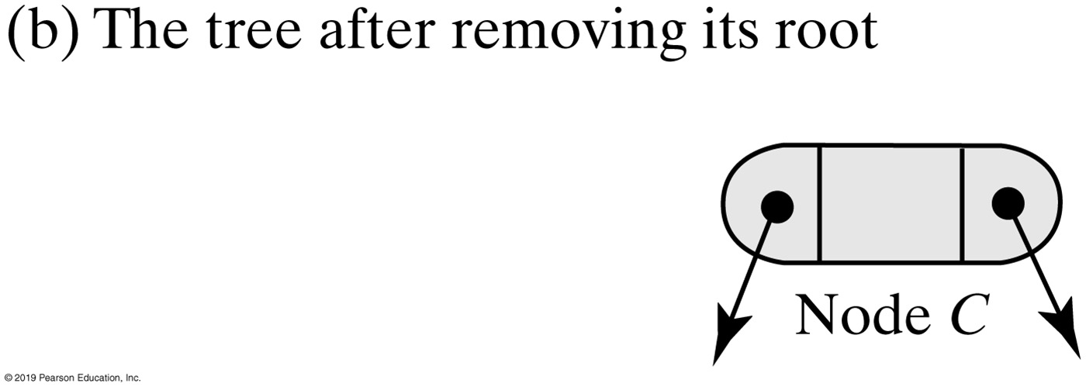
Removing a Value
FIGURE 26-12 Removing the root when it has one child

Slide 32
Recursive Implementation
Algorithm remove(binarySearchTree, anEntry)
oldEntry = null
if (binarySearchTree is not empty)
{
if (anEntry matches the entry in the root of binarySearchTree)
{
oldEntry = entry in root
removeFromRoot(root of binarySearchTree)
}
else if (anEntry < entry in root)
oldEntry = remove(left subtree of binarySearchTree, anEntry)
else // anEntry > entry in root
oldEntry = remove(right subtree of binarySearchTree, anEntry)
}
return oldEntry
Recursive algorithm describes the method’s logic at a high level

Slide 33
Recursive Implementation
public T remove(T anEntry)
{
ReturnObject oldEntry = new ReturnObject(null);
BinaryNode<T> newRoot = removeEntry(getRootNode(), anEntry, oldEntry);
setRootNode(newRoot);
return oldEntry.get();
} // end remove
The public method remove

Slide 34
Recursive Implementation
// Removes an entry from the tree rooted at a given node.
private BinaryNode<T> removeEntry(BinaryNode<T> rootNode, T anEntry,
ReturnObject oldEntry)
{
if (rootNode != null)
{
T rootData = rootNode.getData();
int comparison = entry.compareTo(rootData);
if (comparison == 0) // anEntry == root entry
{
oldEntry.set(rootData);
rootNode = removeFromRoot(rootNode);
}
else if (comparison < 0) // anEntry < root entry
{
BinaryNode<T> leftChild = rootNode.getLeftChild();
BinaryNode<T> subtreeRoot = removeEntry(leftChild, anEntry, oldEntry);
rootNode.setLeftChild(subtreeRoot);
}
else // anEntry > root entry
{
BinaryNode<T> rightChild = rootNode.getRightChild();
// A different way of coding than for left child:
rootNode.setRightChild(removeEntry(rightChild, anEntry, oldEntry));
} // end if
} // end if
return rootNode;
} // end removeEntry
The private method removeEntry

Slide 35
Recursive Implementation
Algorithm removeFromRoot(rootNode)
// Removes the entry in a given root node of a subtree.
if (rootNode has two children)
{
largestNode = node with the largest entry in the left subtree of rootNode
Replace the entry in rootNode with the entry in largestNode
Remove largestNode from the tree
}
else if (rootNode has a right child)
rootNode = rootNode’s right child
else
rootNode = rootNode’s left child // Possibly null
// Assertion: If rootNode was a leaf, it is now null
return rootNode
The algorithm removeFromRoot

Slide 36
Recursive Implementation
// Removes the entry in a given root node of a subtree.
private BinaryNode<T> removeFromRoot(BinaryNode<T> rootNode)
{
// Case 1: rootNode has two children
if (rootNode.hasLeftChild() && rootNode.hasRightChild())
{
// Find node with largest entry in left subtree
BinaryNode<T> leftSubtreeRoot = rootNode.getLeftChild();
BinaryNode<T> largestNode = findLargest(leftSubtreeRoot);
// Replace entry in root
rootNode.setData(largestNode.getData());
// Remove node with largest entry in left subtree
rootNode.setLeftChild(removeLargest(leftSubtreeRoot));
} // end if
// Case 2: rootNode has at most one child
else if (rootNode.hasRightChild())
rootNode = rootNode.getRightChild();
else
rootNode = rootNode.getLeftChild();
// Assertion: If rootNode was a leaf, it is now null
return rootNode;
} // end removeEntry
The private method removeFromRoot

Slide 37
Recursive Implementation
// Finds the node containing the largest entry in a given tree.
// rootNode is the root node of the tree.
// Returns the node containing the largest entry in the tree.
private BinaryNode<T> findLargest(BinaryNode<T> rootNode)
{
if (rootNode.hasRightChild())
rootNode = findLargest(rootNode.getRightChild());
return rootNode;
} // end findLargest
The private method findLargest

Slide 38
Recursive Implementation
// Removes the node containing the largest entry in a given tree.
// rootNode is the root node of the tree.
// Returns the root node of the revised tree.
private BinaryNode<T> removeLargest(BinaryNode<T> rootNode)
{
if (rootNode.hasRightChild())
{
BinaryNode<T> rightChild = rootNode.getRightChild();
rightChild = removeLargest(rightChild);
rootNode.setRightChild(rightChild);
}
else
rootNode = rootNode.getLeftChild();
return rootNode;
} // end removeLargest
The private method removeLargest

Slide 39
Iterative Implementation
Algorithm remove(anEntry)
result = null
currentNode = node that contains a match for anEntry
parentNode = currentNode’s parent
if (currentNode != null) // That is, if entry is found
{
result = currentNode’s data (the anEntry to be removed from the tree)
// Case 1
if (currentNode has two children)
{
// Get node to remove and its parent
nodeToRemove = node containing anEntry inorder predecessor; it has at most one child
parentNode = nodeToRemove’s parent
Copy entry from nodeToRemove to currentNode
currentNode = nodeToRemove
// Assertion: currentNode is the node to be removed; it has at most one child
// Assertion: Case 1 has been transformed to Case 2
}
// Case 2: currentNode has at most one child
Delete currentNode from the tree
}
return result
Pseudocode that describes remove

Slide 40
Iterative remove Implementation (Part 1)
public T remove(T entry)
{
T result = null;
// Locate node (and its parent) that contains a match for entry
NodePair pair = findNode(entry);
BinaryNode<T> currentNode = pair.getFirst();
BinaryNode<T> parentNode = pair.getSecond();
if (currentNode != null) // Entry is found
{
result = currentNode.getData(); // Get entry to be removed
// Case 1: currentNode has two children
if (currentNode.hasLeftChild() && currentNode.hasRightChild())
{
// Replace entry in currentNode with the entry in another node
// that has at most one child; that node can be deleted
// Get node to remove (contains inorder predecessor; has at
// most one child) and its parent
pair = getNodeToRemove(currentNode);
BinaryNode<T> nodeToRemove = pair.getFirst();
parentNode = pair.getSecond();
The public method remove

Slide 41
Iterative remove Implementation (Part 2)
// Copy entry from nodeToRemove to currentNode
currentNode.setData(nodeToRemove.getData());
currentNode = nodeToRemove;
// Assertion: currentNode is the node to be removed; it has at
// most one child
// Assertion: Case 1 has been transformed to Case 2
} // end if
// Case 2: currentNode has at most one child; delete it
removeNode(currentNode, parentNode);
} // end if
return result;
} // end remove
The public method remove

Slide 42
Iterative Implementation
private NodePair findNode(T entry)
{
NodePair result = new NodePair();
boolean found = false;
// . . .
if (found)
result = new NodePair(currentNode, parentNode);
// Located entry is currentNode.getData()
return result;
} // end findNode
The private method findNode

Slide 43
Iterative Implementation
// Find the in-order predecessor by searching the left subtree; it will be the largest
// entry in the subtree, occurring in the node as far right as possible
leftSubtreeRoot = left child of currentNode
rightChild = leftSubtreeRoot
priorNode = currentNode
while (rightChild has a right child)
{
priorNode = rightChild
rightChild = right child of rightChild
}
// Assertion: rightChild is the node to be removed and has no more than one child
Pseudocode for the private method getNodeToRemove

Slide 44
Iterative getNodeToRemove Implementation
private NodePair getNodeToRemove(BinaryNode<T> currentNode)
{
// Find node with largest entry in left subtree by
// moving as far right in the subtree as possible
BinaryNode<T> leftSubtreeRoot = currentNode.getLeftChild();
BinaryNode<T> rightChild = leftSubtreeRoot;
BinaryNode<T> priorNode = currentNode;
while (rightChild.hasRightChild())
{
priorNode = rightChild;
rightChild = rightChild.getRightChild();
} // end while
// rightChild contains the inorder predecessor and is the node to
// remove; priorNode is its parent
return new NodePair(rightChild, priorNode);
} // end getNodeToRemove
Implementation of the private method getNodeToRemove

Slide 45
Iterative removeNode Implementation
private void removeNode(BinaryNode<T> nodeToRemove,
BinaryNode<T> parentNode)
{
BinaryNode<T> childNode;
if (nodeToRemove.hasLeftChild())
childNode = nodeToRemove.getLeftChild();
else
childNode = nodeToRemove.getRightChild();
// Assertion: if nodeToRemove is a leaf, childNode is null
if (nodeToRemove == getRootNode())
setRootNode(childNode);
else if (parentNode.getLeftChild() == nodeToRemove)
parentNode.setLeftChild(childNode);
else
parentNode.setRightChild(childNode);
} // end removeNode
The private method removeNode

Slide 46
Efficiency of Operations
For tree of height h
The operations add, remove, and getEntry are O(h)
If tree of n nodes has height h = n
These operations are O(n)
Shortest tree is full
Results in these operations being O(log n)

Slide 47
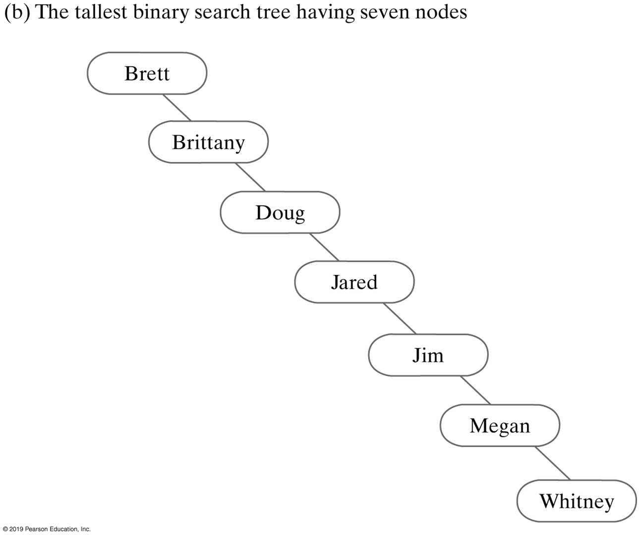
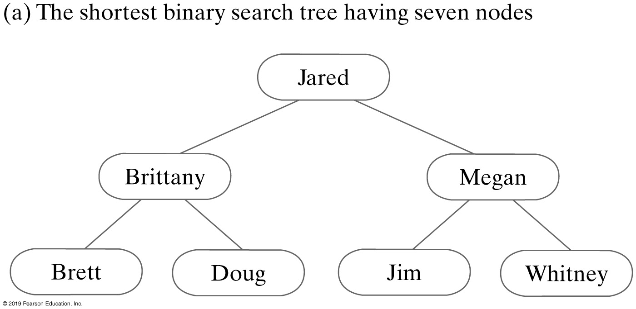
Efficiency of Operations
Operations are O(n)
Operations are O(log n)
FIGURE 26-13 Two binary search trees that contain the same data

Slide 48
End
Chapter 26

