Slide 1
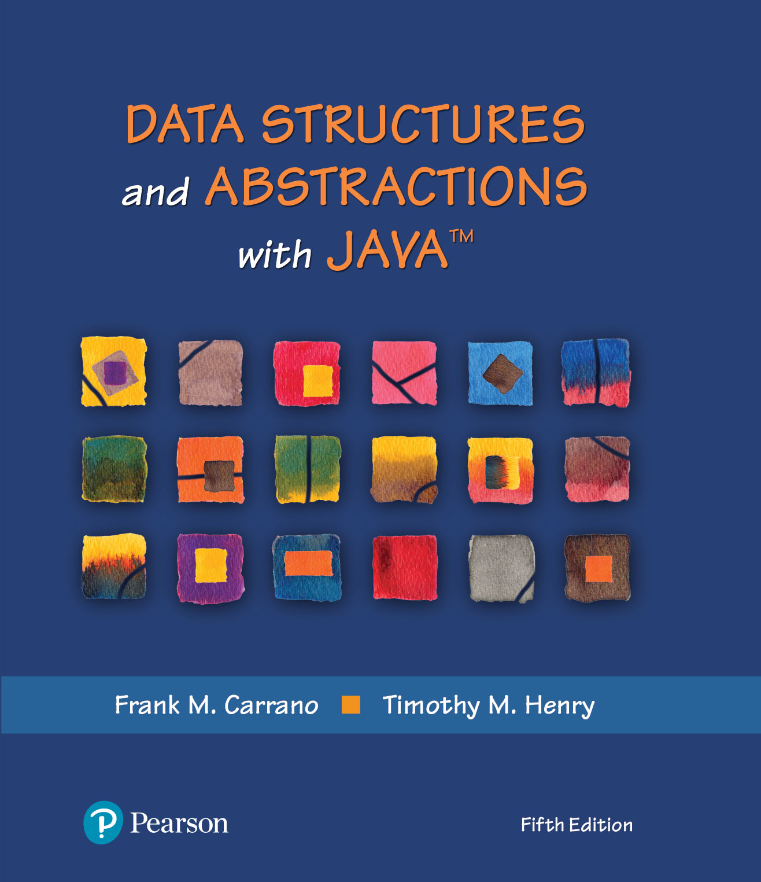
Data Structures and Abstractions with Java™
5th Edition
Chapter 27
A Heap Implementation

Slide 2
Heap and Maxheap
Heap
  Complete binary tree whose nodes contain Comparable objects
Maxheap
  Object in each node is greater than or equal to the objects in the node’s descendants

Slide 3
Heap and Maxheap
/** An interface for the ADT maxheap. */
public interface MaxHeapInterface<T extends Comparable<? super T>>
{ // See Segment 24.33 for a commented version.
public void add(T newEntry);
public T removeMax();
public T getMax();
public boolean isEmpty();
public int getSize();
public void clear();
} // end MaxHeapInterface
Interface for the ADT Maxheap

Slide 4
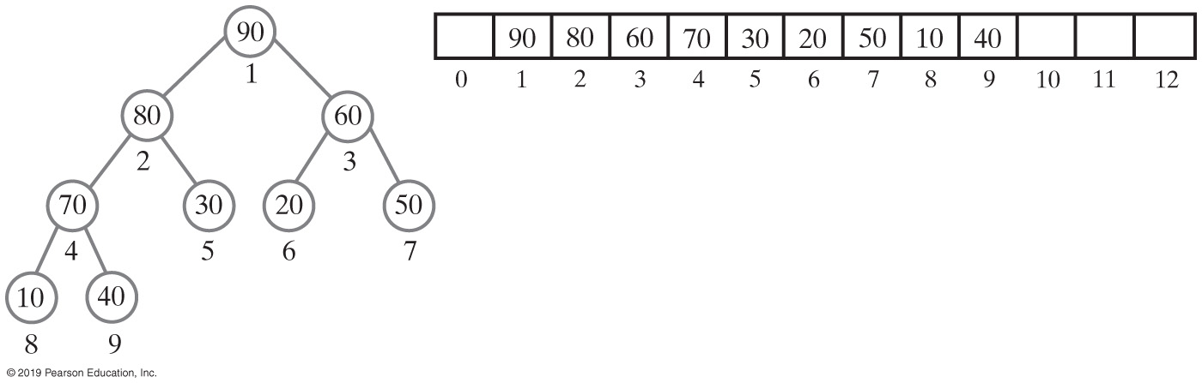
An Array to Represent a Heap
Use an array to represent a complete binary tree
Number nodes in the order in which a level-order traversal would visit them
Can locate either the children or the parent of any node
  Perform a simple computation on the node’s number
FIGURE 27-1 A complete binary tree with its nodes numbered in level order and its representation as an array

Slide 5
An Array to Represent a Heap (Part 1)
/** A class that implements the ADT maxheap by using an array. */
public final class MaxHeap<T extends Comparable<? super T>>
implements MaxHeapInterface<T>
{
private T[] heap; // Array of heap entries; ignore heap[0]
private int lastIndex; // Index of last entry and number of entries
private boolean integrityOK = false;
private static final int DEFAULT_CAPACITY = 25;
private static final int MAX_CAPACITY = 10000;
public MaxHeap(int initialCapacity)
{
// Is initialCapacity too small?
if (initialCapacity < DEFAULT_CAPACITY)
initialCapacity = DEFAULT_CAPACITY;
else // Is initialCapacity too big?
checkCapacity(initialCapacity);
// The cast is safe because the new array contains null entries
@SuppressWarnings("unchecked")
T[] tempHeap = (T[])new Comparable[initialCapacity + 1];
heap = tempHeap;
lastIndex = 0;
integrityOK = true;
} // end constructor
LISTING 27-1 The class MaxHeap, partially completed

Slide 6
An Array to Represent a Heap (Part 2)
public MaxHeap()
{
this(DEFAULT_CAPACITY); // Call next constructor
} // end default constructor
public T getMax()
{
checkIntegrity();
T root = null;
if (!isEmpty())
root = heap[1];
return root;
} // end getMax
public boolean isEmpty()
{
return lastIndex < 1;
} // end isEmpty
public int getSize()
{
return lastIndex;
} // end getSize
LISTING 27-1 The class MaxHeap, partially completed

Slide 7
An Array to Represent a Heap (Part 3)
public void add(T newEntry)
{
// Will address later — See Segment 27.8.
} // end add
public T removeMax()
{
// Will address later — See Segment 27.12.
} // end removeMax
public void clear()
{
checkIntegrity();
while (lastIndex > -1)
{
heap[lastIndex] = null;
lastIndex--;
} // end while
lastIndex = 0;
} // end clear
// Private methods
// . . .
} // end MaxHeap
LISTING 27-1 The class MaxHeap, partially completed

Slide 8
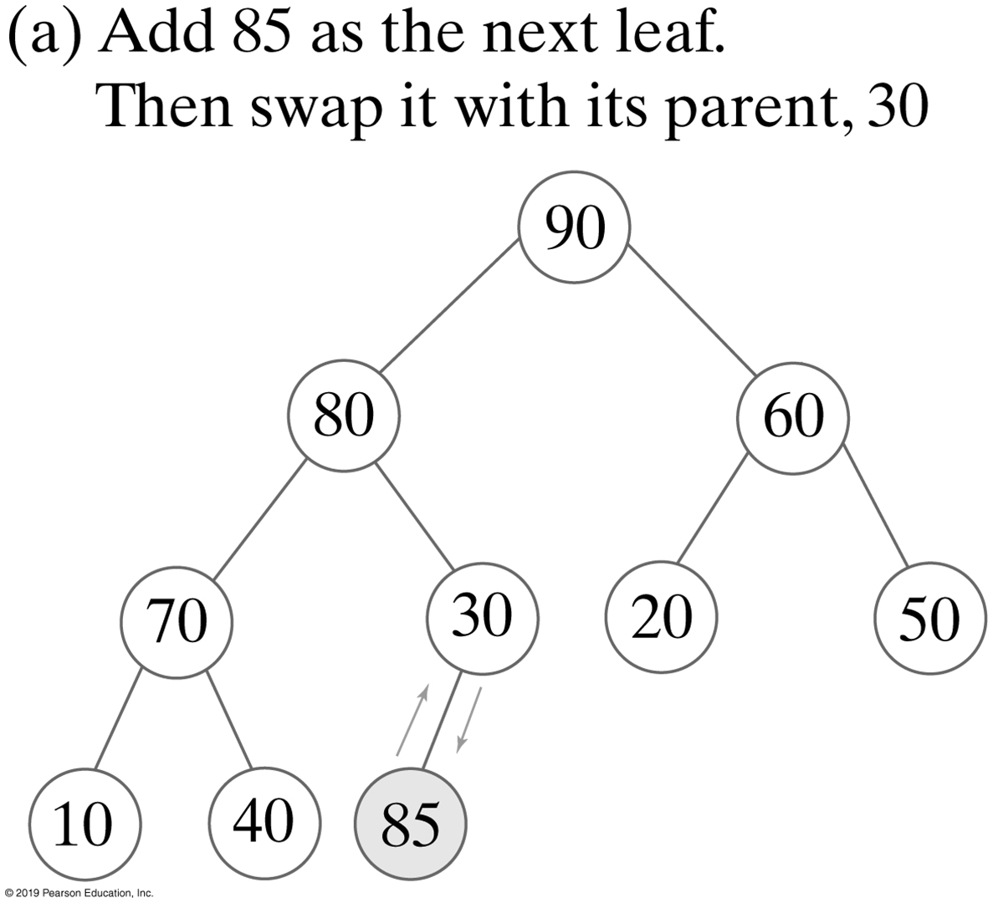
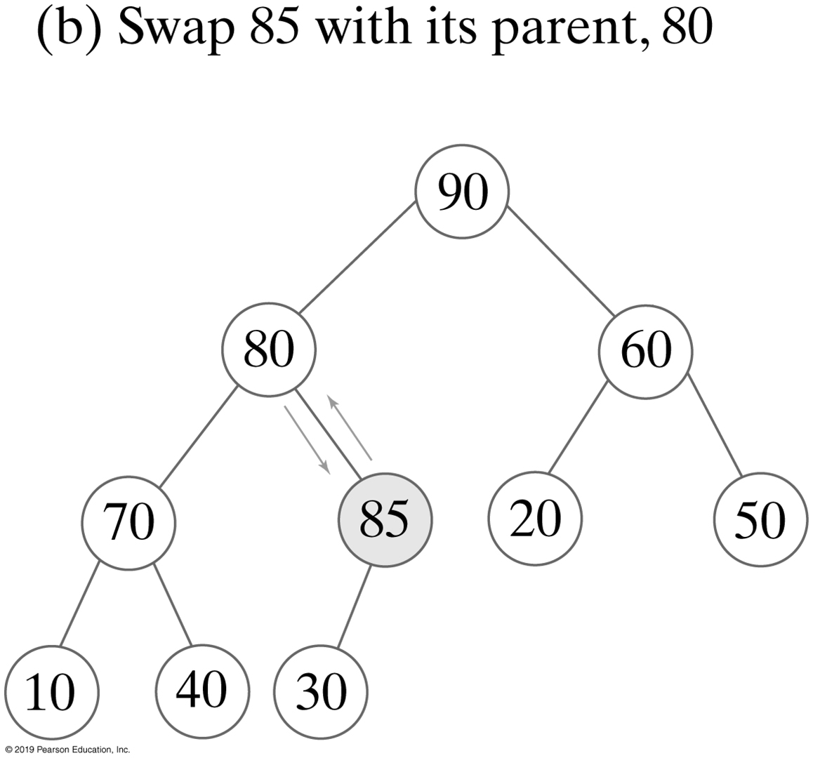
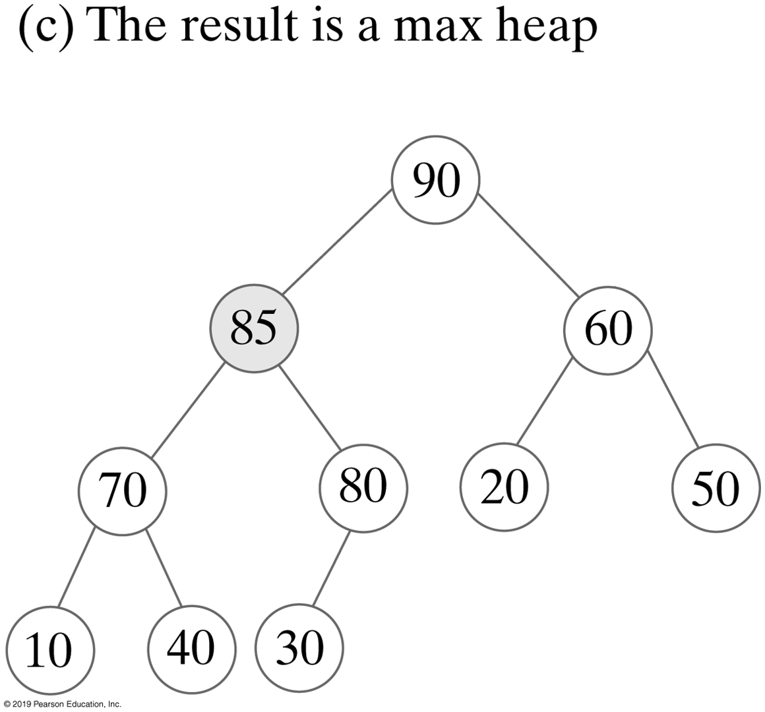
Adding an Entry
FIGURE 27-2 The steps in adding 85 to the maxheap in Figure 27-1a

Slide 9
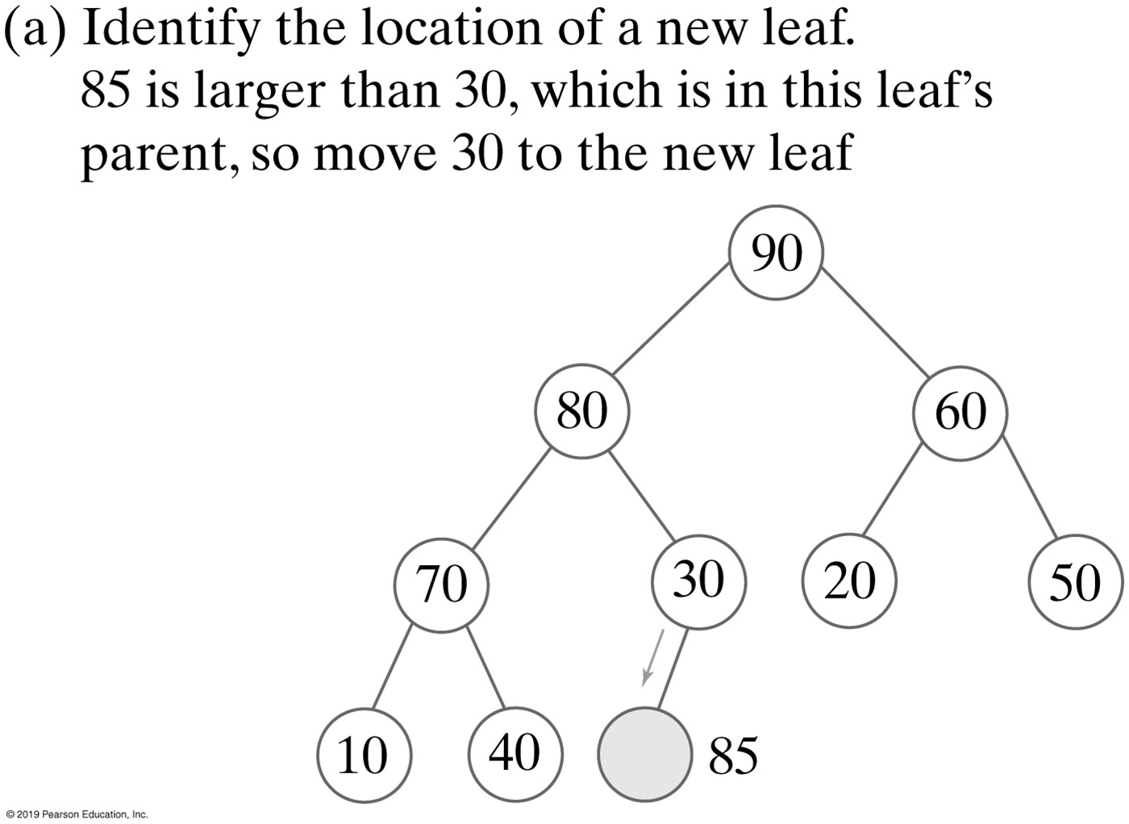
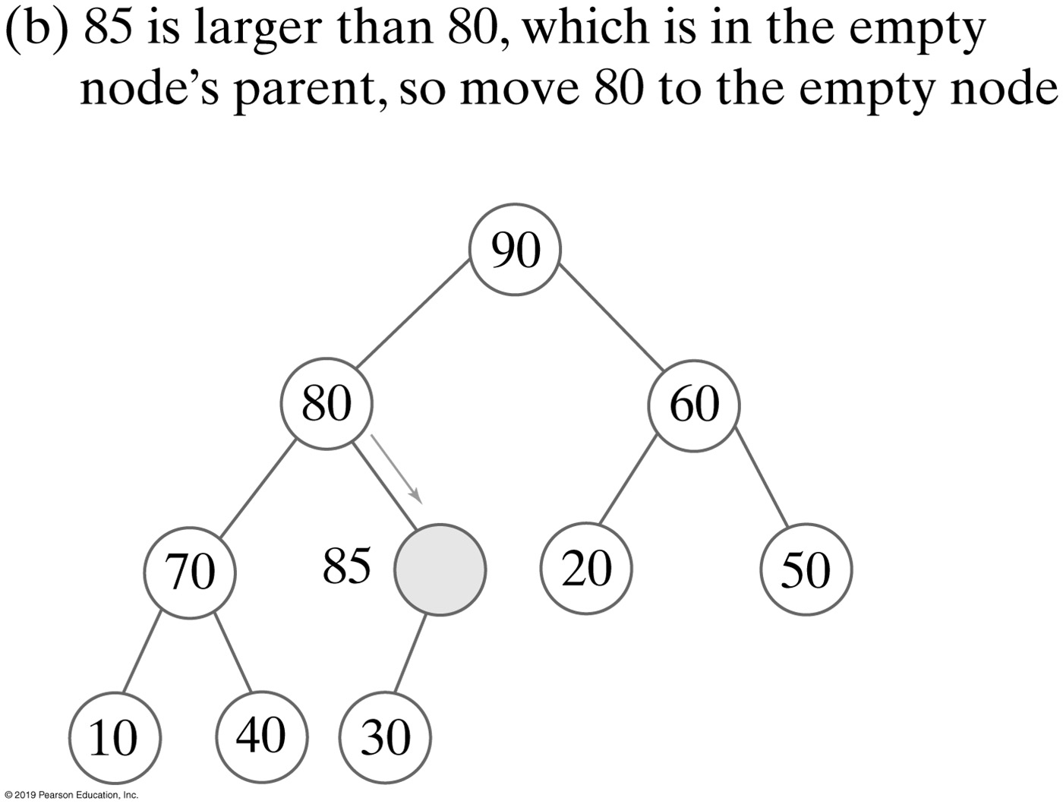
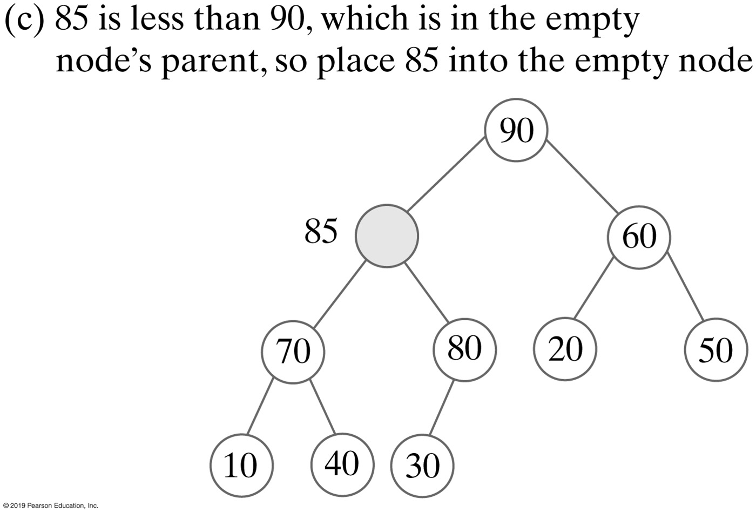
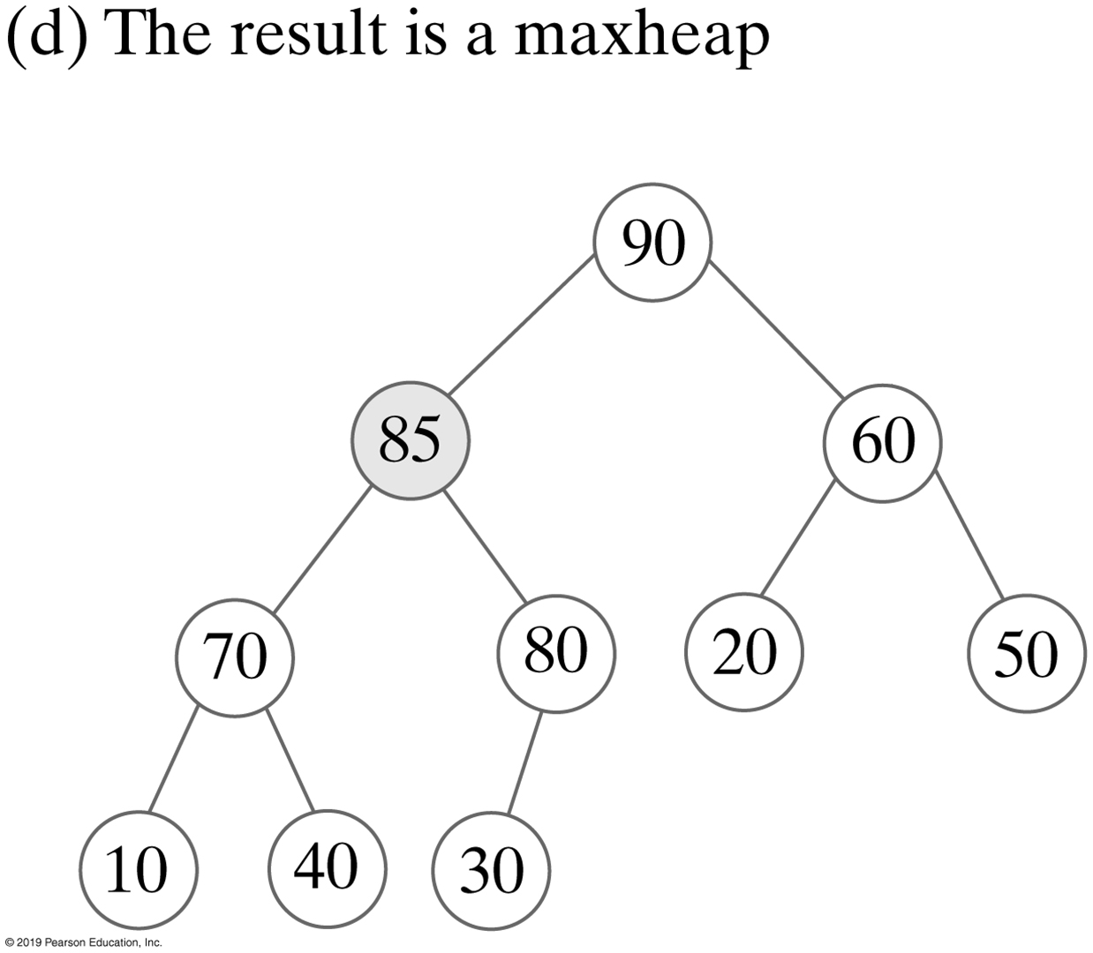
Adding an Entry without Swaps
FIGURE 27-3 A revision of the steps to add 85, as shown in Figure 27-2, to avoid swaps

Slide 10
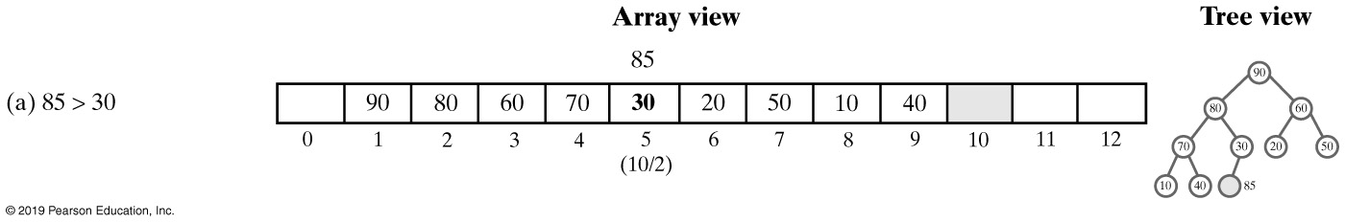
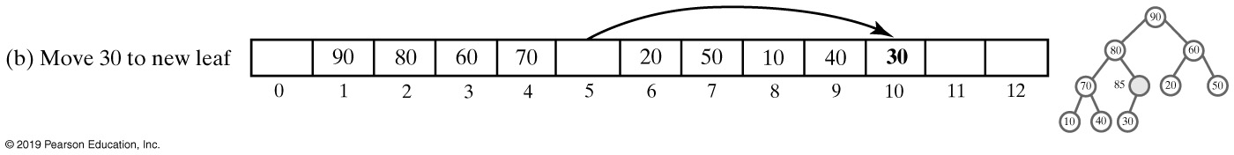
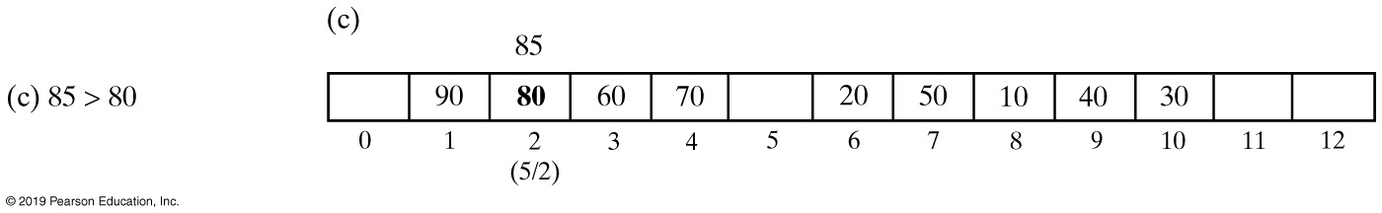
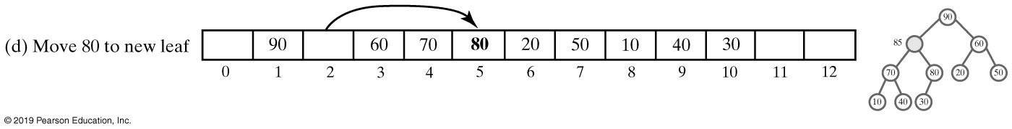
Adding an Entry to Heap (Part 1)
FIGURE 27-4 An array representation of the steps in Figure 27-3

Slide 11
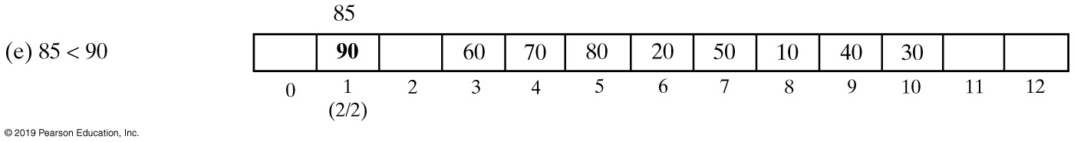
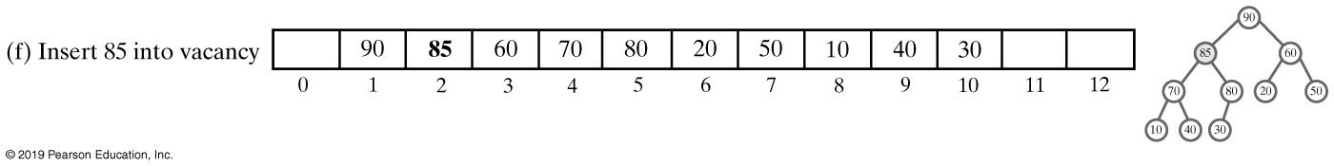
Adding an Entry to Heap (Part 2)
FIGURE 27-4 An array representation of the steps in Figure 27-3

Slide 12
Adding an Entry
Algorithm add(newEntry)
// Precondition: The array heap has room for another entry.
newIndex = index of next available array location
parentIndex = newIndex/2 // Index of parent of available location
while (parentIndex > 0 and newEntry > heap[parentIndex])
{
    heap[newIndex] = heap[parentIndex] // Move parent to available location
    // Update indices
    newIndex = parentIndex parentIndex = newIndex/2
}
heap[newIndex] = newEntry // Place new entry in correct location
if (the array heap is full)
    Double the size of the array
Algorithm to add a new entry to a heap

Slide 13
Adding an Entry
public void add(T newEntry)
{
checkIntegrity(); // Ensure initialization of data fields
int newIndex = lastIndex + 1;
int parentIndex = newIndex / 2;
while ( (parentIndex > 0) && newEntry.compareTo(heap[parentIndex]) > 0)
{
heap[newIndex] = heap[parentIndex];
newIndex = parentIndex;
parentIndex = newIndex / 2;
} // end while
heap[newIndex] = newEntry;
lastIndex++;
ensureCapacity();
} // end add
The method add

Slide 14
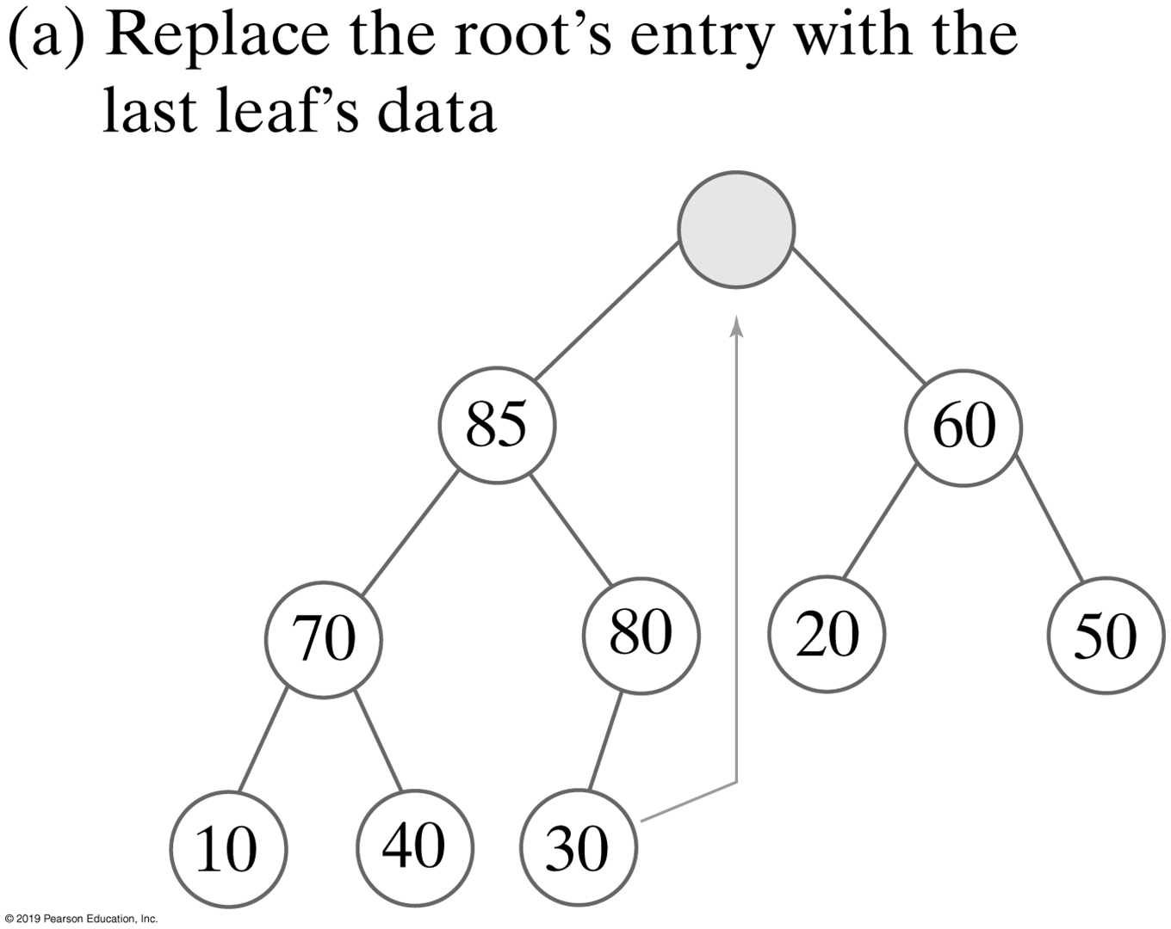
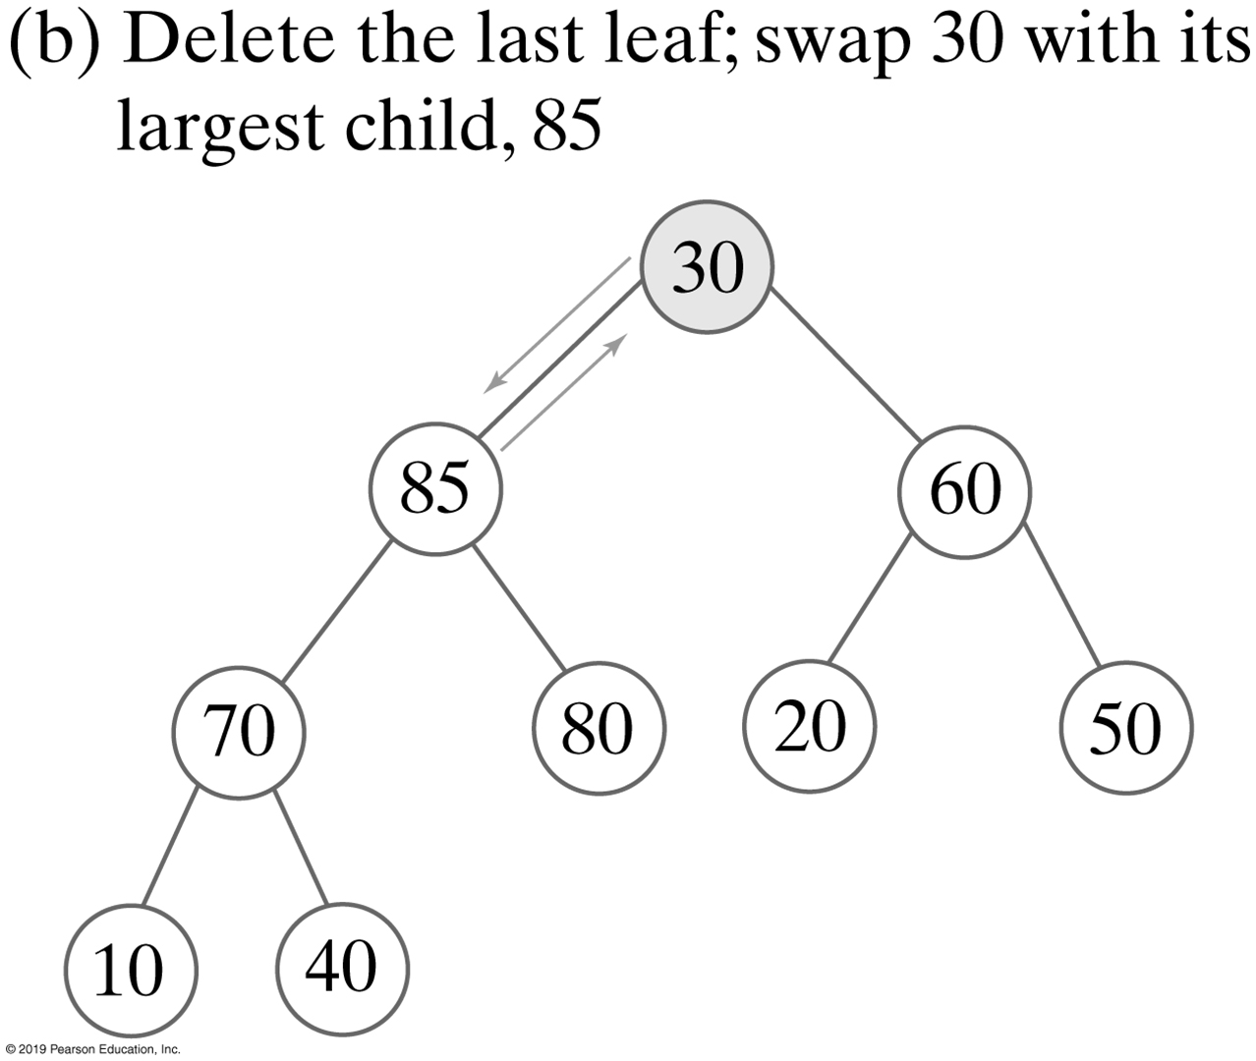
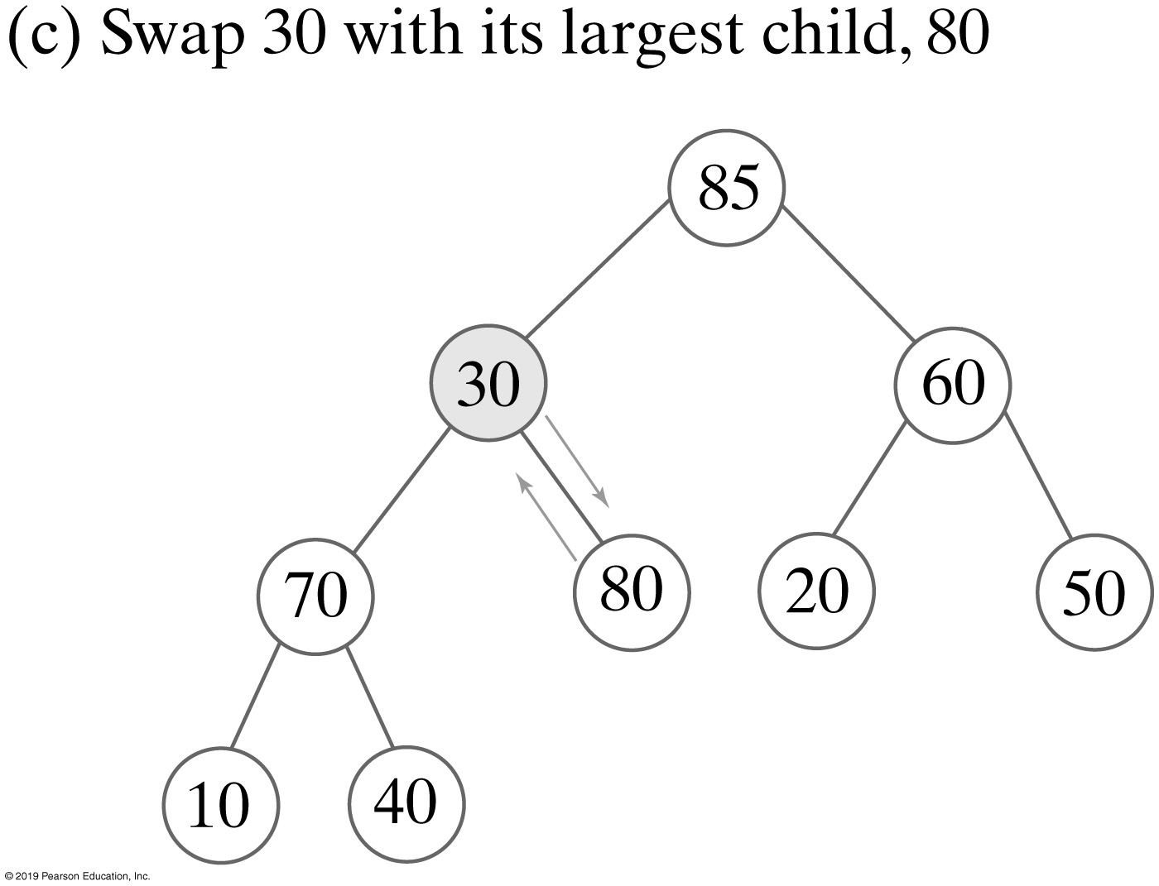
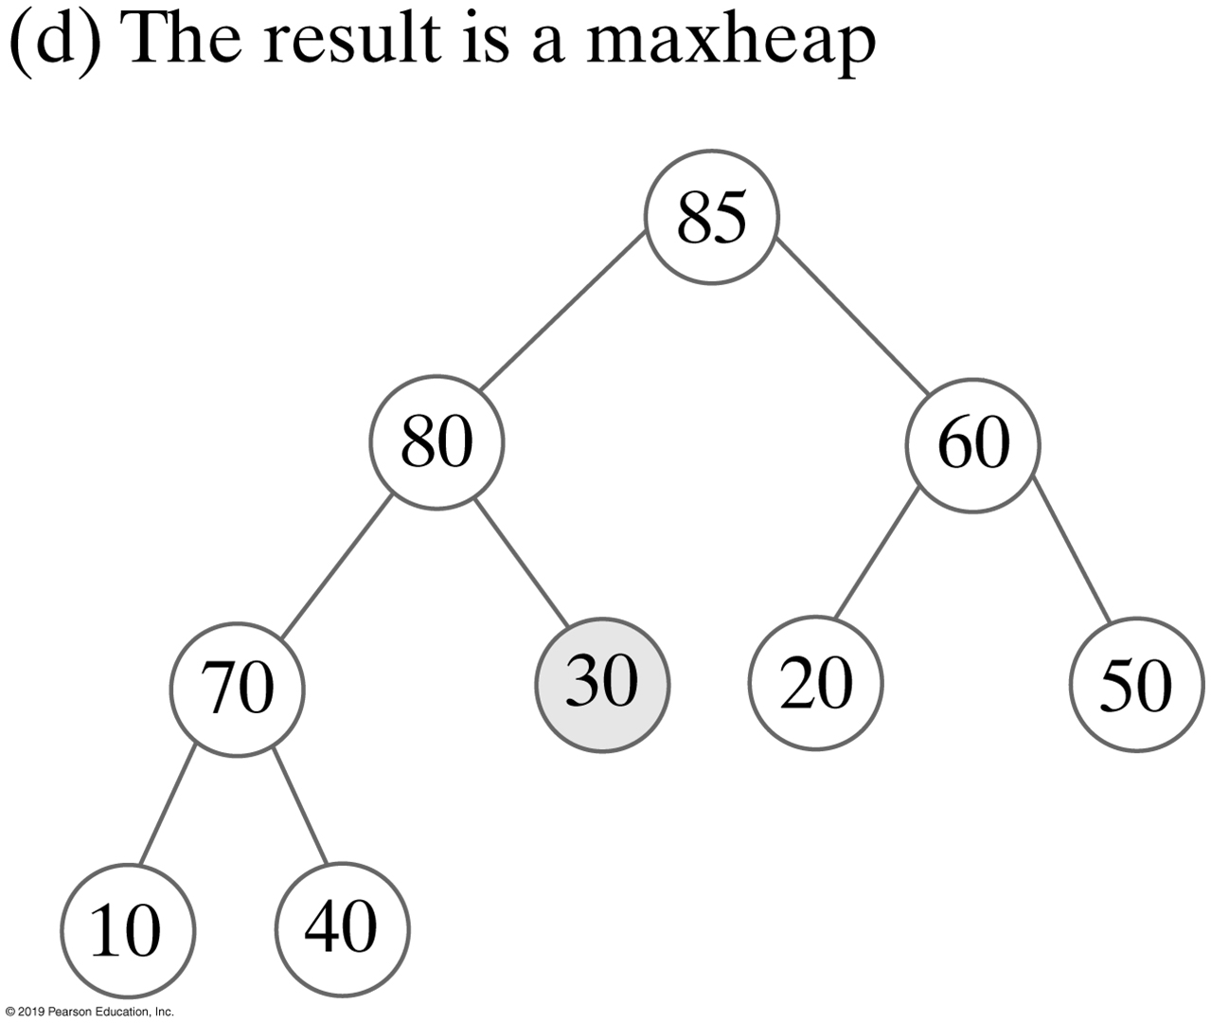
Removing a Value from A Heap
FIGURE 27-5 The steps to remove the entry in the root of the maxheap in Figure 27-3d

Slide 15
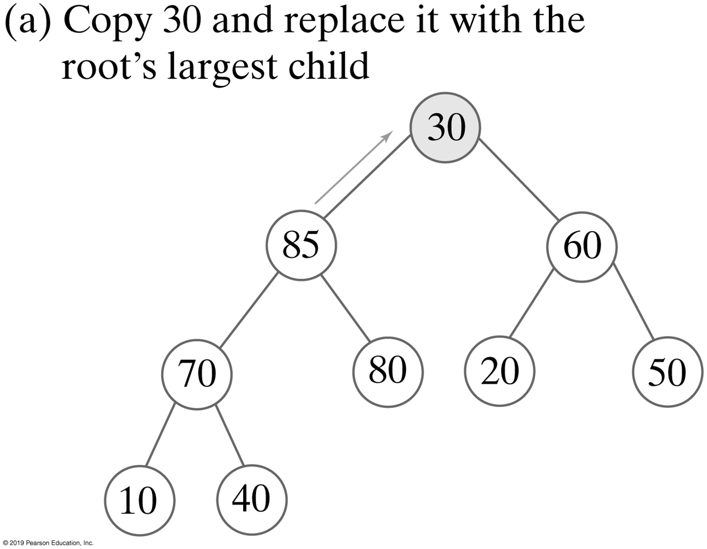
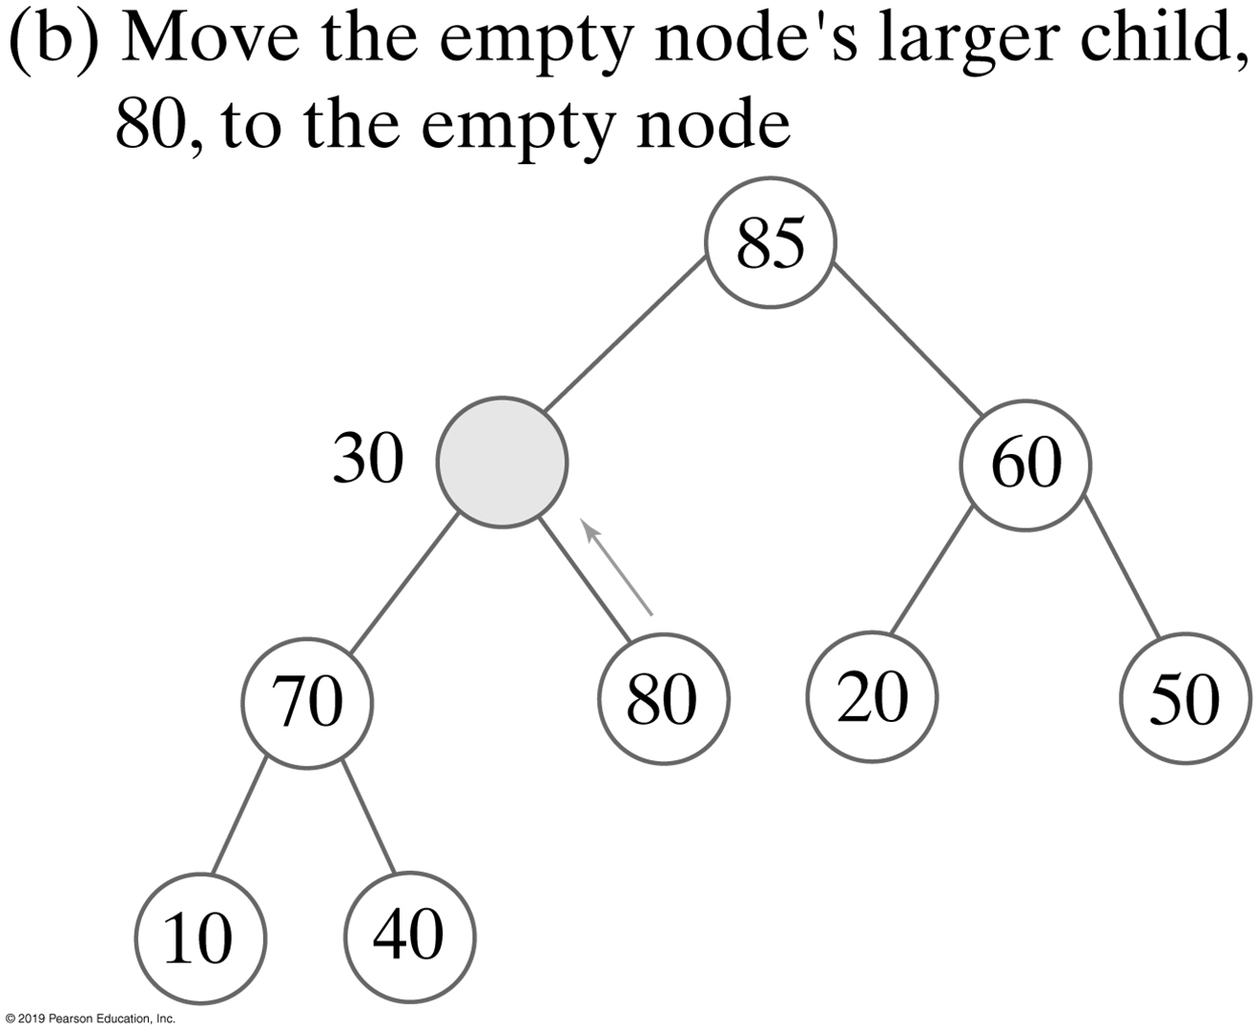
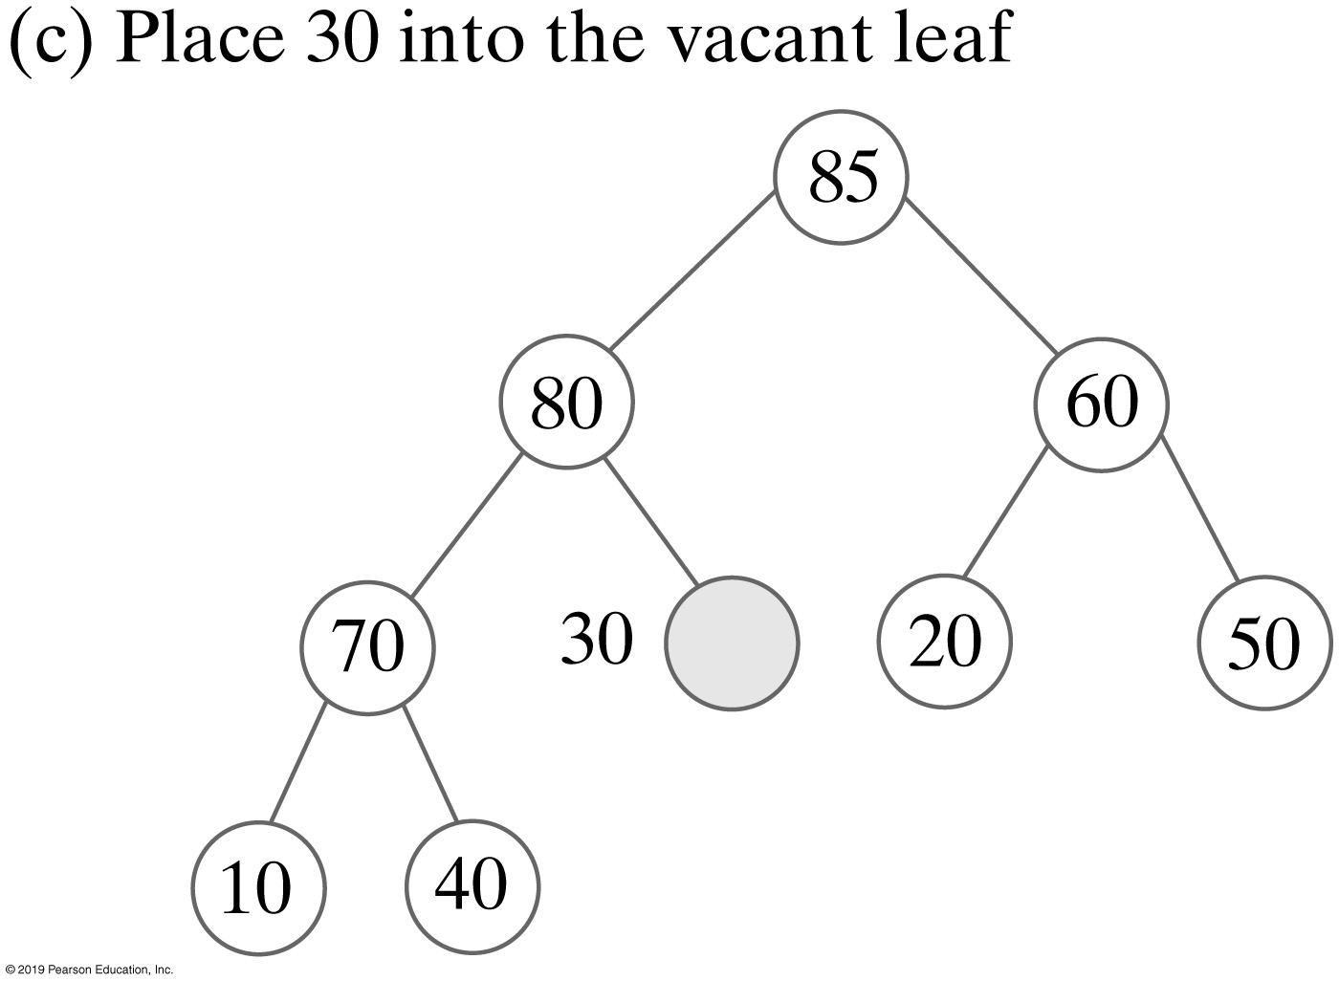
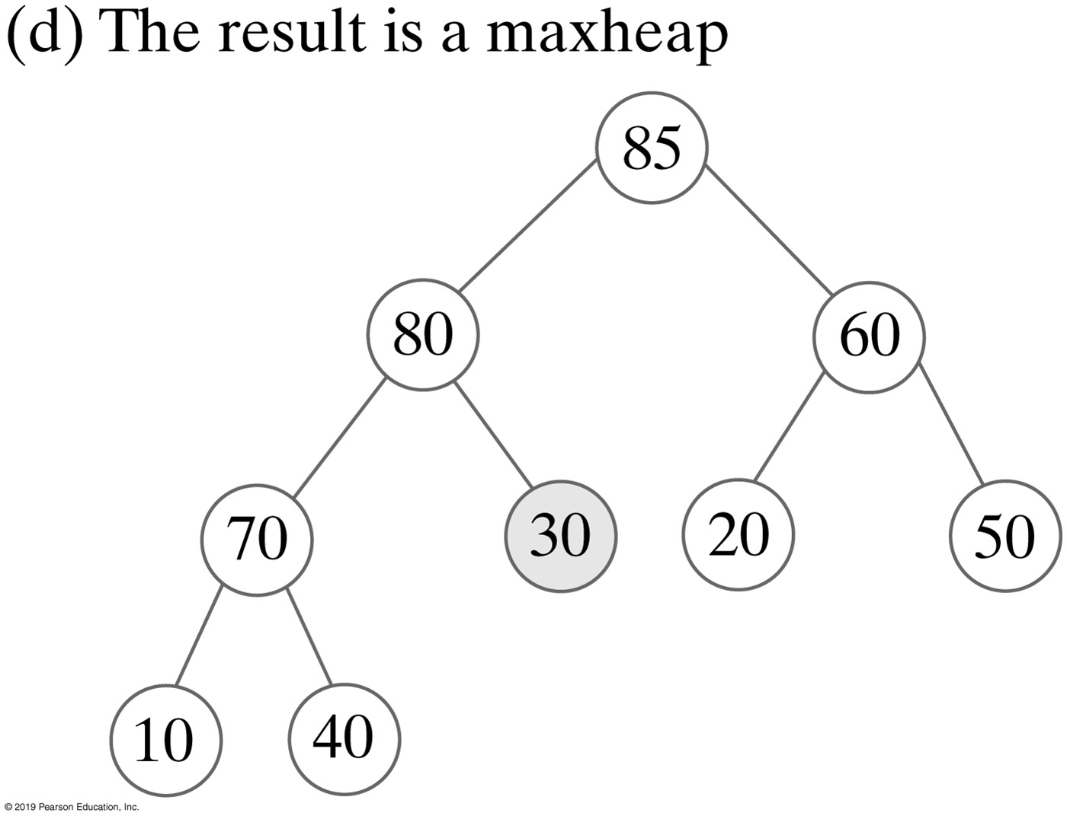
Removing a Value without Swaps
FIGURE 27-6 The steps to transform the semiheap in Figure 27-5b into a heap without using swaps

Slide 16
Removing the Root
Algorithm reheap(rootIndex)
// Transforms the semiheap rooted at rootIndex into a heap
done = false
orphan = heap[rootIndex]
while (!done and heap[rootIndex] has a child)
{
largerChildIndex = index of the larger child of heap[rootIndex]
if (orphan < heap[largerChildIndex])
{
heap[rootIndex] = heap[largerChildIndex]
rootIndex = largerChildIndex
}
else
done = true
}
heap[rootIndex] = orphan
Algorithm to transform a semiheap to a heap

Slide 17
Removing the Root
private void reheap(int rootIndex)
{
boolean done = false;
T orphan = heap[rootIndex];
int leftChildIndex = 2 * rootIndex;
while (!done && (leftChildIndex <= lastIndex) )
{
int largerChildIndex = leftChildIndex; // Assume larger
int rightChildIndex = leftChildIndex + 1;
if ( (rightChildIndex <= lastIndex) &&
heap[rightChildIndex].compareTo(heap[largerChildIndex]) > 0)
{
largerChildIndex = rightChildIndex;
} // end if
if (orphan.compareTo(heap[largerChildIndex]) < 0)
{
heap[rootIndex] = heap[largerChildIndex];
rootIndex = largerChildIndex;
leftChildIndex = 2 * rootIndex;
}
else
done = true;
} // end while
heap[rootIndex] = orphan;
} // end reheap
Implementation of the reheap algorithm as a private method

Slide 18
Removing the Root
public T removeMax()
{
checkIntegrity(); // Ensure initialization of data fields
T root = null;
if (!isEmpty())
{
root = heap[1]; // Return value
heap[1] = heap[lastIndex]; // Form a semiheap
lastIndex--; // Decrease size
reheap(1); // Transform to a heap
} // end if
return root;
} // end removeMax
Implementation of the removeMax method

Slide 19
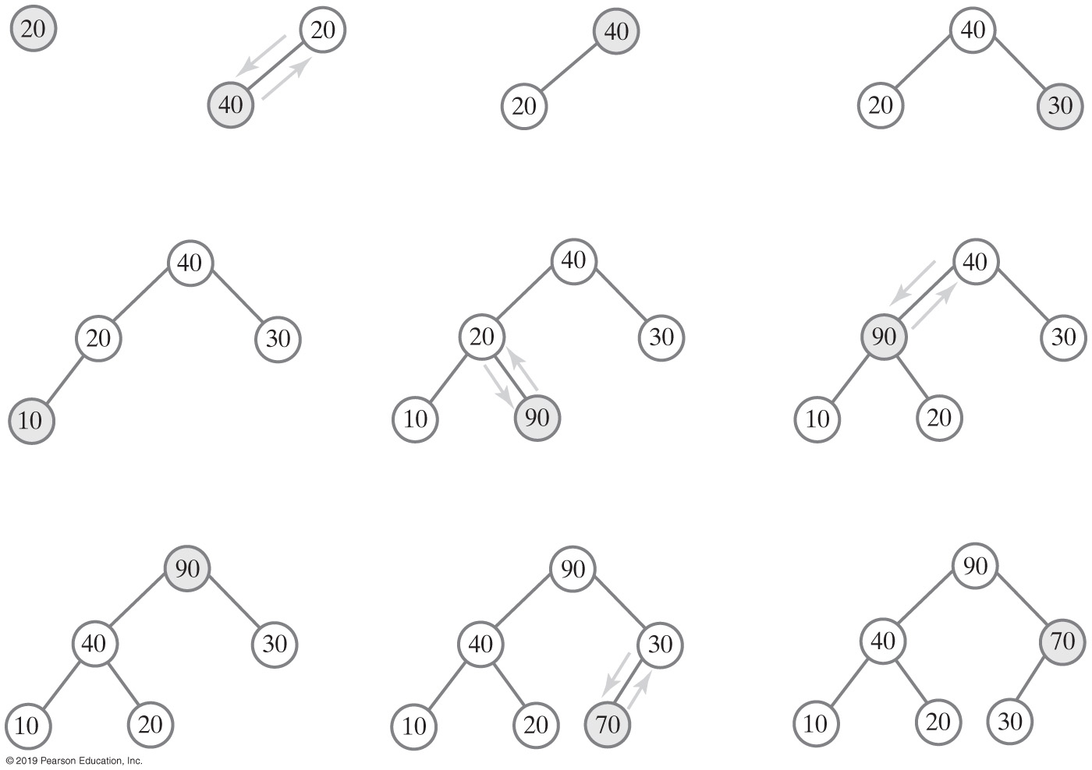
Creating a Heap
FIGURE 27-7 The steps in adding 20, 40, 30, 10, 90, and 70 to an initially empty heap

Slide 20
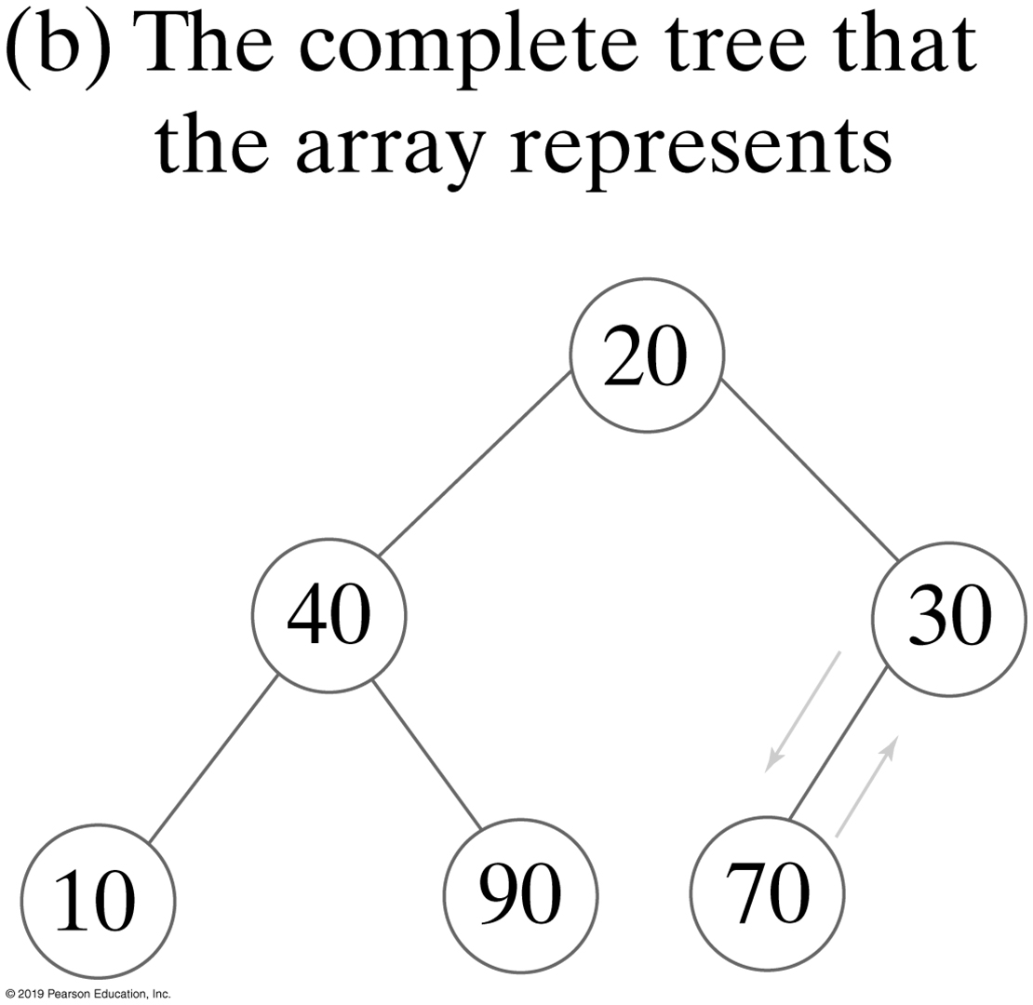
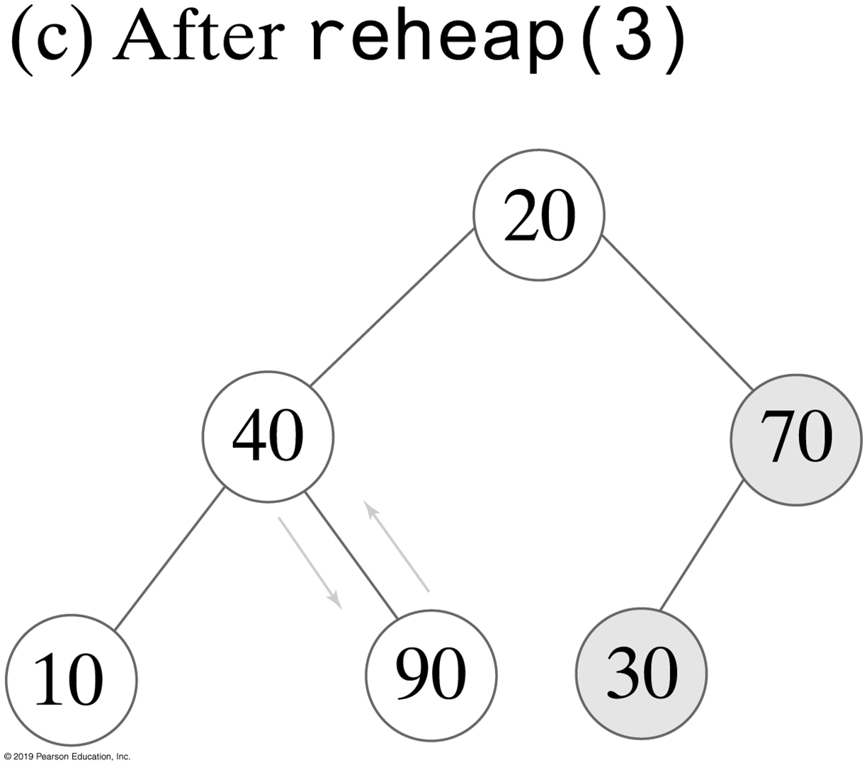
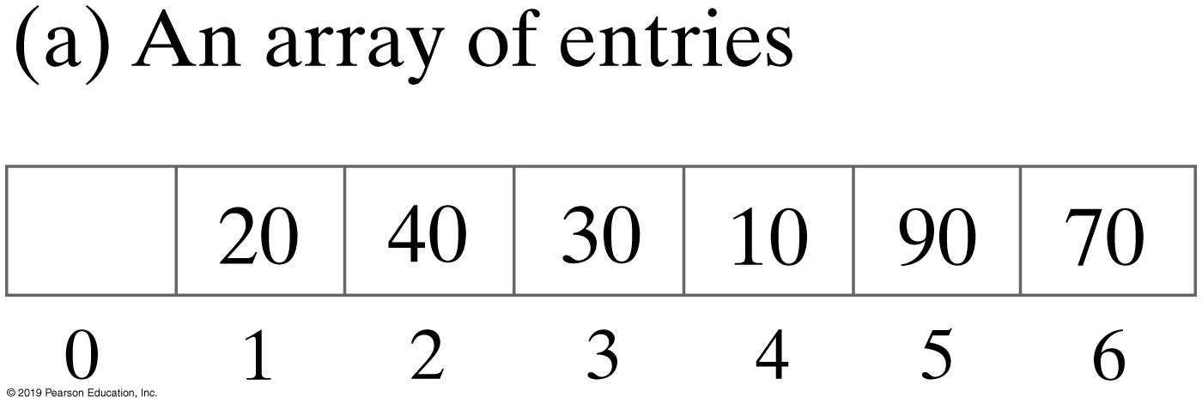
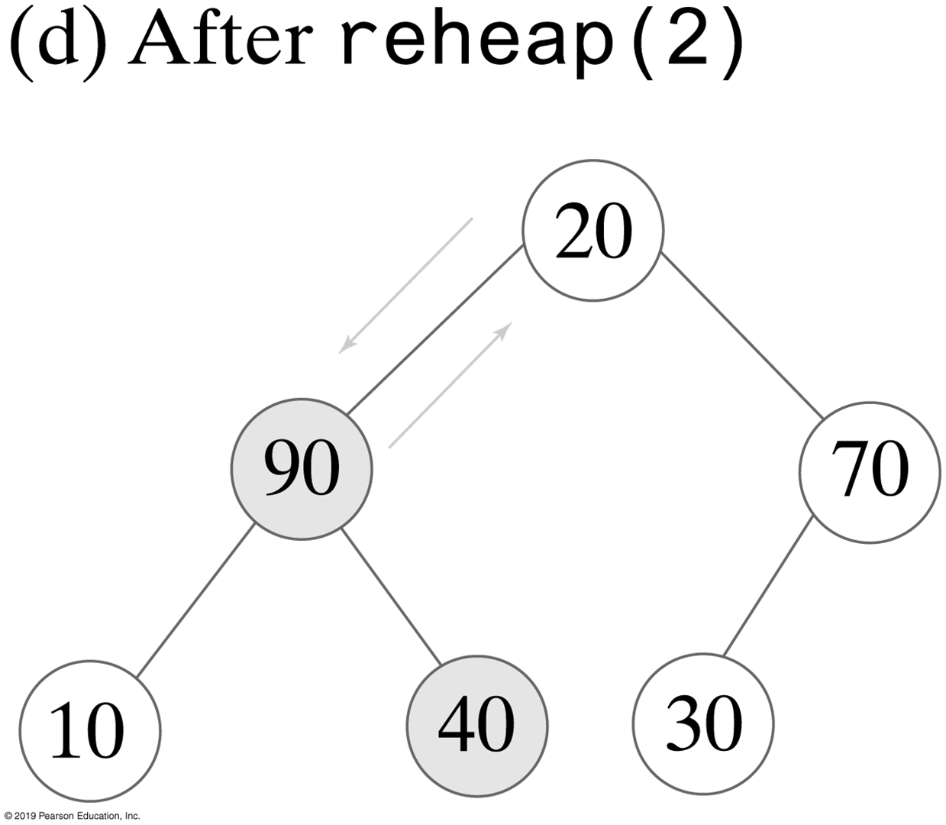
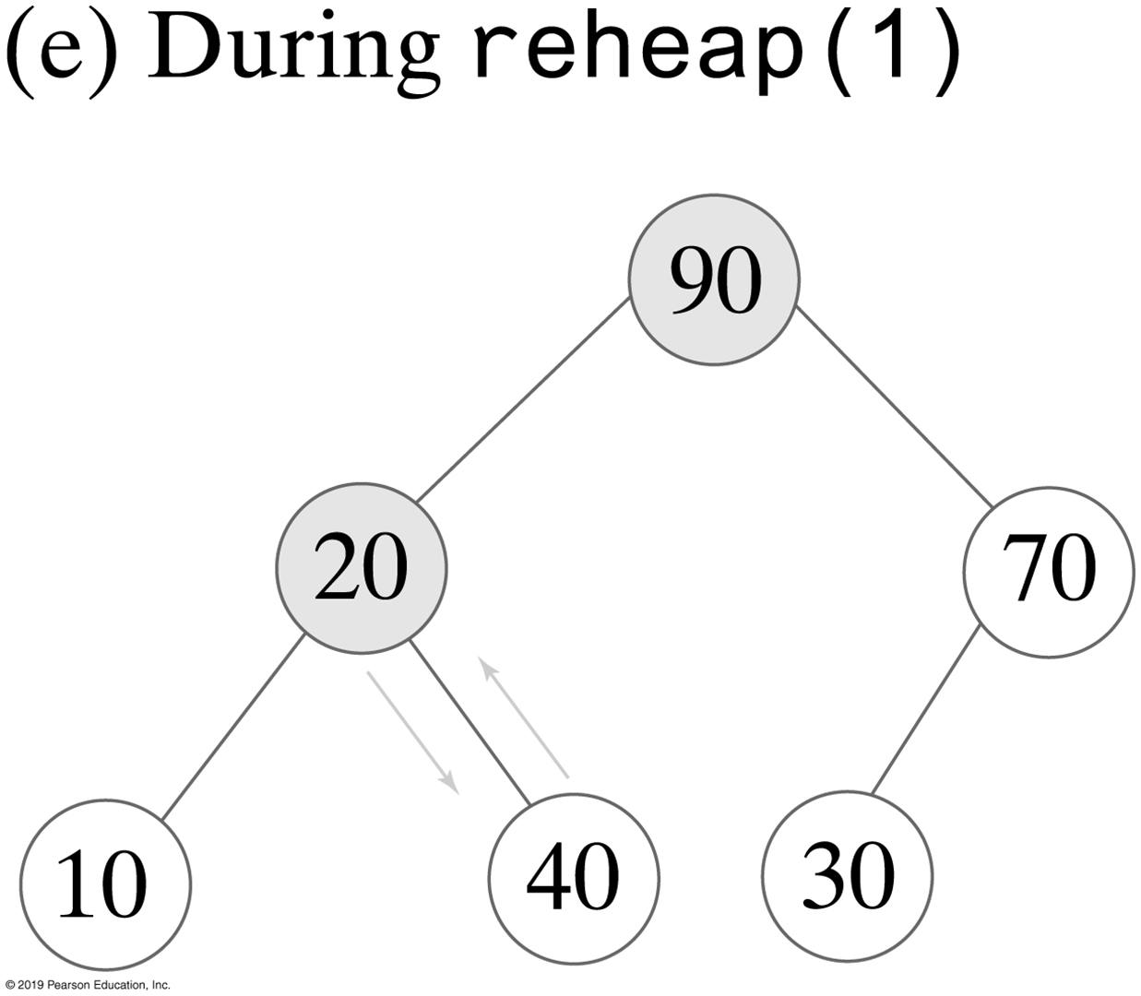
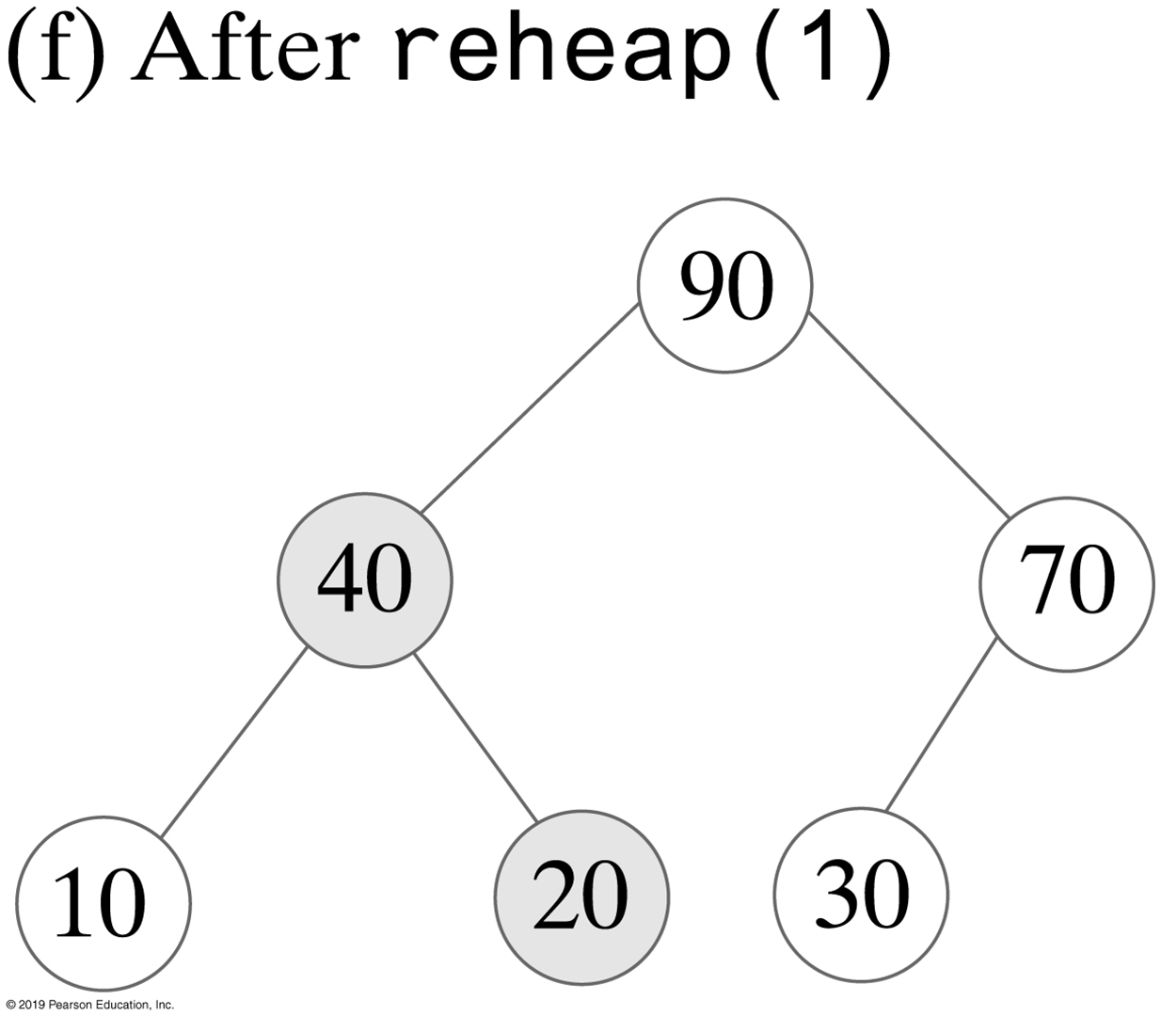
Creating a Heap
FIGURE 27-8 The steps in creating a heap of the entries 20, 40, 30, 10, 90, and 70 by using reheap

Slide 21
Creating a Heap
public MaxHeap(T[] entries)
{
this(entries.length); // Call other constructor
lastIndex = entries.length;
// Assertion: integrityOK = true
// Copy given array to data field
for (int index = 0; index < entries.length; index++)
heap[index + 1] = entries[index];
// Create heap
for (int rootIndex = lastIndex / 2; rootIndex > 0; rootIndex--)
reheap(rootIndex);
} // end constructor
Another constructor for the class MaxHeap

Slide 22
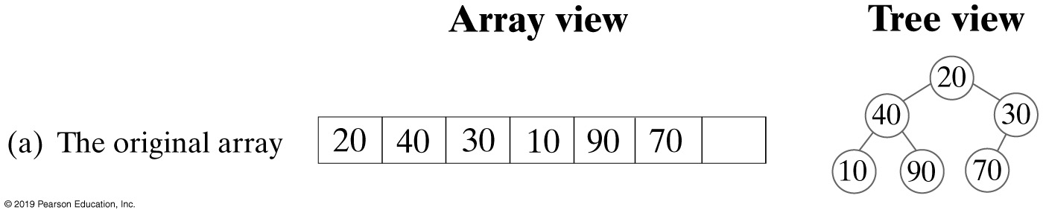
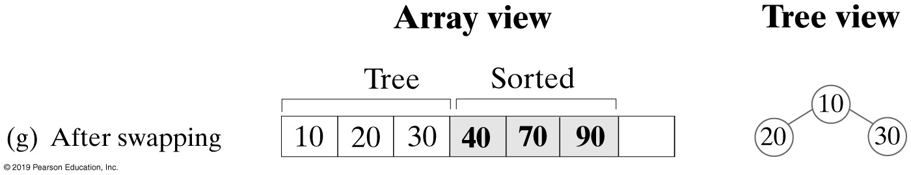
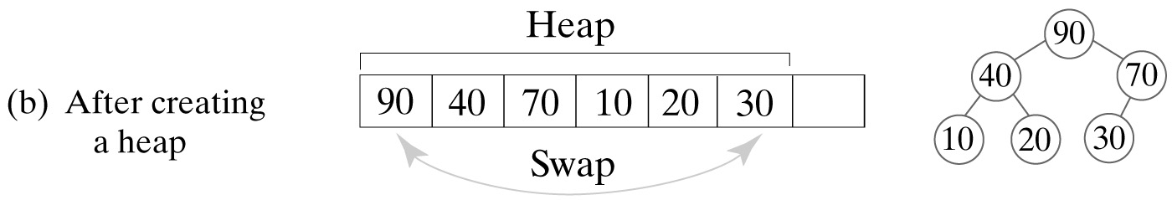
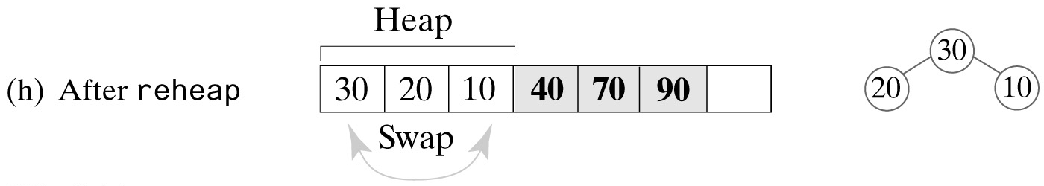
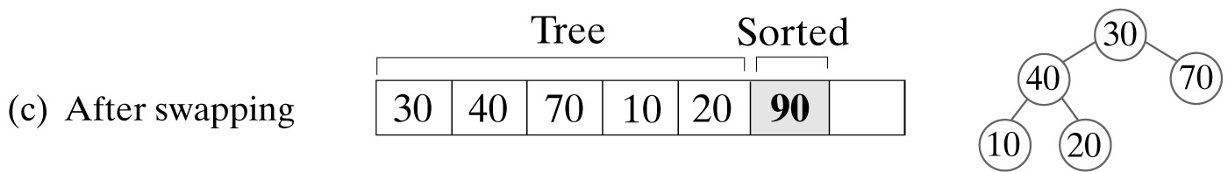
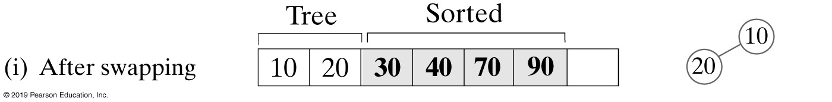
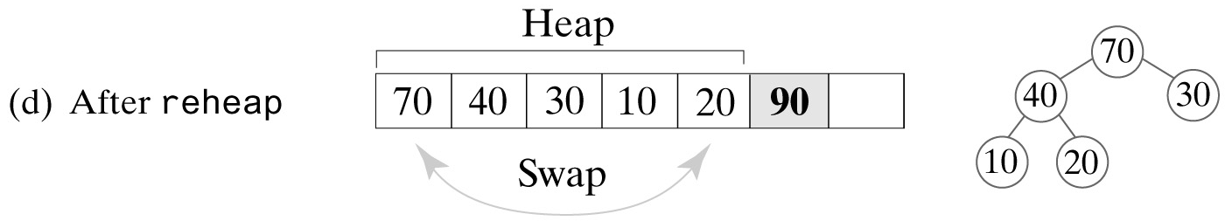
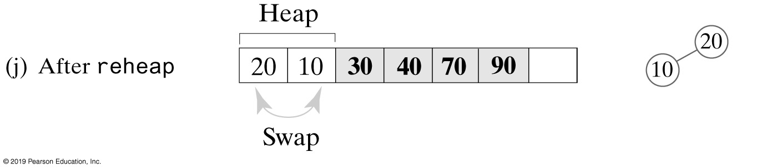
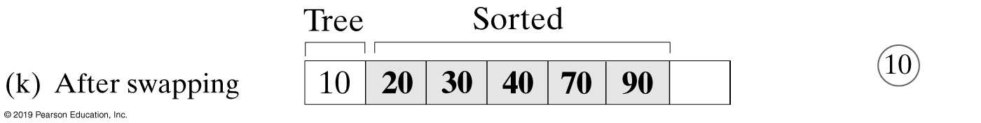
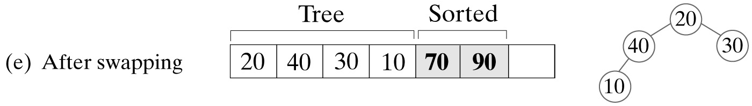
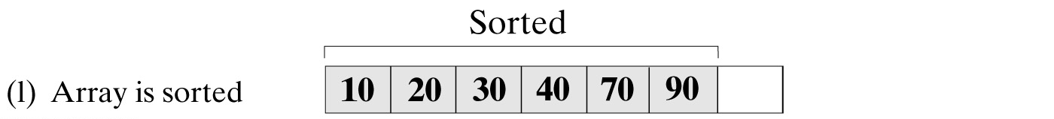
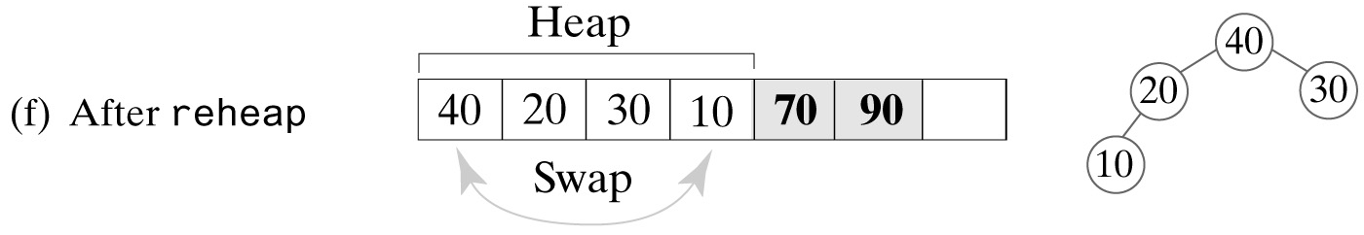
Heap Sort
FIGURE 27-9 A trace of heap sort

Slide 23
Heap Sort - Revised reheap Method
private static <T extends Comparable<? super T>>
void reheap(T[] heap, int rootIndex, int lastIndex)
{
boolean done = false;
T orphan = heap[rootIndex];
int leftChildIndex = 2 * rootIndex + 1;
while (!done && (leftChildIndex <= lastIndex))
{
int largerChildIndex = leftChildIndex;
int rightChildIndex = leftChildIndex + 1;
if ( (rightChildIndex <= lastIndex) &&
heap[rightChildIndex].compareTo(heap[largerChildIndex]) > 0)
{
largerChildIndex = rightChildIndex;
} // end if
if (orphan.compareTo(heap[largerChildIndex]) < 0)
{
heap[rootIndex] = heap[largerChildIndex];
rootIndex = largerChildIndex;
leftChildIndex = 2 * rootIndex + 1;
}
else
done = true;
} // end while
heap[rootIndex] = orphan;
} // end reheap

Slide 24
Heap Sort
public static <T extends Comparable<? super T>>
void heapSort(T[] array, int n)
{
// Create first heap
for (int rootIndex = n / 2 - 1; rootIndex >= 0; rootIndex--)
reheap(array, rootIndex, n - 1);
swap(array, 0, n - 1);
for (int lastIndex = n - 2; lastIndex > 0; lastIndex--)
{
reheap(array, 0, lastIndex);
swap(array, 0, lastIndex);
} // end for
} // end heapSort
The heapSort method with time efficiency is O(n log n)

Slide 25
End
Chapter 27

