Slide 1

Data Structures and Abstractions with Java™
5th Edition
Chapter 28
Balanced Search Trees

Slide 2
AVL Trees
Possible to form several differently shaped binary search trees
From the same collection of data
AVL tree is a binary search tree that
Rearranges its nodes whenever it becomes unbalanced.

Slide 3
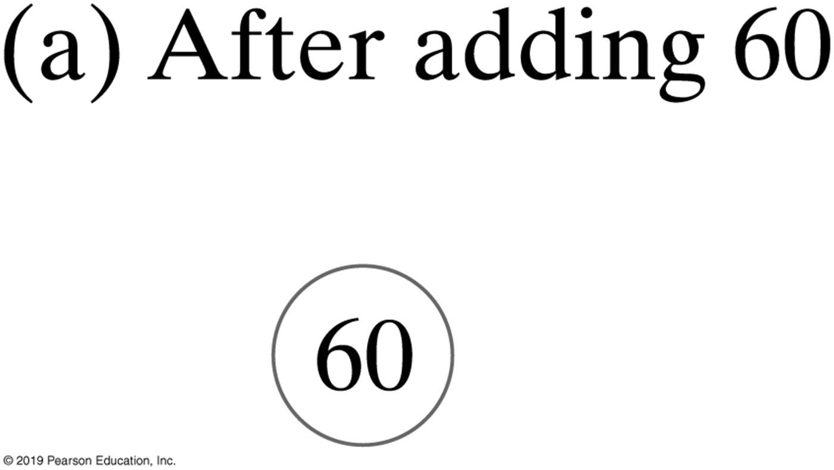
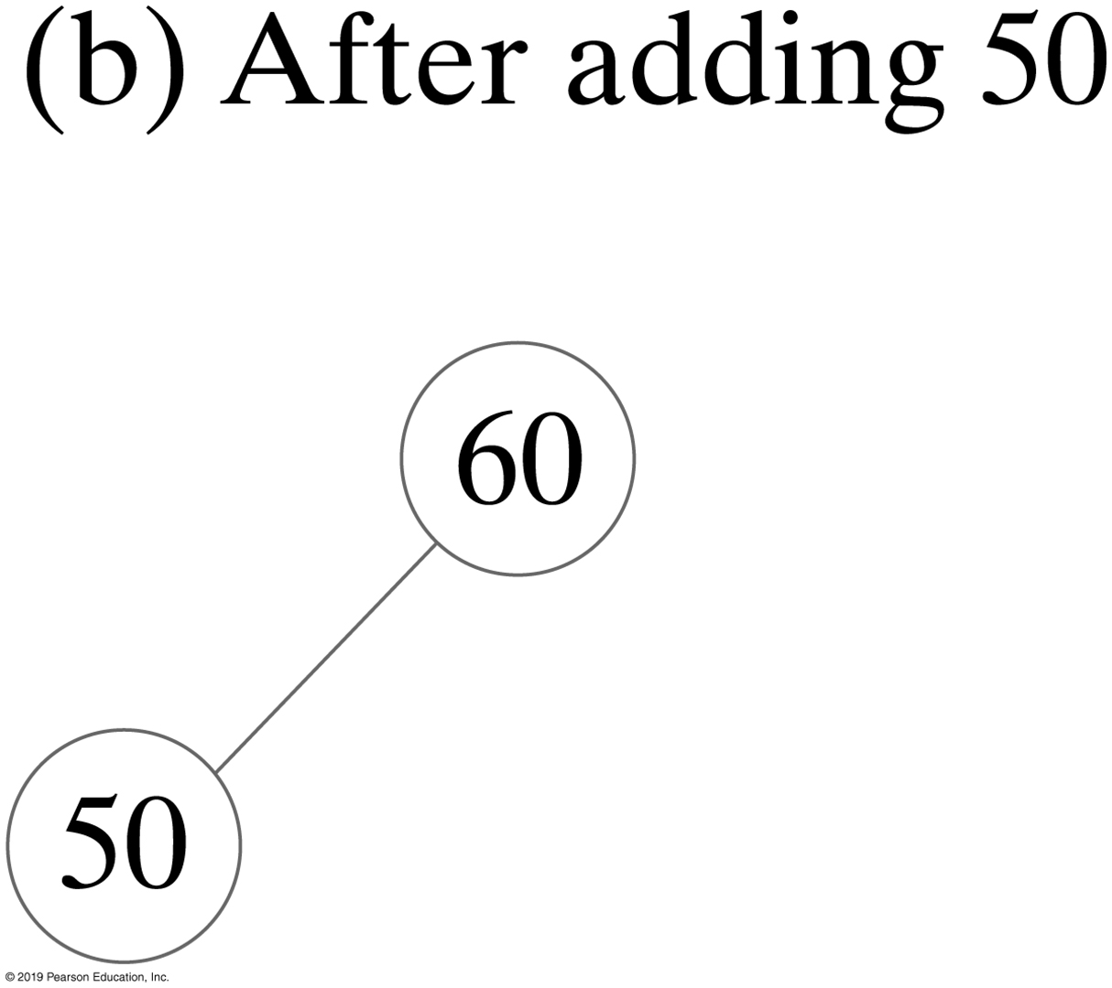
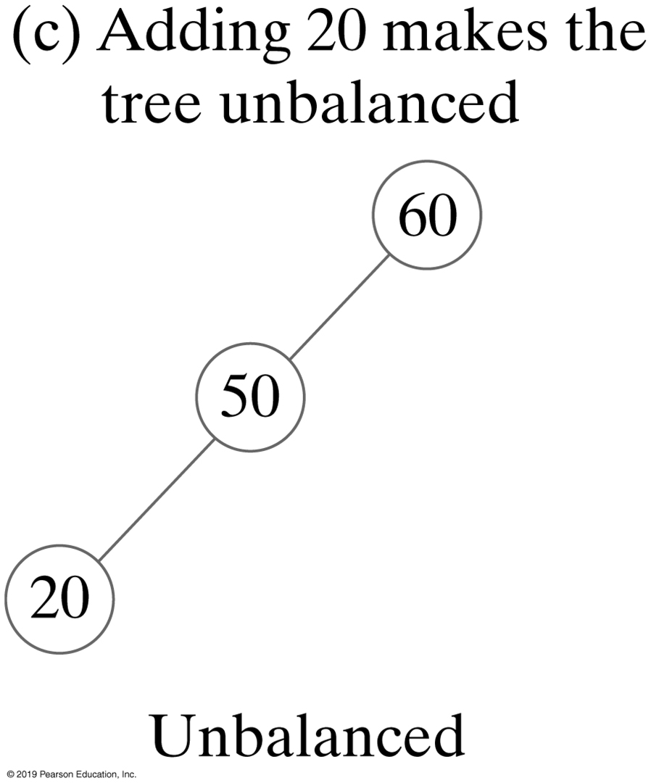
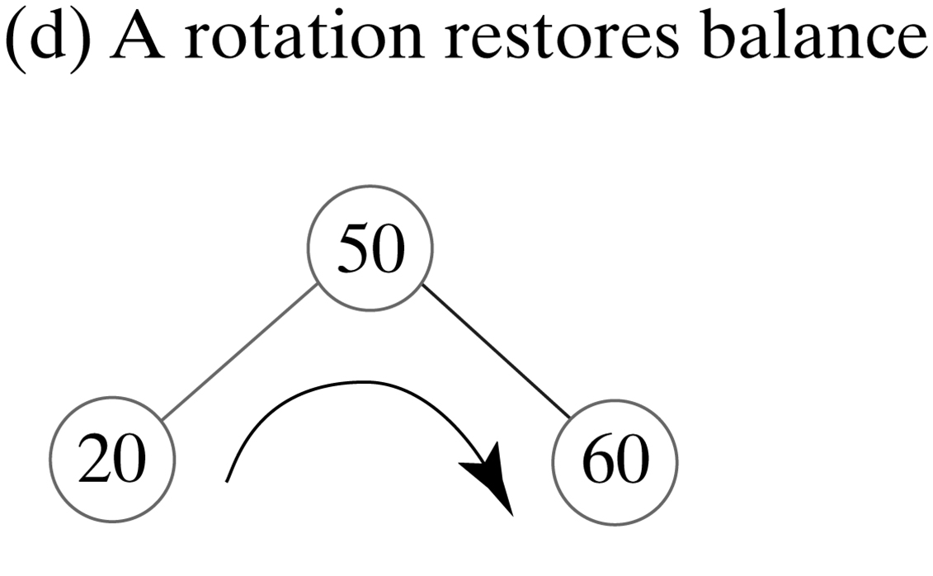
Single AVL Tree Rotations
FIGURE 28-1 Additions to an initially empty AVL tree

Slide 4
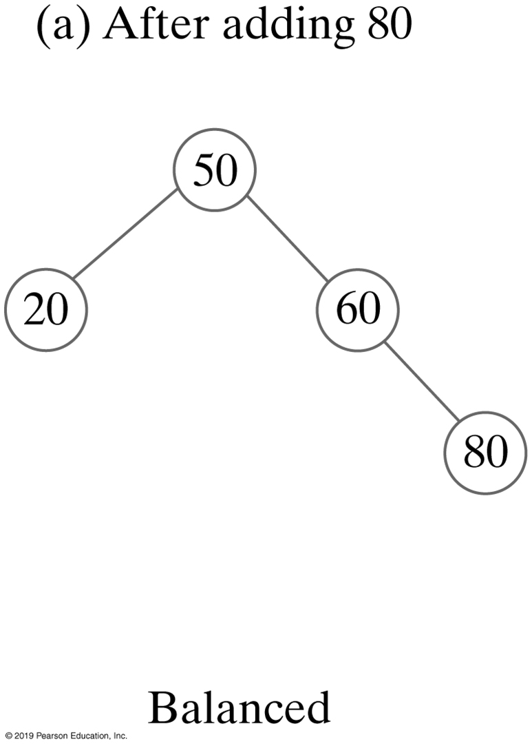
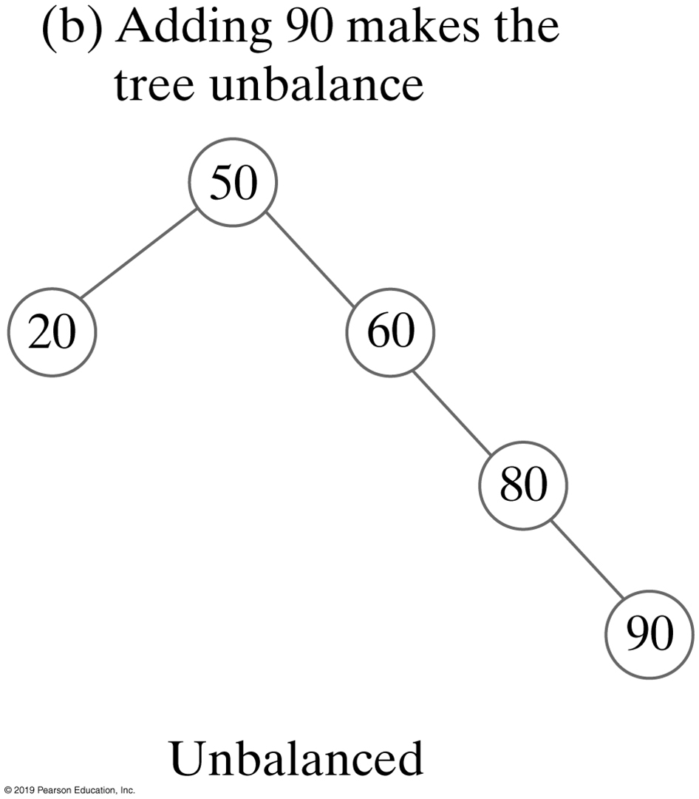
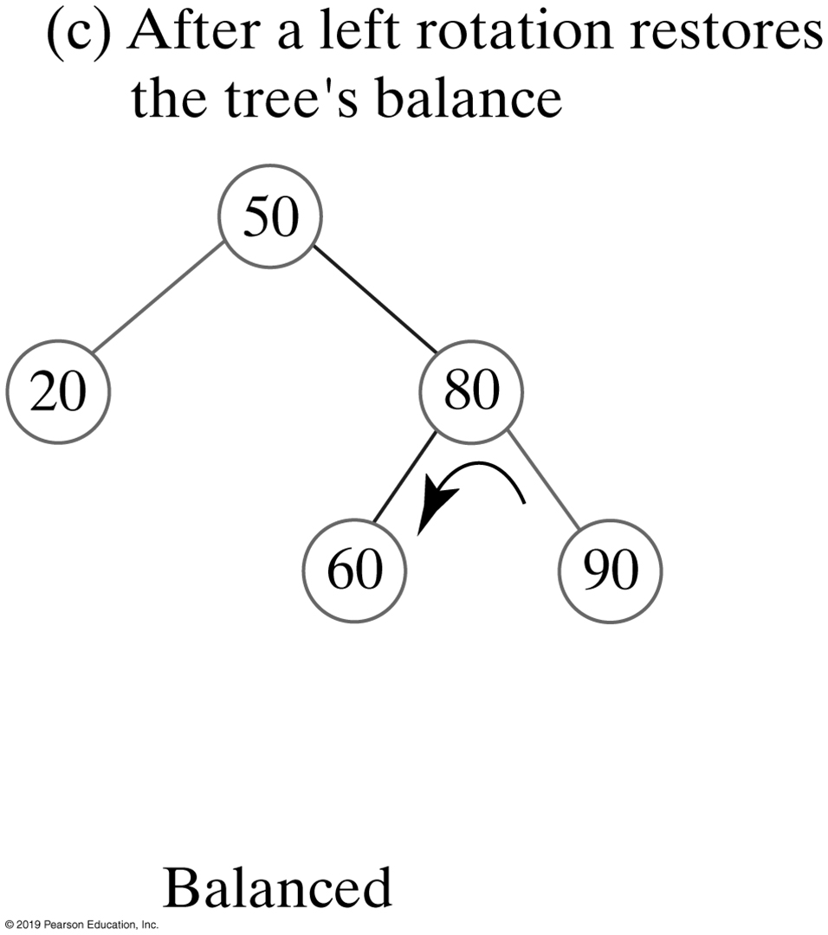
FIGURE 28-2 Additions to the AVL tree in Figure 28-1
FIGURE 28-2 Additions to the AVL tree in Figure 28-1

Slide 5
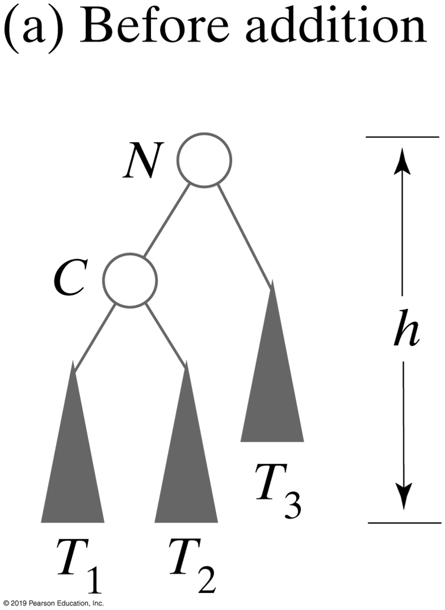
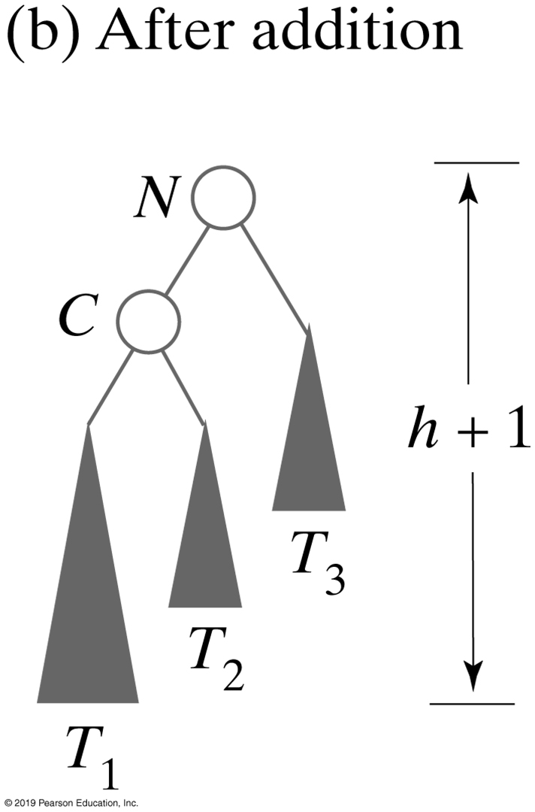
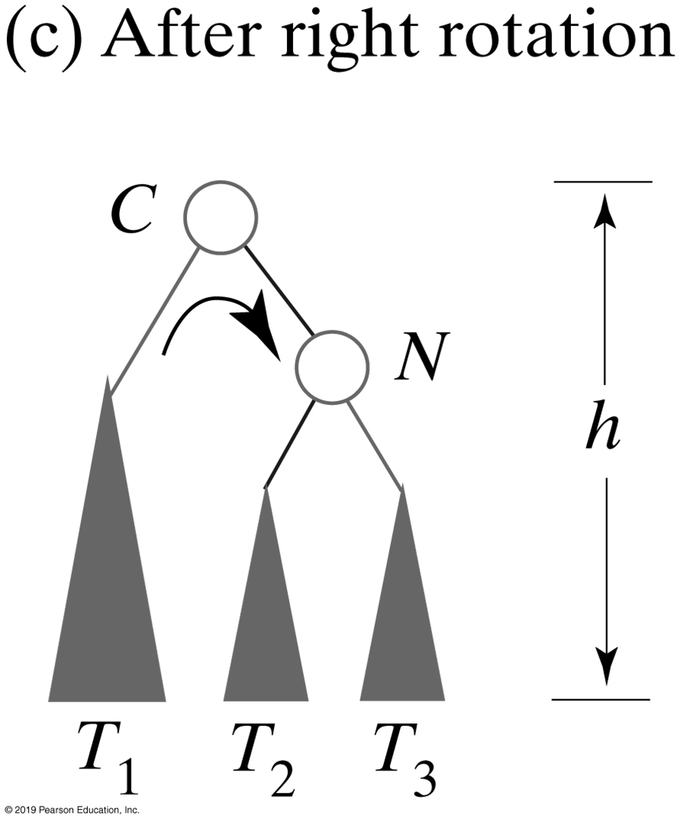
Single Rotations
This algorithm performs the right rotation illustrated in Figures 28-3 and 28-4
Algorithm rotateRight(nodeN)
// Corrects an imbalance at a given node nodeN due to an addition
// in the left subtree of nodeN’s left child.
nodeC = left child of nodeN
Set nodeN’s left child to nodeC’s right child
Set nodeC’s right child to nodeN
return nodeC
FIGURE 28-3 Before and after an addition to an AVL subtree that requires a right rotation to maintain its balance

Slide 6
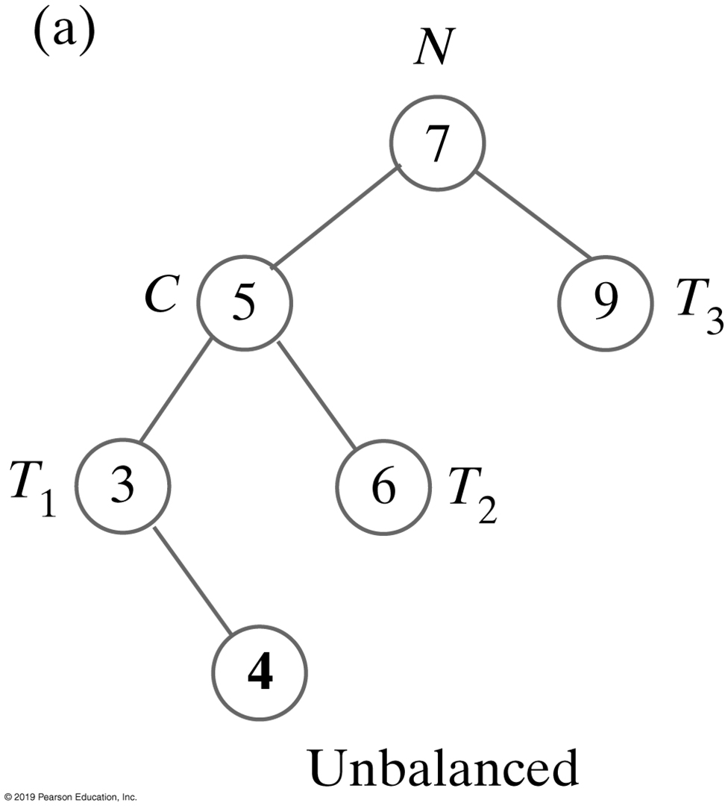
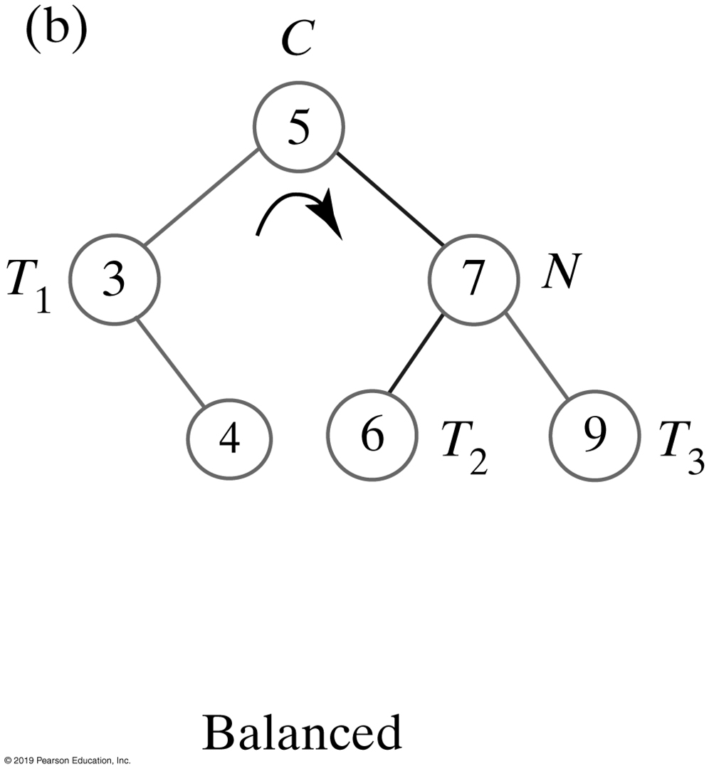
Single Rotation
FIGURE 28-4 Before and after a right rotation restores balance to an AVL tree

Slide 7
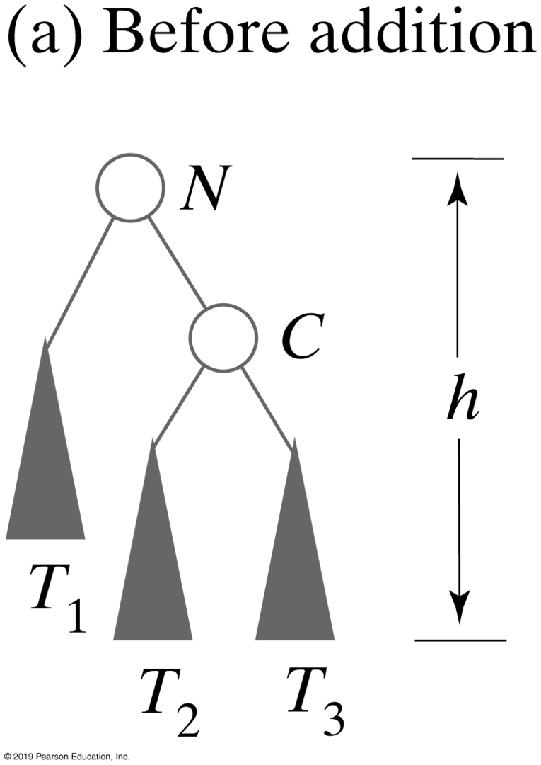
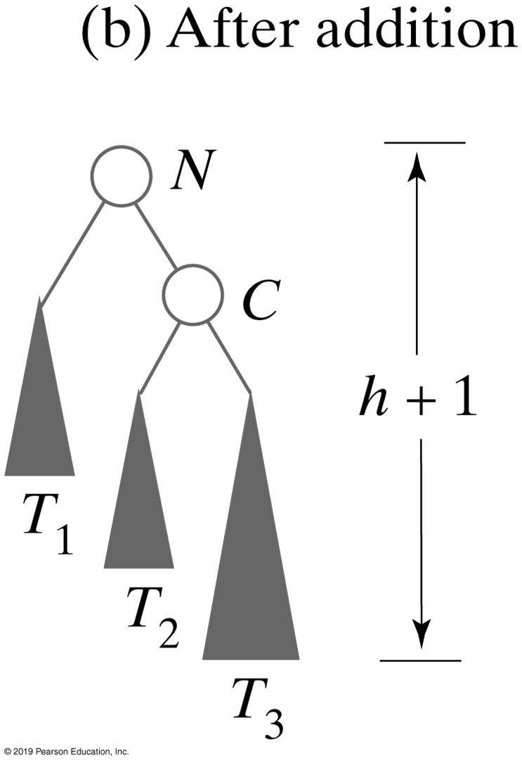
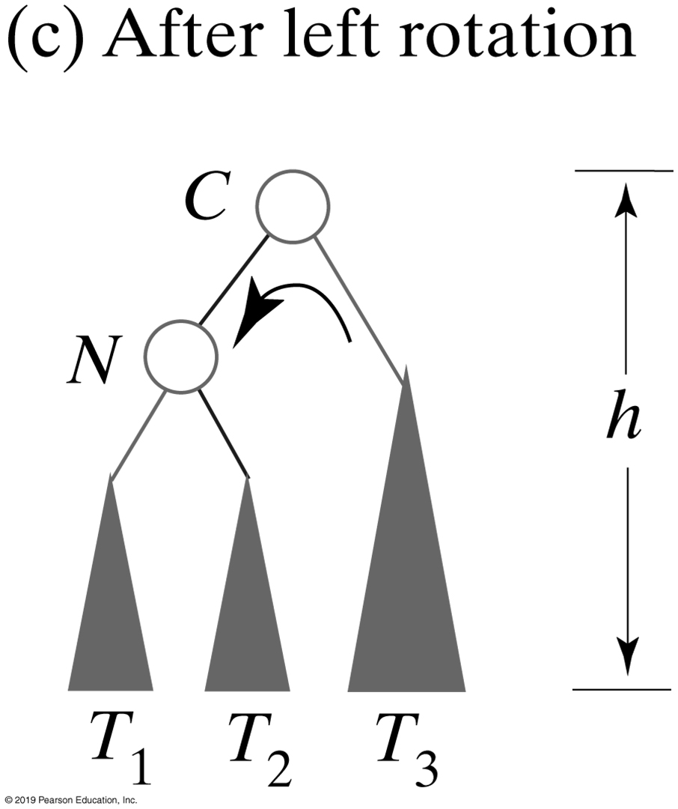
Single Rotation
FIGURE 28-5 Before and after an addition to an AVL subtree that requires a left rotation to maintain its balance

Slide 8
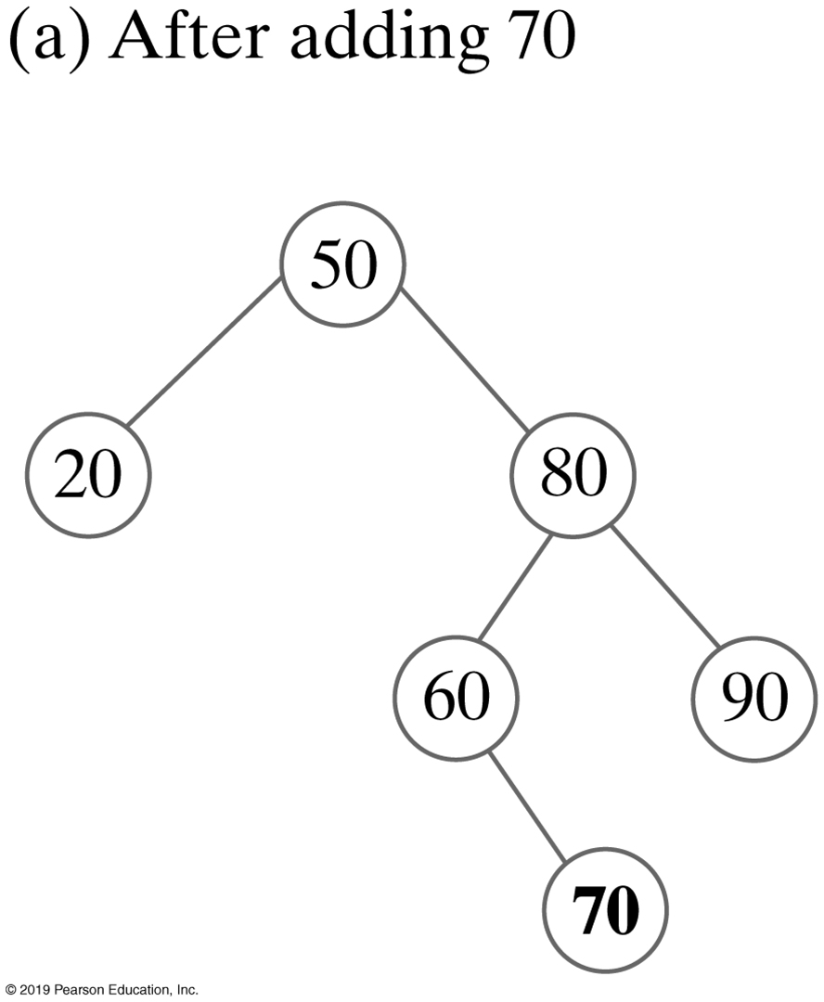
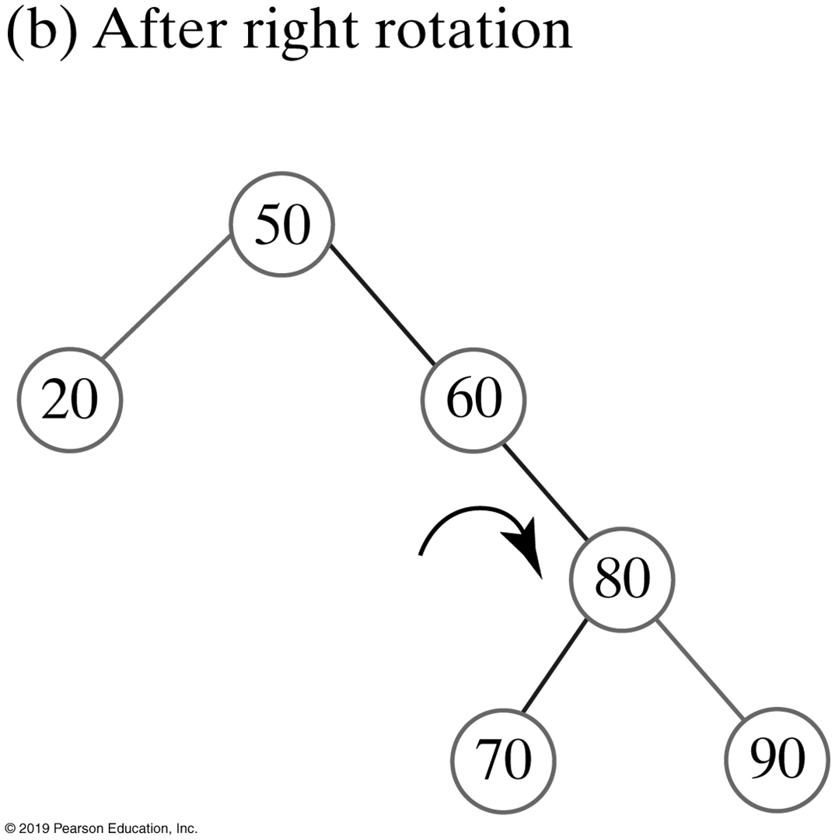
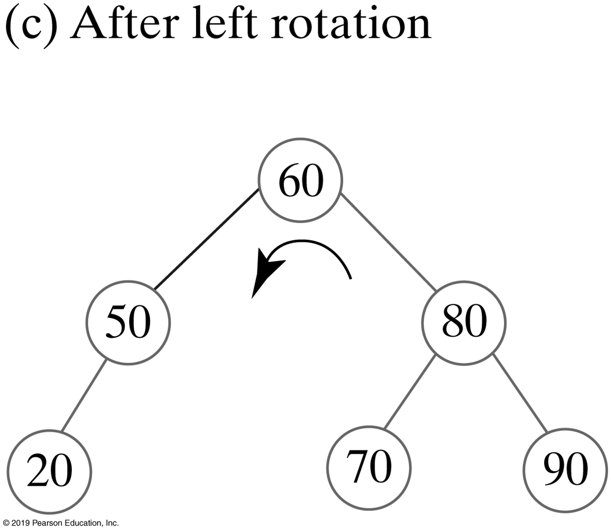
Double Rotation
FIGURE 28-6 Adding 70 to the AVL tree in Figure 28-2c requires both a right rotation and a left rotation to maintain its balance

Slide 9
Left-right Double Rotations
A double rotation is accomplished by performing two single rotations
A rotation about node N’s grandchild G (its child’s child)
A rotation about node N’s new child

Slide 10
Left-right Double Rotations
Four rotations cover the only four possibilities for the cause of the imbalance at node N
The addition occurred in …
the left subtree of N’s left child (right rotation)
the right subtree of N’s left child (left-right rotation)
the left subtree of N’s right child (right-left rotation)
the right subtree of N’s right child (left rotation)

Slide 11
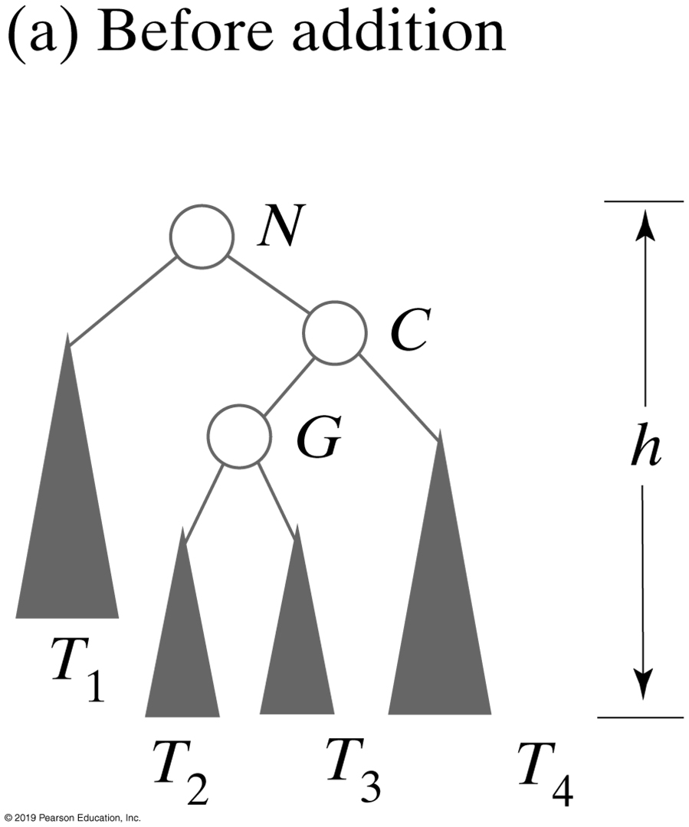
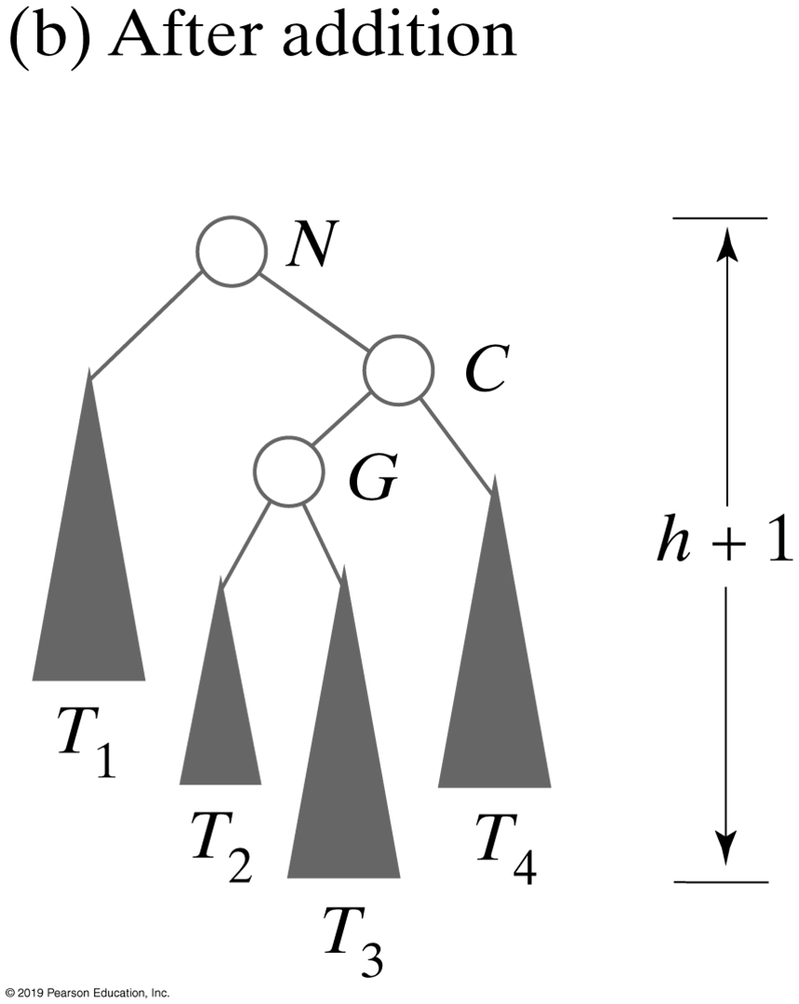
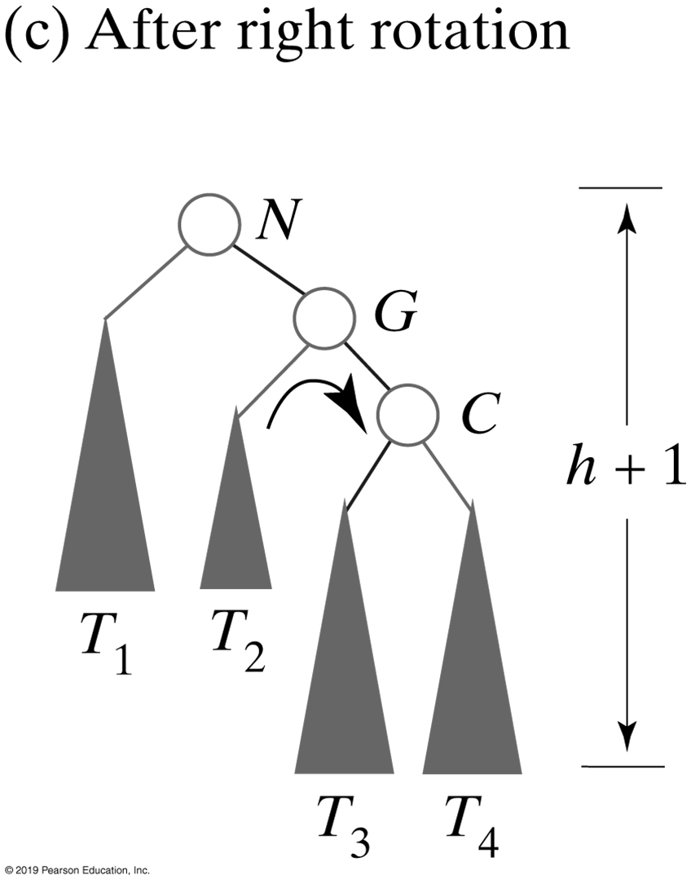
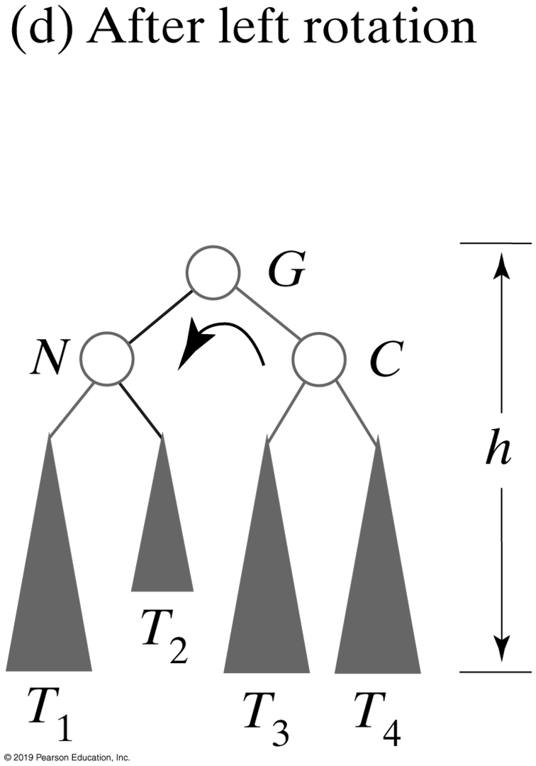
Double Rotations
FIGURE 28-7 Before and after an addition to an AVL subtree that requires both a right rotation and a left rotation to maintain its balance

Slide 12
Double Rotations
Algorithm rotateRightLeft(nodeN)
// Corrects an imbalance at a given node nodeN due to an addition
// in the left subtree of nodeN’s right child.
nodeC = right child of nodeN
Set nodeN’s right child to the node returned by rotateRight(nodeC)
return rotateLeft(nodeN)
This algorithm performs the right-left double rotation illustrated in Figure 28-7

Slide 13
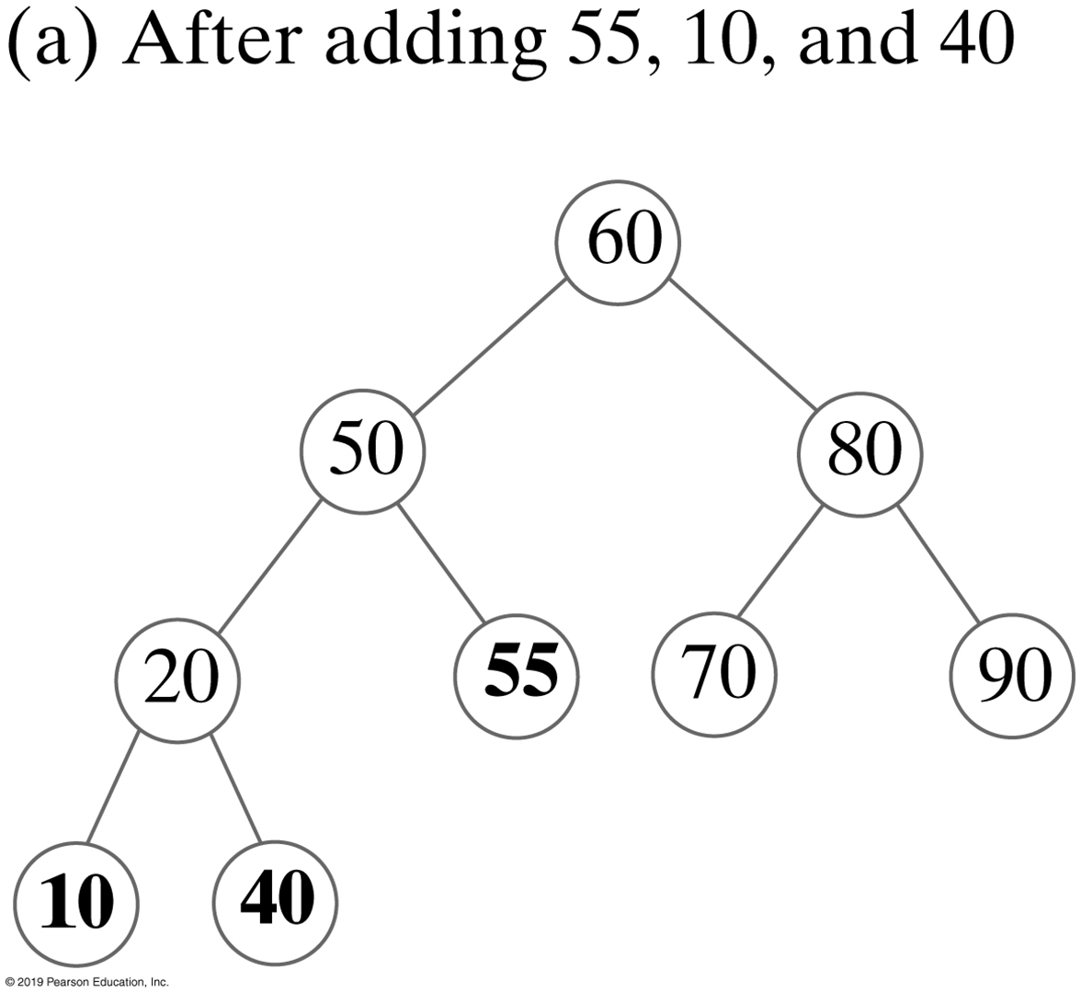
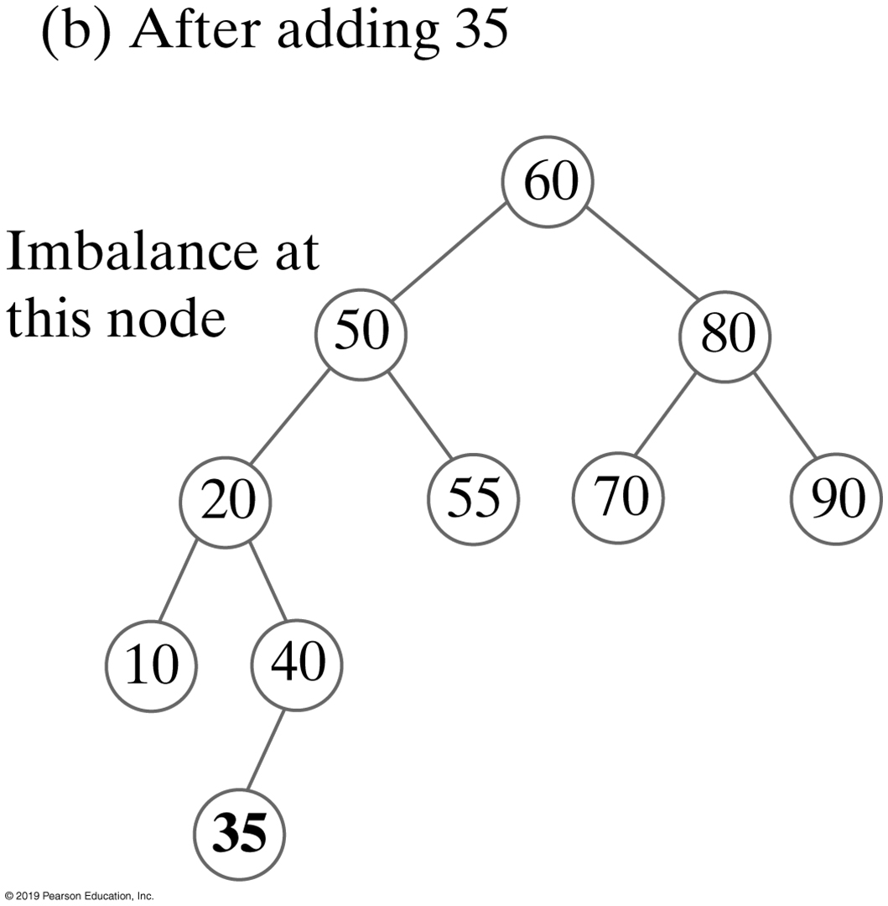
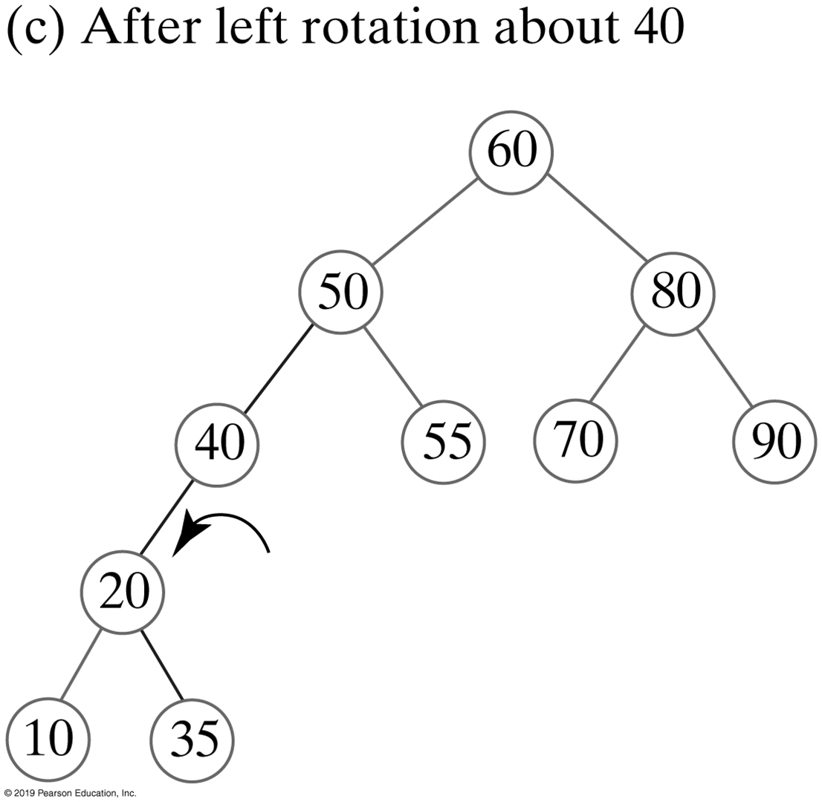
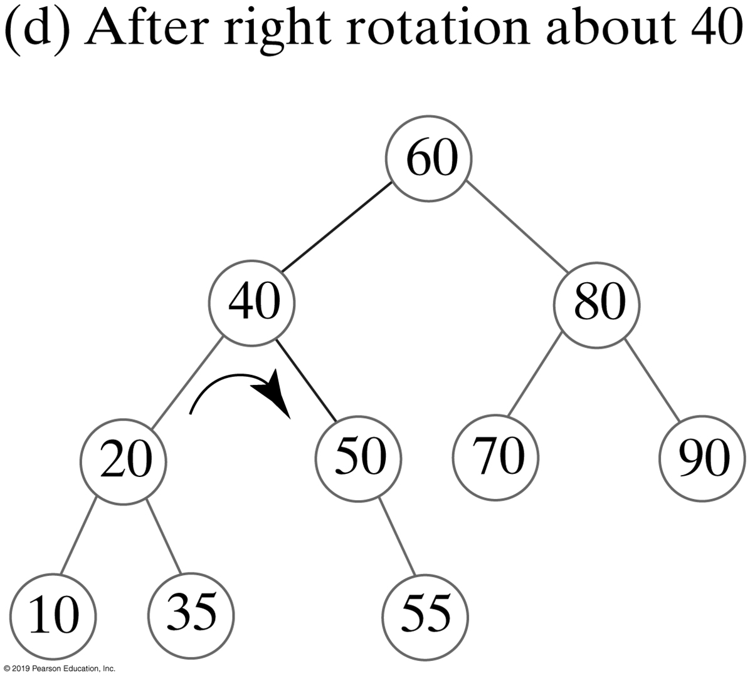
Double Rotations
FIGURE 28-8 Adding 55, 10, 40, and 35 to the AVL tree in Figure 28-6c

Slide 14
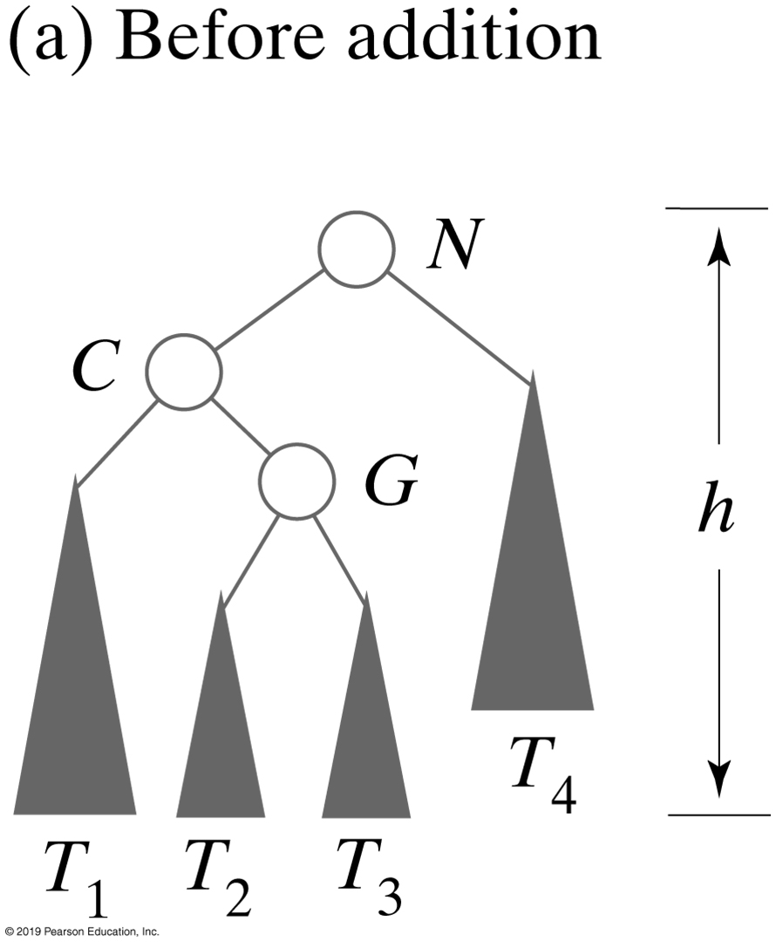
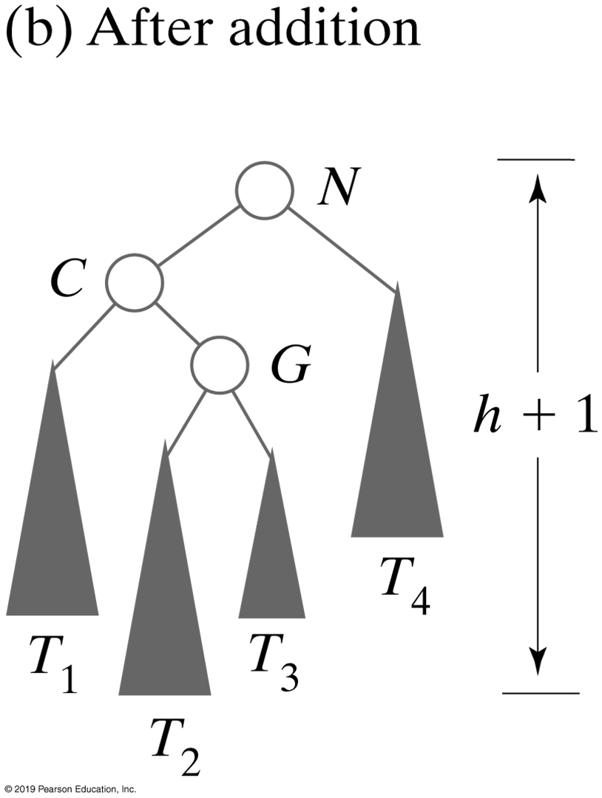
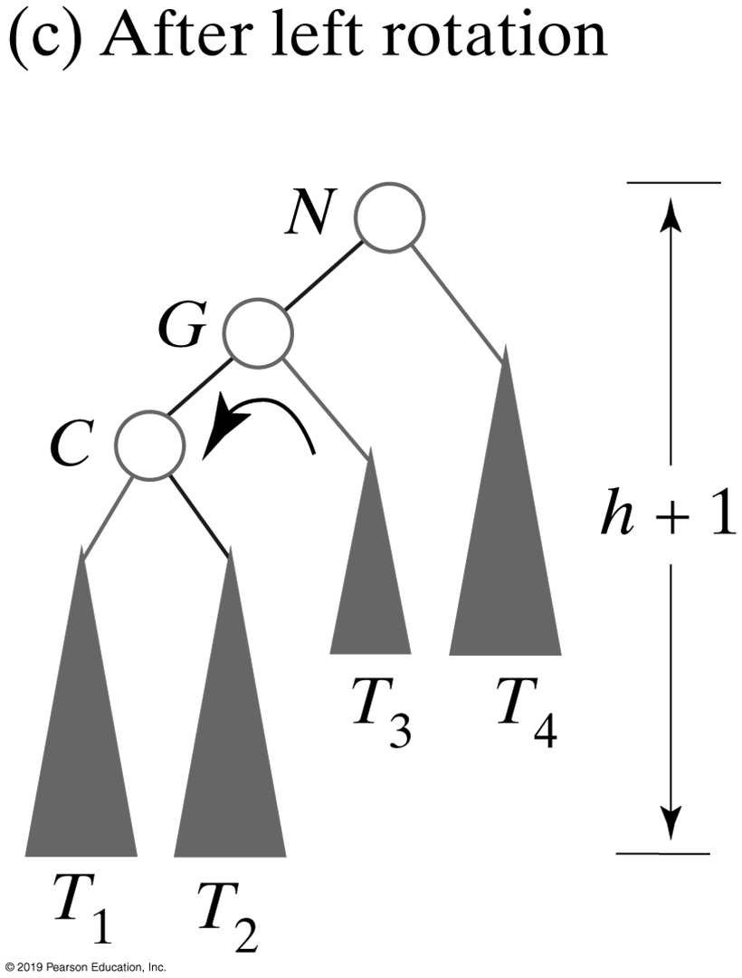
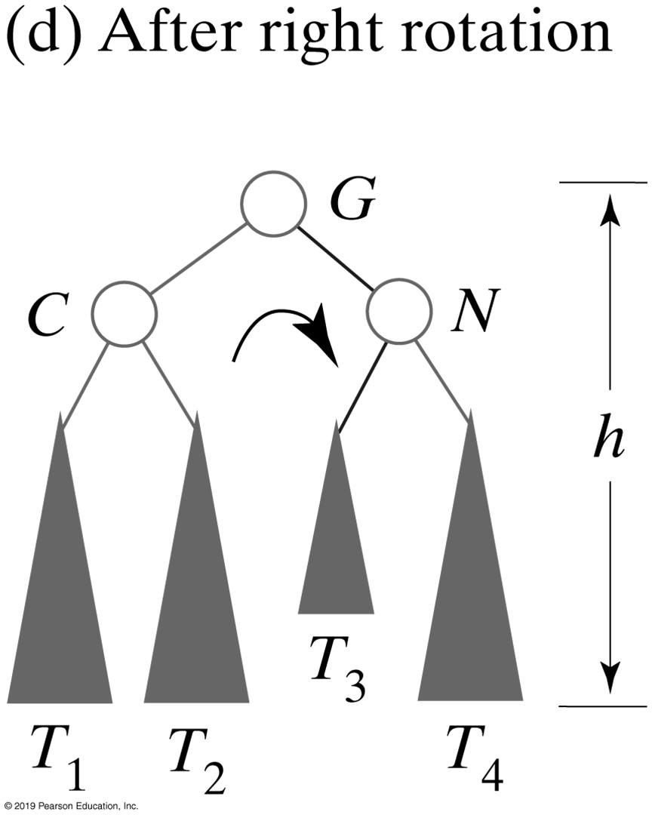
Double Rotations
FIGURE 28-9 Before and after an addition to an AVL subtree that requires both a left rotation and a right rotation to maintain its balance

Slide 15
Left-right Double Rotations
Algorithm rotateLeftRight(nodeN)
// Corrects an imbalance at a given node nodeN due to an addition
// in the right subtree of nodeN’s left child.
nodeC = left child of nodeN
Set nodeN’s left child to the node returned by rotateLeft(nodeC)
return rotateRight(nodeN)
Algorithm that performs the left-right double rotation illustrated in Figure 28-9

Slide 16
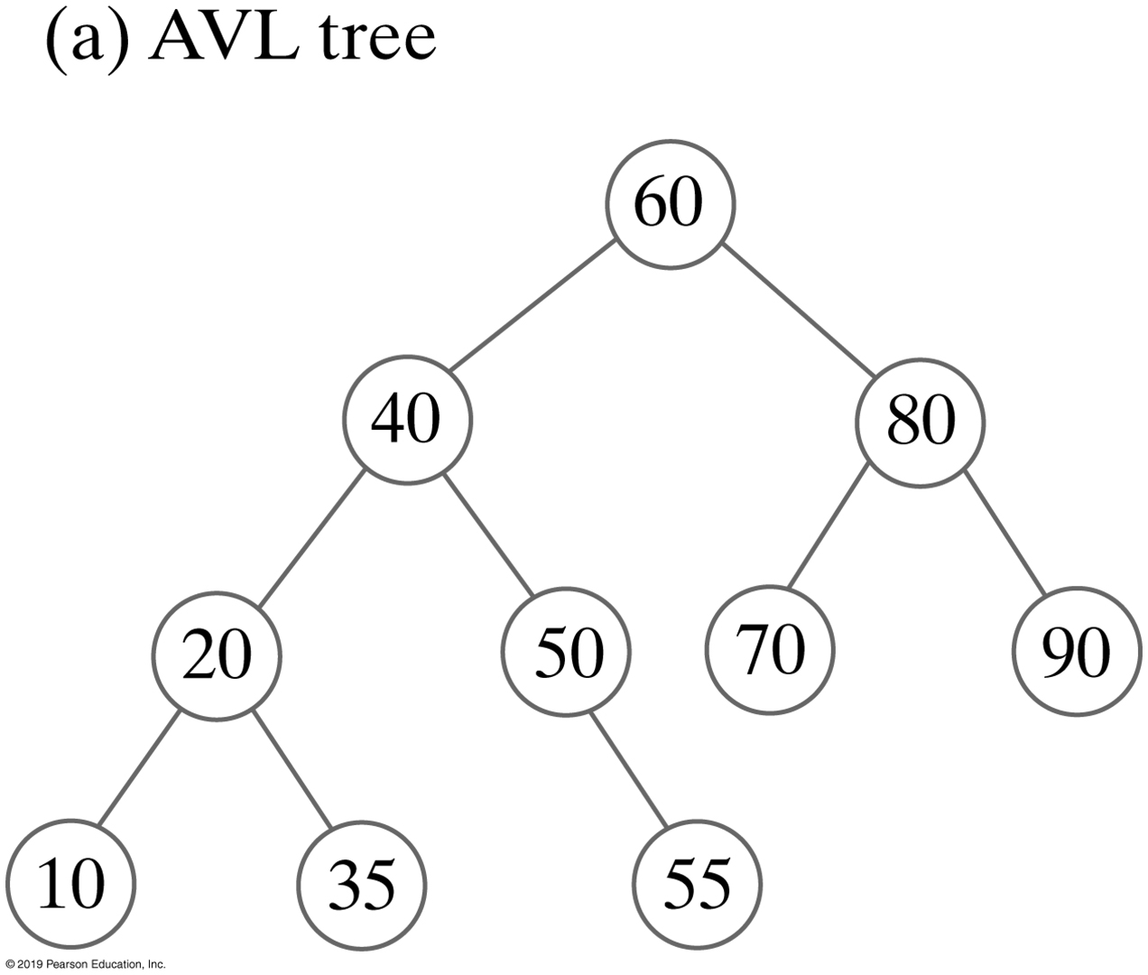
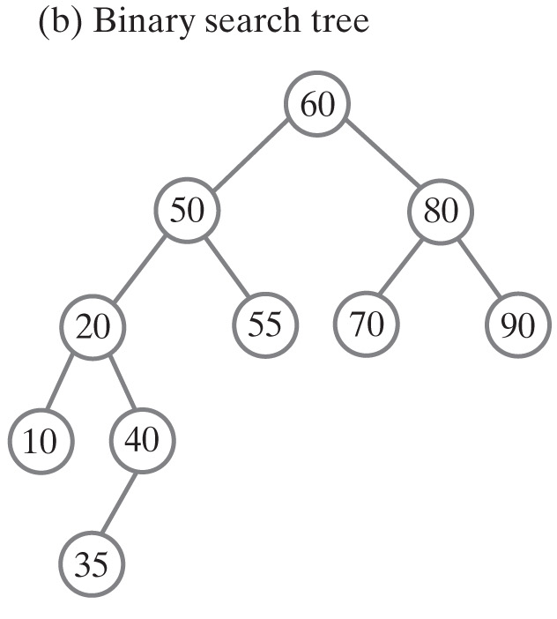
An AVL Tree Versus a Binary Search Tree
FIGURE 28-10 The result of adding 60, 50, 20, 80, 90, 70, 55, 10, 40, and 35 to an initially empty AVL tree and a binary search tree

Slide 17
Implementation Details
/** A class that implements the ADT AVL tree by extending BinarySearchTree.
The remove operation is not supported. */
public class AVLTree<T extends Comparable<? super T>>
extends BinarySearchTree<T> implements SearchTreeInterface<T>
{
public AVLTree()
{
super();
} // end default constructor
public AVLTree(T rootEntry)
{
super(rootEntry);
} // end constructor
/* Implementations of add and remove are here.
A definition of add appears in Segment 28.12 of
this chapter. Other methods in SearchTreeInterface are inherited.
. . .
Implementations of private methods to rebalance the tree
using rotations are here.
. . . */
} // end AVLTree
LISTING 28-1 An outline of the class AVLTree

Slide 18
Rotations
Algorithm rotateRight(nodeN)
// Corrects an imbalance at a given node nodeN due to an addition
// in the left subtree of nodeN’s left child.
nodeC = left child of nodeN
Set nodeN’s left child to nodeC’s right child
Set nodeC’s right child to nodeN
return nodeC
// Corrects an imbalance at the node closest to a structural
// change in the left subtree of the node's left child.
// nodeN is a node, closest to the newly added leaf, at which
// an imbalance occurs and that has a left child.
private BinaryNode<T> rotateRight(BinaryNode<T> nodeN)
{
BinaryNode<T> nodeC = nodeN.getLeftChild();
nodeN.setLeftChild(nodeC.getRightChild());
nodeC.setRightChild(nodeN);
return nodeC;
} // end rotateRight
The implementation of the method for a single right rotation

Slide 19
Rotations
Algorithm rotateRightLeft(nodeN)
// Corrects an imbalance at a given node nodeN due to an addition
// in the left subtree of nodeN’s right child.
nodeC = right child of nodeN
Set nodeN’s right child to the node returned by rotateRight(nodeC)
return rotateLeft(nodeN)
// Corrects an imbalance at the node closest to a structural
// change in the left subtree of the node's right child.
// nodeN is a node, closest to the newly added leaf, at which
// an imbalance occurs and that has a right child.
private BinaryNode<T> rotateRightLeft(BinaryNode<T> nodeN)
{
BinaryNode<T> nodeC = nodeN.getRightChild();
nodeN.setRightChild(rotateRight(nodeC));
return rotateLeft(nodeN);
} // end rotateRightLeft
Implementation for a right- left double rotation

Slide 20
Rotations
Algorithm rebalance(nodeN)
if (nodeN’s left subtree is taller than its right subtree by more than 1)
{ // Addition was in nodeN’s left subtree
if (the left child of nodeN has a left subtree that is taller than its right subtree)
rotateRight(nodeN) // Addition was in left subtree of left child
else
rotateLeftRight(nodeN) // Addition was in right subtree of left child
}
else if (nodeN’s right subtree is taller than its left subtree by more than 1)
{ // Addition was in nodeN’s right subtree
if (the right child of nodeN has a right subtree that is taller than its left subtree)
rotateLeft(nodeN) // Addition was in right subtree of right child
else
rotateRightLeft(nodeN) // Addition was in left subtree of right child
}
Pseudocode to rebalance the tree

Slide 21
Rotations
private BinaryNode<T> rebalance(BinaryNode<T> nodeN)
{
int heightDifference = getHeightDifference(nodeN);
if (heightDifference > 1)
{
// Left subtree is taller by more than 1,
// so addition was in left subtree
if (getHeightDifference(nodeN.getLeftChild()) > 0)
// Addition was in left subtree of left child
nodeN = rotateRight(nodeN);
else
// Addition was in right subtree of left child
nodeN = rotateLeftRight(nodeN);
}
else if (heightDifference < -1)
{
// Right subtree is taller by more than 1,
// so addition was in right subtree
if (getHeightDifference(nodeN.getRightChild()) < 0)
// Addition was in right subtree of right child
nodeN = rotateLeft(nodeN);
else
// Addition was in left subtree of right child
nodeN = rotateRightLeft(nodeN);
} // end if
// Else nodeN is balanced
return nodeN;
} // end rebalance
Implementation for rebalancing within the class AVLTree

Slide 22
Methods to Add
public T add(T newEntry)
{
T result = null;
if (isEmpty())
setRootNode(new BinaryNode<>(newEntry));
else
{
BinaryNode<T> rootNode = getRootNode();
result = addEntry(rootNode, newEntry);
setRootNode(rebalance(rootNode));
} // end if
return result;
} // end add
AVL Tree Method add

Slide 23
Methods to Add — addEntry (Part 1)
private T addEntry(BinaryNode<T> rootNode, T newEntry)
{
// Assertion: rootNode != null
T result = null;
int comparison = newEntry.compareTo(rootNode.getData());
if (comparison == 0)
{
result = rootNode.getData();
rootNode.setData(newEntry);
}
else if (comparison < 0)
{
if (rootNode.hasLeftChild())
{
BinaryNode<T> leftChild = rootNode.getLeftChild();
result = addEntry(leftChild, newEntry);
rootNode.setLeftChild(rebalance(leftChild));
}
else
AVL Tree Method addEntry

Slide 24
Methods to Add — addEntry (Part 1)
else
rootNode.setLeftChild(new BinaryNode<>(newEntry));
}
else
{
// Assertion: comparison > 0
if (rootNode.hasRightChild())
{
BinaryNode<T> rightChild = rootNode.getRightChild();
result = addEntry(rightChild, newEntry);
rootNode.setRightChild(rebalance(rightChild));
}
else
rootNode.setRightChild(new BinaryNode<>(newEntry));
} // end if
return result;
} // end addEntry
AVL Tree Method addEntry

Slide 25
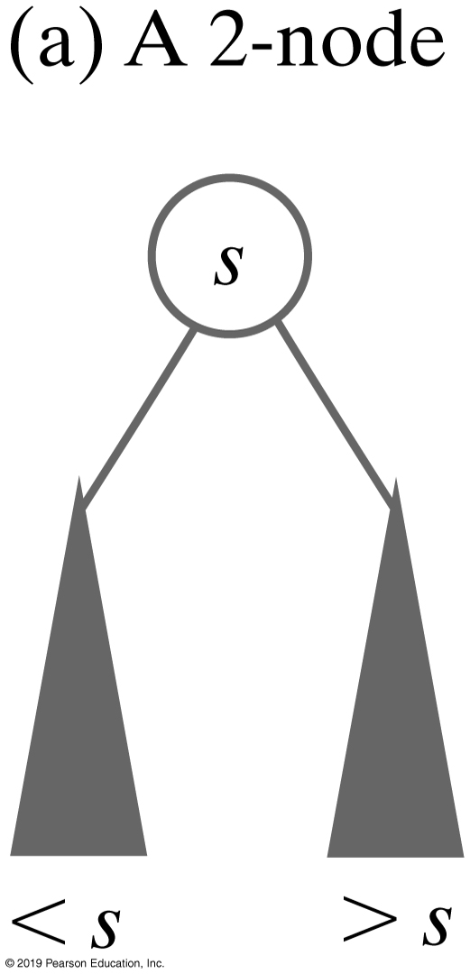
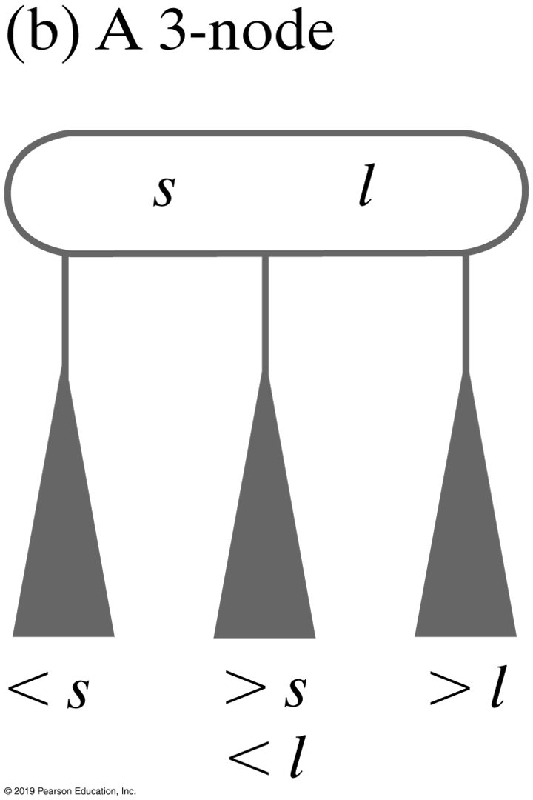
2-3 Trees
General search tree whose interior nodes must have either two or three children
A 2-node contains one data item s and has two children
A 3-node contains two data items, s and l, and has three children
FIGURE 28-11 Nodes in a 2-3 tree

Slide 26
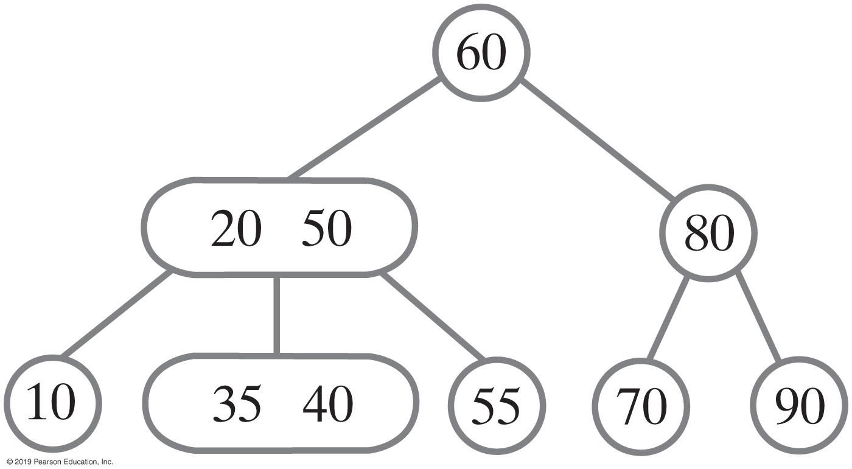
2-3 Trees
FIGURE 28-12 A 2-3 tree

Slide 27
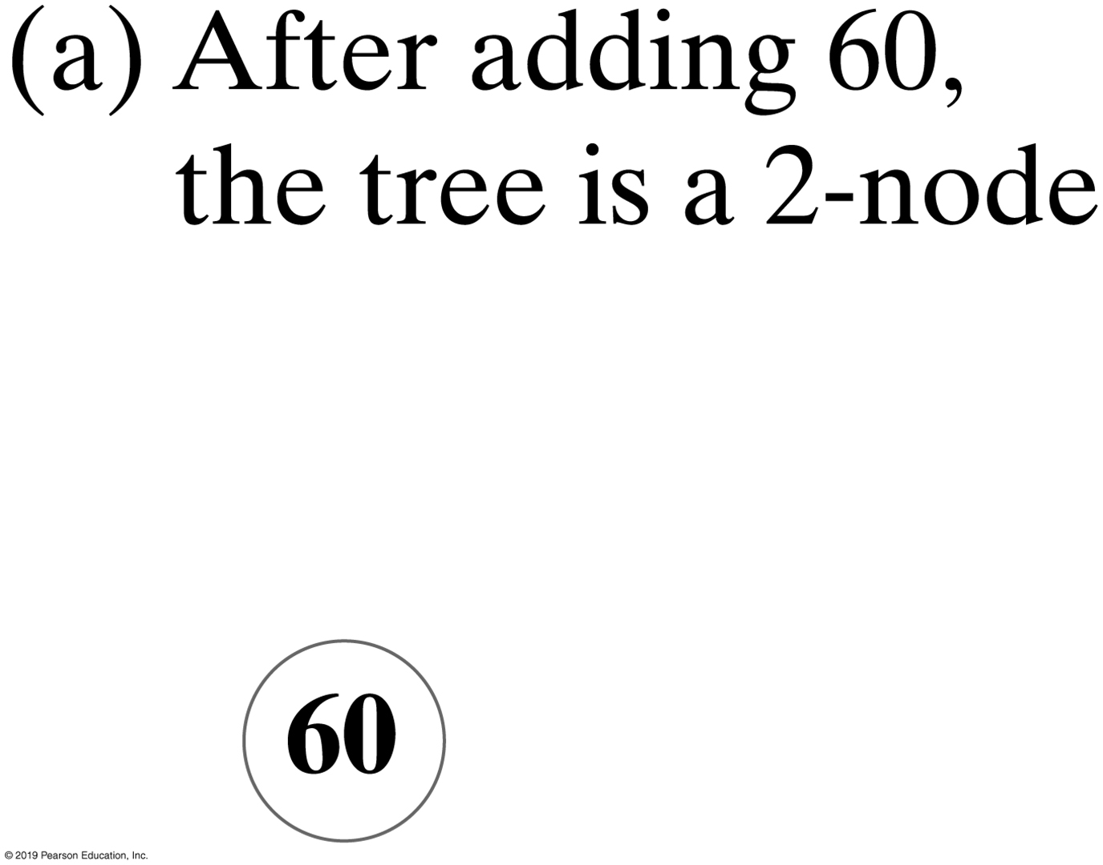
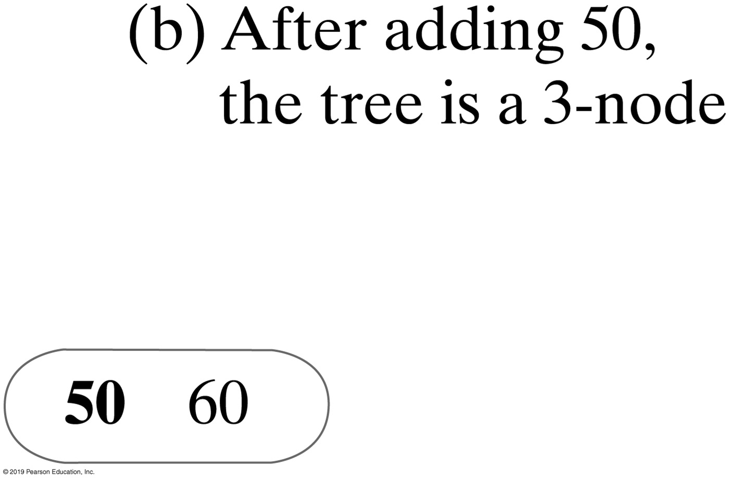
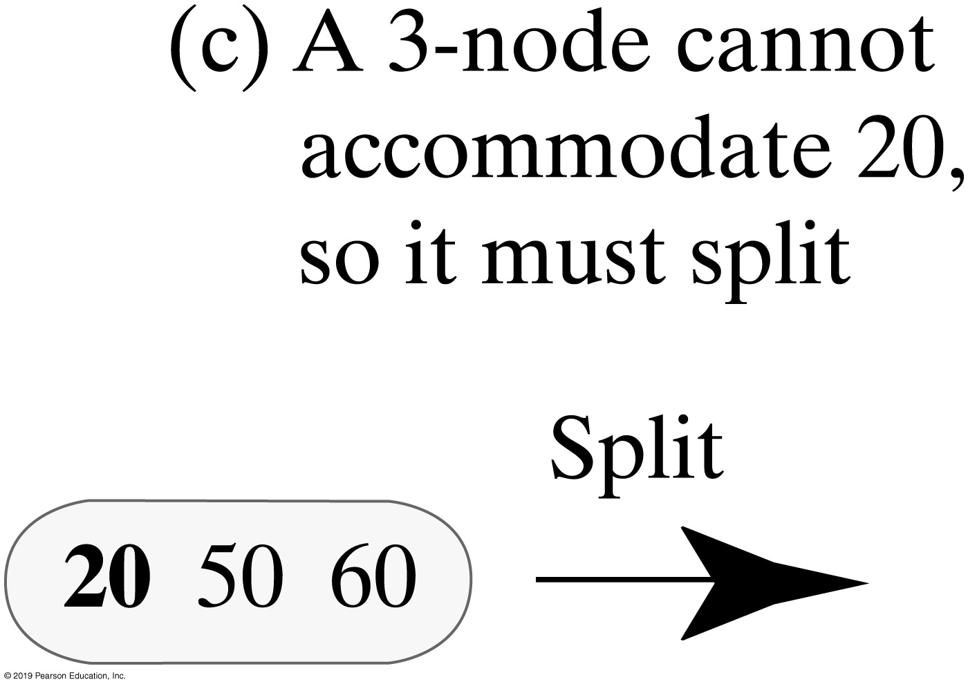
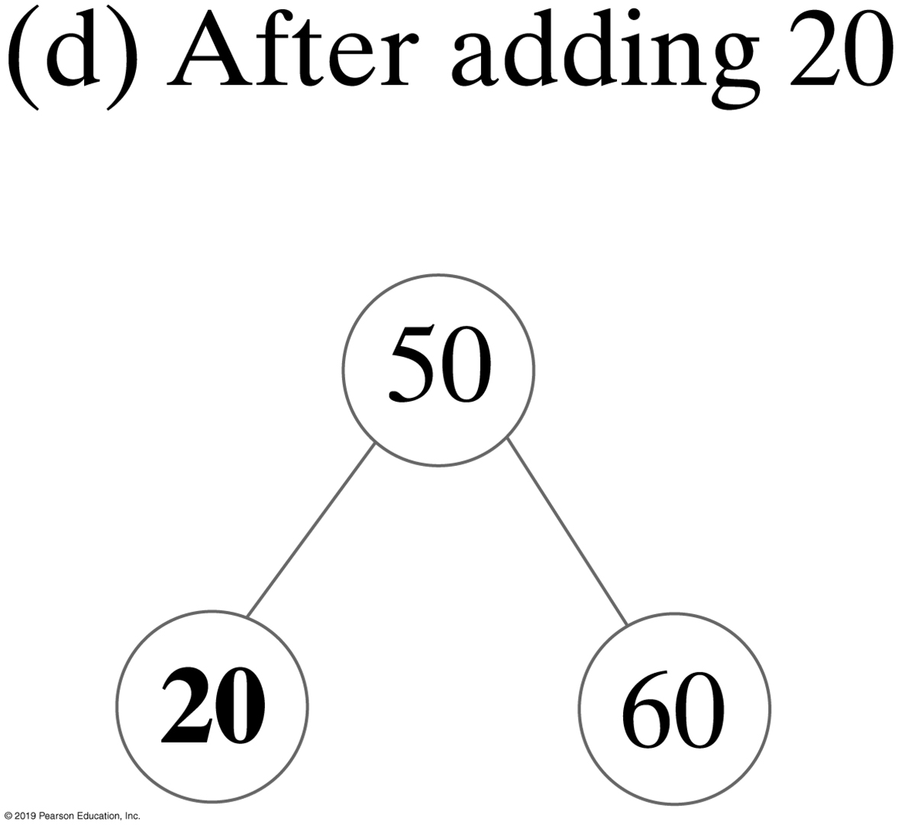
Building 2-3 Trees
FIGURE 28-13 An initially empty 2-3 tree after three additions

Slide 28
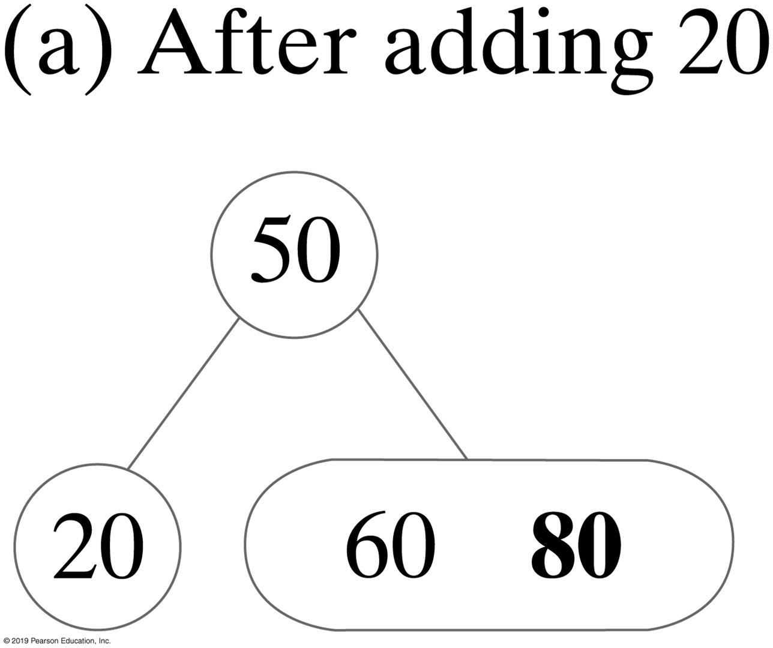
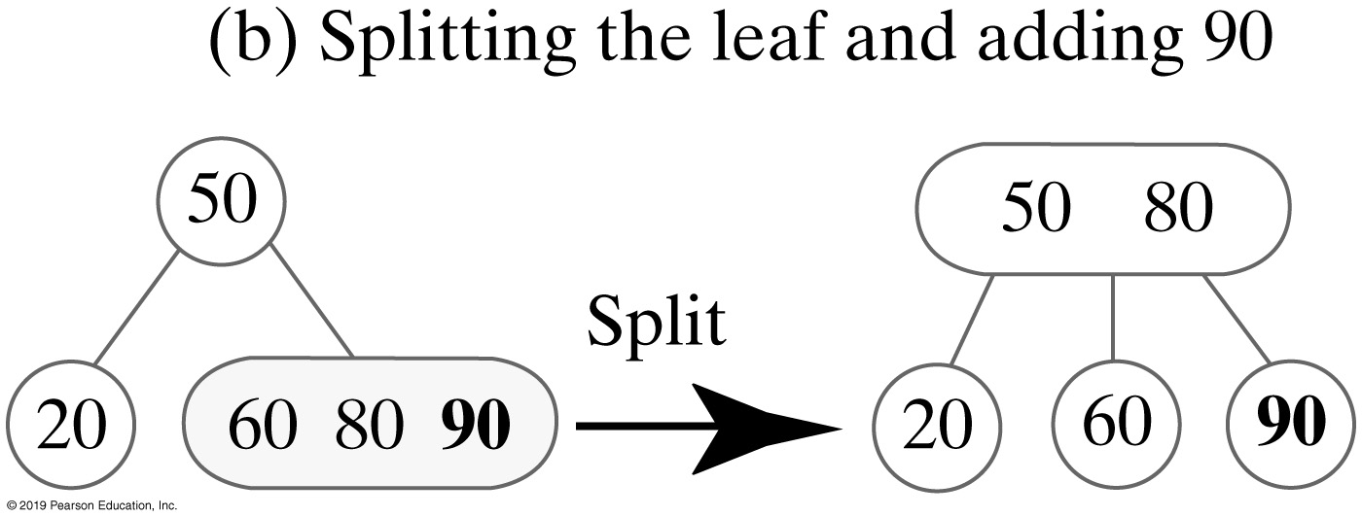
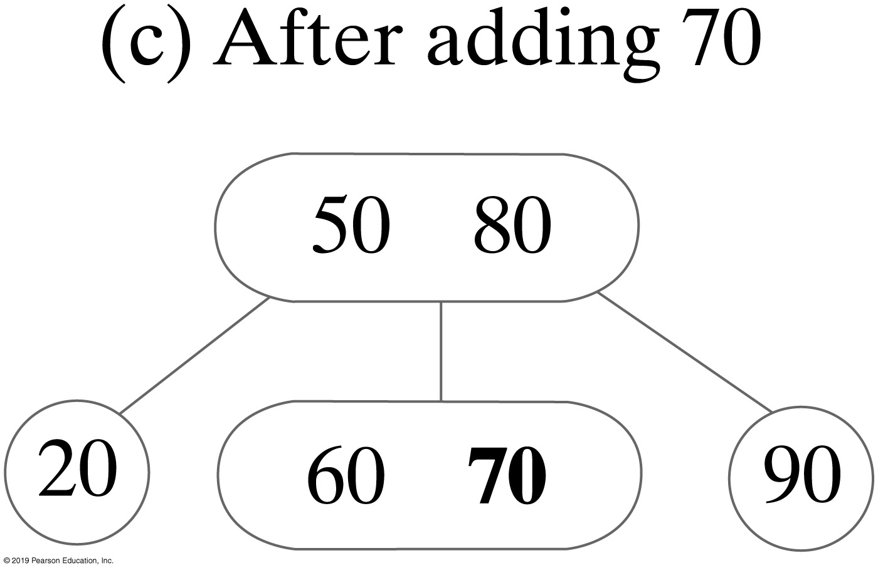
Building 2-3 Trees
FIGURE 28-14 The 2-3 tree after three additions

Slide 29
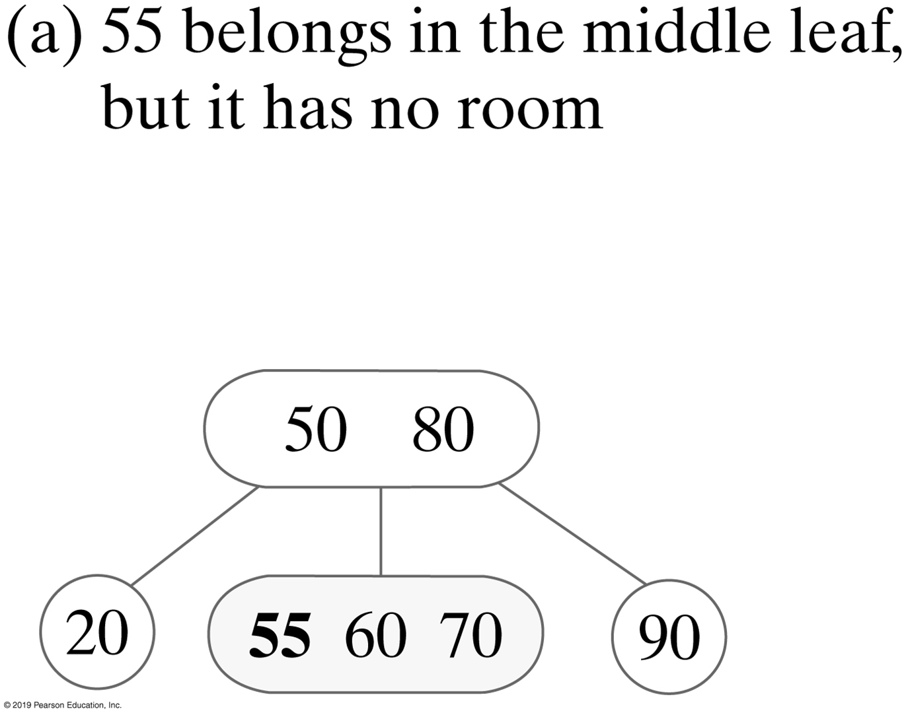
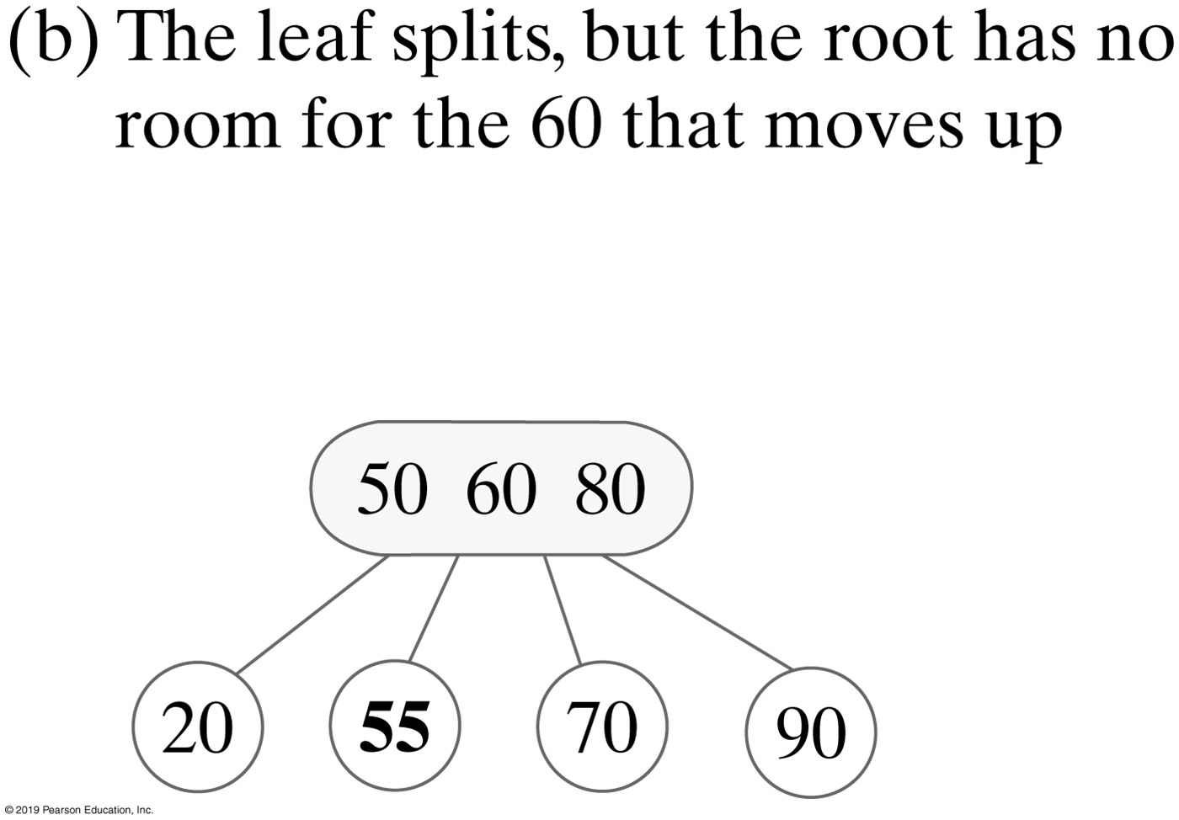
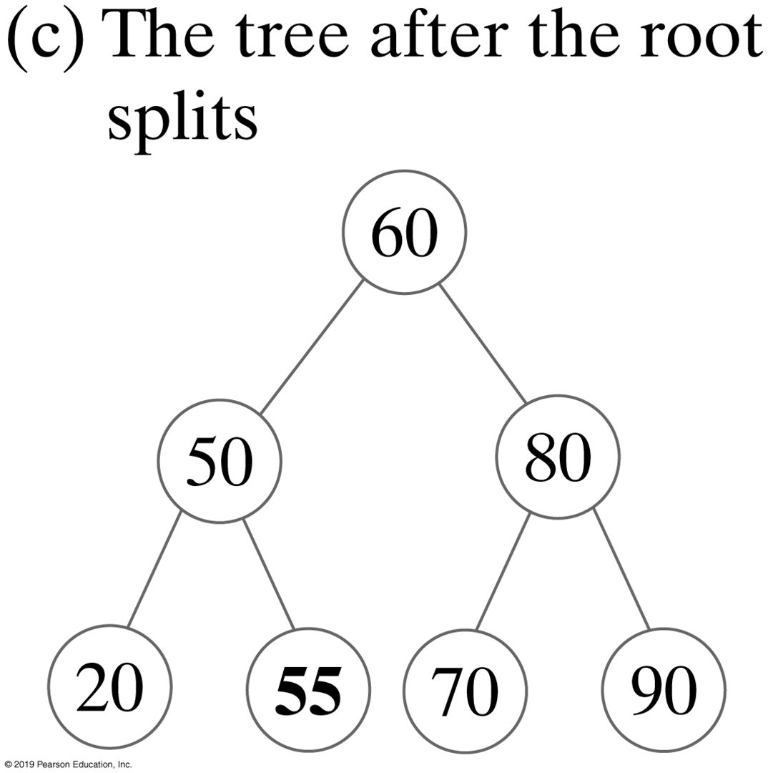
Building 2-3 Trees
FIGURE 28-15 Adding 55 to the 2-3 tree in Figure 28-14c causes a leaf and then the root to split

Slide 30
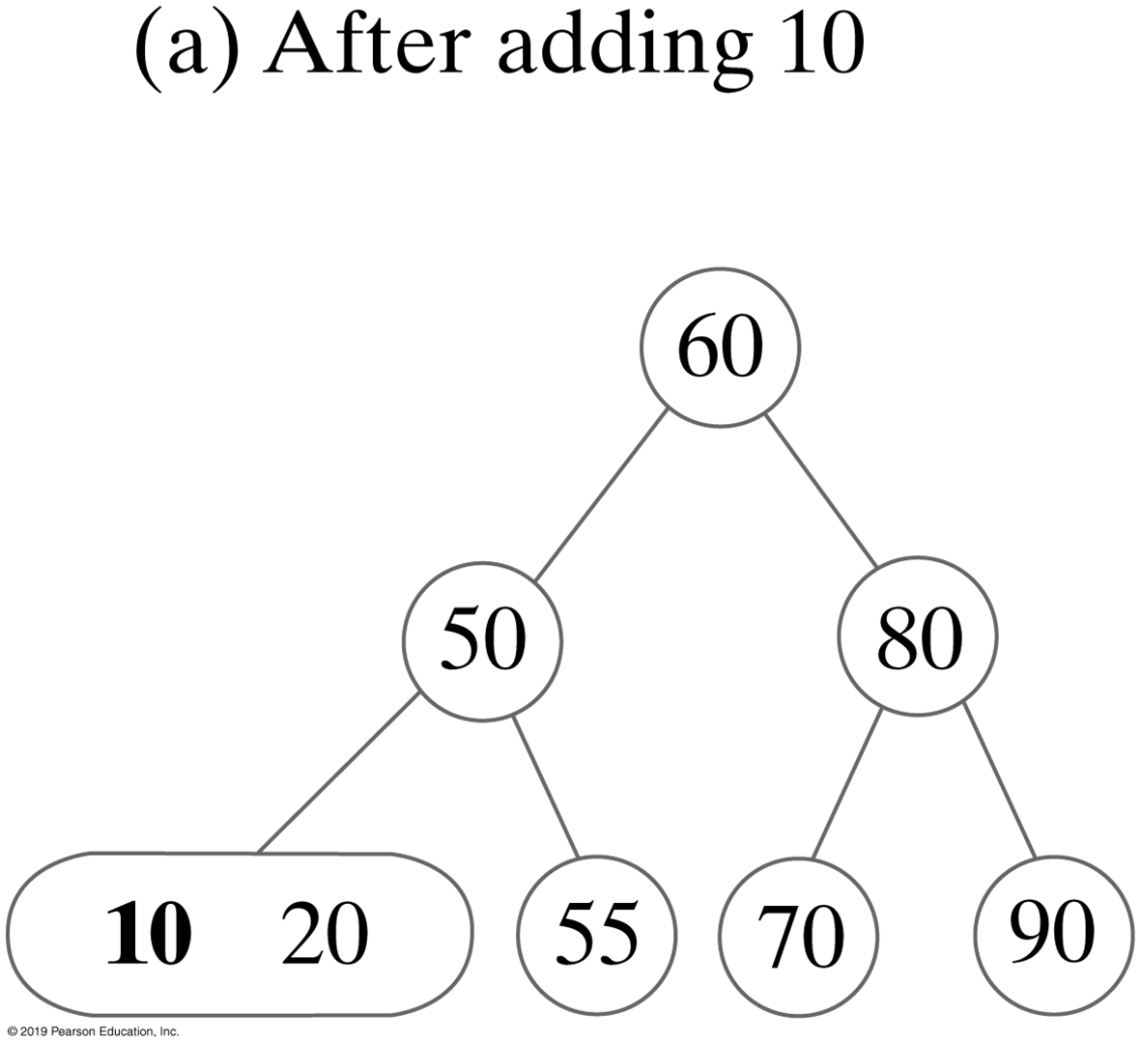
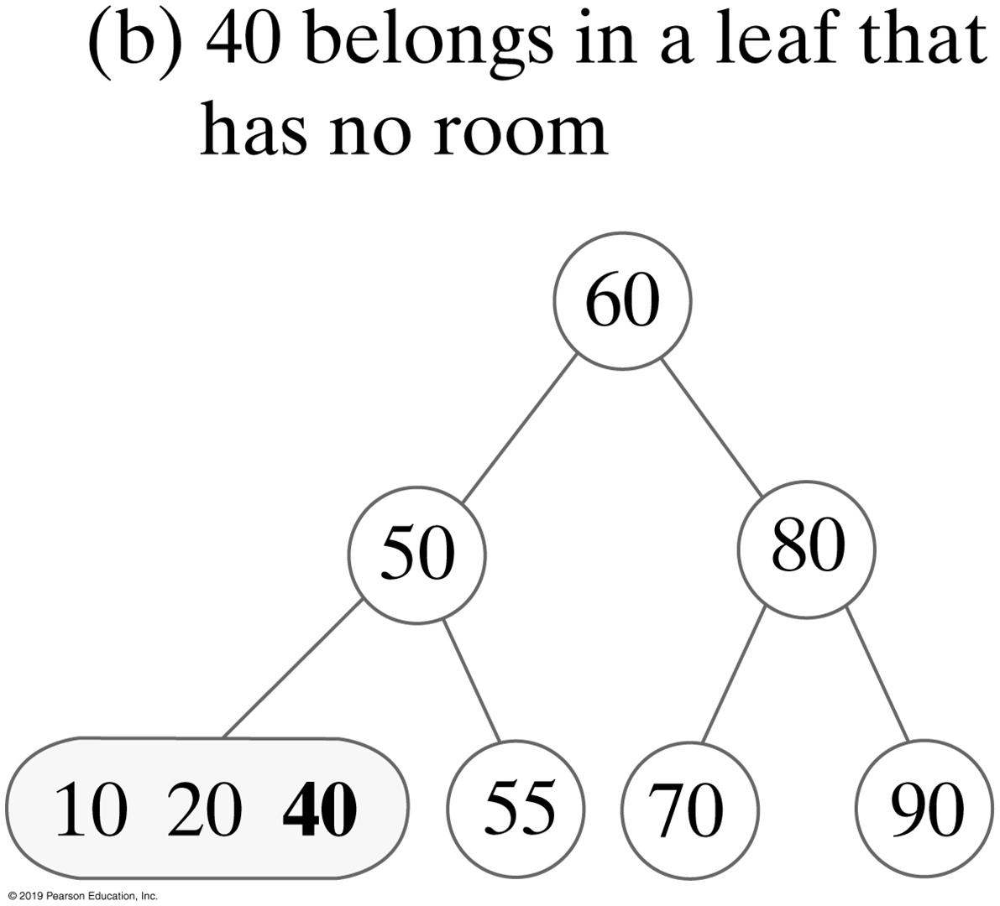
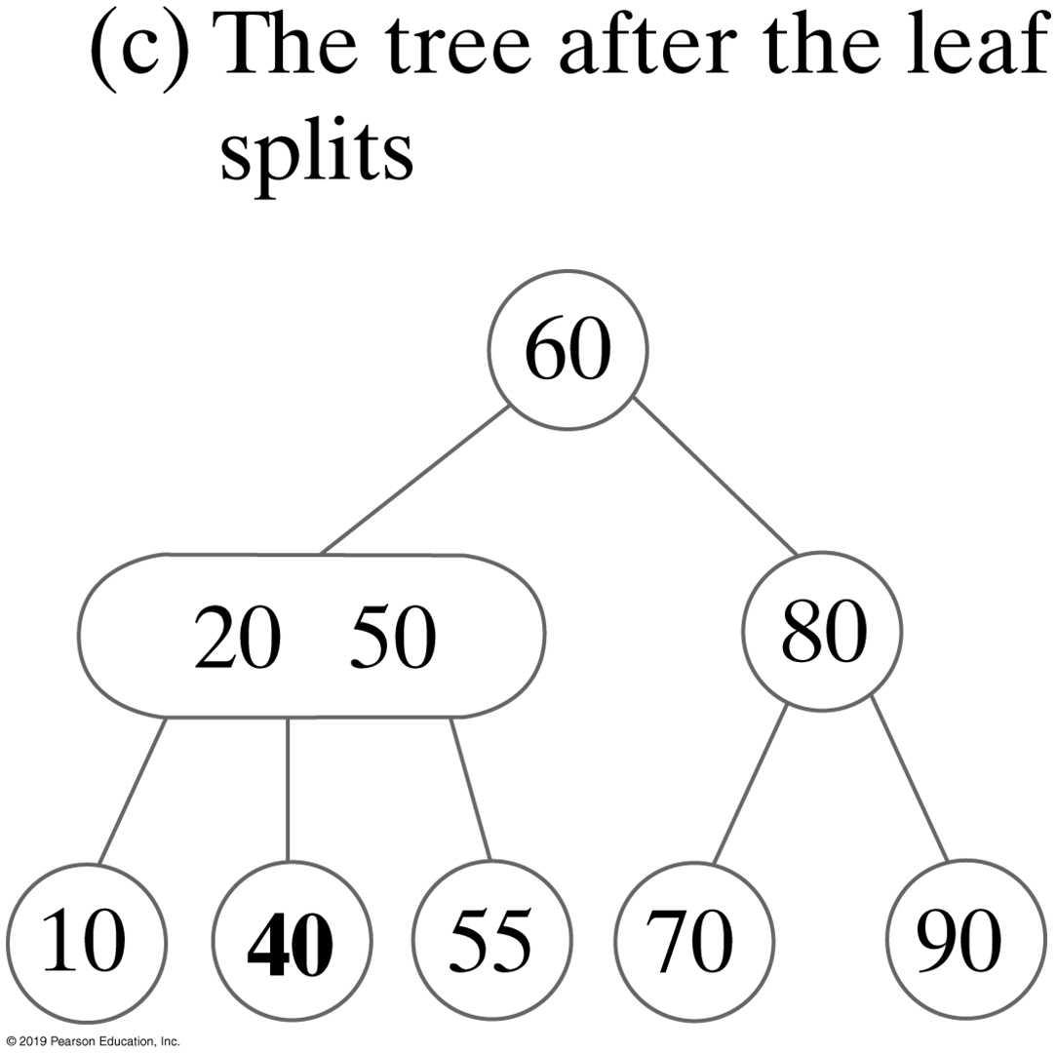
Building 2-3 Trees
FIGURE 28-16 Adding 10 and 40 to the 2-3 tree in Figure 28-15c

Slide 31
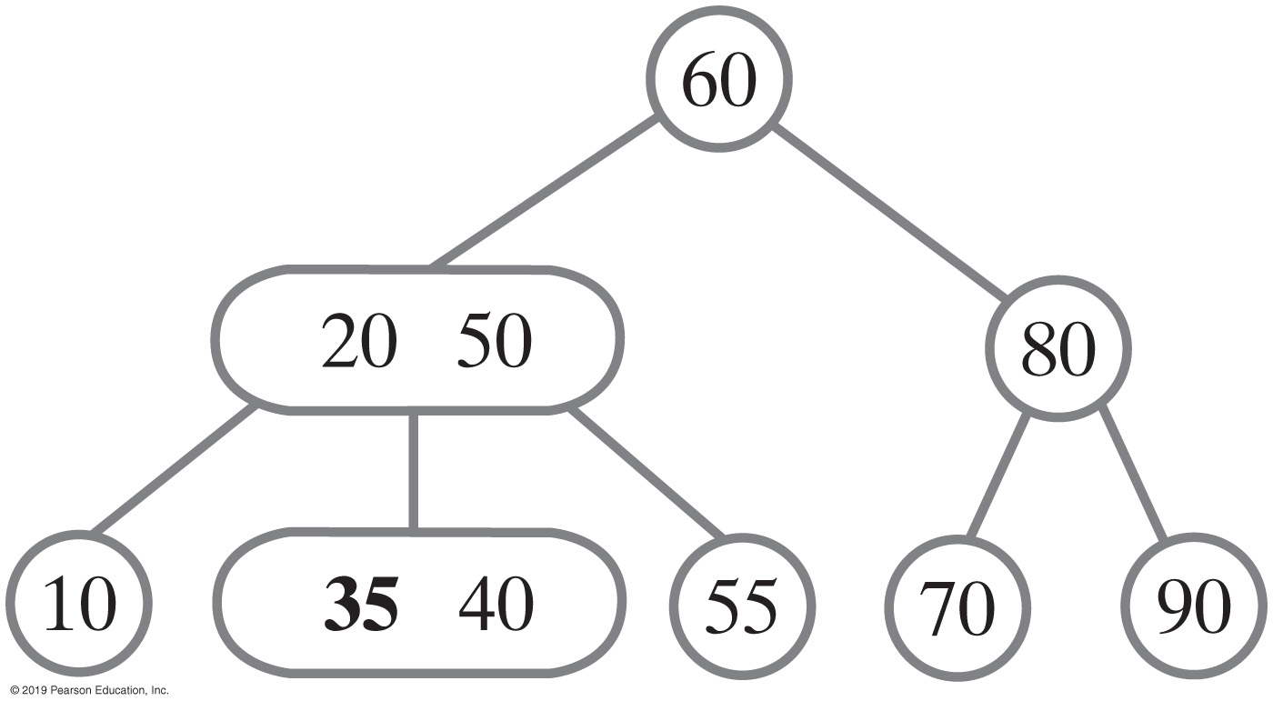
Building 2-3 Trees
FIGURE 28-17 The 2-3 tree in Figure 28-16c after adding 35

Slide 32
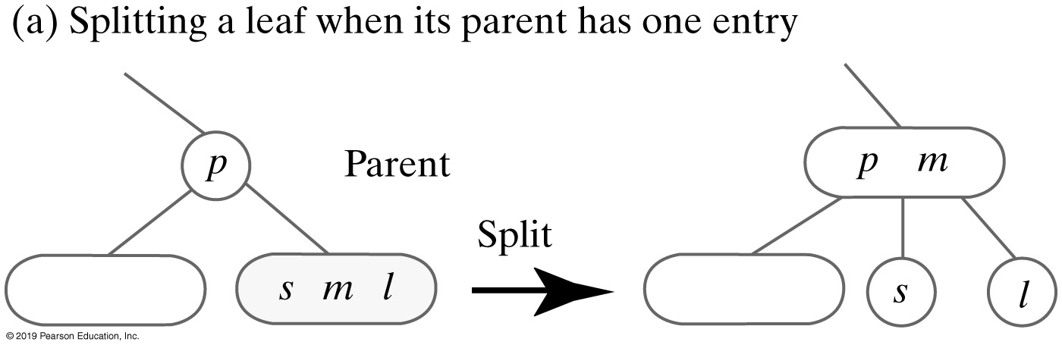

Splitting Nodes During Addition
FIGURE 28-18 Splitting a leaf to accommodate a new entry

Slide 33

Splitting Nodes During Addition
FIGURE 28-19 Splitting an internal node to accommodate a new entry

Slide 34

Splitting Nodes During Addition
FIGURE 28-20 Splitting the root to accommodate a new entry

Slide 35

2-4 Trees
Sometimes called a 2-3-4 tree
General search tree
Interior nodes must have either two, three, or four children
Leaves occur on the same level
This tree also contains 4-nodes.
A 4-node contains three data items s, m, and l and has four children.
FIGURE 28-21 A 4-node

Slide 36






Adding Entries to a 2-4 Tree
FIGURE 28-22 Adding 60, 50, and 20 to an initially empty 2-4 tree
FIGURE 28-23 Adding 80 and 90 to the tree in Figure 28-22c

Slide 37





Adding Entries to a 2-4 Tree
FIGURE 28-24a Adding 70 to the 2-4 tree in Figure 28-23
FIGURE 28-25 Adding 55, 10, and 40 to the 2-4 tree in Figure 28-24b

Slide 38


Adding Entries to a 2-4 Tree
FIGURE 28-26 Adding 35 to the 2-4 tree in Figure 28-25c

Slide 39



Building 2-4 Trees - A Comparison
FIGURE 28-28 Three balanced search trees obtained by adding 60, 50, 20, 80, 90, 70, 55, 10, 40, and 35

Slide 40
Red-Black Trees
Binary tree that is equivalent to a 2-4 tree
Conceptually more involved
Uses only 2-nodes and so is more efficient.
Adding an entry to a red-black tree is like adding an entry to a 2-4 tree
Since it is a binary tree, uses simpler operations to maintain its balance than a 2-4 tree

Slide 41


Red-Black Trees
FIGURE 28-28 Using 2-nodes to represent (a) a 4-node; (b) a 3-node

Slide 42

Red-Black Trees
FIGURE 28-29 A 2-4 tree (Figure 28-28c) and its equivalent red-black tree

Slide 43
Properties of a Red-Black Tree
The root is black.
Every red node has a black parent.
Any children of a red node are black; that is, a red node cannot have red children.
Every path from the root to a leaf contains the same number of black nodes.

Slide 44

Adding Entries to a Red-Black Tree
Adding an entry to a red-black tree results in a new red leaf.
The color of this leaf can change later when other entries are added or removed.
FIGURE 28-30 The result of adding a new entry e to a one-node red-black tree

Slide 45


Adding Entries to a Red-Black Tree
FIGURE 28-31b The possible results of adding a new entry e to a two-node red-black tree

Slide 46

Adding Entries to a Red-Black Tree
FIGURE 28-31c The possible results of adding a new entry e to a two-node red-black tree

Slide 47

Adding Entries to a Red-Black Tree
FIGURE 28-31d The possible results of adding a new entry e to a two-node red-black tree

Slide 48




Adding Entries to a Red-Black Tree
FIGURE 28-32 The possible results of adding a new entry e to a two-node red-black tree: mirror images of Figure 28-31

Slide 49


Splitting a 4-node
FIGURE 28-33 Splitting a 4-node whose parent is a 2-node

Slide 50


Splitting a 4-node
FIGURE 28-34 Splitting a 4-node whose parent is a 3-node

Slide 51




Splitting a 4-node
(a) A red-black 4-node containing s, m, and l
(b) After a color flip
(c) After a left rotation
(d) After a color flip
FIGURE 28-35 Splitting a 4-node that has a red parent within a red-black tree: Case 1

Slide 52




Splitting a 4-node
(a) A red-black 4-node containing s, m, and l
(b) After a color flip
(c) After a right rotation
(d) After a color flip
FIGURE 28-36 Splitting a 4-node that has a red parent within a red-black tree: Case 2

Slide 53





Splitting a 4-node
(a) A red-black 4-node containing s, m, and l
(b) After a color flip
(c) After a right rotation
(d) After a left rotation
(e) After a color flip
FIGURE 28-37 Splitting a 4-node that has a red parent within a red-black tree: Case 3

Slide 54





Splitting a 4-node
(a) A red-black 4-node containing s, m, and l
(b) After a color flip
(c) After a left rotation
(d) After a right rotation
(e) After a color flip
FIGURE 28-38 Splitting a 4-node that has a red parent within a red-black tree: Case 4

Slide 55
End
Chapter 28

