Slide 1
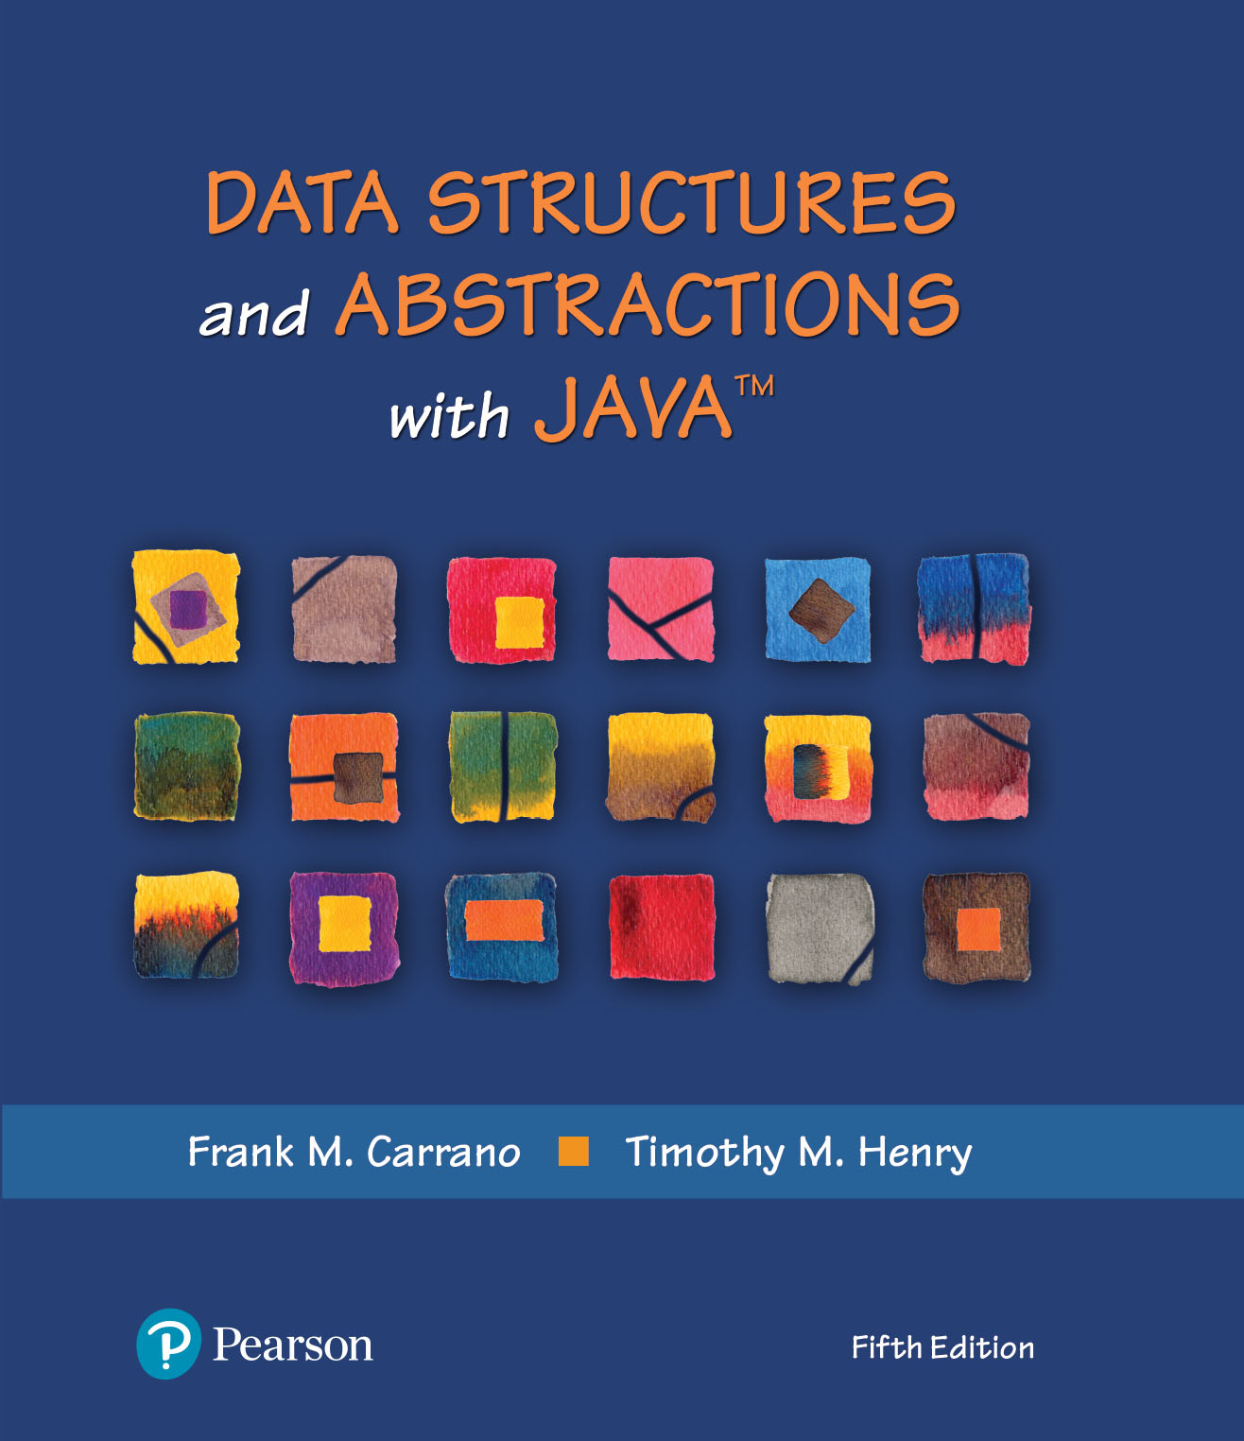
Data Structures and Abstractions with Java™
5th Edition
Chapter 29
Graphs

Slide 2
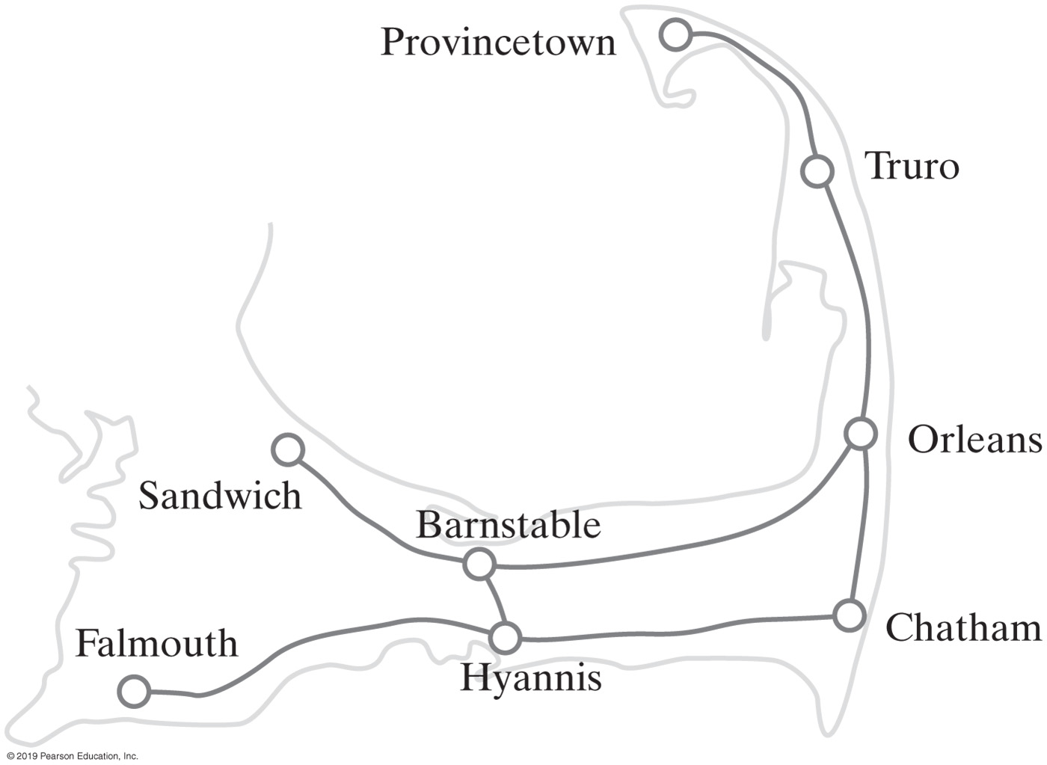
Graphs
A road map is a graph
Definition of a graph:
  A collection of distinct vertices and distinct edges
In the map of Figure 29-1
  The circles are vertices or nodes
  The lines are called edges
A subgraph is a portion of a graph that is itself a graph
FIGURE 29-1 A portion of a road map

Slide 3
Connected Graphs
A graph that has a path between every pair of distinct vertices is connected
A complete graph has an edge between every pair of distinct vertices.
Undirected graphs can be
  Connected
  Complete or
  Disconnected

Slide 4
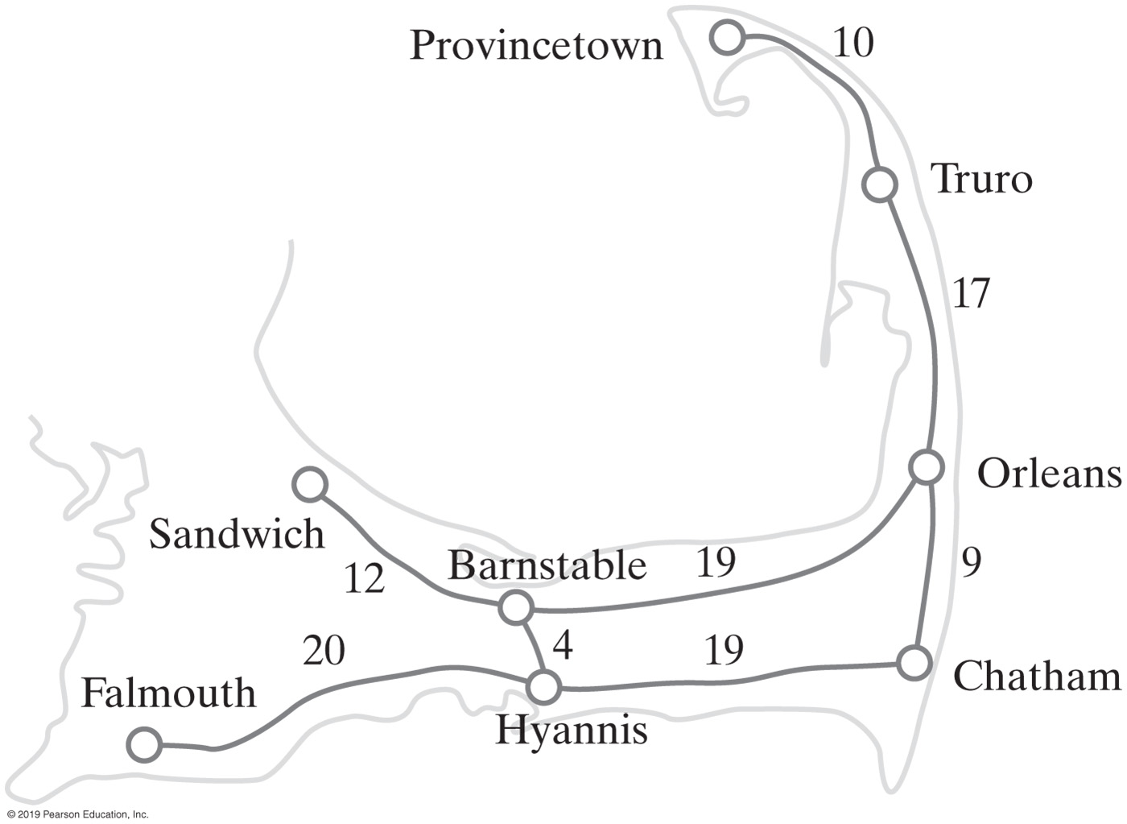
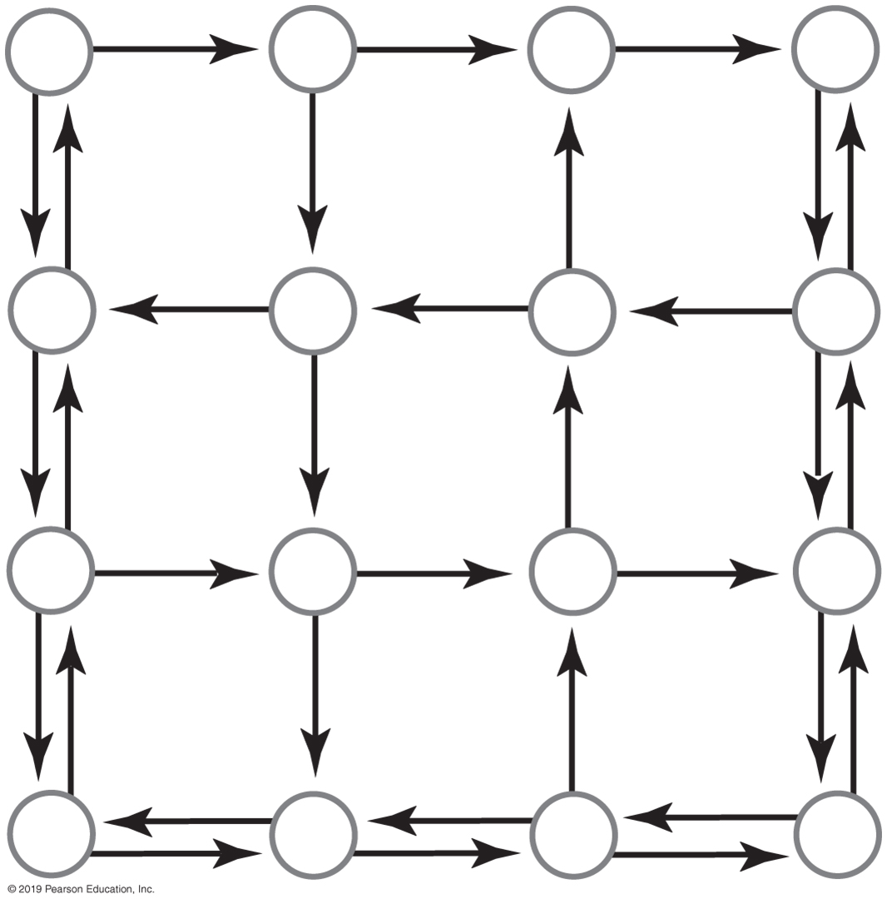
Graphs
FIGURE 29-2 A directed graph representing a portion of a city’s street map
FIGURE 29-3 A weighted graph

Slide 5
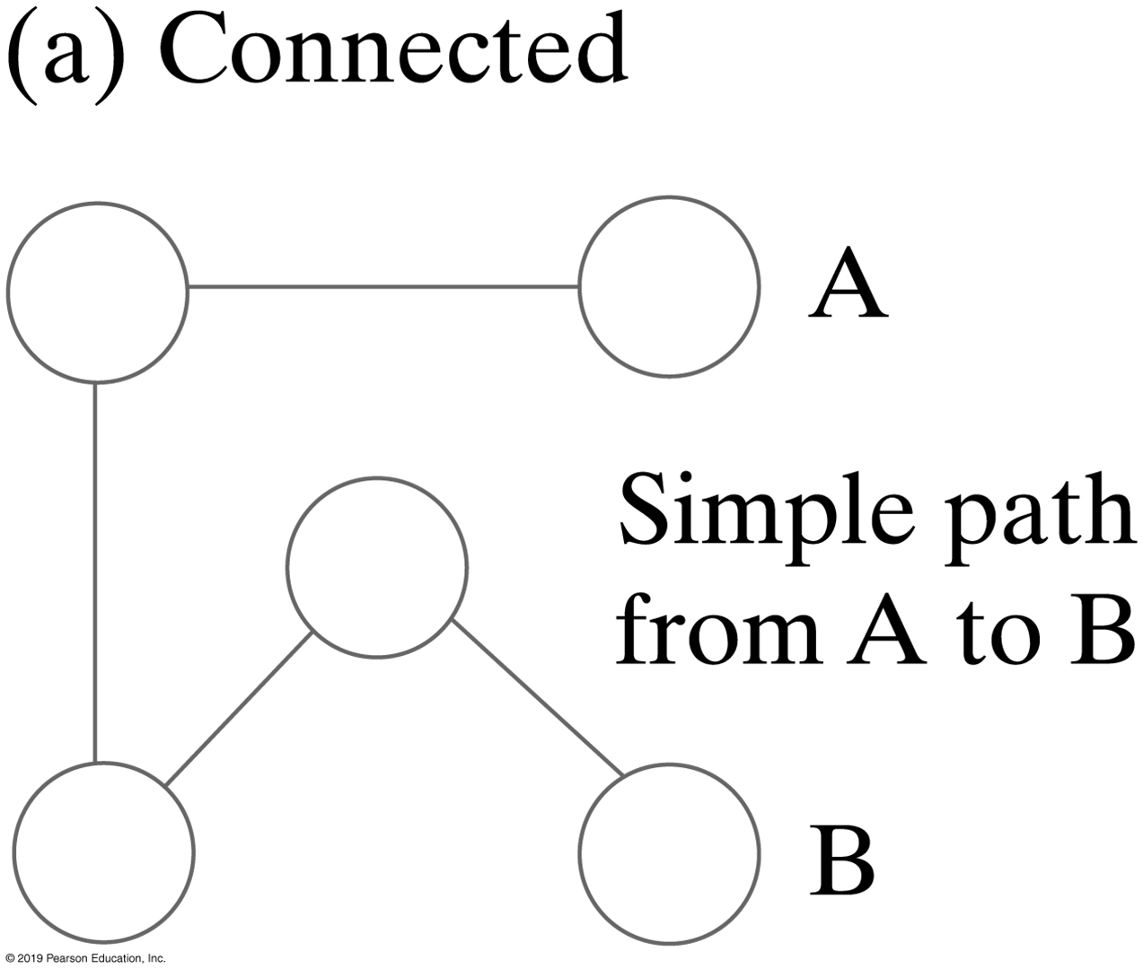
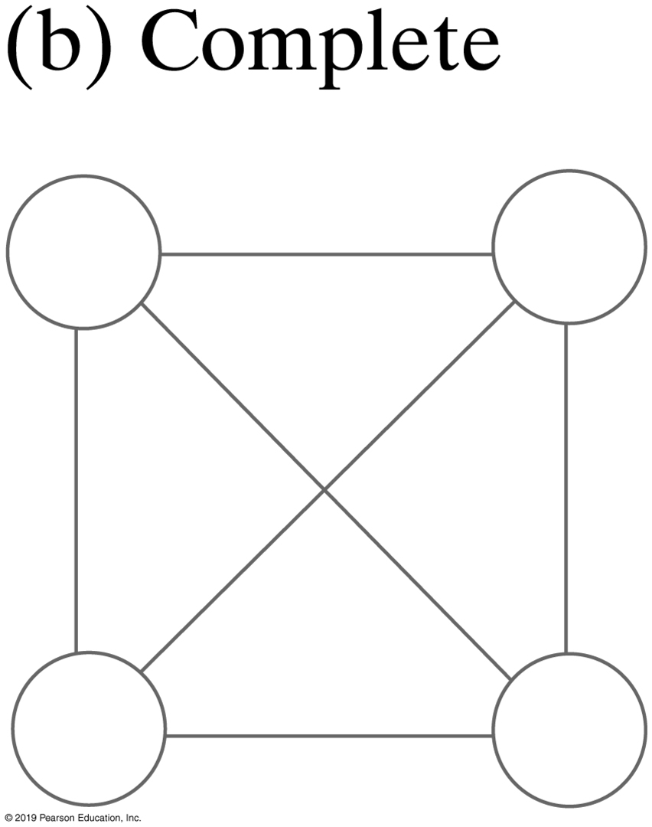
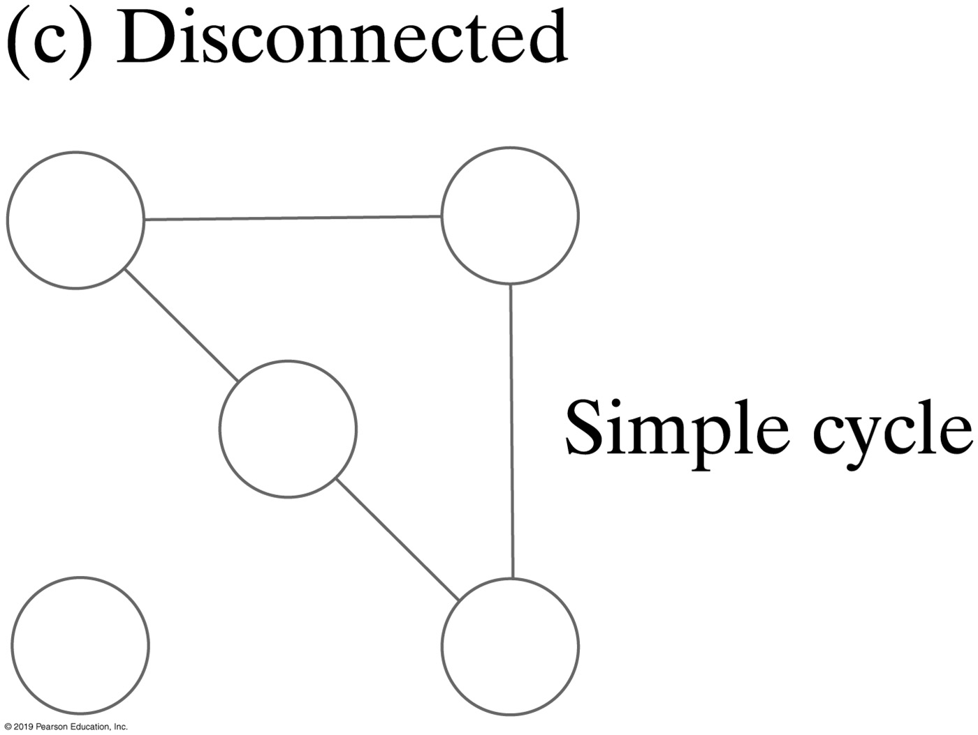
Paths
A path between two vertices in a graph is a sequence of edges
A path in a directed graph must consider the direction of the edges
  Called a directed path
The length of a path is the number of edges that it comprises.
A cycle is a path that begins and ends at the same vertex
FIGURE 29-4 Undirected graphs

Slide 6
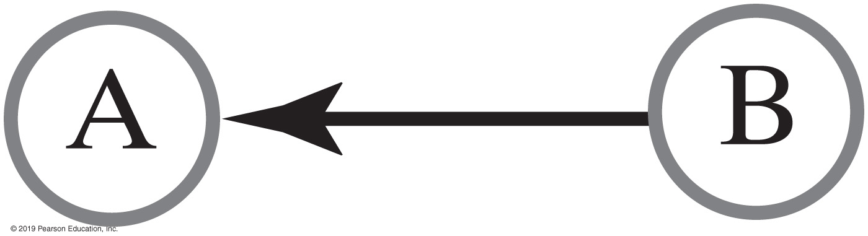
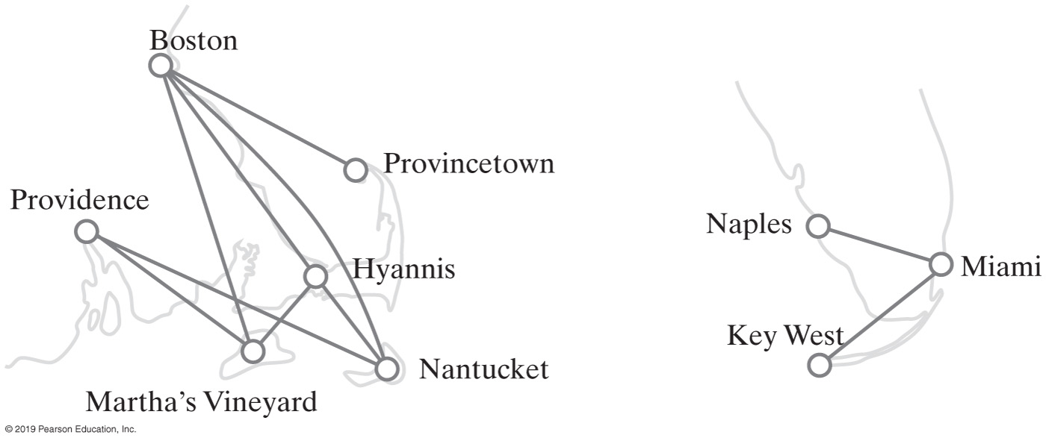
Directed Graphs
FIGURE 29-5 Vertex A is adjacent to vertex B, but B is not adjacent to A
FIGURE 29-6 Airline routes

Slide 7
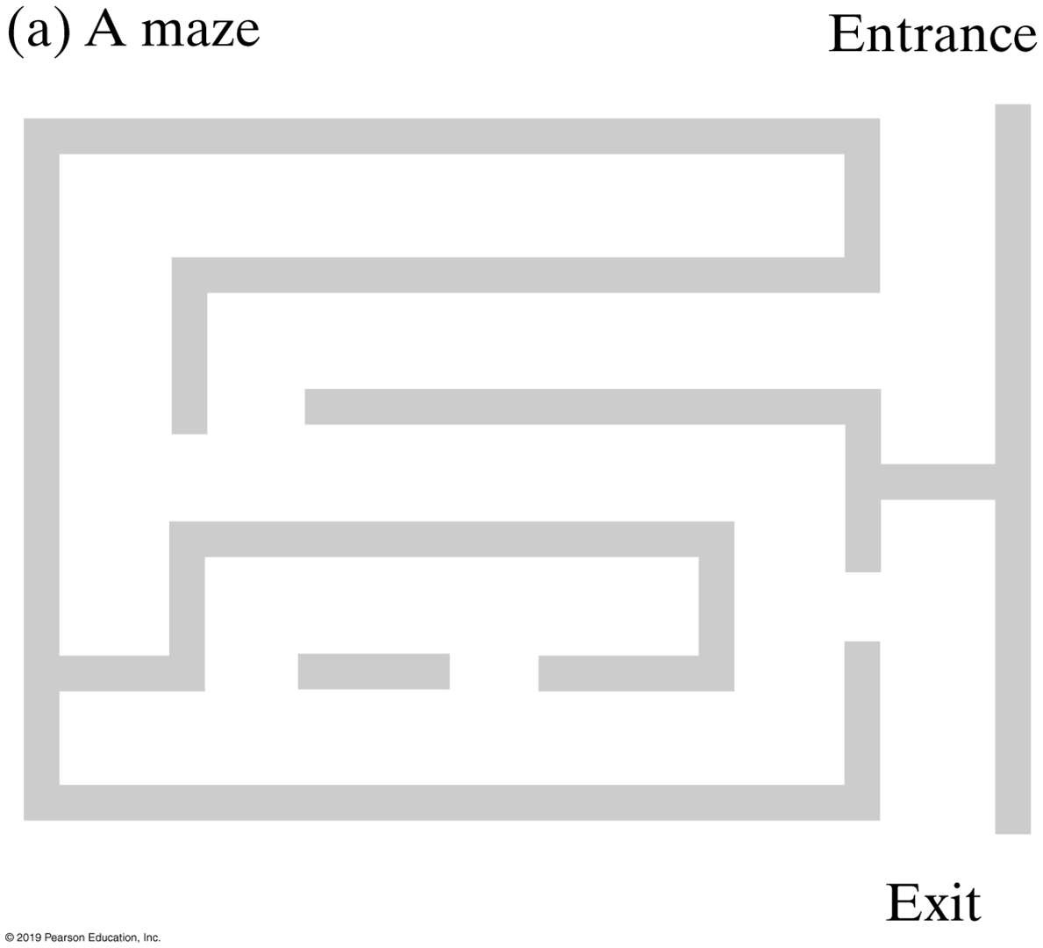
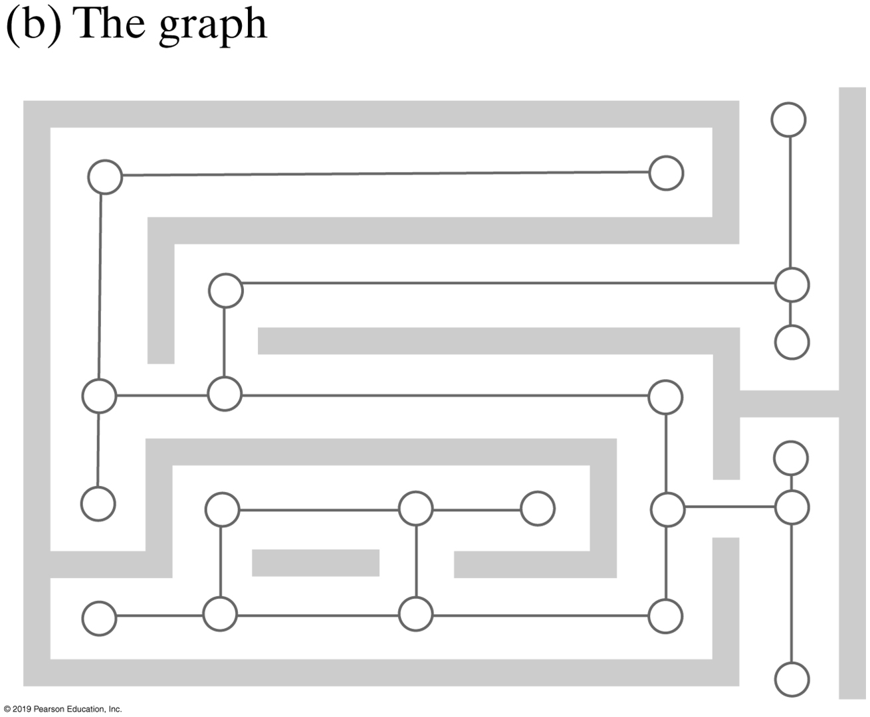
Graphs
FIGURE 29-7 A maze and its representation as a graph

Slide 8
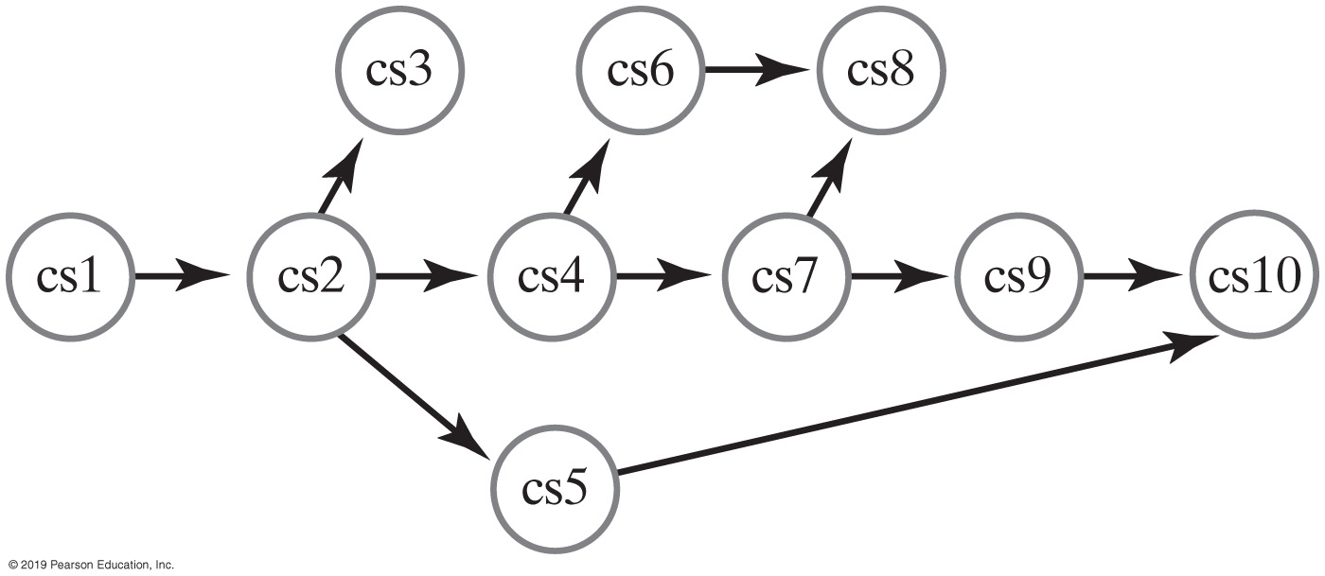
Directed Graphs
FIGURE 29-8 The prerequisite structure for a selection of courses as a directed graph without cycles

Slide 9
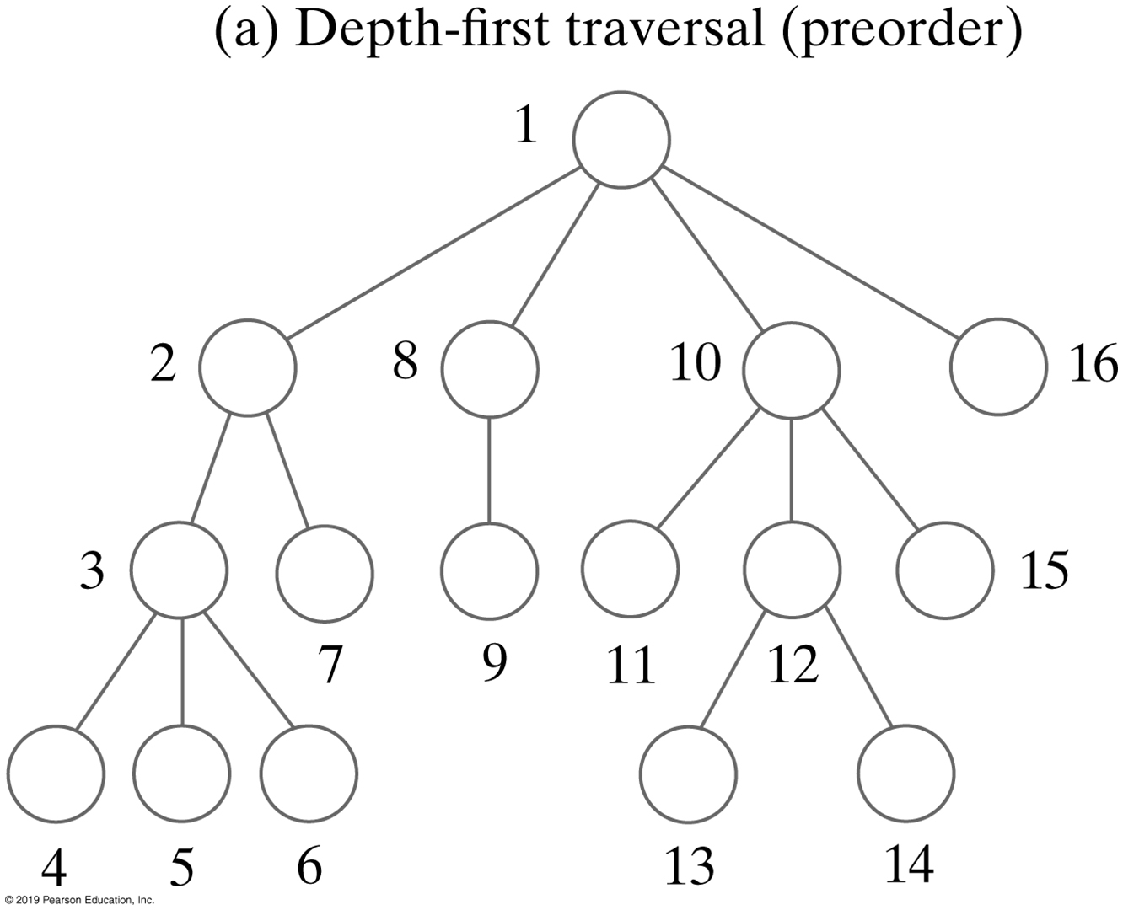
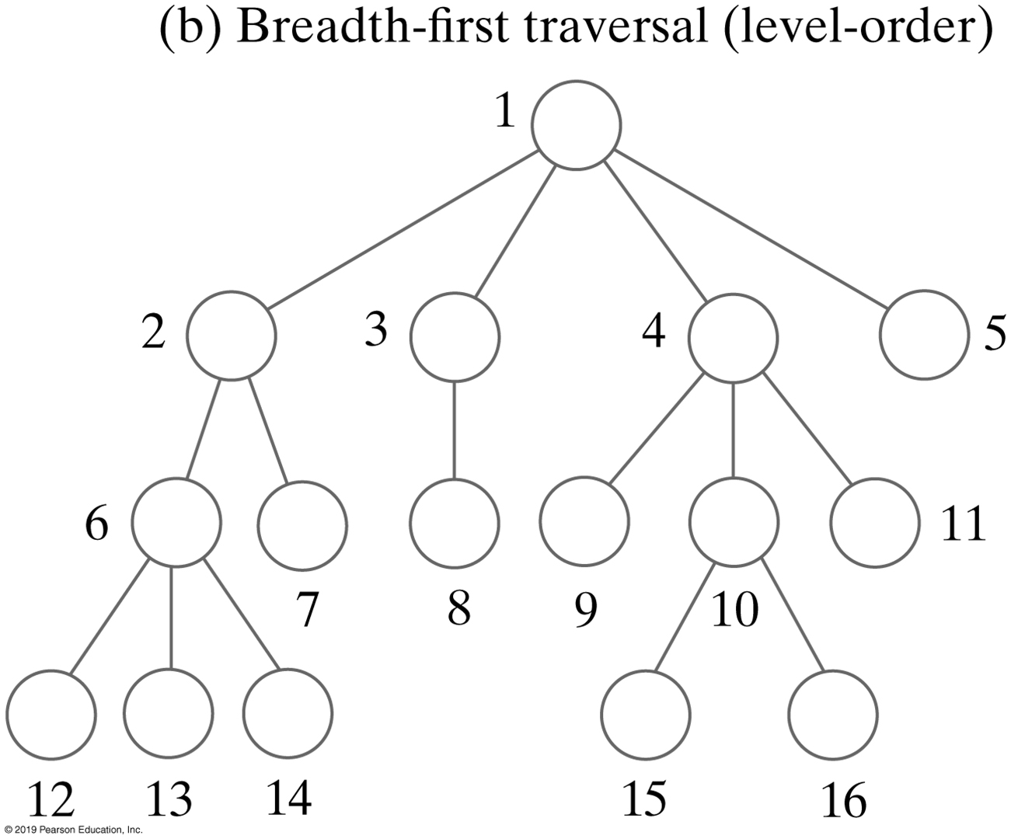
Graph Traversal
FIGURE 29-9 The visitation order of two traversals

Slide 10
Breadth-First Traversal
Algorithm getBreadthFirstTraversal(originVertex)
traversalOrder = a new queue for the resulting traversal order
vertexQueue = a new queue to hold vertices as they are visited
Mark originVertex as visited
traversalOrder.enqueue(originVertex)
vertexQueue.enqueue(originVertex)
while (!vertexQueue.isEmpty())
{
frontVertex = vertexQueue.dequeue()
    while (frontVertex has a neighbor)
    {
        nextNeighbor = next neighbor of frontVertex
        if (nextNeighbor is not visited)
        {
            Mark nextNeighbor as visited
            traversalOrder.enqueue(nextNeighbor)
            vertexQueue.enqueue(nextNeighbor)
        }
    }
}
return traversalOrder
Algorithm that performs a breadth-first traversal of a nonempty graph beginning at a given vertex

Slide 11
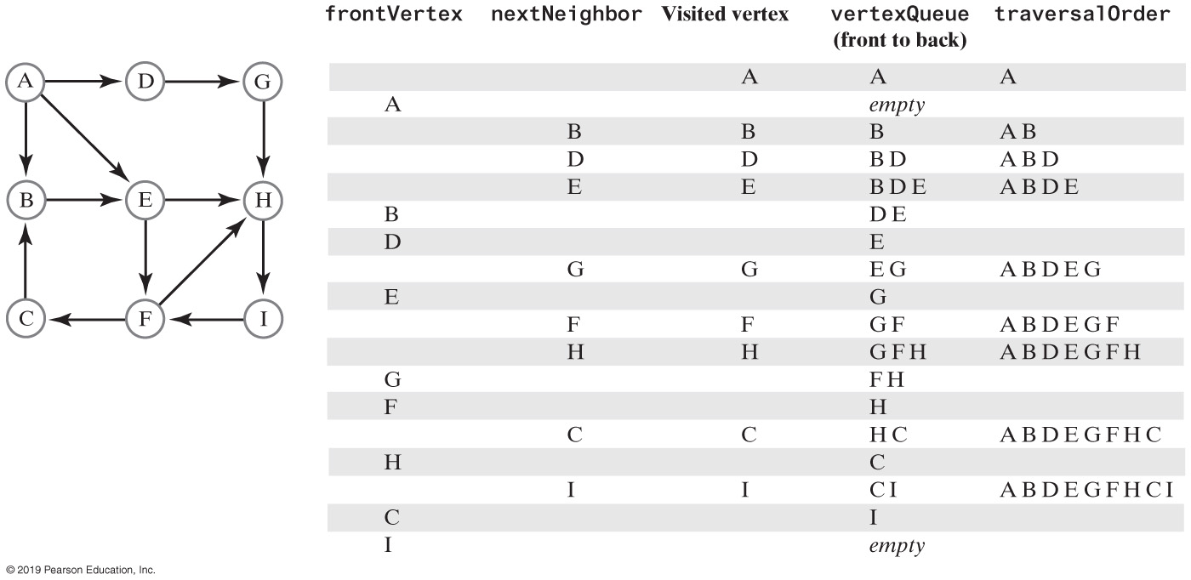
Breadth-First Traversal
FIGURE 29-10 A trace of a breadth-first traversal beginning at vertex A of a directed graph

Slide 12
Depth-First Traversal
Algorithm getDepthFirstTraversal(originVertex)
traversalOrder = a new queue for the resulting traversal order
vertexStack = a new stack to hold vertices as they are visited
Mark originVertex as visited
traversalOrder.enqueue(originVertex)
vertexStack.push(originVertex)
while (!vertexStack.isEmpty())
{
    topVertex = vertexStack.peek()
    if (topVertex has an unvisited neighbor)
    {
        nextNeighbor = next unvisited neighbor of topVertex
        Mark nextNeighbor as visited
        traversalOrder.enqueue(nextNeighbor)
        vertexStack.push(nextNeighbor)
    }
    else // All neighbors are visited
        vertexStack.pop()
}
return traversalOrder
Algorithm that performs a depth-first traversal of a nonempty graph, beginning at a given vertex

Slide 13
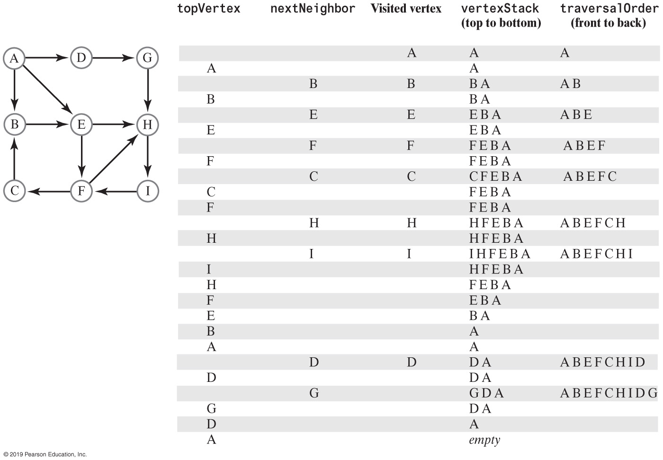
Depth-First Traversal
FIGURE 29-11 A trace of a depth-first traversal beginning at vertex A of a directed graph

Slide 14
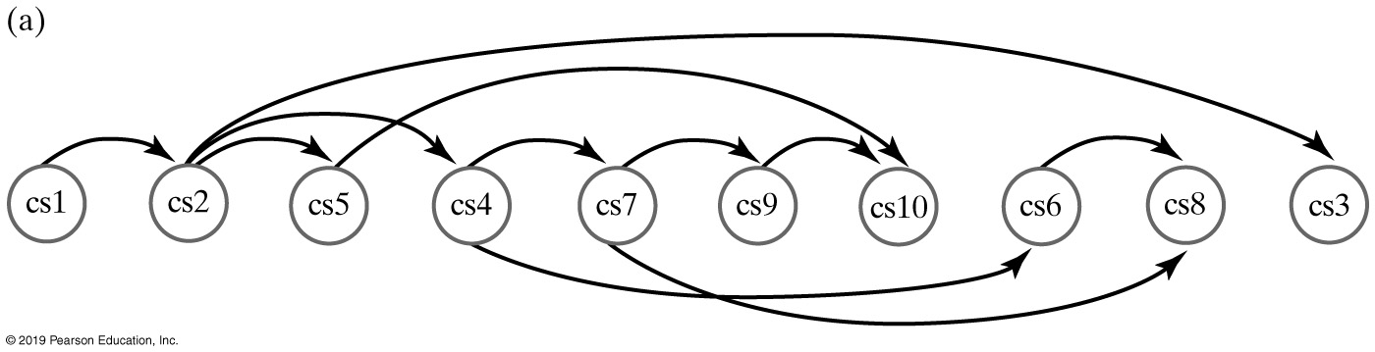
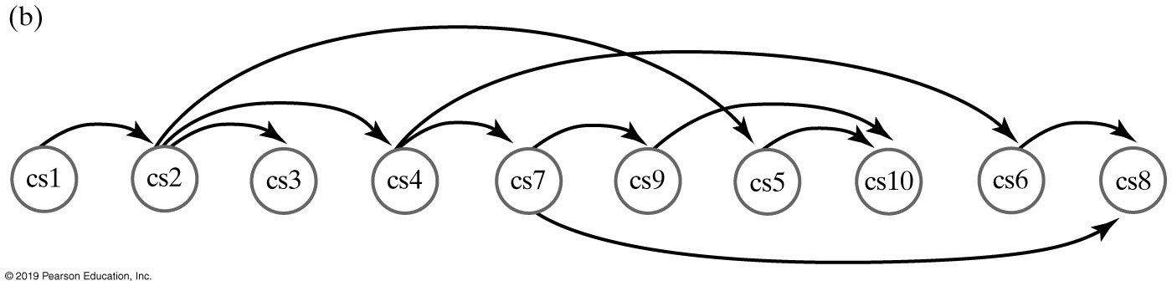
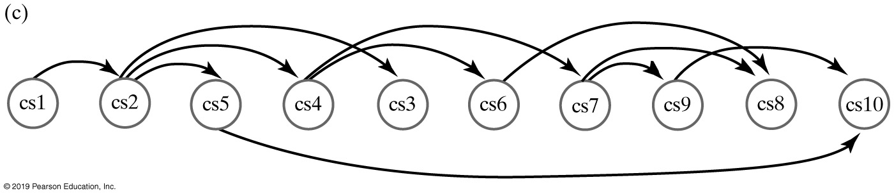
Topological Ordering
Figure 29-8
FIGURE 29-12 Three topological orders for the graph in Figure 29-8

Slide 15

Topological Ordering
In a topological order of the vertices in a directed graph without cycles, vertex a precedes vertex b whenever a directed edge exists from a to b.
FIGURE 29-13 An impossible prerequisite structure for three courses, as a directed graph with a cycle

Slide 16
Topological Order
Algorithm getTopologicalOrder()
vertexStack = a new stack to hold vertices as they are visited
numberOfVertices = number of vertices in the graph
for (counter = 1 to numberOfVertices)
{
    nextVertex = an unvisited vertex whose neighbors, if any, are all visited
    Mark nextVertex as visited
    vertexStack.push(nextVertex)
}
return vertexStack
An algorithm that describes a topological sort

Slide 17
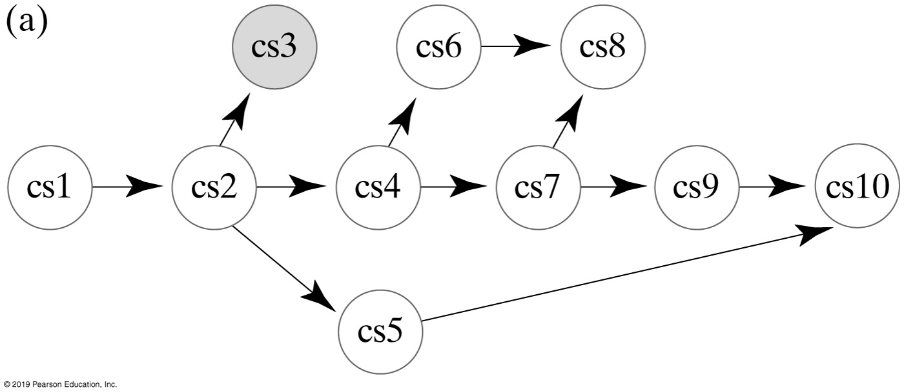
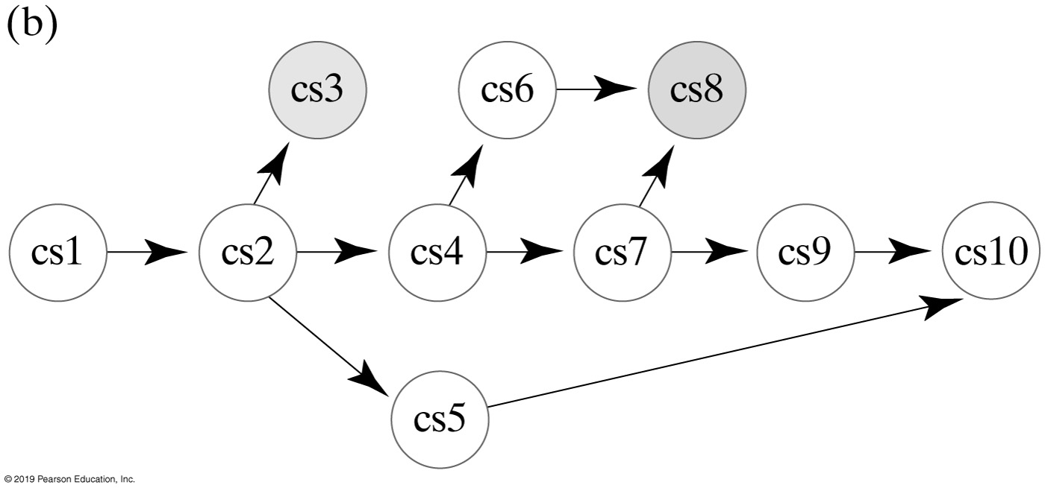
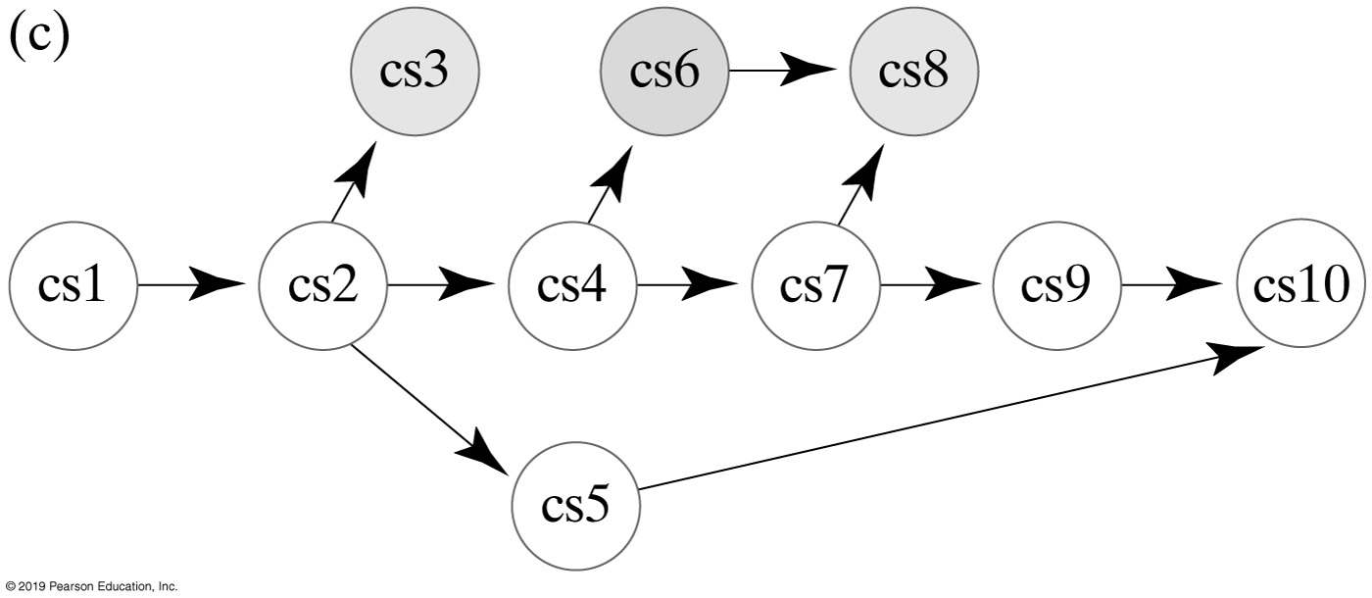
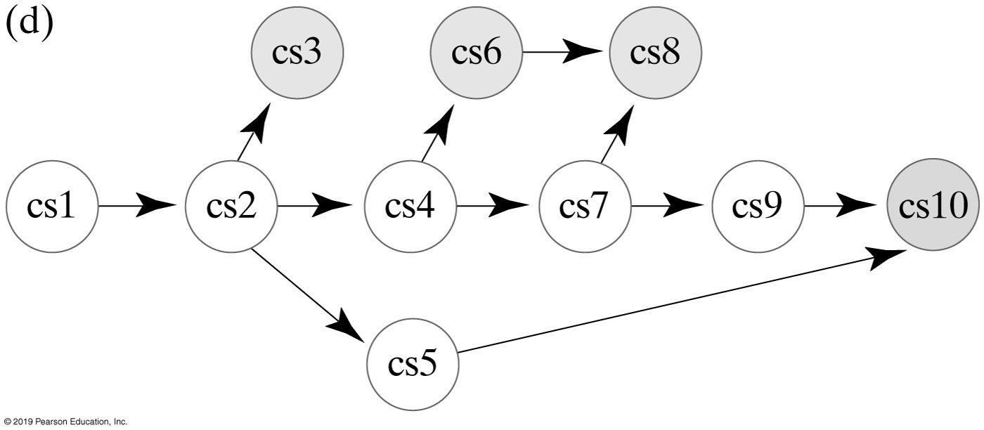
Topological Ordering (Part 1)
Figure 29-8
FIGURE 29-14 Finding a topological order for the graph in Figure 29-8

Slide 18
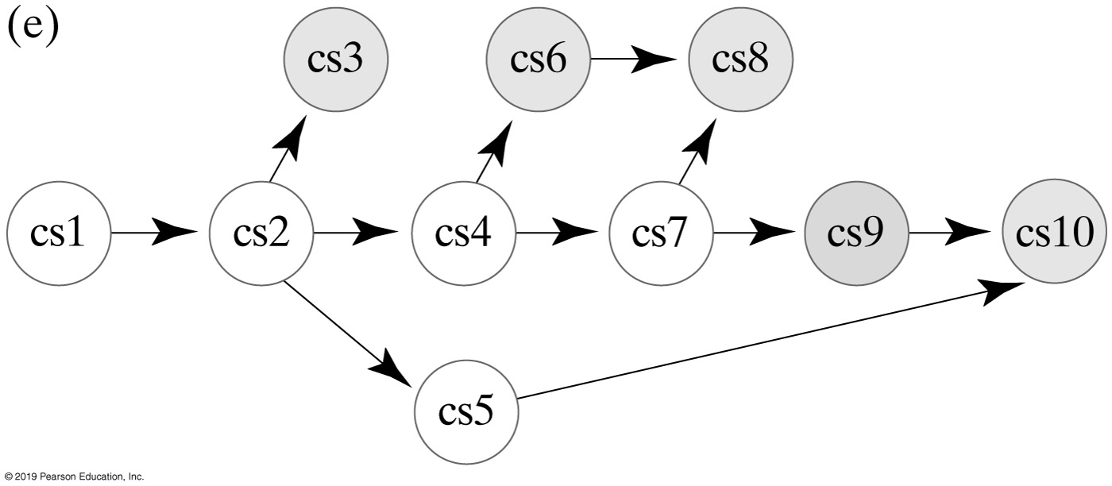
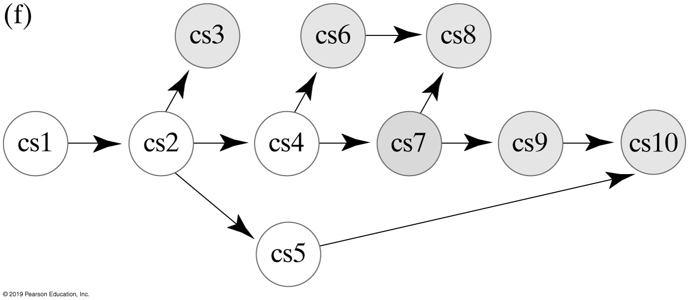
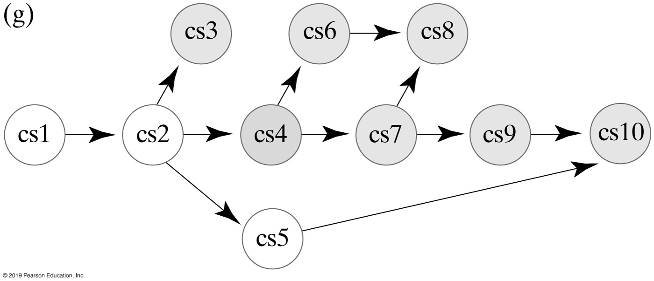
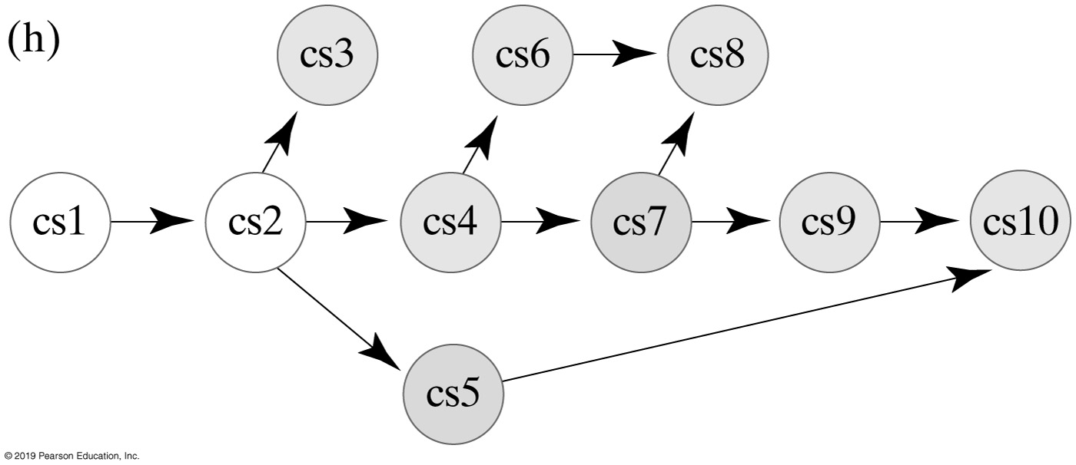
Topological Ordering (Part 2)
Figure 29-8
FIGURE 29-14 Finding a topological order for the graph in Figure 29-8

Slide 19
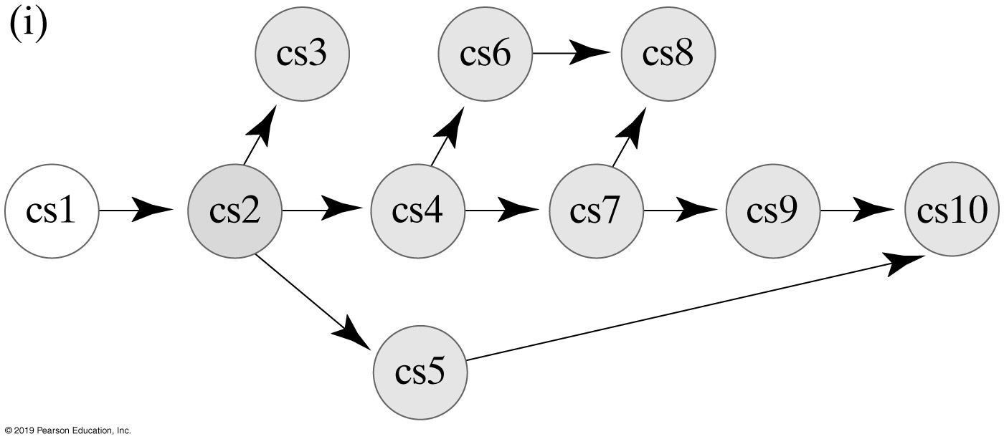
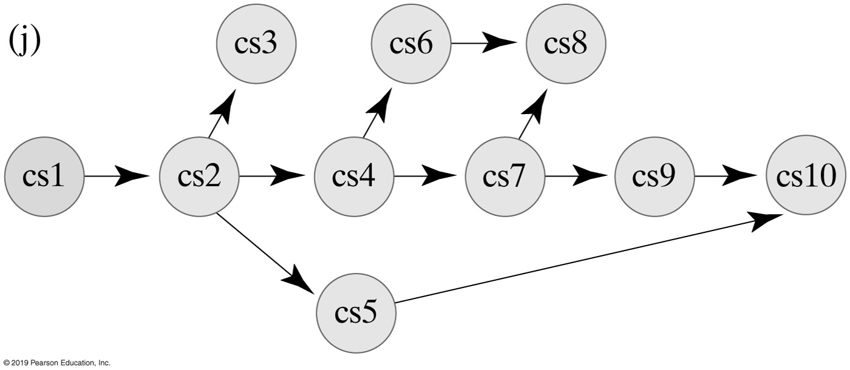
Topological Ordering (Part 3)
Figure 29-8
FIGURE 29-14 Finding a topological order for the graph in Figure 29-8

Slide 20
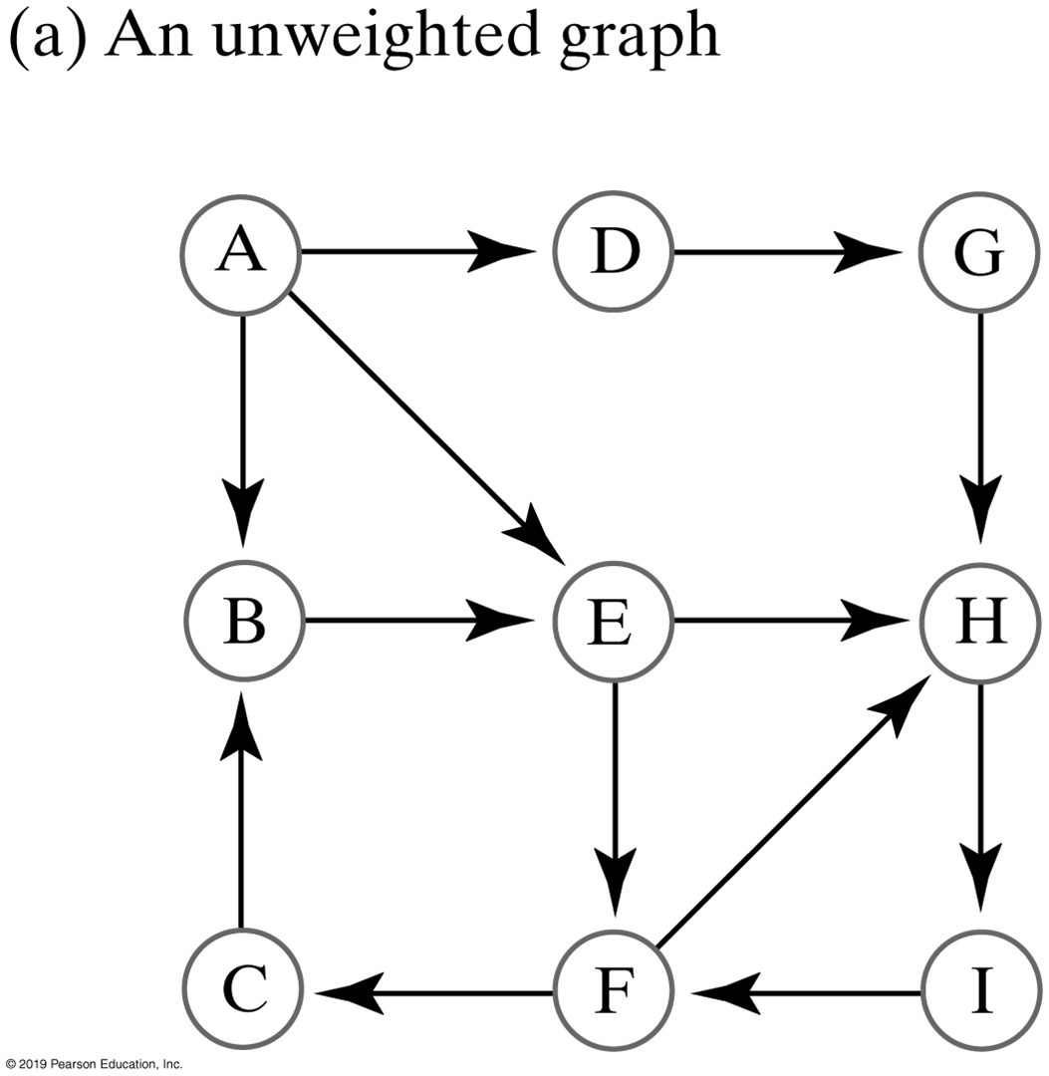
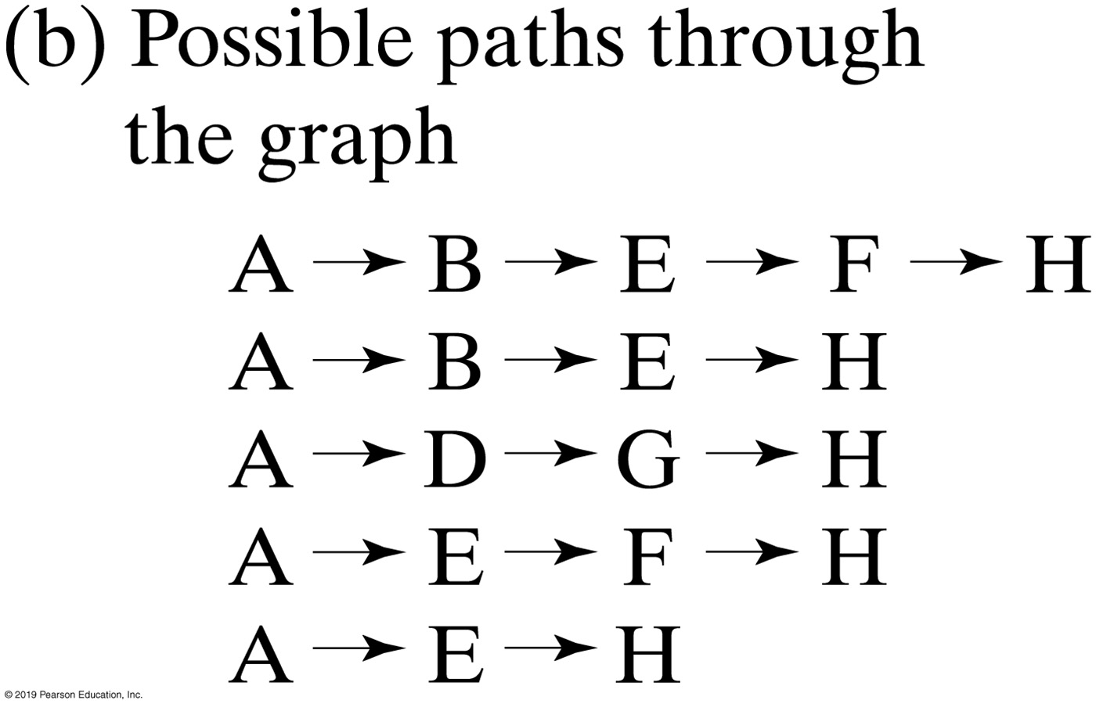
Shortest Path in Unweighted Graph
FIGURE 29-15 An unweighted graph and the possible paths from vertex A to vertex H

Slide 21
Shortest Path in an Unweighted Graph (Part 1)
Algorithm getShortestPath(originVertex, endVertex, path)
done = false
vertexQueue = a new queue to hold vertices as they are visited
Mark originVertex as visited
vertexQueue.enqueue(originVertex)
while (!done && !vertexQueue.isEmpty())
{
    frontVertex = vertexQueue.dequeue()
    while (!done && frontVertex has a neighbor)
    {
        nextNeighbor = next neighbor of frontVertex
        if (nextNeighbor is not visited)
        {
            Mark nextNeighbor as visited
            Set the length of the path to nextNeighbor to 1 + length of path to frontVertex
            Set the predecessor of nextNeighbor to frontVertex
            vertexQueue.enqueue(nextNeighbor)
        }
        if (nextNeighbor equals endVertex)
            done = true
    }
}
Algorithm to find shortest path

Slide 22
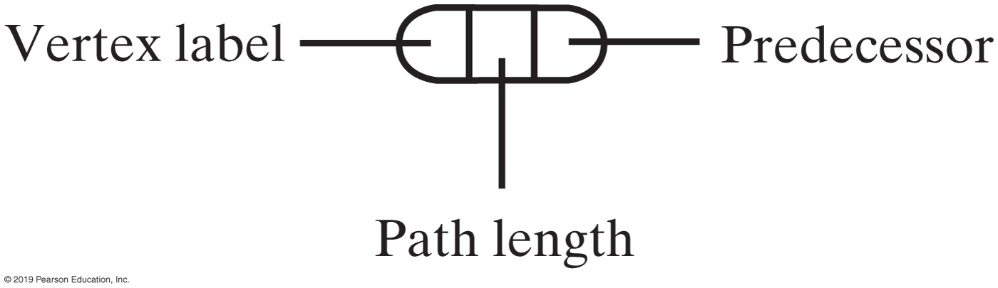
Shortest Path in an Unweighted Graph (Part 2)
// Traversal ends; construct shortest path
pathLength = length of path to endVertex
path.push(endVertex)
vertex = endVertex
while (vertex has a predecessor)
{
    vertex = predecessor of vertex
    path.push(vertex)
}
return pathLength
Algorithm to find shortest path
FIGURE 29-16 The data in a vertex

Slide 23
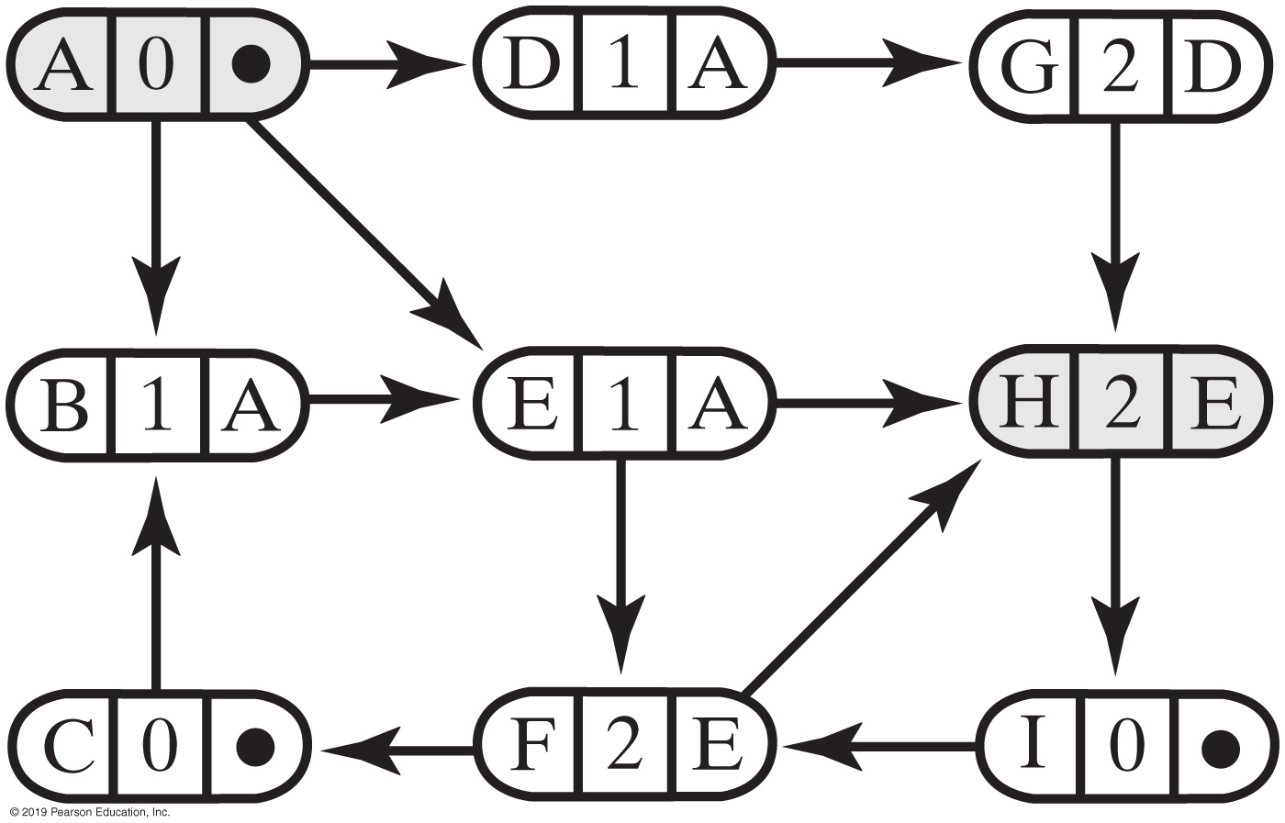
Shortest Path in a Weighted Graph
FIGURE 29-17 The graph in Figure 29-15a after the shortest-path algorithm has traversed from vertex A to vertex H

Slide 24
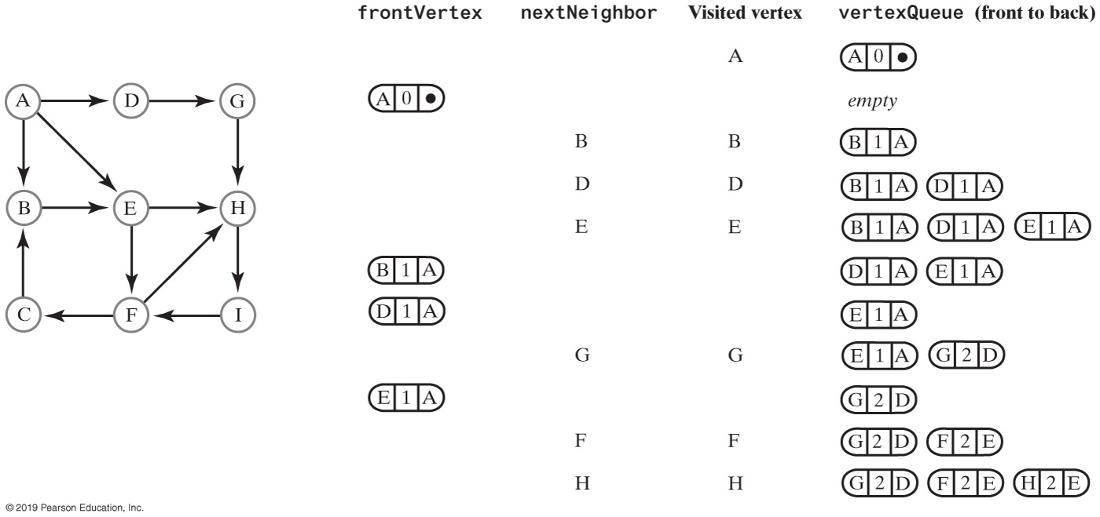
Shortest Path in a Weighted Graph
FIGURE 29-18 A trace of the traversal in the algorithm to find the shortest path from vertex A to vertex H in an unweighted graph

Slide 25
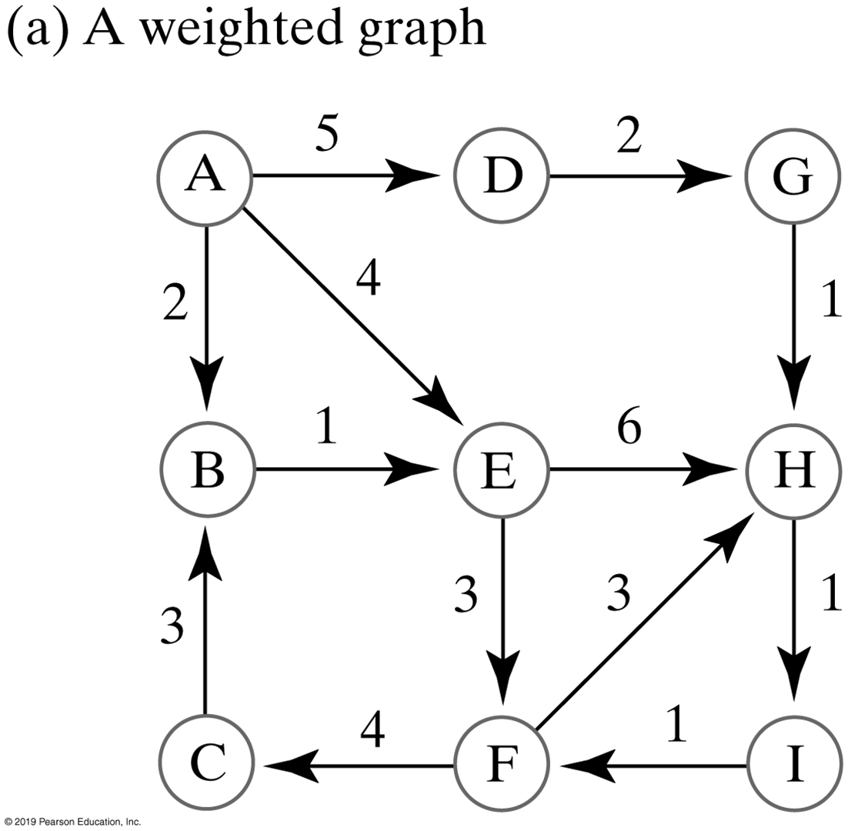
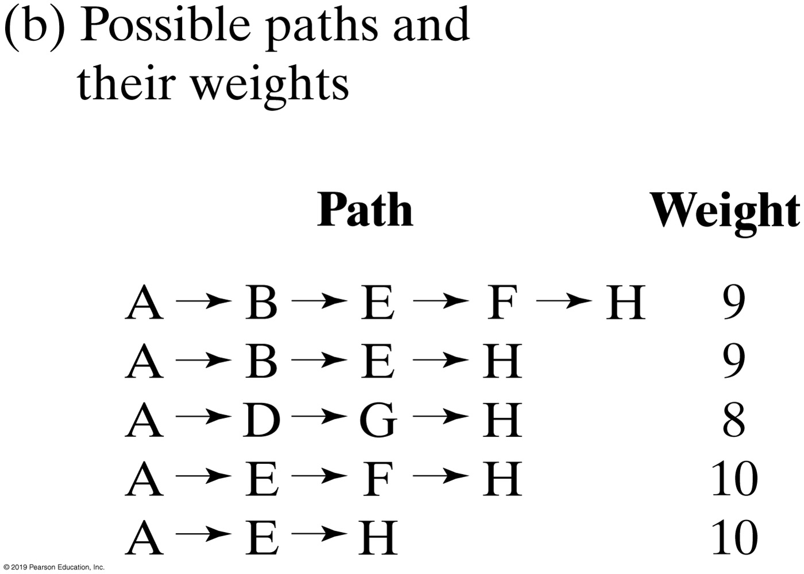
Shortest Path in a Weighted Graph
FIGURE 29-19 A weighted graph and the possible paths from vertex A to vertex H

Slide 26
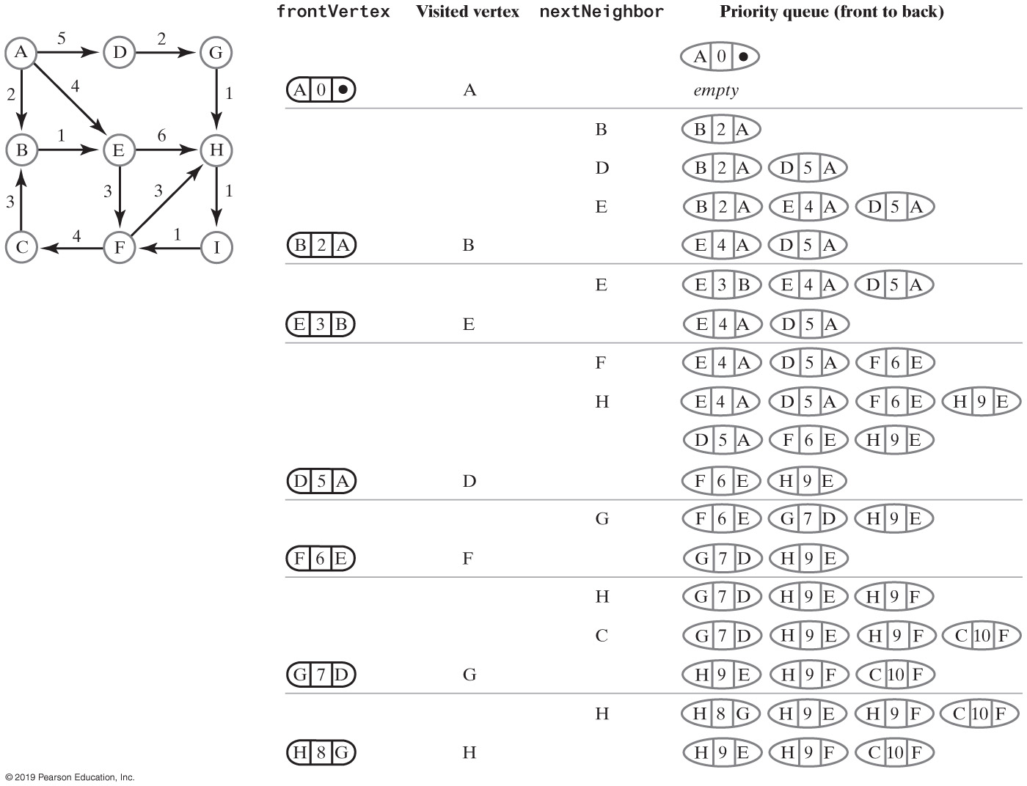
Shortest Path in a Weighted Graph
FIGURE 29-20 A trace of the traversal in the algorithm to find the cheapest path from vertex A to vertex H in a weighted graph

Slide 27
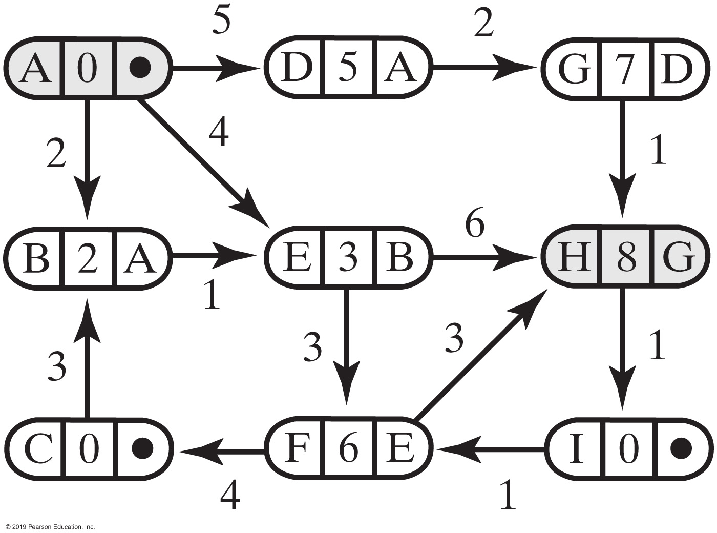
Shortest Path in a Weighted Graph
FIGURE 29-21 The graph in Figure 29-19a after finding the cheapest path from vertex A to vertex H

Slide 28
The Shortest Path in a Weighted Graph (Part 1)
Algorithm getCheapestPath(originVertex, endVertex, path)
done = false
priorityQueue = a new priority queue
priorityQueue.add(new EntryPQ(originVertex, 0, null))
while (!done && !priorityQueue.isEmpty())
{
    frontEntry = priorityQueue.remove()
    frontVertex = vertex in frontEntry
    if (frontVertex is not visited)
    {
        Mark frontVertex as visited
        Set the cost of the path to frontVertex to the cost recorded in frontEntry
        Set the predecessor of frontVertex to the predecessor recorded in frontEntry
        if (frontVertex equals endVertex)
            done = true
        else
        {
Pseudocode for shortest path (weighted)

Slide 29
The Shortest Path in a Weighted Graph (Part 2)
            while (frontVertex has a neighbor)
            {
                nextNeighbor = next neighbor of frontVertex
                weightOfEdgeToNeighbor = weight of edge to nextNeighbor
                if (nextNeighbor is not visited)
                {
                nextCost = weightOfEdgeToNeighbor + cost of path to frontVertex
                priorityQueue.add(new EntryPQ(nextNeighbor, nextCost,
                frontVertex))
                }
            }
        }
    }
}
Pseudocode for shortest path (weighted)

Slide 30
The Shortest Path in a Weighted Graph (Part 3)
// Traversal ends; construct cheapest path
pathCost = cost of path to endVertex
path.push(endVertex)
vertex = endVertex
while (vertex has a predecessor)
{
    vertex = predecessor of vertex
    path.push(vertex)
}
return pathCost
Pseudocode for shortest path (weighted)

Slide 31
Java Interfaces for the ADT Graph (Part 1)
/** An interface of methods providing basic operations for directed
and undirected graphs that are either weighted or unweighted. */
public interface BasicGraphInterface<T>
{
/** Adds a given vertex to this graph.
@param vertexLabel An object that labels the new vertex and is
distinct from the labels of current vertices.
@return True if the vertex is added, or false if not. */
public boolean addVertex(T vertexLabel);
/** Adds a weighted edge between two given distinct vertices that
are currently in this graph. The desired edge must not already
be in the graph. In a directed graph, the edge points toward
the second vertex given.
@param begin An object that labels the origin vertex of the edge.
@param end An object, distinct from begin, that labels the end
vertex of the edge.
@param edgeWeight The real value of the edge's weight.
@return True if the edge is added, or false if not. */
public boolean addEdge(T begin, T end, double edgeWeight);
LISTING 29-1 An interface of basic graph operations

Slide 32
Java Interfaces for the ADT Graph (Part 2)
/** Adds an unweighted edge between two given distinct vertices
that are currently in this graph. The desired edge must not
already be in the graph. In a directed graph, the edge points
toward the second vertex given.
@param begin An object that labels the origin vertex of the edge.
@param end An object, distinct from begin, that labels the end
vertex of the edge.
@return True if the edge is added, or false if not. */
public boolean addEdge(T begin, T end);
/** Sees whether an edge exists between two given vertices.
@param begin An object that labels the origin vertex of the edge.
@param end An object that labels the end vertex of the edge.
@return True if an edge exists. */
public boolean hasEdge(T begin, T end);
/** Sees whether this graph is empty.
@return True if the graph is empty. */
public boolean isEmpty();
LISTING 29-1 An interface of basic graph operations

Slide 33
Java Interfaces for the ADT Graph (Part 3)
/** Gets the number of vertices in this graph.
@return The number of vertices in the graph. */
public int getNumberOfVertices();
/** Gets the number of edges in this graph.
@return The number of edges in the graph. */
public int getNumberOfEdges();
/** Removes all vertices and edges from this graph
resulting in an empty graph. */
public void clear();
} // end BasicGraphInterface
LISTING 29-1 An interface of basic graph operations

Slide 34
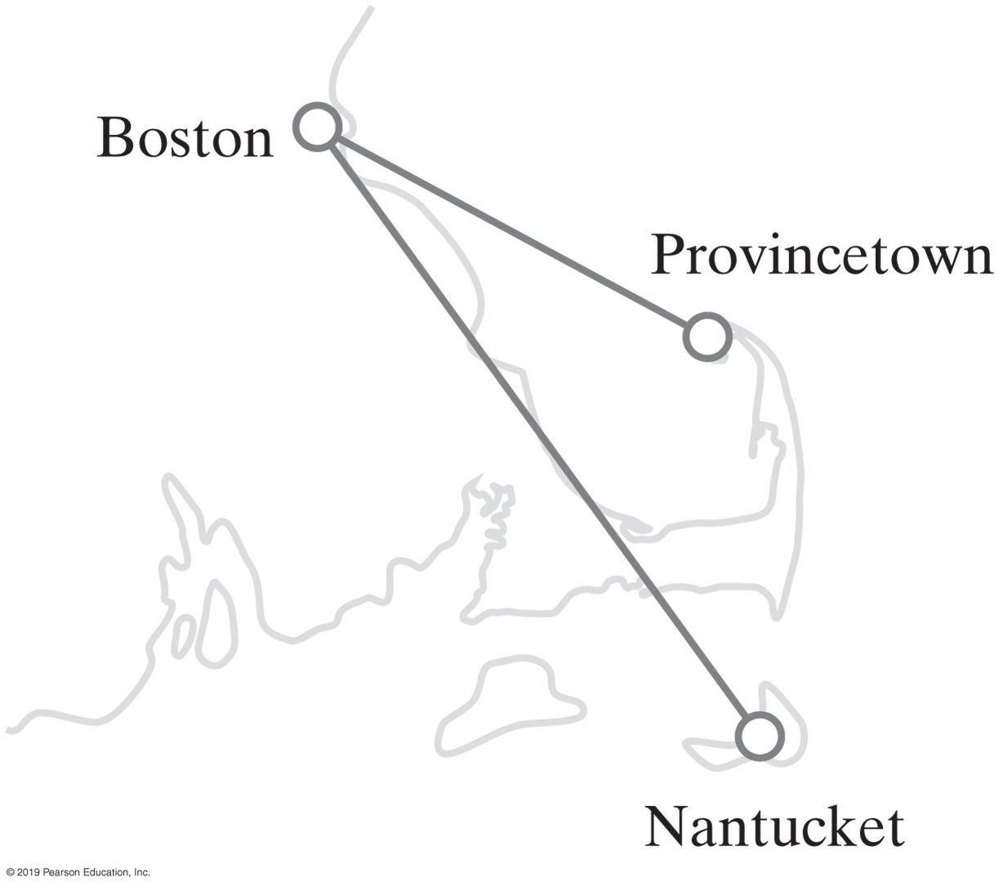
Java Interfaces for the ADT Graph
FIGURE 29-22 A portion of the flight map in Figure 29-6

Slide 35
Java Interfaces for the ADT Graph (Part 1)
/** An interface of methods that process an existing graph. */
public interface GraphAlgorithmsInterface<T>
{
/** Performs a breadth-first traversal of this graph.
@param origin An object that labels the origin vertex of the traversal.
@return A queue of labels of the vertices in the traversal, with
the label of the origin vertex at the queue's front. */
public QueueInterface<T> getBreadthFirstTraversal(T origin);
/** Performs a depth-first traversal of this graph.
@param origin An object that labels the origin vertex of the traversal.
@return A queue of labels of the vertices in the traversal, with
the label of the origin vertex at the queue's front. */
public QueueInterface<T> getDepthFirstTraversal(T origin);
/** Performs a topological sort of the vertices in this graph without cycles.
@return A stack of vertex labels in topological order, beginning
with the stack's top. */
public StackInterface<T> getTopologicalOrder();
LISTING 29-2 An interface of operations on an existing graph

Slide 36
Java Interfaces for the ADT Graph (Part 2)
/** Finds the shortest-length path between two given vertices in this graph.
@param begin An object that labels the path's origin vertex.
@param end An object that labels the path's destination vertex.
@param path A stack of labels that is empty initially;
at the completion of the method, this stack contains
the labels of the vertices along the shortest path;
the label of the origin vertex is at the top, and
the label of the destination vertex is at the bottom
@return The length of the shortest path. */
public int getShortestPath(T begin, T end, StackInterface<T> path);
/** Finds the least-cost path between two given vertices in this graph.
@param begin An object that labels the path's origin vertex.
@param end An object that labels the path's destination vertex.
@param path A stack of labels that is empty initially;
at the completion of the method, this stack contains
the labels of the vertices along the cheapest path;
the label of the origin vertex is at the top, and
the label of the destination vertex is at the bottom
@return The cost of the cheapest path. */
public double getCheapestPath(T begin, T end, StackInterface<T> path);
} // end GraphAlgorithmsInterface
LISTING 29-2 An interface of operations on an existing graph

Slide 37
Java Interfaces for the ADT Graph
/** An interface of methods that create, manipulate, and process a graph. */
public interface GraphInterface<T> extends BasicGraphInterface<T>,
GraphAlgorithmsInterface<T>
{
} // end GraphInterface
LISTING 29-3 An interface for the ADT graph

Slide 38
End
Chapter 29

