Slide 1
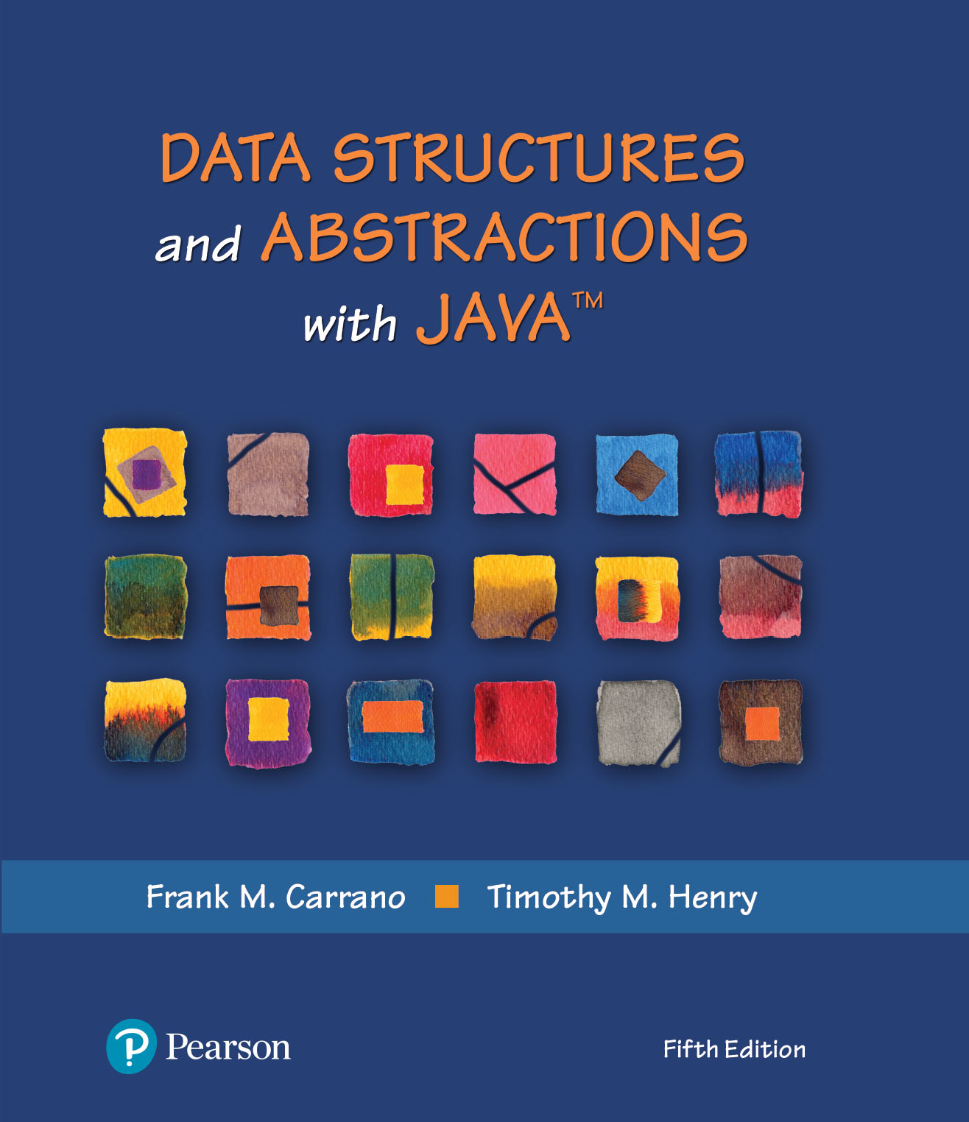
Data Structures and Abstractions with Java™
5th Edition
Chapter 30
Graph Implementations

Slide 2
Overview of Two Implementations
Two common implementations of the ADT graph
  Array:
    Typically a two-dimensional array called an adjacency matrix
  List:
    Referred to as an adjacency list.

Slide 3
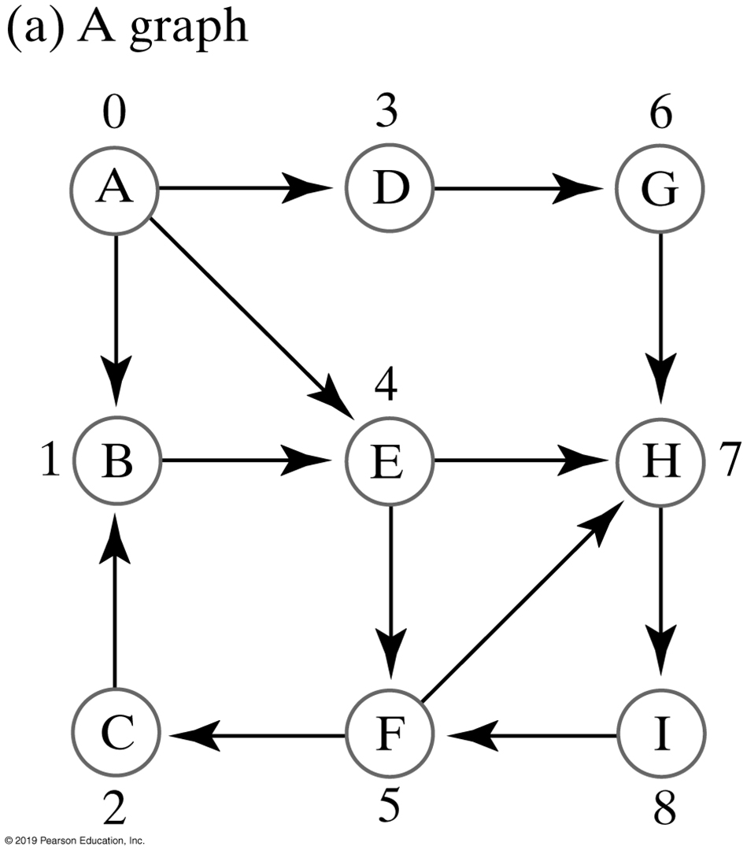
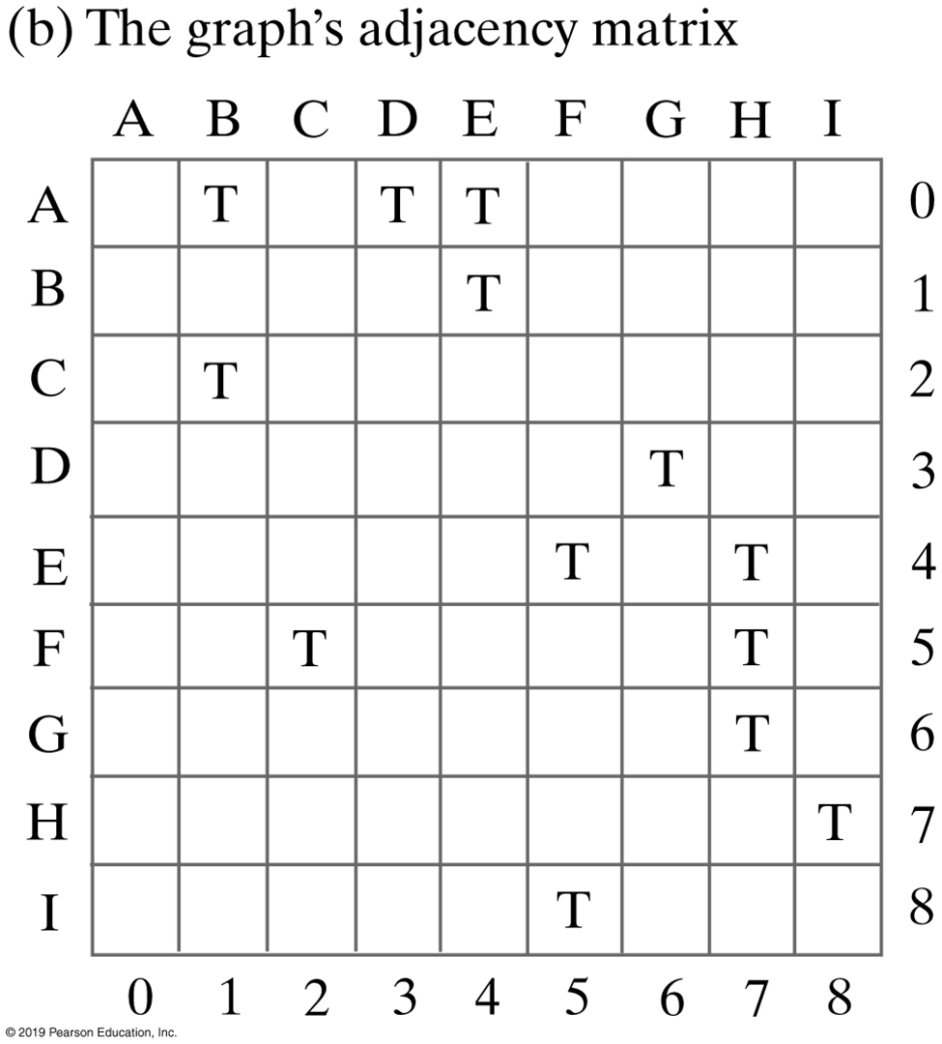
FIGURE 30-1 An unweighted, directed graph and its adjacency matrix
FIGURE 30-1 An unweighted, directed graph and its adjacency matrix

Slide 4
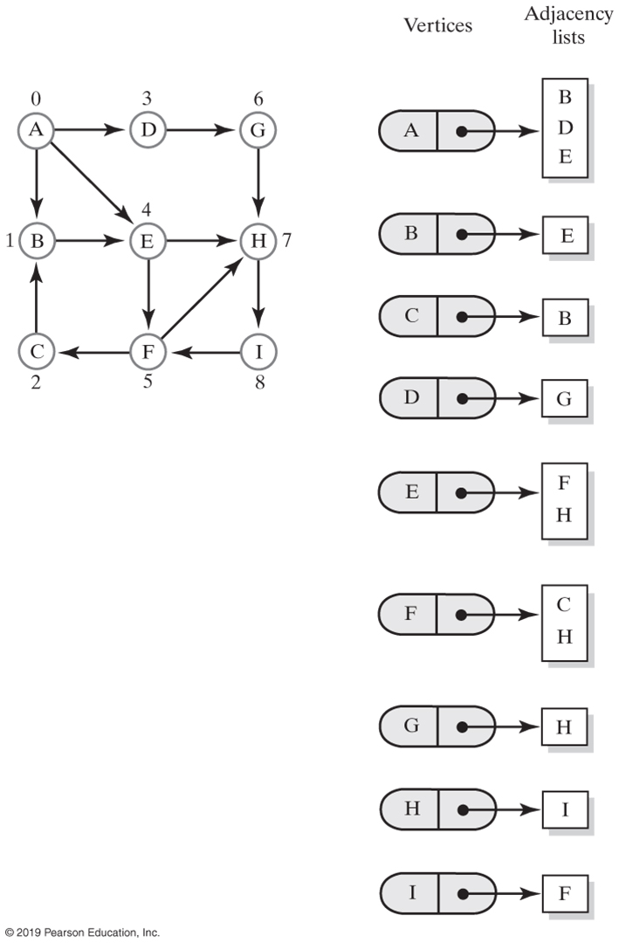
FIGURE 30-2 Adjacency lists for the directed graph in Figure 30-1a
FIGURE 30-2 Adjacency lists for the directed graph in Figure 30-1a

Slide 5
Vertices and Edges
Specifying the Class Vertex
  Identify vertices
  Visit vertices
  Adjacency list
  Path operations

Slide 6
Vertices and Edges — Interface (Part 1)
/** An interface for a vertex in a graph. */
public interface VertexInterface<T>
{
/** Gets this vertex's label.
@return The object that labels the vertex. */
public T getLabel();
/** Marks this vertex as visited. */
public void visit();
/** Removes this vertex's visited mark. */
public void unvisit();
/** Sees whether the vertex is marked as visited.
@return True if the vertex is visited. */
public boolean isVisited();
/** Connects this vertex and a given vertex with a weighted edge.
The two vertices cannot be the same, and must not already
have this edge between them. In a directed graph, the edge
points toward the given vertex.
@param endVertex A vertex in the graph that ends the edge.
@param edgeWeight A real-valued edge weight, if any.
@return True if the edge is added, or false if not. */
public boolean connect(VertexInterface<T> endVertex, double edgeWeight);
LISTING 30-1 An interface for the vertices in a graph

Slide 7
Vertices and Edges — Interface (Part 2)
/** Connects this vertex and a given vertex with an unweighted
edge. The two vertices cannot be the same, and must not
already have this edge between them. In a directed graph,
the edge points toward the given vertex.
@param endVertex A vertex in the graph that ends the edge.
@return True if the edge is added, or false if not. */
public boolean connect(VertexInterface<T> endVertex);
/** Creates an iterator of this vertex's neighbors by following
all edges that begin at this vertex.
@return An iterator of the neighboring vertices of this vertex. */
public Iterator<VertexInterface<T>> getNeighborIterator();
/** Creates an iterator of the weights of the edges to this
vertex's neighbors.
@return An iterator of edge weights for edges to neighbors of this vertex. */
public Iterator<Double> getWeightIterator();
/** Sees whether this vertex has at least one neighbor.
@return True if the vertex has a neighbor. */
public boolean hasNeighbor();
/** Gets an unvisited neighbor, if any, of this vertex.
@return Either a vertex that is an unvisited neighbor or null
if no such neighbor exists. */
public VertexInterface<T> getUnvisitedNeighbor();
LISTING 30-1 An interface for the vertices in a graph

Slide 8
Vertices and Edges — Interface (Part 3)
/** Records the previous vertex on a path to this vertex.
@param predecessor The vertex previous to this one along a path. */
public void setPredecessor(VertexInterface<T> predecessor);
/** Gets the recorded predecessor of this vertex.
@return Either this vertex's predecessor or null if no predecessor
was recorded. */
public VertexInterface<T> getPredecessor();
/** Sees whether a predecessor was recorded for this vertex.
@return True if a predecessor was recorded. */
public boolean hasPredecessor();
/** Records the cost of a path to this vertex.
@param newCost The cost of the path. */
public void setCost(double newCost);
/** Gets the recorded cost of the path to this vertex.
@return The cost of the path. */
public double getCost();
} // end VertexInterface
LISTING 30-1 An interface for the vertices in a graph

Slide 9
The Inner Class Edge
protected class Edge
{
private VertexInterface<T> vertex; // Vertex at end of edge
private double weight;
protected Edge(VertexInterface<T> endVertex, double edgeWeight)
{
vertex = endVertex;
weight = edgeWeight;
} // end constructor
protected Edge(VertexInterface<T> endVertex)
{
vertex = endVertex;
weight = 0;
} // end constructor
protected VertexInterface<T> getEndVertex()
{
return vertex;
} // end getEndVertex
protected double getWeight()
{
return weight;
} // end getWeight
} // end Edge
LISTING 30-2 The protected class Edge, as an inner class of Vertex

Slide 10
Implementing the Class Vertex (Part 1)
/** A class of vertices for a graph. */
class Vertex<T> implements VertexInterface<T>
{
private T label;
private ListWithIteratorInterface<Edge> edgeList; // Edges to neighbors
private boolean visited; // True if visited
private VertexInterface<T> previousVertex; // On path to this vertex
private double cost; // Of path to this vertex
public Vertex(T vertexLabel)
{
label = vertexLabel;
edgeList = new LinkedListWithIterator<>();
visited = false;
previousVertex = null;
cost = 0;
} // end constructor
/* Implementations of the vertex operations go here.
. . . */
LISTING 30-3 An outline of the class Vertex

Slide 11
Implementing the Class Vertex (Part 2)
protected class Edge {
private VertexInterface<T> vertex; // Vertex at end of edge
private double weight;
protected Edge(VertexInterface<T> endVertex, double edgeWeight)
{
vertex = endVertex;
weight = edgeWeight;
} // end constructor
protected Edge(VertexInterface<T> endVertex)
{
vertex = endVertex;
weight = 0;
} // end constructor
protected VertexInterface<T> getEndVertex()
{
return vertex;
} // end getEndVertex
protected double getWeight()
{
return weight;
} // end getWeight
} // end Edge
} // end Vertex

Slide 12
Implementing the Class Vertex — method connect
public boolean connect(VertexInterface<T> endVertex) {
return connect(endVertex, 0);
} // end connect
public boolean connect(VertexInterface<T> endVertex, double edgeWeight). {
boolean result = false;
if (!this.equals(endVertex))
{ // Vertices are distinct
Iterator<VertexInterface<T>> neighbors = getNeighborIterator();
boolean duplicateEdge = false;
while (!duplicateEdge && neighbors.hasNext())
{
VertexInterface<T> nextNeighbor = neighbors.next();
if (endVertex.equals(nextNeighbor))
duplicateEdge = true;
} // end while
if (!duplicateEdge)
{
edgeList.add(new Edge(endVertex, edgeWeight));
result = true;
} // end if
} // end if
return result;
} // end connect

Slide 13
Implementing the Class Vertex
public Iterator<VertexInterface<T>> getNeighborIterator()
{
return new NeighborIterator();
} // end getNeighborIterator
The iterator

Slide 14
Implementing the Class Vertex
private class NeighborIterator implements Iterator<VertexInterface<T>>. {
private Iterator<Edge> edges;
private NeighborIterator()
{
edges = edgeList.getIterator();
} // end default constructor
public boolean hasNext()
{
return edges.hasNext();
} // end hasNext
public VertexInterface<T> next()
{
VertexInterface<T> nextNeighbor = null;
if (edges.hasNext())
{
Edge edgeToNextNeighbor = edges.next();
nextNeighbor = edgeToNextNeighbor.getEndVertex();
}
else
throw new NoSuchElementException();
return nextNeighbor;
} // end next
LISTING 30-4 The private class NeighborIterator, as an inner class of Vertex

Slide 15
Implementing the Class Vertex
public boolean hasNeighbor()
{
return !edgeList.isEmpty();
} // end hasNeighbor
public VertexInterface<T> getUnvisitedNeighbor()
{
VertexInterface<T> result = null;
Iterator<VertexInterface<T>> neighbors = getNeighborIterator();
while ( neighbors.hasNext() && (result == null) )
{
VertexInterface<T> nextNeighbor = neighbors.next();
if (!nextNeighbor.isVisited())
result = nextNeighbor;
} // end while
return result;
} // end getUnvisitedNeighbor
The methods hasNeighbor and getUnvisitedNeighbor

Slide 16
Implementing the Class Vertex
public boolean equals(Object other)
{
boolean result;
if ((other == null) || (getClass() != other.getClass()))
result = false;
else
{
// The cast is safe within this else clause
@SuppressWarnings("unchecked")
Vertex<T> otherVertex = (Vertex<T>)other;
result = label.equals(otherVertex.label);
} // end if
return result;
} // end equals
The method equals

Slide 17
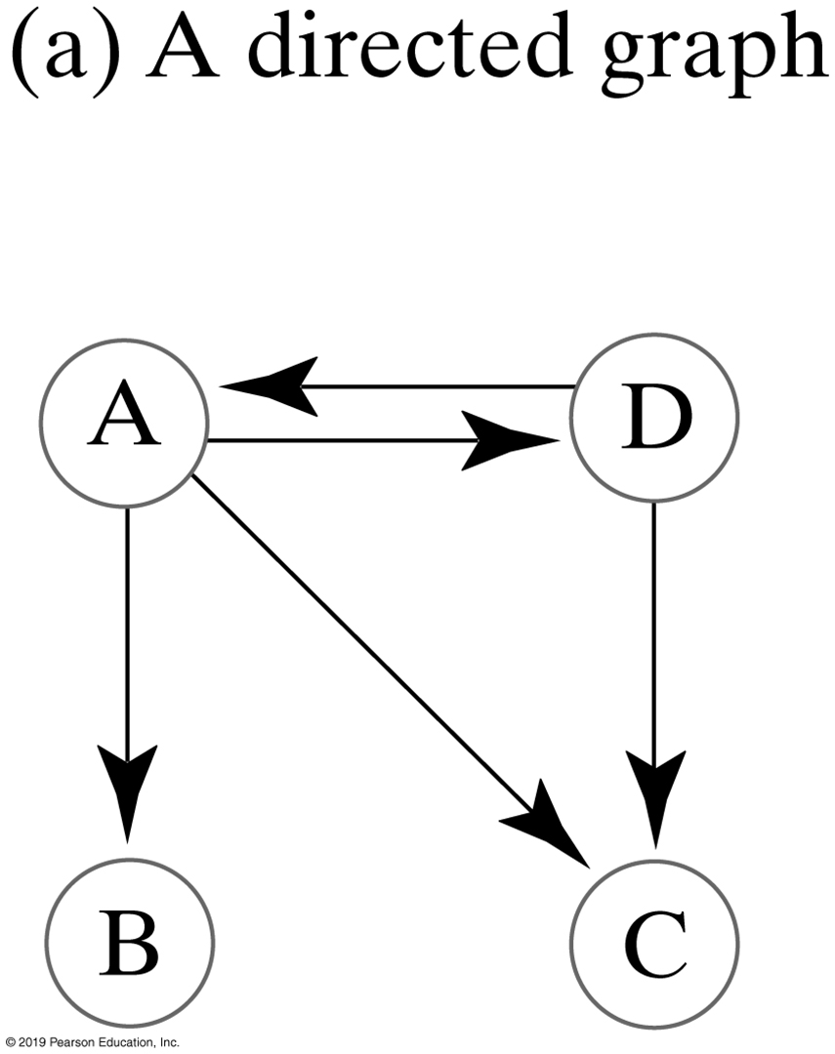
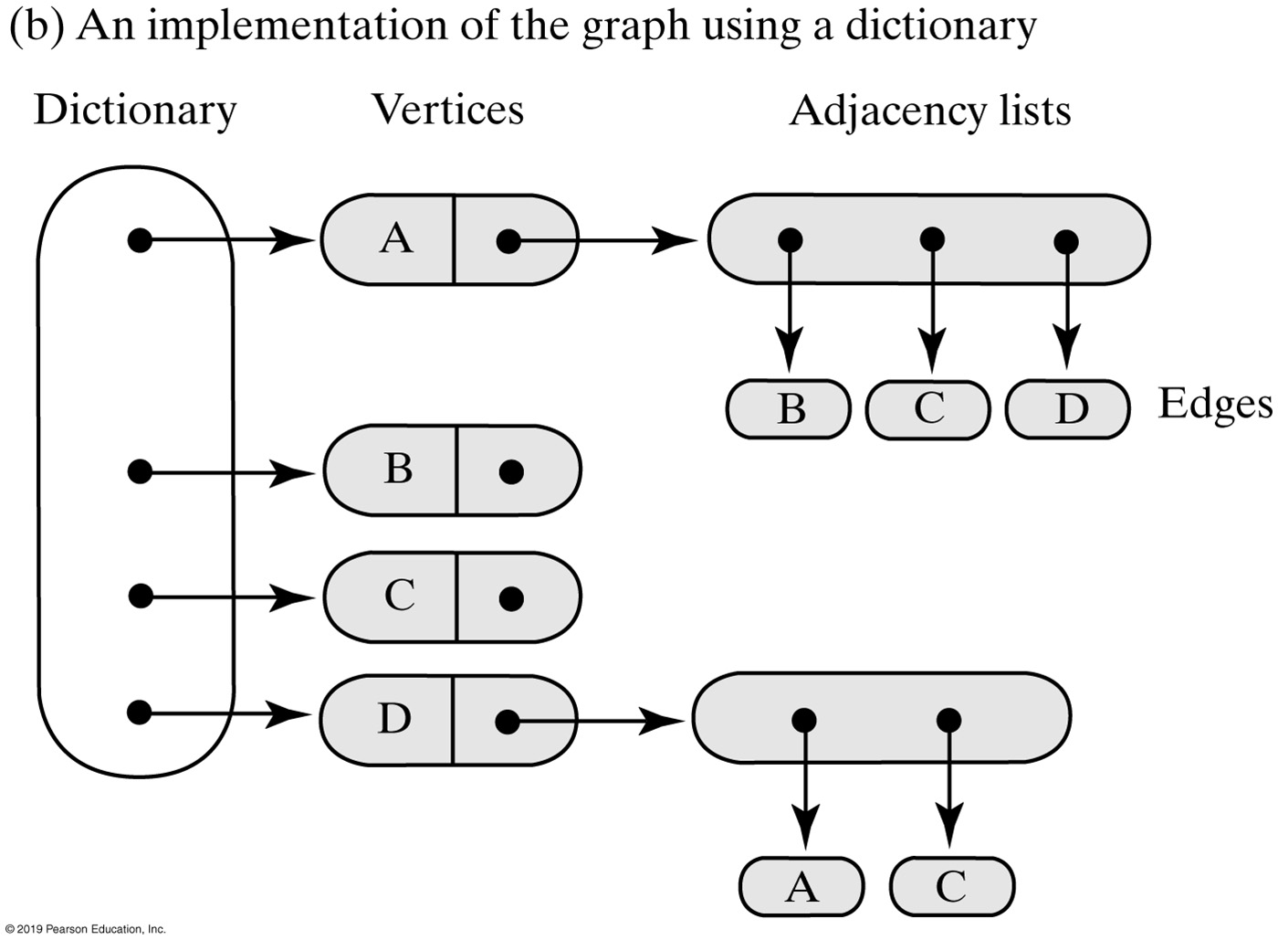
Implementation of the ADT Graph
FIGURE 30-3 A representation of a directed graph using a dictionary of vertices

Slide 18
Implementation of the ADT Graph
/** A class that implements the ADT directed graph. */
public class DirectedGraph<T> implements GraphInterface<T>
{
private DictionaryInterface<T, VertexInterface<T>> vertices;
private int edgeCount;
public DirectedGraph()
{
vertices = new LinkedDictionary<>();
edgeCount = 0;
} // end default constructor
/* Implementations of the graph operations go here.
. . . */
} // end DirectedGraph
LISTING 30-5 An outline of the class DirectedGraph

Slide 19
Implementation of the ADT Graph
public boolean addVertex(T vertexLabel)
{
VertexInterface<T> addOutcome =
vertices.add(vertexLabel, new Vertex<>(vertexLabel));
return addOutcome == null; // Was addition to
// dictionary successful?
} // end addVertex
The dictionary’s method addVertex

Slide 20
Implementation of the ADT Graph
public boolean addEdge(T begin, T end)
{
return addEdge(begin, end, 0);
} // end addEdge
public boolean addEdge(T begin, T end, double edgeWeight)
{
boolean result = false;
VertexInterface<T> beginVertex = vertices.getValue(begin);
VertexInterface<T> endVertex = vertices.getValue(end);
if ( (beginVertex != null) && (endVertex != null) )
result = beginVertex.connect(endVertex, edgeWeight);
if (result)
edgeCount++;
return result;
} // end addEdge
The addEdge methods

Slide 21
Implementation of the ADT Graph
public boolean hasEdge(T begin, T end)
{
boolean found = false;
VertexInterface<T> beginVertex = vertices.getValue(begin);
VertexInterface<T> endVertex = vertices.getValue(end);
if ( (beginVertex != null) && (endVertex != null) )
{
Iterator<VertexInterface<T>> neighbors =
beginVertex.getNeighborIterator();
while (!found && neighbors.hasNext())
{
VertexInterface<T> nextNeighbor = neighbors.next();
if (endVertex.equals(nextNeighbor))
found = true;
} // end while
} // end if
return found;
} // end hasEdge
Testing for an edge

Slide 22
Implementation of the ADT Graph
public boolean isEmpty()
{
return vertices.isEmpty();
} // end isEmpty
public void clear()
{
vertices.clear();
edgeCount = 0;
} // end clear
public int getNumberOfVertices()
{
return vertices.getSize();
} // end getNumberOfVertices
public int getNumberOfEdges()
{
return edgeCount;
} // end getNumberOfEdges
Miscellaneous methods

Slide 23
Implementation of the ADT Graph
protected void resetVertices()
{
Iterator<VertexInterface<T>> vertexIterator =
vertices.getValueIterator();
while (vertexIterator.hasNext())
{
VertexInterface<T> nextVertex = VertexIterator.next();
nextVertex.unvisit();
nextVertex.setCost(0);
nextVertex.setPredecessor(null);
} // end while
} // end resetVertices
Resetting vertices

Slide 24
Efficiency of Basic Graph Operations
Operation
addVertex | O(n)
addEdge | O(n)
hasEdge | O(n)
isEmpty | O(1)
getNumberOfVertices | O(1)
getNumberOfEdges | O(1)
Clear | O(1)
FIGURE 30-4 The performance of basic operations of the ADT graph when implemented by using adjacency lists

Slide 25
Graph Algorithms — Breadth-first traversal
public QueueInterface<T> getBreadthFirstTraversal(T origin)
{
resetVertices();
QueueInterface<T> traversalOrder = new LinkedQueue<>();
QueueInterface<VertexInterface<T>> vertexQueue = new LinkedQueue<>();
VertexInterface<T> originVertex = vertices.getValue(origin);
originVertex.visit();
traversalOrder.enqueue(origin); // Enqueue vertex label
vertexQueue.enqueue(originVertex); // Enqueue vertex
while (!vertexQueue.isEmpty())
{
VertexInterface<T> frontVertex = vertexQueue.dequeue();
Iterator<VertexInterface<T>> neighbors = frontVertex.getNeighborIterator();
while (neighbors.hasNext())
{
VertexInterface<T> nextNeighbor = neighbors.next();
if (!nextNeighbor.isVisited())
{
nextNeighbor.visit();
traversalOrder.enqueue(nextNeighbor.getLabel());
vertexQueue.enqueue(nextNeighbor);
} // end if
} // end while
} // end while
return traversalOrder;
} // end getBreadthFirstTraversal

Slide 26
Graph Algorithms — Finding the shortest path (Part 1)
public int getShortestPath(T begin, T end, StackInterface<T> path)
{
resetVertices();
boolean done = false;
QueueInterface<VertexInterface<T>> vertexQueue = new LinkedQueue<>();
VertexInterface<T> originVertex = vertices.getValue(begin);
VertexInterface<T> endVertex = vertices.getValue(end);
originVertex.visit();
vertexQueue.enqueue(originVertex);
while (!done && !vertexQueue.isEmpty())
{
VertexInterface<T> frontVertex = vertexQueue.dequeue();
Iterator<VertexInterface<T>> neighbors = frontVertex.getNeighborIterator();
while (!done && neighbors.hasNext())
{
VertexInterface<T> nextNeighbor = neighbors.next();
if (!nextNeighbor.isVisited())
{
nextNeighbor.visit();
nextNeighbor.setCost(1 + frontVertex.getCost());
nextNeighbor.setPredecessor(frontVertex);
vertexQueue.enqueue(nextNeighbor);
} // end if

Slide 27
Graph Algorithms — Finding the shortest path (Part 2)
if (nextNeighbor.equals(endVertex))
done = true;
} // end while
} // end while
// Traversal ends; construct shortest path
int pathLength = (int)endVertex.getCost();
path.push(endVertex.getLabel());
VertexInterface<T> vertex = endVertex;
while (vertex.hasPredecessor())
{
vertex = vertex.getPredecessor();
path.push(vertex.getLabel());
} // end while
return pathLength;
} // end getShortestPath

Slide 28
End
Chapter 30

